Slide 1
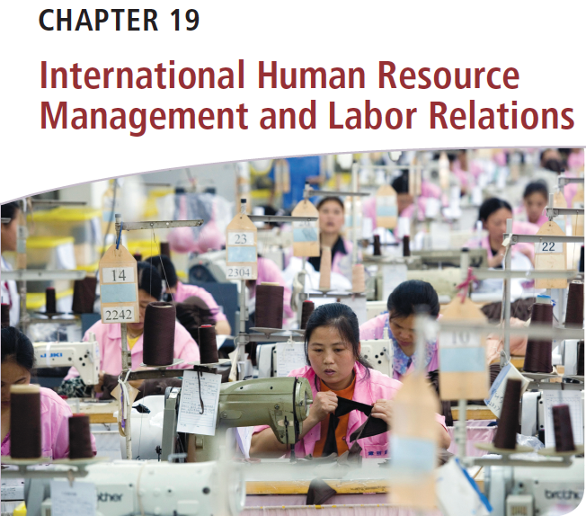
Διεθνείς Επιχειρήσεις και Επιχειρηματικότητα 8^{η} Έκδοση
ΚΕΦΑΛΑΙΟ 19
Διεθνής Διοίκηση Ανθρώπινων Πόρων και Εργασιακών Σχέσεων
Griffin & Pustay

Slide 2
Μαθησιακοί Στόχοι
Να περιγράψετε τη φύση της διοίκησης ανθρώπινων πόρων σε διεθνείς επιχειρήσεις.
Να εξηγήσετε με λεπτομέρεια τον τρόπο με τον οποίο οι επιχειρήσεις προσλαμβάνουν και επιλέγουν διευθυντικά στελέχη για διεθνείς αποστολές.
Να εξηγήσετε τον τρόπο με τον οποίο οι διεθνείς επιχειρήσεις εκπαιδεύουν και αναπτύσσουν τα εκπατρισμένα διευθυντικά στελέχη.
Να συζητήσετε τους τρόπους με τους οποίους οι διεθνείς επιχειρήσεις εκπονούν αξιολογήσεις απόδοσης και καθορίζουν τις αμοιβές για τα εκπατρισμένα διευθυντικά στελέχη τους.

Slide 3
Μαθησιακοί Στόχοι
Να αναλύσετε ζητήματα σχετικά με τη διατήρηση των ανθρώπινων πόρων και την εναλλαγή του προσωπικού στις διεθνείς επιχειρήσεις.
Να εξηγήσετε βασικά θέματα ανθρώπινων πόρων που αφορούν εργαζομένους που κατέχουν μη διευθυντικές θέσεις.
Να περιγράψετε τις εργασιακές σχέσεις στις διεθνείς επιχειρήσεις.

Slide 4
Η Φύση της Διεθνούς Διοίκησης Ανθρώπινων Πόρων
Διοίκηση ανθρώπινων πόρων
Στρατολόγηση και επιλογή εργαζομένων σε μη διευθυντικές και σε διευθυντικές θέσεις
Παροχή κατάρτισης και ανάπτυξης
Αξιολόγηση απόδοσης
Χορήγηση αμοιβών και παροχών
Notes:
Human resource management (HRM) is the set of activities directed at attracting, developing, and maintaining the effective workforce necessary to achieve a firm’s objectives.
HRM includes recruiting and selecting nonmanagers and managers, providing training and development, appraising performance, and providing compensation and benefits. HR managers must develop procedures and policies for accomplishing these tasks.

Slide 5
Η Φύση της Διεθνούς Διοίκησης Ανθρώπινων Πόρων
Προκλήσεις της διεθνούς διοίκησης ανθρώπινων πόρων
Διαφορές στην κουλτούρα
Επίπεδα οικονομικής ανάπτυξης
Νομικά συστήματα
Βέλτιστος συνδυασμός εργαζομένων
Σύνθετες προκλήσεις κατάρτισης και ανάπτυξης
Συστήματα αμοιβών
Notes:
International HR managers face challenges beyond those confronting their counterparts in purely domestic companies. Specifically, differences in cultures, levels of economic development, and legal systems among the countries in which a firm operates may force it to customize its HR programs on a country-by-country basis.
The international firm also must determine where various employees should come from—the home country, the host country, or third countries. The optimal mix of employees may differ according to the location of the firm’s operations. Local laws also must be considered because they may limit or constrain hiring practices.
International businesses also face complex training and development challenges. HR managers must provide cross-cultural training for corporate executives chosen for overseas assignments. Similarly, training systems for production workers in host countries must be adjusted to reflect the education offered by local school systems.
Because working conditions and the cost of living may vary dramatically by country, international HR managers often tailor compensation systems to meet the needs of the host country’s labor market. They must take into account variations in local laws, which may require the payment of a minimum wage or mandate certain benefits. These managers also must determine how to compensate executives on overseas assignments.

Slide 6
Η Στρατηγική Σημασία της Διοίκησης Ανθρώπινων Πόρων
Στρατηγική διοίκησης ανθρώπινων πόρων
Συνολικές εταιρικές και επιχειρηματικές στρατηγικές
Notes:
The firm’s managers must design an HRM strategy that promotes the company’s overall corporate and business strategies. The cultural nuances inherent in international business heighten the complexities of developing an effective human resource strategy.

Slide 7
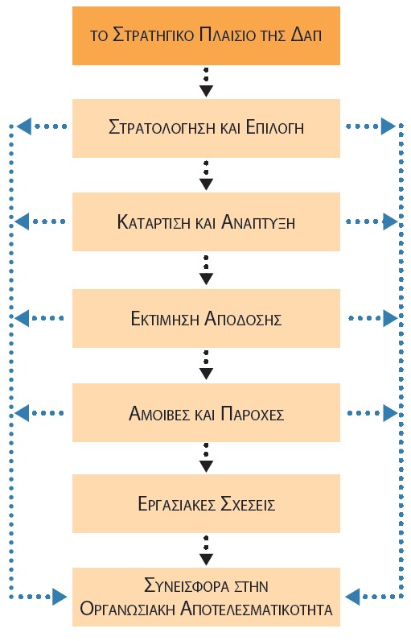
Η Στρατηγική Σημασία της Διοίκησης Ανθρώπινων Πόρων
Notes:
The basic elements of the international HRM process are shown in Figure 19.1, which provides the framework around which this Κεφάλαιο is organized. The starting point is recognizing and appreciating HRM’s strategic position within the firm and the interconnection between the firm’s overall strategy and HRM strategy. A company’s decision to expand into the international marketplace will require its HR department to select key managerial personnel. Few of those managers will be able to function effectively in a foreign operation the first day they arrive. Therefore, HR must provide them with the training they need to be successful. HR managers also define performance effectiveness and assess how well each international manager is doing relative to that definition. International managers must also be compensated for their work. Further, companies invest time and money in their international managers, so HR managers must carefully assess how effectively their organization manages labor relations, retention, and turnover.

Slide 8
Διεθνείς Ανάγκες σε Διευθυντικό Προσωπικό
Ζητήματα στελέχωσης: στρατολόγηση, κατάρτιση και διατήρηση
Διευθυντικά και ανώτατα διοικητικά στελέχη
Εργαζόμενοι σε μη διευθυντικές θέσεις
Notes:
The staffing issues confronting international HR managers can be divided into two broad categories. One of these is recruiting, training, and retaining managerial and executive employees. The other is recruiting, training, and retaining nonmanagerial employees, such as blue-collar production workers and white-collar office staff. For managerial employees, strategic and developmental issues are of primary importance. For non-managerial workers, differences in cultural, political, and legal conditions among countries may be of greater significance.

Slide 9
Πεδίο Εφαρμογής της Διεθνοποίησης
Τμήμα εξαγωγών
Διεύθυνση διεθνών επιχειρηματικών δραστηριοτήτων
Παγκόσμιος οργανισμός
Εύρος διεθνών δραστηριοτήτων
Notes:
We begin by focusing on recruiting, training, and retaining managers. The size of this task depends on the scope of the firm’s international involvement.
Export Department: A firm’s initial foray into international business usually involves small-scale exporting using output from existing domestic production facilities. Its international activities are administered by a local export department with a home-country manager. As export sales increase, the firm will hire specialists in export documentation, international trade financing, and overseas distribution and marketing.
International Division: As its international operations grow in importance, a firm often creates a separate division to administer its international activities. Typically, this division is housed at corporate headquarters in its home country and is headed by a home country citizen. The heads of the firm’s foreign subsidiaries in turn report to the vice president of the international division. These foreign subsidiaries’ managers may be either home country or host country citizens.
Global Organization: A firm further along in the internationalization process often adopts a global organization form. Managers must have the expertise to produce, finance, and market products worldwide. They also must have expertise in the firm’s product line, international markets, and the firm’s global strategy.

Slide 10
Πεδίο Εφαρμογής της Διεθνοποίησης
Συλλογική εμπειρία και γνώση
Γραμμή παραγωγής
Λειτουργικές δεξιότητες
Μεμονωμένες αγορές χωρών
Παγκόσμια στρατηγική
Notes:
To operate successfully, a global firm needs a team of managers that collectively possess expertise in and knowledge of the following:
The firm’s product line: Product managers must be aware of such factors as the latest manufacturing techniques, research and development opportunities, and competitors’ strategies.
The functional skills (accounting, logistics, marketing, manufacturing management, and so on) necessary to ensure global competitiveness: Functional specialists strive to capture global economies of scale and synergies in a firm’s financial, marketing, and production activities.
The individual country markets in which the firm does business: Country managers must understand such factors as local laws, culture, competitors, distribution systems, and advertising media. These managers play a key role in meeting the needs of local customers, ensuring compliance with host country rules and regulations, and enlarging the firm’s market share and profitability in the host country.
The firm’s global strategy: High-level executives at corporate headquarters must formulate a global strategy for the firm and then control and coordinate the activities of the firm’s product, functional, and country managers to ensure that its strategy is successfully implemented.

Slide 11
Συγκέντρωση Έναντι Αποκέντρωσης Ελέγχου
Λήψη αποφάσεων
Πραγματοποιείται αποκεντρωμένα (με ανάθεση) σε θυγατρικές.
Πραγματοποιείται κεντρικά στην εταιρική έδρα.
Notes:
International HRM needs also are affected by whether the firm wants decision making to be centralized at corporate headquarters or decentralized (delegated) to operating subsidiaries. Firms that use a centralized approach often employ home country managers; firms that follow a decentralized decision-making philosophy are more likely to employ host country managers.
The majority of international businesses operate somewhere along the continuum from pure centralization to pure decentralization. Most adopt an overall HRM strategy at the corporate headquarters level but delegate many day-to-day HR issues to local and regional offices. Doing this allows each foreign operation to meet its own needs and to more effectively deal with local conditions, cultures, and HR practices.

Slide 12
Φιλοσοφία Στελέχωσης
Πρόσληψη διεθνών ανώτατων διοικητικών στελεχών
Υπήκοοι της μητρικής χώρας
Υπήκοοι της χώρας υποδοχής
Υπήκοοι τρίτων χωρών
Notes:
The extent of the firm’s internationalization and its degree of centralization or decentralization depend upon its philosophy regarding the nationality of its international managers. Firms can hire from three groups:
Parent country nationals (PCNs) are residents of the international business’s home country. Since they share a common culture and educational background with corporate headquarters staff, PCNs facilitate communication and coordination with corporate headquarters. However, most PCNs lack knowledge of the host country’s laws, culture, economic conditions, social structure, and political processes. They can be trained, but the costs and outcomes of such training may outweigh its benefits. Because of these factors, PCNs are often used in upper-level and/or technical positions in host countries.
Host country nationals (HCNs) reside in the host country. They are commonly used to fill middle-level and lower-level jobs, but they also may appear in managerial and professional positions. HCNs understand local laws, culture, and economic conditions. Furthermore, the firm avoids expenses associated with expatriate managers. However, HCNs may be unfamiliar with the firm’s business culture and practices, thus limiting their effectiveness.
Third-country nationals (TCNs) are most likely to be used in upper-level or technical positions. TCNs and PCNs collectively are known as expatriates, or people working and residing in countries other than their native country. In the past, TCNs were likely to be used when they had specialized expertise. Today, they are being employed by some firms to promote a global outlook throughout their operations.

Slide 13
Φιλοσοφία Στελέχωσης
Μοντέλα στελέχωσης
Εθνοκεντρικό
Πολυκεντρικό
Γεωκεντρικό
Notes:
Most international firms develop a systematic strategy for choosing among HCNs, PCNs, and TCNs for various positions. National culture often affects the staffing model chosen by a firm.
Some firms rely on the ethnocentric staffing model, whereby they primarily use PCNs to staff higher-level foreign positions. This approach is based on the assumption that home office perspectives should take precedence over local perspectives. In this case, expatriate PCNs usually will be the most effective in representing the views of the home office in the foreign operation.
Other international firms follow a polycentric staffing model; that is, they emphasize the use of HCNs in the belief that they know the local market best.
Finally, the geocentric staffing model puts PCNs, HCNs, and TCNs on an equal footing. Firms that adopt this approach want to hire the best person available, regardless of where he or she comes from.

Slide 14
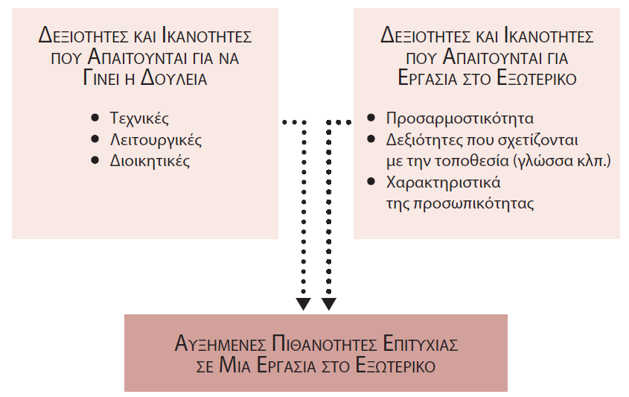
Στρατολόγηση και Επιλογή Προσωπικού
Notes:
A firm’s scope of internationalization, level of centralization, and staffing philosophy help determine the skills and abilities its international managers need. As shown in Figure 19.2, these skills and abilities fall into two general categories: those needed to do the job and those needed to work in a foreign location.

Slide 15
Πρόσληψη Διευθυντικών Στελεχών
Πρόσληψη έμπειρων διευθυντικών στελεχών
Μεταξύ υφιστάμενων εργαζομένων
Ανώτερα στελέχη που συνταξιοδοτήθηκαν
Μελλοντικά διευθυντικά στελέχη
«Κυνηγοί κεφαλών»
Παγκοσμιοποιημένη αγορά για ταλαντούχα ανώτερα στελέχη
Πρόσληψη νεότερων διευθυντικών στελεχών
Notes:
Once the international business determines the skills and abilities an international manager must have, it next must develop a pool of qualified applicants for the job, and then recruit and select the best candidate.
Recruitment of Experienced Managers: International businesses recruit experienced managers through a variety of channels. A common source of recruits is within the firm itself; for example, employees already working for the firm in the host country or home country employees who might be prepared for an international assignment. An international business also may attempt to identify prospective managers who work for other firms. For higher-level positions firms often rely on so-called headhunters to help them locate prospective candidates. Headhunters are recruiting firms that actively seek qualified managers and other professionals for possible placement in positions in other organizations.
Recruitment of Younger Managers: It is uncommon for large MNCs to hire new college graduates for immediate foreign assignments. Some firms, however, will hire new graduates they ultimately intend to send abroad and, in the short term, give them domestic assignments.

Slide 16
Επιλογή Διευθυντικών Στελεχών
Υποσχόμενοι υποψήφιοι
Διοικητικές ικανότητες
Κατάλληλη κατάρτιση
Προσαρμογή σε νέες καταστάσεις
Αποτυχία εκπατρισμού
Πολιτισμική προσαρμοστικότητα
Κίνητρο και το ενδιαφέρον
Notes:
After the pool of prospective managers has been identified, HR managers must decide which persons from that pool are the best qualified for the assignment. The most promising candidates share the following characteristics: managerial competence, appropriate training, and adaptability to new situations.
Expatriate failure is the early return of a manager to the home country because of an inability to perform in the overseas assignment. Experts suggest that costs associated with the failure of expatriate managers range from $200,000 to $1.2 million.
The primary cause of expatriate failure is the inability of the managers or their spouse and family to adapt to the new locale. As a result, international HR managers increasingly are evaluating the nontechnical aspects of a candidate’s suitability for a foreign assignment. Most firms use a combination of tests (such as personality and aptitude tests) and interviews to assess a candidate’s cultural adaptability.
Another important consideration is the prospect’s motivation for and interest in the foreign assignment. Some managers are attracted to foreign assignments, perhaps because they want to live abroad or they believe the experience will enhance their careers. Others balk at the thought of uprooting their family and moving to a foreign environment.

Slide 17
Ζητήματα Εκπατρισμού και Επαναπατρισμού
ζητηματα
Φασεισ ενσωματωσησ
Ζητήματα εκπατρισμού
Προκλήσεις ενσωμάτωσης
Πολιτισμικό σοκ
Ζητήματα επαναπατρισμού
Μήνας του μέλιτος
Απογοήτευση
Προσαρμογή
Διαπολιτισμικότητα
Notes:
Parent country nationals on long-term foreign assignments face great acculturation challenges. Living and working in a foreign culture can lead to culture shock, which may lead to feelings of fear, helplessness, irritability, and disorientation. Such feelings can hamper the effectiveness and productivity of an expatriate manager.
Acculturation typically proceeds through four phases.
International businesses cannot assume that repatriation (bringing a manager back home after a foreign assignment has been completed) will be easy. Returning home can be almost as traumatic as the original move abroad, especially for managers and family members who have become comfortable with working and living in the foreign culture. By some estimates, one-quarter of repatriated employees leave their employer within a year after returning home. Each repatriated executive who leaves the firm represents a million-dollar investment walking out the door.

Slide 18
Ζητήματα Εκπατρισμού και Επαναπατρισμού
Ελευθερία επιλογής
Ρεαλιστική προεπισκόπηση
Ρεαλιστικές προσδοκίες
Μέντορας στην πατρίδα
Σαφής σχέση μεταξύ εκπατρισμού και μακροπρόθεσμης σταδιοδρομίας
Notes:
Expatriation and repatriation problems can be reduced if international businesses systematically provide career development programs for their expatriate managers. Recent research indicates that the likelihood of managers being successful at an overseas assignment increases if those managers:
Can freely choose whether to accept or reject the expatriate assignment.
Have been given a realistic preview of the new job and assignment.
Have been given a realistic expectation of their repatriation assignment.
Have a mentor back home who will guard their interests and provide corporate and social support during the assignment.
See a clear link between the expatriate assignment and their long-term career path.
Of these five elements, the last is the most critical in determining expatriate success.

Slide 19
Κατάρτιση και Ανάπτυξη
Κατάρτιση
Ενίσχυση συγκεκριμένων δεξιοτήτων και ικανοτήτων που σχετίζονται με κάθε θέση εργασίας
Ανάπτυξη
Προετοιμασία διευθυντικών στελεχών για νέες εργασίες ή ανώτερες θέσεις
Notes:
The international firm’s HR managers also must provide training and development for its home and host country managers to help them perform more effectively. Training is directed at enhancing specific job-related skills and abilities. For example, training programs might be designed to help employees learn to speak a foreign language, use new equipment, or implement new manufacturing procedures. Development is concerned with preparing managers for new assignments or higher-level positions. For instance, a development program could be aimed at helping managers improve their ability to make decisions.

Slide 20
Αξιολόγηση των Αναγκών Κατάρτισης
Ανάγκες κατάρτισης και ανάπτυξης
Νεοσύστατες επιχειρήσεις
Καθιερωμένες επιχειρήσεις
Notes:
Before a firm can undertake a meaningful training or development program, it must assess its exact training and development needs. A lack of knowledge about foreign customers and markets is a major barrier to successful entry into such markets.
A firm just moving into the global marketplace will have different training and development needs from those of an established global firm. When a firm enters the international arena, it is likely to have few, if any, experienced international managers. Thus, its training and development needs will be substantial. In contrast, a global firm will have a cadre of managers with international backgrounds, skills, and abilities. Yet even then, changes in the organization or in the marketplace may necessitate training.

Slide 21
Βασικές Μέθοδοι και Διαδικασίες Κατάρτισης
Τυποποιημένα προγράμματα
Προσαρμοσμένα προγράμματα
Μέσα διδασκαλίας
Διαλέξεις
Κατ’ οίκον μελέτη
Βιντεοσκοπημένη διδασκαλία και διαδικτυακά εκπαιδευτικά βίντεο
Τεχνολογίες πολυμέσων
Notes:
The first issue an international business must consider as it plans its training and development efforts is whether to use standardized programs or develop customized programs. Standardized programs tend to be cost effect; however, a standardized program may not fit the firm’s needs precisely. Customized programs are more costly than standardized programs; however, they can conform to the firm’s exact training and development needs. As a result, most corporate training and development programs are customized.
Regardless of whether training and development programs are standardized or customized, most use a variety of methods as instructional vehicles. Lectures and assigned readings are common, as are videotaped and web-based instruction. Multimedia technologies are increasingly being incorporated into cross-cultural training.

Slide 22
Ανάπτυξη Νεότερων Διευθυντικών Στελεχών σε Διεθνές Επίπεδο
Παγκοσμιοποίηση
Διεθνοποίηση διευθυντών σε πρώιμα στάδια της καριέρας τους
Συστηματική ενσωμάτωση διεθνών αποστολών σε ατομικά σχέδια σταδιοδρομίας για νέους διευθυντές
Notes:
The increasing globalization of business has prompted most MNCs to recognize the importance of internationalizing their managers earlier in their careers. Until the late 1980s, most U.S. MNCs delayed giving their managers significant overseas assignments until they had spent 7 to 10 years with the firm. Today, many MNCs are realizing that they need to enhance the knowledge of their managers by developing their international awareness and competence earlier in their careers. Those firms are also recognizing the importance of the systematic integration of international assignments into individual career plans.
For example, GE provides language and cross-cultural training to its professional staff, even though they may not be scheduled for immediate overseas postings. Such training is important because they are likely to work with GE employees from other countries, as well as foreign partners, suppliers, and customers. Such training also helps them gain a better understanding of the firm’s international markets.
U.S. firms are not the only ones integrating international assignments into career development plans for younger managers. Honda’s U.S. manufacturing subsidiary has been sending U.S. managers to Tokyo for multiyear assignments, so they can learn more about the firm’s successful manufacturing and operating philosophies.

Slide 23
Αξιολόγηση Απόδοσης και Αμοιβές: Αξιολόγηση της Απόδοσης στις Διεθνείς Επιχειρήσεις
Στόχοι της αξιολόγησης της απόδοσης
Ενημέρωση ατόμων σχετικά με το πόσο καλά τα πηγαίνουν
Παροχή μιας βάσης για την ανταμοιβή των ατόμων με την καλύτερη απόδοση
Αναγνώριση τομέων στους οποίους μπορεί να χρειάζεται πρόσθετη κατάρτιση και ανάπτυξη
Εντοπισμός προβληματικών περιοχών που μπορεί να απαιτούν αλλαγή στις ανατεθειμένες αποστολές
Notes:
Performance appraisal is the process of assessing how effectively people are performing their jobs. The purposes of performance appraisal are to provide feedback to individuals on how well they are doing; to provide a basis for rewarding top performers; to identify areas in which additional training and development may be needed; and to identify problem areas that may call for a change in assignment.

Slide 24
Αξιολόγηση της Απόδοσης στις Διεθνείς Επιχειρήσεις
Αξιολόγηση διευθυντών
Στόχοι
Μέτρηση
Συχνότητα
Notes:
Performance appraisals of top managers must be based on a clear understanding of the firm’s goals for its foreign operations. A successful subsidiary in a mature and stable foreign market will have different goals than a start-up operation in a growing but unstable market.
In assessing a manager’s actual performance, the firm may consider sales, profit margin, market share growth, or any other measures it deems important. Expected and actual performance must be compared and any differences between them must be addressed.
Circumstances will dictate how frequently performance appraisals occur. In a domestic firm they may occur as often as every quarter. However, geographical factors may limit the frequency of international performance appraisals.

Slide 25
Προσδιορισμός Αμοιβών στις Διεθνείς Επιχειρήσεις
Δυνάμεις της αγοράς εργασίας
Επαγγελματική κατάσταση
Απαιτήσεις για άδεια άσκησης επαγγέλματος
Βιοτικό επίπεδο
Κυβερνητικές ρυθμίσεις
Φορολογικοί κώδικες
Notes:
Determining managerial compensation is another important international HRM issue. In order to remain competitive, firms must provide prevailing compensation packages for their managers. These packages include salary and non-salary items. They are determined by labor market forces, such as the supply and demand of managerial talent, occupational status and licensing requirements, standards of living, government regulations and tax codes, and similar factors.

Slide 26
Αμοιβές Εκπατρισμένων Διευθυντικών Στελεχών
Διαφοροποιημένη αποζημίωση
Επίδομα κόστους διαβίωσης
Πριμ δυσχέρειας/ξένης υπηρεσίας
Σύστημα εξισορρόπησης φόρων
Notes:
A more complex set of compensation issues apply to expatriate managers. Most international businesses find it necessary to provide these managers with differential compensation to make up for dramatic differences in currency valuation, standards of living, lifestyle norms, and so on.
The starting point in differential compensation is a cost-of-living allowance. This allowance is intended to offset differences in the cost of living in the home and host countries. The premise is that a manager who accepts a foreign assignment is entitled to the same standard of living that he or she enjoyed at home.
Sometimes firms find they must supplement base pay to get a manager to accept an assignment in a relatively unattractive location. Called either a hardship premium or a foreign-service premium, this supplement is essentially an inducement to the individual to accept the international assignment.
Finally, many international businesses also find they must set up a tax equalization system. This system is a means of ensuring that the expatriate’s after-tax income in the host country is similar to what the person’s after-tax income would be in the home country.

Slide 27
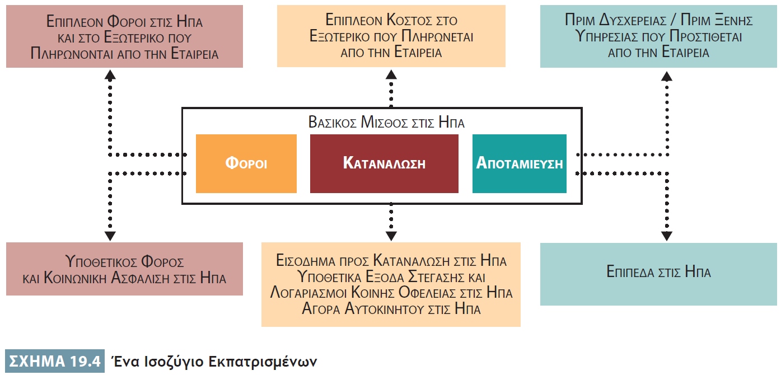
Αμοιβές Εκπατρισμένων Διευθυντικών Στελεχών
Notes:
Figure 19.4 shows how one major oil company creates compensation packages for its expatriate managers. The blocks in the center reflect an individual’s U.S. base compensation prior to being posted to an international assignment. After an assignment has been made, the blocks above and below are used to calculate appropriate adjustments to the employee’s compensation. For example, suppose a U.S. executive being transferred abroad currently earns $100,000, of which $25,000 is paid in taxes, $10,000 is saved, and the remaining $65,000 consumed. Further suppose that the executive currently spends $2,000 a month on housing (mortgage plus utilities). The firm will adjust that executive’s total compensation to make it as equal as possible to that currently earned in the United States. Assume that housing and utilities in the host country cost about 20 percent more than in the United States, and other consumables cost about 10 percent more. Thus, the firm will pay the executive a supplemental housing allowance that is equal to what the executive currently pays (times 20 percent) or a total of $400 a month. The remaining part of the executive’s consumption spending will be increased by 10 percent. Similar adjustments will be made to the other components of Figure 19.4.

Slide 28
Πακέτα Παροχών για Εκπατρισμένα Διευθυντικά Στελέχη
Ειδικές παροχές
Στέγαση
Εκπαίδευση
Ιατρικές παροχές
Επίδομα μετακίνησης για ταξίδια
Συμμετοχή σε συλλόγους
Notes:
International businesses must provide not only salary adjustments but also special forms of benefits for their expatriate managers in addition to standard benefits such as health insurance and vacation allowances. Special benefits include housing, education, medical treatment, travel to the home country, and club memberships.

Slide 29
Ισότητα στην Αποζημίωση
Εκπατρισμένα διευθυντικά στελέχη
Υπήκοοι της χώρας υποδοχής
Υπήκοοι τρίτων χωρών
Ισότητα στην αποζημίωση
Notes:
Often the compensation package offered to the expatriate manager is much more lucrative than the compensation offered to a host-country national (HCN) who holds an equivalent position of power and responsibility. The equity issue becomes even more complex when dealing with third-country nationals (TCNs).
Unfortunately, there is no simple solution to this problem, and MNCs use a variety of approaches in grappling with it. For example, some countries pay expatriates on short-term assignments according to home country standards and those on long-term assignments according to host country standards. A company could also compare the compensation package it offers in the expatriate’s home country with what it normally pays HCNs, and then give the expatriate the higher pay package. In addition, a firm could peg a TCN’s salary to that of the person’s home country but make adjustments to that salary by offering housing allowances, educational plans, and other benefits based on costs in the host country.

Slide 30
Διατήρηση και Εναλλαγή Προσωπικού
Διατήρηση
Εναλλαγή
Βαθμός στον οποίο μια επιχείρηση είναι σε θέση να διατηρήσει πολύτιμους εργαζομένους στις θέσεις εργασίας τους
Ρυθμός με τον οποίο οι εργαζόμενοι εγκαταλείπουν μια επιχείρηση
Notes:
Another important element of international HRM focuses on retention and turnover. Retention is the extent to which a firm is able to retain valued employees. Turnover is the rate at which people leave a firm.

Slide 31
Διατήρηση και Εναλλαγή Προσωπικού
Τι προκαλεί την εναλλαγή;
Δυσαρέσκεια για τον μισθό
Καλύτερες προσφορές εργασίας αλλού
Εργασιακές μετακινήσεις (εκπατρισμός, επαναπατρισμός)
Εργασιακές δεξιότητες υψηλής ζήτησης
Notes:
People choose to leave a firm for any number of reasons—for example, dissatisfaction with their current pay or promotion opportunities, or receipt of a better offer to work elsewhere. Turnover is often a result of job transitions such as those associated with expatriation and repatriation. A worker contemplating changing work locations also may consider changing employers.
Turnover is a particular problem in international business because of the high cost of developing managers’ international business skills. Managers with those skills are in high demand. Therefore, keeping successful managers should be a high priority for any international business.

Slide 32
Διατήρηση και Εναλλαγή Προσωπικού
Διαχείριση εναλλαγής
Ανάπτυξη σταδιοδρομίας
Συμβουλευτική ή διαπολιτισμική κατάρτιση
Παροχή κινήτρων
Χρονικό πλαίσιο
Συνεντεύξεις αποχώρησης
Notes:
One way to control managerial turnover is to develop strategies designed to reduce the level of failure involved with expatriation and repatriation. These strategies may include providing career development counseling or cross-cultural training to ease the stress of relocation. In addition, a company may have to provide special inducements or incentives to its most valuable international managers. The firm also may make stronger guarantees to them regarding the time frame of their assignments.
Another important element of turnover management is the exit interview. An exit interview involves an employee who is leaving a firm. Its purpose is to find out as much as possible about why the person decided to leave. The potential value of the information gleaned is high. Managers can use it to reduce future employee losses.

Slide 33
Ζητήματα Ανθρώπινου Δυναμικού για Εργαζομένους σε Μη Διευθυντικές Θέσεις
Τοπική νομοθεσία
Πολιτισμός
Οικονομικές συνθήκες
Notes:
Next, we shift the focus of our discussion of HR issues to nonmanagerial employees in host countries. The standard HRM tasks associated with nonmanagerial employees (recruitment, selection, training, compensation, and so on) are strongly influenced by local laws, culture, and economic conditions. To prosper in the host country environment, HR managers must be willing to do things the way the locals want, not the way things are done at home.

Slide 34
Στρατολόγηση και Επιλογή
Υπήκοοι μητρικής χώρας
Υπήκοοι τρίτων χωρών
Υπήκοοι της χώρας υποδοχής
Notes:
In the foreign operations of multinational enterprises, non-managerial employees, such as blue-collar production workers and white-collar office workers, are typically HCNs. In most cases, there are economic reasons for this decision: HCNs are usually cheaper to employ than are PCNs or TCNs. HCNs also are used because local laws often promote the hiring of locals.
Nonetheless, an international business must develop and implement a plan for recruiting and selecting its employees in a host country market. This plan should include assessments of the firm’s HR needs, sources of labor, labor force skills and talents, and training requirements. It also should account for special circumstances that exist in the local labor market.
When hiring PCNs for foreign assignments, the firm’s must adhere to their home country’s hiring regulations, laws, and norms. When hiring HCNs, the firms must be aware of those regulations, laws, and norms within the host country.

Slide 35
Κατάρτιση και Ανάπτυξη
Ανάγκες σε κατάρτιση και ανάπτυξη
Τοποθεσία
Αγορές με υψηλό βαθμό εκβιομηχάνισης
Σχετικά υποανάπτυκτες περιοχές
Παραγωγικότητα
Κόστος κατάρτισης
Notes:
HR managers also must assess the training and development needs of the host country’s workforce to help them perform their jobs more effectively. These training and development needs will depend on several factors.
An important consideration for a company is the location its the foreign operations. In highly industrialized markets, firms usually find a nucleus of capable workers who may need only a bit of firm-specific training. In a relatively underdeveloped area, training needs will be much greater.
Training also is a critical element, if an international business wants to take full advantage of locating production abroad. In recent years, MNCs have moved facilities to areas where labor is inexpensive. Often, however, the productivity of this labor is low, unless the firm is willing to invest in workforce training.

Slide 36
Αποζημίωση και Αξιολόγηση Απόδοσης
Πρακτικές αποζημίωσης και αξιολόγησης της απόδοσης των εργαζομένων σε μη διευθυντικές θέσεις
Τοπική νομοθεσία
Έθιμα
Πολιτισμοί
Notes:
Compensation and performance appraisal practices for non-managerial employees also differ dramatically among countries, depending on local laws, customs, and cultures.
Individualistic cultures focus on assessing the individual’s performance and then compensating the person accordingly. More group-oriented cultures emphasize training and motivating the group, while placing less emphasis on individual performance appraisal and compensation. Given these observations, HR managers at each foreign operation must develop and implement the performance appraisal and reporting system that is appropriate for that setting.
Compensation practices also reflect local economic conditions, so the mix among wages, benefits, and incentive payments will vary. By adjusting the compensation package to meet local norms, HR managers ensure their workers (and the firm) get the maximum value from each compensation dollar spent.

Slide 37
Εργασιακές Σχέσεις: Συγκριτικές Εργασιακές Σχέσεις
Εργασιακές σχέσεις χώρας υποδοχής
Νόμοι
Πολιτισμός
Κοινωνική δομή
Οικονομικές συνθήκες
Notes:
Labor relations in a host country often reflect its laws, culture, social structure, and economic conditions.
Membership in U.S. labor unions has been steadily declining in recent years. Today, union membership constitutes less than 15 percent of the country’s total workforce. Labor relations in the United States are heavily regulated by various laws, as are the interactions of labor and management. Therefore, most negotiations are relatively formal and mechanical, with both parties relying on the letter of law.
In Europe, labor unions are much more important than in the United States. Labor unions are aligned with political parties, and their fortunes ebb and flow as a function of which party is in control of the government.
In Japan, labor relations tend to be cordial. Labor unions usually are created and run by businesses themselves. The Japanese culture discourages confrontation and hostility, and these norms carry over into labor relations. Therefore, unions and management tend to work cooperatively toward their mutual best interests.

Slide 38
Εργασιακές Σχέσεις: Συλλογικές Διαπραγματεύσεις
Διοίκηση
Εργατικό σωματείο
Συλλογικές διαπραγμα- τεύσεις
Notes:
Collective bargaining is the process used to make agreements between management and labor unions. In the United States, collective bargaining is highly regulated. While government enacts laws that regulate the process, it plays a relatively passive role in establishing labor agreements. Instead, union and management representatives meet and negotiate a contract. Bargaining normally takes place on a firm-by-firm and union-by-union basis.
In some European countries, collective bargaining is undertaken by representatives of several firms and unions, along with government officials. The outcome is an umbrella agreement that applies to entire industries and collections of related labor unions. In Japan, collective bargaining is done on a firm-by-firm basis. During the process, a government official acts as an observer, recording what transpires and answers questions that arise during the negotiations.

Slide 39
Επιρροή των Εργατικών Σωματείων και Συνδιοίκηση
Βιομηχανική δημοκρατία
Συνδιοίκηση
Κοινωνικός χάρτης / κοινωνική πολιτική
Notes:
Union influence can be manifested in various ways, including membership, strikes, and public relations. In Europe, much of the influence of labor unions arises from the premise of industrial democracy—the belief that workers should have a voice in how businesses are run.
The approach taken in Germany is codetermination. It is the result of a 1947 German law that required firms in the coal and steel industries to allow unions to have input into how the firms were operated. It provides for cooperation between management and labor in running the business. This model promotes a high level of industrial democracy. Some European countries (including Sweden, Denmark, and Austria) take similar approaches in requiring some form of labor representation in running businesses. In contrast, Italy, Ireland, the United Kingdom, and Latvia have little mandated labor participation.
The EU has been attempting to standardize labor practices, employment regulations, and benefits packages throughout its member states. The ongoing implementation of its social charter (sometimes called the social policy) focuses on such concerns as maternity leave, job training, and superannuation (pension) benefits. One motivation for the social charter is to reduce the potential loss of jobs from richer countries, such as Germany or Belgium, to countries with lower wages and poorer benefit programs, such as Portugal, Greece, and Spain.

Slide 40
Ερωτήσεις Ανασκόπησης
Σε ποιες διαστάσεις η διοίκηση ανθρώπινων πόρων διαφέρει μεταξύ εγχώριου και διεθνούς επιπέδου;
Πώς ο βαθμός συγκέντρωσης ή αποκέντρωσης επηρεάζει τη στελέχωση σε διεθνές επίπεδο;
Ποια είναι τα βασικά ζητήματα της στρατολόγησης και της επιλογής διευθυντικών στελεχών για εργασίες στο εξωτερικό;
Ποια ζητήματα βρίσκονται στον πυρήνα των προβλημάτων εκπατρισμού και επαναπατρισμού;

Slide 41
Ερωτήσεις Ανασκόπησης
Γιατί η αξιολόγηση της απόδοσης είναι σημαντική για τις διεθνείς επιχειρήσεις;
Ποια ειδικά ζητήματα αμοιβών και παροχών προκύπτουν στη διεθνή διοίκηση ανθρώπινων πόρων;
Πώς διαφέρει η διεθνής διοίκηση ανθρώπινων πόρων μεταξύ των εργαζομένων σε διευθυντικές θέσεις και των εργαζομένων σε μη διευθυντικές θέσεις;

Slide 42
Σημείωση της αγγλικής έκδοσης των διαφανειών
Το παρόν έργο προστατεύεται από νόμους πνευματικών δικαιωμάτων των Ηνωμένων Πολιτειών και παρέχεται αποκλειστικά για χρήση από διδάσκοντες κατά τη διδασκαλία των μαθημάτων τους και την αξιολόγηση της εκμάθησης των φοιτητών. Η διάδοση ή πώληση οποιουδήποτε μέρους αυτού του έργου (συμπεριλαμβανομένης της δημοσίευσης στον Παγκόσμιο Ιστό) καταστρέφει την ακεραιότητα του έργου και δεν επιτρέπεται. Το περιεχόμενο του έργου δεν θα πρέπει ποτέ να διατίθεται στους φοιτητές, παρά μόνο στους διδάσκοντες που χρησιμοποιούν το συνοδευτικό κείμενο στα μαθήματά τους. Όλοι οι αποδέκτες αυτού του έργου αναμένεται να συμμορφώνονται με αυτούς τους περιορισμούς και να σέβονται τους προβλεπόμενους παιδαγωγικούς σκοπούς και τις ανάγκες των άλλων διδασκόντων που βασίζονται σε αυτήν την ύλη.
Αποκλειστικότητα για την ελληνική γλώσσα: ΕΚΔΟΣΕΙΣ ΤΖΙΟΛΑ

