Slide 1
BUSINESS ECONOMICS Competition Strategy and Pricing Policy
Professor Christos Nikas
Business Economics

Slide 2
Monopoly
Competition Strategy and Pricing Policy
A monopoly is an industry in which there is only one producer.
Thus there is no competition.
A monopolist has significant market power; it can dictate the price.
A monopolist does not have to continuously modify its product since there is no competition.
Business Economics
Notes:
We jump to the other extreme of the market structure spectrum.
Just as there was difficulty finding an industry in perfect competition, it is difficult to find one (not required by government) that is a monopoly.

Slide 3
Market Power
Competition Strategy and Pricing Policy
Market power: the ability to alter the market price of a good or service.
A monopoly firm has total market power and confronts the downward-sloping market demand curve for its own output.
This complicates the profit maximization procedure.
In imperfect competition (including monopoly), MR no longer equals price.
Business Economics
Notes:
In perfect competition, no one had any market power at all. They simply took the market price.
In a monopoly (one seller), the supply curve for the firm is the market supply curve.
When the firm makes decisions that influence its MC curve, it is influencing the market supply curve.

Slide 4
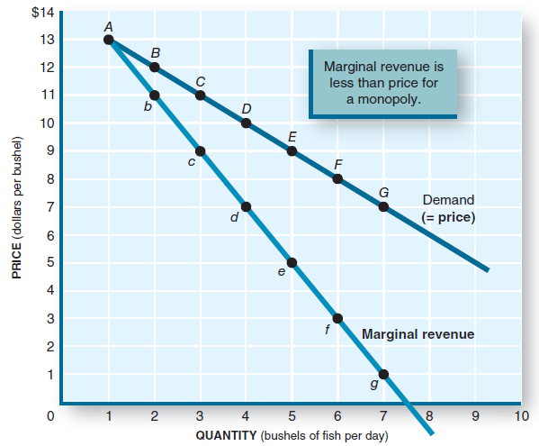
Price and Marginal Revenue (MR)
Competition Strategy and Pricing Policy
Points on the demand curve indicate a price for each output.
However, to sell more the monopolist must lower the price, so MR will always be less than price.
For the most part, the MR curve lies below the demand curve.
Business Economics
Notes:
The monopolist owns the market supply curve. So it faces the market demand curve.
The market demand curve says that if you want to sell more, lower the price.
Also, if you want to get a higher price, you must accept that you will sell less.
The data accompanying this graph in the book could be used to do a board presentation.

Slide 5
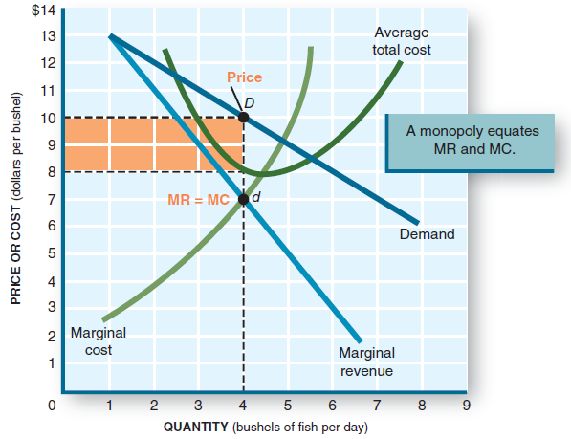
Profit Maximization
Competition Strategy and Pricing Policy
Find where the MR curve intersects the MC curve (point d).
Drop down to the output axis to find the profit-maximizing quantity.
Go up to the demand curve and then left to the price axis to find the profit-maximizing price.
Business Economics
Notes:
This is a step-by-step procedure to find the monopolist’s profit-maximizing quantity and the associated price.
Now might be a good time to expand this application to ALL forms of imperfect competition.

Slide 6
Profit Maximization
Competition Strategy and Pricing Policy
Only one price is compatible with the profit-maximizing output.
The monopolist will charge that price.
If it charges a higher price, profits fall.
If it charges a lower price, profits also fall.
Business Economics
Notes:
A discussion about “price gouging” is appropriate here.
Will the greedy firm jack the price up high? Not if that means charging a price higher than the profit-maximizing price.
What price gouging is depends on the definition chosen, but in relation to natural disasters, several U.S. states have put their own definitions into law, ranging from the vague to the specific. If the result is to generate a price ceiling on the good, then it will be in shortage because of the law.

Slide 7
The Production Decision
Competition Strategy and Pricing Policy
A monopolist will select an output quantity that corresponds to the profit maximization rules:
If MR>MC, increase output and profits rise.
If MR<MC, decrease output and profits rise.
If MR=MC, produce this profit-maximizing output.
Business Economics
Notes:
Will the monopolist increase output if society indicates it needs more of the good?
Maybe not, if the firm is operating at its profit-maximizing quantity.

Slide 8
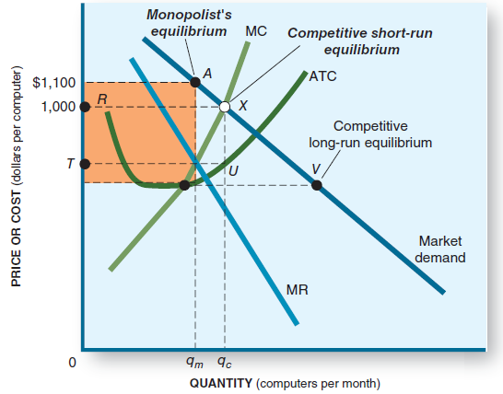
Monopoly Profit
Competition Strategy and Pricing Policy
The profit-maximizing output is q_{m}.
The rectangle indicates the size of profit.
Note that the monopolist will produce less (q_{m} vs. q_{c} ) and charge a higher price (A vs. X) than a competitive market.
Business Economics
Notes:
It might be a good exercise to ensure that students recognize that the rectangular area actually is profit.
Our society disapproves of monopolies because they produce less and charge more than competitive firms for the good.

Slide 9
Comparing Monopoly and a Competitive Industry
Competition Strategy and Pricing Policy
Competitive:
High profits attract more suppliers.
Supply shifts right and price falls.
Economic profits go to zero.
P = MC.
Profits are squeezed, so there is great pressure to reduce costs and improve quality.
Monopoly:
High profits, but barriers to entry exclude new suppliers.
No production change, so price does not fall.
Economic profits do not change.
P > MC.
No profit squeeze, so no pressure to reduce costs or improve quality.
Business Economics
Notes:
A step-by-step procession highlighting the difference could be instructive.

Slide 10
Where Does Market Power Come From?
Competition Strategy and Pricing Policy
A significant barrier to entry will keep competition out. The sole producer then has total power over market price.
The barrier could be due to control of an input, sheer size, or some legal means of excluding competition.
Patents.
Exclusive franchises.
Political appointment.
Considerable market power generates resources that could be used by the firm to exert political power.
Business Economics
Notes:
Note that monopoly power comes from sanction by a government agency.
This might encourage “rent seeking”: the desire of a firm to acquire monopoly power by spreading influence in the halls of government.
Once attained, this power need not only be directed into the market but could be used to influence government itself.
The result is called “crony capitalism.”

Slide 11
Price Discrimination
Competition Strategy and Pricing Policy
Some customers have a more inelastic demand for a good.
They are willing to pay more for a product than someone like customer B who has an elastic demand.
A monopolist can increase profits by selling to customer A at a higher price than customer B.
Airlines charge business travelers higher fares and lower prices to attract more nonbusiness travelers.
Business Economics
Notes:
This practice is not solely one of a monopolist. Other structures (except perfect competition) can do it too.
One needs only to separate customers by their price elasticity of demand (or by geographical split) and then keep them from interacting.
Examples: airlines, movie theaters, college tuition.

Slide 12
Natural Monopolies
Competition Strategy and Pricing Policy
Natural monopoly: an industry in which one firm can achieve economies of scale over the entire range of the market.
Economies of scale act as a “natural” barrier to entry.
Utilities have been examples of natural monopolies.
Government sets up natural monopolies.
Government describes the quality and area of service.
Government sets the rate (price) the natural monopoly can charge its customers.
The rate is set so there is no economic profit.
A normal profit is – usually- allowed.
Business Economics
Notes:
Why does only one power company distribute to a city (or area)?
You could have your students imagine what the city would look like if there were several power companies operating in competition.
Power lines everywhere, duplicating, criss-crossing, touching, shorting out, etc.
Aside from this aesthetic reason, if only one power distribution firm can reach economies of scale in this market, then you have made the case for natural monopoly.

Slide 13
Oligopoly
Competition Strategy and Pricing Policy
In an oligopoly
There are only a few firms, generally big relative to the size of the market.
Barriers to entry are high.
Each sells a basically standardized product, but with differentiating elements. Generally one firm’s product will substitute for another's.
Each dominant firm has substantial market power.
Business Economics
Notes:
These are the characteristics of oligopoly.

Slide 14
Oligopoly Behavior
Competition Strategy and Pricing Policy
Firms in an oligopoly make decisions based on what they think their competitors will do.
They are interdependent in their decision making.
Market share: the percentage of the total market produced by a single firm.
If the total produced is 1,000,000 units, and firm A produces 300,000, A’s market share is 30%.
Business Economics
Notes:
Interdependence means that no one firm can make decisions without retaliation by the others, which might negate the original decision.
So each firm “games” the others to figure out what to do: If we do this, what will they do? If they come back and do that, what should we do?
The reason is the possessiveness each firm has over its market share.

Slide 15
Oligopoly Behavior
Competition Strategy and Pricing Policy
A significant behavior of an oligopolist is to preserve market share.
If firm A sees its market share drop from 30% to 28%, that means one of its rivals took sales away from firm A. This is not acceptable.
An increase in market share of one firm reduces the market share of other firms.
How can one firm accomplish this?
What will the other firms do?
Business Economics
Notes:
When a few firms dominate, one firm’s loss in market share is a rival firm’s gain. That will not do! CEOs get fired when this happens.

Slide 16
Oligopoly Behavior
Competition Strategy and Pricing Policy
Firm A could lower its price and undercut its rivals.
At the lower price, sales would increase and firm A would increase its market share.
However, others in the oligopoly would immediately notice this. Since they do not want to lose market share to firm A, they would retaliate by lowering their prices also.
Business Economics
Notes:
This is the simplest method to acquire increased market share. Lower the price and buyers will buy more.
Note the retaliation. Also, if each firm is operating at profit-maximizing quantity, lowering the price to sell more (and increase market share) will move the firm away from its profit-maximizing quantity, lowering profits.
It seems that increasing or preserving market share is more important than profit maximization to an oligopolist.

Slide 17
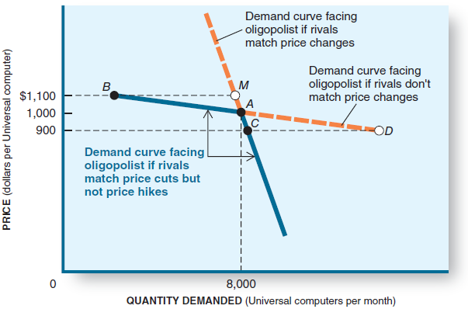
The Kinked Demand Curve
Competition Strategy and Pricing Policy
A firm will match a rival’s price decrease but will not match a rival’s price increase.
The different responses can be seen in the firm’s demand curve, which is kinked at point A.
Business Economics
Notes:
It might be worthwhile to trace the change in P and Q as one goes up the kinked demand curve and as one goes down the kinked demand curve.

Slide 18
Non-price Competition
Competition Strategy and Pricing Policy
Oligopolists avoid price competition and instead pursue nonprice competition.
Advertising.
Convince the consumer that firm A’s product is a better buy than those of its rivals.
Product differentiation.
Firm A could modify its products to make them appealingly different in order to sell more.
Both strategies are designed to improve brand loyalty, thus maintaining or gaining market share.
Business Economics
Notes:
Oligopolists are heavy advertisers. The principal goal is to instill in consumers a strong brand loyalty. If successful, then the consumer will replace a used-up product with the identical brand. This preserves market share.
One way to convince consumers to do this is to point out (real or imagined) appealing differences between the firm’s product and those of its competitors.

Slide 19
Game Theory
Competition Strategy and Pricing Policy
Playing the “What if?” game: Each oligopolist has to consider the potential responses of rivals when formulating price or output strategies.
Game strategy requires the creation of possible outcomes. This is called the payoff matrix.
Business Economics
Notes:
Game theory is much more elaborate than this. However, the “What if?” game is indeed played. Two of the greatest players of this game (with the highest stakes) were the U.S. and the USSR during the Cold War.

Slide 20
Game Theory
Competition Strategy and Pricing Policy
Each cell in the payoff matrix shows how profit will change for each action/response combination.
In the example above, Universal’s best bet is to initiate a price cut. (Dominant Strategy)
The Rivals’ Dominant Strategy is also Price Cut
Business Economics
Notes:
Remember that each “player” can choose only from his two options. He cannot choose his opponent’s option (but he’d like to).
To maximize his payout, he has to guess what his opponent will do.
It might be worthwhile to play out the various options in class.

Slide 21
Coordination
Competition Strategy and Pricing Policy
Oligopolies try to behave like a monopoly, choosing an industry output that maximizes total industry profit.
This requires oligopoly firms to agree to restrict output and raise prices – that is, to no longer compete.
Each must be content with its market share, and that share must occur at its individual profit-maximizing output.
Business Economics
Notes:
What if, instead of trying to outguess what the others will do, the firms agree to coordinate their actions?
The profit maximization rule can be applied to the entire industry. Once found, the quantity produced can be allotted in proportion to the firms’ market share. The ideal situation occurs when each firm’s assigned quota is identical to the quantity where it realizes profit maximization.

Slide 22
Methods of Coordination
Competition Strategy and Pricing Policy
Price-fixing: they could explicitly agree to charge the same price.
Price leadership: one firm would set the price and the others would match it.
Allocation of market shares: each firm would be assigned a quota of production, with the sum of all output being the industry’s profit-maximizing rate of output.
Agree on periodical change of leadership in the industry
Business Economics
Notes:
Instead of undercutting each other in price, they could collectively agree to one price for the entire industry.
Or they might agree to let the industry “leader” set the price and have all others match it.
Or they might simply divide up the customers in some way – say, geographically.

Slide 23
Cartels
Competition Strategy and Pricing Policy
Cartel: a group of firms with an explicit, formal agreement to fix prices and output shares in a particular market.
Cartels openly violate U.S. and EU antitrust laws, so we have to go abroad to find an example.
The Organization of Petroleum Exporting Countries (OPEC) is a cartel. OPEC assigns explicit production quotas for each of its members.
Business Economics
Notes:
A formal coordination agreement is called a cartel.
Such coordination is illegal in the United States.
This is the reason why the oil-producing United States is not a member of OPEC.

Slide 24
Cartels
Competition Strategy and Pricing Policy
Cartels are most effective when
All producers are included in the cartel.
Each producer obeys the quota that is assigned.
OPEC sometimes has problems maintaining its desired price of oil because
Not all oil producers are members of OPEC (Russia, Norway, e.g. are not)
Some OPEC producers “cheat” by increasing production to their individual profit-maximizing level.
Business Economics
Notes:
This slide outlines why sometimes the OPEC members squabble with each other and “cheat” on each other.
When members “cheat” and produce more than their quotas, the market supply shifts right, leading to falling prices.

Slide 25
Barriers to Entry
Competition Strategy and Pricing Policy
Oligopoly, like monopoly, maintains economic profits due to barriers to entry.
Barriers to entry include
Patents.
Distribution control.
Acquisition of a rival (merger).
Government regulation that limits competition.
Brand loyalty.
Network economies (e.g. PC compatibles)
Business Economics
Notes:
The Polaroid Land camera is an example of a patent as a barrier to entry.
DeBeers has worldwide distribution control on diamonds.
A merger between competitors reduces competition.
In New York, the city allocates only a few taxi permits, thereby limiting competition.
Brand loyalty, if successful, makes it extremely difficult for new competitors to get shelf space or to get the customer to try the product.
If everyone else is using Microsoft Office, it will be very difficult to get you to use a new competing office package.

Slide 26
Monopolistic Competition
Competition Strategy and Pricing Policy
Monopolistic competition: a market in which many firms produce similar goods or services but each maintains some independent control of its own price.
Concentration ratios in monopolistic competition are low.
Most of the local outlets and retail centers are examples of monopolistic competition.
Your local McDonalds competes with other nearby fast-food outlets, for example.
Business Economics
Notes:
Price competition is small. The profit margin (P – ATC) could be thin. This in itself limits price competition.
If one outlet does lower its price, the other local outlets could follow by lowering theirs, but the consequences are not nearly so great as in oligopoly.
Market share among large numbers of competitors is not so precious.

Slide 27
Market Power
Competition Strategy and Pricing Policy
The monopoly aspect comes from a firm’s ability to make variations in its basic good and make modest changes in its price.
They have some market power.
Their demand curve is downward sloping.
Their decisions are much less interdependent than those of the oligopolist.
There are low barriers to entry.
Business Economics
Notes:
Once the firm creates some unique aspect of its products, and the customers increase their demand for this good (and decrease demand for the competitor’s version), then the unique firm can raise its price and increase economic profit.
The others will scramble as demand for their product decreases. To get back in the game, they will clone the unique firm’s idea. They can do this because the barriers are low to nonexistent.

Slide 28
Monopolistic Competition Behavior
Competition Strategy and Pricing Policy
Product differentiation: features that make one product appear different from competing products.
Profit margins are usually small and competitor’s products are substitutes, so firms resort to nonprice competition.
Your goal is to create a distinct identity – a brand image. Consumers become loyal to your brand and buy only at your outlet. You become a monopolist to them.
Business Economics
Notes:
This is the technique one firm will use to make its product unique compared to the competitors.
The uniqueness may be due to a real difference between the competing products, or it may be totally fabricated in the creation of a brand image that resonates with the customers.

Slide 29
Monopolistic Competition Behavior
Competition Strategy and Pricing Policy
Brand loyalty: convince the consumer that your version of a product is unique and more desirable than that of the competition.
As long as the consumer remains brand-loyal, you are a monopolist.
You could increase the price without losing the consumer’s business.
Your “monopoly” will continue until your competition clones your special feature or convinces the fickle consumer to switch to their brand.
Business Economics
Notes:
The monopoly aspect will be short-lived if the competitors simply add your unique feature to their goods.
Then they offer their products at a lower price than your “unique” good, and customer loyalty disappears and competition is back to its intense original state. It will stay that way until some firm makes the next breakout.

Slide 30
Profit Maximization
Competition Strategy and Pricing Policy
Monopolistically competitive firms are profit maximizers.
They face a downward-sloping demand curve, so MR slopes downward also (the curves are like those of Monopoly)
They will produce an output where MR = MC.
At long-run equilibrium, economic profits tend to zero as new entrants shift supply to the right and drive down prices.
Business Economics
Notes:
The graphical depiction is identical to monopoly.
Profit squeeze occurs as it does in perfect competition because of low barriers to entry.

Slide 31
Entry Effects
Competition Strategy and Pricing Policy
New entrants can’t be kept out of the market.
Economic profits draw in new competitors.
Profits, existing due to having a unique product and brand loyalty, will be squeezed to zero as the new entries clone the uniqueness.
Individual firms’ demand curves will shift to the left as new firms enter.
Industrywide demand shifts right as new firms enter, driving down price.
Ultimately economic profits are eliminated.
Business Economics
Notes:
This cloning of unique features is instrumental to product improvement across the industry.

Slide 32
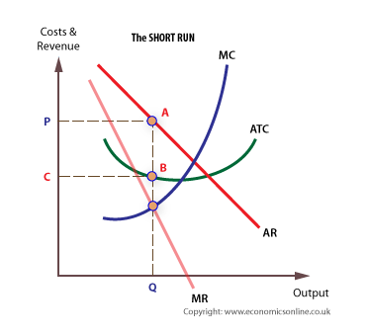
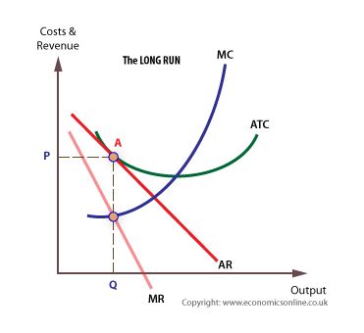
Profit Maximization
Competition Strategy and Pricing Policy
Business Economics
Notes:
The graphical depiction is identical to monopoly.
Profit squeeze occurs as it does in perfect competition because of low barriers to entry.

Slide 33
Inefficiency
Competition Strategy and Pricing Policy
With a downward-sloping demand curve, long-run equilibrium will not occur at minimum ATC.
Thus this form of market structure will use more than the minimum amount of resources to produce the product.
It will be inefficient compared to perfect competition.
There also will be more outlets than needed. There is excess capacity.
Monopolistic competition results in both
Productive inefficiency (above-minimum ATC).
Allocative inefficiency (wrong mix of output).
Business Economics
Notes:
LR equilibrium will occur at a quantity to the left of minimum ATC.
If economic profits are being made in fast food at a certain location in the city, new entrants will be lured to that area.
Soon more fast-food outlets are located there. It is not out of the question that the capacity to serve all the fast-food customers in that area will become excessive.

Slide 34
Government Intervention
Competition Strategy and Pricing Policy
Markets sometimes fail. Unregulated markets may produce the wrong mix of output, undesirable methods of production, or an unfair distribution of income.
But government intervention can fail as well.
Business Economics
Notes:
Activities run by the government can be highly effective; however, they are nearly always very expensive to operate.
Because of this, a government intervention that is not effective would fail the MB - MC test.

Slide 35
Ideal Market Conditions
Competition Strategy and Pricing Policy
The market’s answer to WHAT, HOW, and FOR WHOM to produce would be ideal if
All producers would be perfect competitors.
People had full information about tastes, costs, and prices.
All costs and benefits were reflected in market prices.
Pervasive economies of scale were absent.
Business Economics
Notes:
These were the basic ideals we set forth in the discussion of perfect competition.
Since almost all firms are in the other three market structures, ideal market conditions cannot possibly exist in great numbers.

Slide 36
Market Failure and Government Intervention
Competition Strategy and Pricing Policy
The market does not operate in this ideal way.
Market failure prevents optimal outcomes.
Government may intervene in two ways:
Antitrust: government intervention to alter market structure or prevent abuse of market power.
Regulation: government intervention to alter the behavior of firms – for example, in pricing, output, or advertising.
Business Economics
Notes:
Antitrust looks out for illegal coordination and adjudicates the merit of mergers.
Regulation arises from laws passed in Congress that establish a government agency to administer the regulation.

Slide 37
Natural Monopoly
Competition Strategy and Pricing Policy
Natural monopoly: an industry in which one firm can achieve economies of scale over the entire range of market supply.
One firm can provide the good or service at a lower cost than several competing firms.
The firm would have a downward-sloping ATC curve.
Such a firm also would have high fixed costs – that is, a large capital input and low marginal costs.
Business Economics
Notes:
You can demonstrate this by drawing a downward-sloping LRATC and intersecting the market demand curve at the low end of the LRATC.
Then identify one firm to produce a quantity equal to the intersection. On the vertical axis, identify the corresponding price as C₁. Now go to the left along the horizontal axis to one-fourth the quantity as the intersection. If there were four equal-sized firms in competition, they would be this big. On the LRATC, identify the cost associated with this firm and label it C₄. This cost would have to be much higher than that of the natural monopolist.

Slide 38
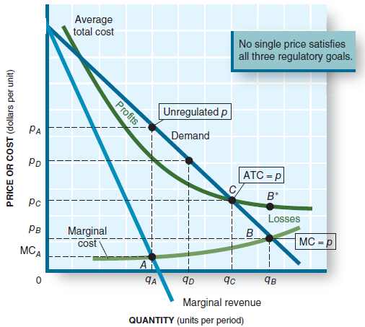
Natural Monopoly
Competition Strategy and Pricing Policy
An unregulated natural monopoly produces output q_{A} and charges p_{A}, related to MR = MC.
Efficiency calls for marginal cost pricing, p = MC, at point B.
Zero economic profits occur at point C, where p = ATC.
Business Economics
Notes:
Note that the market is not fully supported and the corresponding price is high.

Slide 39
Regulatory Options
Competition Strategy and Pricing Policy
Price regulation: the monopoly will not be allowed to charge p_{A,} its profit-maximizing price.
Business Economics
Notes:
There is no need for the natural monopolist to profit-maximize. A normal profit is all that is necessary.
Economic profits are zero. Economic profits lure in new suppliers, which will not be allowed.

Slide 40
Regulatory Options
Competition Strategy and Pricing Policy
Price efficiency.
(p = MC). Point B. Price equals to opportunity cost. Efficient but generates a loss to the firm (p<ATC).
To get the firm to produce, it must be provided a subsidy that equals the loss, ATC - p.
Business Economics
Notes:
This would be the economically most efficient approach, but it requires a subsidy (out of tax dollars) to induce the firm to perform.

Slide 41
Regulatory Options
Competition Strategy and Pricing Policy
Production efficiency.
(p = min ATC). Beyond Q_{B .}The ATC curve slopes downward; by increasing output we lower costs more.
Again, the firm operates at a loss and would need again a subsidy.
Business Economics
Notes:
Per-unit costs would be the lowest in this case, and, if passed to the customers, the price would be at its lowest.
However, to induce the firm to produce, a government subsidy would be needed.

Slide 42
Regulatory Options
Competition Strategy and Pricing Policy
Profit regulation.
Require the firm to produce output q_{C} and charge price p_{C}.
At that point p = ATC at zero economic profits.
No subsidy is needed.
Allows a normal profit
Rate increase requests must be approved by a competent board.
Business Economics
Notes:
This method allows the firm to have a normal profit (its stockholders receive a return on investment equal to their alternative investment choices).
No subsidy is needed.
The competent board must understand how the cost structure of the industry operates.
The firm will petition for a rate increase based on the need to cover rising costs.

Slide 43
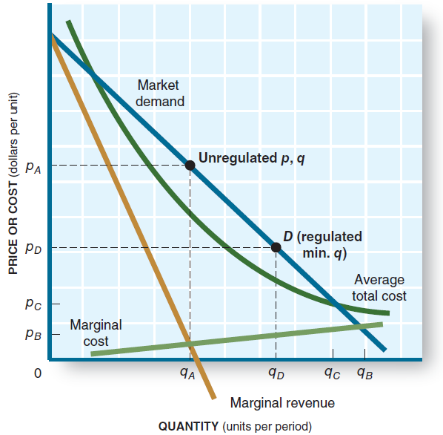
Regulatory Options
Competition Strategy and Pricing Policy
Output regulation.
The monopolist could be compelled to provide a minimum of output q_{D} (there is profit) in excess of q_{A}, which again is a gain for customers
By doing this, there is a risk of reduced quality if the firm cuts costs to increase profits.
Business Economics
Notes:
Imagine a franchise of In-and-Out Burgers in your city. The owner of the franchise puts one store in the affluent north part of town, another in the vibrant center, and a third in the not-so-wealthy south. After a year or so, the first two are highly profitable; the third is losing money. So the owner closes that one. This would be perfectly legal and makes good business sense.
Now do the same for an electric distribution company. Even though it may lose money in the south part of town, it must continue to provide service.

Slide 44
Government Regulation
Competition Strategy and Pricing Policy
The options are conflicting. Ideally we want marginal cost pricing, no subsidy, full service, and quality service.
The choice society has is not between imperfect markets and flawless government intervention.
It is between imperfect markets and imperfect government intervention.
Sometimes government failure occurs.
Business Economics
Notes:
When the government intervenes, it implements legislation that was created in a highly political arena. There is no reason to expect that the results of this legislation will lead to perfection. The unintended consequences of implementation could make market outcomes worse.

Slide 45
Government Regulation
Competition Strategy and Pricing Policy
Government failure: government intervention that fails to improve economic conditions.
Government failure may be worse than market failure.
Market outcomes after regulation may be worse than before the industry was regulated.
Business Economics

Slide 46
Costs of Regulation
Competition Strategy and Pricing Policy
In any event, success or failure, government regulation has significant costs:
Collecting information on demand and costs in the industry.
Creating and staffing bureaucracies to administer and ensure compliance with the regulations.
Regulated firms also have huge compliance costs.
Government failure alters the mix of output in undesired ways, causing a cost to society.
Business Economics
Notes:
Compliance costs are often overlooked when assessing the cost of government regulation.

Slide 47
Deregulation
Competition Strategy and Pricing Policy
Two reasons to consider deregulation of an industry:
The regulated industry is less productive than desired, due to regulation.
Advancing technology destroys the reason for regulation.
Business Economics
Notes:
In the 1930s, many industries were regulated: telephone, radio, trucking, and airlines, for example.
To staff the regulatory agencies, the industries themselves provided expert people.
After their time at the regulatory agency is over, they go back into industry.
Thus it is likely that the regulator and the existing firms in the industry begin to “scratch each other’s backs.”
The regulatory body ends up restricting new entrants into the industry.
When this happens, the industry is better off being deregulated than remaining in regulation.

