Slide 1
INTERNATIONAL DEVELOPMENT AND THE GLOBAL SOUTH
DIMITRIS KYRKILIS

Slide 2
DEFINITIONS
Economic Growth
Economic growth can be defined as the rise of the per capita domestic income in a given period of time. It can be understood as the outward expansion of the Production Possibility Frontier (PPF)of a given national economy in a defined time period.
The PPF defines the maximum bundles of goods and services a national economy is able to produce given the amount of resources and the technology available to this economy in a specified time period and the efficient use of the technology available.
The outward expansion of the PPF may be achieved either by increasing the amount of resources or by improving the efficiency of the economy or both.

Slide 4
Economic Development
Development is a concept that includes economic growth but it also refers to the conditions of life and the extent of poverty. A country develops as conditions of life improve and poverty is being reduced. The common denominator of both is economic growth in the sense of the necessary condition for achieving better conditions of life and less poverty but not the sufficient condition. Economic growth may improve the conditions of life for a share, some times a small one of the population without reducing poverty. The latter may be attained when the distribution of income becomes more equal, and this is not guaranteed by economic growth alone. It is the result of a process subject to social and political factors, i.e. institutions that are open and inclusive and they do not allow the expropriation of the additional wealth by certain elite (the latter act as rent seekers)

Slide 5
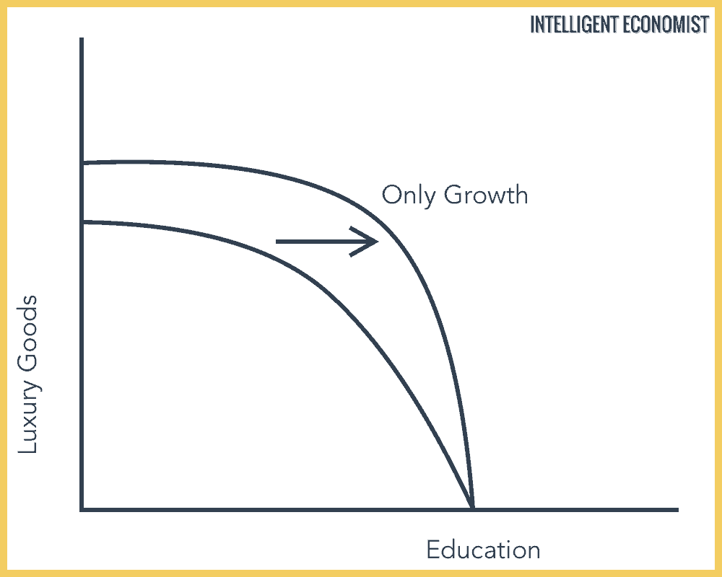

Slide 6
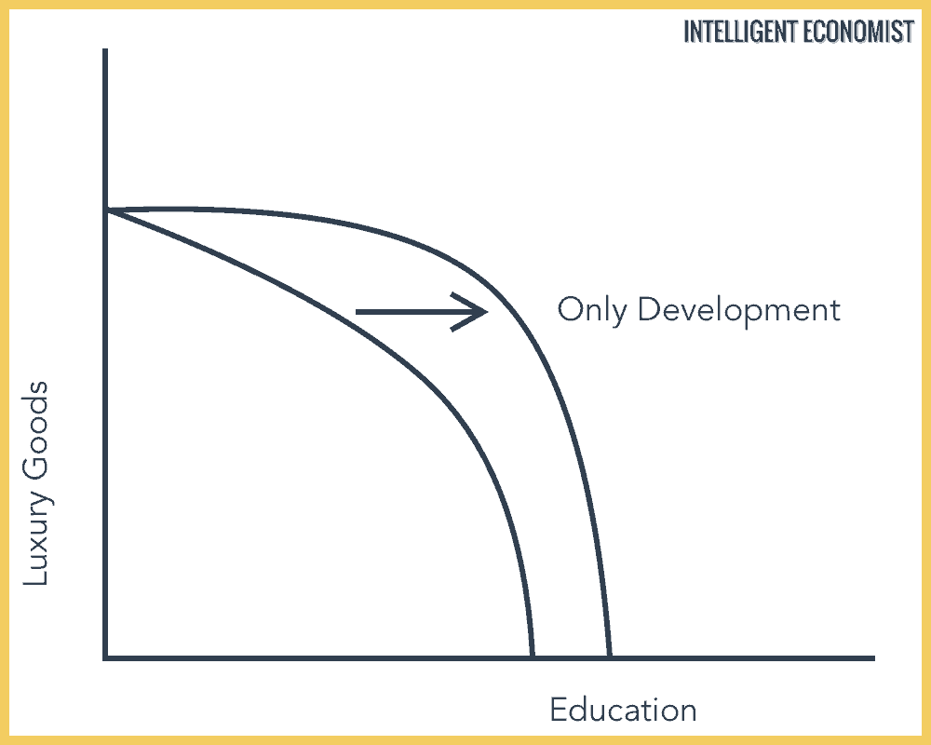

Slide 7
International Development
International Development may be understood as any action of assistance on the part of states and international organisations that promotes international and inter-organizational connections and collaborations, in order to benefit regions and countries under conditions of poverty, or a relatively low level of development.

Slide 8
International Development
International assistance was established with the founding of the Bretton Woods organizations such as the World Bank and the International Monetary Fund, and the Marshall plan of the US government established initially to aid various countries to reconstruct their economies which were devastated by the II World War.
During the 1980s, when many developing countries found themselves in difficulties with public budget deficits and balance of payments deficits, these organizations began to supply them with credit under alternative terms, which mainly included changes in the management of the country that were meant to lead to development. These included the liberalization of markets and the promotion of openness, transparency and privatization. While some of the countries managed to gain strength following this assistance, most of them, especially the African countries, did not succeed in leveraging this international aid into long term development. Included among the additional international companies were aid organizations of the UN (the Development Program, the Environment Program, the World Health Organization, etc.) as well as additional international banks, such as the African Development Bank and the Asian Development Bank.

Slide 10
Global South
Three primary definitions may be proposed fir ghe concept of Global South.
First, it has traditionally been used within intergovernmental development organizations –– primarily those that originated in the Non-Aligned Movement­ ­–– to refer to economically disadvantaged nation-states and as a post-cold war alternative to “Third World.”

Slide 11
Global South
Second, in recent years and within a variety of fields, the Global South is employed in a post-national sense to address spaces and peoples negatively affected by contemporary capitalist globalization. In this sense Global South captures a non aligned to specific teritories geography of capitalism’s externalities and accounts for populations living in lower than the average development conditions within the borders of wealthier countries. It implies that that there are economic Souths in the geographic North and economic Norths in the geographic South. Furthermore, the term South based on the centre periphery tradition represents an internal periphery and social and political marginalised positions of groups of people, while the term “global” is used to detach “South” from a one-to-one relation to geography.

Slide 12
Global South
Third, the second definition of the Global South has led to the understanding of the concept as a transnational political subject that results from a shared experience or condition of subjugation under contemporary global capitalism. This subject is forged when the world’s "Souths" recognize one another and view their conditions as shared (López 2007; Prashad 2012). The use of the Global South to refer to a political subjectivity undertakes a radical internationalist stsnce arising from lateral solidarities among the world’s multiple Souths, which engulf all populations that have become worse off under contemporary capitalist globalisation, and moves beyond the analysis of the operation of power through colonial

Slide 13
Global South
Critical scholarship that falls under the rubric of Global South Studies is invested in the analysis of the formation of a Global South subjectivity, the study of power and racialization within global capitalism in ways that transcend the nation-state as the unit of comparative analysis, and in tracing both contemporary South-South relations –– or relations among subaltern groups across national, linguistic, racial, and ethnic lines –– as well as the histories of those relations in prior forms of South-South exchange.

Slide 14
Global South
The concept of Global South has been criticized as vague and inaccurate in three main dimensions
First, descriptively even when it refers to general notions such as economic development.
Second, it homogenizes across different countries obscuring important differences between countries that are supposed to be part of Global South and/or North groups. In this respect the term is not better than the term Third World the term Global South is proposed to replace.
Third, the term implies a geographic determinism in the sense that countries located in the Southern hemisphere are meant to be poor on geographic reasons only

Slide 15
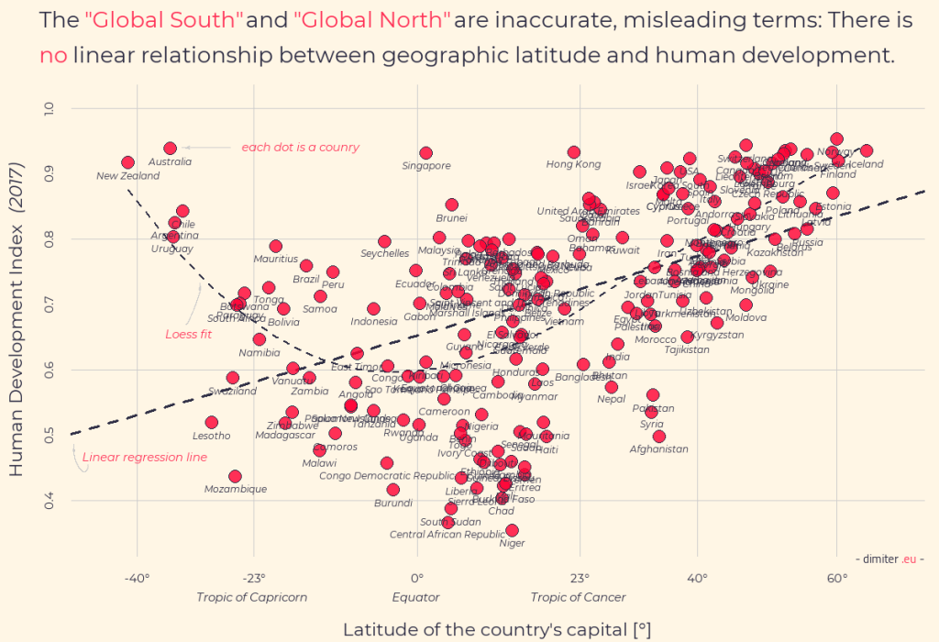

Slide 16
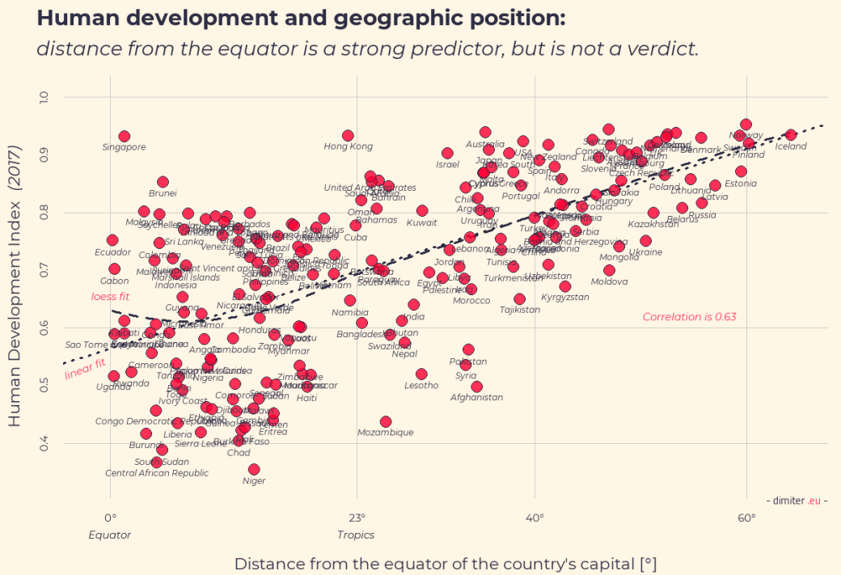

Slide 17
Production Stages
Primary Production
Economies specialise to the production of: raw materials in mines, quarries, etc. Agriculture products, e.g. raw foostuff, products if fishery, timber, etc.
There is some manufacturing output mainly of artisanal production mode focused in traditional products, e.g. Textiles, simple metal products, etc.
Countries of low per capita GDP.
Secondary Production
Economies specialise in industrial production mainly manufacturing.
Countries of middle per capita GDP.
Tertiary Production
Economies specialise in services maintaining though a strong industrial basis.
Countries of high per capita GDP

