Slide 1
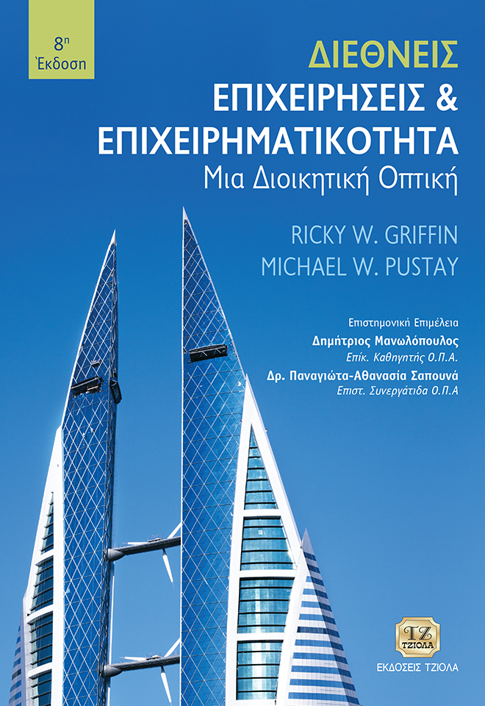
Διεθνείς Επιχειρήσεις και Επιχειρηματικότητα 8^{η} Έκδοση
ΚΕΦΑΛΑΙΟ 12
Αξιολόγηση και Ανάλυση Ξένων Αγορών και Τρόποι Εισόδου
Griffin & Pustay

Slide 2
Μαθησιακοί Στόχοι
Συζητήσετε πώς οι επιχειρήσεις αξιολογούν και αναλύουν τις ξένες αγορές.
Σκιαγραφήσετε τη διαδικασία με την οποία οι επιχειρήσεις επιλέγουν τον τρόπο εισόδου τους σε μια ξένη αγορά.
Περιγράψετε τις μορφές των εξαγωγών και τις κατηγορίες μεσαζόντων που μπορούν να βοηθήσουν τις επιχειρήσεις να εξάγουν τα προϊόντα τους.

Slide 3
Μαθησιακοί Στόχοι
Προσδιορίσετε τα βασικά ζητήματα που ανακύπτουν αναφορικά με την αδειοδότηση και δικαιόχρηση στο διεθνές περιβάλλον και να συζητήσετε σχετικά με τα πλεονεκτήματα και τα μειονεκτήματα αυτών των μορφών εισόδου σε ξένες αγορές.
Αναλύσετε τις συμφωνίες υπεργολαβίας, τις συμβάσεις διαχείρισης και τις συμβάσεις ετοιμοπαράδοτου έργου ως εξειδικευμένους τρόπους εισόδου των διεθνών επιχειρήσεων σε ξένες αγορές.
Χαρακτηρίσετε τους τύπους των άμεσων ξένων επενδύσεων, ήτοι την εκ του μηδενός επένδυση και την εξαγορά.

Slide 4
Ανάλυση Ξένων Αγορών
Αξιολόγηση
Εκτίμηση
Επιλογή
Notes:
Regardless of their strategies, most international businesses have the fundamental goals of expanding market share, revenues, and profits. They often achieve these goals by entering new markets or by introducing new products into markets where they already have a presence. In order to increase market share, revenue, and profits, firms must follow three steps: (1) assess alternative markets, (2) evaluate the respective costs, benefits, and risks of entering each one, and (3) select those with the most potential for entry or expansion.

Slide 5
Αξιολόγηση των Εναλλακτικών Ξένων Αγορών
Προοπτικές της αγοράς
Επίπεδα ανταγωνισμού
Νομικό και πολιτικό περιβάλλον
Κοινωνικοπολιτισμικές επιρροές
Αξιολόγηση
Notes:
In assessing alternative foreign markets, a firm must consider a variety of factors:
The first step involves assessing market potential. Data about population, per capita GDP, and public infrastructure permit firms to screen various foreign markets. The decisions a firm draws from this information often depend upon the positioning of its products relative to those of its competitors.
Another factor in selecting a foreign market is the level of competition in the market. To assess the competitive environment, a firm should identify the number and sizes of firms competing in the target market, their relative market shares, their pricing and distribution strategies, and their relative strengths and weaknesses. It must then weigh these factors against actual market conditions and its own competitive position.
A firm contemplating entry into a particular market must also understand the host country’s general legal and political environment. A firm may choose to forgo exporting its goods to a country that has high tariffs, in favor of exporting to one that has fewer barriers. Government stability also is an important factor in foreign market assessment. Some less developed countries have been prone to military coups and similar disruptions.
Managers assessing foreign markets must also consider sociocultural influences. Firms that fail to recognize the needs and preferences of host country consumers often run into trouble. Firms must also evaluate sociocultural factors associated with potential employees.

Slide 6
Εκτίμηση του Κόστους, του Οφέλους και του Κινδύνου
Κόστος
Άμεσο κόστος
Κόστος ευκαιρίας
Notes:
The next step in foreign market assessment is a careful evaluation of the costs, risks, and benefits associated with doing business in a particular foreign market.
Two types of costs are relevant at this point: direct and opportunity.
Direct costs are incurred when a firm enters a new foreign market. Such costs are associated with setting up a business operation, transferring managers to run it, and shipping equipment and merchandise.
The firm also incurs opportunity costs. Because a firm has limited resources, entering one market may preclude or delay its entry into another. The profits it would have earned in that second market are its opportunity costs—the organization has forfeited or delayed its opportunity to earn those profits by choosing to enter another market first.

Slide 7
Εκτίμηση του Κόστους, του Οφέλους και του Κινδύνου
Οφέλη
Πωλήσεις και κέρδη
Χαμηλότερο κόστος
Κατάκτηση αγορών
Ανταγωνιστικό πλεονέκτημα
Νέα τεχνολογία
Συνέργεια
Notes:
Entering a new market presumably offers a firm many potential benefits; otherwise, why do it? Among the most obvious potential benefits are the expected sales and profits from the market. Others include lower acquisition and manufacturing costs (if materials or labor are cheap), foreclosing of markets to competitors (which limits competitors’ ability to earn profits), competitive advantage (which allows the firm to keep ahead of or abreast with its competition), access to new technology, and the opportunity to achieve synergy with other operations.

Slide 8
Εκτίμηση του Κόστους, του Οφέλους και του Κινδύνου
Κίνδυνοι
Διακύμανση συναλλαγματικών ισοτιμιών
Οργανωσιακή πολυπλοκότητα
Άμεσες οικονομικές απώλειες
Πολιτικοί κίνδυνοι
Notes:
Generally, a firm entering a new market incurs the risks of exchange rate fluctuations, additional operating complexity, and direct financial losses resulting from inaccurate assessment of market potential. In extreme cases, it also faces the risk of loss through government seizure of property or as a result of war or terrorism.

Slide 9
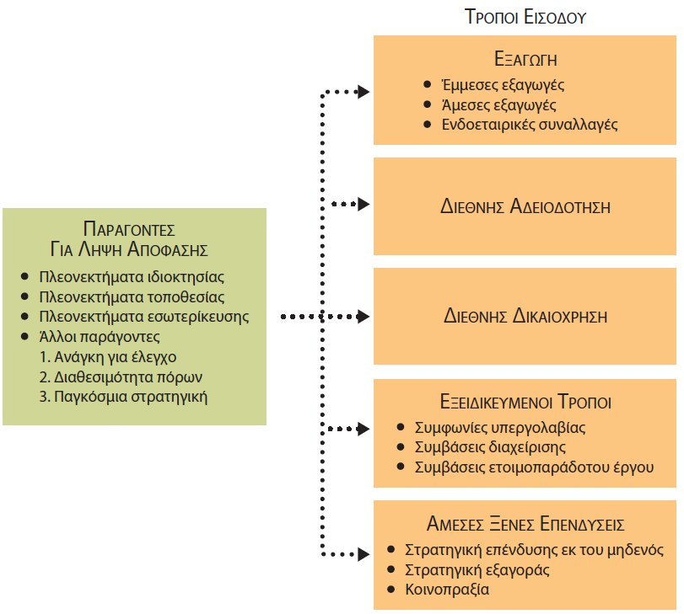
Επιλογή του Τρόπου Εισόδου
Notes:
Having decided which markets to enter, the firm is now faced with another decision: Which mode of entry should it use?
Dunning’s eclectic theory, discussed in chapter 6, provides useful insights into the factors that affect the choice among either home country production (exporting), host country production in firm-owned factories (FDI and joint ventures), or host country production performed by others (licensing, franchising, and contract manufacturing). Recall that the eclectic theory considers three factors: ownership advantages, location advantages, and internalization advantages. Other factors include the firm’s need for control, availability of resources, and global strategy. The role of these factors in the entry mode decision is illustrated in Figure 12.1.

Slide 10
Επιλογή του Τρόπου Εισόδου
Πλεονεκτήματα ιδιοκτησίας
Πλεονεκτήματα τοποθεσίας
Πλεονεκτήματα εσωτερίκευσης
Παράγοντες απόφασης
Άλλοι παράγοντες
Notes:
Ownership advantages are resources owned by a firm that give it a competitive advantage over its industry rivals. Because ownership advantages often determine a firm’s bargaining strength, they can influence the outcome of entry mode negotiations.
Location advantages affect the desirability of host country production relative to home country production. If home country production is found to be more desirable than host country production, the firm will choose to enter the host country market via exporting. Conversely, if host country production is more desirable, the firm may invest in foreign facilities or license the use of its technology and brand names to existing host country producers.
Internalization advantages make it desirable for a firm to produce a good or service itself, rather than contracting with another firm to produce it. Transaction costs are critical to this decision. If such costs are high, the firm may rely on FDI and joint ventures as entry modes. If they are low, the firm may use franchising, licensing, or contract manufacturing.
Other factors may affect the choice of entry mode. For example, a firm is likely to consider its need for control and the availability of resources. To reduce uncertainty, a firm may prefer an initial entry mode that offers a high degree of control. However, if capital and executive talent are in short supply, that firm may not be able to afford the large capital investments this control entails. Therefore, the firm may use an entry mode such as licensing that will be less costly. A firm’s overall global strategy also may affect the choice of entry mode. If it intends to exploit economies of scale and synergies between its domestic and international operations, the firm may prefer ownership-oriented entry modes. Conversely, if the firm’s competitive strengths are flexibility and responsiveness to changing market conditions, it can consider all entry modes warranted by local conditions in a given host country.

Slide 11
Εξαγωγή σε Ξένες Αγορές
ΚΥΡΙΑ ΠΛΕΟΝΕΚΤΗΜΑΤΑ ΕΞΑΓΩΓΗΣ
ΚΥΡΙΑ ΜΕΙΟΝΕΚΤΗΜΑΤΑ ΕΞΑΓΩΓΗΣ
Σχετικά χαμηλή χρηματοοικονομική δέσμευση
Δυνατότητα σταδιακής εισόδου στην αγορά
Απόκτηση γνώσης για την τοπική αγορά
Αποφυγή περιορισμών σε ξένες επενδύσεις
Ευπάθεια σε δασμούς και μη δασμολογικούς φραγμούς
Υλικοτεχνική πολυπλοκότητα
Πιθανές συγκρούσεις με διανομείς
Notes:
Exporting offers a firm several advantages.
First, the firm can control its financial exposure to the host country market. If the firm chooses to hire a host country firm to distribute its products, its financial exposure may be limited to start-up costs for marketing research, selecting a local distributor, and advertising. If the firm chooses to distribute its products itself, financial exposure may rise substantially; since it will have to equip and operate distribution centers, hire employees, and market products.
Second, exporting permits a firm to enter a foreign market gradually, thereby allowing it to assess local conditions and fine-tune its products to meet the needs of host country consumers. If its exports are well received by foreign consumers, the firm may use this experience as a basis for a more extensive entry into that market.

Slide 12
Εξαγωγή σε Ξένες Αγορές
Εξαγωγές
Προδραστικά κίνητρα
Κίνητρα αντίδρασης
Notes:
Firms may have proactive or reactive motivations for exporting. Proactive motivations are those that pull a firm into foreign markets as a result of opportunities available there.
Reactive motivations for exporting are those that push a firm into foreign markets, often because opportunities are decreasing in the domestic market. Some firms turn to exporting because their production lines are running below capacity or because they seek higher profit margins in foreign markets in the face of downturns in domestic demand.

Slide 13
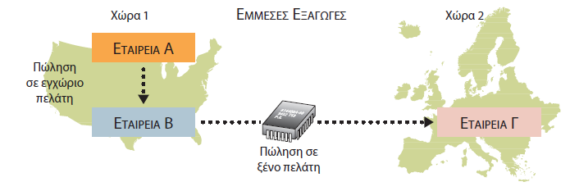
Μορφές Εξαγωγής: Έμμεση Εξαγωγή
Notes:
Indirect exporting occurs in several ways. For example, a firm may sell its product to a domestic customer, a domestic wholesaler, or a foreign firm’s local subsidiary. All of them which will export the product, in either its original form or a modified form. In most cases, indirect exporting activities are not part of a conscious internationalization strategy by a firm. Thus, the firm will gain little international business experience from indirect exporting.

Slide 14
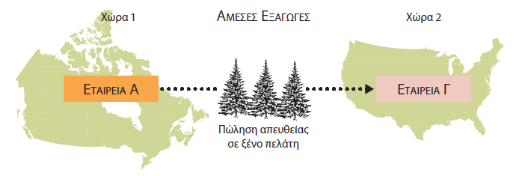
Μορφές Εξαγωγής: Άμεση Εξαγωγή
Notes:
Direct exporting occurs through sales to customers located outside the firm’s home country. Initially, direct exporting to a foreign market is often the result of an unsolicited order. Subsequent direct exporting typically results from the company’s deliberate efforts to expand its business internationally. Through direct exporting, the firm will learn about operating internationally. Such expertise can encourage it to become more aggressive in exploiting new international exporting opportunities.

Slide 15
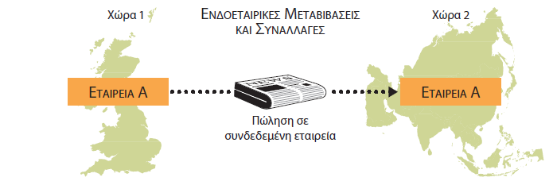
Μορφές Εξαγωγής: Ενδοεταιρικές μεταβιβάσεις
Notes:
An intracorporate transfer is the sale of goods by a firm in one country to an affiliated firm in another country. Such transfers are an important part of international trade. Many MNEs import and export semi-finished products and component parts constantly. By so doing, they use the productive capacity of both their domestic and foreign factories more efficiently.

Slide 16
Επιπρόσθετοι Παράγοντες
Κυβερνητικές πολιτικές
Ζητήματα σε σχέση με το μάρκετινγκ
Παράγοντες εφοδιαστικής διαχείρισης
Ζητήματα διανομής
Notes:
A firm must consider many other factors besides which form of exporting to use:
Government policies such as financing programs and other forms of home country subsidization can encourage exporting as an entry mode. Conversely, host countries may discourage exports by imposing tariffs and NTBs on imported goods.
Marketing concerns such as image, distribution, and customer service, may also affect the decision to export. Often foreign goods have a certain product image or cachet that domestically produced goods cannot duplicate. In addition, the firm’s need for quick and constant feedback from customers will influence how it handles exports.
Logistical considerations also enter into the decision to export. The firm must consider the physical distribution costs of warehousing, packaging, transporting, and distributing its goods, as well as inventory carrying costs for itself and its customers. Firms choosing to export from domestic factories must also maintain competitive levels of customer service for their foreign customers.
Distribution issues also influence a firm’s decision to export. A firm experienced in exporting may establish its own distribution networks in key markets. If a firm lacks the expertise to market its products abroad, it will seek a local distributor in its target market. The importance of selecting a distributor whose goals and business methods are compatible with those of the exporter cannot be overstated.

Slide 17
Εξαγωγικοί Μεσάζοντες
Εταιρεία διαχείρισης εξαγωγών
Ένωση Webb-Pomerene
Διεθνής εμπορική εταιρεία
Notes:
An exporter may market and distribute its goods in international markets by using one or more intermediaries, third parties that specialize in facilitating imports and exports. Intermediaries include export management companies, Webb-Pomerene associations, and international trading companies. These specialists may offer limited services, such as handling transportation and documentation. Or they may perform more extensive roles, including taking ownership of foreign-bound goods or assuming total responsibility for marketing and financing exports.

Slide 18
Εταιρεία Διαχείρισης Εξαγωγών
Εταιρεία διαχείρισης εξαγωγών
Αντιπρόσωποι εξαγωγέων με προμήθεια
Ανάληψη κυριότητας επί των αγαθών
Notes:
An export management company (EMC) acts as its client’s export department. An EMC’s staff is knowledgeable about the legal, financial, and logistical details of exporting, so the exporter does not need to develop this expertise in-house. The EMC may also provide advice about consumer needs and available distribution channels in the foreign markets the exporter wants to penetrate.
EMCs usually operate in one of two ways. Some act as commission agents for exporters. They handle the details of shipping, clearing customs, and preparing documents in return for an agreed-upon fee. In this case, the exporter normally invoices the client and provides any financing it may need. Others take title to the goods. They make money by reselling them at a higher price to foreign customers. These EMCs may offer customer financing or design and implement advertising and promotional campaigns for the product.

Slide 19
Ένωση Webb-Pomerene
Περιλαμβάνει επιχειρήσεις από την ίδια βιομηχανία.
Συντονίζει τις εξαγωγικές τους δραστηριότητες.
Αναλαμβάνει δραστηριότητες προώθησης.
Επιβλέπει την ενοποίηση των εμπορευματικών μεταφορών.
Εμπλέκεται σε διαπραγματεύσεις συμβάσεων.
Εξάγει προϊόντα για τα μέλη.
Notes:
First authorized by the Export Trade Act of 1918, a Webb-Pomerene association is a group of U.S. firms that operate within the same industry. Members of this association are allowed by law to coordinate their export activities without fear of violating U.S. antitrust laws. In addition, a Webb-Pomerene association engages in market research. It also oversees promotional activities, freight consolidation, contract negotiations, and other services for its members. It may also directly engage in exporting—buying goods from members and selling them in foreign markets on the association’s behalf.
Although these associations were originally designed to allow smaller, related firms to cooperate in promoting exports, most are now dominated by larger firms. However, these associations don’t play a major role in international business. Fewer than 25 such associations exist today, and they tend to be concentrated in raw materials such as wood pulp, sulfur, and phosphate rock.

Slide 20
Διεθνής Εμπορική Εταιρεία
Έρευνα αγοράς
διεκπεραίωση τελωνειακών εγγράφων
Διεθνή μεταφορά
διανομή στη χώρα υποδοχής
Μάρκετινγκ
Χρηματοδότηση
Ιαπωνικές sogo shosha
Notes:
An international trading company is a firm directly engaged in importing and exporting a wide variety of goods for its own account. It provides a full gamut of services; including market research, customs documentation, international transportation, and host country distribution, marketing, and financing. Typically, international trading companies have agents and offices worldwide. The economic intelligence information they glean from these international operations is one of their most potent competitive weapons.
The most important international trading companies in the global marketplace are Japan’s sogo shosha, an integral part of Japan’s keiretsu system. The sogo shosha have prospered for several reasons. Because of their global operations, they continuously obtain information about economic conditions and business opportunities in virtually every corner of the world. Furthermore, they have ready access to financing (from the keiretsu’s lead bank) and a built-in source of customers (fellow keiretsu members).

Slide 21
Άλλοι Μεσάζοντες
Αντιπρόσωποι μεταποιητικών επιχειρήσεων
Εξαγωγικοί αντιπρόσωποι μεταποιητικών επιχειρήσεων
Διαμεσολαβητές εξαγωγών και εισαγωγών
Διαμεταφορείς
Notes:
In addition to the intermediaries that provide a broad range of services to international exporters and importers, numerous other types offer specialized services.
Manufacturers’ agents solicit domestic orders for foreign manufacturers, usually on a commission basis. Manufacturers’ export agents act as a foreign sales department for domestic manufacturers by selling their goods in foreign markets. Export and import brokers bring together international buyers and sellers of standardized commodities, such as coffee, cocoa, and grains. Freight forwarders specialize in the physical transportation of goods, arranging customs documentation and obtaining transportation services for their clients. This list is by no means complete. Indeed, specialists are available to provide virtually every service needed by exporters and importers in international trade.

Slide 22
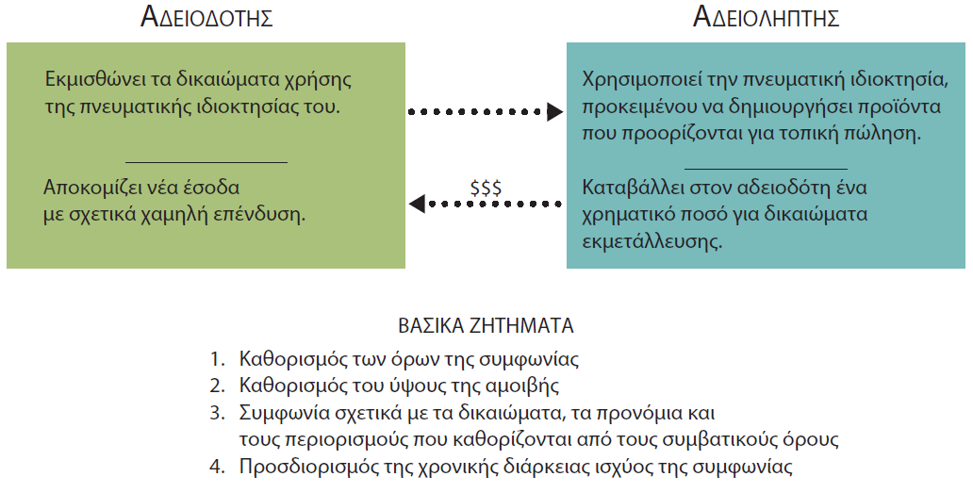
Διεθνής Αδειοδότηση
Notes:
Another means of entering a foreign market is licensing. With this method, a firm, called the licensor, leases the right to use its intellectual property (such as patents, brand names, or trademarks) to another firm, called the licensee, in return for a fee. This process is illustrated in Figure 12.3.
Licensing is a popular mode for entering foreign markets because it involves little out-of-pocket cost. Since a firm has already incurred the costs of developing the intellectual property, revenues received through a licensing agreement often go straight to the firm’s bottom line. Licensing also allows a firm to obtain location advantages of foreign production without incurring ownership, managerial, or investment obligations.

Slide 23
Βασικά Ζητήματα στη Διεθνή Αδειοδότηση
Όρια της συμφωνίας
Τρόποι αμοιβής
Δικαιώματα, προνόμια και περιορισμοί
Διάρκεια της σύμβασης
Notes:
Normally a licensing agreement addresses issues such as the following:
Specifying the boundaries of the agreement. The licensor and licensee must determine which rights and privileges are and are not being conveyed in the agreement.
Determining Compensation. Obviously, the licensor wants to receive as much compensation as possible, while the licensee wants to pay as little as possible. Yet each also wants the agreement to be profitable for the other, so that both parties will willingly perform their contractual obligations. Under a licensing agreement, a royalty is paid to the licensor in the form of a flat fee or a percentage of the sales of the licensed product or service.
Establishing rights, privileges, and constraints. Licensing agreements usually limit the licensee’s freedom to divulge information it has obtained from the licensor to third parties. They also specify the type of records the licensee must keep regarding sales of the licensed products or services, and define standards regarding product and service quality. The agreement also details how disagreements will be resolved.
Specifying the agreement’s duration. The licensor may view the agreement as a short-term, low-cost strategy designed to obtain knowledge about the foreign market. However, if the contract’s duration is too short, the licensee may be unwilling to invest in consumer research, distribution networks, or production facilities. As a rule, the greater the investment costs incurred by the licensee, the longer the duration of the licensing agreement.

Slide 24
Πλεονεκτήματα και Μειονεκτήματα της Διεθνούς Αδειοδότησης
πλεονεκτηματα
μειονεκτηματα
Χαμηλός χρηματοοικονομικός κίνδυνος
Αξιολόγηση αγοράς
Ευκαιρίες πώλησης
Περιορισμένες ευκαιρίες αγοράς
Πιθανοί δικαστικοί αγώνες
Ζητήματα ανταγωνιστικότητας
Notes:
Licensing carries relatively low financial risk, provided the licensor fully investigates its market opportunities and the abilities of its licensees. It also allows the licensor to learn more about the sales potential of its products and services in a new market, without a significant commitment of financial and managerial resources. Licensees benefit through the opportunity to make and sell products and services that have been successful in other international markets.
Licensing limits the market opportunities for both parties. The licensor and licensee depend on each other to maintain product quality and promote the product's brand image. Improper actions by one party can damage the other party. Further, if the licensee or licensor does not adhere to the agreement, costly and tedious litigation may hurt both parties. A final concern is the long-term strategic implications of licensing a firm's technology. Many firms are concerned that sharing technology will create a future competitor. The licensee may be able to learn the manufacturing secrets of the licensor or develop new production tricks of its own. The licensee can also build an independent reputation for manufacturing quality and service excellence, while operating under the contract. After the licensing agreement has expired, the former licensee may choose to expand its operations into the licensor's existing territory.

Slide 25
Διεθνής Δικαιόχρηση
Δικαιοδόχος
Αμοιβή
Δικαιοπάροχος
Εμπορικά σήματα, διαδικασίες, φήμη προϊόντος, υπηρεσίες
Notes:
Franchising is among the fastest-growing forms of international business activity today. It is actually a special form of licensing. Franchising allows the franchisor more control over the franchisee and provides more support from the franchisor to the franchisee than is the case in the licensor-licensee relationship. A franchising agreement allows an independent entrepreneur or organization, called the franchisee, to operate a business under the name of another, called the franchisor, in return for a fee. The franchisor provides its franchisees with trademarks, operating systems, and well-known product reputations, as well as continuous support services such as advertising, training, reservation services, and quality assurance programs.

Slide 26
Βασικά Ζητήματα στη Διεθνή Δικαιόχρηση
Δικαιόχρηση σε μοναδικά προϊόντα και πλεονεκτικές επιχειρησιακές διαδικασίες
Δυνατότητα μεταφοράς σε ξένες τοποθεσίες
Επιτυχημένη δικαιόχρηση στην εγχώρια αγορά
Ξένοι επενδυτές
Notes:
International franchising is likely to succeed when certain market conditions exist. First, it may work when the franchisor has been successful domestically because of unique products and advantageous operating procedures and systems. Franchising may also be effective when the factors that contributed to domestic success are transferable to foreign locations. Third, this may be a viable option if the franchisor has already achieved considerable success in franchising in its domestic market. Finally, foreign investors must be interested in entering into franchise agreements. For well-established franchisors, this is typically not a problem.

Slide 27
Πλεονεκτήματα και Μειονεκτήματα της Διεθνούς Δικαιόχρησης
πλεονεκτηματα
μειονεκτηματα
Εδραιωμένο προϊόν και σύστημα
Επέκταση χαμηλού κόστους
Ευκαιρίες μάθησης
Διαμοιρασμός εσόδων
Αυξημένη πολυπλοκότητα
Έλεγχος ποιότητας
Notes:
On the plus side, franchisees can enter a business that has an established and proven product and operating system, and franchisors can expand internationally with relatively low risk and cost. A franchisor also can obtain critical information about local-market customs and cultures from host country entrepreneurs, that it otherwise might have difficulty obtaining. Furthermore, the firm can learn valuable lessons from franchisees that apply to more than the host country.
On the negative side, as with licensing, both parties to a franchising agreement must share the revenues earned at the franchised location. International franchising may also be more complicated than domestic franchising. Maintaining control over quality standards is also an issue.

Slide 28
Εξειδικευμένοι Τρόποι Εισόδου για Διεθνείς Επιχειρήσεις
Συμφωνία υπεργολαβίας
Σύμβαση διαχείρισης
Σύμβαση ετοιμοπαράδοτου έργου
Notes:
A firm may also use any of several specialized strategies to participate in international business without making long-term investments. Such specialized modes include contract manufacturing, management contracts, and turnkey projects.
Firms of all sizes can use contract manufacturing to outsource most or all of their manufacturing needs to other companies. This strategy reduces the costs that firms need to devote to the physical production of their products. By using this approach, international businesses can focus on that part of the value chain where their distinctive competence lies. They also can benefit from any location advantages generated by host country production. However, they also surrender control over the production process, which can lead to quality issues or other unexpected problems.
A management contract is an agreement whereby one firm provides managerial assistance, technical expertise, or specialized services to a second firm for some agreed-upon time, in return for monetary compensation. For its services, the first firm may receive either a flat fee or a percentage of sales. The management contract may also specify performance bonuses based on profitability, sales growth, or quality measures. Management contracts allow firms to earn additional revenues without incurring investment risks or obligations.
A turnkey project is a contract under which a firm agrees to fully design, construct, and equip a facility and then turn the project over to the purchaser when it is ready for operation. The turnkey contract may be for a fixed price, in which case the firm makes its profit by keeping its costs below the fixed price. Or the contract may provide for payment on a cost-plus basis, which shifts the risk of cost overruns from the contractor to the purchaser. International turnkey contracts often involve large, complex, multiyear projects such as construction of a nuclear power plant, an airport, or an oil refinery. Managing such complex construction projects requires special expertise. A popular variant of the turnkey project is the so-called B-O-T project. In this arrangement, the firm builds a facility, operates it, and then transfers ownership of the project to some other party. Through this approach, the contractor profits from operation and ownership of the project for some period of time; however, it also bears any financial risks associated with owning and operating it during this period.

Slide 29
Άμεσες Ξένες Επενδύσεις
Στρατηγική επένδυσης εκ του μηδενός (greenfield)
Στρατηγική εξαγοράς (brownfield)
Κοινοπραξίες
Notes:
Exporting, licensing, franchising, and the specialized strategies just discussed all allow a firm to internationalize its business without investing in foreign factories or facilities. However, many firms prefer to enter international markets through ownership and control of assets in host countries. Other firms may first establish themselves in a foreign market through exporting, licensing, franchising, or contract manufacturing. Then, after learning how to operate in the host country, they can expand in the market through ownership of production or distribution facilities.
There are three methods for FDI: (1) building new facilities (called the greenfield strategy), (2) buying existing assets in a foreign country (called the acquisition strategy or the brownfield strategy), and (3) participating in joint ventures.

Slide 30
Άμεσες Ξένες Επενδύσεις
ΟΦΕΛΗ
ΠΡΟΚΛΗΣΕΙΣ
Αυξημένος έλεγχος
Προοπτική κερδοφορίας
Τοπικά εργοστάσια
Οικονομικοί κίνδυνοι
Πολιτικοί κίνδυνοι
Επιχειρησιακή πολυπλοκότητα
Κυβερνητικές πολιτικές
Notes:
Foreign Direct Investment offers the firm increased control over its international business operations, as well as increased profit potential. Control is particularly important to the firm, if it needs to closely coordinate the activities of its foreign subsidiaries to achieve strategic synergies. It may also determine that the control is necessary in order to fully exploit the economic potential of proprietary technology, manufacturing expertise, or some other intellectual property. FDI is also beneficial if host country customers prefer dealing with local factories. Many firms and governments participate in programs that favor locally made products, in order to promote their local economies. Equally important, many purchasing managers perceive that local production implies more reliable supply, faster service, and better communication with suppliers.
On the other hand, FDI exposes the firm to greater economic and political risks and operating complexity, as well as the potential erosion of the value of its foreign investments if exchange rates change adversely. A firm’s decision to engage in FDI may also be influenced by government policies. As noted in Chapter 3, host countries may discourage FDI through direct controls on foreign capital, bans on the acquisition of local companies by foreigners, or restrictions on repatriation of dividends and capital; home countries can promote FDI through such devices as political risk insurance. Firms using FDI must also meet the standard challenges of managing, operating, and financing their foreign subsidiaries while facing the additional hurdle of doing so in political, legal, and cultural milieus different from their own.

Slide 31
Στρατηγική Greenfield
Πλεονεκτήματα
Επιλογή της πιο χρήσιμης τοποθεσίας
Κατασκευή σύγχρονων εγκαταστάσεων
Προσφορά οικονομικών κινήτρων ανάπτυξης
Έναρξη από μηδενική βάση
Εγκλιματισμός στη νέα επιχειρηματική νοοτροπία
Notes:
Research indicates that the greater the cultural differences between the home and host countries, the more likely a firm is to choose to build a new factory rather than purchase an existing firm. The greenfield strategy involves starting a new operation from scratch. The firm buys or leases land, constructs new facilities, hires and/or transfers managers and employees, and then launches the new operation.
This strategy has several advantages. For one thing, the firm can select the site that best meets its needs and construct modern, up-to-date facilities. Local communities often offer economic development incentives to attract such facilities because they will create new jobs; these incentives lower the firm’s costs. The firm also starts with a clean slate. Managers do not have to deal with existing debts, nurse outmoded equipment, or struggle to modify work rules protected by labor unions. In addition, the firm can acclimate itself to the new business culture at its own pace, rather than having the instant responsibility of managing a newly acquired, ongoing business.

Slide 32
Στρατηγική Greenfield
Μειονεκτήματα
Η υλοποίηση χρειάζεται χρόνο και υπομονή.
Η τοποθεσία μπορεί να μην είναι διαθέσιμη ή να είναι πολύ ακριβή.
Η επιχείρηση πρέπει να ανταποκριθεί στους κυβερνητικούς κανονισμούς.
Η επιχείρηση πρέπει να προσλάβει και να εκπαιδεύσει τοπικούς εργαζομένους.
Η επιχείρηση μπορεί να στιγματιστεί ως «ξένη».
Notes:
However, the greenfield strategy also has some disadvantages. For one thing, successful implementation takes time and patience. For another, land in the desired location may be unavailable or very expensive. In building the new factory, the firm must also comply with various local and national regulations and oversee the factory’s construction. It must also recruit a local workforce and train those workers to meet the firm’s performance standards. Finally, by constructing a new facility, the firm may be more strongly perceived as a foreign enterprise.

Slide 33
Στρατηγική Βrownfield
πλεονεκτηματα
ΜΕΙονεκτηματα
Έλεγχος των πόρων της επιχείρησης
Άμεση κερδοφορία
Χωρίς προσθήκη νέας παραγωγικής ικανότητας
Ανάληψη των υποχρεώσεων της επιχείρησης
Κληρονόμηση άλυτων προβλημάτων
Απαίτηση για σημαντικές προκαταβολικές δαπάνες
Notes:
A second FDI strategy is acquisition of an existing firm conducting business in the host country. Sometimes international businesses acquire local firms simply as a means of entering a new market. At other times, acquisitions may be undertaken by a firm as a means of implementing a major strategic change.
Although the actual transaction may be complex, the basic motivation for it is quite simple. By acquiring a going concern, the purchaser quickly obtains control over the acquired firm’s factories, employees, technologies, brand names, and distribution networks. The acquired firm can continue to generate revenues as the purchaser integrates the firm into its overall international strategy. And, unlike the greenfield strategy, the acquisition strategy adds no new capacity to the industry.
The acquisition strategy does have some disadvantages, however. The acquiring firm assumes all the liabilities—financial, managerial, and otherwise—of the acquired firm. For example, if the acquired firm has poor labor relations, unfunded pension obligations, or hidden environmental cleanup liabilities, the acquiring firm becomes responsible for solving those problems. The acquiring firm usually must also spend substantial sums of money to finalize the acquisition.

Slide 34
Κοινοπραξίες
Ξεχωριστή επιχείρηση συνιδιοκτησίας
Προώθηση αμοιβαίων συμφερόντων
Notes:
A joint venture involves two or more firms that agree to work together and create a jointly-owned, separate firm to promote their mutual interests. The number of such arrangements is burgeoning as rapid changes in technology, telecommunications, and government policies outstrip the ability of international firms to exploit opportunities on their own. Because of the growing importance of inter-corporate cooperation, as well as the unique challenges it presents to international firms, this subject will be treated in depth in Chapter 13.

Slide 35
Ερωτήσεις Ανασκόπησης
Ποια είναι τα βήματα για την ανάλυση μιας ξένης αγοράς;
Ποια είναι μερικά από τα βασικά ζητήματα που πρέπει να αντιμετωπίσει μια επιχείρηση, όταν καλείται να επιλέξει με ποιον τρόπο θα εισέλθει σε μια νέα ξένη αγορά;
Πώς ορίζεται η εξαγωγή προϊόντων/υπηρεσιών; Γιατί έχει αυξηθεί τόσο θεαματικά τα τελευταία χρόνια;
Ποια είναι τα κύρια πλεονεκτήματα και μειονεκτήματα των εξαγωγών;
Ποιες είναι οι τρεις μορφές εξαγωγής;

Slide 36
Ερωτήσεις Ανασκόπησης
Πώς ορίζεται ένας εξαγωγικός μεσάζοντας; Ποιον ρόλο επιτελεί; Ποιοι είναι οι διάφοροι τύποι των εξαγωγικών μεσαζόντων;
Τι είναι η διεθνής αδειοδότηση; Ποια είναι τα πλεονεκτήματα και τα μειονεκτήματά της;
Τι είναι η διεθνής δικαιόχρηση; Ποια είναι τα πλεονεκτήματα και τα μειονεκτήματά της;
Ποιοι είναι οι τρεις εξειδικευμένοι τρόποι εισόδου που μπορούν να χρησιμοποιήσουν οι διεθνείς επιχειρήσεις και πώς λειτουργούν;
Τι είναι οι άμεσες ξένες επενδύσεις; Ποιες είναι οι τρεις βασικές μορφές τους; Ποια είναι τα συγκριτικά πλεονεκτήματα και μειονεκτήματα κάθε μορφής;

Slide 37
Σημείωση της αγγλικής έκδοσης των διαφανειών
Το παρόν έργο προστατεύεται από νόμους πνευματικών δικαιωμάτων των Ηνωμένων Πολιτειών και παρέχεται αποκλειστικά για χρήση από διδάσκοντες κατά τη διδασκαλία των μαθημάτων τους και την αξιολόγηση της εκμάθησης των φοιτητών. Η διάδοση ή πώληση οποιουδήποτε μέρους αυτού του έργου (συμπεριλαμβανομένης της δημοσίευσης στον Παγκόσμιο Ιστό) καταστρέφει την ακεραιότητα του έργου και δεν επιτρέπεται. Το περιεχόμενο του έργου δεν θα πρέπει ποτέ να διατίθεται στους φοιτητές, παρά μόνο στους διδάσκοντες που χρησιμοποιούν το συνοδευτικό κείμενο στα μαθήματά τους. Όλοι οι αποδέκτες αυτού του έργου αναμένεται να συμμορφώνονται με αυτούς τους περιορισμούς και να σέβονται τους προβλεπόμενους παιδαγωγικούς σκοπούς και τις ανάγκες των άλλων διδασκόντων που βασίζονται σε αυτήν την ύλη.
Αποκλειστικότητα για την ελληνική γλώσσα: ΕΚΔΟΣΕΙΣ ΤΖΙΟΛΑ

