Slide 1
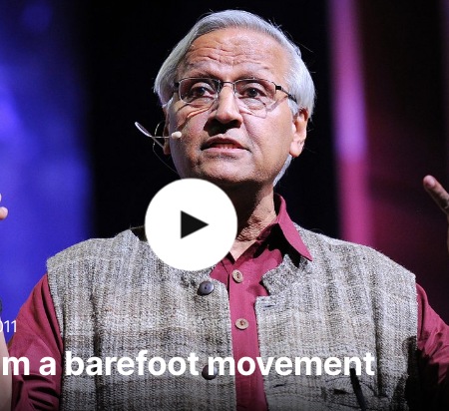
Learning from the barefoot movement, by Bunker Roy
On education

Slide 2
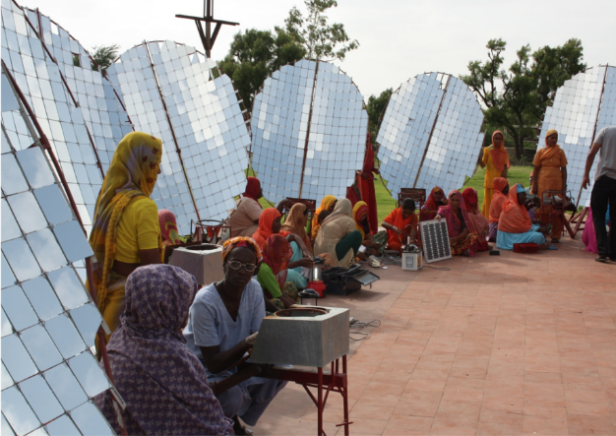
Main ideas
What are the main principles of barefoot college?
How was a ‘professional’ defined in the barefoot college?
How did they train people who were highly illiterate and could not speak the same language?
How did women contribute to barefoot college?
What is said about people with “certificates”?
Which countries were barefoot colleges built in?
What point is made about the solution of problems in the conclusion?

Slide 3
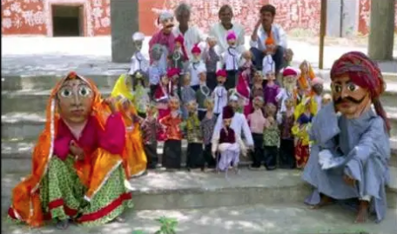
Rhetorical strategies
How does the speaker introduce his talk about barefoot college?
The speaker uses many examples to describe the construction of the first barefoot college. Briefly mention some of them. What is the effect of using multiple examples?
What instances of humor can you identify? What do you think is the effect of such humor on the audience?
What do you think is the effect of saying “puppets are made of World Bank recycled paper reports”?

Slide 4
Rhetorical strategies
What do you think is the effect of quoting the woman’s reply about the benefit of having solar-electricity in a snow-covered hut in Ladakh at -0, "It's the first time I can see my husband's face in winter”?
The speaker frequently reports what people told him in direct speech. What do you think is the effect on the audience?
What strategies does the speaker use to end his speech in “I'll just wind up by saying that I think you don't have to look for solutions outside. Look for solutions within. And listen to people. They have the solutions in front of you. They're all over the world. Don't even worry. Don't listen to the World Bank, listen to the people on the ground. They have all the solutions in the world. I'll end with a quotation by Mahatma Gandhi. ‘First they ignore you, then they laugh at you, then they fight you, and then you win.’"

Slide 5
Vocabulary: complete the blanks with the words given
1. Leaving early is a good response to working student ______ from university.
2. Participants engaging in any of the forbidden activities will be ______ and will forfeit any prizes won.
3. Jack’s political rival cast an ______ against him right before the election.
4. The journalist got fired when his editor learned of his plan to ______ a story about the president.
5. The ______ helps the president make decisions, gives advice and provides information to the President.
6. Betsy sensed ______ between parents and their children.
7. He has become a ______ liar and his friends lost faith in him.
8. The government decided to make ______ to the workers on strike.
9. We really must ______ finance and help small investors.
10. I would suggest ______ it for a couple of days to see how it goes and take decisions later.
Monitoring
Cabinet
Compulsive
Concessions
Fabricate
Aspersion
Dropout
Demystify
Disqualified
Friction

Slide 6
Your thoughts
What impressed you the most about barefoot college and why?
What point was made about education?
What relevance can the speech have to your education/educational system?

Slide 7
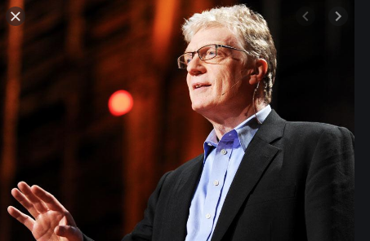
The learning revolution, by Ken Robinson
On education

Slide 8
Core argument
What kind of revolution does the speaker suggest should take place in the way we learn?
How should the model of education change?

Slide 9
Main ideas
How is Al Gore’s climate crisis similar to the crisis in human resources?
What is to “disenthrall ourselves”?
What point is made about how parents view kindergarten?
What is implied in “College begins in kindergarten” and “kindergarten begins in kindergarten”?
When the fireman saved his teacher’s and his wife’s life, he said “I think he thinks better of me now” what is the significance of this wording?

Slide 10
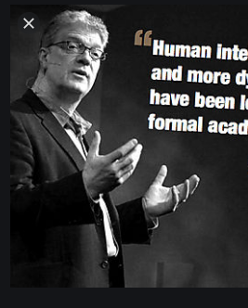
Rhetorical strategies
How does the speaker introduce his subject?
What examples does the speaker use to explain that “we become enthralled to some ideas”
Consider the impact of the humor used in this talk on the audience. To what effect is it used apart from being merely entertaining? Give an example.
Give some examples of sarcasm. What effect does it have on the audience?
How does the speaker end his speech? How effective is it and why?

Slide 11
Vocabulary: complete the blanks with the words given
It didn't matter that she had no choice, the _______ was the same.
The first half of the 20th century saw the UK's strength seriously _______ in two World Wars.
Life does not evolve in _______ ways. It works in multiple circular ways.
Into that gap has come a _______ private education system.
A considerable economy was effected by a _______ in the establishment for collecting the land tax.
To unlearn, we must learn to _______ ourselves.
To some people, a global economic crisis still poses a _______ threat.
He suggested the center change their _______ and not tape calls in the future.
Because I am a seeker of truth, I do not accept every bit of _______ as fact.
In _______ with your request, I am sending you the following information.
Not only in trade liberalization but in every other aspect of globalization even seemingly _______ efforts have often backfired.
Critics charge the higher interest rates will ______ economic development.
Suppress
Dogma
Disenthrall
Flourishing
Linear
Potential
Depleted
Policy
Well-intentioned
Conformity
Outcome
reform

Slide 12
Your thoughts
Do you agree with the point made about education?
Do you agree or disagree with the speaker about encouraging diversity of talent?
What other reforms do you think should take place in education?

