Slide 1
International Development and Global South
Inequalities

Slide 2
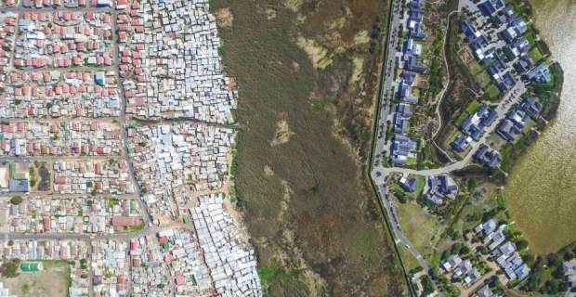
Social and economic inequality. Dual structure within the same area.
https://www.youtube.com/watch?v=_PeSroA_aPA&feature=youtu.be
2

Slide 3
Two communities just outside Cape Town in South Africa. Masiphumelele with 380.000 inhabitants with the majority living in slums, without health services, while many suffer of AIDS, and high unemployment rate.
At a distance of 200 metres the community of «Lake Michelle» with wealthy inhabitants living in conditions of high standards is the other quite opposite face of Janus.
Poverty and richness the one next to the other a characteristic example of social and economic inequality.

Slide 5
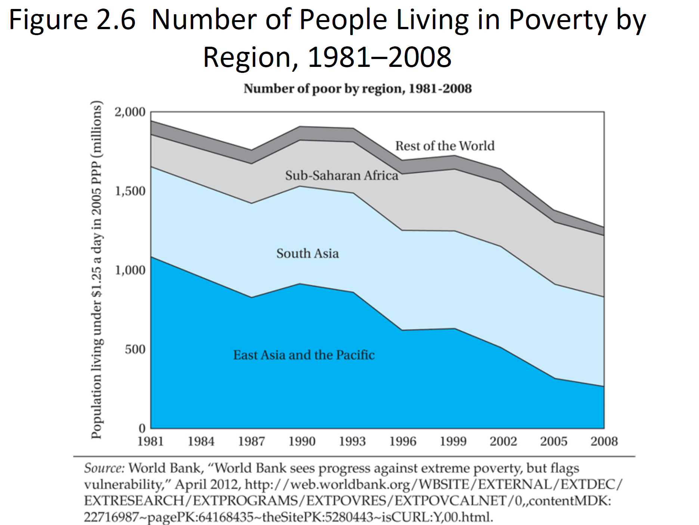

Slide 6
Measurement of Economic Growth
Gross Domestic Product – GDP: It is the total value in money terms of all final goods and services produced within the boundaries of a country irrespectively of the nationality of the production factors used for the production process. In other words the production factors are both nationals and non nationals of the country where the production takes place.
Gross National Product – GNP: It is the total value in money terms of all final goods and services produced globally by national production factors. In this case is of no interest the country where production takes place but the nationality of the production factors that should be of the country’s the GNP is to be estimated.
The relation between GNP and GDP is as it follows:
GNP = GDP + net income from abroad

Slide 7
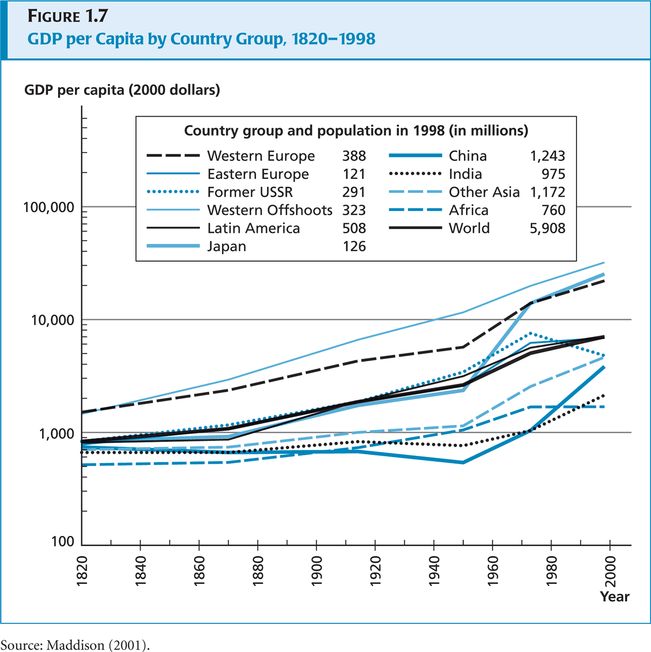

Slide 8
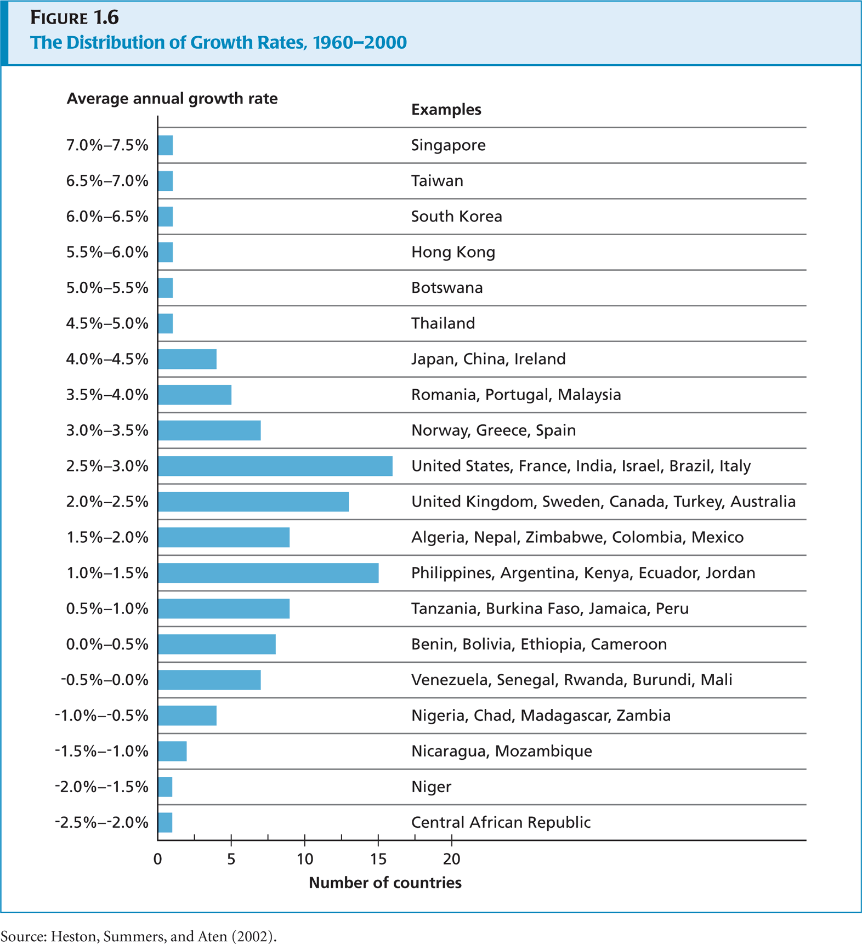

Slide 9
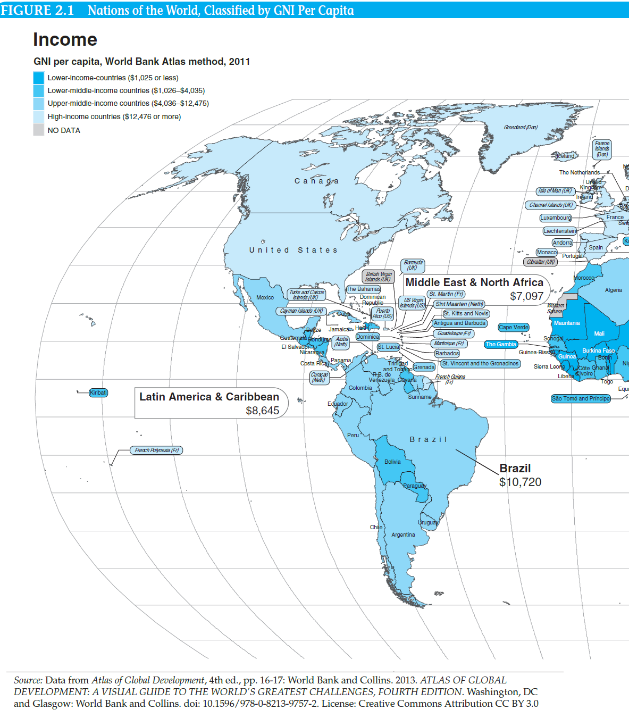

Slide 10
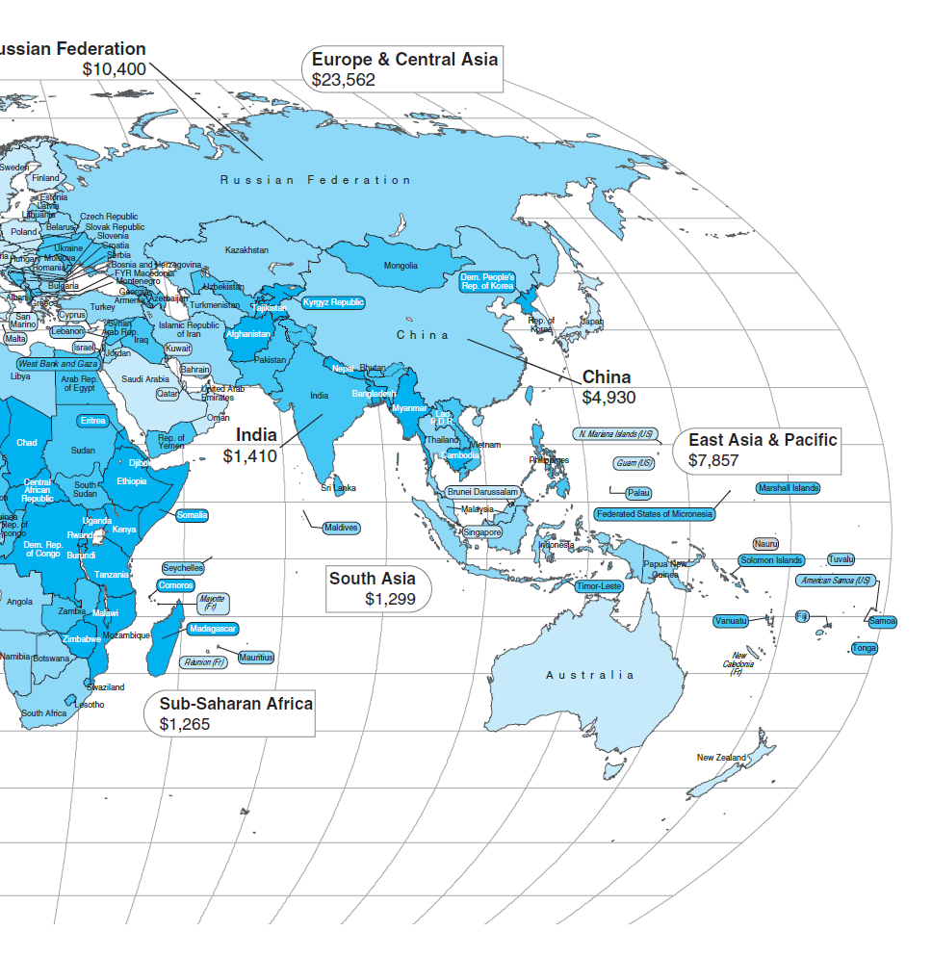

Slide 11
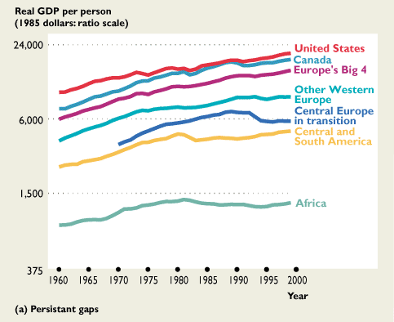

Slide 12
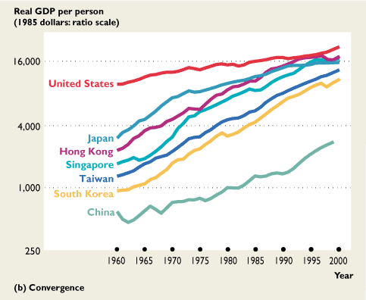

Slide 13
HUMAN DEVELOPMENT INDEX
The HDI was created to emphasize that people and their capabilities should be the ultimate criteria for assessing the development of a country, not economic growth alone. The HDI can also be used to question national policy choices, asking how two countries with the same level of GNI per capita can end up with different human development outcomes. These contrasts can stimulate debate about government policy priorities.
The HDI is a summary measure of average achievement in key dimensions of human development: a long and healthy life, being knowledgeable and have a decent standard of living. The HDI is the geometric mean of normalized indices for each of the three dimensions.
The health dimension is assessed by life expectancy at birth, the education dimension is measured by mean of years of schooling for adults aged 25 years and more and expected years of schooling for children of school entering age.
The standard of living dimension is measured by gross national income per capita. The HDI uses the logarithm of income, to reflect the diminishing importance of income with increasing GNI. The scores for the three HDI dimension indices are then aggregated into a composite index using geometric mean.

Slide 14
With the actual value for a given country, and the global maximum and minimum, the dimension (indices) value for each metric is calculated as:
Dimension Index = ( actual value – minimum value )/ (maximum value – minimum value )
The dimension index is therefore 1 in a country that achieves the maximum value and it is 0 for a country that is at the minimum value.
DI health = ( life expectancy at birth of a country – 20years)/ (83.2 years – 25 years)
Note that before 2010 the maximum value was 85 years, while the minimum one was 20 years
The education dimension is the arithmetic mean of the two education indices,i.e mean years of schooling with maximum and minimum values 13.1 and 0 years respectively; and expected years of schooling with maximum and minimum values 18 and 0 years respectively. While before 2010 the two indices were the percentage literacy rate of the adult population and the gross enrolment ratio in percentage terms.
The DI income is calculated in logarithmic terms of the per capita GNP in Purchasing Parity Power US dollars, while before 2010 it was used the per capita GDP in Purchasing Parity Power US dollars .
Once each of the individual indices have been calculated, they are aggregated to calculate the HDI.
The HDI is calculated as the geometric mean (equally-weighted) of life expectancy, education, and GNI per capita, as follows:
HDI = ( DI health * DI education * DI income)^{1/3}

Slide 15
The HDI simplifies and captures only part of what human development entails. It does not reflect on inequalities, poverty, human security, empowerment, etc. There are a number of other composite indices as broader proxy on some of the key issues of human development, inequality, gender disparity and poverty.
The Human Poverty Index (HPI) was an indication of the poverty of community in a country, developed by the United Nations (UN) to complement the HDI and was first reported as part of the Human Deprivation Report in 1997. It was considered to better reflect the extent of deprivation in deprived countries compared to the HDI. In 2010 it was supplanted by the UN’s Multidimensional Poverty Index.
The HPI concentrates on the deprivation in the three essential elements of human life already reflected in the HDI: longevity, knowledge and a decent standard of living. The HPI is derived separately for developing countries (HPI-1) and a group of select high-income OECD countries (HPI-2) to better reflect socio-economic differences and also the widely different measures of deprivation in the two groups

Slide 16
For Developing Countries (HPI-1)
HPI-1 = (1/3 (P1ª + P2ª + P3ª)^{1/a}
Where:
P1: Probability at birth of not surviving to age 40 (times 100) P2: Adult illiteracy rate P3: Arithmetic average of 3 characteristics:
The percentage of the population without access to safe water.
The percentage of population without access to health services.
The percentage of malnourished children under five.
a: 3

Slide 17
For Selected High Income OECD Countries ( HPI-2)
HPI-2 = (1/4( P1ª + P2ª + P3ª + P4ª)^{1/a}
Where:
P1:Probability at birth of not surviving to age 60 (times 100) P2: Adults lacking functional literacy skills P3: Population below income poverty line (50% of median adjusted household disposable income) P4: Rate of long-term unemployment lasging 12 months or more
a: 4

Slide 18
The Social Progress Index (SPI) measures the extent to which countries provide for the social and environmental needs of their citizens. Fifty-four indicators in the areas of basic human needs, foundations of well-being, and opportunity to progress show the relative performance of nations. The SPI measures the well-being of a society by observing social and environmental outcomes directly rather than the economic factors. The social and environmental factors include wellness (including health, shelter and sanitation), equality, inclusion, sustainability and personal freedom and safety.

Slide 19
The Gini index or Gini coefficient is a statistical measure of distribution used to quantify economic inequality, measuring income distribution or, less commonly, wealth distribution among a population. The coefficient ranges from 0 (or 0%) to 1 (or 100%), with 0 representing perfect equality and 1 representing perfect inequality. Values over 1 are theoretically possible due to negative income or wealth. More specifically:
The Gini index is a simple measure of the distribution of income across income percentiles in a population.
A higher Gini index indicates greater inequality, with high income individuals receiving much larger percentages of the total income of the population.
Global inequality as measured by the Gini index increased over the 19th and 20th centuries, but has declined in more recent years.
Because of data and other limitations, the Gini index may overstate income inequality and can obscure important information about income distribution.
Understanding the Gini Index
Gini coefficient is an important tool for analyzing income or wealth distribution within a country or region, but it should not be mistaken for an absolute measurement of income or wealth. A high-income country and a low-income one can have the same Gini coefficient, as long as incomes are distributed similarly within each: Turkey and the U.S. both had income Gini coefficients around 0.39-0.40 in 2016, according to OECD, though Turkey’s GDP pdr capita was less than half the U.S.'s (in 2010 dollar terms).

Slide 20
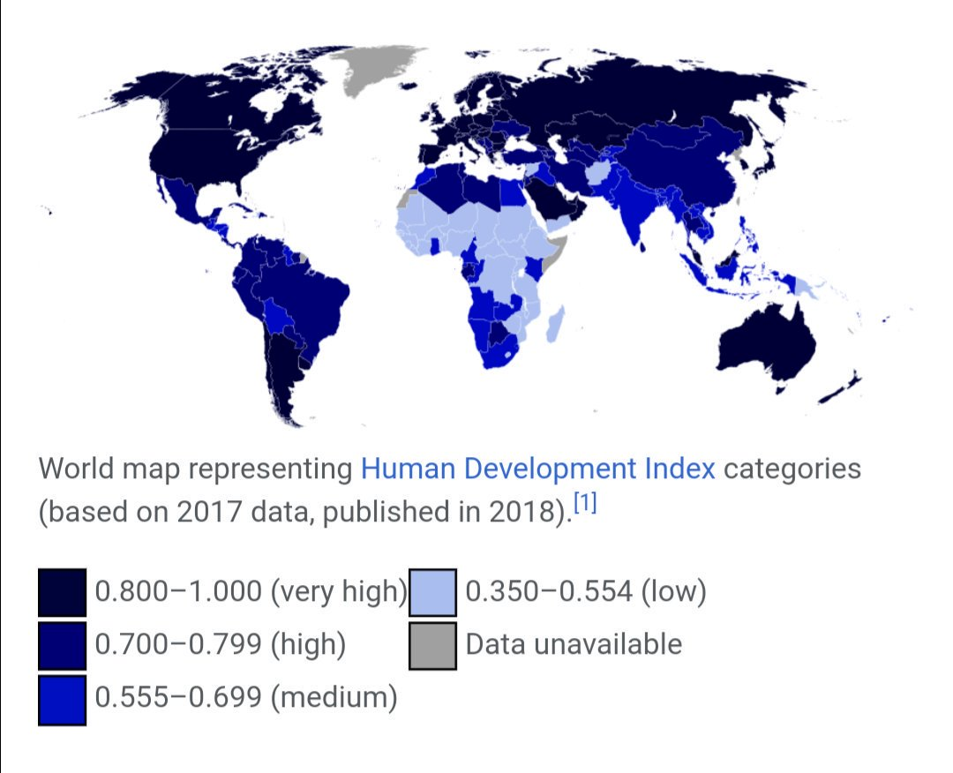

Slide 21
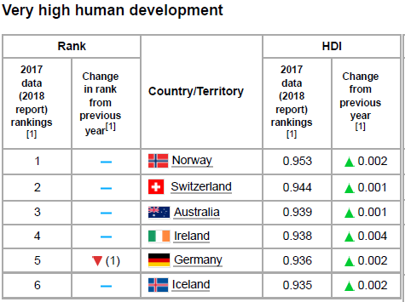
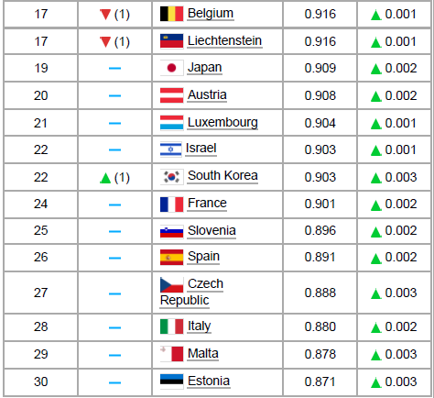
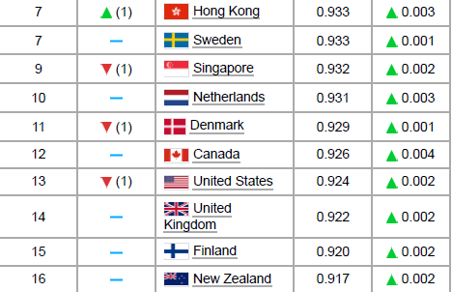
Αναλυτικότερα…

Slide 22
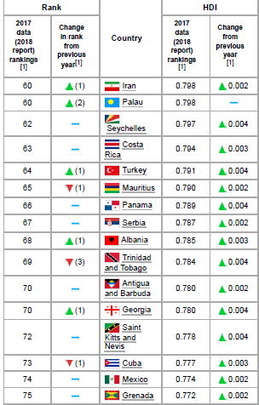
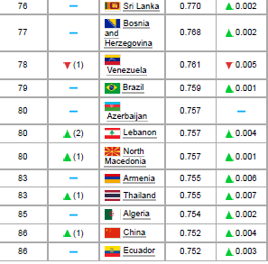

Slide 23
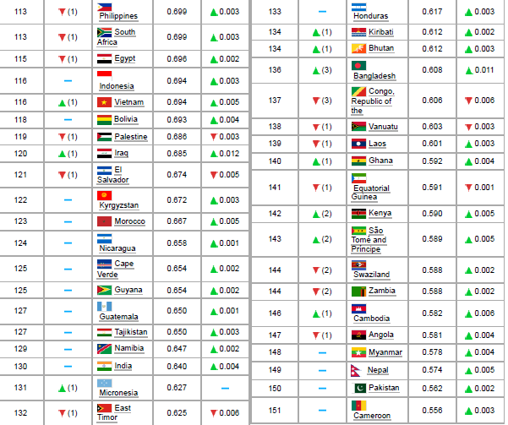

Slide 24
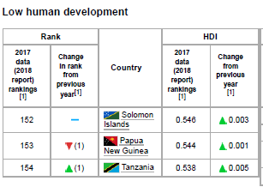
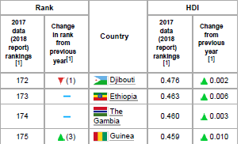
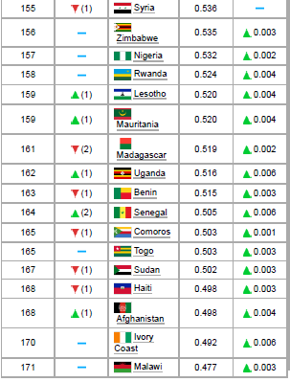
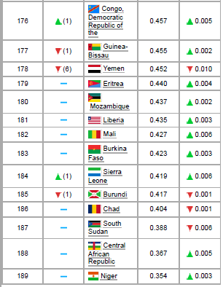

Slide 25
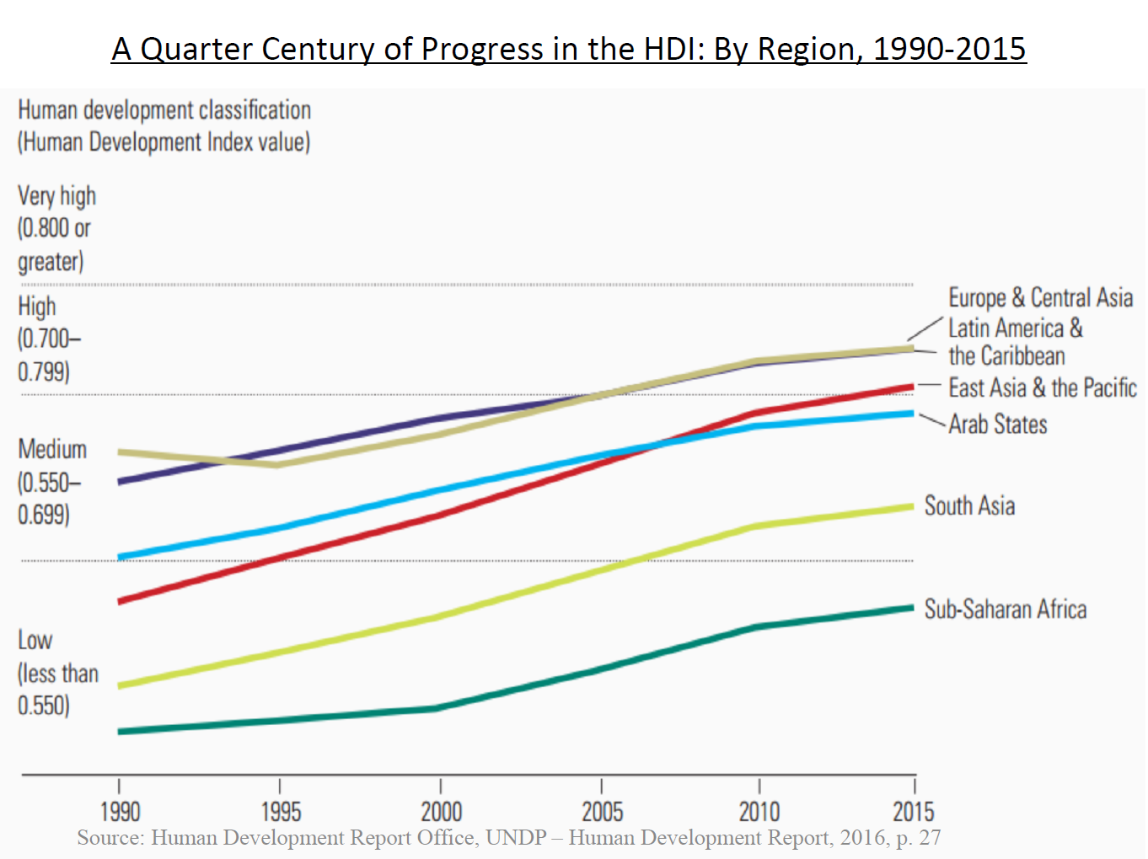

Slide 26
United Nations Human Development Index
https://hdr.undp.org/data-center/country-insig#/ranks

Slide 27
Poverty Reduction
In 1990, nearly 2 billion people worldwide lived in extreme poverty – in other words, on less than $2.15 per day.
Between 1990 and 2019, the number of people living in extreme poverty was reduced by around 66 percent, from 2 billion to around 660 million.
Over the same period, the world’s population increased by around 2.4 billion people and the number of people with incomes above the international poverty line increased from 3.3 billion to 7 billion. As a result, the share of the global population living in extreme poverty was reduced from about 38 percent to 8.5 percent.

Slide 28
Uneven Distribution of Poverty Reduction
This large reduction at the global level masks uneven progress at the regional level. In 1990, most of the extreme poor were located in East Asia and South Asia.
Between 1990 and 2019, extreme poverty decreased significantly in those regions thanks to strong economic growth.
By contrast, the number of extreme poor increased in Sub-Saharan Africa over this time period. This is a result of rapid population growth – the share of people living in extreme poverty in Sub-Saharan Africa fell from 54 percent to 35 percent from 1990 to 2019.

Slide 29
COVID 19 Pandemic
The COVID-19 pandemic has reversed some of the progress made. In 2020, for the first time since the 1997 Asian financial crisis, the number of people living in extreme poverty increased.
It is estimated that the number of extreme poor increased by about 70 million in 2020.
Close to 11 percent more people lived in extreme poverty in 2020 compared to 2019. Since then, an uneven economic recovery, rising food prices, and conflict among some of the world’s biggest food producers have stalled progress further

Slide 30
Poverty Threshold
Progress in poverty reduction is measured against a national poverty line. The international poverty line is derived from countries' own national poverty lines. Many low- and middle-income countries set these lines to reflect the basic needs that must be satisfied to escape poverty, often related to nutrition, clothing, shelter, and more. High-income countries, meanwhile, often set national poverty lines based on relative standards, such as obtaining an income higher than a fraction of the mean or median income of the country.

Slide 31
Poverty Threshold
In 2017, Tanzania’s national poverty line was the equivalent of $1.62 per person per day.
In the European Union, on the other hand, poverty is defined as the share of the population living below 60 percent of the median income. For France, in 2017 this established a poverty line of $27.39 per day.
In general, richer countries have higher national poverty lines. In other words, the definition of basic needs depends on a country’s level of income. In poorer countries, for example, participating in the labor market may require only clothing and food, while in a richer country a person might need internet access, a vehicle, and a cell phone.

Slide 32
International Poverty Line
In order to compare poverty levels across countries, a poverty line that is fixed across countries is needed. The International Poverty Line reflects the typical poverty line of the poorest countries of the world. It is derived as the median national poverty line of all low-income countries.
7
Th
In order to compare poverty levels across countries, a poverty line that is fixed across countries is needed. The International Poverty Line reflects the typical poverty line of the poorest countries of the world. It is derived as the median national poverty line of all low income countries.
The international poverty line was originally set by the World Bank at $1 a day in 1990 based on the national poverty lines of the poorest countries in the world at the time. Since then, inflation has increased the cost of basic goods in the poorest countries, and as a result this benchmark has been adjusted to $2.15 per day.

Slide 33
Poverty and GDP per Capita
In general, a country’s GDP per capita is highly predictive of its extreme poverty rate. As countries grow, their extreme poverty rates tend to fall.

Slide 34
World Bank ATLAS of Sustainable Development
https://datatopics.worldbank.org/sdgatlas/?lang=en

