Slide 1
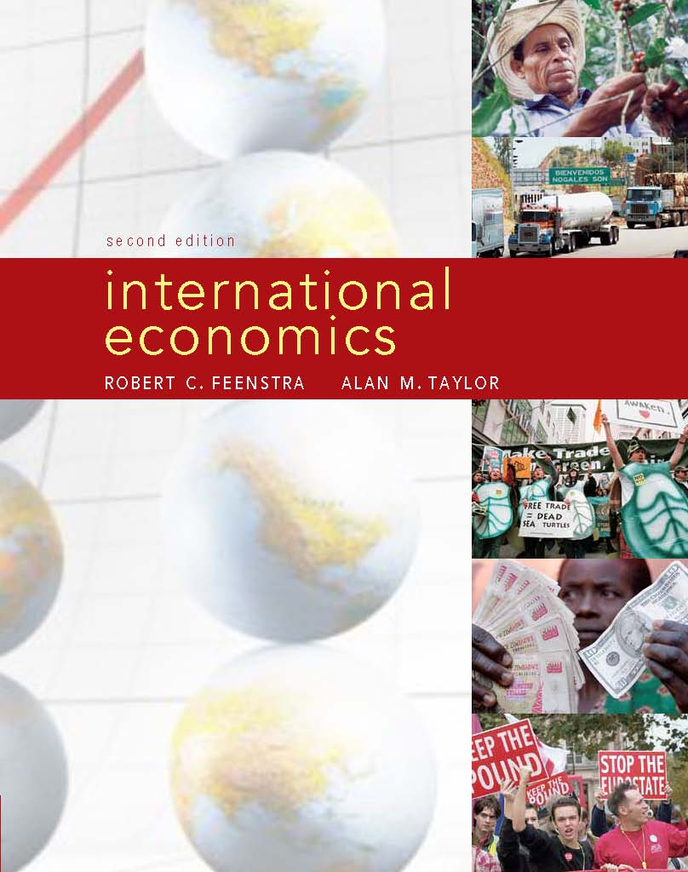
Migration in the Global Economy
1
 | Migration
Prepared by: Fernando Quijano Dickinson State University

Slide 2
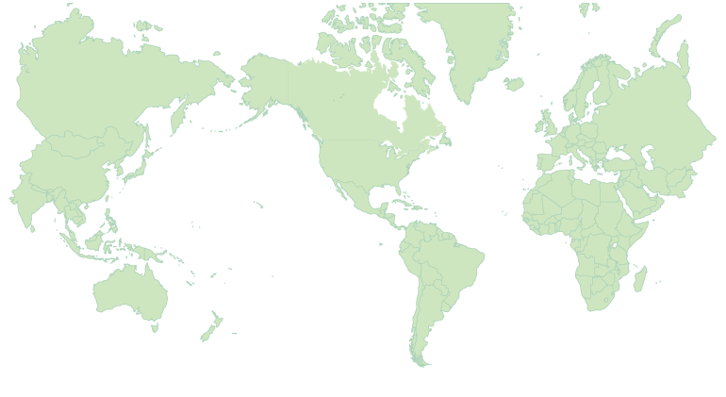
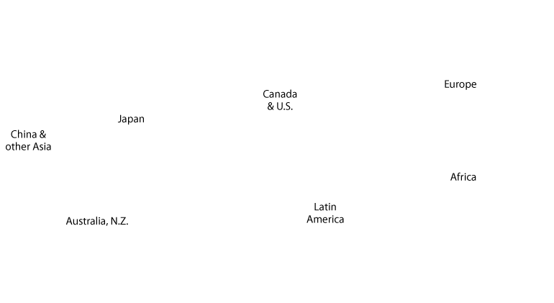
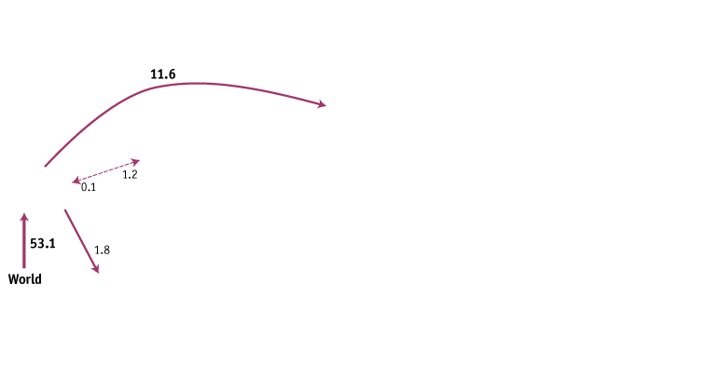
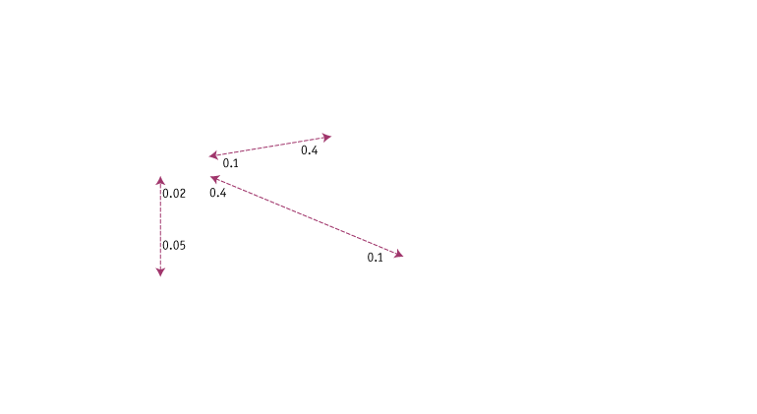
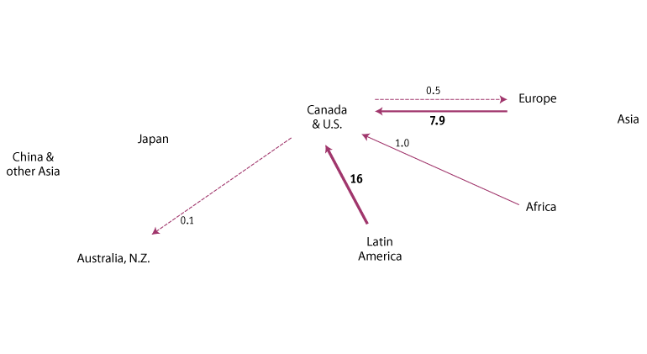
Migration
Map of Migration
FIGURE 1-6
Foreign-Born Migrants, 2005 (millions)
This figure shows the number of foreign-born migrants living in selected countries and regions of the world for 2005 in millions of people.
Notes:
The level of migration is illustrated by the width of the lines, with the largest migrant numbers having the heaviest lines and the smallest having dashed lines.

Slide 3
Migration
Map of Migration
European and U.S. Immigration Prior to 2004 the European Union (EU) consisted of 15 countries in western Europe, and labor mobility was very open.
After 10 more countries joined the EU on May 1, 2004, (and 2 more countries joined in 2007) a large difference in per capita income and wages in these countries created a strong incentive for labor migration.
The per capita incomes of these new countries were only about one-quarter of the average per capita incomes in those western European countries that were already EU members.

Slide 4
2 Migration and Foreign Direct Investment
Map of Migration
European and U.S. Immigration
In the United States, the concern that immigration will drive down wages applies to Mexican migration and is amplified by the exceptionally high number of illegal immigrants.

