Slide 1
Migration Policies in the EU: Main Trends and Challenges

Slide 2
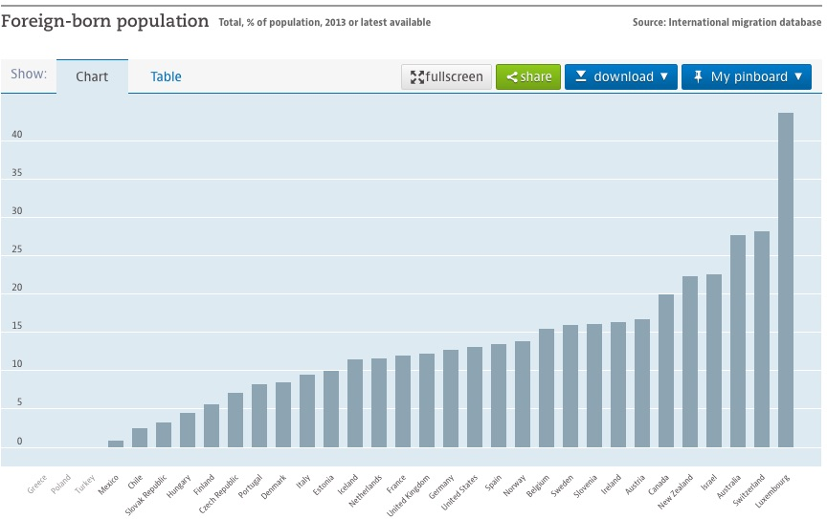
Source : OECD International migration database (2013)

Slide 3
Partnership Framework With Third Countries (2016)
Short Term Objectives
To save lives in the Mediterranean sea;
To increase the rate of returns to countries of origin and transit;
To enable migrants and refugees to stay close to home and to avoid taking dangerous journeys.

Slide 4
Long Term Objectives
Work with key partners to improve the legislative and institutional framework for migration;
Concrete assistance for capacity building on border and migration management, including providing protection for refugees;
Increasing rates of return and readmission with a preference to voluntary return and a focus on reintegration;
Stemming the irregular flows while offering legal migration channels, including increased resettlement efforts.
Source: European Commission (2016)

Slide 5
Approaches
Security Development
Remote Control Root Cause
Visa Policy
Mobility Partnership

Slide 6
Remote Control Approach
Strengthening border controls
Combating illegal entry, migrant smuggling and trafficking.
Readmitting migrants who have cressed into the EU illegally.
Coastguard patrols and other instruments for controlling migration and asylum flow.

Slide 7
Root Cause Approach
Not to restrain the movement of people but encourage it.
Reduce the push factors.
Employment issues, developing governance and demographic changes to minimize economig migration.
Increasing respect for democracy and human rights to minimize the number of asylum seekers and refugees.

Slide 8
Global Approach to Migration (GAM) 2005
Aims to increase legal migration while decreasing irregular migration through a perceptive of development cooperation.
Building capacity for manage migration and asylum flows.

Slide 9
Mobility Partnership to Foster Legal Migration (2007)
With third countries:
Discourage irregular migration
Strengthening border control in return for EU commitments on improved opportunities for legal migration,
Develop third countries capacity to manage migration
Risk of brain drain
Improving procedures for issuing visas to nationals of the third country.
But; European Commission can only monitor process without having any competence to impose official sanctions in case of lack of progress.

Slide 10
Visa Policy
The Schengen Agreement (1985)
Common visa policy as part of the acquis.
Aims: migration control rather than stability and integration.
Rouge states
Historical bounds

Slide 11
EU Readmission Agreement (EURAs)
Aim to control and facilitate the return of irregular migrants and rejected asylum seekers.
Principle of International law that every country should take back its own nationals.
Conditionality for EU candidacy, accession and with countries have close relations.
Main difficulties: Lack of incentives and lack of flexibility.
Visa and quotas.
Elite.
Resource and facilities.
Source: The European Union’s Immigration Policy, A.G.YILDIZ (2016)

Slide 12
EU Interests
Return and readmission
Less irregular migration
Disruption of Fewer deaths
human smuggling in transit
Security and stability
Sustainable development
Third Country Interests Migrants’ Interests
Money and markets Legal Respect for human rights
Less brain drain pathways Better living conditions
Reputational gains No life in limbo

Slide 13
References
Migration - Foreign-born population - OECD Data. (n.d.). Retrieved October 19, 2017, from https://data.oecd.org/migration/foreign-born-population.htm#indicator-chart
E. (2016, June 07). Communication on establishing a new Partnership Framework with third countries under the European Agenda on Migration [PDF]. Strasbourg: European Union.
Yildiz, A. G. (2016). The European Unions immigration policy: managing migration in Turkey and Morocco. London: Palgrave Macmillan.
Koenig , N. (2017, April 06). The EU'S External Migration Policy: Towards Win-Win-Win Partnership [PDF]. Berlin: Jacques Delors Institut.

