Slide 1
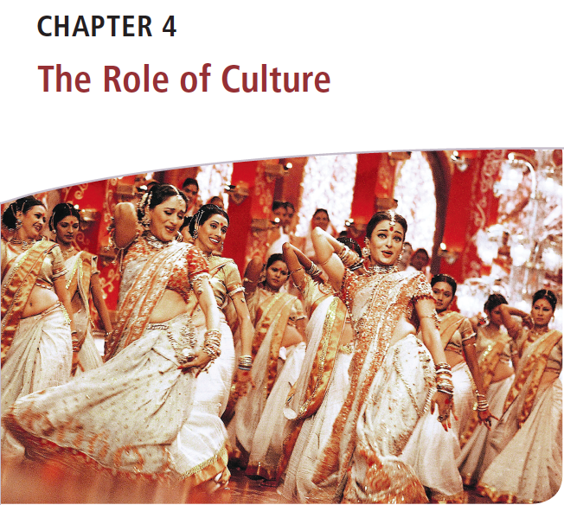
Διεθνείς Επιχειρήσεις και Επιχειρηματικότητα 8^{η} Έκδοση
ΚΕΦΑΛΑΙΟ 4
Ο Ρόλος του Πολιτισμού
Griffin & Pustay

Slide 2
Μαθησιακοί Στόχοι
Να συζητήσετε τα κύρια χαρακτηριστικά του πολιτισμού.
Να περιγράψετε τα διάφορα στοιχεία του πολιτισμού και να δώσετε παραδείγματα για το πώς επηρεάζουν τις διεθνείς επιχειρηματικές δραστηριότητες.
Να προσδιορίσετε τα μέσα με τα οποία τα μέλη ενός πολιτισμού επικοινωνούν μεταξύ τους.
Να συζητήσετε πώς οι θρησκευτικές και άλλες αξίες επηρεάζουν το εγχώριο περιβάλλον στο οποίο λειτουργούν οι διεθνείς επιχειρήσεις.
Να περιγράψετε τις μεγάλες πολιτισμικές ομάδες και τη χρησιμότητά τους για τα διεθνή διευθυντικά στελέχη.
Να εξηγήσετε τα βασικά ευρήματα του Hofstede σχετικά με τις διαφορές στις πολιτιστικές αξίες.
Να εξηγήσετε πώς μπορεί να προκύψουν πολιτισμικές συγκρούσεις στις διεθνείς επιχειρήσεις.

Slide 3
Χαρακτηριστικά του Πολιτισμού
Πολιτισμός είναι η συλλογή αξιών, πεποιθήσεων, συμπεριφορών, εθίμων και στάσεων που διακρίνουν μία κοινωνία από μια άλλη.
Χαρακτηριστικά του Πολιτισμού
Διδαγμένη συμπεριφορά
Αλληλένδετα στοιχεία
Προσαρμοστικός
Κοινός μεταξύ των μελών
Notes:
Culture reflects learned behavior that is transmitted from one member of a society to another. Some elements of culture are transmitted intergenerationally, as when parents teach their children table manners. Other elements are transmitted intragenerationally, as when seniors educate incoming freshmen about a school’s traditions.
The elements of culture are interrelated. For example, Japan’s group-oriented, hierarchical society stresses harmony and loyalty, which historically translated into lifetime employment and minimal job switching.
Because culture is learned behavior, it is adaptive; that is, the culture changes in response to external forces that affect the society. For example, after World War II, Germany was divided into free-market-oriented West Germany and communist-controlled East Germany. Despite their having a common heritage developed over centuries, this division created large cultural differences between Ossis (East Germans) and Wessis (West Germans). The differences resulted from adaptations of the East German culture to the dictates of communist ideology regarding attitudes toward work, risk taking, and fairness of reward systems.
Culture is shared by members of the society and indeed defines the membership in the society. Individuals who share a culture are members of a society; those who do not are outside the boundaries of the society

Slide 4
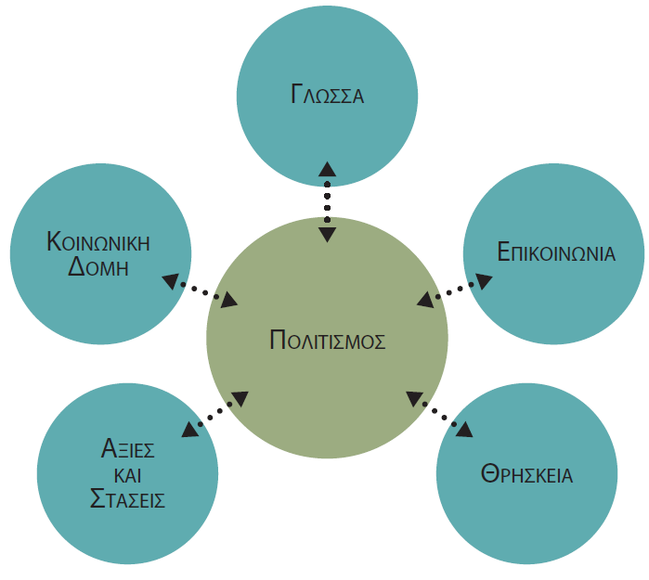
Στοιχεία του Πολιτισμού
Notes:
A society’s culture determines how its members communicate and interact with each other. The basic elements of culture (see Figure 4.1) are social structure, language, communication, religion, and values and attitudes. The interaction of these elements affects the local environment in which international businesses operate. They also affect the ability of countries to respond to changing circumstances.

Slide 5
Στοιχεία του Πολιτισμού: Κοινωνική Διαστρωμάτωση
Άτομα, Οικογένειες και Ομάδες
Ορισμός οικογένειας
Ρόλος των ατόμων εντός των ομάδων
Σημασία του ατόμου σε σχέση με την ομάδα
Κοινωνική διαστρωμάτωση
Γνωρίσματα
Πολύ διαστρωμένες κοινωνίες
Λιγότερο διαστρωμένες κοινωνίες
Κοινωνική κινητικότητα
Χαμηλή κοινωνική κινητικότητα
Υψηλή κοινωνική κινητικότητα
Notes:
Basic to every society is its social structure, the overall framework that determines the roles of individuals within the society, the stratification of the society, and individuals’ mobility within the society
Societies differ in the way they define family and in the relative importance they place on the individual’s role within groups
Cultures also differ in the importance of the individual relative to the group
Societies differ in their degree of social stratification. All societies categorize people to some extent on the basis of their birth, occupation, educational achievements, or other attributes. However, the importance of these categories in defining how individuals interact with each other within and between these groups varies by society
Social mobility is the ability of individuals to move from one stratum of society to another. Social mobility tends to be higher in less stratified societies

Slide 6
Στοιχεία του Πολιτισμού: Γλώσσα
Προσδιορίζει τις πολιτισμικές ομάδες.
Διαμορφώνει τις αντιλήψεις των ατόμων για τον κόσμο.
Φιλτράρει παρατηρήσεις και αντιλήψεις.
Παρέχει σημαντικές ενδείξεις για τις πολιτιστικές αξίες της κοινωνίας.
Προσφέρει ενδείξεις για την ποικιλομορφία του πληθυσμού μιας χώρας.
Notes:
Language is a primary delineator of cultural groups because it is an important means by which a society’s members communicate with each other
Language organizes the way members of a society think about the world. It filters observations and perceptions and thus affects unpredictably the messages that are sent when two individuals try to communicate
In addition to shaping one’s perceptions of the world, language provides important clues about the cultural values of the society and aids acculturation
The presence of more than one language group is an important signal about the diversity of a country’s population and suggests that there may also be differences in income, cultural values, and educational achievement

Slide 7
Στοιχεία του Πολιτισμού: Γλώσσα
Η γλώσσα ως ένα ανταγωνιστικό εργαλείο
Γλωσσική κληρονομιά της αποικιοκρατίας
Η κυρίαρχη κοινή γλώσσα ή lingua franca
Αγγλική γλώσσα
Μετάφραση
Αντίστροφη μετάφραση
Οι λέξεις μπορεί να έχουν διαφορετικές σημασίες.
Διατύπωση άρνησης
Notes:
Language as a Competitive Weapon : Linguistic ties often create important competitive advantages because the ability to communicate is so important in conducting business transactions
Lingua Franca: To conduct business, international businesspeople must be able to communicate. As a result of British economic and military dominance in the nineteenth century and U.S. dominance since World War II, English has emerged as the predominant common language, or lingua franca, of international business
Translation: Of course, some linguistic differences may be overcome through translation. The process, however, requires more than merely substituting words of one language for those of another. Translators must be sensitive to subtleties in the connotations of words and focus on translating ideas, not the words themselves. Far too often, translation problems create marketing disasters
Firms can reduce the chances that they are sending the wrong message to their customers by using a technique known as backtranslation. With backtranslation, one person translates a document, then a second person translates the translated version back into the original language. This technique provides a check that the intended message is actually being sent, thus avoiding communication mistakes
Saying No: Another cultural difficulty international businesspeople face is that words may have different meanings to persons with diverse cultural backgrounds

Slide 8
Στοιχεία του Πολιτισμού: Επικοινωνία
Μη λεκτική επικοινωνία
Εκφράσεις προσώπου
Χειρονομίες
Ένταση φωνής
Οπτική επαφή
Τοποθέτηση σώματος
Στάση σώματος
Notes:
Members of a society communicate with each other using more than words. In fact, some researchers believe 80 to 90 percent of all information is transmitted among members of a culture by means other than language. This nonverbal communication includes facial expressions, hand gestures, intonation, eye contact, body positioning, and body posture
Although most members of a society quickly understand nonverbal forms of communication common to their society, outsiders may find the nonverbal communication difficult to comprehend. Table 4.1 lists some of the many common forms of nonverbal communication

Slide 9
Στοιχεία του Πολιτισμού: Επικοινωνία
Notes:
Members of a society communicate with each other using more than words. In fact, some researchers believe 80 to 90 percent of all information is transmitted among members of a culture by means other than language. This nonverbal communication includes facial expressions, hand gestures, intonation, eye contact, body positioning, and body posture
Although most members of a society quickly understand nonverbal forms of communication common to their society, outsiders may find the nonverbal communication difficult to comprehend. Table 4.1 lists some of the many common forms of nonverbal communication

Slide 10
Στοιχεία του Πολιτισμού: Επικοινωνία
Δώρα και φιλοξενία
Σημαντικά μέσα επικοινωνίας
Διαφορετικές εθιμοτυπίες προσφοράς δώρων
Διαφορετικά έθιμα φιλοξενίας
Ανακοίνωση άσχημων νέων
Notes:
Gift-Giving and Hospitality Gift-giving are important means of communication in many business cultures
Japanese business etiquette requires solicitous hospitality. Elaborate meals and after-hours entertainment serve to build personal bonds and group harmony among the participants. These personal bonds are strengthened by the exchange of gifts, which vary according to the occasion and the status of the giver and the recipient. However, business gifts are opened in private so as not to cause the giver to lose face should the gift be too expensive or too cheap relative to the gift offered in return. Because the rules for gift-giving can be quite complicated, even to native Japanese, etiquette books that detail the appropriate gift for each circumstance are available
Hospitality customs also differ. When wooing clients, power-lunching U.S. executives often seek the most conspicuous table in a fancy restaurant as a means of communicating their status and clout. Conversely, in China business banquets are an important mechanism for developing the personal relationships so important in that business culture
Norms of hospitality even affect the way bad news is delivered in various cultures. In the United States bad news is typically delivered as soon as it is known. In Korea it is delivered at day’s end so it will not ruin the recipient’s whole day. Further, in order not to disrupt personal relationships, the bad news is often only hinted at. In Japan maintaining harmony among participants in a project is emphasized, so bad news often is communicated informally from a junior member of one negotiating team to a junior member of the other team. Even better, a third party may be used to deliver the message to preserve harmony within the group

Slide 11
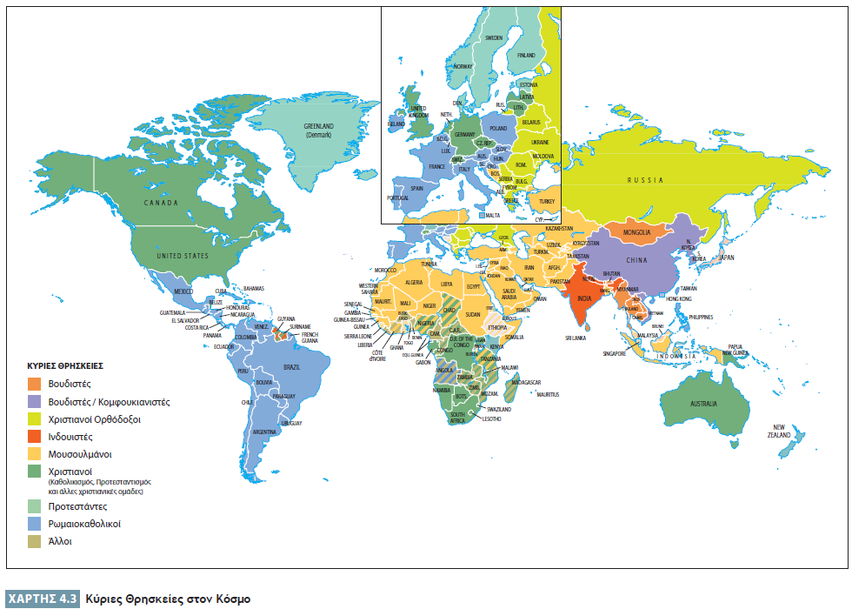
Στοιχεία του Πολιτισμού: Θρησκεία
Notes:
Religion is an important aspect of most societies. It affects the ways in which members of a society relate to each other and to outsiders. Approximately 84 percent of the world’s 6.9 billion people claim some religious affiliation. As reflected in Map 4.3, 77 percent of the world’s population adheres to one of four religions: Christianity (31.5 percent), including Roman Catholics, Protestants, and Eastern Orthodox; Islam (23.2 percent); Hinduism (15.0 percent); and Buddhism (7.1 percent)

Slide 12
Στοιχεία του Πολιτισμού: Θρησκεία
Διαμορφώνει τις στάσεις των υποστηρικτών.
Περιορίζει τους ρόλους των ατόμων στην κοινωνία.
Επηρεάζει την αγοραστική συμπεριφορά των καταναλωτών.
Επηρεάζει τα εποχιακά πρότυπα κατανάλωσης.
Επηρεάζει τις διεθνείς επιχειρήσεις.
Νομικό σύστημα
Ομοιότητα θρησκευτικών πεποιθήσεων
Ανεκτικότητα
Notes:
Religion shapes the attitudes its adherents have toward work, consumption, individual responsibility, and planning for the future
Religion affects the business environment in other important ways. Often religions impose constraints on the roles of individuals
Religion also affects the types of products consumers may purchase as well as seasonal patterns of consumption
The impact of religion on international businesses varies from country to country, depending on the country’s legal system, its homogeneity of religious beliefs, and its toleration of other religious viewpoints

Slide 13
Στοιχεία του Πολιτισμού: Αξίες και συμπεριφορές
Χρόνος
Ηλικία
Εκπαίδευση
Κοινωνική θέση
Notes:
Culture also affects and reflects the secular values and attitudes of the members of a society. Values are the principles and standards accepted by the members; attitudes encompass the actions, feelings, and thoughts that result from those values. Cultural values often stem from deep-seated beliefs about the individual’s position in relation to his or her deity, the family, and the social hierarchy. Cultural attitudes toward such factors as time, age, education, and status reflect these values and in turn shape the behavior of and opportunities available to international businesses operating in a given culture
Time: Attitudes about time differ dramatically across cultures. In Anglo-Saxon cultures, the prevailing attitude is “time is money.” Time represents the opportunity to produce more and to raise one’s income, so it is not to be wasted
Age: Important cultural differences exist in attitudes toward age. Youthfulness is considered a virtue in the United States. Many U.S. firms devote much time and energy to identifying young “fast-trackers” and providing them with important, tough assignments, such as negotiating joint ventures with international partners. In Asian and Arab cultures, however, age is respected and a manager’s stature is correlated with age
Education: A country’s formal system of public and private education is an important transmitter and reflection of the cultural values of its society
Status: The means by which status is achieved also vary across cultures. In some societies status is inherited as a result of the wealth or rank of one’s ancestors. In others it is earned by the individual through personal accomplishments or professional achievements

Slide 14
Βλέποντας το Δάσος και Όχι το Δέντρο: Η Προσέγγιση του Hall για Πολιτισμό Υψηλού και Χαμηλού Εννοιολογικού Πλαισίου
Διαφορά πολιτισμών χαμηλού και υψηλού εννοιολογικού πλαισίου
Λέξεις
Συμφραζόμενα
Πολιτισμικές ενδείξεις
Επιχειρηματικές συμπεριφορές
Notes:
One useful way of characterizing differences in cultures is the low-context–high-context approach developed by Edward and Mildred Hall. In a low-context culture, the words used by the speaker explicitly convey the speaker’s message to the listener. Anglo-Saxon countries such as Canada, the United Kingdom, and the United States, and Germanic countries are good examples of low-context cultures (see Table 4.2). In a high-context culture, the context in which a conversation occurs is just as important as the words that are actually spoken, and cultural clues are important in understanding what is being communicated. Examples are Arab countries and Japan
Business behaviors in high-context cultures often differ from those in low-context cultures. For example, German advertising is typically fact oriented, whereas Japanese advertising is often more emotion oriented. High-context cultures place higher value on interpersonal relations in deciding whether to enter into a business arrangement. In such cultures preliminary meetings are often held to determine whether the parties can trust each other and work together comfortably. Low-context cultures place more importance on the specific terms of a transaction

Slide 15
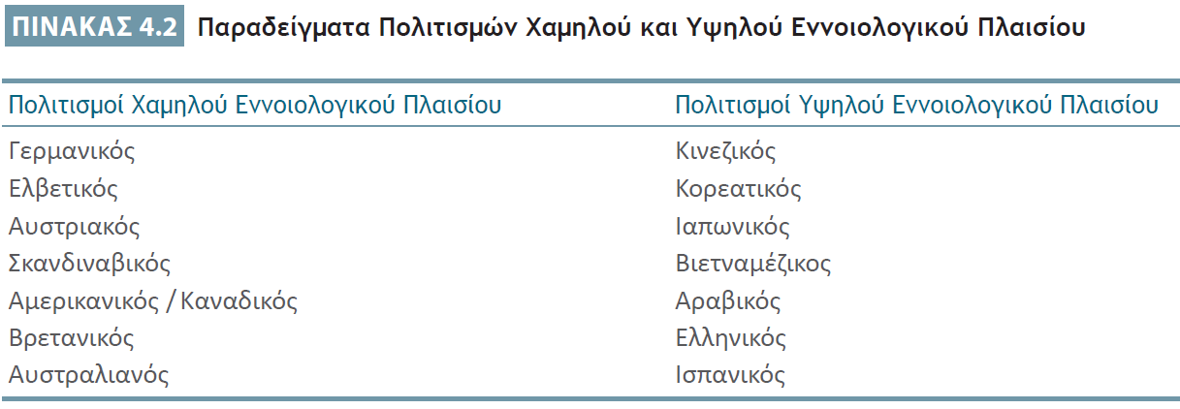
Βλέποντας το Δάσος και Όχι το Δέντρο: Η Προσέγγιση του Hall για Πολιτισμό Υψηλού και Χαμηλού Εννοιολογικού Πλαισίου
Notes:
One useful way of characterizing differences in cultures is the low-context–high-context approach developed by Edward and Mildred Hall. In a low-context culture, the words used by the speaker explicitly convey the speaker’s message to the listener. Anglo-Saxon countries such as Canada, the United Kingdom, and the United States, and Germanic countries are good examples of low-context cultures (see Table 4.2). In a high-context culture, the context in which a conversation occurs is just as important as the words that are actually spoken, and cultural clues are important in understanding what is being communicated. Examples are Arab countries and Japan
Business behaviors in high-context cultures often differ from those in low-context cultures. For example, German advertising is typically fact oriented, whereas Japanese advertising is often more emotion oriented. High-context cultures place higher value on interpersonal relations in deciding whether to enter into a business arrangement. In such cultures preliminary meetings are often held to determine whether the parties can trust each other and work together comfortably. Low-context cultures place more importance on the specific terms of a transaction

Slide 16
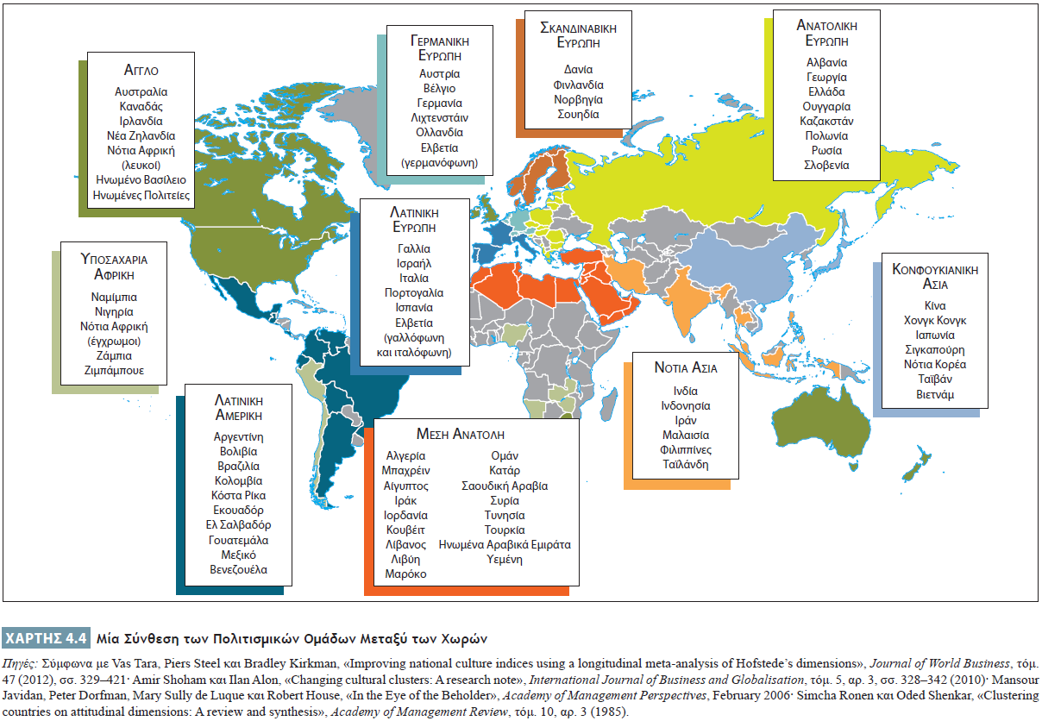
Βλέποντας το Δάσος και Όχι το Δέντρο: Η Προσέγγιση της Πολιτισμικής Ομάδας
Notes:
The cultural cluster approach is another technique for classifying and making sense of national cultures. Similarities exist among many cultures, thereby reducing some of the need to customize business practices to meet the demands of local cultures. Anthropologists, sociologists, and international business scholars have analyzed such factors as job satisfaction, work roles, and interpersonal work relations in an attempt to identify clusters of countries that share similar cultural values that can affect business practices
Map 4.4 shows ten country clusters, synthesized from the work of several teams of researchers
A cultural cluster comprises countries that share many cultural similarities, although differences do remain. Many clusters are based on language similarities, as is apparent in the Anglo, Germanic, Latin American, and Middle East (excepting Turkey) clusters and, to a lesser extent, in the Nordic and Latin European clusters. Of course, one can disagree with some placements of countries within clusters. Spain and the countries of Latin America share many culture values, for example

Slide 17
Βλέποντας το Δάσος και Όχι το Δέντρο: Η Προσέγγιση της Πολιτισμικής Ομάδας
Στρατηγικές διεθνοποίησης
Μέθοδοι εισόδου σε ξένες αγορές
Notes:
Many international businesses instinctively use the cultural cluster approach in formulating their internationalization strategies. U.S. firms’ first exporting efforts often focus on Canada and the United Kingdom. Hong Kong and Taiwanese firms have been successful in exploiting China’s markets. Similarly, many Spanish firms have chosen to focus their international expansion efforts on Spanish-speaking areas in the Americas
Closeness of culture may affect the form that firms use to enter foreign markets. Researchers have found, for example, that Canadian firms are more likely to enter the British market by establishing joint ventures with British firms, whereas Japanese firms are more likely to enter the British market via a greenfield investment, that is, a brand-new investment. The likely reason for the difference? Because of the relative closeness of their national cultures, Canadian firms are more comfortable working with British partners than are Japanese firms

Slide 18
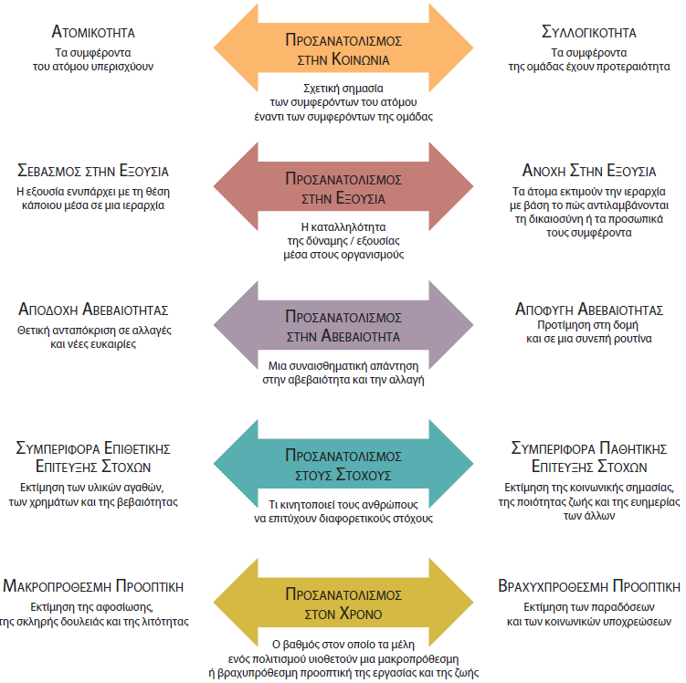
Βλέποντας το Δάσος και Όχι το Δέντρο: Οι Πέντε Διαστάσεις του Hofstede
Notes:
The most influential studies analyzing cultural differences and synthesizing cultural similarities are those performed by Geert Hofstede, a Dutch researcher who studied 116,000 people working for IBM in dozens of different countries. Although Hofstede’s work has been criticized for methodological weaknesses and his own cultural biases, it remains the largest and most comprehensive work of its kind. Hofstede’s work identified five important dimensions along which people seem to differ across cultures. These dimensions are shown in Figure 4.2. Note that these dimensions reflect tendencies within cultures, not absolutes. Within any given culture, there are likely to be people at every point on each dimension. Moreover, cultures can change over time, albeit usually slowly

Slide 19
Βλέποντας το Δάσος και Όχι το Δέντρο: Προσανατολισμός στην Κοινωνία
Notes:
Social orientation is a person’s beliefs about the relative importance of the individual and the groups to which that person belongs. The two extremes of social orientation, summarized in Table 4.4, are individualism and collectivism
Individualism is the cultural belief that the person comes first. Key values of individualistic people include a high degree of self-respect and independence. These people often put their own career interests before the good of their organizations, and they tend to assess decisions in terms of how those decisions affect them as individuals
Collectivism, the opposite of individualism, is the belief that the group comes first. Societies that tend to be collectivistic are usually characterized by well-defined social networks, including extended families, tribes, and coworkers. People are expected to put the good of the group ahead of their own personal welfare, interests, or success. Individual behavior in such cultures is strongly influenced by the emotion of shame; when a group fails, its members take the failure personally and experience shame. In addition, group members try to fit into their group harmoniously, with a minimum of conflict or tension

Slide 20
Βλέποντας το Δάσος και Όχι το Δέντρο: Προσανατολισμός στην Εξουσία
Σεβασμός στην εξουσία
Ανοχή στην εξουσία
Άκρα του προσανατολισμού στην εξουσία
Notes:
Some cultures are characterized by power respect. This means that people in a culture tend to accept the power and authority of their superiors simply on the basis of the superiors’ positions in the hierarchy. These same people also tend to respect the superiors’ right to that power. People at all levels in a firm accept the decisions and mandates of those above them because of the implicit belief that higher-level positions carry the right to make decisions and issue mandates
In contrast, people in cultures characterized by power tolerance attach much less significance to a person’s position in the hierarchy. These people are more willing to question a decision or mandate from someone at a higher level or perhaps even refuse to accept it. They are willing to follow a leader when that leader is perceived to be right or when it seems to be in their own self-interest to do so but not because of the leader’s intangible right to issue orders
Persons from power-tolerant cultures believe that hierarchies exist to solve problems and organize tasks within organizations

Slide 21
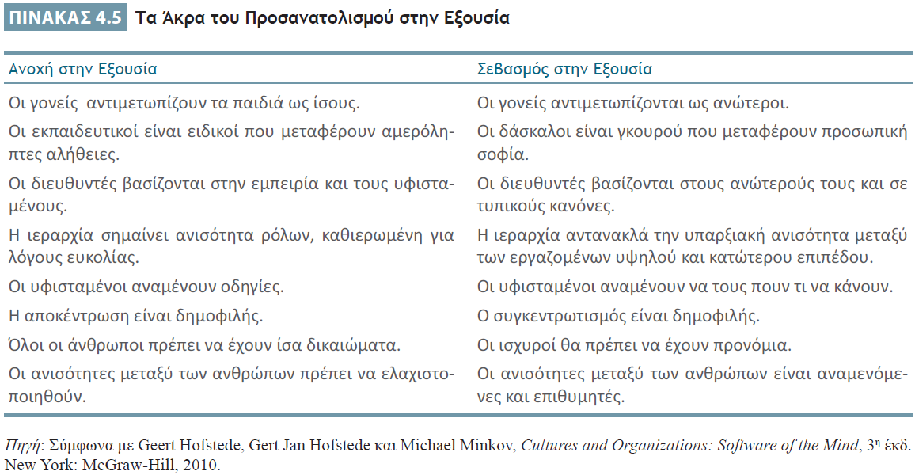
Βλέποντας το Δάσος και Όχι το Δέντρο: Προσανατολισμός στην Εξουσία
Notes:
Power orientation refers to the beliefs that people in a culture hold about the appropriateness of power and authority differences in hierarchies such as business organizations. The extremes of the dimension of power orientation are summarized in Table 4.5

Slide 22
Βλέποντας το Δάσος και Όχι το Δέντρο: Προσανατολισμός στην Αβεβαιότητα
Notes:
Uncertainty orientation is the feeling people have regarding uncertain and ambiguous situations. The extremes of this dimension are summarized in Table 4.6
People in cultures characterized by uncertainty acceptance are stimulated by change and thrive on new opportunities. Ambiguity is seen as a context within which an individual can grow, develop, and carve out new opportunities. In these cultures certainty carries with it a sense of monotony, routineness, and overbearing structure
In contrast, people in cultures characterized by uncertainty avoidance dislike ambiguity and will avoid it whenever possible. Ambiguity and change are seen as undesirable. These people tend to prefer a structured and routine, even bureaucratic, way of doing things

Slide 23
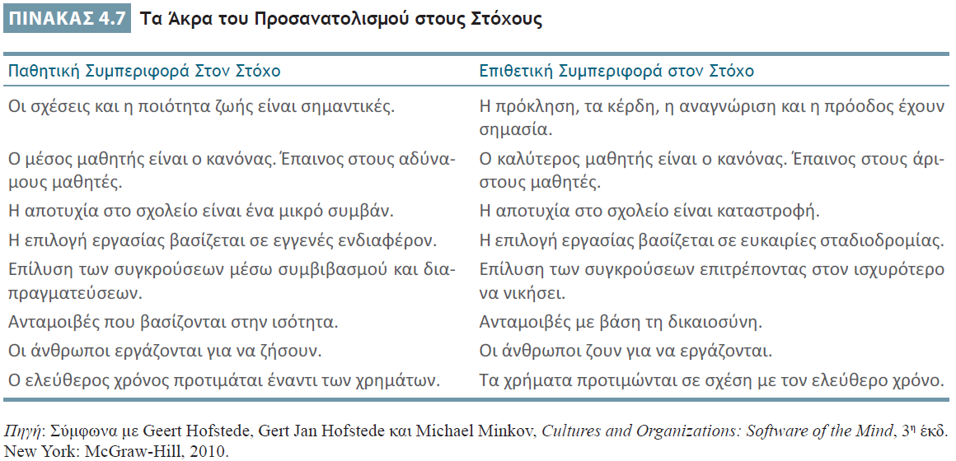
Βλέποντας το Δάσος και Όχι το Δέντρο: Προσανατολισμός στους Στόχους
Notes:
Hofstede’s fourth dimension, goal orientation, is the manner in which people are motivated to work toward different kinds of goals. One extreme on the goal orientation continuum is aggressive goal behavior (see Table 4.7). People who exhibit aggressive goal behavior tend to place a high premium on material possessions, money, and assertiveness. At the other extreme, people who adopt passive goal behavior place a higher value on social relationships, quality of life, and concern for others

Slide 24
Βλέποντας το Δάσος και Όχι το Δέντρο: Προσανατολισμός στον Χρόνο
Προσανατολισμός στον χρόνο
Βραχυπρόθεσμος
Μακροπρόθεσμος
Notes:
Hofstede’s fifth dimension, time orientation, is the extent to which members of a culture adopt a long-term versus a short-term outlook on work, life, and other aspects of society

Slide 25
Διοίκηση σε Διεθνές Επίπεδο και Πολιτισμικές Διαφορές: Κατανοώντας Νέους Πολιτισμούς
Κριτήριο της αυτοαναφοράς
Αφομοίωση
Διαπολιτισμική επίγνωση
Notes:
When dealing with a new culture, many international businesspeople make the mistake of relying on the self-reference criterion, the unconscious use of one’s own culture to help assess new surroundings
To be successful, international businesspeople traveling abroad must remember that they are the foreigners and must attempt to behave according to the rules of the culture at hand. There are numerous ways to obtain knowledge about other cultures to achieve cross-cultural literacy
Cross-cultural literacy is the first step in acculturation, the process by which people not only understand a foreign culture but also modify and adapt their behavior to make it compatible with that culture. Acculturation is of particular importance to home country managers who frequently interact with host country nationals—for example, a plant manager from the home country or a marketing director working overseas at a foreign subsidiary

Slide 26
Ερωτήσεις Ανασκόπησης
Τι είναι πολιτισμός;
Ποια είναι τα κύρια χαρακτηριστικά του πολιτισμού;
Περιγράψτε τη διαφορά ανάμεσα σε πολιτισμούς υψηλού και χαμηλού εννοιολογικού πλαισίου.
Τι είναι τα πολιτιστικά συμπλέγματα;
Τι είναι ο ατομικισμός και τι η συλλογικότητα; Σε τι διαφέρουν;
Συζητήστε τις διαφορές στα συστήματα αμοιβής μεταξύ αμερικανικών και ιαπωνικών επιχειρήσεων. Σε ποιο βαθμό αυτές οι διαφορές καθορίζονται από τον πολιτισμό;

Slide 27
Ερωτήσεις Ανασκόπησης
Τι είναι ο προσανατολισμός στην εξουσία;
Τι είναι ο προσανατολισμός στην αβεβαιότητα;
Ποιες είναι οι επιθετικές και οι παθητικές συμπεριφορές ως προς τους στόχους; Σε τι διαφέρουν;
Τι είναι το κριτήριο αυτοαναφοράς;

Slide 28
Σημείωση της αγγλικής έκδοσης των διαφανειών
Το παρόν έργο προστατεύεται από νόμους πνευματικών δικαιωμάτων των Ηνωμένων Πολιτειών και παρέχεται αποκλειστικά για χρήση από διδάσκοντες κατά τη διδασκαλία των μαθημάτων τους και την αξιολόγηση της εκμάθησης των φοιτητών. Η διάδοση ή πώληση οποιουδήποτε μέρους αυτού του έργου (συμπεριλαμβανομένης της δημοσίευσης στον Παγκόσμιο Ιστό) καταστρέφει την ακεραιότητα του έργου και δεν επιτρέπεται. Το περιεχόμενο του έργου δεν θα πρέπει ποτέ να διατίθεται στους φοιτητές, παρά μόνο στους διδάσκοντες που χρησιμοποιούν το συνοδευτικό κείμενο στα μαθήματά τους. Όλοι οι αποδέκτες αυτού του έργου αναμένεται να συμμορφώνονται με αυτούς τους περιορισμούς και να σέβονται τους προβλεπόμενους παιδαγωγικούς σκοπούς και τις ανάγκες των άλλων διδασκόντων που βασίζονται σε αυτήν την ύλη.
Αποκλειστικότητα για την ελληνική γλώσσα: ΕΚΔΟΣΕΙΣ ΤΖΙΟΛΑ

