Slide 1
What explains the rise of humans?
Yuval Harari

Slide 2
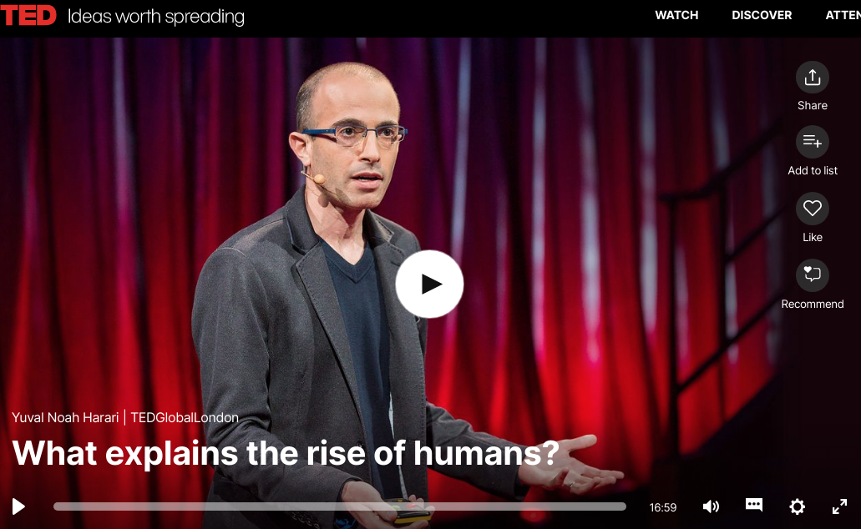
Watch the speech at
https://www.ted.com/talks/yuval_noah_harari_what_explains_the_rise_of_humans

Slide 3
Note-taking
How did we turn ourselves from insignificant apes, minding their own business in a corner of Africa, into the rulers of planet earth?
on the individual level
on the collective level
Answer: the ability to ______
How, exactly, do we do it? What enables us alone, of all the animals, to cooperate in such a way?
On the religious field
On the legal field
On the political field
On the economic field
Conclusion: ____ reality
___
___

Slide 4
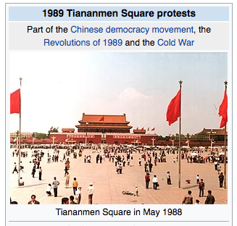
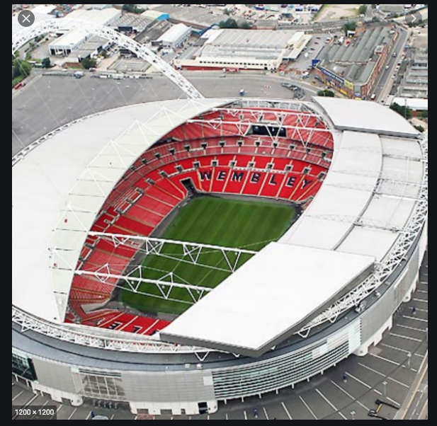
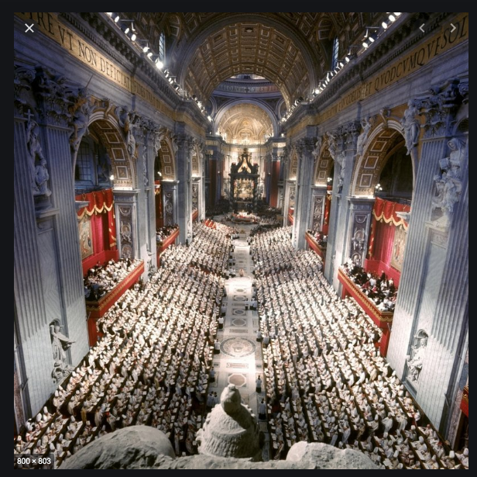
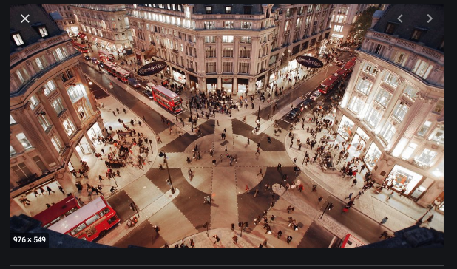
Do you know these places? What do they symbolize?
Oxford Street
Wembley Stadium
Tienanmen Square
the Vatican

Slide 5
Which of the following is the rhetorical organization pattern/s adopted in the speech?
Question & answer
Problem-solution
General to specific - exemplification
Comparison-contrast
Narration
Description

Slide 6
What is the purpose of the speech?
Informative or persuasive speech? To what extent?

Slide 7
Speech techniques
Humor
Irony
Visual aids
Anecdotes –personal stories
Imagery
Vivid details
Contrasts
Use of questions (signposting, rhetorical, no answer, help the audience follow the argument)
Parallel structure
Intentionally repeated vocabulary

Slide 8
What speech strategies can be identified in the extracts?
And if you now try to cram 100,000 chimpanzees into Oxford Street, or into Wembley Stadium, or Tienanmen Square or the Vatican, you will get chaos, complete chaos. Just imagine Wembley Stadium with 100,000 chimpanzees. Complete madness.
"Look, there is a god above the clouds! And if you don't do what I tell you to do, when you die, God will punish you and send you to hell." And if you all believe this story that I've invented, then you will follow the same norms and laws and values, and you can cooperate. This is something only humans can do. You can never convince a chimpanzee to give you a banana by promising him, "... after you die, you'll go to chimpanzee heaven ..."

Slide 9
What speech strategies can be identified in the extracts?
We want to believe -- I want to believe -- that there is something special about me, about my body, about my brain, that makes me so superior to a dog or a pig, or a chimpanzee.
And if there's a new opportunity or a new danger, the bees cannot reinvent the social system overnight. They cannot, for example, execute the queen and establish a republic of bees, or a communist dictatorship of worker bees.
I'm a chimpanzee and you're a chimpanzee, and I want to cooperate with you. I need to know you personally. What kind of chimpanzee are you? Are you a nice chimpanzee? Are you an evil chimpanzee? Are you trustworthy? If I don't know you, how can I cooperate with you?

Slide 10
What speech techniques are used in the conclusion?
To conclude, then: We humans control the world because we live in a dual reality. All other animals live in an objective reality. Their reality consists of objective entities, like rivers and trees and lions and elephants. We humans, we also live in an objective reality. In our world, too, there are rivers and trees and lions and elephants. But over the centuries, we have constructed on top of this objective reality a second layer of fictional reality, a reality made of fictional entities, like nations, like gods, like money, like corporations. And what is amazing is that as history unfolded, this fictional reality became more and more powerful so that today, the most powerful forces in the world are these fictional entities. Today, the very survival of rivers and trees and lions and elephants depends on the decisions and wishes of fictional entities, like the United States, like Google, like the World Bank -- entities that exist only in our own imagination.

Slide 11
What speech techniques strategies can be identified in the extracts?
We want to believe -- I want to believe -- that there is something special about me, about my body, about my brain, that makes me so superior to a dog or a pig, or a chimpanzee. COMMON GROUND
And if there's a new opportunity or a new danger, the bees cannot reinvent the social system overnight. They cannot, for example, execute the queen and establish a republic of bees, or a communist dictatorship of worker bees. VIVID IMAGE, examples, METAPHOR
I'm a chimpanzee and you're a chimpanzee, and I want to cooperate with you. I need to know you personally. What kind of chimpanzee are you? Are you a nice chimpanzee? Are you an evil chimpanzee? Are you trustworthy? If I don't know you, how can I cooperate with you? VIVID IMAGE, direct address, a series of short questions (simplification), similarity with CHIMPS
And if you now try to cram 100,000 chimpanzees into Oxford Street, or into Wembley Stadium, or Tienanmen Square or the Vatican, you will get chaos, complete chaos. Just imagine Wembley Stadium with 100,000 chimpanzees. Complete madness. EXAMPLES, VIVID IMAGE, parallelism, direct address, SIMILARITY & DISSIMILARITY WITH THE CHIMPS
"Look, there is a god above the clouds! And if you don't do what I tell you to do, when you die, God will punish you and send you to hell." And if you all believe this story that I've invented, then you will follow the same norms and laws and values, and you can cooperate. This is something only humans can do. You can never convince a chimpanzee to give you a banana by promising him, "... after you die, you'll go to chimpanzee heaven ..." (LAUGHTER- HUMOR)

Slide 12
Critical thinking discussion
What impressed you in this speech? What did you like/dislike?
How does this dual reality affect our everyday life?
In a positive way
In a negative way

Slide 13
Derivatives
The ___(inquire) listener will wonder what ___ (able) us alone, of all the animals, to cooperate in such a way. The answer is our imagination. We can cooperate ___ (flexible) with ___(count) numbers of strangers, because we alone, of all the animals on the planet, can create and believe ___(fiction) stories.
The bees cannot ___(invent) the ___(socialize) system overnight. They cannot, for example, execute the queen and establish a republic of bees, or a ___(communism) _____ (dictator) of worker bees.

