Slide 1
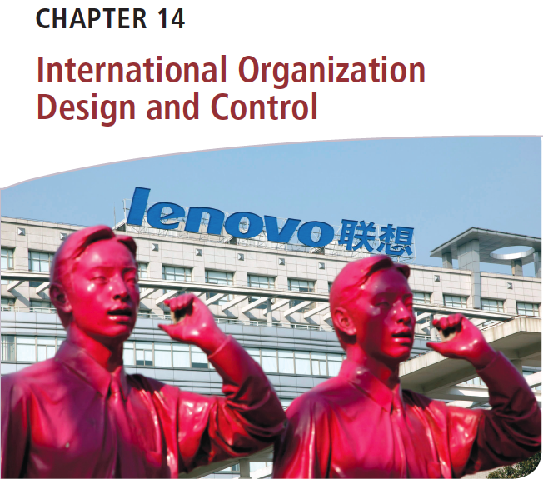
Διεθνείς Επιχειρήσεις και Επιχειρηματικότητα 8^{η} Έκδοση
ΚΕΦΑΛΑΙΟ 14
Οργανωσιακός Σχεδιασμός και Έλεγχος στις Διεθνείς Επιχειρήσεις
Griffin & Pustay

Slide 2
Μαθησιακοί Στόχοι
Να ορίσετε και να συζητήσετε τη φύση του οργανωσιακού σχεδιασμού στο διεθνές περιβάλλον· να προσδιορίσετε και να περιγράψετε την επίδραση της διεθνούς επιχειρηματικής δραστηριότητας στον σχεδιασμό της διεθνούς επιχείρησης.
Να προσδιορίσετε και να περιγράψετε πέντε εξελιγμένες μορφές διεθνούς οργανωσιακού σχεδιασμού και να συζητήσετε σχετικά με τις υβριδικές οργανωσιακές μορφές της διεθνούς επιχείρησης.

Slide 3
Μαθησιακοί Στόχοι
Να προσδιορίσετε και να περιγράψετε τα κρίσιμα ζητήματα που ανακύπτουν στον οργανωσιακό σχεδιασμό της διεθνούς επιχείρησης.
Να εξηγήσετε τον σκοπό και τα επίπεδα του ελέγχου στις διεθνείς επιχειρήσεις.
Να περιγράψετε πώς οι διεθνείς επιχειρήσεις αντιμετωπίζουν τη λειτουργία του ελέγχου.

Slide 4
Η Φύση του Διεθνούς Οργανωσιακού Σχεδιασμού
Κατανομή οργανωσιακών πόρων
Ανάθεση καθηκόντων
Ενημέρωση
Συγκέντρωση και κοινοποίηση πληροφοριών
Οργανωσιακός σχεδιασμός
Notes:
Organization design (sometimes called organization structure) is the overall pattern of structural components and configurations used to manage the total organization. The appropriate design for any given organization may depend on the firm’s size, strategy, technology, and environment, as well as the cultures of the countries in which the firm operates. Organization design is also the basic vehicle through which strategy is implemented and the work of the organization is actually accomplished.
A firm cannot function unless its various structural components are appropriately assembled. Through its design, the firm does four things. First, it allocates organizational resources. Second, it assigns tasks to its employees. Third, it informs those employees about the firm’s rules, procedures, and expectations about the employees’ job performances. Fourth, it collects and transmits information necessary for problem solving, decision making, and effective organizational control. This last task is particularly important for large MNCs, which must manage the sharing of information between corporate headquarters, subsidiaries, and staff.

Slide 5
Η Φύση του Διεθνούς Οργανωσιακού Σχεδιασμού
Προσέγγιση της φυσικής συνακολουθίας
Τμήμα εξαγωγών
Διεύθυνση διεθνών επιχειρηματικών δραστηριοτήτων
Notes:
A strategy calling for increased internationalization will have an impact on the firm’s organization design. To see how this begins to happen, consider a domestic firm that has no international sales. No changes are needed to the firm’s organization design.
Now assume that the firm begins to engage in direct exporting on a modest level. Its initial response to international orders is the corollary approach, whereby the firm delegates responsibility for processing such orders to individuals within an existing department. The firm continues to use its existing domestic organization design.
As the firm’s exports become more significant, its next step is to create a separate export department. It will oversee international operations, market products, process orders, work with foreign distributors, and arrange financing. If selling to foreign customers is essentially the same as selling to domestic ones, the export department may not need to know much about foreign markets. However, as international activities increase, knowledge of foreign markets will be more important, and new methods for organizing may be required.
The firm can respond by creating an international division that specializes in managing foreign operations. Then, the firm can concentrate resources and target international business activity, while keeping that activity segregated from ongoing domestic activities.

Slide 6
Παγκόσμιοι Οργανωσιακοί Σχεδιασμοί
Γνώση προϊόντων
Γνώση λειτουργιών
Γνώση περιοχών
Παγκόσμιος σχεδιασμός
Notes:
As a firm evolves from being domestically oriented with international operations to becoming a true multinational corporation with global aspirations, it will abandon the international division approach. It usually creates a global organization design to achieve synergies among its far-flung operations and implement its organizational strategy.
The global design adopted by any firm must deal with the need to integrate three types of knowledge:
Area Knowledge: Managers must understand the cultural, commercial, social, and economic conditions in each host country market.
Product Knowledge: Managers must comprehend such factors as technological trends, customer needs, and competitive forces affecting the goods the firm produces and sells.
Functional Knowledge: Managers must have access to co-workers with expertise in basic business functions such as production, marketing, finance, accounting, human resource management, and information technology.

Slide 7
Παγκόσμιοι Οργανωσιακοί Σχεδιασμοί
Κοινές μορφές
Σχεδιασμός βάσει προϊόντων
Σχεδιασμός βάσει περιοχών
Σχεδιασμός βάσει λειτουργιών
Σχεδιασμός βάσει πελατών
Σχεδιασμός βάσει δομής μήτρας
Φιλοσοφία διοίκησης
Εθνοκεντρική
Πολυκεντρική
Γεωκεντρική
Notes:
The five most common forms of global organization design are product, area, functional, customer, and matrix. As we will discuss, each form allows the firm to emphasize one type of knowledge. However, each form can make it more difficult to incorporate the other types of knowledge into the firm’s decision-making processes.
The global design the MNC chooses will reflect the relative importance of each of the three types of knowledge in the firm’s operations. It will also reflect the need for coordination among its units, the source of its firm-specific advantages, and its managerial philosophy about its role in the world economy.
MNCs typically adopt one of three managerial philosophies that guide their approach to such functions as organization design and marketing. The ethnocentric approach is used by firms that operate internationally the same way they do domestically. The polycentric approach is used by firms that customize their operations for each foreign market they serve. The geocentric approach is used by firms that analyze the needs of their customers worldwide and then adopt standardized operations for all markets they serve. These concepts are discussed more fully in Chapter 16.

Slide 8
Παγκόσμιος Σχεδιασμός Βάσει Προϊόντων
Σχετιζόμενα προϊόντα
Μορφή πολλαπλών διευθύνσεων
Ασυσχέτιστα προϊόντα
Μορφή εταιρείας συμμετοχών
Notes:
The most common form of organization design adopted by MNCs is the global product design, which assigns worldwide responsibility for specific products or product groups to separate operating divisions within a firm. This design works best when the firm has diverse product lines or when its product lines are sold in diverse markets, thereby reducing the need for coordination between product lines.
If the products are related, the organization of the firm takes on what is often called an M-form design; if the products are unrelated, the design is called an H-form design. The “M” in M-form stands for “multidivisional”—the various divisions of the firm are usually self-contained operations with interrelated activities. The “H” in H-form stands for holding, as in a holding company where the various unrelated businesses function with autonomy and little interdependence.

Slide 9
Παγκόσμιος Σχεδιασμός Βάσει Προϊόντων
Πλεονεκτήματα
Εμπειρογνωσία
Αποδοτικότητα
Παγκόσμιο μάρκετινγκ
Γεωκεντρικές εταιρικές φιλοσοφίες
Μειονεκτήματα
Δαπανηρός πολλαπλασιασμός πόρων
Ανάπτυξη γνώσης
Επίπεδα συντονισμού
Εταιρική μάθηση
Notes:
Global product design offers several competitive advantages. First, since a division focuses on a single product group, division managers gain expertise in all aspects of the product, better enabling them to compete globally. Second, the global product design facilitates efficiencies in production. Managers are free to manufacture the product wherever manufacturing costs are the lowest and coordinate production at their various facilities. Global product design also facilitates global marketing by allowing for flexibility in introducing, promoting, and distributing each product.
The global product design also has disadvantages. It may encourage expensive duplication because each product group needs its own functional-area skills and sometimes even its own physical facilities for production, distribution, and research and development (R&D). In addition, each product group must develop its own knowledge about the regional and national markets in which it operates. Coordination and corporate learning across product groups also become more difficult.

Slide 10
Παγκόσμιος Σχεδιασμός Βάσει Περιοχών
Πλεονεκτήματα
Στρατηγική που καθοδηγείται από το μάρκετινγκ
Φήμη επώνυμων προϊόντων
Εμπειρογνωσία για την τοπική αγορά
Μειονεκτήματα
Μπορεί να θυσιάσει την αποδοτικότητα κόστους.
Μπορεί να επιβραδύνει τη διάχυση της τεχνολογίας
οδηγεί σε πολλαπλασιασμό πόρων
Αυξάνει το κόστος συντονισμού
Αποθαρρύνει τον παγκόσμιο σχεδιασμό των προϊόντων
Notes:
The global area design organizes the firm’s activities around specific areas or regions of the world. This system is particularly useful in two situations:
In a firm whose strategy is driven by marketing rather than predicated on manufacturing efficiencies or technological innovation.
In a firm whose competitive strength lies in the reputation of its brand name products.
Further, the geographical focus of this design allows a firm to develop expertise about the local market. Area managers can adapt the firm’s products to meet local needs and respond to changes in the local marketplace. They also can tailor the product mix they offer within a given area.
The global area design does have disadvantages. By focusing on the needs of the area market, the firm may sacrifice cost efficiencies that might be gained through global production. Diffusion of technology is also slowed because innovations generated in one area division may not be adopted by all the others. Therefore, this design may not be suitable for product lines undergoing rapid technological change. Further, the global area design results in duplication of resources because each area division must have its own functional specialists, product experts, and, in many cases, production facilities. And finally, it makes coordination across areas expensive and discourages global product planning.

Slide 11
Παγκόσμιος Σχεδιασμός Βάσει Λειτουργιών
Πλεονεκτήματα
Μεταφορά εμπειρογνωσίας
Κεντρικός έλεγχος
Εστίαση στις λειτουργίες
Μειονεκτήματα
Περιορισμένα προϊόντα ή πελάτες
Δύσκολος συντονισμός
Πολλαπλασιασμός πόρων
Notes:
The global functional design calls for a firm to create departments or divisions that have worldwide responsibility for the common organizational functions—finance, operations, marketing, R&D, and human resources management. This design is used by MNCs that have relatively narrow or similar product lines. It results in what is often called a U-form organization, where the “U” stands for unity.
The global functional design offers several advantages. First of all, the firm can easily transfer expertise within each functional area. Second, managers can maintain highly centralized control over functional operations. Finally, the global functional design focuses attention on the key functions of the firm.
Despite these advantages, this design is inappropriate for many businesses. For one thing, the global functional design is practical only when the firm has relatively few products or customers. For another, coordination between divisions can be a major problem. Finally, there may also be duplication of resources among managers.
Because of these problems, the global functional design has limited applicability. It is used by many firms engaged in extracting and processing natural resources, such as the mining and energy industries, because in their case the ability to transfer technical expertise is important.

Slide 12
Παγκόσμιος Σχεδιασμός Βάσει Πελατών
Ευκαιρίες
Εξυπηρέτηση διαφορετικών πελατών
Εστίαση μάρκετινγκ
Ανταπόκριση σε συγκεκριμένες ανάγκες
Προκλήσεις
Πολλαπλασιασμός πόρων
Ζητήματα συντονισμού
Notes:
The global customer design is used when a firm serves different customers or customer groups, each with specific needs calling for special expertise or attention.
This design is useful when the various customer groups targeted by a firm are so diverse as to require totally distinct marketing approaches. The global customer approach allows the firm to meet the specific needs of each customer segment and track how well the firm’s products or services are doing among those segments. On the other hand, the global customer design may lead to a significant duplication of resources, if each customer group needs its own area and functional specialists. Coordination between the different divisions is also difficult because each is concerned with a fundamentally different market.

Slide 13
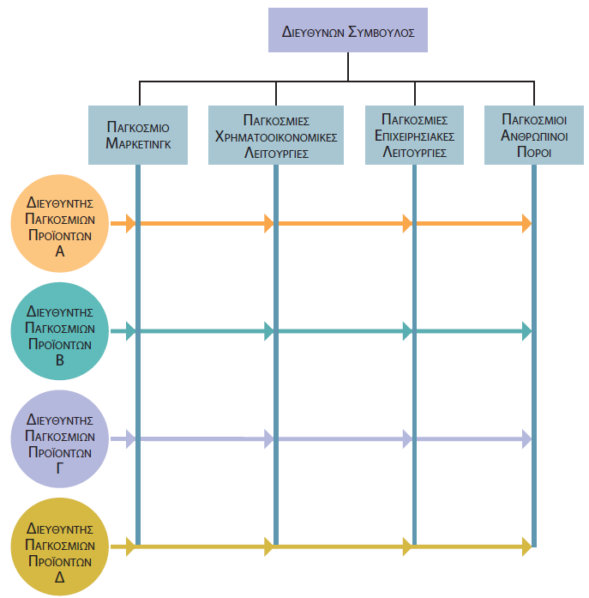
Παγκόσμιος Σχεδιασμός Τύπου Μήτρας
Notes:
A global matrix design is the result of superimposing one form of organization design on top of an existing, different form. The resulting design is usually quite fluid, with new matrix dimensions being created, downscaled, and eliminated as needed. For example, the global matrix design shown in Figure 14.5 was created by superimposing a global product design (shown down the side) on an existing global functional design (shown across the top).

Slide 14
Παγκόσμιος Σχεδιασμός Τύπου Μήτρας
Πλεονεκτήματα
Οργανωσιακή ευελιξία
Συντονισμός και επικοινωνία
Μειονεκτήματα
Περιορισμένη χρήση σε επιχείρηση με λίγα προϊόντα
Περιορισμένη χρήση σε σχετικά ευσταθείς αγορές
Υποβολή αναφοράς σε περισσότερους από έναν διευθυντές
Παράδοξες σχέσεις εξουσίας
Τάση για προώθηση συμβιβαστικών λύσεων
Notes:
An advantage of the global matrix design is that it helps bring together the functional, area, and product expertise of the firm into teams to develop new products or respond to new challenges in the global marketplace. The global matrix design thus promotes organizational flexibility. It allows firms to take advantage of functional, area, customer, and product organization designs as needed while simultaneously minimizing the disadvantages of each. Members of a product development team can be added or dropped from the team as the firm’s needs change. The global matrix design also promotes coordination and communication among managers from different divisions.
The global matrix design has limitations, however. First of all, it is not appropriate for a firm that has few products and that operates in relatively stable markets. Second, it often puts employees in the position of being accountable to more than one manager. As a result, the individual may have split loyalties—caught between competing sets of demands and pressures. Similarly, the global matrix design creates a paradox regarding authority. On the one hand, part of the design’s purpose is to put decision-making authority into the hands of those managers most able to use it quickly. On the other hand, because reporting relationships are so complex and vague, getting approval for major decisions may actually take longer. Finally, the global matrix design tends to promote compromises, or decisions based on the relative political clout of the managers involved.

Slide 15
Υβριδικοί Παγκόσμιοι Σχεδιασμοί
Μέγεθος
Στρατηγική
Τεχνολογία
Περιβάλλον
Κουλτούρα
Notes:
Each global form of international organization design described in this section represents an ideal or pure type. Most firms, however, create a hybrid design that best suits their purposes, as dictated in part by their size, strategy, technology, environment, and culture.
Managers start with the basic prototypes, merge and adjust them, and create new elements as they respond to changes in the organization’s strategy and competitive environment. In fact, if it were possible to compare the designs used by the world’s 500 largest MNCs, no two would look exactly the same.

Slide 16
Ζητήματα Σχετικά με τον Παγκόσμιο Οργανωσιακό Σχεδιασμό
Συγκεντρωτισμός έναντι αποκέντρωσης
Ρόλος των διοικητικών συμβουλίων των θυγατρικών
Συντονισμός στην παγκόσμια οργάνωση
Notes:
In addition to the fundamental issues of organization design we have addressed, multinational corporations also face a number of other related organizational issues that must be carefully managed.

Slide 17
Συγκεντρωτισμός Έναντι Αποκέντρωσης
Κέντρο λήψης αποφάσεων | Ανταπόκριση στην τοπική αγορά | Συνολικές ανάγκες επιχείρησης
Κεντρικά γραφεία εταιρείας | Χαμηλή | Περισσότερες
Τοπικά γραφεία θυγατρικής | Υψηλή | Λιγότερες
Notes:
When designing its organization, an MNC must make a particularly critical decision that determines the level of autonomy, power, and control it wants to grant its subsidiaries.
Suppose it decentralizes decision making by giving subsidiaries the authority to make finance, production, and marketing decisions. This approach allows those closest to the market to respond quickly to changes in local conditions. However, local managers may focus on the subsidiary’s needs rather than on the firm’s overall needs.
An MNC can remedy this deficiency by tightly centralizing decision-making authority at corporate headquarters. Decisions made by the corporate staff can then take into account the firm’s overall needs. However, these decisions often hinder the ability of subsidiary managers to quickly and effectively respond to changes in their local market conditions.
Because both centralization and decentralization offer attractive benefits, most firms constantly tinker with a blend of the two, the purpose being to achieve the best outcome in terms of overall strategy.

Slide 18
Ο Ρόλος των Διοικητικών Συμβουλίων των Θυγατρικών
Σημαντική εξουσία λήψης αποφάσεων
Διοικητικό συμβούλιο
Πολυεθνική εταιρεία
Ελάχιστη εξουσία
Notes:
An MNC typically incorporates each of its subsidiaries in the subsidiary’s country of operation. Most countries require each corporation, including a wholly-owned subsidiary of a foreign MNC, to have a board of directors. The board is elected by corporate shareholders, is responsible to those shareholders for the effective management of the subsidiary, and oversees the activities of the subsidiary’s top-level managers.
The issue facing most MNCs is whether to view the creation of a subsidiary board of directors as a pro forma exercise (thus giving the board little authority), or to empower the board with substantial decision-making authority. As a rule, a subsidiary board is most useful when the subsidiary has a great deal of autonomy, its own self-contained management structure, and a business identity separate from the parent’s.
Empowering the subsidiary’s board promotes decentralization. Foreign subsidiaries may need the authority to act quickly and decisively without having to always seek the parent’s approval. Also, if the MNC decentralizes authority to local levels, an active board provides clear accountability and a reporting link back to corporate headquarters.
Some MNCs also have found that appointing prominent local citizens to the subsidiary’s board is helpful in conducting business in a foreign country. These members can help the subsidiary integrate into the local business community. They can also be an effective source of information for both parent and subsidiary about local business and political conditions. A subsidiary board also can help monitor the subsidiary’s ethical and social responsibility practices.
A potential disadvantage of empowering a subsidiary’s board is that the subsidiary may become too independent, as its board assumes substantial authority. As a result, it may fail to maintain the desired level of accountability to the parent.

Slide 19
Συντονισμός στην Παγκόσμια Οργάνωση
Οργανωσιακή ιεραρχίας
Κανόνες και διαδικασίες
Ad hoc τεχνικές συντονισμού
Άτυποι μηχανισμοί συντονισμού
Άτυπο δίκτυο διαχείρισης
Notes:
Coordination is the process of linking and integrating functions and activities of different groups, units, or divisions. MNCs can use any of several strategies to achieve and manage their desired level of coordination.
The organizational hierarchy itself is one way to manage interdependence and promote coordination. An organization design that clearly specifies all reporting relationships expedites coordination because each manager knows how to channel communications, decision making, and so on. Rules and procedures also facilitate coordination.
Many international firms also rely heavily on informal coordination mechanisms. Informal management networks can be especially effective. An informal management network is simply a group of managers from different parts of the world who are connected to one another in some way. These connections often form as a result of personal contact, mutual acquaintances, and interaction achieved via travel, training programs, joint meetings, task force experiences, and so on. Informal management networks can be very powerful for short-circuiting bureaucracy that may delay communication and decision making. They also can be effective for getting things done more quickly and more effectively than if normal and routine procedures were always followed.

Slide 20
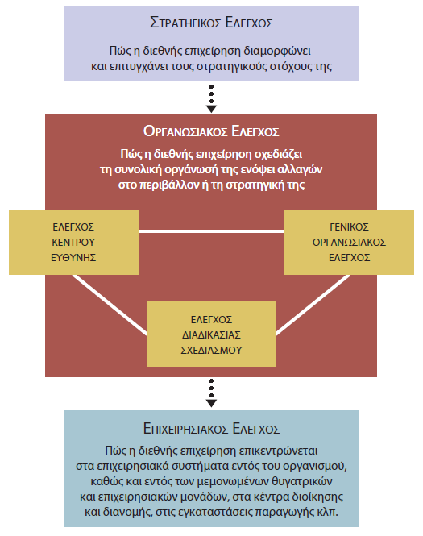
Η Λειτουργία Ελέγχου στις Διεθνείς Επιχειρήσεις
Notes:
Another important role of organization design is to enable the firm to manage its control function more effectively. Control is the process of monitoring ongoing performance and making necessary changes to keep the organization moving toward its performance goals.
As illustrated in Figure 14.7, there are three main levels at which control can be implemented and managed in an international business. These three key levels of control are the strategic, organizational, and operations levels. Although each is important on its own merits, the three levels also are important collectively as an organizing framework for managers to use in approaching international control from a comprehensive and integrated perspective.

Slide 21
Στρατηγικός Έλεγχος
Στρατηγικός έλεγχος
Διαμόρφωση στρατηγικής
Υλοποίηση στρατηγικής
Ρόλος στρατηγικού ελέγχου
Οικονομικοί πόροι
Διαχείριση αποθεμάτων
Διακύμανση συναλλαγματικών ισοτιμιών
Κοινοπραξίες και στρατηγικές συμμαχίες
Notes:
Strategic control is intended to monitor how an international business formulates strategy and how well it implements that strategy. Strategic control thus focuses on how well the firm defines and maintains its desired strategic alignment with its environment and how effective the firm is at setting and achieving its strategic goals.
Strategic control also plays a major role in the decisions that firms make about foreign-market entry and expansion. This is especially true when the market holds both considerable potential and considerable uncertainty and risk.
Often, the most critical aspect is control of an international firm’s financial resources. Therefore, international companies must develop and maintain effective accounting systems.
In large international firms, a corporate controller is responsible for the financial resources of the entire organization. A special concern of an international controller is managing the various currencies needed to run the firm’s subsidiaries and pay its vendors. Given the possibility of exchange rate fluctuations, the controller needs to oversee the firm’s holdings of diverse currencies to avoid losses, if exchange rates change.
Control of joint ventures and other strategic alliances is increasingly important to international firms. It follows that strategic control systems also must account for the performance of such alliances.

Slide 22
Οργανωσιακός Έλεγχος
Έλεγχος των κέντρων ευθύνης
Γενικός οργανωσιακός έλεγχος
Έλεγχος της διαδικασίας σχεδιασμού
Notes:
Organizational control focuses on the design of the organization itself.
The most common type of organizational control is responsibility center control. Using this system, the firm first identifies fundamental responsibility centers within the organization. Once the centers are identified, the firm then evaluates each one according to how effectively it is meeting its strategic goals. Thus, a unique control system is developed for each responsibility center.
A firm may use generic organizational control across its entire organization; that is, the control systems used are the same for each unit or operation, and the locus of authority generally resides at the firm’s headquarters. Often, generic organizational control is used by international firms that pursue similar strategies in each market in which they compete.
Planning process control focuses on the actual mechanics and processes that the firm uses to develop strategic plans. This approach is based on the assumption that if the firm controls its strategies, desired outcomes are more likely to result.

Slide 23
Επιχειρησιακός Έλεγχος
Διαδικασίες
Απόδοση
Notes:
Operations control focuses specifically on operating processes and systems within the firm, its subsidiaries, and its operating units. The firm also may need an operations control system for each of its manufacturing facilities, distribution centers, and administrative centers.
Operations control involves relatively short periods of time, dealing with components of performance that need to be assessed on a regular basis. Normally, this method of control focuses on the lower levels of a firm, such as first-line managers and operating employees.

Slide 24
Διαχείριση της Λειτουργίας του Ελέγχου στις Διεθνείς Επιχειρήσεις
Αποτελεσματική διαχείριση της λειτουργίας του ελέγχου
Δημιουργία συστημάτων διεθνούς ελέγχου
Βασικές τεχνικές ελέγχου
Συμπεριφορικές πτυχές του διεθνούς ελέγχου
Notes:
Given the obvious complexities in control, it should come as no surprise that international firms must address a variety of issues in managing the control function. To effectively manage control, managers need to understand how to establish control systems, what the essential techniques for control are, why some people resist control, and what managers can do to overcome this resistance.

Slide 25
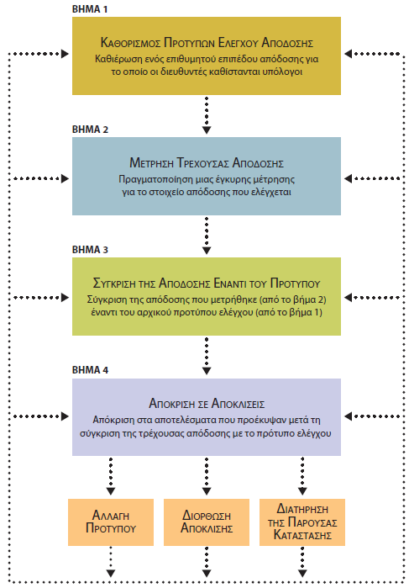
Δημιουργία Συστημάτων Διεθνούς Ελέγχου
Notes:
As illustrated in Figure 14.8, control systems in international business are established through four basic steps: (1) set control standards for performance, (2) measure actual performance, (3) compare performance against standards, and (4) respond to deviations. There obviously will be differences in specificity, time frame, and sophistication, but these steps are applicable to any area and any level of control.
The first step is to define relevant control standards. A control standard is a target, or a desired level of the performance component the firm is attempting to control. These standards must be objective and consistent with the firm’s goals.
The second step is to develop a valid measure of the performance component being controlled. Some elements of performance (such as unit sales or actual output) are relatively easy to measure. Other elements are more difficult to measure, such as the effectiveness of an advertising campaign to improve a firm’s public image.
The third step in establishing an international control system is to compare measured performance against the original control standards. Again, when control standards and elements of performance are straightforward, this comparison is easy. When control standards and performance measures are less concrete, comparing one against the other is considerably more complicated.
The fourth and final step in establishing an international control system is responding to deviations observed in step 3. One of three different outcomes can result when comparing a control standard and actual performance: the control standard has been met, it has not been met, or it has been exceeded. Depending on the circumstances, managers could change the standard, correct the deviation, or maintain the status quo.

Slide 26
Βασικές Τεχνικές Ελέγχου
Λογιστικά συστήματα
Πολιτικές, διαδικασίες, κανόνες και κανονισμοί
Συντελεστές απόδοσης
Notes:
Because of the complexities of both the international environment and international firms themselves, those firms rely on a wide variety of different control techniques.
Accounting is a comprehensive system for collecting, analyzing, and communicating data about a firm’s financial resources. International businesses must develop accounting systems to control and monitor the performance of the overall firm and each division, operating unit, or subsidiary.
Policies, standard operating procedures, rules, and regulations all help managers carry out the control function.
International firms also use performance ratios to maintain control. A performance ratio is a numerical index of performance that the firm wants to maintain. A common performance ratio is inventory turnover.

Slide 27
Συμπεριφορικές Πτυχές του Διεθνούς Ελέγχου
Αντίσταση στον έλεγχο
Αντίδραση στον υπερβολικό έλεγχο
Ακατάλληλο σημείο εστίασης
Αυξημένη υποχρέωση λογοδοσίας
Κάμψη της αντίστασης στον έλεγχο
Συμμετοχή
Υποχρέωση λογοδοσίας
Διαγνωστικός μηχανισμός
Κουλτούρα
Notes:
Regardless of how well formulated and implemented a control system may be, managers must understand that human behavior plays a fundamental role in how well control works. Essential to this understanding is being aware that some people resist control. Also essential is recognizing that resistance can be minimized. Although resistance to control is likely to exist within most cultures, its magnitude will vary across cultures.
People in international firms may resist control for various reasons. One potential reason is over-control, whereby the firm tries to exert more control over individuals than they think is appropriate
People also may resist control because it may be inappropriately focused; that is, the firm may be trying to control the wrong things.
Finally, people may resist because control increases their accountability. It is important to strike a balance between appropriate and acceptable levels of accountability without edging over into over-control.
Although there are no guaranteed methods for eliminating resistance to control, there are ways to minimize it. The appropriate method, as well as its likely effectiveness, will vary by culture.
One effective way to overcome resistance to control is to promote participation. Involving employees will enable them to better understand the goal of the control system, how the system works, and how their jobs fit into the system. If the control system provides an appropriate level of accountability without over-controlling, then workers will be less likely to resist it. A firm also may overcome resistance to control by providing a diagnostic mechanism for addressing unacceptable deviations.
Behavioral aspects of control can be approached and managed from a cultural perspective. Being careful to hire people with values, experiences, and work habits that are consistent with the firm’s culture can go a long way toward minimizing resistance to control.

Slide 28
Ερωτήσεις Ανασκόπησης
Ποιες είναι μερικές από τις αρχικές επιπτώσεις που επιφέρει η διεθνής δραστηριότητα στον οργανωσιακό σχεδιασμό;
Τι είναι ο παγκόσμιος σχεδιασμός βάσει προϊόντων; Ποια είναι τα δυνατά και αδύναμα σημεία του;
Τι είναι ο παγκόσμιος σχεδιασμός βάσει περιοχών; Ποια είναι τα δυνατά και αδύναμα σημεία του;
Τι είναι ο παγκόσμιος σχεδιασμός βάσει λειτουργιών; Ποια είναι τα δυνατά και αδύναμα σημεία του;
Τι είναι ο παγκόσμιος σχεδιασμός βάσει πελατών; Ποια είναι τα δυνατά και αδύναμα σημεία του;

Slide 29
Ερωτήσεις Ανασκόπησης
Τι είναι ο παγκόσμιος σχεδιασμός τύπου μήτρας; Ποια είναι τα δυνατά και αδύναμα σημεία του;
Ποια είναι τα τρία επίπεδα ελέγχου στις διεθνείς επιχειρήσεις;
Γιατί ο χρηματοοικονομικός έλεγχος είναι τόσο σημαντικός;
Ποια είναι τα τέσσερα βασικά βήματα για τη δημιουργία ενός συστήματος διεθνούς ελέγχου;

Slide 30
Σημείωση της αγγλικής έκδοσης των διαφανειών
Το παρόν έργο προστατεύεται από νόμους πνευματικών δικαιωμάτων των Ηνωμένων Πολιτειών και παρέχεται αποκλειστικά για χρήση από διδάσκοντες κατά τη διδασκαλία των μαθημάτων τους και την αξιολόγηση της εκμάθησης των φοιτητών. Η διάδοση ή πώληση οποιουδήποτε μέρους αυτού του έργου (συμπεριλαμβανομένης της δημοσίευσης στον Παγκόσμιο Ιστό) καταστρέφει την ακεραιότητα του έργου και δεν επιτρέπεται. Το περιεχόμενο του έργου δεν θα πρέπει ποτέ να διατίθεται στους φοιτητές, παρά μόνο στους διδάσκοντες που χρησιμοποιούν το συνοδευτικό κείμενο στα μαθήματά τους. Όλοι οι αποδέκτες αυτού του έργου αναμένεται να συμμορφώνονται με αυτούς τους περιορισμούς και να σέβονται τους προβλεπόμενους παιδαγωγικούς σκοπούς και τις ανάγκες των άλλων διδασκόντων που βασίζονται σε αυτήν την ύλη.
Αποκλειστικότητα για την ελληνική γλώσσα: ΕΚΔΟΣΕΙΣ ΤΖΙΟΛΑ

