Slide 1
The way we think about work is broken
Barry Schwartz, 2014

Slide 2
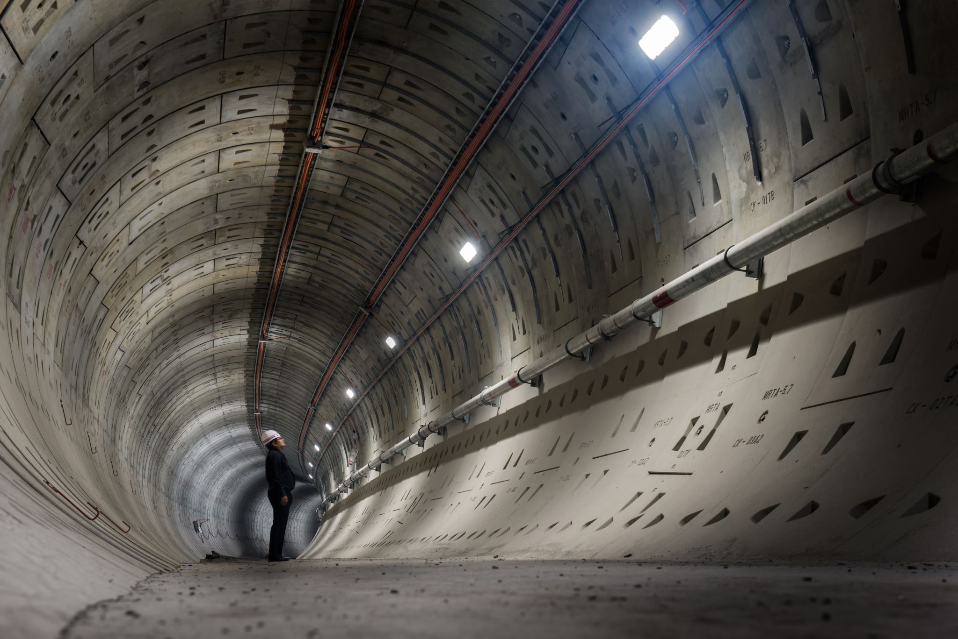
?

Slide 3
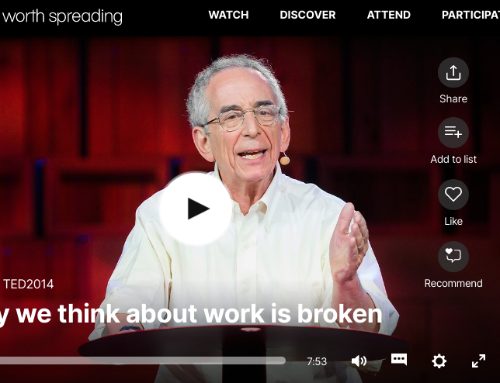
Watch the speech at
https://www.ted.com/talks/barry_schwartz_the_way_we_think_about_work_is_broken

Slide 4
Listen for the answers to these questions …
He asks and answers these questions. Write down the answers
Why do we work?
Why is it that as capitalism developed, it created a mode of production, of goods and services, in which all the nonmaterial satisfactions that might come from work were eliminated?

Slide 5
Theories about human nature
Write as many terms as you can related to these theories
Adam Smith
Clifford Geertz

Slide 6
Theories about human nature KEY
Adam Smith
Clifford Geertz
Factory system
Assembly line
Division of labour
Demeaning, soulless work
Becoming stupid
Humans: unfinished animals
Products of society
Created rather than discovered
Designed by institutions

Slide 7
Answer the questions
What two false ideas does he talk about?
Why are false ideas dangerous?

Slide 8
Sources of poverty
source
result

Slide 9
Sources of poverty KEY
source
Result/ Action
God
Your inadequacy
Oppression
Prayer
Feeling of despair
Revolution

Slide 10
What speech strategies are used in thE following?
Today I'm going to talk about work. And the question I want to ask and answer is this: "Why do we work?" Why do we drag ourselves out of bed every morning instead of living our lives just filled with bouncing from one TED-like adventure to another?
Why, if this is so obvious, why is it that for the overwhelming majority of people on the planet, the work they do has none of the characteristics that get us up and out of bed and off to the office every morning? How is it that we allow the majority of people on the planet to do work that is monotonous, meaningless and soul-deadening? Why is it that as capitalism developed, it created a mode of production, of goods and services, in which all the nonmaterial satisfactions that might come from work were eliminated?

Slide 11
What speech strategies are used in thE following?
Today I'm going to talk about work. And the question I want to ask and answer is this: "Why do we work?" Why do we drag ourselves out of bed every morning instead of living our lives just filled with bouncing from one TED-like adventure to another? (signposting-questions encouraging thought-parallelism-common ground)
Why, if this is so obvious, why is it that for the overwhelming majority of people on the planet, the work they do has none of the characteristics that get us up and out of bed and off to the office every morning? How is it that we allow the majority of people on the planet to do work that is monotonous, meaningless and soul-deadening? Why is it that as capitalism developed, it created a mode of production, of goods and services, in which all the nonmaterial satisfactions that might come from work were eliminated? (questions-parallelism-vivid examples: affective language)

Slide 12
What speech strategies are used in thE following?
If you think your poverty is God's will, you pray. If you think your poverty is the result of your own inadequacy, you shrink into despair. And if you think your poverty is the result of oppression and domination, then you rise up in revolt.
"He generally becomes as stupid as it is possible for a human being to become." Now, notice the word here is "become." "He generally becomes as stupid as it is possible for a human being to become."
Conclusion: And so you people -- pretty much the closest I ever get to being with masters of the universe -- you people should be asking yourself a question, as you go back home to run your organizations. Just what kind of human nature do you want to help design?

Slide 13
What speech strategies are used in thE following?
If you think your poverty is God's will, you pray. If you think your poverty is the result of your own inadequacy, you shrink into despair. And if you think your poverty is the result of oppression and domination, then you rise up in revolt. (parallelism, key word intentional repetition-direct address)
"He generally becomes as stupid as it is possible for a human being to become." Now, notice the word here is "become." "He generally becomes as stupid as it is possible for a human being to become." (intentional repetition of key words-direct address)
And so you people -- pretty much the closest I ever get to being with masters of the universe -- you people should be asking yourself a question, as you go back home to run your organizations. Just what kind of human nature do you want to help design? (direct address-question: challenge to think/reconsider)

Slide 14
Contrasts: adjectives related to work
positive
Negative

Slide 15
contrasts: adjectives related to work KEY
positive
Negative
challenging
engaging
stimulating
meaningful
important
monotonous
meaningless
soul-deadening
demeaning
soulless

Slide 16
What is the purpose of the speaker?

Slide 17
Critical thinking
What is the main message /core argument of this speech?
In what way is it similar/different to Harrari’s “What explains the rise of humans”

Slide 18
In what ways human nature appears to be ‘designed’ today?
Relevance to today’s world?

