Slide 1
Διεθνείς Επιχειρήσεις και Επιχειρηματικότητα 8^{η} Έκδοση
ΚΕΦΑΛΑΙΟ 13
Διεθνείς Στρατηγικές
Συμμαχίες
Griffin & Pustay

Slide 2
Μαθησιακοί Στόχοι
Να συγκρίνετε τις κοινοπραξίες με άλλες μορφές στρατηγικών συμμαχιών.
Να προσδιορίσετε τα οφέλη των στρατηγικών συμμαχιών.
Να περιγράψετε το πεδίο εφαρμογής των στρατηγικών συμμαχιών.
Να συζητήσετε σχετικά με τις μορφές διοίκησης που χρησιμοποιούνται στις στρατηγικές συμμαχίες.
Να προσδιορίσετε τους περιορισμούς των στρατηγικών συμμαχιών.

Slide 3
Διεθνής Εταιρική Συνεργασία
Στρατηγικές συμμαχίες
Αμοιβαία αδειοδότηση αποκλειστικής τεχνολογίας
Κοινή χρήση εγκαταστάσεων παραγωγής
Συγχρηματοδότηση ερευνητικών προγραμμάτων
Προώθηση των προϊόντων της μίας επιχείρησης στην άλλη με τα υφιστάμενα δίκτυα διανομής
Κοινοπραξία
Από κοινού ανάληψη διοικητικών καθηκόντων
Ανάληψη ευθύνης από μία εταιρεία
Πρόσληψη ανεξάρτητων διευθυντών
Notes:
Cooperation between international firms can take many forms, such as cross-licensing of proprietary technology, sharing of production facilities, co-funding of research projects, and marketing of each other’s products using existing distribution networks. Such forms of cooperation are known collectively as strategic alliances, business arrangements whereby two or more firms choose to cooperate for their mutual benefit. The partners in a strategic alliance may agree to pool R&D activities, marketing expertise, or managerial talent.
A joint venture (JV) is a special type of strategic alliance in which two or more firms join together to create a new business entity that is legally separate and distinct from its parents. Joint ventures are normally established as corporations and are owned by the founding parents in whatever proportions they negotiate. Although unequal ownership is common, many are owned equally by the founding firms. Each participant in a strategic alliance is motivated to promote its own self-interest, but each one has determined that cooperation is the best way to achieve its goals.
A joint venture, as a separate legal entity, must have its own set of managers and board of directors. It may be managed in one of three ways.
The founding firms may jointly share management, with each appointing key personnel who report back to officers of the parent.
One parent may assume primary responsibility.
An independent team of managers may be hired to run it. The third approach is often preferred, because independent managers focus on what is best for the joint venture rather than attempting to placate bosses from the founding firms.

Slide 4
Διεθνής Εταιρική Συνεργασία
Στρατηγική συμμαχία | Σκοπός | Πεδίο εφαρμογής | Διάρκεια
Κοινοπραξίες | Ευρύτερος | Ευρύτερο | Μεγαλύτερη
Μη κοινοπραξίες | Περιορισμένος | Περιορισμένο | Μικρότερη
Notes:
A formal management organization allows a joint venture to be broader in purpose, scope, and duration than other types of strategic alliances. In contrast, a non–joint venture strategic alliance may be formed merely to allow the partners to overcome a particular hurdle that each faces in the short run. A joint venture will be more helpful if the two firms plan a more extensive and long-term relationship. A typical non–joint venture strategic alliance has a narrow purpose and scope. Because of their narrow mission and lack of a formal organizational structure, non–joint ventures are relatively less stable than joint ventures.

Slide 5
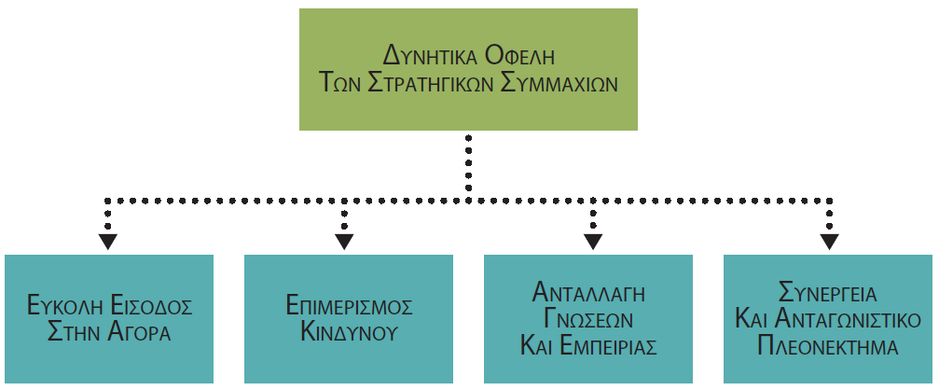
Οφέλη των Στρατηγικών Συμμαχιών
Notes:
As summarized in Figure 13.1, international business may realize four benefits from strategic alliances: ease of market entry, shared risk, shared knowledge and expertise, and synergy and competitive advantage.

Slide 6
Εύκολη Είσοδος στην Αγορά
Αντιμετώπιση εδραιωμένου ανταγωνισμού
Αντιμετώπιση κυβερνητικών κανονισμών
Επίτευξη οικονομιών κλίμακας και φάσματος
Διαχείριση του κόστους της επιχειρηματικής δραστηριοποίησης
Notes:
A firm wishing to enter a new market often faces major obstacles, such as entrenched competition or hostile government regulations. Partnering with a local firm can often help it navigate around such barriers. In other cases, economies of scale and scope in marketing and distribution confer benefits on firms that aggressively and quickly enter numerous markets. Yet the costs of speed and boldness are often high and beyond the capabilities of a single firm. A strategic alliance may allow the firm to achieve the benefits of rapid entry, while keeping costs down.

Slide 7
Επιμερισμός Κινδύνου
Νέα αγορά / νέο προϊόν
Στρατηγικές συμμαχίες
Μείωση/έλεγχος κινδύνων
Notes:
Today’s major industries are so competitive that no firm has a guarantee of success when it enters a new market or develops a new product. Strategic alliances can be used to either reduce or control individual firms’ risks. Shared risk is an especially important consideration when a firm is entering a market that has just opened up or that is characterized by uncertainty and instability.

Slide 8
Ανταλλαγή Γνώσεων και Εμπειρίας
Στρατηγικές συμμαχίες
Απόκτηση γνώσεων και εμπειρίας
Notes:
Still another common reason for strategic alliances is the potential for the firm to gain knowledge and expertise that it lacks. A firm may want to learn more about how to produce a product or service, acquire certain resources, deal with local governments’ regulations, or manage in a different environment. A business partner can often provide such information.

Slide 9
Συνέργεια και Ανταγωνιστικό Πλεονέκτημα
Είσοδος σε αγορά
Μείωση κινδύνων
Δυνατότητα μάθησης
Notes:
Firms may also enter into strategic alliances in order to attain synergy and competitive advantage. These related advantages reflect combinations of the other advantages discussed in this section. The idea is that through some combination of market entry, risk sharing, and learning potential, each collaborating firm will be able to achieve more than if it had attempted to enter a new market or industry alone.

Slide 10
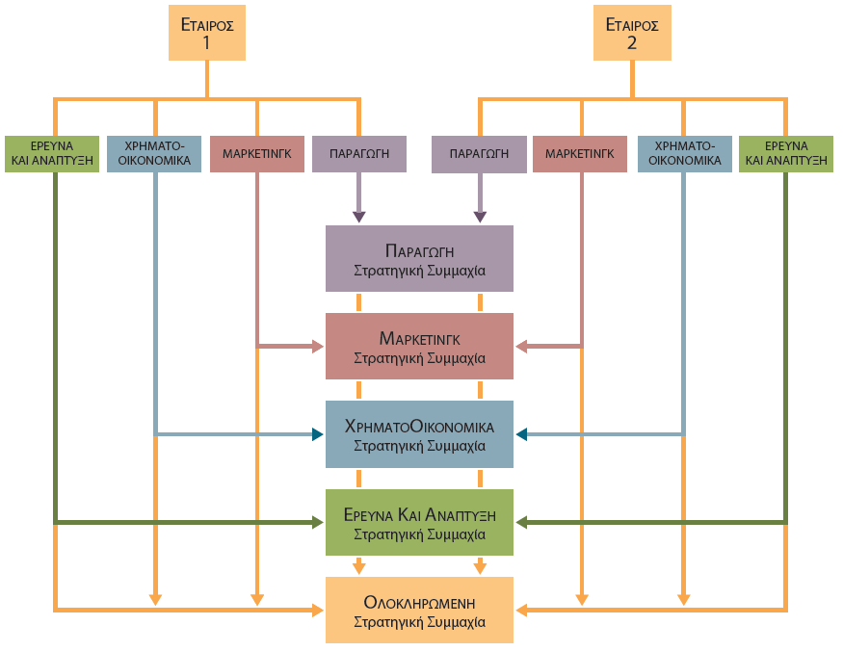
Πεδίο Εφαρμογής των Στρατηγικών Συμμαχιών
Notes:
The scope of cooperation among firms may vary significantly, as Figure 13.2 illustrates. For example, it may consist of a comprehensive alliance, in which the partners participate in all facets of conducting business, ranging from product design to manufacturing to marketing. Or it may consist of a more narrowly defined alliance that focuses on only one element of the business, such as R&D. The degree of collaboration will depend on the basic goals of each partner.

Slide 11
Ολοκληρωμένες Συμμαχίες
Έρευνα και ανάπτυξη
Σχεδιασμός
Παραγωγή
Μάρκετινγκ
Διανομή
Ολοκληρωμένες συμμαχίες
Notes:
Comprehensive alliances arise when the participating firms work together to perform multiple stages of the process by which goods or services are brought to the market.
Because of the broad scope of comprehensive alliances, the firms must establish procedures for meshing functional areas as finance, production, and marketing for the alliance to succeed. As a result, most comprehensive alliances are organized as joint ventures.
As an independent entity, the joint venture can adopt operating procedures that suit its specific needs, rather than attempting to accommodate the procedures of the parents, as might be the case with another type of strategic alliance. Moreover, by fully integrating their efforts, participating firms in a comprehensive alliance are able to achieve greater synergy through sheer size and total resources.

Slide 12
Συμμαχίες Περιορισμένου Εύρους
Συμμαχίες παραγωγής
Συμμαχίες μάρκετινγκ
Οικονομικές συμμαχίες
Συμμαχίες έρευνας και ανάπτυξης
Notes:
Strategic alliances may also be narrow in scope, involving only a single functional area of the business. In such cases, integrating the needs of the parent firms is less complex. For this reason, functionally based alliances often do not take the form of a joint venture. Types of functional alliances include production alliances, marketing alliances, financial alliances, and R&D alliances.
In a production alliance, two or more firms manufacture products or provide services in a shared or common facility. A production alliance may utilize a facility one partner already owns.
A marketing alliance is a functional alliance in which two or more firms share marketing services or expertise. In most cases, one partner introduces its products or services into a market in which the other partner already has a presence. The established firm helps the newcomer by promoting, advertising, or distributing its products or services. The established firm may negotiate a fixed price for its assistance, or it may share in a percentage of the newcomer’s sales or profits. As an alternative, the firms may agree to market each others’ products on a reciprocal basis. No matter what the arrangements of a marketing alliance may be, all partners must ensure that their expectations and needs are mutually understood.
A financial alliance is formed by firms that want to reduce financial risks associated with a project. Partners may share equally in contributing financial resources to the project. On the other hand, one partner may contribute the bulk of the financing, while special expertise or other contributions are provided by its partner (or partners) in lieu of financial investments.
In an R&D alliance, the partners agree to undertake joint research to develop new products or services. Such alliances are usually not formed as joint ventures, since scientific knowledge can be transmitted through private research conferences, exchange of scientific papers, and laboratory visits. Instead, each partner may simply agree to cross-license whatever new technology is developed in its labs. That way, each partner will have equal access to all technology developed by the alliance, an arrangement that guarantees none of the partners will fall behind in the technological race. In addition, partners are freed from legal disputes among themselves over ownership and validity of patents. Because of the importance of high-tech industries to the world economy, many countries are supporting the efforts of R&D consortia as part of their industrial policies. An R&D consortium is a confederation of organizations that band together to research and develop new products and processes for world markets. It represents a special case of strategic alliance, in that governmental support plays a major role in its formation and continued operation.

Slide 13
Δημιουργία Στρατηγικών Συμμαχιών
Επιλογή εταίρων
Ιδιοκτησιακό καθεστώς
Ζητήματα κοινής διοίκησης
Notes:
The decision to form a strategic alliance should develop from the firm’s strategic planning process. Having made this decision, managers must then address several significant issues, which set the stage for how the arrangement will be managed. Some of the most critical issues are the selection of partners, the form of ownership, and joint management considerations.

Slide 14
Επιλογή Εταίρων
Συμβατότητα μεταξύ των εταίρων
Φύση προϊόντων και υπηρεσιών
Σχετική ασφάλεια της συμμαχίας
Προοπτική μάθησης μέσα από τη συμμαχία
Notes:
Research suggests that strategic alliances are more likely to be successful if the skills and resources of the partners are complementary—each must bring to the alliance some organizational strength the other lacks. In addition, a firm should select a compatible partner that it can trust and with whom it can work effectively.
Another factor to consider is the nature of a potential partner’s products or services. A firm should ally itself with a partner whose products or services are complementary to (but not directly competitive with) its own.
Managers should gather as much information as possible about a potential partner before entering into a strategic alliance. For example, managers should assess the success or failure of previous strategic alliances formed by the potential partner. Also, it often makes sense to analyze the prospective deal from the other firm’s side. The probability of success will increase if the alliance makes good business sense for both parties.
Before establishing a strategic alliance, partners should also assess the potential to learn from each other. At the same time, each partner should protect proprietary information and not offer information that will result in competitive disadvantages for itself, should the alliance dissolve.

Slide 15
Ιδιοκτησιακό Καθεστώς
Ανώνυμη εταιρεία
Ετερόρρυθμη εταιρεία
Notes:
Another issue in establishing a strategic alliance is the exact form of ownership that is to be used. A joint venture almost always takes the form of a corporation, usually incorporated in the country in which it will be doing business. The corporate form enables the partners to arrange a beneficial tax structure, implement novel ownership arrangements, and protect their other assets. This form also allows the joint venture to create its own identity apart from those of the partners. Of course, if either or both of the partners have favorable reputations, the new corporation may choose to rely on them, perhaps by including the partners’ names as part of its name.
In isolated cases, incorporating a joint venture may not be possible or desirable. In such cases, the partners usually operate under a limited partnership. In a limited partnership, the managing partner assumes full financial responsibility for the venture, regardless of the amount of its own investment. The liability of other partners is limited to the amount of their investments. Obviously, such arrangements are riskier for the managing partner.

Slide 16
Ιδιοκτησιακό Καθεστώς: Σύμπραξη Δημόσιου και Ιδιωτικού Τομέα
ευκαιριεσ
προκλησεισ
Νέα αγορά
Κυβερνητική υποστήριξη
Μειωμένος ανταγωνισμός
Χαμένη επένδυση
Κατάσχεση περιουσιακών στοιχείων
Διακοπή λειτουργίας
Notes:
Another form of joint venture is a public-private venture. This arrangement involves a partnership between a privately owned firm and a government entity. When the government of a country controls a resource, it may enlist the assistance of a firm with expertise related to that resource. Similarly, a firm may pursue a public-private venture if a particular country does not allow wholly-owned foreign operations. Such arrangements are typical in the oil industry.
In assessing such a venture, a firm should consider the political and legal environment it will be facing. Foremost is the stability of the government. If the existing government is replaced with another, the firm may face serious challenges. At best, the venture will be considered less important by the new government. At worst, the firm’s investment may be wiped out, its assets seized, and its operation shut down.
However, if the local government is relatively stable, public-private ventures can be quite beneficial. The government may act benignly and allow the firm to run the joint venture. It may also use its position to protect its own investment (and its partner) by restricting competing business activity.

Slide 17
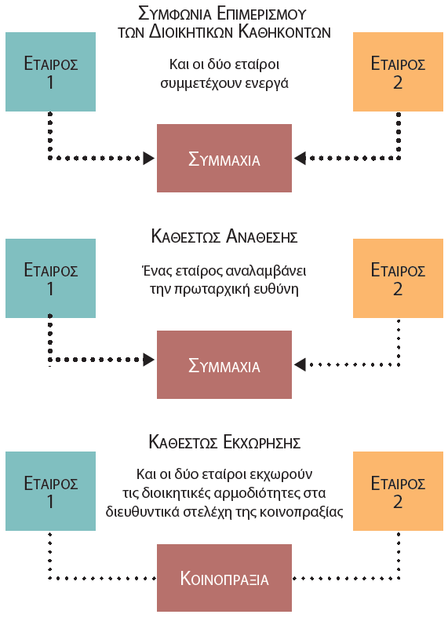
Ζητήματα Κοινής Διοίκησης
Notes:
Further issues and questions are associated with how a strategic alliance will be managed. Three standard approaches are often used to jointly manage a strategic alliance (see Figure 13.3): shared management agreements, assigned arrangements, and delegated arrangements.
Under a shared management agreement, each partner fully and actively participates in managing the alliance. The partners run the alliance, and their managers regularly pass on instructions and details to the alliance’s managers. The alliance’s managers have limited authority of their own and must defer most decisions to managers from the parent firms. This type of agreement requires a high level of coordination and near-perfect agreement between the participating partners. As such, it is the most difficult to maintain and the one most prone to conflict among the partners.
Under an assigned arrangement, one partner assumes primary responsibility for the operations of the strategic alliance. Management of the alliance is greatly simplified because the dominant partner has the power to set its own agenda for the new unit, break ties among decision makers, and even overrule its partner(s). Of course, these actions may create conflict, but they keep the alliance from becoming paralyzed, which may happen if equal partners cannot agree on a decision.
Under a delegated arrangement, which is reserved for joint ventures, the partners agree not to get involved in ongoing operations. Instead, the partners delegate management control to the executives of the joint venture itself. These executives may be hired to run the new operation or may be transferred from the participating firms. They are responsible for making day-to-day decisions, managing the venture, and implementing its strategy. Because they have the power and autonomy needed to make significant decisions, these executives are much less accountable to managers in the partners’ firms.

Slide 18
Τα Προβλήματα των Στρατηγικών Συμμαχιών
Notes:
Regardless of the care and deliberation a firm puts into constructing a strategic alliance, it still must consider limitations and pitfalls. Figure 13.4 summarizes five fundamental sources of problems that often threaten the viability of strategic alliances: incompatibility of partners, access to information, conflicts over distributing earnings, loss of autonomy, and changing circumstances.
Incompatibility among the partners of a strategic alliance is a primary cause of the failure of such arrangements. At times, incompatibility can lead to outright conflict, although typically it merely leads to poor performance of the alliance.
Limited access to information is another issue. For a collaboration to work effectively, one partner (or both) may have to provide the other with information it would prefer to keep secret. Each firm may have to be forthcoming with the information or else compromise the effectiveness of the collaboration.
An obvious limitation of strategic alliances relates to the distribution of earnings. Because the partners share risks and costs, they also share profits. The partners must agree on the ratio of earnings that will be distributed as opposed to being reinvested in the business. They must also agree on accounting procedures that will be used to calculate earnings or profits, and the way transfer pricing will be handled.
Another pitfall of a strategic alliance is the potential loss of autonomy. Just as firms share risks and profits, they also share control, thereby limiting what each can do.
Changing circumstances may also affect the viability of a strategic alliance. The economic conditions that motivated the cooperative arrangement may no longer exist, or technological advances may have rendered the agreement obsolete.

Slide 19
Ερωτήσεις Ανασκόπησης
Ποιες είναι οι βασικές διαφορές μιας κοινοπραξίας από άλλους τύπους στρατηγικών συμμαχιών;
Γιατί οι στρατηγικές συμμαχίες έχουν γίνει πιο δημοφιλείς τα τελευταία χρόνια;
Ποια είναι τα βασικά οφέλη που είναι πιθανόν να αποκομίσουν οι εταίροι από τη στρατηγική συμμαχία τους; Εξηγήστε εν συντομία το καθένα.
Ποια είναι τα βασικά χαρακτηριστικά μιας ολοκληρωμένης συμμαχίας; Ποια οργανωσιακή μορφή είναι πιθανόν να λαμβάνουν οι ολοκληρωμένες συμμαχίες;
Ποιοι είναι οι τέσσερις συνήθεις τύποι των συμμαχιών περιορισμένου εύρους; Εξηγήστε εν συντομία τον καθένα.

Slide 20
Ερωτήσεις Ανασκόπησης
Πώς ορίζεται μια σύμπραξη έρευνας και ανάπτυξης;
Ποιοι παράγοντες θα πρέπει να λαμβάνονται υπόψη κατά την επιλογή ενός εταίρου για μια στρατηγική συμμαχία;
Ποιοι είναι οι τρεις βασικοί τρόποι διοίκησης μιας στρατηγικής συμμαχίας;
Υπό ποιες συνθήκες θα μπορούσε να συσταθεί μια στρατηγική συμμαχία μεταξύ εταίρων του δημόσιου και του ιδιωτικού τομέα;
Ποιες είναι οι δυνητικές παγίδες των στρατηγικών συμμαχιών;

Slide 21
Σημείωση της αγγλικής έκδοσης των διαφανειών
Το παρόν έργο προστατεύεται από νόμους πνευματικών δικαιωμάτων των Ηνωμένων Πολιτειών και παρέχεται αποκλειστικά για χρήση από διδάσκοντες κατά τη διδασκαλία των μαθημάτων τους και την αξιολόγηση της εκμάθησης των φοιτητών. Η διάδοση ή πώληση οποιουδήποτε μέρους αυτού του έργου (συμπεριλαμβανομένης της δημοσίευσης στον Παγκόσμιο Ιστό) καταστρέφει την ακεραιότητα του έργου και δεν επιτρέπεται. Το περιεχόμενο του έργου δεν θα πρέπει ποτέ να διατίθεται στους φοιτητές, παρά μόνο στους διδάσκοντες που χρησιμοποιούν το συνοδευτικό κείμενο στα μαθήματά τους. Όλοι οι αποδέκτες αυτού του έργου αναμένεται να συμμορφώνονται με αυτούς τους περιορισμούς και να σέβονται τους προβλεπόμενους παιδαγωγικούς σκοπούς και τις ανάγκες των άλλων διδασκόντων που βασίζονται σε αυτήν την ύλη.
Αποκλειστικότητα για την ελληνική γλώσσα: ΕΚΔΟΣΕΙΣ ΤΖΙΟΛΑ

