Slide 1
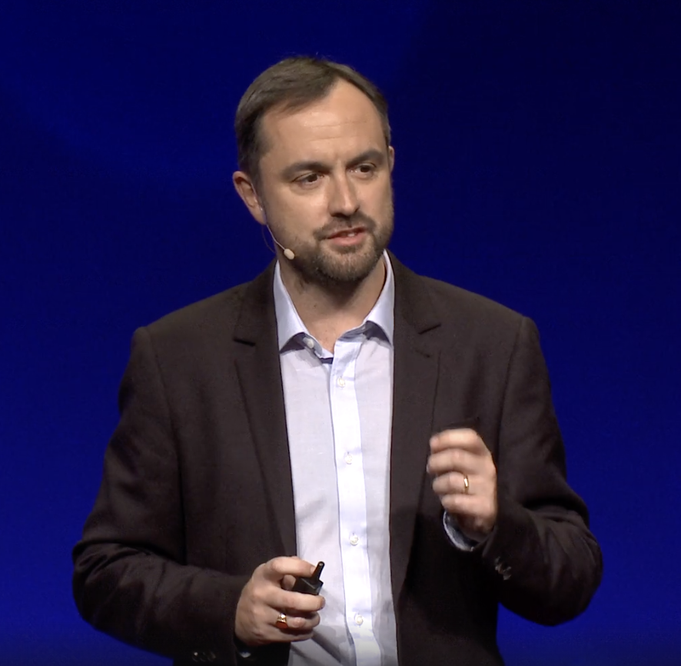
We need money for aid. Let’s print it.
Michael Metcalf

Slide 2
Core ideas
1. What is the speaker’s main proposition?
2. Explain the story about him and his daughter meeting a man collecting money for charity. What is the significance of that story?
3. What does the speaker say about the success of the Millennium Development Goals?
4. How did the central banks react to the financial crisis?
5. What is ‘Print Aid’ and how risky is it?
6. Why is now a good opportunity to implement the scheme?

Slide 3
Rhetorical strategies
1. How is attention drawn in the beginning of the speech?
2. To describe the (in)effectiveness of the millennium goals the speaker draws a metaphor with the auditorium. What is the metaphor and what is he trying to achieve through it?
3. The speaker frequently uses short sentences. What effect do they have on the audience?
4. Give some examples of strong contrast.
5. Give some examples of intentional repetition of words.
6. The speaker often repeats the questions ‘why not’. What is the significance of the phrase?
7. How does the speaker establish common ground?

Slide 4
Match the words with their definitions
1. unprecedented | A. To buy
2. To match | B. in a row, continuous
3. Purchase | C. To contribute money to a cause
4. Consecutive | D. Influence effect
5. To strive | E. Try hard, struggle
6. Overriding | F. easily affected
7. Vulnerable | G. To offer an amount equal/analogous to another person’s contribution
8. Impact | H. To accept sth although you may not want it
9. To settle for | I. Without anything like it having happened before
10. To fund | J. Most important

Slide 5
Match the words with their definitions
1. Unprecedented I | A. To buy
2. To match G | B. In a row, continuous
3. Purchase A | C. To contribute money to a cause
4. Consecutive B | D. Influence effect
5. To strive E | E. Try hard, struggle
6. Overriding J | F. Easily affected
7. Vulnerable F | G. To offer an amount equal/analogous to another person’s contribution
8. Impact D | H. To accept sth although you may not want it
9. To settle for H | I. Without anything like it having happened before
10. To fund C | J. Most important

Slide 6
Complete the missing derivative forms
VERB | NOUN | ADJECTIVE
To aspire | 1 | 2
To precede | 3 5 | 4
To think | 6 7 | 8
To coincide | 9 | 10
To invest | 11. 12.
To mandate | 13 | 14
To govern | 15 16 | 17

Slide 7
Complete the missing derivative forms
VERB | NOUN | ADJECTIVE
To aspire | 1 aspiration | 2 aspiring
To precede | 3 precedence 5precedent | 4preceding, unprecedented
To think | 6 thought 7thinker, thinking | 8 thoughtful, Unthinkable
To coincide | 9coincidence | 10coincidental
To invest | 11.investment 12.investor
To mandate | 13mandate | 14mandatory
To govern | 15government, governance 16governor | 17governmental

