Slide 1
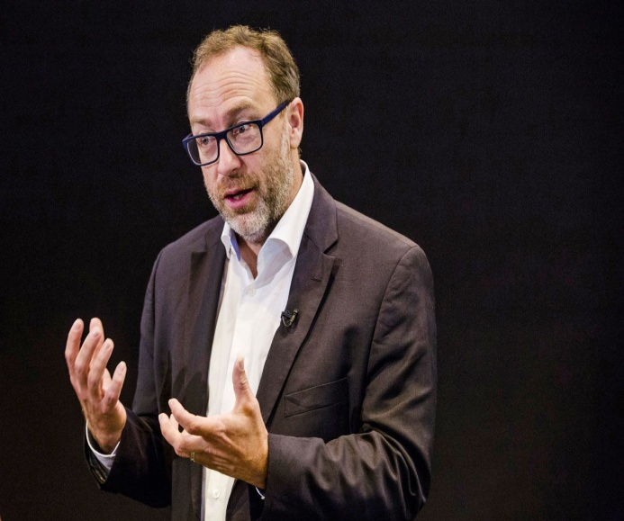
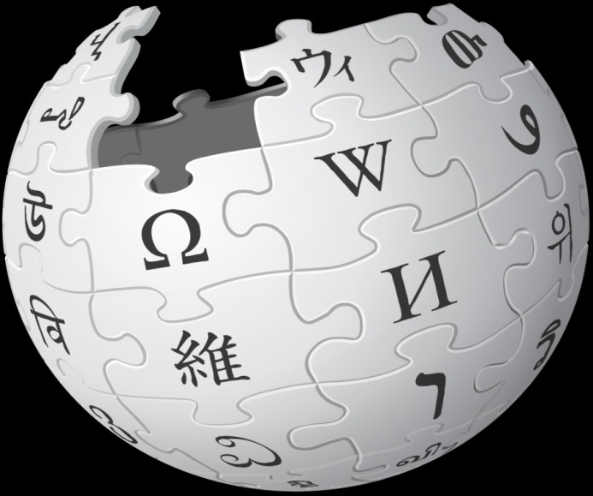
Wikipedia
Combining Reading and Video watching

Slide 2
Completing the following will help you identify the main ideas and those relevant to the task
Topic of the reading passage:
Wikipedia ( in particular) credibility of Wikipedia
The central idea of the reading passage (the writer’s point of view on Wikipedia):
Supporting arguments (main characteristics of Wikipedia):
Organization of the reading passage:
Par1:
Par2:
Pars3-4:
Pars5-7:

Slide 3
Topic of the reading passage :
Wikipedia ( in particular) credibility of Wikipedia
The central idea of the reading passage (the writer’s point of view on Wikipedia):
The writer defends Wikipedia against media criticism about it being inaccurate
Supporting arguments (main characteristics of Wikipedia):
+ members of the Wikipedia community are responsible citizens that will protect its reliability.
+ it is expandable and has greater popularity
Organization of the reading passage:
Par 1: Encarta is discontinued, beaten by Wikipedia
Par 2: What is tragedy of the commons
Par 3-4: Criticisms of Wikipedia
Par 5-7: Author’s point of view

Slide 4
Vocabulary practice
Match the words with their definitions
1. Discard | A. To increase in size, range, or amount
2. Inaccurate | B. A change to an opposite state, condition, decision
3. Expand | C. To feel or express sorrow or regret for
4. Lament | D. To get rid of, cast aside
5. Reversal | E. A share or a financial involvement in something such as a business
6. Spendthrift | F. Having a mistake, not accurate, not true
7. Awe | G. Fabricated, especially in order to deceive or mislead, untrue
8. Stake | H. partner, friend (slang)
9. Fictitious | I. a strong feeling of fear or respect and also wonder
10. Mate | J. a person who spends money in a careless or wasteful way

Slide 5
Vocabulary practice- KEY
1. Discard | D. To get rid of, cast aside
2. Inaccurate | F. Having a mistake, not accurate, not true
3. Expand | A. To increase in size, range, or amount
4. Lament | C. To feel or express sorrow or regret for
5. Reversal | B. A change to an opposite state, condition, decision
6. Spendthrift | J. a person who spends money in a careless or wasteful way
7. Awe | I. a strong feeling of fear or respect and also wonder
8. Stake | E. A share or a financial involvement in something such as a business
9. Fictitious | G. Fabricated, especially in order to deceive or mislead, untrue
10. Mate | H. partner, friend (slang)

Slide 6
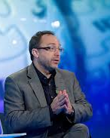
Video watching
Watch the video
https://www.ted.com/talks/jimmy_wales_the_birth_of_wikipedia

Slide 7
Completing the following will help you identify the main ideas & those relevant to the task
What is the topic of the video?
How Wikipedia works (its main principles including its credibility)
The central idea of the video (the writer’s point of view on Wikipedia):
Radical, ……
……………
Supporting arguments (main characteristics of Wikipedia):
Radical
Freely licensed
…..
…..

Slide 8
Completing the following will help you identify the main ideas & those relevant to the task
What is the topic of the video?
How Wikipedia works (its main principles including its credibility)
The central idea of the video (the writer’s point of view on Wikipedia):
Radical, freely licensed
of high quality, credible
Supporting arguments (main characteristics of Wikipedia):
Radical (flexible, not safe, written by many semi-professionals)
Freely licensed (many contributors, access to everyone, commercial & non-commercial redistribution)
Democratic (volunteering employees, donations, voting, neutrality policy)
of high quality (neutrality policy, credibility: administrators who monitor edits, experienced & admired passionate volunteers, Wales as benevolent dictator, tools & software, tests & comparisons)

Slide 9
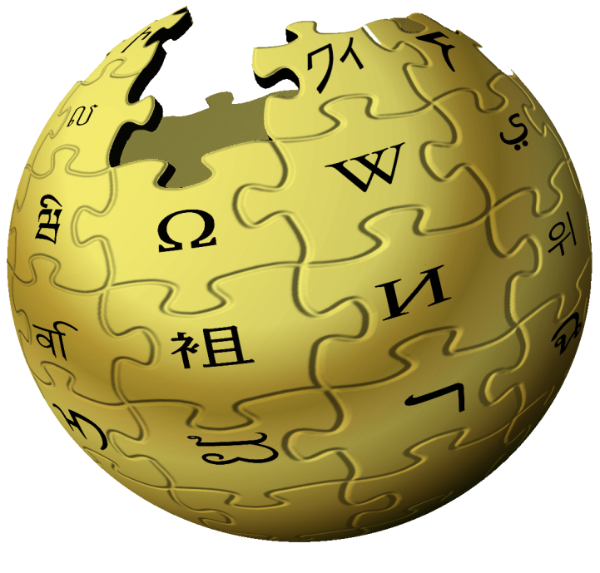
Synthesis task
Task: How does the speech relate to the reading passage in connection with the reliability of Wikipedia?
Complete the table with the main arguments of the two sources

Slide 10
The reliability of Wikipedia
Reading passage
Encarta was …………..
Members of the Wikipedia community are responsible citizens that will protect ………..
It is expandable and has greater popularity
It is …………..
Vulnerability to ………. is acknowledged
Video
The Wikipedia beat Encarta in quality tests
Arguments in favour of the Wikipedia reliability:
There is a ……………… policy to resolve issues of diversity (and most people understand the need for neutrality.
Problems with vandalism, ……….. are expected but the Wikipedia people deal with them There are administrators who …………….. all the edits & decide on what to …………. & fix
The core principle of the community is the social contract of cooperation & ……….. about the work.

Slide 11
The reliability of Wikipedia
Reading passage
Encarta was discontinued
Members of the Wikipedia community are responsible citizens that will protect its reliability.
It is expandable and has greater popularity
It is free
Vulnerability to vandalism is acknowledged
Video
The Wikipedia beat Encarta in quality tests
Vulnerability to vandalism acknowledged
Arguments in favour of the Wikipedia reliability:
There is a neutrality policy to resolve issues of diversity (and most people understand the need for neutrality.
Problems with vandalism, hoaxes & fraud are expected but the Wikipedia people deal with them. There are administrators who monitor & check all the edits & decide on what to delete & fix
The core principle of the community is the social contract of cooperation & passion about the work.

Slide 12
Practice synthesizing information in an oral presentation 1. Talk for about 15 secs about Wikipedia’s reliability using information from the two sources. 2. Talk for about 30 secs about the relation of the viewpoints of the two sources

Slide 13
What is the connection between the viewpoints of the reading passage and of the video?
The reading passage addresses media criticism regarding Wikipedia inaccuracies, defending it and arguing that it is one of the success stories of the public domain and volunteerism. All public property is susceptible to vandalism and so is the Wikipedia. Yet, members of the Wikipedia community are responsible citizens that will protect its reliability. Even with weaknesses, the Wikipedia has greater popularity for its expandability than any encyclopedia you have to pay for.
The speaker corroborates this view, saying that vandalism is indeed an issue for Wikipedia, but it is taken care of by means of specific software & experienced passionate administrators who check all the edits. In addition, an argument in favour of its reliability is the neutrality policy it has to deal with controversial topics and the diversity of opinions of its community.

Slide 14
Vocabulary practice
reputable, administrator, governance, conspiracy, bulk, hoax, monopoly, consensus, vandalism, verifiable
The ___ was discovered. Biron & Auvergne were arrested and Biron was executed.
To infer that climate change is a __ seems ridiculous to me.
Each report represents a __, or agreement among hundreds of leading scientists.
It’s a story about ___ and how local government can go wrong.
Many instances of __ are usually reported in times of social unrest.
Honest __ and good businessmen will have nothing to do with money laundering.
Since 1894 the government has had a ___ on retailing spirituous liquors, but distilling is left in private hands.
It is administered by an elective municipal council with a civil service ___ as mayor.
Don’t worry, the ___ of the work is finished.
It is important to work with objectively ___ measures of progress in world development.

Slide 15
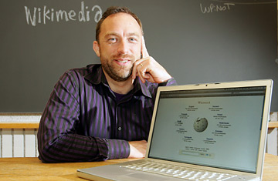
Talk about the following for one minute.
How often do you use Wikipedia and for what purposes?
How reliable and effective do you think it is in its role as an encyclopedia?

