Slide 1
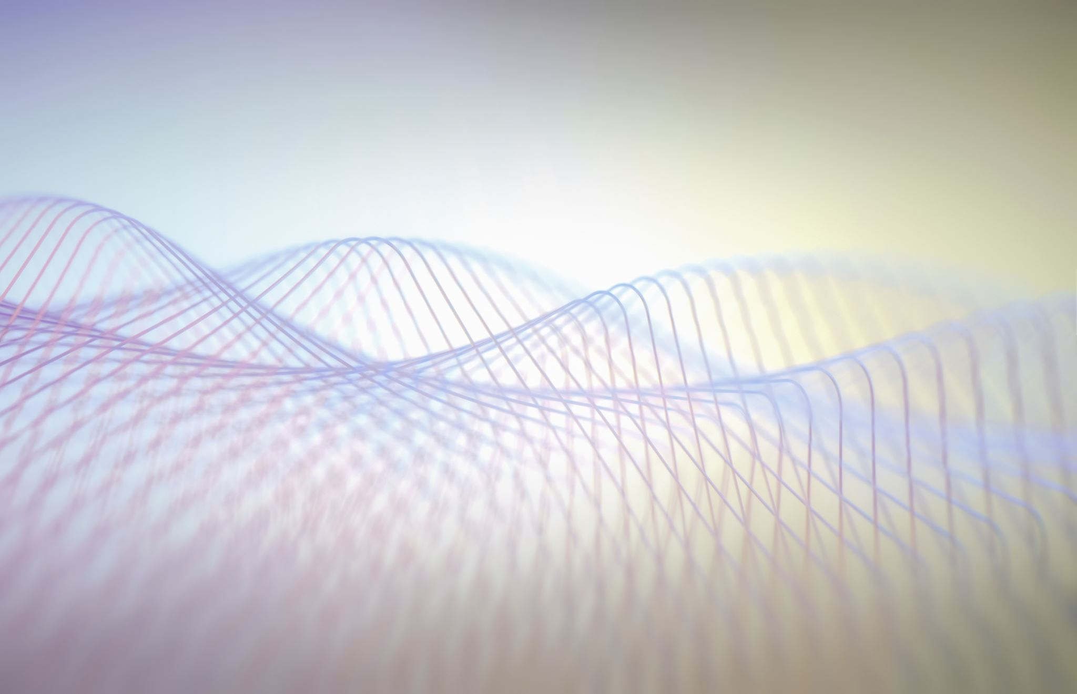
Who controls the world James Glattfelder
Watch the video on http://www.ted.com/talks/james_b_glattfelder_who_controls_the_world

Slide 2
Core ideas
1. What can physics explain and what can’t it explain?
2. What are complex systems and which approach helps better explain them?
3. How effective has this approach been in the study of the various fields (e.g., physics, biology, computer science, economics)?
4. Why are ownership networks important?
5. Why is interconnectivity risky?
6. Explain in our words, what the speaker did in his research study?
7. What did they find about how this network is organized?
8. What is the importance of saying “this extreme concentration of control is the result of self organization and not the result of a top-down approach like a global conspiracy”
9. What does he mean by saying “our study is an impression of the moon’s surface not a street map”?
10. What is left for future researchers to do?

Slide 3
Rhetorical strategies
1. What rhetorical techniques are used in the introduction?
2. How does he build credibility?
3. How does he help his listeners better understand what he says?
4. What rhetorical techniques are used in the conclusion?

Slide 4
Terminology practice
Terms | Meanings
1. Implications | A. Situation of very severe congestion/traffic
2. Accumulate | B. Hold, be true (for sb/sth)
3. Revenue | C. The owner of shares, stocks
4. Property | D. Characteristic, attribute
5. Apply | E. Description or portrayal of sb/sth, speaking on behalf of someone else
6. Representation | F. Allocate, give, appoint
7. Assign | G. Gradually gather or acquire (a resulting whole)
8. Shareholder | H. Profit gained in a particular period of time
9. Leverage | I. Indirect results, consequences
10. Gridlock | J. The degree to which an investor utilizes borrowed money

Slide 5
Derivatives
1. The ________ (dominate) parties are at the core of the network.
2. The _________ (imply) of interconnectivity for global economic ______ (stable) are serious.
3. Potential power, according to Max Weber, is the ______ (probable) of the ______ (impose) of one’s will despite the others’ ______ (oppose).
4. It is ______ (appear) that the laws of physics have _____ (limit).
5. Very few ______ (share) of TNCs hold a very high percent of TNCs’ value.
6. We hope for the ______ (emerge) of long-term well-funded research programs.
7. _______ (prominence) scientists have looked into the issue of global power.
8. The _____ (interact) parties are important but the rules and manner of their _____ (interact) is even more important.

