Slide 1
Forecasting Non-Seasonal Series
Chapter 3

Slide 2
Forecasting Non-Seasonal Series
3.1 Method or Model?
3.2 Extrapolative Methods
3.3 Simple Exponential Smoothing
3.4 Linear Exponential Smoothing
3.5 Exponential Smoothing with a Damped Trend
3.6 Other Approaches to Trend Forecasting
3.7 The Use of Transformations
3.8 Prediction Intervals
3.9 Method Selection
3.10 Principles of Extrapolative Methods

Slide 3
3.1 Method or Model?
A forecast function is an equation for calculating the forecasts over the forecast horizon.
A forecasting method is a (numerical) procedure for generating a forecast. It involves the direct use of a forecast function. When such methods are not based upon an underlying statistical model, they are termed heuristic.
e.g., $F_{t}=b_{0}+b_{1}t$
A statistical (forecasting) model is a statistical description of the data generating process. The forecasting function is then derived from the statistical model.
A statistical model is a necessary foundation for the construction of prediction intervals, e.g., $Y_{t}=β_{0}+β_{1}t+ε_{t}$
Plus assumptions about the distribution of the random error term.
The estimated model is used to generate the forecast function, along with the framework to make statements about model uncertainty.

Slide 4
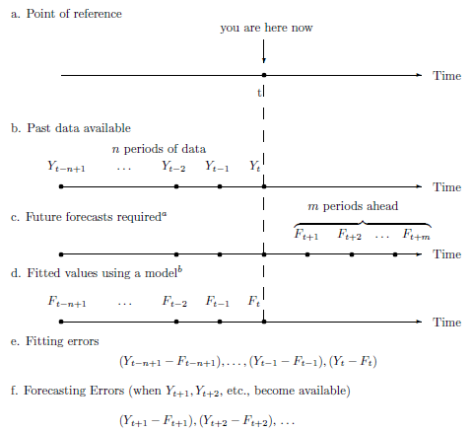
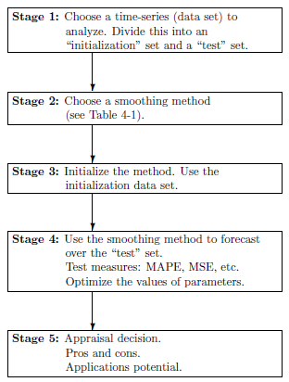
3.2 Extrapolative Methods

Slide 5
3.2 Extrapolative Methods
Figure 3.2 Plot of Actual Sales for Periods 1–12 and a Range of Possible Values for Periods 13–20

Slide 6
4.1 Components of a Time Series
A time series is said to have a seasonal component if it displays a recurrent pattern with a fixed and known duration (e.g. months of the year, days of the week).
A time series is said to have a cyclical component if it displays somewhat regular fluctuations about the trend but those fluctuations have a random periodicity albeit with a constant mean period length (e.g. a business cycle).
Define T = Trend + Cycle, S = Seasonal, E = Error
Additive model: Y = T + S + E
Multiplicative model: Y = TSE
Mixed additive-multiplicative model: Y = TS + E

Slide 7
4.1 Components of a Time Series
Figure 4.1 The Components of a Time Series

Slide 9
4.1 Components of a Time Series
A time series is said to have a cyclical component if it displays somewhat regular fluctuations about the trend. The series below has 20 peaks in 100 observations so the mean periodicity is about 5.

Slide 10
4.2 Forecasting Purely Seasonal Series
Monthly Temperatures in Boulder
Figure 4.2 Monthly Average Temperatures (In Degrees Fahrenheit) in Boulder, CO, 1991–2015

Slide 11
4.2 Forecasting Purely Seasonal Series
Plot of Seasonal Patterns for Boulder Data
Figure 4.3 Seasonal Plot of Average Temperatures (In Degrees Fahrenheit) in Boulder, CO (2012–2015, plotted against month, partitioned by year)

Slide 12
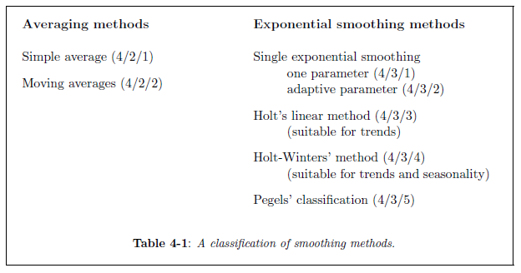

Slide 13
3.2 Extrapolative Methods
Locally Constant Forecasts
A series is locally constant if the mean level changes gradually over time but there is no reason to expect a systematic increase or decrease in the future. The forecast function is:
That is, the plot showing future forecasts is a horizontal line. When a new observation becomes available, the constant is updated.

Slide 14
3.2 Extrapolative Methods
Locally Constant Forecasts
Figure 3.4 Time Series Plot for Weekly Sales for WFJ for the First 26 Weeks, Compared with the Average

Slide 15
3.2 Extrapolative Methods
Use of Moving Averages
The moving average of order k evaluated at time t is denoted by:
At each point in time, we drop the oldest observation and add a new one.
Large values of k produce smoother plots but are slower to adapt to changes.

Slide 16
3.2 Extrapolative Methods
Calculation of Moving Averages
Table 3.2 Calculation of Moving Averages for WFJ Sales

Slide 17
3.2 Extrapolative Methods
Use of Moving Averages
Figure 3.5 WFJ Sales for First 26 Weeks, with Moving Averages of Lengths 3 and 7

Slide 18
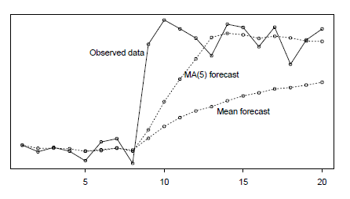
3.2 Extrapolative Methods

Slide 19
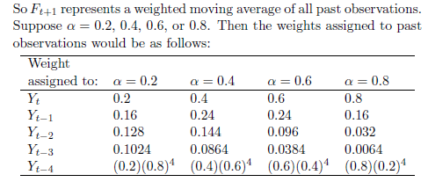
3.3 Simple Exponential Smoothing (SES)
Simple (or Single) Exponential Smoothing follows the same general idea but makes a smooth transition from one period to the next.
We select a smoothing constant α, such that 0<α<1 making for a partial adjustment.

Slide 20
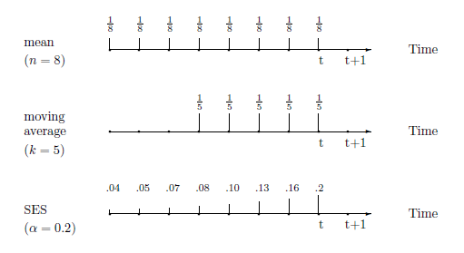
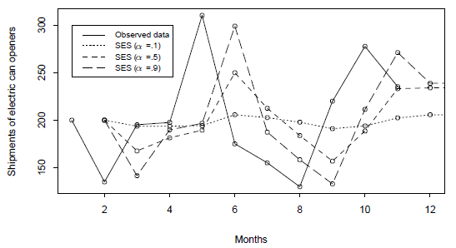
3.3 Simple Exponential Smoothing (SES)

Slide 21
3.3 Simple Exponential Smoothing
Exponential Smoothing Macro – An Example
Figure 3.7 SES Forecasts for WFJ Sales: The Effects of Different Smoothing Constants

Slide 22
3.3 Simple Exponential Smoothing – Example
Table 3.5 Summary Error Measures for One-Step-Ahead Forecasts of WFJ Sales Data (Hold-out sample, weeks 27–62)

Slide 23
3.4 Holt’s Linear Exponential Smoothing (Double)
When a time series has a long-term trend (e.g. increases in GDP or sales) the forecasting method must accommodate such features. There are two main approaches:
Convert the series to rates of change (growth rates, either absolute or percentage) then predict the rate of change, OR
Develop forecasting methods that account for trends.
The method that accounts for trends directly is known as Linear Exponential Smoothing (LES) or as Holt’s Method.

Slide 24
3.4 Holt’s Linear Exponential Smoothing (Double)
Netflix Example
Figure 3.11 Netflix Revenues and One-Step-Ahead Forecasts for Observations 53–64 from (A) Single Exponential Smoothing and (B) Linear Exponential Smoothing
When there is a trend, single exponential smoothing lags behind the data.

Slide 25
3.5 Exponential Smoothing with a Damped Trend
Choice of Method: Possible Trend Patterns
Figure 3.12 Possible Trend Patterns Showing Trend/No Trend and Additive/Multiplicative Trend

Slide 26
4.5 The Census X-13 Decomposition
Step 1: The time series is first adjusted to take into account any anomalous observations
create an initial time series model. Anomalous observations can then be identified and appropriate adjustments made to the data.
Step 2: The multiplicative (or additive) version of seasonal adjustment is applied to the series
preliminary seasonal factors are estimated by taking a moving average
Step 3: An initial set of seasonal adjustments
applied as in Table 4.4, but using more complex moving averages
Step 4: The series is extended (using ARIMA) so that moving averages can be computed for each time period up to the end of the series, using the seasonally adjusted data.
resulting in a revised estimate of the trend and seasonal factors
Step 5: A final round of detrending is applied, and the error term is then estimated by dividing the observation by the trend and seasonal factors, to complete the decomposition.

Slide 27
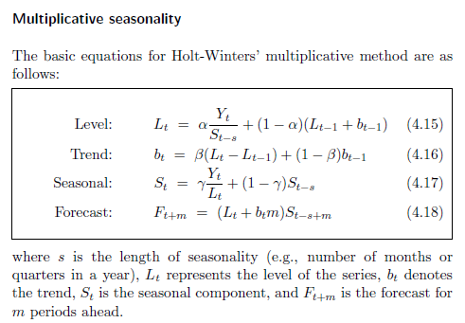
4.6 The Holt-Winters Seasonal Smoothing Methods

Slide 28
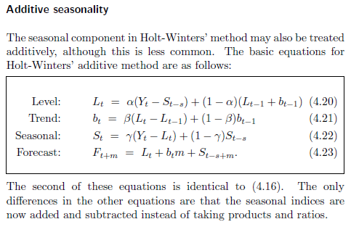
4.6 The Holt-Winters Seasonal Smoothing Methods

Slide 29
4.10 Prediction Intervals
As before, we can define a prediction interval using the normal distribution as:
Table 4.10 One-Step-Ahead Prediction Intervals for Quarterly Autos_index for 2015 [$α$ = 0.93, $γ$ = 0.26]

