Slide 1
BUSINESS ECONOMICS The Theory of the Firm
Professor Christos Nikas
Business Economics

Slide 2
The Costs of Production
The Theory of the Firm
Before anyone can consume to satisfy wants and needs, goods and services must be produced.
Producers are profit-seeking, so they aim to produce a salable product at the lowest cost of resources used.
Many times this means producing overseas.
However, costs are not the only consideration.
Productivity is also important.
Paying $10 an hour to typist A who types 90 words a minute is a lot cheaper than paying $2 an hour to typist B who types 10 words a minute.
Business Economics
Notes:
It might be useful to really stress that production must precede consumption, that producers are not “our enemies.”

Slide 3
The Production Function
The Theory of the Firm
Production function: a technological relation-ship expressing the maximum quantity of a good attainable from different combinations of factor inputs.
In other words, how much can we produce with the land, labor, and capital available?
We will consider the land to be a fixed amount. So we can vary only the labor and the capital.
In order for labor to produce, it needs land and capital. With neither, production is zero.
With fixed land and capital, adding more labor will increase production.
Business Economics
Notes:
Right away, we introduce the decisions a firm has to make: What mix of resources will I use? How much of each?
What happens if I increase one resource but not the other?

Slide 4
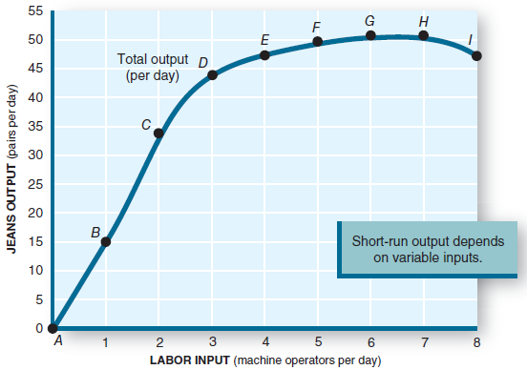
The Production Function
The Theory of the Firm
The productivity of any factor of production (e.g., labor) depends on the amount of other resources (e.g., capital) available to it.
Business Economics
Notes:
Point out diminishing marginal returns setting in as more workers are added to the fixed amount of capital.

Slide 5
The Production Function
The Theory of the Firm
Note that when capital is fixed, as labor increases, output increases but ultimately at a slower rate. Ultimately output maxes out and begins to decline.
The measure of this added output as labor increases is marginal physical product (MPP).
Business Economics
Notes:
It might be useful to point out the parallel between MPP and MU.
“Anytime you put a variable amount of something into a fixed-size facility, diminishing returns occur.”
Pizza into a fixed-size stomach; workers into a fixed-size workplace.

Slide 6
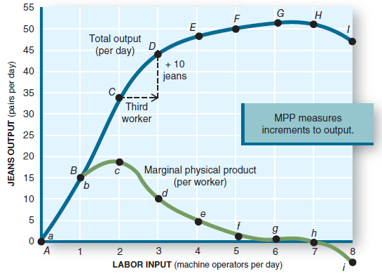
Marginal Physical Product (MPP)
The Theory of the Firm
Business Economics
Notes:
At the third worker, MPP stops increasing and will decrease with added workers.
Total output continues to increase, but at a decreasing rate, as shown by diminishing MPP.

Slide 7
Diminishing Marginal Returns
The Theory of the Firm
Law of diminishing returns: the marginal physical product of a variable input declines as more of it is employed with a given quantity of other (fixed) inputs.
Added output begins to decrease and ultimately goes negative as more and more workers are added with no increase in capital.
Business Economics
Notes:
This formalizes the definition.
Now might be the time to discuss when MPP goes negative and total output (utility) begins to decrease.
Too many workers get in each other’s way and retard production.
Too many slices of pizza make the consumer feel sick.

Slide 8
Resource Costs
The Theory of the Firm
The sales manager wants to maximize sales revenue.
The production manager wants to minimize production costs.
The business owner wants, instead, to maximize profit.
There is no reason to expect these three goals to occur at the same output.
Business Economics
Notes:
The bulk of the remainder of this chapter is concerned about costs of production.
We know that the ATC has a minimum point. That’s where the production manager would like to be.
The other decision makers in the firm have different ideas.
The owner will prevail and will try to maximize profit.

Slide 9
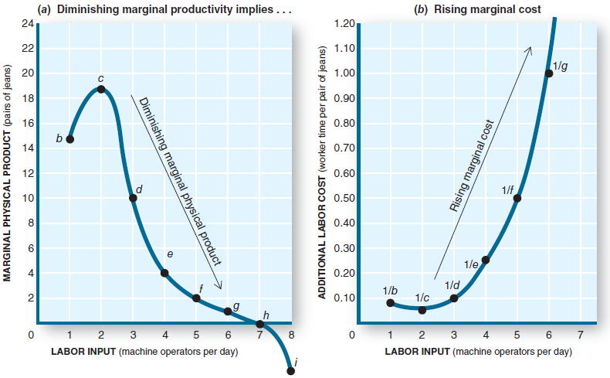
Resource Costs
The Theory of the Firm
Business Economics
Notes:
As MPP falls, the added output per added worker decreases. Assume each worker costs the same to hire.
Then as MPP falls, MC (the added cost to produce more output) rises.
The reverse is true at the start-up: MPP rises and MC falls.

Slide 10
Resource Costs
The Theory of the Firm
As MPP decreases with added workers, we continue to pay the added workers, but we get less added product with each added worker.
Therefore, the cost per added product increases as MPP declines.
Marginal cost (MC): the increase in total cost associated with a one-unit increase in production.
Business Economics
Notes:
Summarizes the previous slide.

Slide 11
Marginal Cost (MC)
The Theory of the Firm
Change in total cost
Marginal cost (MC) =
Change in output
When MPP decreases, MC must increase, and vice versa.
For any production with fixed capital, the MC curve will fall at low levels of production but will rise sharply at higher levels when diminishing marginal returns set in.
Business Economics
Notes:
This formally defines MC.

Slide 12
Costs
The Theory of the Firm
Total cost (TC): the market value of all resources used to produce a good or service.
Fixed cost (FC): costs of production that don’t change when the rate of output is altered.
Variable cost (VC): costs of production that change when the rate of output is altered.
Total Costs = Fixed costs + Variable costs
TC = FC + VC
Business Economics
Notes:
FC are the costs of the fixed input (capital). VC are the costs of the variable input (raw materials, labor). They add up to total costs.

Slide 13
Fixed Costs
The Theory of the Firm
Payments for the fixed inputs.
Includes the cost of basic plants and equipment.
Must be paid even if output is zero.
Do not increase as output increases.
Business Economics
Notes:
Emphasize that FC stay the same no matter what the output level is, including zero output.

Slide 14
Variable Costs
The Theory of the Firm
Payments for the variable inputs.
Include the costs of labor and raw materials.
At zero output, these costs are zero.
As output increases, variable costs increase rapidly at first, then more slowly, and finally very fast as the firm approaches maximum capacity.
Business Economics
Notes:
If nothing is produced, no raw materials or labor are needed, so VC = 0 when output = 0.
VC rise fast during start-up (when MPP is rising). VC rise more slowly during the middle or production range.
VC again rise fast as maximum capacity to produce is approached (MPP goes negative).

Slide 15
Average Costs
The Theory of the Firm
Average total cost (ATC): total cost divided by the quantity of output in a given time period.
ATC = TC / q
Average fixed costs (AFC): total fixed cost divided by the quantity of output in a given time period.
AFC = FC / q
Average variable cost (AVC): total variable cost divided by the quantity of output in a given time period.
AVC = VC / q
Business Economics
Notes:
Cost per unit produced is the preferred measure for the production manager. For each level of q, divide q into FC, VC, and TC to get the variables on the slide.
It would not be difficult to create an in-class exercise requiring students to actually do this.

Slide 16
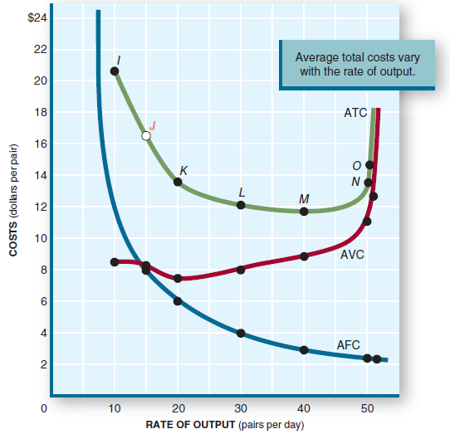
Average Costs
The Theory of the Firm
Business Economics
Notes:
Discuss the general shapes of the three curves. AFC continuously decreases with increasing q.
AVC falls at low output, hits a minimum, then rises as q increases.
ATC is the sum of AFC and AVC. So it falls at low levels of q as q increases, hits its minimum, then rises along with AVC at higher levels of q.
At low levels of q, ATC is dominated by AFC. At high levels of q, ATC is dominated by AVC.

Slide 17
Characteristics of the Cost Curves
The Theory of the Firm
Falling AFC: as output increases, AFC decreases rapidly. Any increase in output will lower AFC.
U-shaped AVC: AVC decreases at first, hits a minimum, and then rises as output increases (as a result of diminishing returns).
U-shaped ATC: at low output, falling AFC dominates and ATC decreases. As output increases, rising AVC begins to dominate. ATC hits a minimum, then begins to rise.
Notes:
Summarizes the previous slide.

Slide 18
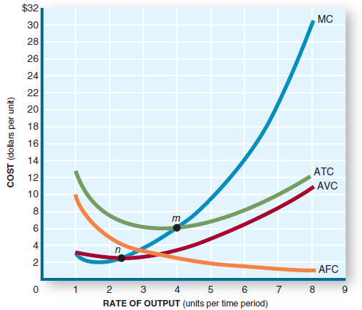
Minimum Average Cost
The Theory of the Firm
The output at which ATC switches from being dominated by AFC to being dominated by rising AVC is the point where average costs are minimal.
It is at this output where the firm can produce at the lowest cost per unit...
… and where the firm minimizes the amount of resources being used.
However, this amount of output is not necessarily the output where profit is maximized.
Business Economics
Notes:
This point is the production manager’s dream: to produce at minimum average cost.
It is also the economist’s dream, since at this point production occurs at the minimum consumption of resources (i.e., efficiently).

Slide 19
Marginal Cost (MC)
The Theory of the Firm
Diminishing returns in production cause MC to increase as output increases.
After a brief drop in MC at low output, MC rises rapidly as output increases.
As MC rises, it intersects ATC at its minimum point.
ATC decreases when MC<ATC.
ATC increases when MC>ATC.
Business Economics
Notes:
Time to drive the MC curve through the ATC curve at its minimum point.
You could use GPA as an example of the MC - ATC relationship.
If you have a B average (equivalent to ATC), and you make a C in the next class (equivalent to MC below ATC), your GPA goes down.
If you have a B average (equivalent to ATC), and you make an A in the next class (equivalent to MC above ATC), your GPA goes up.

Slide 20
Long-Run Costs
The Theory of the Firm
The short run is characterized by fixed costs.
In the short run, the plants and equipment are fixed.
The objective is to make the best use of those fixed inputs while making the production decision.
In the long run, we can change the plants and equipment.
Long run: a period of time long enough for all inputs to be varied.
There are no fixed costs in the long run. All costs are variable.
Business Economics
Notes:
The owners decide whether to acquire fixed assets in a start-up or an expansion.
Also the owners decide whether to close and dispose of fixed assets.
Thus in the long run, all costs become variable as fixed costs can be increased or decreased.

Slide 21
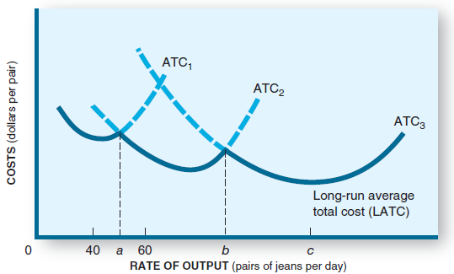
Long-Run Average Costs
The Theory of the Firm
In the long run, a firm can build a plant of any desired size.
As plant size gets larger, each plant’s ATC curve has a lower minimum point.
In this case, building a larger plant would lower production costs.
Business Economics
Notes:
Here are three plants, of different sizes. As size grows, the AVC drops.
Sculpting the three plants for outputs that don’t overlap gives us a look at long-run ATC.

Slide 22
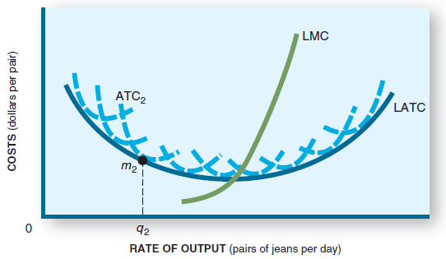
Long-Run Average Costs
The Theory of the Firm
There are unlimited options.
One option delivers the lowest ATC.
It is at this point where the long-run marginal cost curve intersects the long-run average total cost curve.
Business Economics
Notes:
Now expand the possibilities of plant size, and the long-run ATC curve smoothes out.
Its MC curve intersects the long-run ATC at its minimum point.

Slide 23
Economies of Scale
The Theory of the Firm
Economies of scale: reductions in minimum average costs that come through increases in the size (scale) of plants and equipment.
Larger plants reduce minimum average costs.
Greater efficiency may come from
Specialization vs. multifunction workers.
Mass production vs. small batch mode production.
Business Economics
Notes:
Costs fall as size increases due to economies of scale.
In many cases, efficiencies can be obtained in a larger facility than in a smaller one.
Each type of production tends to have its “ideal size” where economies of scale have been achieved.
Each was probably found by trial and error. This is the reason why many retail outlets are the same size, many supermarkets are the same size, etc.

Slide 24
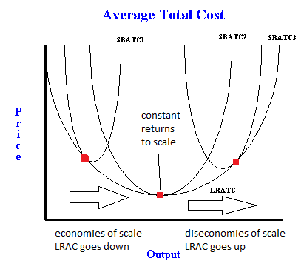
Diseconomies of Scale
The Theory of the Firm
If the plant size gets too big, however, long-run average costs begin to rise, creating diseconomies of scale.
Operating efficiency may be reduced.
Worker alienation may increase.
Rigid corporate structures emerge.
Off-site management may be unresponsive.
Bigger isn’t always better.
Business Economics
Notes:
If a plant is built that is larger than the ideal size, costs rise.
There are many examples of diseconomies of scale in government bureaucracies.

Slide 25
The Profit Motive
The Theory of the Firm
The expectation of profit is the basic incentive to produce.
Profit: the difference between total revenue and total cost.
The profit motive encourages firms to produce the goods and services that consumers desire, at prices they are willing to pay.
What will happen to a firm if it produces goods that no consumers want or are willing to pay for?
Business Economics
Notes:
Possible discussion: Is profit a good thing? Or should a firm operate only to serve the needs of society?

Slide 26
Economic vs. Accounting Profits
The Theory of the Firm
Economists include all costs in economic costs, both implicit costs (like opportunity cost) and explicit costs.
Accountants include only explicit costs.
Profit equals total revenue minus total costs.
Economic profit, then, is smaller than accounting profit because more costs are subtracted:
Economic profit = Total revenue – Explicit costs – Implicit costs
Accounting profit = Total revenue – Explicit costs only
Economic profit = Accounting profit – Implicit costs
Business Economics
Notes:
Implicit costs are difficult for some students to grasp.
You could build a picture where a commuter, tired of the rat race, is considering quitting her job and opening a business.
What would she have to give up to do this? Obviously her day job. Maybe some savings that are earning interest. Maybe some assets she owns, like a building that she could lease. It wouldn’t be too hard to calculate the opportunity costs of lost salary and redeployment of assets as implicit costs of starting a business.

Slide 27
Normal Profit
The Theory of the Firm
Normal profit: the opportunity cost of capital.
The owner could have invested these resources elsewhere. If the opportunity cost is a lost return of 10%, then the owner will expect at least a 10% return in this business, preferably higher.
Normal profit is equivalent to an implicit cost.
It is earned if economic profit is zero, which, maybe surprisingly, is the typical case.
A productive activity reaps an economic profit only if it earns more than its opportunity cost.
Business Economics
Notes:
Economists want to see the receivers of a good (the customers) pay exactly the cost of the resources used in producing that good.
If they pay more, economic profit exists.
If they pay less, economic losses exist.
If they pay exactly that amount, no economic profits exist, but the resources we cited as implicit costs are paid for.
This is normal profit.

Slide 28
Entrepreneurship and Risk
The Theory of the Firm
The entrepreneur will go into business only if the prospect of earning more is greater than the alternative use of resources.
The owner expects a return of more than a normal profit.
There is no guarantee of profit. Thus the owner is willing to undertake the risk of suffering economic losses.
The inducement to face this risk is the potential for economic profit.
Business Economics
Notes:
A prospective businessperson should do homework before jumping in.
If this person can’t see a return of more than the normal profit (what those assets are earning now), then the decision to start the business should be “no.”
Obviously there is uncertainty, and the risk factor needs to be included in the calculation.

Slide 29
Market Structure
The Theory of the Firm
Market structure: the number and relative size of firms in an industry.
The market structures range from monopoly at one extreme to perfect competition at the other extreme. Most real-world firms are along the continuum of imperfect competition.
Business Economics
Notes:
This figure serves as a good introduction to the next few chapters.

Slide 30
Perfect Competition
The Theory of the Firm
Characteristics:
Many firms compete for consumer purchases.
The products of each firm are identical.
Low entry barriers make it easy to get into the business.
No firm has any market power, thus they cannot manipulate the price. They are price takers.
Each firm’s output is small relative to the total market amount.
Business Economics
Notes:
This is the first, and simplest to describe, market structure.

Slide 31
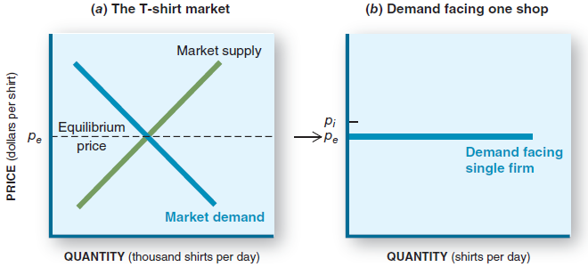
Market Demand vs. Firm Demand
The Theory of the Firm
Although the entire market has a typical downward-sloping demand curve, the individual firm perceives its demand curve to be horizontal.
Business Economics
Notes:
Example: An egg rancher takes his eggs to a central location where they are cleaned and graded.
He is one of many farmers to do so. On the way into the facility, the current buying price is posted.
It doesn’t matter how many eggs he has; that’s the price. So quantity can be higher or lower, but the price is the same.
Sketch that out on a graph, and the perceived demand curve is horizontal.

Slide 32
A Firm’s Demand Curve
The Theory of the Firm
Why horizontal?
The firm is a price taker. It will charge only the market price.
If it raises its price, nobody will buy.
If it lowers its price, it will sell out, but it can do that at the market price.
It can sell increased quantities at the market price.
If you draw a line for any quantity at the market price, the line will be horizontal.
Business Economics
Notes:
Example: T-shirts sell for $5 at dozens of shops all over the boardwalk.
You insist on $10 for your shirts. What will the customers do?
Also, you would sell for $4 only if you wanted to get home early since you can sell all you have for $5.

Slide 33
The Production Decision
The Theory of the Firm
There are no pricing decisions. Firms take the market price.
There are no quality decisions since all products are identical.
The only decision left is how much to produce.
This is the production decision.
Business Economics
Notes:
Remember, this is the simple case.
There is no quality difference or price difference between competitors.
The only question left is “How many to produce?”

Slide 34
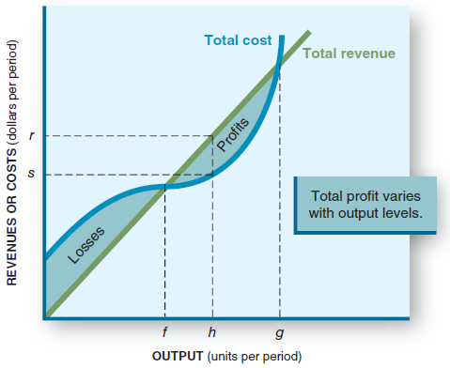
The Production Decision
The Theory of the Firm
A firm’s goal is to maximize profits, not revenues.
Profit equals total revenue (price x quantity) minus total costs.
The goal is to find the output that maximizes profits.
Is h that output?
Business Economics
Notes:
You could point out the break-even point f.
You could point out that if you produce too much, costs will eat you up (point g).
Somewhere between points f and g, profits maximize.
It is difficult to identify point h as that point.

Slide 35
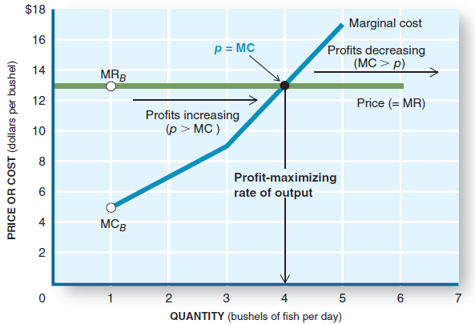
The Production Decision
The Theory of the Firm
Never produce a unit of output that yields less revenue than it costs.
Marginal revenue (MR) is equal to price, the added amount received from selling one more unit.
MR = Change in total revenue Change in output
Business Economics
Notes:
On this graph, it is much easier to find the profit-maximizing quantity.
Profits grow as long as we produce those units where MR=P=MC.
At the intersection of MR=P and MC, profits cease to be added.
If we go beyond that point, MR=P < MC, and we make a loss on each unit we produce.
Clearly profits max out when we reach the intersection.

Slide 36
The Production Decision
The Theory of the Firm
As output increases, marginal cost (MC) increases, squeezing the profit from the added units.
Compare P to MC:
If P>MC, we add to profit by selling that one.
If P<MC, we make a loss by selling that one.
If P=MC, we make no profit or loss on that one.
Business Economics
Notes:
If a firm finds itself producing where MR=P < MC, it should cut back production, getting rid of those units on which it is losing money. Profits will rise.

Slide 37
Profit Maximization Rule
The Theory of the Firm
For perfectly competitive firms,
If P > MC, increase output and profits will grow.
If P < MC, decrease output and losses will go away.
If P = MC, produce this output because it is the quantity at which profits are maximized.
Profit maximization rule:
Produce at that rate of output where marginal revenue (MR = P) equals marginal cost (MC).
Business Economics
Notes:
Summary slide.

Slide 38
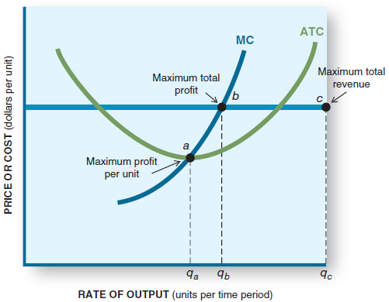
Graphical Look at Profit Maximization
The Theory of the Firm
Here we relate ATC and MC to P=MR.
To maximize profits, choose the quantity related to point b. That is where MR=MC.
Note that it is not the same as maximum profit per unit (point a) or maximum revenues (point c).
Business Economics
Notes:
Here is a good way to contrast some decisions a firm faces.
Produce at the lowest cost per unit (point a)?
Produce at maximum revenue (point c)?
Produce at maximum profit (point b)?

Slide 39
The Shutdown Decision
The Theory of the Firm
Shutting down the firm does not eliminate all costs.
Fixed costs must be paid even if all output ceases.
If a firm makes losses, it cannot pay all its fixed costs and its variable costs.
The firm will lose less by shutting down (output=0) if losses from continuing production exceed fixed costs.
Business Economics
Notes:
Firms make losses sometimes.
Most react by either boosting sales (if possible) or reducing costs.
Their intention is to get back to profitability.
However, at times the best decision is to shut down.
No production eliminates VC; only FC remain.

Slide 40
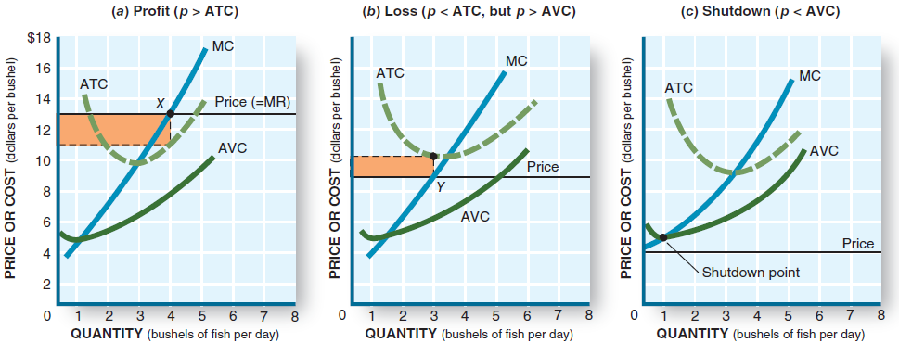
The Shutdown Decision
The Theory of the Firm
Always set P=MR=MC to maximize profits or minimize losses.
If prices fall below ATC, a loss is made.
The firm should not shut down until the price falls below AVC. When this happens the firm can’t pay its labor and suppliers, so shutting down is the best option.
Business Economics
Notes:
As price falls, what was a profit becomes a loss.
P falling below ATC generates a loss.
If P falls below AVC, it is time to shut down.

Slide 41
The Investment Decision
The Theory of the Firm
Investment decision: the decision to build, buy, or lease plants and equipment or to enter or exit an industry.
The shutdown decision is a short-run decision.
Investment decisions are long-run.
Fixed costs are the owners’ investment in the business. They must generate enough revenue to recoup the investment.
Investment will occur if the anticipated (economic) profits are large enough to compensate for the effort and risk.
Business Economics
Notes:
Now we are in the long run.
The investment decision concerns paying for fixed inputs and incurring FC.
Shutdown is short-run in that it can be reversed.
Closing a factory and selling its assets is a long-run decision.
Same for opening a factory.

Slide 42
Determinants of Supply
The Theory of the Firm
A producer will increase output only if profits are increasing. Conversely, a producer will decrease output if profits are decreasing.
Each of these determinants affects a producer’s willingness and ability to supply a product:
The price of factor inputs.
Technology.
Expectations.
Taxes and subsidies.
Business Economics
Notes:
This is a review of the law of supply and the determinants of supply.

Slide 43
The Short-Run Supply Curve
The Theory of the Firm
The supply curve shows the quantity a producer is willing to supply at each price.
The profit maximization rule leads us to the short-run supply curve.
At each price, the producer sets output where MR=MC.
The producer resets this output when price changes.
Raise the price, produce more.
Lower the price, produce less.
The marginal cost curve is the firm’s short-run supply curve. (and it meets the demand curve – Price curve to the point of equilibrium)
Business Economics
Notes:
The MC curve relates to how much quantity the firm will produce at any given price.
Thus it is the firm’s supply curve (above the AVC minimum; shut down if below).

Slide 44
Supply Shifts
The Theory of the Firm
If any determinant of supply changes, the supply curve shifts.
A change that lowers costs will cause the supply curve to shift right.
A change that raises costs will cause the supply curve to shift left.
Business Economics
Notes:
If supply shifts right, the firm’s MC shifts right, and vice versa.

Slide 45
Tax Effects
The Theory of the Firm
Raising property taxes.
Fixed costs and total costs rise, but MC does not. So there is no change in the production decision.
Raising payroll taxes.
Variable costs and total costs rise, but MC rises also. The MC curve will shift upward to the left, and production output will be decreased.
Raising profit taxes.
Neither fixed nor variable costs are changed. But owners receive less return and may reduce investment in new business.
Business Economics
Notes:
“Let’s raise taxes on business.”
Which tax gets raised or lowered is significant.
Want more production? Lower payroll taxes and profit taxes.
Want less production? Well …

