Slide 1
The asylum seekers as potential immigrants: The case of the OECD countries
Prof. Christos Nikas, University of Macedonia, Thessaloniki

Slide 2
The asylum seekers as potential immigrants: The case of the OECD countries
Introduction
The refugee issue is one of the hottest European countries are facing in the last few years. Besides the political, socioeconomic and other implications on the one hand and the humanitarian elements on the other, the main concern is that a considerable number of the refugees will not leave after the problems in their countries are resolved. In such a case refugees will simply evolve to long-duration or even permanent immigrants

Slide 3
The asylum seekers as potential immigrants: The case of the OECD countries
The transformation process
Refugees like emigrants are pushed by their country of origin and pulled by the country of destination. The difference is that economic factors predominate in the case of migration whereas political, environmental and others in the case of refugee flows.
After finding a safe new country refugees may consider permanent stay as a better solution than eventual repatriation especially when they are escorted by their families and problems in the homeland remain unsolved for a long period of time.
The next step is to look for a job and better living conditions. In such a case the refugee status is simply used instead of a stay or/and work permit.

Slide 4
The asylum seekers as potential immigrants: The case of the OECD countries
Evidence
There are cases of refugees eventually returning to their homeland by the time things settled down there the most notable being the one of the Hungarians and the Chechoslovakians who left their countries in the 1950s and 1960s respectively and returned when they were pardoned by the Communist regimes.
There is also however the case of the Kosovars who (in some European countries) did not return to Kosovo after the end of the war in the 1990s declaring Albanian nationality.

Slide 5
The asylum seekers as potential immigrants: The case of the OECD countries
The most notorious case worldwide however is the “Mariel Boat Lift” in 1980 when president Carter pressed Fidel Castro to release 10.000 Cuban political prisoners to whom he granted asylum. At the end of the day 150.000 Cubans moved to Miami. Very few of them (if any) returned to Cuba.

Slide 6
The asylum seekers as potential immigrants: The case of the OECD countries
The countries of origin
64% of the asylum seekers in Europe come from three countries: Syria, Afganistan and Iraq. Regarding the situation in these countries and their perspectives for recovery and repatriation, one could highlight:
Syria: bellum omnium contra omnes on top of an environmental disaster
Afganistan: at war since 9/11, no visible termination
Iraq: Dividenda est.

Slide 7
The asylum seekers as potential immigrants: The case of the OECD countries
Asylum seekers in Europe
The three basic elements to analyse are:
Recent trends
The uneven distribution between European countries
The origin and the present status of the asylum seekers.

Slide 8
The asylum seekers as potential immigrants: The case of the OECD countries
Emigrants in Europe
The four basic elements to analyse are:
The percentage of foreign born population in Europe
The origin of the emigrants
The evolution of the bulk of emigrants in Europe after the economic crisis
The most expanding emigration populations in Europe

Slide 9
The asylum seekers as potential immigrants: The case of the OECD countries
Why Europe? Why Germany?
Refugee friendly asylum provision legislation.
Organised to generous welfare states in the European North compared to the South.
Existing social networks.
Latent pull forces emerging by factors such as the ageing of the population.
Economic opportunity for upgrading.

Slide 10
Countries attracting migrants and countries needing migrants

Slide 11
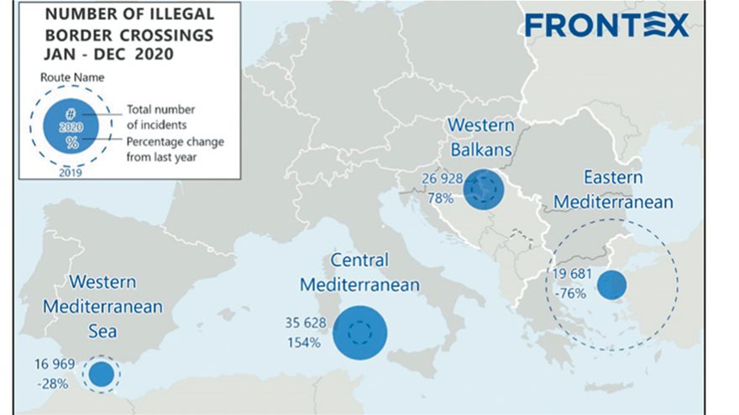

Slide 12
The asylum seekers as potential immigrants: The case of the OECD countries
Conclusions
The European countries were caught by surprise.
It has been dealt with as a national rather than a European problem.
Need for policy harmonisation and cooperation.
The ultimate target should be a Common EU Policy.

