Slide 1
Protection of refugees and migrants
UOM
Department of Balkan, Slavic and Oriental Studies
1st lecture

Slide 2
What makes a refugee and what makes a migrant?

Slide 3
Numbers and facts UNHCR
73 percent of refugees under UNHCR’s mandate originate from just five countries. The largest numbers of refugees were from Afghanistan (6.4 million), Syria (6.4 million), Venezuela (6.1 million), Ukraine (6.0 million), and Sudan (1.5 million).
Most refugees are in low- and middle-income countries, mainly in countries neighboring their own. Low- and middle-income countries hosted 75 percent of the world’s refugees and other people in need of international protection, while the Least Developed Countries provided asylum to 21 percent of the total. 69 percent of refugees and other people in need of international protection were hosted in neighboring countries at the end of 2023.
The global number of IDPs increased by 10 percent to 68.3 million people at the end of 2023, accounting for 58 percent of all forcibly displaced people. The largest numbers of IDPs were in Sudan (9.1 million), Syria (7.2 million), Colombia (6.9 million), the Democratic Republic of the Congo (6.7 million), and Yemen (4.5 million). Additionally, there were 7.7 million IDPs who remained displaced due to disasters at the end of 2023.

Slide 4
Not “illegal”- undocumented Picum(see pdf words matter)
‘Illegality’ as a form of status has been deliberately assigned to undocumented migrants to justify a category of people who are undeserving of rights.
Language shapes people’s perceptions. Discriminatory language in reference to undocumented migrants leads to perceptions and actions which negatively impact the daily realities of people.
Irregular entry’ and never ‘illegal entry’ to describe people who cross the borders without required documentation.
Everyone has a right to seek protection, but the term ‘illegal entry’ automatically implies that certain people have no right to seek protection.

Slide 5
Why not illegal ? PICUM Inaccurate
Legally incorrect
Misleading
Ignores international legal obligations
Violates principle of due process
Inaccurate to describe people arriving at the borders
Notes:
5

Slide 6
Why not illegal ? Harmful
Dehumanising
Criminalising
Prevent fair debate
Threatens solidarity and costs lives
Undermines social cohesion

Slide 7
Why not illegal ? Against Europe’s values
Discriminatory
Oppressive
Outdated

Slide 8
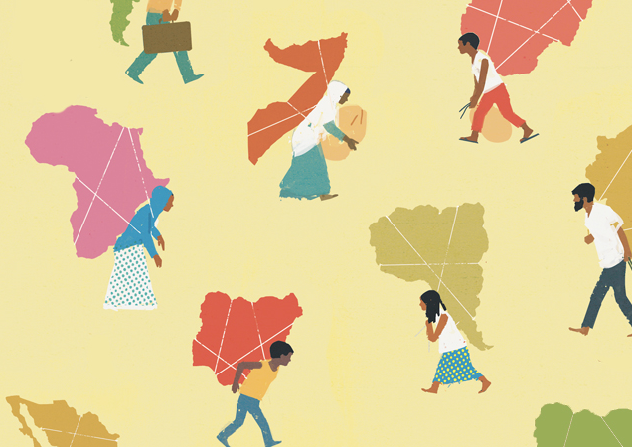
Migration studies an interdisciplinary field
History (comparativeness)
Sociology and social Anthropology (migration as a phenomenon – reveals the norms and values of societies)
Human Geography (space and place)
Political Science (policies and practices)

Slide 9
On anthropology
The study of human beings – the branches that study the social and cultural constructions of human groups : cultural anthropology (ethnology), social anthropology
Other disciplines also study human beings. Anthropology focuses on groups of people and what interactions take place between people in such groups

Slide 10
Anthropology and sociology
Both share common grounds: Object of the study (race, gender,); theoretical and methodological overlap.
Example that illustrates the difference – Student that cannot travel in order to attend a conference because her birth certificate did not have a name officially printed on it.

Slide 11
Anthropologist: I thought it was so interesting that a name meant so much in our culture- that not having an official name in the United States meant that you did not have an identity.
Sociologist: I thought about the structures that perpetuate the economic inequalities related to race and class, and how these were playing out in our institutions’ inability to help the student get another certificate or bypass the strict laws and travel with the group.
Common grounds but different vantage points

Slide 12
A holistic approach through time and around the world- a part cannot be understood separately from the whole and that different parts of society and culture are interrelated; they interact and depend upon one another. Without an understanding of the whole, the understanding of any part will be insufficient
Material, social and symbolic dimensions of human action
Comparing for understanding - Whatever social institutions, practices or belief systems you claim must be universal, the anthropologist will find a counterexample, some society or culture, which thinks or does things differently, and which still functions (Persson-Fischier).

Slide 13
Mainly qualitative methods

Slide 15
Methodological relativism - when trying to understand another individual or community, temporarily leave our own norms behind and refrain from judging according to our standards
The aim is to “understand,” and not necessarily to “fix,” although we do have an ethical obligation to put our data and energy into addressing injustice
(Kristina Brains)

Slide 18
Dominant representations of humanitarian aid (Chika Watanabe, on the exhibition)
In the first picture – representations of aid givers: ‘desirable development’; international aid workers; poverty and underdevelopment in the global south.
In the second picture – representations of aid receivers: aid recipients; local aid workers; media coverage of humanitarian intervention.
The contrast of the two presents the inequalities and disparities that the hierarchical structure generates.

Slide 19
Representations of aid givers, aid receivers, and what constitutes “development” and “underdevelopment” draw heavily upon ideas of ‘the West and the Rest’ (Hall, 1992).
These representations rarely align with the applied practice of everyday humanitarian work.
Humanitarian aid programmes often perpetuate existing and ‘dominant power structures’ at the expense of those they advertise to be helping.
Humanitarian projects may achieve their ‘political effects’, whether they help or not.
Ethnographic research indicates that ‘foreign’ (international) workers often feel distressed by structural constraints imposed upon them by aid organisations (bureaucratic management and imperatives).

Slide 20
Aid worker - Aid recipient
Example of refugee camps: human’s ‘biology’ is prioritised over their ‘biography’.
The meaning of humanitarian work is reduced to the bare minimum of keeping survivors alive as opposed to being attentive to their individual needs and requirements.
Holistic approach to the involvement of both foreign and local workers in aid projects may assist in giving voice to and mitigating the effects of overlooked inequalities both within and without humanitarian organisations

Slide 21
Local aid workers
Local aid workers are typically afforded fewer privileges and less pay than foreign workers.
Local aid workers are subject to more screening and hold less decision-making power.
Local aid workers have to navigate the gap between the ‘ideal worlds’ and ‘social realities’ of aid work.

Slide 22
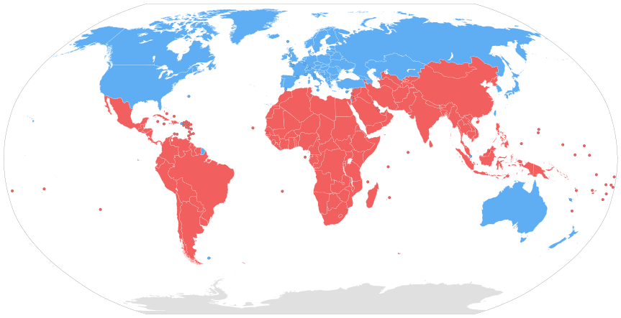
From global south to global souths…
Countries classified by the World Bank as low or middle income that are located in Africa, Asia, Oceania, Latin America and the Caribbean – descriptive definition, that, like its predecessors (periphery; less-developed, developing, underdeveloped; third world) it lumps together very diverse economic, social and political experiences and positions into one all-encompassing category.
“Spaces and peoples negatively impacted by globalisation”, including dominated peoples and poorer regions within wealthier countries.
A transnational political subjectivity and subaltern resistance under contemporary capitalist globalisation – There are Souths in the geographic North and Norths in the geographic South (Mahler, 2018).

Slide 24
Defining the South (Pacitto,Fiddian-Qasmiyeh/ see pdf south_south_humanitarianism)
Oppositional categorizations such as North/South, West/East, Developed/Developing, do not reflect the complexity and diversity of the world.
McEwan suggests to use Global North and Global South as a metaphorical, rather than geographical distinction.
When analyzing how countries respond in humanitarian situations, it's important to look at their overall global position. This means considering political, geographical, social, and economic factors that help explain their actions. This approach helps counter the oversimplified North/South divide and promotes a better understanding of the complexities of South-South relations and the diversity within the "global South."

Slide 25
On humanitarianism – an introduction
Since the mid 19th humanitarian intervention was increasingly become the dominant instrument framing protection, aid and democratization at the global level
This process accelerated after WWII and in the wake of the Cold War – when the stability of the nation state was loosing ground, making room for new forms of sovereignty (private and humanitarian)

Slide 26
Suffix ‘ism’ – a set of beliefs, practices, categories, discourses and procedures
Humanitarianism may be seen as an ethos, as a political mode of controlling territories and lives and governing international relations
Humanitarianism consists of theories and practices, ideologies and contradictions, movements for change and conservatism

Slide 27
The universe of humanitarianism : Humanitarianism keywords/ Table of contents

Slide 28
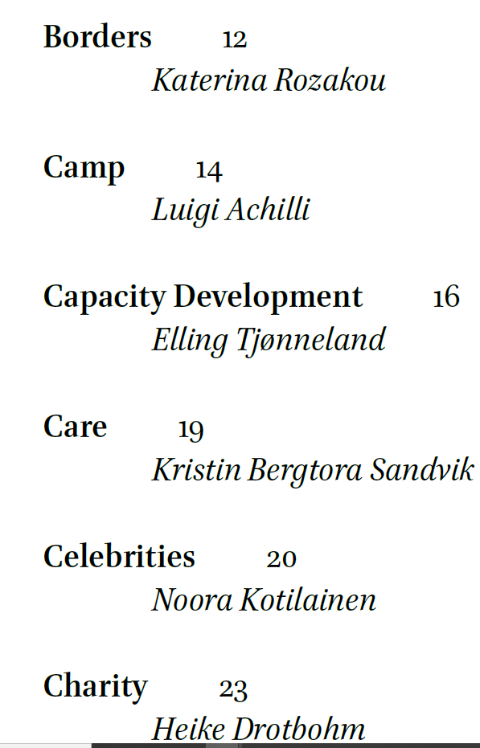
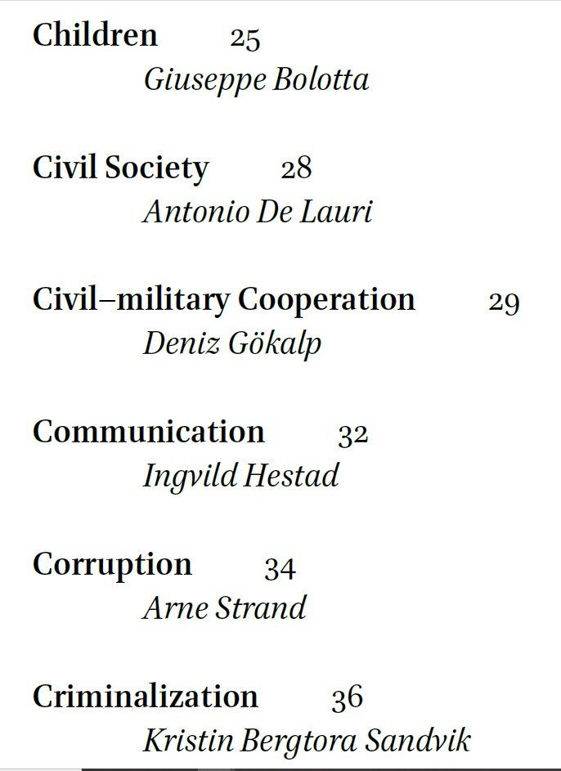

Slide 29
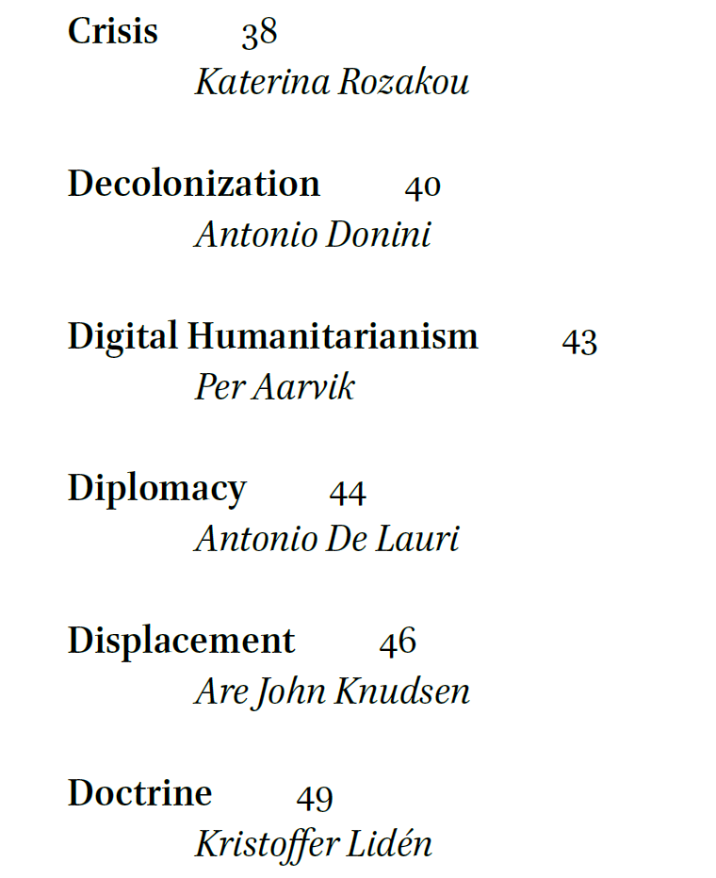

Slide 30
Crisis
It is seen as a disruption to an assumed state of normality. An exceptional, extraordinary situation.
It seems to be linked to a particular historical moment within the sequence of events.
Example : The European Commission has emphasized that the Syrian conflict (2011/12) has resulted in one of “the worst humanitarian crises since World War II.” However, it was not until over 1 million displaced people arrived on Europe’s shores in 2015 that this label was applied, prompting the European Union to provide humanitarian aid and establish an extensive humanitarian infrastructure: Year 2015 is known as an exceptional moment in history.
The humanitarian crisis framework depoliticizes suffering, providing it with a moral basis. This narrative redirects focus from the political and economic roots of the crisis to emotions of pity and compassion. The logic of crisis-thinking lays the foundation for the typical next step: the response of humanitarian actors.
What about undefined or chronic crisis? Can you think of any example?

Slide 31
Activity
Search for articles or posts where you can find the keyword crisis. Reflect on the use of the word in the specific articles according to what you have read.
https://brill.com/display/book/9789004431140/BP000018.xml

Slide 32
Course presentation
Critically present and discuss the way protection of refugees and migrants is conceived, designed and implemented mainly in the current period, based however in a brief historical perspective
The different sections will discuss the different stakeholders that take part in the field of migration and asylum and the way their interventions have evolved
Critical approach of the distinction between refugees and migrants, and this aspect will be developed based in different key periods
Reflect on the use of terms and categories and the importance “words” have to the reality of refugees, migrants and the hosting societies

Slide 33
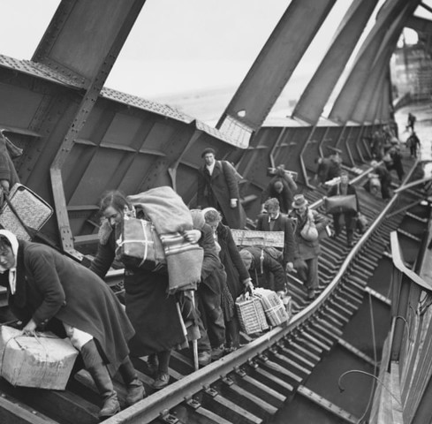
First section: mobility and borders – people always move - borders do not divide the world, the enable or disable the channeling of mobility - mobility must be seen together with the periods of settlement “migratory process as a sequence of movements that are linked to each other by periods of settlement in spaces of relationships” (de Sans, 2004) - forced and voluntary mobility : a critical scrutiny of existing categories - The emergence of Human Rights. Are human rights universal? - Refugeeness is historically, socially and legally constructed - The adventures of the Geneva Convention

Slide 34
Sections
A presentation of Elis Island in order to begin understanding reception/ On place-space, a methodological and more analytical discussion/ historical facts about international migration / text of Arendt “We refugees”
Colonialism, nation-state and forced mobility
Refugeedom (Gatrell)/ Representing refugees throughout photos/ The emergence of human rights/ The legal and social construction of the refugee
The European border regime/ Transit migration/ Case studies
Gender and migration/ Intersectionality

Slide 35
Sections
Asylum and migration basic definitions/ non-refoulement/ push backs at the borders/ The discussion on refugees and migrant’s rights and citizenship and naturalization/ Different examples
Critically discuss the use of the term crisis/ the era before and during 2015/ Documentary “Feeling of a home”
The post 2015 era/ Safe country of origin/ Safe third country/ European Agenda on Migration/ Hotspots
Camps and “campization” and forms of non-collective housing, formal, informal, institutional, grassroots
NGOisation of migration/ “Pop-up” governance
On humanitarianism and humanitarian governance
A reflective discussion on the basic aspects that this course covered – presentations

Slide 36
Second section: migrant protection, gender intersectionality and racism

Slide 37
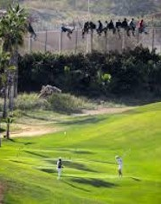
Third section: transit migration, emergence of cams and the border regime
Transit migration is a construction that occurs during the 90s
Self constructed and strategic refugee camps emerge
The border regime establishes and evolves. The CEAS and its new reform.

Slide 38
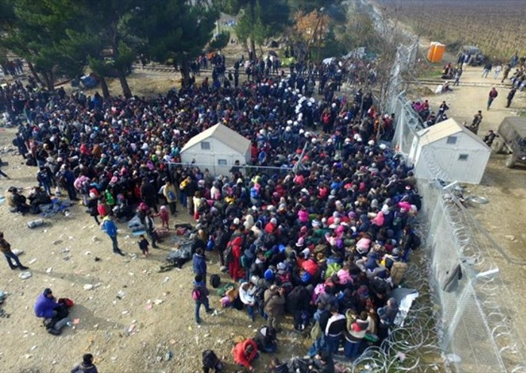
The post 2015 era until nowadays
Is this a “crisis”? This is not a crisis
The role of IOs, NGOs and other stakeholders in the refugee and migrant situation
The late evolutions in the Common Asylum System (CEAS)

Slide 39
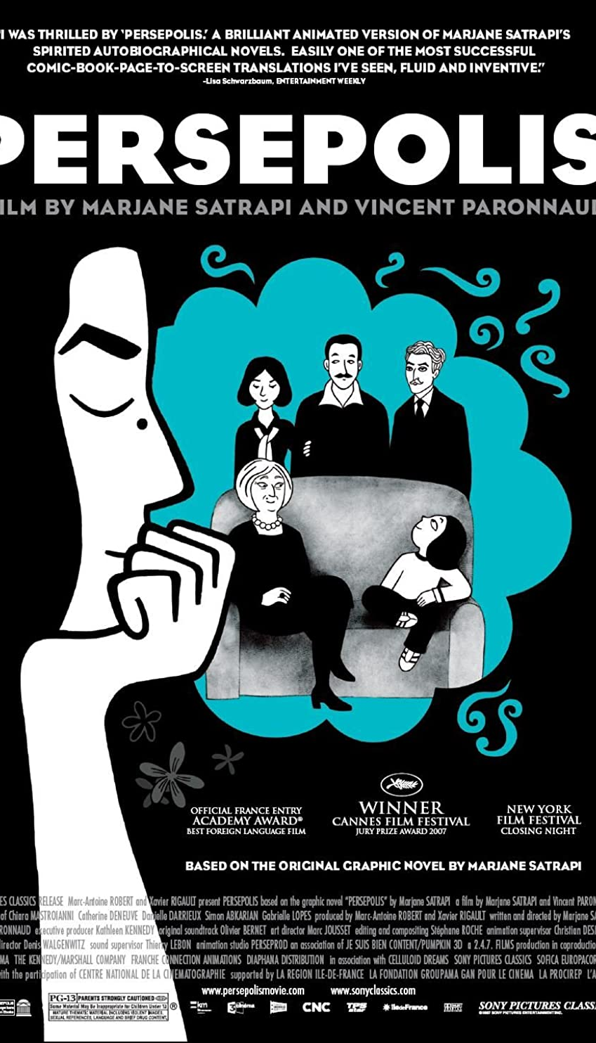

Slide 40
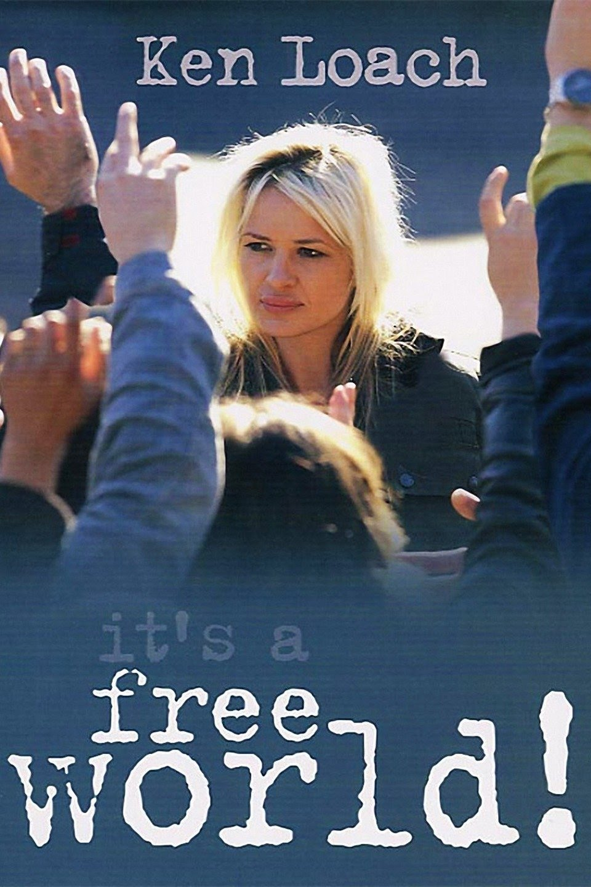

Slide 42
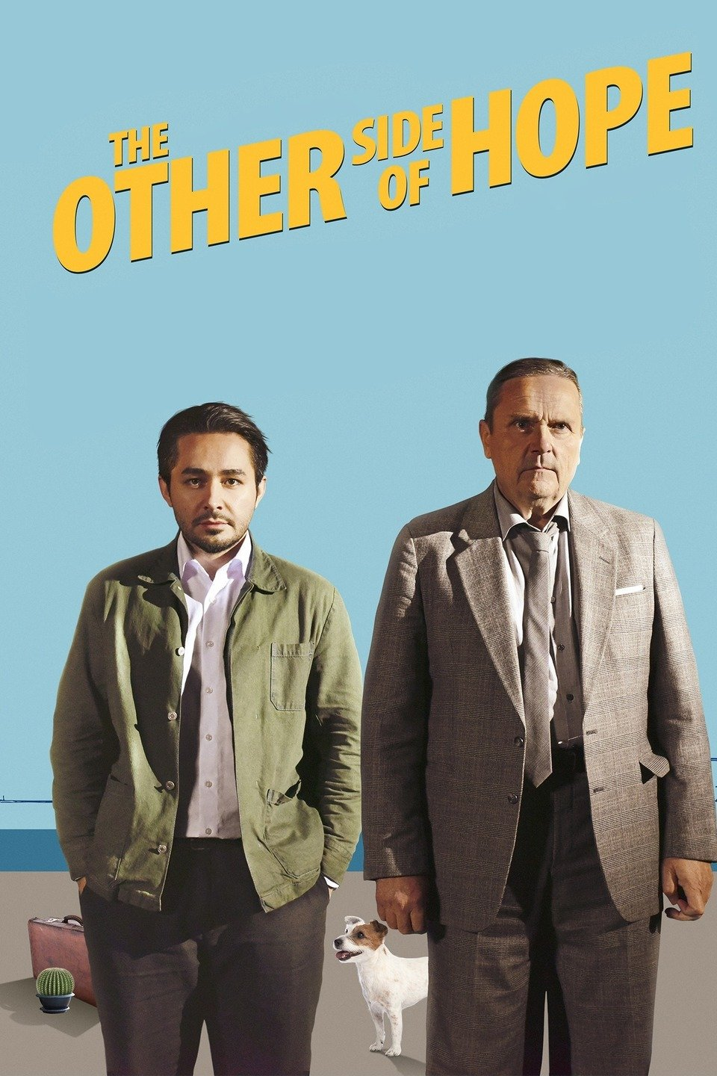

Slide 43
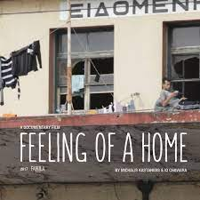

Slide 44
Sources
UNHCR, Joint Data Centre on Forced Displacement (2024), Global Trends: Forced Displacement in 2023 https://www.jointdatacenter.org/literature_review/global-trends-forced-displacement-in-2023/#:~:text=By%20the%20end%20of%202023,seekers%2C%20and%2068.3%20million%20IDPs
Middle East Eye, Joseph Massad (2024), Israel’s legitimacy was built on the Holocaust. Now its own genocide is destroying it. https://www.middleeasteye.net/opinion/israel-support-built-on-holocaust-own-genocide-destroying-it
Modern Diplomacy, Mariamme Latif Estafan (2024), The failure of the international community to the Palestinians. https://moderndiplomacy.eu/2024/05/14/the-failure-of-the-international-community-to-the-palestinians/
Global South: what does it mean and why you use the term. https://onlineacademiccommunity.uvic.ca/globalsouthpolitics/2018/08/08/global-south-what-does-it-mean-and-why-use-the-term/
Hegemonic Representations and Aid Workers (2022-2023) https://sites.manchester.ac.uk/anthropology-of-aid/the-issues/professions-of-doing-good/2022-2023-hegemonic-representations-and-aid-workers/
Cool Anthropology, What is the difference between anthropology and sociology https://www.coolanthropology.com/ask-a-cool-anthropologist/what-is-the-difference-between-anthropology-and-sociology/
What is anthropology (slide presentation) https://www.slideserve.com/mari/what-is-anthropology

