Slide 1
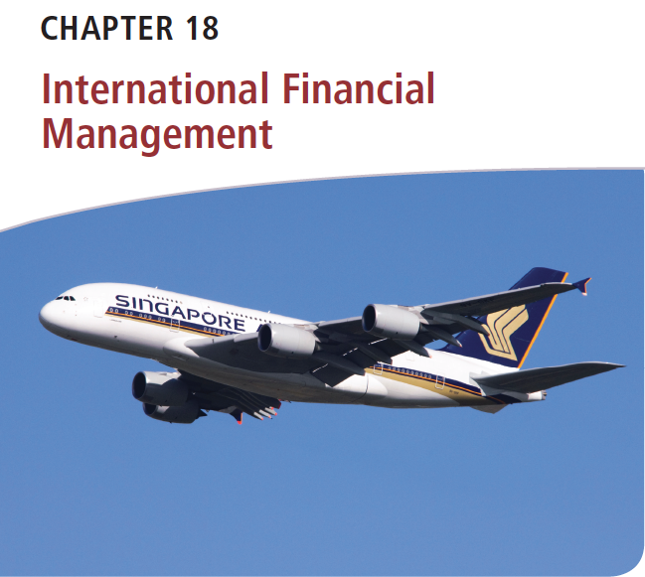
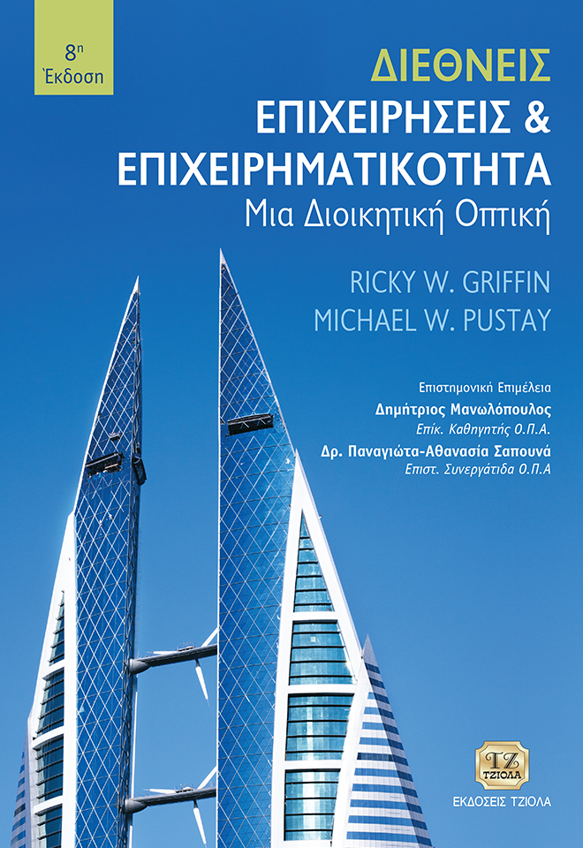
Διεθνείς Επιχειρήσεις και Επιχειρηματικότητα 8^{η} Έκδοση
ΚΕΦΑΛΑΙΟ 18
Διεθνής Χρηματοοικονομική Διοίκηση
Griffin & Pustay

Slide 2
Μαθησιακοί Στόχοι
Να αναλύσετε τα πλεονεκτήματα και τα μειονεκτήματα των κύριων μορφών πληρωμών στο διεθνές εμπόριο.
Να προσδιορίσετε τους κύριους τύπους συναλλαγματικού κινδύνου που αντιμετωπίζουν οι διεθνείς επιχειρήσεις.
Να περιγράψετε τις τεχνικές που χρησιμοποιούν οι επιχειρήσεις για τη διαχείριση του κεφαλαίου κίνησής τους.
Να αξιολογήσετε τις διάφορες τεχνικές προϋπολογισμού κεφαλαίων που χρησιμοποιούνται για τις διεθνείς επενδύσεις.
Να συζητήσετε τις κύριες πηγές επενδυτικών κεφαλαίων που είναι διαθέσιμες στις διεθνείς επιχειρήσεις.

Slide 3
Χρηματοοικονομικά Ζητήματα στο Διεθνές Εμπόριο
Επιλογή Νομίσματος: Ποιο νόμισμα θα χρησιμοποιηθεί για τη συναλλαγή;
Πιστωτικός Έλεγχος: Πότε και πώς θα ελεγχθεί η πιστοληπτική ικανότητα;
Μέθοδος Πληρωμής: Ποια μορφή πληρωμής θα χρησιμοποιηθεί;
Χρηματοδότηση Εμπορίου: Πώς θα διευθετηθεί η χρηματοδότηση;
Notes:
In any business transaction, the buyer and seller must negotiate and reach agreement on such basic issues as price, quantity, and delivery date. However, when the transaction involves a buyer and a seller from two countries, several other issues arise:
Which currency to use
When and how to check credit
Which form of payment to use
How to arrange financing

Slide 4
Επιλογή Νομίσματος
Νόμισμα εισαγωγέα
Νόμισμα εξαγωγέα
Τρίτο νόμισμα
Notes:
One problem unique to international business is choosing the currency to use to settle a transaction. Exporters and importers usually have clear—and conflicting—preferences as to which currency to use. The exporter typically prefers payment in its home currency, so it can know the exact amount it will receive from the importer. The importer generally prefers to pay in its home currency so it can know the exact amount it must pay the exporter. Sometimes, an exporter and an importer may elect to use a third currency. For example, if both parties are based in countries with relatively weak or volatile local currencies, they may prefer to deal in a more stable currency, such as the Japanese yen or the U.S. dollar. Among the major exporting countries, the most common practice is for the exporter to invoice foreign customers using its home currency. However, smaller exporting countries may choose to use the currency of a major trading partner; most of Thailand’s exports are invoiced in U.S. dollars, for example.

Slide 5
Πιστωτικός Έλεγχος
Συστατικές αναφορές πιστοληπτικής ικανότητας
Διαπιστευμένες πηγές παροχής πιστωτικών πληροφοριών
Τραπεζικές λειτουργίες εξωτερικού
Εθνικές κυβερνητικές υπηρεσίες που είναι επιφορτισμένες με την προώθηση των εξαγωγών
Notes:
Another critical financial issue in international trade concerns the reliability and trustworthiness of the buyer. The firm that ignores the credit-checking process may run into serious payment problems. For most domestic business transactions firms have simple and inexpensive mechanisms for doing this. In North America, for instance, firms may ask for credit references or contact established sources of credit information, such as Dun & Bradstreet or Moody’s. Similar sources are available in other countries; however, many first-time exporters are unaware of them. Fortunately, an exporter’s domestic banker often can obtain credit information on foreign customers through the bank’s foreign banking operations or through its correspondent bank in a customer’s country. Most national government agencies in charge of export promotion also offer credit-checking services.

Slide 6
Μέθοδος Πληρωμής
Προκαταβολή
Ανοικτός λογαριασμός
Φορτωτικά έγγραφα
Εγγυητική επιστολή
Πιστωτικές κάρτες
Αντισταθμιστικό εμπόριο
Notes:
Parties to the international transaction normally negotiate a method of payment based on the exporter’s assessment of the importer’s creditworthiness and the norms of their industry. Many forms of payment have evolved over the centuries, including payment in advance, open accounts, documentary collection, letters of credit, credit cards, and countertrade. As with most aspects of finance, each form involves different degrees of risk and cost.

Slide 7
Μέθοδος Πληρωμής: Προκαταβολή
Πλευρα του εξαγωγεα
πλευρα του εισαγωγεα
Μείωση κινδύνου
Ταχύτερη πληρωμή
Χαμένες πωλήσεις προς όφελος των ανταγωνιστών
Κίνδυνος μη παράδοσης
Προτιμώμενη μορφή για χαμηλή πιστοληπτική ικανότητα
Notes:
Payment in advance is the safest method of payment from the exporter’s perspective: The exporter receives the importer’s money prior to shipping the goods. Using this method, the exporter reduces its risk and receives payment quickly, which may be important if its working capital balance is low.
From the importer’s perspective, payment in advance is very undesirable. The importer must give up the use of its cash prior to its receipt of the goods and bears the risk that the exporter will fail to deliver the goods in accordance with the sales contract. For these reasons, exporters that insist on payment in advance are vulnerable to losing sales to competitors willing to offer more attractive payment terms. Nonetheless, payment in advance may be the preferred form if the importer is a poor credit risk.

Slide 8
Μέθοδος Πληρωμής: Ανοικτός Λογαριασμός
πλευρα του εισαγωγεα
Πλευρα του εξαγωγεα
Επιταχύνει την παραλαβή αγαθών.
Προσφέρει βραχυπρόθεσμη χρηματοδότηση.
Εξαλείφει τα τέλη για τραπεζικές υπηρεσίες.
Απαιτεί λιγότερη γραφειοκρατία.
Αυξάνει τον κίνδυνο μη πληρωμής.
Αποκλείει την εμπειρία των τραπεζιτών.
Στερείται δικαιολογητικών εγγράφων.
Απαιτεί χρήση κεφαλαίου κίνησης.
Notes:
From the importer’s perspective, the safest form of payment is the open account, in which the exporter ships the goods and the importer receives them prior to payment. The exporter then bills the importer for the goods. Open accounts offer buyers short-term financing. They also eliminate bank fees and require less paperwork than other forms of payment.
From the exporter’s perspective, an open account may be undesirable for several reasons:
The exporter must rely primarily on the importer’s reputation for paying promptly.
Because the transaction does not involve a financial intermediary such as a bank, the exporter cannot fall back on an intermediary’s expertise, if a dispute arises with the importer.
If the importer refuses to pay, the lack of documentation can hamper the exporter’s pursuit of a claim in the courts of the importer’s home country.
The exporter must tie up working capital to finance foreign accounts receivable.
As a result, an open account is best suited for dealing with well-established, long-term customers, or larger firms with impeccable credit ratings and reputations for timely payment of their bills.

Slide 9
Μέθοδος Πληρωμής: Φορτωτικά Έγγραφα
Φορτωτικά έγγραφα
Οι εμπορικές τράπεζες λειτουργούν ως μεσάζοντες για να διευκολύνουν τη διαδικασία πληρωμής.
Συναλλαγματική/γραμμάτιο
Η πληρωμή γίνεται απαιτητή από τον αγοραστή σε καθορισμένο χρόνο.
Φορτωτικές
Συμβόλαιο μεταφοράς
Τίτλος κτήσης εμπορευμάτων
Notes:
To get around the cash flow and risk problems caused by the use of payment in advance and open accounts, international businesses and banks have developed several other methods to finance transactions. One is documentary collection, whereby commercial banks serve as agents to facilitate the payment process.
To initiate this method of payment, the exporter draws up a document called a draft (often called a bill of exchange outside the United States), in which payment is demanded from the buyer at a specified time. After the exporter ships its goods, it submits to its local banker the draft and appropriate shipping documents, such as the packing list and the bill of lading. The bill of lading plays two important roles in documentary collection: It serves both as a contract for transportation between the exporter and the carrier and as a title to the goods in question.

Slide 10
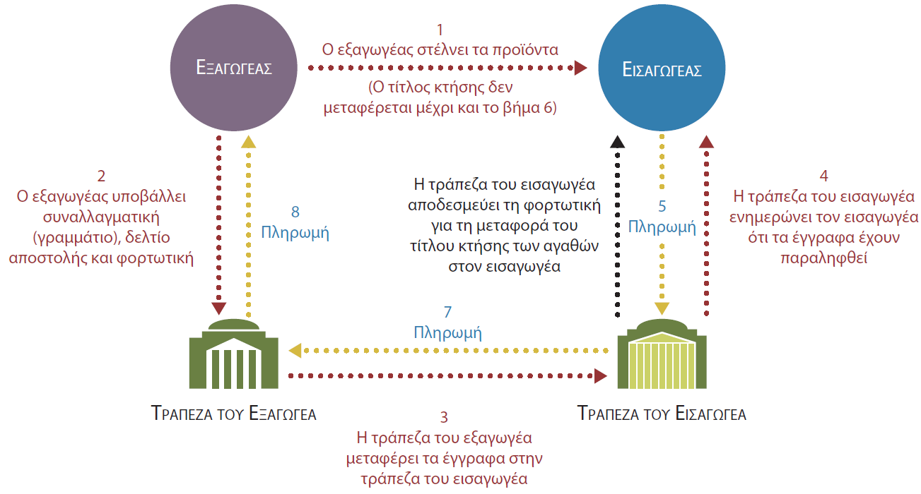
Μέθοδος Πληρωμής: Φορτωτικά Έγγραφα
Notes:
After the exporter ships its goods, it submits to its local banker the draft and appropriate shipping documents, such as the packing list and the bill of lading. The bill of lading plays two important roles in documentary collection: It serves both as a contract for transportation between the exporter and the carrier and as a title to the goods in question. Acting on the exporter’s instructions, the exporter’s bank then contacts its correspondent bank in the importer’s country (or one of its own branches there, if it has any). The latter bank is authorized to release the bill of lading, thereby transferring title of the goods, when the importer honors the terms of the exporter’s draft. This process is shown in Figure 18.1.

Slide 11
Μέθοδος Πληρωμής: Φορτωτικά Έγγραφα
Συναλλαγματική όψεως
Συναλλαγματική προθεσμίας
Συναλλαγματική με ημερομηνία λήξης
Γραμμάτιο εμπορικής αποδοχή
Γραμμάτιο τραπεζικής αποδοχής
Πώληση χωρίς δικαίωμα προσφυγής
Πώληση με δικαίωμα προσφυγής
Notes:
There are two major forms of drafts:
A sight draft requires payment upon the transfer of title to the goods from the exporter to the importer. When the bank in the importer’s country receives the bill of lading and the sight draft from the exporter’s bank, it notifies the importer, which then pays the draft. On payment, the bank gives the bill of lading to the importer, which then can take title to the goods.
A time draft extends credit to the importer by requiring payment at some specified time, such as 30 or 60 days, after the importer receives the goods. (A variant of the time draft, the date draft, specifies a particular date on which payment will be made.)
To obtain title to the goods when a time draft is used, the importer must write “accepted” on the draft, thereby incurring a legal obligation to pay the draft when it comes due. An accepted time draft is called a trade acceptance, which under the laws of most countries is a legally enforceable and negotiable debt instrument. For a fee, the importer’s bank also may accept a time draft, thereby adding its own obligation to pay the draft to the importer’s obligation. In this case the time draft becomes a banker’s acceptance. The exporter may hold either a trade acceptance.
The exporter may hold either a trade acceptance or a banker’s acceptance until it comes due. However, banks and other commercial lenders often are willing to buy acceptances at a discount, thereby allowing the exporter to receive immediate cash. Some acceptances are sold without recourse, meaning the buyer of the acceptance is stuck with the loss if the importer does not pay. Others are sold with recourse, meaning the exporter will have to reimburse the buyer of the acceptance in the case of nonpayment by the importer.

Slide 12
Μέθοδος Πληρωμής: Φορτωτικά Έγγραφα
Πλεονεκτηματα
Μειονεκτηματα
Εύλογα τραπεζικά τέλη
Εκτελεστά χρεωστικά μέσα
Απλοποιημένη διαδικασία είσπραξης
Ευκολότερη και οικονομικότερη χρηματοδότηση
Πιθανή άρνηση αποστολής από εισαγωγέα
Τέλη υπερημερίας
Πιθανή αθέτηση της συναλλαγματικής προθεσμίας από εισαγωγέα
Πιθανώς δαπανηρή δικαστική προσφυγή
Notes:
For an exporter, payment through documentary collection has several advantages over the use of open accounts. First, the bank fees for documentary collection are quite reasonable because the banks act as agents rather than risk takers. Second, a trade acceptance or a banker’s acceptance is an enforceable debt instrument under the laws of most countries, thereby solidifying the exporter’s legal position if the importer refuses to pay. Third, using banks simplifies the collection process for the exporter. Since the collection agent is a local bank, and the importer does not want to jeopardize its business reputation with a local lender, the importer is more likely to pay promptly. Finally, arranging financing for foreign accounts receivable is easier and less expensive when documentary collection is used than when open accounts are used.
With documentary collection the exporter still bears some risks, however. Suppose local business conditions change or the importer finds a cheaper supply source. If this happens, the importer may simply refuse the shipment and decline to accept the draft. As a result, the exporter may have to leave its goods piled up on a foreign loading dock (and running up storage fees known as demurrage) while receiving no payment for them. Another risk is that the importer may default on the time draft when it comes due. The exporter may have legal remedies in either case, but pursuing them is often costly in terms of time, energy, and money.

Slide 13
Μέθοδος Πληρωμής: Εγγυητικές Επιστολές
Εγγυητική επιστολή
Εκδίδεται από μια τράπεζα.
Περιέχει υπόσχεση πληρωμής του εξαγωγέα.
Απαιτούμενα έγγραφα
Αίτηση
Τιμολόγιο
Τελωνειακά έγγραφα
Φορτωτική
Κατάλογος περιεχομένων
Απόδειξη ασφάλισης
Άδειες εξαγωγής
Πιστοποιητικά προέλευσης
Πιστοποιητικά ελέγχου
Notes:
To avoid such difficulties, exporters often request payment using a letter of credit. This document is issued by a bank and contains its promise to pay the exporter on receiving proof that the exporter has fulfilled all requirements specified in the document.
Usually, an importer applies to its local bank for a letter of credit. The bank assesses the importer’s creditworthiness, and, assuming everything is in order, issues the letter of credit. Therefore, the exporter benefits from the bank’s knowledge of the importer’s creditworthiness, the home country’s customs service, and government restrictions on currency movements.
Most letters of credit require the exporter to supply an invoice, appropriate customs documents, a bill of lading, a packing list, and proof of insurance. Depending on the product involved, the importer’s bank may demand additional documentation such as the following before it will fund the letter:
Export licenses are issued by an agency of the exporter’s home country. They may be required for politically sensitive goods, such as nuclear fuels, or for high-technology goods that may have military uses.
Certificates of product origin confirm that the goods being shipped were produced in the exporting country. They may be required by the importing country so it can assess tariffs and enforce quotas.
Inspection certificates may be needed to provide assurance that the products have been inspected and conform to relevant standards. For example, imported foodstuffs often must meet rigorous standards regarding pesticide residues, cleanliness, sanitation, and storage.

Slide 14
Μέθοδος Πληρωμής: Εγγυητικές Επιστολές
Συμβουλευτική πιστωτική επιστολή
Πιστοποιημένη πιστωτική επιστολή
Ανέκκλητη εγγυητική επιστολή
Ανακλητή εγγυητική επιστολή
Notes:
After issuing the letter of credit, the importer’s bank sends it and the accompanying documents to the exporter’s bank, which advises the exporter of the terms of the instrument, thereby creating an advised letter of credit. The exporter can also request its bank to add its own guarantee of payment to the letter of credit, thereby creating a confirmed letter of credit. This type of instrument is particularly appropriate when the exporter is concerned about political risk. If the importer’s home country government later imposes currency controls or otherwise blocks payment by the importer’s bank, the exporter can look to the confirming bank for payment.
Another type of letter of credit is the irrevocable letter of credit, which cannot be altered without the written consent of both the importer and the exporter. A bank may also issue a revocable letter of credit, which the bank may alter at any time and for any reason.

Slide 15
Μέθοδος Πληρωμής: Πιστωτικές Κάρτες
Μικρές διεθνείς συναλλαγές
Εταιρείες πιστωτικών καρτών
Προμήθεια συναλλαγής
Χρέωση μετατροπής συναλλάγματος
Notes:
For small international transactions, particularly those between international merchants and foreign retail customers, credit cards such as American Express, VISA, and MasterCard may be used. A firm may tap into the well-established credit card network to facilitate international transactions, subject to the normal limitations of these cards. The credit card companies collect transaction fees (usually 2 to 4 percent) from the merchant and, in return, assume the costs of collecting the funds from the customer and any risks of nonpayment. The companies typically charge an additional 1 to 3 percent for converting currencies. However, they offer exporters and importers none of the help banks do in dealing with paperwork and documentation requirements of international trade.

Slide 16
Μέθοδος Πληρωμής: Αντισταθμιστικό Εμπόριο
Αντιπραγματισμός
Ανταγορά
Επαναγορά
Αντισταθμιστικές αγορές
Notes:
Countertrade occurs when a firm accepts something other than money as payment for its goods or services. Forms of countertrade include barter, counterpurchase, buy-back, and offset purchase.
The simplest form of countertrade is barter, in which each party simultaneously swaps its products for the products of the other.
A more sophisticated form of countertrade is counterpurchase. In this case, one firm sells its products to another at one point in time and is compensated in the form of the other’s products at some future time. Counterpurchase is sometimes called parallel barter, because it disconnects the timing of contract performance by the participating parties.
Another variant of countertrade involves buy-back. In this situation, one firm sells capital goods to a second firm and is compensated in the form of output generated as a result of their use. A buy-back is particularly useful when the buyer of the goods needs to ensure the exporter will provide necessary after-sale services such as equipment repairs or instructions on how to use the equipment.
Another important type of countertrade involves offset purchases, whereby part of an exported good is produced in the importing country. Offset arrangements are particularly important in sales to foreign governments of expensive military equipment, such as fighter jets or tanks.

Slide 17
Μέθοδος Πληρωμής: Αντισταθμιστικό Εμπόριο
Συμψηφιστικοί λογαριασμοί
Συμφωνίες μεταβίβασης
Notes:
To facilitate countertrade, firms may agree to establish clearinghouse accounts. In this case, an exporting firm incurs a counter-purchase obligation of an equivalent value. This obligation is recorded in its clearinghouse account. When the exporting firm eventually buys goods from its partner, its clearinghouse obligation is reduced.
Sometimes firms use switching arrangements to expand their international sales, without having to engage in countertrade. These arrangements allow the firm to obtain the goods needed to expand its sales by purchasing another company’s countertrade obligation for those goods. This technique helps both parties reach a satisfactory financial outcome and expands export markets. However, switch trading can be difficult to arrange, and it may require the expertise of specialist brokers.

Slide 18
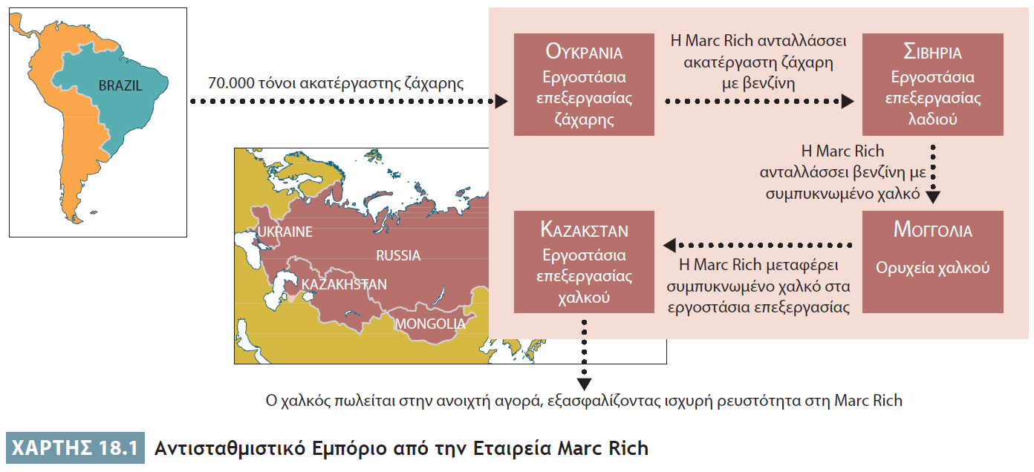
Μέθοδος Πληρωμής: Αντισταθμιστικό Εμπόριο
Notes:
Some firms specialize in exploiting countertrade opportunities by constructing complicated multiple-market trades as part of the firms’ normal business. Consider, for example, Marc Rich & Co., which did over $3 billion in business annually in the former Soviet Union. (Marc Rich & Co. later morphed into Swiss-headquartered Glencore International plc, a leading multinational commodities trading and mining conglomerate.) Soon after the Soviet Union broke up in the early 1990s, the firm engineered a complicated deal among several cash-poor countries. As this figure shows, it began with its buying 70,000 tons of Brazilian raw sugar on the open market. It then hired a Ukrainian firm to refine the sugar and paid the refinery with part of the sugar. Next, it swapped the rest of the refined sugar to oil refineries in Siberia, which needed the sugar for their workers, in return for gasoline. It then swapped 130,000 tons of gasoline to Mongolia in return for 35,000 tons of copper concentrate. The copper concentrate was shipped to copper refineries in Kazakhstan, which received payment in kind. The refined copper then was sold on the world market. At that point, Marc Rich—after several months of efforts—was able to extract its profits on these countertrades in the form of hard currency.

Slide 19
Χρηματοδότηση του Εμπορίου
Εξαγωγικές επιχειρήσεις
Τράπεζες και δανειοδότες
Κυβερνητικά χρηματοδοτικά προγράμματα
Notes:
In most industries standard financing arrangements exist, and an international firm must be ready to offer those terms to its foreign customers.
In many emerging markets, capital markets are often not well developed, and local lenders may charge extremely high interest rates, especially to smaller borrowers. Thus, exporters with access to low-cost capital can gain a competitive advantage by offering financing to foreign customers who lack access to cheaper financing. Of course, before deciding to extend credit, the exporter must examine the trade-off between the benefits of increased sales and the higher risks of default.
Banks and other commercial lenders often are willing to finance accounts receivable of exporters by purchasing letters of credit and time drafts, or factoring open accounts at a discount from face value. Many developed countries supplement the services of these commercial lenders with government-supported financing programs to promote exports.

Slide 20
Διαχείριση του Συναλλακτικού Κινδύνου
Συναλλαγματική έκθεση
Συναλλακτικός κίνδυνος
Κίνδυνος λόγω μετατροπής
Οικονομικός κίνδυνος
Notes:
By using contracts denominated in a foreign currency, firms that conduct international business are exposed to the risk that exchange rate fluctuations may affect them adversely. Experts have identified three types of foreign-exchange exposure confronting international firms: transaction, translation, and economic.

Slide 21
Έκθεση σε Συναλλακτικό Κίνδυνο
Αγορά ή πώληση αγαθών, υπηρεσιών ή περιουσιακών στοιχείων
Επέκταση πίστωσης ή δανεισμός χρημάτων
Notes:
A firm faces transaction exposure when the financial benefits and costs of an international transaction can be affected by exchange rate movements that occur after the firm is legally obligated to complete the transaction. The following types of international business transactions denominated in a foreign currency can lead to transaction exposure: purchasing or selling goods, services, or assets; and lending or borrowing money.

Slide 22
Έκθεση σε Συναλλακτικό Κίνδυνο
Notes:
Table 18.2 summarizes the benefits and costs of different techniques available to manage transaction exposure:
Go naked: The benefits include no capital outlay, along with a potential for capital gain if the home currency rises in value. However, there is a potential for capital loss if the home currency falls in value.
Buy forward currency: This alternative eliminates transaction exposure, and the size and timing of the contract are flexible. Costs include bank fees and lost capital gains, if the home currency rises in value.
Buy currency future: This method is relatively easy and inexpensive, and there is no transaction exposure. But the size and timing of the contract are inflexible, and the costs include bank fees and lost capital gains, if the home currency rises in value.
Buy a currency option: With this approach, transaction exposure is erased, and there is a potential for capital gain if the home currency rises in value. However, it requires an up-front premium, and the size and timing of the contract are not flexible.
Acquire an offsetting asset: This tactic eliminates transaction exposure. However, it can be costly and time consuming to arrange the offsetting transaction. In addition, there is no opportunity for capital gains, should the home currency rise in value.
Unfortunately, these techniques are either unavailable or very expensive to use in many developing markets. As a result, companies operating in those economies will often choose to “go naked.”

Slide 23
Έκθεση σε Κίνδυνο Λόγω Μετατροπής
Αντιστάθμιση στοιχείων του ισολογισμού
Έκθεση σε κίνδυνο λόγω μετατροπής
Notes:
As part of reporting its operating results to its shareholders, a firm must integrate the financial statements of its subsidiaries into a set of consolidated financial statements. Problems can arise, however, when the financial statements of a foreign subsidiary are denominated in a foreign currency rather than the firm’s home currency. Translation exposure is the impact on the firm’s consolidated financial statements of fluctuations in exchange rates that change the value of foreign subsidiaries as measured in the parent’s currency. If exchange rates were fixed, translation exposure would not exist.
Financial officers can reduce their firm’s translation exposure through the use of a balance sheet hedge. A balance sheet hedge is created when an international firm matches its assets denominated in a given currency with its liabilities denominated in that same currency. This balancing occurs on a currency-by-currency basis, not on a subsidiary-by-subsidiary basis.
A controversy exists among financial experts over whether or not firms should protect themselves from translation exposure.

Slide 24
Έκθεση σε Κίνδυνο Λόγω Μετατροπής
Barclays Bank
General Motors Import & Distribution Company Ltd (βρετανική θυγατρική διανομής)
1 £ = 2.00 $ → 10.000.000 £
20.000.000 $
Ενοποιημένες οικονομικές καταστάσεις της GM
1 £ = 1,95 $ → 19.500.000 $
Ζημία λόγω μετατροπής = 500.000 $
General Motors (GM)
Notes:
Consider this simple example of translation exposure. Suppose GM transfers $20 million to Barclays Bank to open an account for a new British distribution subsidiary, General Motors Import & Distribution Company Ltd., so the subsidiary can begin operations. Further assume that the exchange rate on the day of the transfer is £1 = $2.00. Thus, the subsidiary’s sole asset is a bank account containing £10 million. If the value of the dollar were to rise to £1 = $1.95, the subsidiary still would have £10 million. However, when GM’s accountants prepare the firm’s consolidated financial statements, its investment in the British subsidiary would be worth only $19,500,000 (10 million pounds × $1.95). GM thus would suffer a translation loss of $500,000 ($20,000,000 – $19,500,000).

Slide 25
Οικονομική Έκθεση
Εμπειρογνώμονες επί των συναλλαγματικών ισοτιμιών
Επιχειρησιακή αντιστάθμιση κινδύνου
Οικονομική Έκθεση
Notes:
The third type of foreign-exchange exposure is economic exposure, the impact on the value of a firm’s operations of unanticipated exchange rate changes. From a strategic perspective, the firm’s highest policy makers must deal with the threat of economic exposure because it affects virtually every area of operations, including global production, marketing, and financial planning.
One approach firms can use to address the problem of economic exposure is to utilize an operational hedge (or natural hedge) by trying to match their revenues in a given currency with an equivalent flow of costs.
A wide variety of exchange rate experts and expertise is available to assist international businesses in this task. These range from private consultants to the staffs of international banks to the published forecasts of international organizations such as the World Bank and the International Monetary Fund.

Slide 26
Διαχείριση Κεφαλαίου Κίνησης
Εταιρικοί οικονομικοί στόχοι
Ελαχιστοποίηση των υπολοίπων του κεφαλαίου κίνησης
Ελαχιστοποίηση του κόστους μετατροπής νομισμάτων
Ελαχιστοποίηση του συναλλαγματικού κινδύνου
Notes:
Managing foreign-exchange exposure is related to another task that financial officers of international businesses perform—managing working capital, or cash balances. This task is more complicated for MNCs than for purely domestic firms. Financial officers must consider the firm’s working capital position for each of its foreign subsidiaries, as well as for the firm as a whole. In the process, they must balance three corporate financial goals:
Minimizing working capital balances
Minimizing currency conversion costs
Minimizing foreign-exchange risk

Slide 27
Ελαχιστοποίηση των Υπολοίπων Κεφαλαίου Κίνησης στον Ισολογισμό
Ανάγκη για μετρητά
Κόστος ευκαιρίας της διακράτησης χρηματοοικονομικών περιουσιακών στοιχείων
Notes:
Both domestic and international firms must hold working capital to facilitate day-to-day transactions and cover the firm against unexpected demands for cash. However, the rate of return on working capital is extremely low. Thus, they need to balance the firm’s needs for cash against the opportunity cost of holding the firm’s financial assets in such low-yielding forms.

Slide 28
Ελαχιστοποίηση των Υπολοίπων Κεφαλαίου Κίνησης στον Ισολογισμό
Κεντρική ταμειακή διαχείριση
Ελαχιστοποίηση ρευστών διαθεσίμων σε όλη την εταιρεία
Notes:
A multinational corporation can minimize company-wide cash holdings by using a system of centralized cash management to coordinate its worldwide cash flows. This system reduces the precautionary cash balances held by the firm as a whole and the amount of assets tied up in such a low-yielding form.

Slide 29
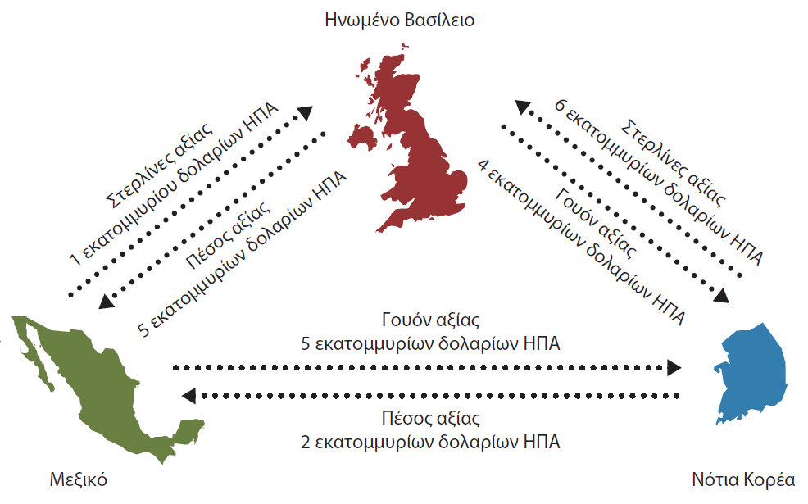
Ελαχιστοποίηση του Κόστους Μετατροπής Νομισμάτων
Notes:
International businesses face another complication. Their foreign subsidiaries may continually buy and sell parts and finished goods among themselves. Cumulative bank charges for transferring these funds and converting the currencies involved can be high. This cost can be cut considerably, however, if the subsidiaries engage in bilateral netting. In this arrangement, two parties agree to net their bilateral obligations.
Let us consider Samsung’s operations in just three countries: Mexico, the United Kingdom, and South Korea. As depicted in Figure 18.3, the gross trade among the firm’s subsidiaries in the three countries is $21 million (= 1 + 3 + 6 + 4 + 5 + 2). (We have denominated their trade in a common currency—U.S. dollars—for simplicity.) If the costs of converting currencies total 0.5 percent of the transactions’ value, Samsung would pay 0.5 percent times $21 million, or $105,000, to convert the currencies necessary to settle these transactions among its subsidiaries.

Slide 30
Ελαχιστοποίηση του Κόστους Μετατροπής Νομισμάτων
Διμερής συμψηφισμός
Πολυμερής συμψηφισμός
Κόστος μετατροπής νομίσματος
Notes:
Currency conversion cost can be cut considerably if the subsidiaries engage in bilateral netting, in which two subsidiaries net out their mutual invoices.
Currency conversion costs can be reduced further if a company engages in multilateral netting. As shown on the next slide, this is an arrangement in which three or more parties agree to net their obligations and reconcile their multilateral net settlement positions.

Slide 31
Ελαχιστοποίηση του Κόστους Μετατροπής Νομισμάτων
Notes:
Bilateral Netting: Rather than have the Mexican subsidiary convert $1 million worth of pesos into pounds and the British subsidiary convert $3 million worth of pounds into pesos, it makes more sense for them to net out the difference. In this case, the British subsidiary simply should pay the Mexican subsidiary $2 million in pesos, making them even. In similar fashion, the South Korean subsidiary can pay the British subsidiary $2 million worth of pounds ($6 million –$4 million = $2 million), and the Mexican subsidiary can pay the Korean subsidiary $3 million worth of Korean won ($5 million – $2 million = $3 million). By engaging in bilateral netting, Samsung reduces its currency conversion costs to $35,000 (0.5 percent × $7 million).

Slide 32
Ελαχιστοποίηση του Κόστους Μετατροπής Νομισμάτων
Notes:
Multilateral Netting: As shown in Table 18.3, the British subsidiary owes the equivalent of $7 million to the other two subsidiaries but also is owed $7 million by them. The South Korean subsidiary is owed $9 million but owes $8 million, for a net receipt of $1 million. The Mexican subsidiary is owed $5 million but owes $6 million, for a net debt of $1 million. When accompanied by the appropriate bookkeeping entries, all transactions among the three subsidiaries can be settled by the Mexican subsidiary transferring $1 million worth of won to the South Korean subsidiary. Because only $1 million is being converted physically in the foreign-exchange market and transferred through the banking system, Samsung’s conversion costs shrink to $5,000 (0.5 percent × $1 million) as a result of the multilateral netting operation.

Slide 33
Ελαχιστοποίηση του Συναλλαγματικού Κινδύνου
Στρατηγική προπορείας και καθυστέρησης
Αύξηση καθαρής διακράτησης νομισμάτων
Notes:
Financial officers also typically adjust the mix of currencies that make up the firm’s working capital to minimize foreign-exchange risk. Often firms use a leads and lags strategy to try to increase their net holdings of currencies that are expected to rise in value and to decrease their net holdings of currencies that are expected to fall in value.

Slide 34
Προϋπολογισμός Κεφαλαίων σε Διεθνές Επίπεδο
Καθαρή παρούσα αξία
Εσωτερικός συντελεστής απόδοσης
Περίοδος αποπληρωμής
Notes:
Another task that financial officers of any business face is capital budgeting. Financial officers must establish mechanisms for developing, screening, and selecting projects in which the firm will make significant new investments. Numerous approaches for evaluating investment projects are available, but the most commonly used methods include net present value, internal rate of return, and payback period.

Slide 35
Προϋπολογισμός Κεφαλαίων σε Διεθνές Επίπεδο: Καθαρή Παρούσα Αξία
Προσαρμογή έναντι κινδύνου
Επιλογή νομίσματος
Επιλογή οπτικής γωνίας
Notes:
The net present value approach is based on the theory that a dollar today is worth more than a dollar in the future. To calculate the net present value of a project, a firm’s financial officers estimate the cash flows the project will generate in each time period and then discount them back to the present.
Financial officers must decide which interest rate, called the rate of discount, to use in the calculation, based on the firm’s cost of capital. For example, if the firm’s cost of capital is 10 percent, then financial officers will use an annual interest rate of 10 percent to discount the cash flows generated by the project through time in order to calculate the present value. The firm will undertake only projects that generate a positive net present value.
The net present value approach can be used for both domestic and international projects. However, several additional factors must be considered when determining whether to undertake an international project. These factors are risk adjustment, currency selection, and choice of perspective for the calculations.
Risk Adjustment. A foreign project may be riskier than a domestic project. In response to this risk, an international business may adjust either the discount rate upward or the expected cash flows downward to account for a higher level of risk.
Choice of Currency. If the project is an integral part of the business of an overseas subsidiary, use of the foreign currency is appropriate. If the project is an integral part of a firm’s global procurement strategy, translation into the home country currency may make sense.
Whose Perspective: Parent’s or Project’s? Another factor is determining whether the cash flows that contribute to the net present value of the capital investment should be evaluated from the perspective of the parent or that of the individual project. In practice, some international businesses analyze the cash flows of the individual project, others focus on the project’s impact on the parent, and others do both.

Slide 36
Προϋπολογισμός Κεφαλαίων σε Διεθνές Επίπεδο: Εσωτερικός Συντελεστής Απόδοσης
1. Εκτίμηση ταμειακών ροών
2. Υπολογισμός επιτοκίου
3. Σύγκριση με το ενδεικτικό επιτόκιο
Notes:
A second approach commonly used for evaluating investment projects is to calculate the internal rate of return. With this approach, financial officers first estimate the cash flows generated by each project under consideration in each time period, as in the net present value analysis. They then calculate the interest rate—called the internal rate of return—that makes the net present value of the project just equal to zero. Then they compare the project’s internal rate of return with the hurdle rate—the minimum rate of return the firm finds acceptable for its capital investments. The hurdle rate may vary by country to account for differences in risk. The firm will only undertake projects for which the internal rate of return is higher than the hurdle rate.

Slide 37
Προϋπολογισμός Κεφαλαίων σε Διεθνές Επίπεδο: Περίοδος Αποπληρωμής
Απλότητα
Αγνόηση μακροπρόθεσμου κέρδους
Notes:
A third approach for assessing and selecting projects is to calculate a project’s payback period. This is the number of years it will take the firm to recover, or pay back, the original cash investment from the project’s earnings. This technique has the virtue of simplicity: All one needs is simple arithmetic to calculate the payback period. However, the approach ignores the profits generated by the investment in the longer run.
Because of its simplicity, many firms use the payback period technique for a quick-and-dirty screening of projects. Then, they apply a more sophisticated method for further analysis of those projects that pass the preliminary screening.

Slide 38
Πηγές Διεθνών Επενδυτικών Κεφαλαίων
Εξωτερικές πηγές επενδυτικών κεφαλαίων
Εσωτερικές πηγές επενδυτικών κεφαλαίων
Notes:
Firms use capital budgeting techniques to allocate their financial resources toward those domestic and international projects that promise the highest rates of return. Having identified such profitable opportunities, firms must secure sufficient capital to fund them, from either external or internal sources. In doing so, an international business wants to minimize the worldwide cost of its capital, while also minimizing its foreign-exchange risk, political risk, and global tax burden.

Slide 39
Εξωτερικές Πηγές Επενδυτικών Κεφαλαίων
Επενδυτικές τράπεζες
Χρηματιστηριακές αγορές
Κεφάλαια με δανεισμό
Αγορά συμβάσεων ανταλλαγής
Notes:
When raising external financing for their investment projects, international businesses may choose from a rich source of debt and equity alternatives. Investment bankers, such as Goldman Sachs, and securities firms, such as Merrill Lynch and Nomura, can help firms acquire capital from external sources.
To facilitate the raising of equity internationally, many MNCs list their common stock on stock markets in several different countries. International firms also have many opportunities to borrow funds internationally on either a short-term or a long-term basis. They may shop for the best credit terms in their home country market, in the host country market, or in other markets.
A particularly important facet of the international capital market is the swap market, in which two firms can exchange their financial obligations. Swaps are undertaken to change the cost and nature of a firm’s interest obligations or to change the currency in which its debt is denominated.

Slide 40
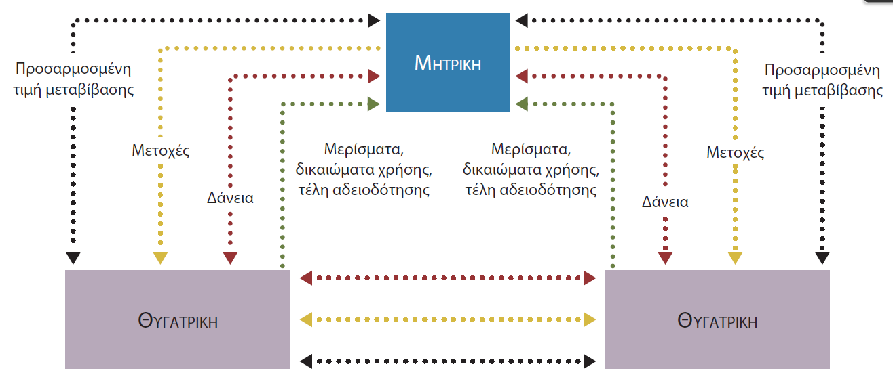
Εσωτερικές Πηγές Επενδυτικών Κεφαλαίων
Notes:
Another source of investment capital for international businesses is the cash flows generated internally. Figure 18.4 summarizes the various internal sources of capital available to the parent and its subsidiaries.

Slide 41
Στρατηγική Χρήση της Μεταβιβαστικής Τιμολόγησης
Υπολογισμός τιμής μεταβίβασης
Μέθοδος που βασίζεται στην αγορά
Μέθοδος που δεν βασίζεται στην αγορά
Notes:
A significant percentage of world trade involves transactions between subsidiaries of the same corporation. A transfer price is the price paid for goods and services involved in intra-corporate transactions between a subsidiary and other branches of the corporate family. In practice, transfer prices are calculated in one of two ways:
Market-based method
Nonmarket-based methods

Slide 42
Στρατηγική Χρήση της Μεταβιβαστικής Τιμολόγησης: Μέθοδος που Βασίζεται στην Αγορά
Οφέλη
Μειώνει τη διαμάχη μεταξύ των δύο μονάδων σε ό,τι αφορά την τιμή.
Προάγει τη συνολική κερδοφορία της πολυεθνικής εταιρείας.
Notes:
The market-based method utilizes prices determined in the open market to transfer goods between units of the same corporate parent. This approach has two benefits.
The higher the price charged in the intra-corporate transfer, the better the selling subsidiary’s performance appears and the poorer the buying subsidiary’s performance appears. Therefore, managers may squabble over the transfer price because they care about how the MNC’s accounting system reports their unit’s performance. Assuming both subsidiaries recognize the basic fairness of the market-based price, such intra-corporate conflict will be reduced.
The market-based approach promotes the MNC’s overall profitability by encouraging the efficiency of the selling unit. Managers know the unit’s profitability depends on their ability to control its costs. Market-based transfer pricing acknowledges their efforts in full. Motivated by the prospects of bonuses and promotions, unit managers have every incentive to improve the efficiency and profitability of their operations.

Slide 43
Στρατηγική Χρήση της Μεταβιβαστικής Τιμολόγησης: Μέθοδος που δεν Βασίζεται στην Αγορά
Μειονεκτηματα
Πλεονεκτηματα
Υποκίνηση συγκρούσεων
Μείωση αποδοτικότητας
Μείωση δασμών και φόρων
Επαναπατρισμός κέρδους
Notes:
Transfer prices also may be established using nonmarket-based methods. Prices may be set by negotiations between the buying and selling units or by cost-based rules of thumb, such as production costs plus a fixed markup. The use of nonmarket-based prices has both disadvantages and advantages.
One disadvantage is that managers of the buying and selling units may waste time and energy arguing over the appropriate transfer price because it will affect their reported profits. Nonmarket-based transfer prices also may reduce the selling unit’s efficiency. A transfer price based on the seller’s costs plus some markup may reduce the seller’s incentive to keep its costs low because it can pass along any cost increases to other members of the corporate family.
Strategic use of nonmarket-based transfer prices may benefit an international business. Lowering transfer prices charged by the subsidiary will lower import tariffs. Adjusting transfer prices can decrease reported profits in high-tax countries and increase reported profits in low-tax countries. This can reduce overall corporate income tax. In addition, adjusting the subsidiary’s transfer prices can also allow a firm to evade host country restrictions on repatriation of profits.

Slide 44
Φορολογικοί Παράδεισοι
Ελάχιστοι φόροι εταιρικού εισοδήματος
Σταθερό πολιτικό και επιχειρηματικό κλίμα
Αποτελεσματικό δικαστικό σύστημα
Προηγμένοι κλάδοι τραπεζών και επικοινωνιών
Notes:
A tax haven is a country that imposes little or no corporate income taxes. For a relatively small fee, a multinational corporation may set up a wholly owned subsidiary in a tax haven. The MNC may divert income from subsidiaries in high-tax countries to the subsidiary operating in the tax haven. To attract MNCs, a tax haven must not only refrain from imposing income taxes but also provide a stable political and business climate, an efficient court system, and sophisticated banking and communications industries. In return, the tax haven is able to capture franchising and incorporation fees, and generate lucrative professional jobs.

Slide 45
Φορολογικοί Παράδεισοι
Κυβερνητική απόκριση
Έλεγχος σε καθαρά εμπορική βάση
Συμφωνία προκαθορισμένης τιμολόγησης
Notes:
Governments scrutinize the transfer-pricing policies of MNCs operating within their borders to ensure they do not evade their tax obligations. A common approach is to use an arm’s length test, whereby government officials attempt to determine the price that two unrelated firms operating at arm’s length would have agreed on. In many cases, however, an appropriate arm’s length price is difficult to establish, leading to conflict between international businesses and tax authorities.
To remedy the cost and uncertainty of the resolution of complex transfer pricing conflicts, firms may negotiate an Advance Pricing Agreement (APA) with the U.S. Internal Revenue Service. The APA represents a binding contract between the firm and the IRS.

Slide 46
Ερωτήσεις Ανασκόπησης
Ποιος φέρει τον κίνδυνο όταν χρησιμοποιείται η προκαταβολή για τη διευθέτηση μιας διεθνούς συναλλαγής;
Ποιος φέρει τον κίνδυνο όταν χρησιμοποιείται ένας ανοικτός λογαριασμός για τη διευθέτηση μιας διεθνούς συναλλαγής;
Ποιοι είναι οι διαφορετικοί τύποι εγγυητικών επιστολών;
Σε τι διαφέρει μια συναλλαγματική όψεως από μια συναλλαγματική προθεσμίας;
Πώς διαφέρει ένα γραμμάτιο εμπορικής αποδοχής από ένα γραμμάτιο τραπεζικής αποδοχής;

Slide 47
Ερωτήσεις Ανασκόπησης
Σε τι διαφέρουν οι διάφοροι τύποι διακανονισμών αντισταθμιστικού εμπορίου μεταξύ τους;
Τι είναι η έκθεση σε κίνδυνο λόγω μετατροπής; Τι αντίκτυπο έχει μια αντιστάθμιση στοιχείων του ισολογισμού στην έκθεση σε κίνδυνο λόγω μετατροπής;
Ποιες τεχνικές προϋπολογισμού κεφαλαίων είναι διαθέσιμες στις διεθνείς επιχειρήσεις;
Τι είναι η τιμή μεταβίβασης; Πώς την καθορίζουν οι επιχειρήσεις;

Slide 48
Σημείωση της αγγλικής έκδοσης των διαφανειών
Το παρόν έργο προστατεύεται από νόμους πνευματικών δικαιωμάτων των Ηνωμένων Πολιτειών και παρέχεται αποκλειστικά για χρήση από διδάσκοντες κατά τη διδασκαλία των μαθημάτων τους και την αξιολόγηση της εκμάθησης των φοιτητών. Η διάδοση ή πώληση οποιουδήποτε μέρους αυτού του έργου (συμπεριλαμβανομένης της δημοσίευσης στον Παγκόσμιο Ιστό) καταστρέφει την ακεραιότητα του έργου και δεν επιτρέπεται. Το περιεχόμενο του έργου δεν θα πρέπει ποτέ να διατίθεται στους φοιτητές, παρά μόνο στους διδάσκοντες που χρησιμοποιούν το συνοδευτικό κείμενο στα μαθήματά τους. Όλοι οι αποδέκτες αυτού του έργου αναμένεται να συμμορφώνονται με αυτούς τους περιορισμούς και να σέβονται τους προβλεπόμενους παιδαγωγικούς σκοπούς και τις ανάγκες των άλλων διδασκόντων που βασίζονται σε αυτήν την ύλη.
Αποκλειστικότητα για την ελληνική γλώσσα: ΕΚΔΟΣΕΙΣ ΤΖΙΟΛΑ

