Slide 1
Migration Policies in the EU: Main Trends and Challenges

Slide 2
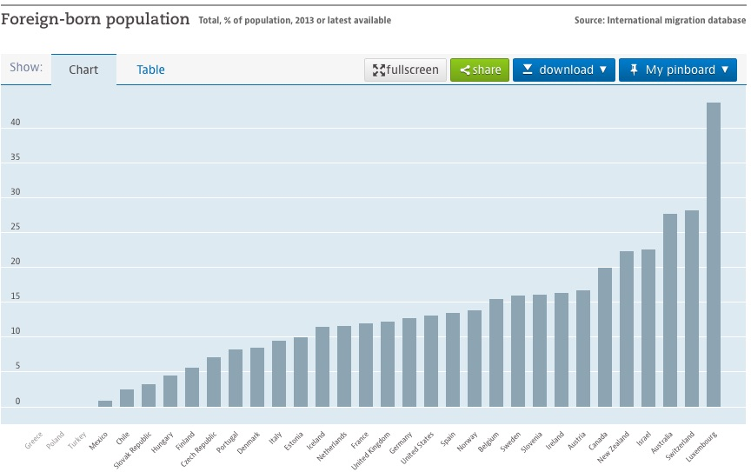
Source : OECD International migration database (2013)

Slide 3
EU´S MIGRATION “POLICY” BACKGROUNDS
FIRST STEPS
“DUBLIN SYSTEM”
SCHENGEN AGREEMENTS
INTERGOVERNAMENTAL APPROACH
NON EU POLITICAL COMPETENCE

Slide 4
INTERNATIONAL PROTECTION
C.E.A.S. DESIGN
DIRECTIVES: 2001/55,2004/83
2013/32 & 33; DUBLIN III REGULATION; EURODAC
2014 EUROFUND IMMIGRATION & INTEGRATION
2010 E.A.S.O. REGULATION
AUTUMN 2015: NEW PACKAGE C.E.A.S. PROPOSALS
NO IMPLEMENTATION: FROZEN

Slide 5
REALITY BITES
FAMINE IN AFRICA: SOMALIA, ERITREA, ETHIOPIA
CRISIS ON NORTHERN AFRICA: SO –CALLED “ARAB SPRINGS”: LIBYA
HUMANITARIAN DISASTERS: AFGHANISTAN, IRAQ, MYANMAR…
WAR ON SYRIA, SUDAN…

Slide 6
NEW RESPONSES
NEW E.U. MIGRATION AGENDA: MAY 2015
FOUR PILARS TO MANAGE MIGRATION BETTER
-Reducing the incentives for irregular migration
-Border management – saving lives and securing external borders
-Europe's duty to protect: a strong common asylum policy
-A new policy on legal migration
-Resettlement & reubication
-EU European Border and Coast Guard (september 2016)

Slide 7
CURRENT SITUATION
EU – TURKEY “AGREEMENT” (?)
CONTROLS & FENCES BETWEEN EU MEMBERS
SCHENGEN COLLAPSE
CEAS FAILURE
OCTOBER 2018 E.C. NEW TOUGH PROPOSALS

Slide 8
Long Term Objectives
Work with key partners to improve the legislative and institutional framework for migration;
Concrete assistance for capacity building on border and migration management, including providing protection for refugees;
Increasing rates of return and readmission with a preference to voluntary return and a focus on reintegration;
Stemming the irregular flows while offering legal migration channels, including increased resettlement efforts.
Source: European Commission (2016)

Slide 9
Approaches
Security Development
Remote Control Root Cause
Visa Policy
Mobility Partnership

Slide 10
Remote Control Approach
Strengthening border controls
Combating illegal entry, migrant smuggling and trafficking.
Readmitting migrants who have cressed into the EU illegally.
Coastguard patrols and other instruments for controlling migration and asylum flow.

Slide 11
Root Cause Approach
Not to restrain the movement of people but encourage it.
Reduce the push factors.
Employment issues, developing governance and demographic changes to minimize economig migration.
Increasing respect for democracy and human rights to minimize the number of asylum seekers and refugees.

Slide 12
Global Approach to Migration (GAM) 2005
Aims to increase legal migration while decreasing irregular migration through a perceptive of development cooperation.
Building capacity for manage migration and asylum flows.

Slide 13
Mobility Partnership to Foster Legal Migration (2007)
With third countries:
Discourage irregular migration
Strengthening border control in return for EU commitments on improved opportunities for legal migration,
Develop third countries capacity to manage migration
Risk of brain drain
Improving procedures for issuing visas to nationals of the third country.
But; European Commission can only monitor process without having any competence to impose official sanctions in case of lack of progress.

Slide 14
Visa Policy
The Schengen Agreement (1985)
Common visa policy as part of the acquis.
Aims: migration control rather than stability and integration.
Rouge states
Historical bounds

Slide 15
EU Readmission Agreement (EURAs)
Aim to control and facilitate the return of irregular migrants and rejected asylum seekers.
Principle of International law that every country should take back its own nationals.
Conditionality for EU candidacy, accession and with countries have close relations.
Main difficulties: Lack of incentives and lack of flexibility.
Visa and quotas.
Elite.
Resource and facilities.
Source: The European Union’s Immigration Policy, A.G.YILDIZ (2016)

Slide 16
EU Interests
Return and readmission
Less irregular migration
Disruption of Fewer deaths
human smuggling in transit
Security and stability
Sustainable development
Third Country Interests Migrants’ Interests
Money and markets Legal Respect for human rights
Less brain drain pathways Better living conditions
Reputational gains No life in limbo

