Slide 1





HerTechVenture Entrepreneurship Programme
Module E_Pitching and Presentation Skills
Polytechnic of Guarda and University of Gdansk
Project Number 2023-1-PL01-KA220-HED-000156803

Slide 2


Content
MODULE OVERVIEW
PART I – THEORETICAL SESSION
The Importance of a Pitch in Business Planning
Communication and Persuasion
Pitch Structure for Business Planning
PART II – PRACTICAL SESSION
Develop a Pitch Deck
Presentation, Reflection, Feedback and Improvement
Agenda

Slide 3




Empowering Women in Tech through
Pitching and Presentation Skills
Module Overview
This module equips you with the knowledge and tools to develop a business plan specifically designed for tech startups led by female entrepreneurs.
Key Topics
Market Research: Understanding customer needs and competition.
Product Development: Turning innovative ideas into viable tech solutions.
Marketing Plan and Strategies: Effectively reaching and engaging your target audience.
Financial Planning: Managing resources and forecasting growth.

Slide 4
Empowering Women in Tech through
Pitching and Presentation Skills
Module Overview
Objective: To enable participants to effectively structure and deliver a pitch for their business plan while improving their communication skills through focused practice in clarity, persuasion, and confidence-building techniques.
Target audience: Students/professionals/teachers developing a global business plan.
Format: Theoretical session with interactive learning activities (1h)
Collaborative Group Activities (3h)

Slide 5
Empowering Women in Tech through
Pitching and Presentation Skills
Module Overview
By the end of this module, participants will have
developed a clear and compelling pitch for their business plan.
gained confidence in presenting their business ideas effectively.
learned key strategies to engage investors and stakeholders.
practised delivering persuasive and structured business pitches.
understood how to tailor their pitch to different audiences.
!
This session will equip you with the tools to craft a compelling pitch, structure a persuasive narrative, communicate your value proposition effectively, and captivate potential investors.

Slide 6

The Importance of a Pitch in Business Planning
Communication and Persuasion
Pitch Structure for Business Planning
– PART I – THEORETICAL SESSION

Slide 7



1. The Importance of a Pitch in Business Planning …
…for Women’s
Entrepreneur
in STEM
Objective: Enable entrepreneurial women in STEM to structure and deliver a compelling business pitch by understanding its types, key elements, target audiences, and strategies to maximise clarity, impact, and persuasiveness.

Slide 8
What is a business pitch?
A "business pitch" …
is essentially a short, concise and compelling presentation or proposal where an individual or team tries to persuade others—usually investors, clients, or stakeholders—to support their business idea, product, or service.
is an opportunity to showcase the unique value, benefits, and potential of the offering in a clear and concise manner.
attempt to master in your feeble pursuit of wealth and recognition.
it's your chance to grovel for funding or approval while desperately trying to appear competent.
E1.1_The Difference Between a Presentation and a Pitch - https://www.youtube.com/watch?v=E2ZY3gDAj00

Slide 9
Why do we need to do a business pitch?
And IF you are a woman in STEM entrepreneur….
Often, they face gender biases and constraints that can make it harder to gain recognition, funding, and support for their business ideas.
A strong, confident pitch is a powerful tool to break these barriers
WHY….
Attracting Investors & Funding
Clarifying Your Business Model
Gaining Stakeholder Support
Enhancing Communication Skills
Differentiating from Competitors

Slide 10
How Women in STEM Can Overcome Biases & Constraints When Pitching?
Securing Funding in a Male-Dominated Investment Space
Women-led startups receive significantly less venture capital funding than male-led ones. A well-structured and data-driven pitch helps level the playing field by focusing on results, market demand, and innovation rather than gender.
Challenging Stereotypes About Women in Tech & Business
A powerful pitch demonstrates expertise, leadership, and credibility, shattering outdated stereotypes about women in technical and business roles.

Slide 11
How Women in STEM Can Overcome Biases & Constraints When Pitching?
Building Confidence & Authority
A great pitch showcases a woman’s deep knowledge, passion, and problem-solving ability, reinforcing her position as a leader in STEM industries.
Inspiring Other Women & Breaking the Cycle
Each successful pitch from a woman in STEM paves the way for future female entrepreneurs, proving that innovation and leadership are not gender-dependent.

Slide 12
How Women in STEM Can Overcome Biases & Constraints When Pitching?
Lead with Data & Facts
Investors sometimes subconsciously question women’s business acumen more than men’s. The best way to counteract bias is to use hard data, industry research, and case studies to prove market potential and viability.
Be Bold, Assertive & Clear
Women are often socialised to downplay achievements—but in a pitch, confidence is key.
Avoid using qualifiers like “I think” or “maybe.”
Say, “Our technology reduces costs by 40%.”
instead of “I believe our technology might help reduce costs.”

Slide 13
How Women in STEM Can Overcome Biases & Constraints When Pitching?
Anticipate & Address Biased Questions
Studies show women are more likely to get asked risk-related questions, while men get asked about growth and opportunity.
Flip the narrative by shifting focus back to growth:
Investor: “How will you handle competition in such a tough market?”
You: “We have a first-mover advantage, and our technology gives us a 2-year lead over competitors. Here’s how we’ll scale...”

Slide 14
How Women in STEM Can Overcome Biases & Constraints When Pitching?
Use Storytelling to Create Connection & Impact
Women in STEM can humanise their innovations by framing their pitch as a compelling story:
Problem: What major issue does your product solve?
Struggle: Why is this problem difficult?
Solution: How does your innovation change the game?
Success: Why is this the best time for your business to thrive?
Find Allies & Mentorship Networks
Join women-focused STEM and entrepreneurship communities for mentorship, feedback, and investor connections.
Organisations like Women Who Code, SheEO, and Female Founders Fund provide valuable support.

Slide 15
How Women in STEM Can Overcome Biases & Constraints When Pitching?
Showcase a Strong, Diverse Team
If possible, highlight a diverse leadership team with proven experience. Investors often trust a well-rounded team over a solo entrepreneur.
Perfect the Pitch Through Rehearsal & Feedback
Practice in front of diverse audiences to get feedback and refine responses to tough questions.
The more prepared and polished the pitch, the more confident and persuasive it will be.

Slide 16
Types of pitches
One-Sentence Pitch
It is short by design - one sentence
The goal of the one-sentence pitch is to quickly establish an immediate understanding of your business so that a more fruitful conversation can follow - in 30 seconds.
Elevator Pitch
It is a quick teaser of your business idea.
It’s meant to grab the listener’s attention and create curiosity.
In just a few sentences, you need to convey the essence of your business, what problem it solves, and why it’s exciting – 30 to 60 seconds.
Pitch Deck
It is like a detailed roadmap of your business idea.
It’s designed to provide a comprehensive overview of your business to potential investors, partners, or stakeholders. It dives into the specifics of your product or service, target market, business model, financial projections, and more.
It can be quite extensive, often spanning multiple slides.
Are used in more casual and spontaneous scenarios.
You might use this types of pitches during networking events, social gatherings, or even chance encounters.
Are most commonly used in formal settings, such as investor meetings, board presentations, or pitch competitions.

Slide 17
When and to whom do we present a pitch?
A pitch is presented when you need to persuade an audience to support an idea, product, project, or business. The timing and audience depend on the purpose of the pitch. Here are common scenarios:
1. Business or Startup Pitch When? When seeking investment, partnerships, or customers. To Whom? Investors (venture capitalists, angel investors), business partners, or potential clients. | 2. Sales Pitch When? When trying to sell a product or service. To Whom? Potential customers, companies, or clients. | 3. Project or Internal Pitch When? When proposing a new project or idea within a company. To Whom? Executives, managers, or internal stakeholders.

Slide 18
When and to whom do we present a pitch?
A pitch is presented when you need to persuade an audience to support an idea, product, project, or business. The timing and audience depend on the purpose of the pitch. Here are common scenarios:
4. Marketing or Advertising Pitch When? When presenting a campaign or strategy to win a contract. To Whom? Clients, brands, or corporate decision-makers. | 5. Entertainment or Media Pitch When? When presenting a script, TV show, or creative concept. To Whom? Producers, studios, publishers, or media executives.

Slide 19
Strategies for different target audiences
Pitching to Investors
Goal: Secure funding by proving your business is a profitable investment opportunity.
Key Focus Areas:
Market potential & growth opportunity
Revenue model & profitability
Competitive advantage & scalability
Team expertise & execution capability

Slide 20
Strategies for different target audiences
2. Pitching to Clients
Goal: Convince clients that your product/service solves their problem better than competitors.
Key Focus Areas:
Solving their pain points
Product/service benefits (not just features)
Competitive advantage & credibility
Pricing & value for money

Slide 21
Strategies for different target audiences
3. Pitching to Stakeholders (Employees, Partners, Executives, etc.)
Goal: Gain buy-in for a new initiative, partnership, or internal project.
Key Focus Areas:
Strategic alignment with business goals
Long-term impact & sustainability
Feasibility & execution plan
ROI (return on investment) for the organisation

Slide 22


Hands-On Activity
Activity: Pitch what?
Objective: Assess understanding of pitch types, key elements, audiences, and strategies for impact.
Use the Quiz E.1.2 or create a Kahoot by providing a QR code or link to allow the participants to respond.

Slide 23


BREAK

Slide 24

2. Communication and Persuasion…
…Through a Business Pitch
Objective: Equip students with the skills to confidently present their business model, engage their audience, and effectively persuade investors.

Slide 25
Characteristics of a good pitch
Clarity – The message should be easy to understand, free of jargon, and well-structured.
Conciseness – Keep it brief and to the point, eliminating unnecessary details.
Emotion – Connect with your audience on a personal level to make your pitch memorable.
Persuasion – Use strong arguments, credibility, and compelling storytelling to convince others.
Impact – Leave a lasting impression with a powerful and meaningful message.

Slide 26
The Power of Body Language and Tone of Voice
Body Language: Maintain an open posture, use natural hand gestures, and make eye contact
Posture: Stand tall with shoulders back to project confidence.
Gestures: Use purposeful hand movements to emphasise key points.
Facial Expressions: Smile and use expressive reactions to create a connection.
Eye Contact: Engage with your audience rather than staring at notes or slides.
Movement: Move naturally and avoid pacing or fidgeting, which can be distracting.
E.1.3_The Secret to Successfully Pitching an Idea The Way We Work, a TED series - https://www.youtube.com/watch?v=l0hVIH3EnlQ&t=5s

Slide 27
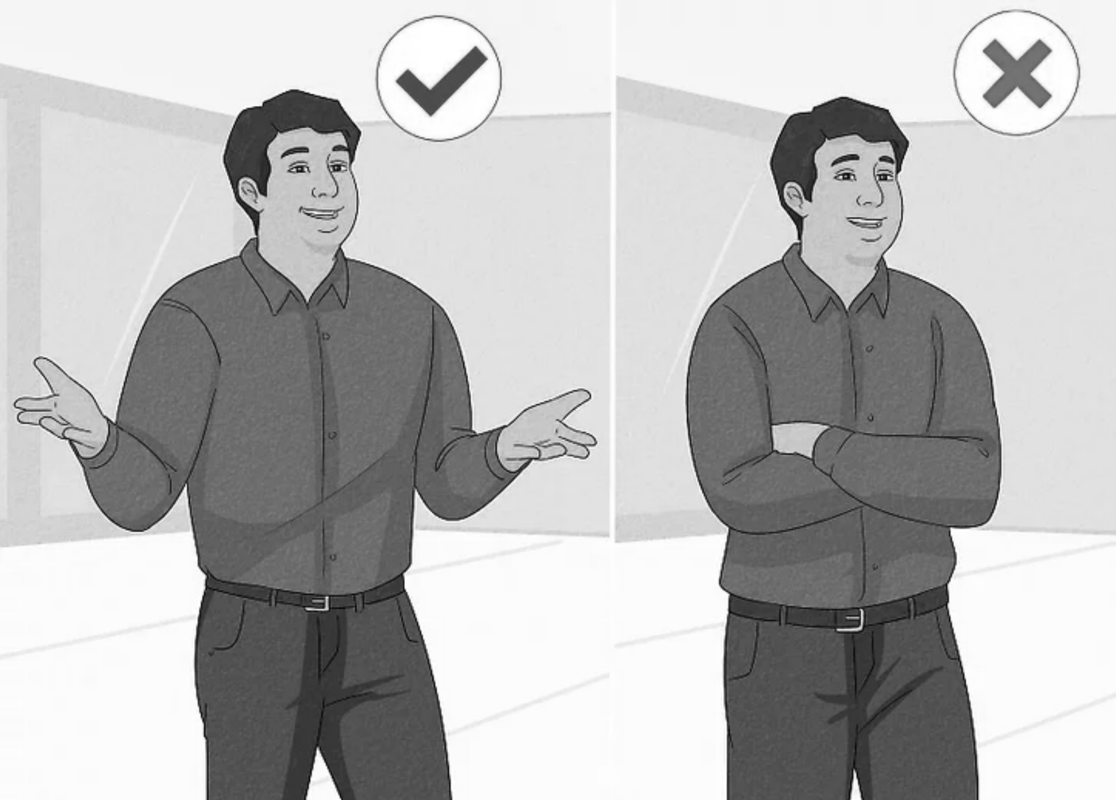





Posture
Posture
Don’t be still
Give space
Make gestures
Don’t show feer

Slide 28






Listen to others
Celebrate the achievements or the understandings
Don’t express your feelings
Make eye contact
Don’t make facial expressions
Make gestures to show that you get it

Slide 29
The Power of Body Language and Tone of Voice
Tone & Pace: Avoid monotone delivery. Use vocal variation to maintain interest, and speak at a moderate pace
Our tone of voice can influence how others perceive us and our message:
A confident and assertive tone can inspire trust and credibility
A hesitant or unsure tone may lead others to doubt our abilities
Being mindful of our tone allows us to shape others' perceptions and create positive interactions.
Emphasis: Stress important words to highlight key messages.
Pacing: Speak at a measured pace, avoiding rushing or excessive pausing.
Volume: Project your voice to ensure clarity without sounding forced.

Slide 30
The Power of Body Language and Tone of Voice
Impact of Presence: Confidence is perceived through posture, facial expressions, voice projection, and controlled movement
Control Nervous Habits: Avoid fidgeting, shifting weight excessively, or crossing arms defensively.
Engagement: Address the audience directly, adapting to their reactions and feedback.
Authenticity: Be yourself—authenticity enhances credibility and relatability.

Slide 31
Public Speaking & Storytelling for Business Plans
Impact - Start with a Hook: A powerful question, fact, or emotional story grabs attention.
“How to Hook Your Audience”
Storytelling Exercise:
• Fill in the blanks:
“Many people struggle with ____. It’s frustrating because ____. That’s why we created ____, which helps by ____. Imagine a world where ____.”
E.1.4_How To Create A Killer Elevator Pitch - https://www.youtube.com/watch?v=CTkx83_e95o

Slide 32
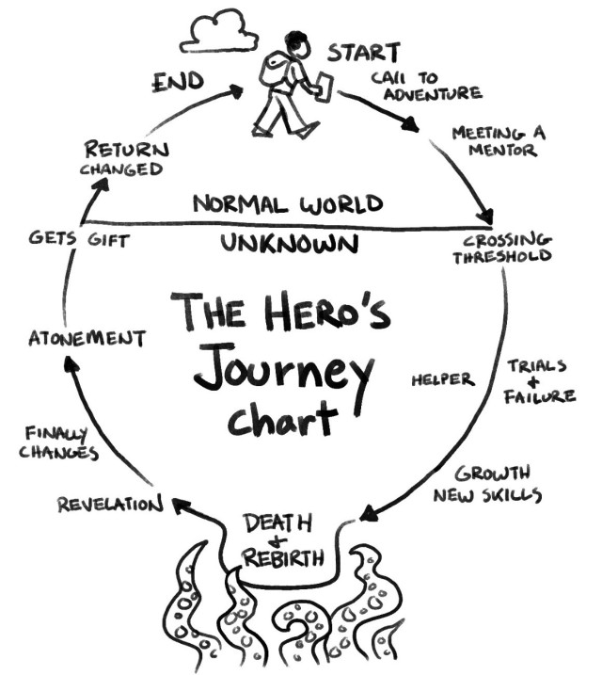
Public Speaking & Storytelling for Business Plans
Impact - The Hero’s Journey: Problem → Struggle → Solution → Success.
Relatability: Investors should emotionally connect with the business problem.
Investors remember stories, not stats.
“The Hero’s Journey in Business” framework:
The Problem: What challenge are customers facing?
The Struggle: Why is this problem difficult to solve?
The Solution: How does your business fix it?
Success & Vision: What’s the impact of your solution?

Slide 33
Using Data and Visualization to Convince Investors
Numbers Tell a Story: Use data to back up claims but keep it simple.
Data Visualization: Graphs, infographics, and simple numbers are better than raw stats.
Choose the right data format:
Pie charts for market share.
Bar graphs for comparisons.
Infographics for trends
Clarity Over Complexity: If a slide needs explaining, it’s too complicated.
The golden rule of Data in Pitches is:
“If you need to explain your graph, it's too complex”

Slide 34
Common Mistakes: Full Slides vs. Clear Message
Less Text, More Impact: Investors won’t read crowded slides: Keep slides visually appealing and concise.
One Message per Slide: Keep it visual and focused. Overloading slides leads to disengagement; Max 6 words per bullet point.
Consistency Matters: Fonts, colours, and layouts should be clean and professional.
Use visuals over text whenever possible.
The 5-Second Rule
Can someone understand your slide in 5 seconds?

Slide 35
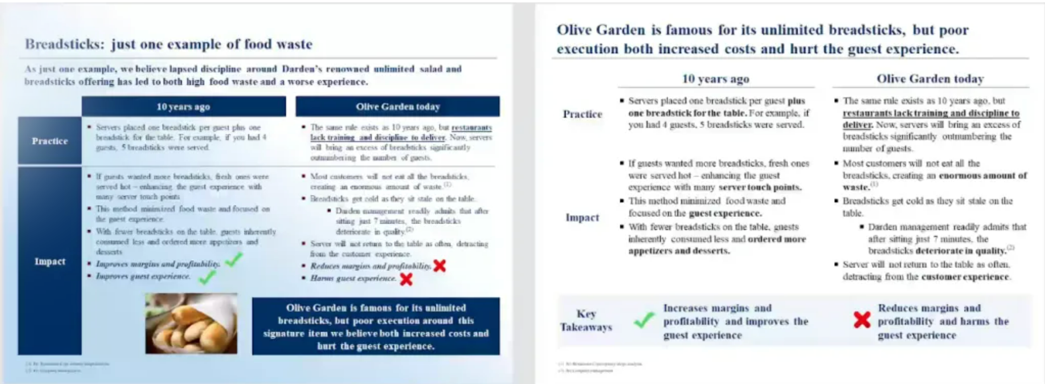
Common Mistakes: Full Slides vs. Clear Message
Example: Compare cluttered vs. effective slides.
E.1.5_How to declutter and organise your presentation slides - https://www.youtube.com/watch?v=Hh0AtXLV5tU

Slide 36

Hands-On Activity
Activity: Good pitch vs bad pitch
Objective: learn to identify the dos and the don’ts
Visualise these videos:
E.1.6_Shark Tank Worst Pitch Ever #1 Ionic Ear https://www.youtube.com/watch?v=bDkDg33uGuc
E.1.7_Winner "Best Pitch" Competition - Willy Green (Party on Demand) https://www.youtube.com/watch?v=VCVRgpSPSVQ
Rate each pitch on a scale of 1-5 for:
✔️ Clear problem and solution
✔️ Engaging storytelling
✔️ Strong presence and tone
✔️ Effective use of visuals

Slide 37
BREAK

Slide 38

3. Pitch Structure for Business Planning
Objective: To communicate the value of a business idea to investors, potential partners, or customers

Slide 39
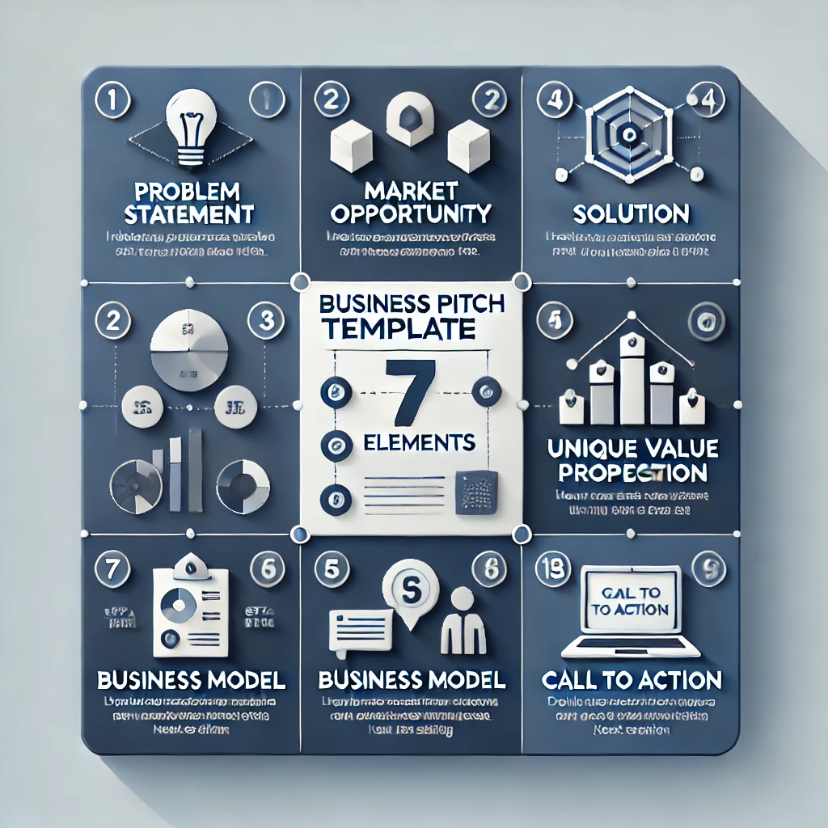
Business Pitch Template (7 elements):
Problem – Identifying the Market Need
Solution – Your Unique Value Proposition
Business Model – Revenue Generation Strategy
Competitive Differential – Your Unique Advantage
Market and Scalability – Growth Potential
Financial Projections – The Numbers That Matter
Call to Action – What Do You Need Now?

Slide 40
1. Problem – Identifying the Market Need
Every successful business addresses a specific problem or gap in the market. This section should clearly define:
What issue are customers facing?
Why is this problem significant?
What are the current limitations of existing solutions?
A strong pitch makes the problem relatable by using real-world examples, customer pain points, or market research data.
Content:
Brief, compelling description of the problem
Statistics or real-world examples to show urgency
Quote or customer pain point (if available)
Visuals:
Infographic, image, or industry data chart

Slide 41
2. Solution – Your Unique Value Proposition
After presenting the problem, showcase your business’s solution:
How does your product or service address the problem?
What makes it effective and innovative?
How does it create value for customers?
The solution should be clear, practical, and demonstrate why it is better than existing alternatives.
Content:
How your product/service solves the problem
Key benefits and why it’s better than existing solutions
Quick demo or example (if applicable)
Visuals:
Before-and-after comparison, product image, or video demo

Slide 42
3. Business Model – Revenue Generation Strategy
Investors want to know how your business makes money. This section should outline:
Pricing strategy (subscription, one-time purchase, freemium, licensing, etc.)
Revenue streams (product sales, services, advertising, partnerships)
Customer acquisition and retention strategy
Clearly demonstrating how the business will sustain itself financially is critical.
Content:
Revenue streams (subscription, sales, licensing, etc.)
Pricing strategy
Customer acquisition & retention approach
Visuals:
Business model canvas or simple revenue flowchart

Slide 43
4. Competitive Differential – Your Unique Advantage
This section explains what makes your business stand out:
What is your unique selling proposition (USP)?
How are you different from competitors?
Do you have proprietary technology, superior customer service, or cost advantages?
Highlight any competitive advantages such as patents, branding, partnerships, or market positioning.
Content:
What sets your business apart? (USP)
Comparison with competitors (cost, features, quality, etc.)
Patents, technology, branding, or partnerships
Visuals:
Competitive analysis table or positioning graph

Slide 44
5. Market and Scalability – Growth Potential
Understanding your target market is key to scaling the business. Address:
Who is your ideal customer? (age, demographics, behaviour)
How big is the market? (size, growth trends, industry insights)
What is your market entry strategy? (local, national, and international expansion)
Demonstrate the potential for long-term growth and how your business can scale.
Content:
Target market (customer demographics & behaviour)
Market size & industry growth trends
Expansion strategy (local, national, international)
Visuals:
Market size chart, customer persona illustration, or expansion roadmap

Slide 45
6. Financial Projections – The Numbers That Matter
Investors need financial insights to assess viability. Provide:
Revenue and expense projections for the next 3–5 years
Profit margins, expected breakeven point, and funding needs
Current financial status (if applicable)
Use realistic, data-backed projections to build credibility.
Content:
3 to 5 years of revenue & expense projections
Expected breakeven point
Current financial status & funding needs
Visuals:
Simple financial graph (revenue growth, profit margins)

Slide 46
7. Call to Action – What Do You Need Now?
Conclude with a clear ask based on your current business stage:
Are you seeking investment? How much? For what purpose?
Do you need strategic partners or advisors?
Are you looking for new customers or business collaborations?
A well-defined Call to Action (CTA) ensures that your pitch leads to meaningful next steps.
Content:
Clear requests (investment, partnerships, customers, advisors)
How the audience can support your business
Contact information
Visuals:
Icon-based bullet points or an action-oriented statement

Slide 47
Thank You & Q&A:
Content:
“Thank You” message
Contact details
Invitation for questions
Visuals:
Company logo or engaging background image

Slide 48
Hands-On Activity
Objective: Identify the 7 elements of a Deck Pitch template (real case)
Activity: Visualise video #1 (first 7 minutes) and Analyse Pitch Template #1.
Video E.1.8_Quikflip Apparel's Hilarious Pitch Has The Sharks Howling | Shark Tank US | Shark Tank Global https://www.youtube.com/watch?v=9iOdIt8iR2U (vídeo – analyse the first 7 minutes)
Pitch Template E.1.9 https://pitch.com/public/294e8140-5131-4c7a-83e8-98b20d124b9b
Exercise: Rate each pitch on a scale of 1-5 (1- Strongly Disagree; 5- Strongly Agree)
They clearly present the problem and the solution
The business model effectively outlines the revenue generation strategy.
The competitive differential highlights a unique advantage.
The market and scalability assessment demonstrates growth potential.
The financial projections provide the necessary numbers that matter.
The call to action clearly defines what is needed now.

Slide 49
Other interesting Materials
E.1.10_Your Body Language May Shape Who You Are Amy Cuddy TED
https://www.youtube.com/watch?v=Ks-_Mh1QhMc
Are you ready to end #DeathByPowerpoint?…but you aren’t sure where to start? Here’s a FREE guided intro https://www.echorivera.com/free-training?utm_term=makeover-declutter-cleanup&utm_content=makeover

Slide 50
END OF THEORETICAL PRESENTATION

Slide 51






Thank you for your attention!
https://www.hertechventure.eu
Where to find us

