Slide 1






HerTechVenture
“HerTechVenture” Entrepreneurship programme
Module D: Gendered Innovations
Erasmus+ Project - KA220-HED - Cooperation partnerships in higher education
University of Salamanca and University of Gdansk
Project Number 2023-1-PL01-KA220-HED-000156803

Slide 2



Part 2: How the concepts influence gendered innovation

Slide 3
CHECK YOUR POTENTIAL!
Activities empowering self-reflection and individual strengths

Slide 4

Free Strengths Survey
A scientific survey of character strengths (available in different languages):
https://www.viacharacter.org/
Designed by stories / Freepik

Slide 5
Activity: Find your leadership power!
Imagine that you are taking leadership in some group. Which leadership role is primarily familiar to you?
ACTIVE LEADER is energetic and needs action, movement, and pronounced leadership. She/he could act in a bit chaotic way, sharing grand visions and inspiring goals. An active leader is particularly suitable for giving the first impulse to the group.
LEADER NAVIGATOR can accurately set the direction of the group's activity. She/he is able to prioritize and organize activities. A leader navigator can maintain consistency and flexibility in the group's activities.
EMOTIONAL LEADER takes care of a good atmosphere in the group and senses the mood in the group well. A leader has good emotional hearing (senses inconsistencies, insincerity, etc.) and is invaluable when tensions and conflicts appear in the group.
Additional questions:
What do you think are the limitations of each leadership role?
In what circumstances, tasks, or groups can an active leader, a navigator leader, and an emotional leader excel?

Slide 6
Activity: Your potential!
Self-reflection exercise.
WORKING SHEET Think about what you are good at and what you like to do. What do people value you for, and what issues bring them to you? Finish the sentences. I am very good at…… I am very good at…… I am very good at…… People say I can…… People say I can…… People say I know…… People say I know…… I have a right to…… I have a right to…… I can…… I can…… Think about how these characteristics can support you during your studies, in a working setting, and your career plans.

Slide 7
Gender mainstreaming in educational spaces

Slide 8
Empowering Women in Tech through
Gender mainstreaming in educational spaces
It is the process of assessing the implications for women and men of any planned activity, including laws, policies or programs, in all sectors and at all levels
It is a strategy designed to make women's as well as men's concerns and experiences an integral element in the design, implementation, monitoring and evaluation of policies and programs in all political, economic and social spheres, so that women and men benefit equally and inequality is not perpetuated
Gender mainstreaming does not replace the need for women-specific policies and programs or positive legislation, nor does it replace gender units or gender focal points
United Nations. (1997). Informe del Consejo Económico y Social correspondiente a 1997 (A/52/3/Rev.1). https://digitallibrary.un.org/record/271316

Slide 9

Empowering Women in Tech through
Gender mainstreaming in educational spaces
University
Society
Competences training
+
Innovation
+
Coeducation
STEM workers
Science, technology, engineering and mathematics with gender mainstreaming

Slide 10
Empowering Women in Tech through
Gender mainstreaming in educational spaces
Project/problem-based learning (knowledge and observation of the environment)
Breaking with traditional educational dynamics and practices
Active, participatory and motivating methodologies.
Non-sexist language
Sensitization of students, teachers and the immediate environment.
Participation and cooperation
Discovery, critical thinking and debate

Slide 11
Empowering Women in Tech through
Gender mainstreaming in educational spaces
It is a current pedagogical proposal to respond to the demand for equality made by feminist theory, which proposes a reformulation of the model of transmission of knowledge and ideas from a gender perspective in the spaces of socialization destined for training and learning.
(National Institute for Woman, Spanish Government, 2007)
Coeducation

Slide 12

Empowering Women in Tech through
Gender gap in innovation
Impact on innovation:
Reduced creativity and diverse perspectives. Innovation thrives on diverse teams that bring different viewpoints.
Slower technological advancement and limits scientific breakthroughs.
Gender-blind product design:
Many products are designed without considering women’s needs, leading to biased designs in technology, healthcare, and engineering.
Products and services created without a gender perspective often overlook crucial aspects that affect women’s safety, health, and usability.

Slide 13

Empowering Women in Tech through
Gender gap in innovation
Effect on economy and development:
The STEM workforce shortage is a major economic issue, and excluding women reduces the available talent pool.
Global GDP could increase if gender gaps in the workforce were reduced.
Inclusive workplaces report higher productivity and better financial performance.
Countries that fail to close the STEM gender gap risk slower economic growth and innovation lack.
The absence of women in STEM leadership roles perpetuates inequality, affecting education, employment, and women’s overall economic independence.

Slide 14
Empowering Women in Tech through
Technological innovations are gender-biased
'Neutral' technology
The premise that technology is gender-neutral can lead to exclusion in the use of technology
A ‘neutral’ approach to technology can mean that designers unconsciously project their own characteristics, skills, knowledge and social status onto end-users, a fact that can result in the technological exclusion of certain social groups

Slide 15

Empowering Women in Tech through
Technological innovations are gender-biased
Replicating stereotypes
When technologies target specific user groups (e.g. women consumers, or support for women in the workplace) they can reinforce gender differences, traditional stereotypes and hierarchies
Technologies that attempt to represent ‘human’ characteristics, such as behaviour and the body, may in fact normalise gender stereotypes

Slide 16
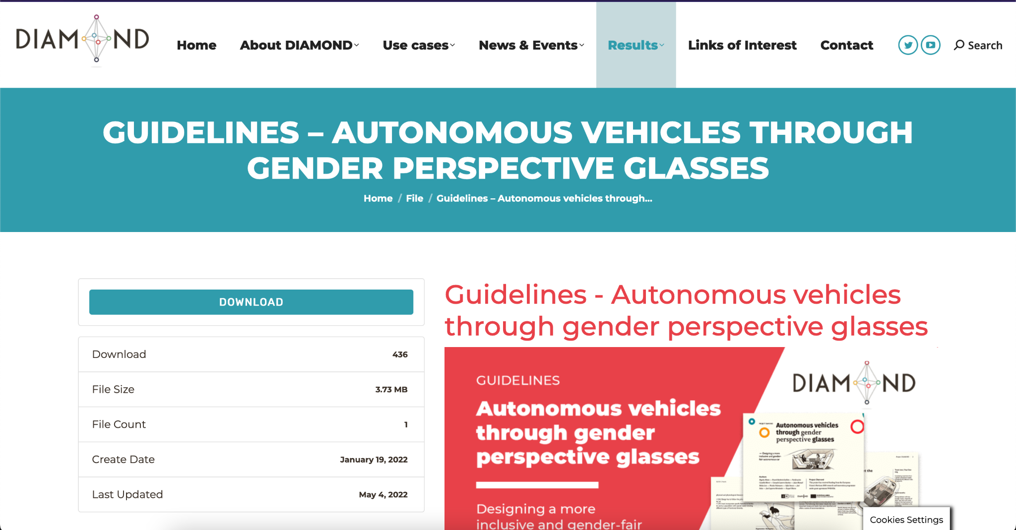
Empowering Women in Tech through
Technological innovations are gender-biased
Source: https://diamond-project.eu/download/guidelines-autonomous-vehicles-through-gender-perspective-glasses/

Slide 17
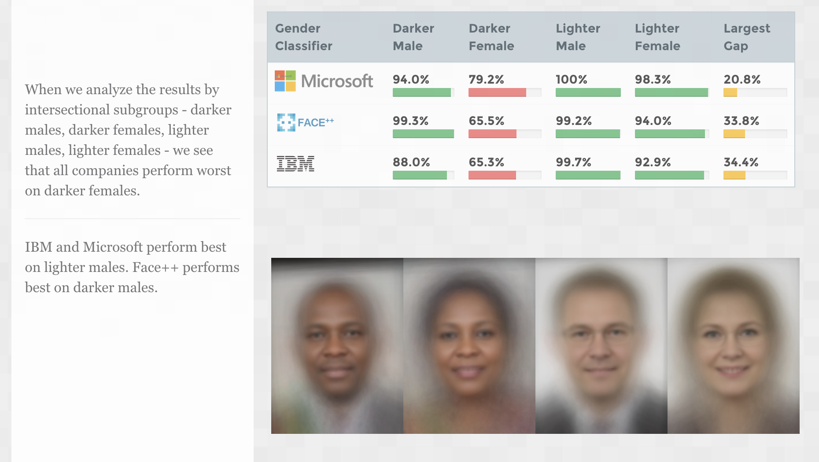
Empowering Women in Tech through
Technological innovations are gender-biased
The Gender Shades research used 1270 faces to reveal IBM, Miscrosoft, and Face++ were better at guessing the gender of male faces than female faces and especially struggled on darker female faces
Source: http://gendershades.org/overview.html

Slide 18
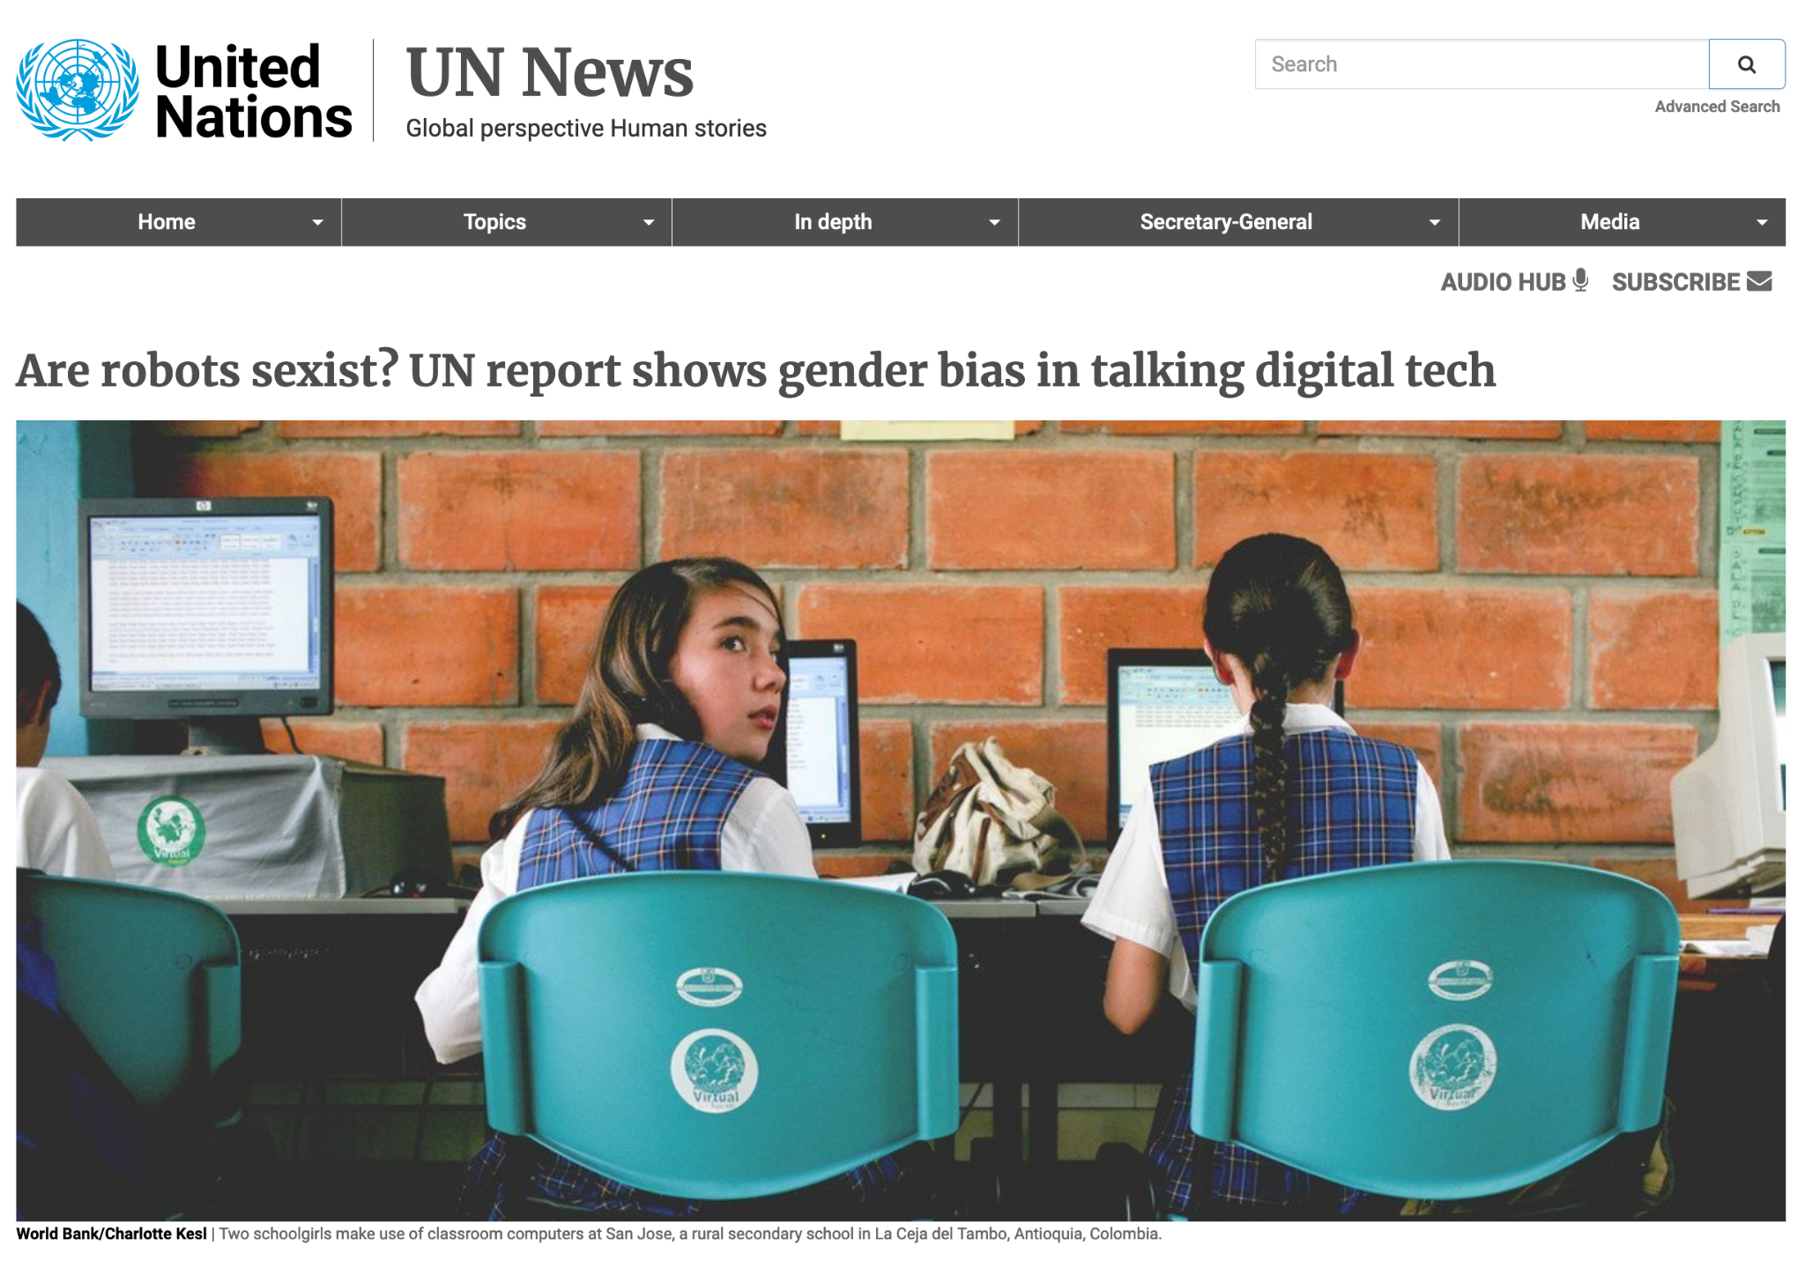
Empowering Women in Tech through
Technological innovations are gender-biased
Female’ voice assistants express submissive traits, an expression of the gender bias embedded in Artificial Intelligence (AI) products as a result of what UNESCO calls the “stark gender imbalances in skills, education and the technology sector”
Source: https://news.un.org/en/story/2019/05/1038691

Slide 19
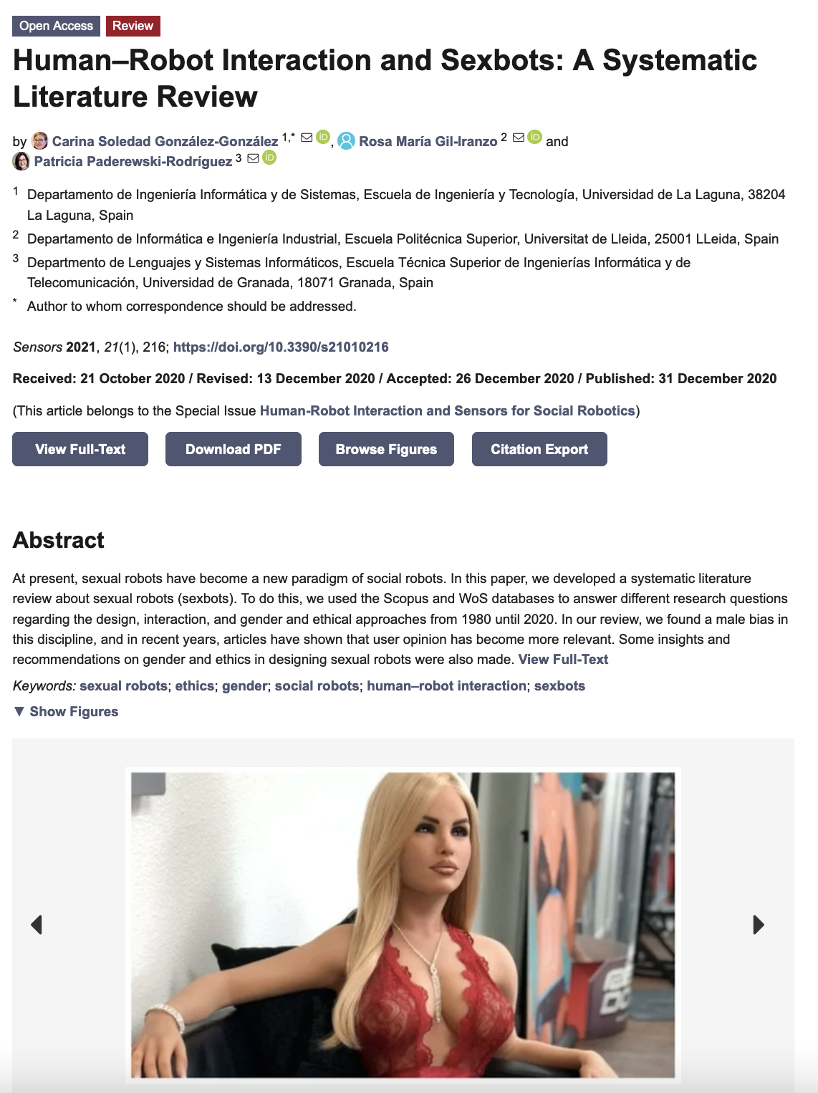
Empowering Women in Tech through
Technological innovations are gender-biased
While sexbots and social robots offer new possibilities, their design and usage raise critical questions about ethics, gender biases, and human interaction that must be carefully addressed
Some concerns has to be taken into account about gender representation, objectification, and reinforcement of stereotypes in sexbot design
Source: González-González, C. S., Gil-Iranzo, R. M., & Paderewski-Rodríguez, P. (2021). Human–Robot Interaction and Sexbots: A Systematic Literature Review. Sensors, 21(1), 216. https://www.mdpi.com/1424-8220/21/1/216

Slide 20
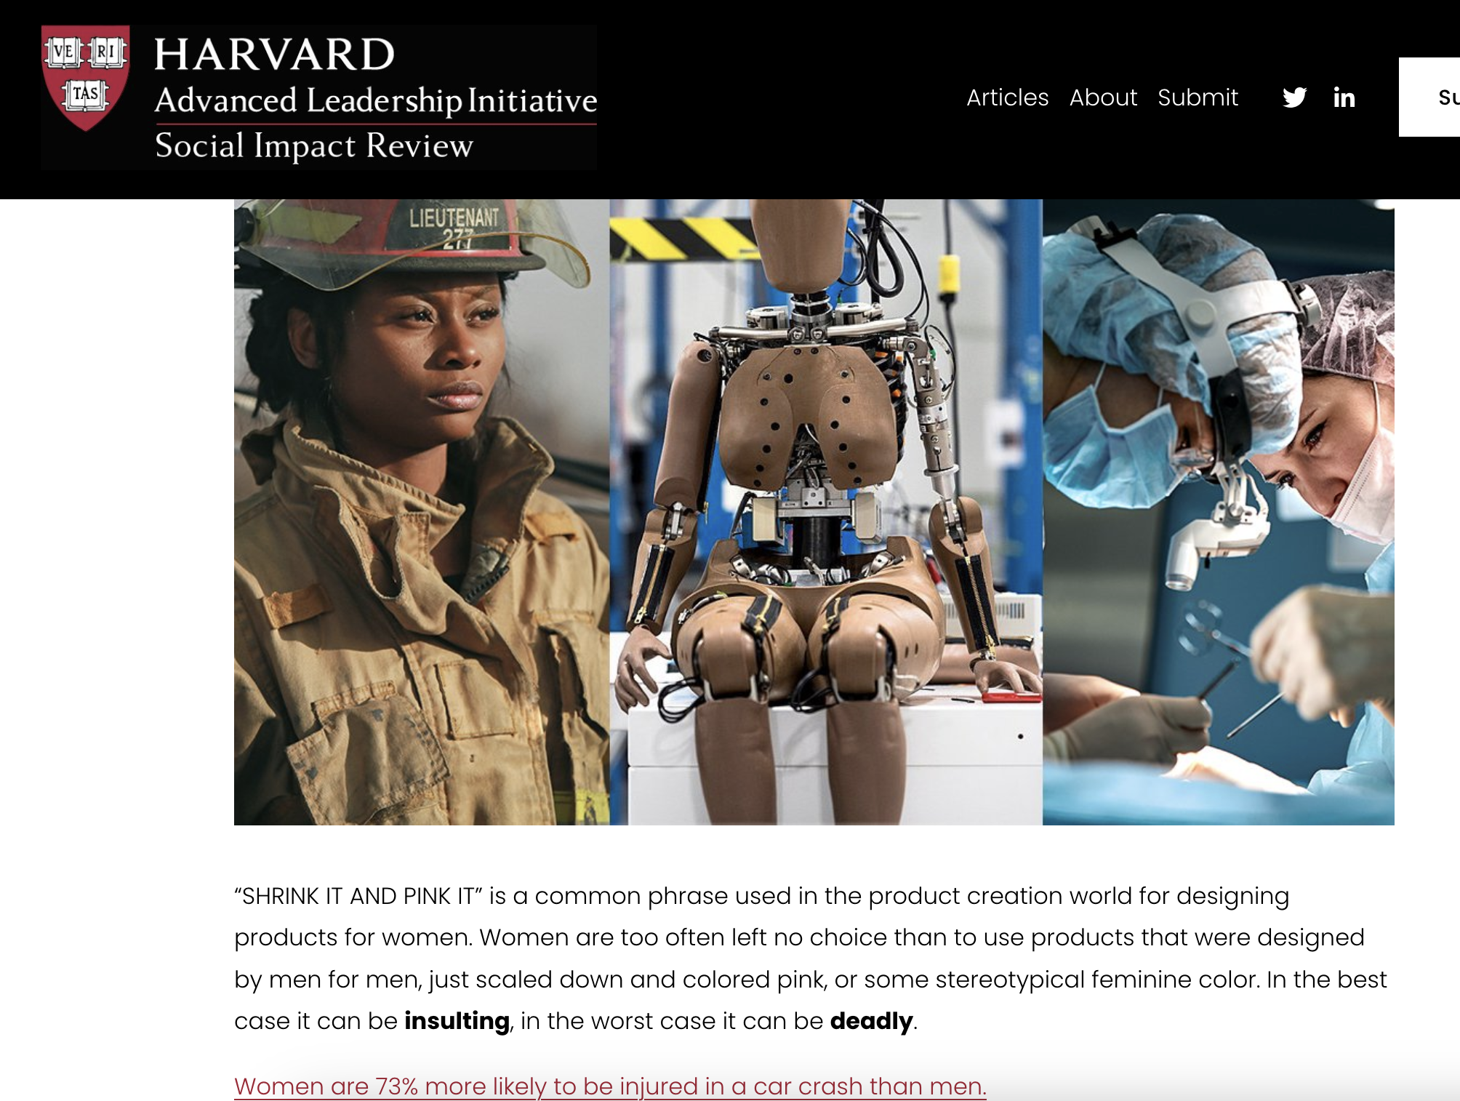
Empowering Women in Tech through
Technological innovations are gender-biased
More examples
Shrink It and Pink It: Gender Bias in Product Design: https://www.sir.advancedleadership.harvard.edu/articles/shrink-it-and-pink-it-gender-bias-product-design

Slide 21
Individual activity:
Analysis of real products / ideas / projects to identify gender gap problems

Slide 22
Empowering Women in Tech through
Gender mainstreaming in R+D+i
Integrating sex and/or gender analysis into research content and innovation adds value to research in terms of excellence, creativity and business opportunities.
Takes into account biological and/or social aspects, sex and gender analysis and intersecting social categories, such as ethnicity or socio-economic status.
Favours innovation and equality by ensuring that results, products and programmes benefit all citizens and society as a whole.
Source: Directorate General for Research and Innovation (European Commission) (2020) Gendered innovations 2. How inclusive analysis contributes to research and innovation: policy review. Available at https://op.europa.eu/en/publication detail/detail/--/publication/33b4c99f 2e66 11eb b27b 01aa75ed71a1/language en

Slide 23
Empowering Women in Tech through
Gender mainstreaming in R+D+I
The gender dimension:
The R+D+I approach clearly states how the findings of the project will apply to the specific needs of men and/or women.
The literature review identifies possible sex/gender differences and/or similarities to be taken into account for the implications on/of the research results on women and/or men.
The research questions and hypotheses include a rigorous sex and/or gender analysis that clearly addresses the question of possible differences and/or similarities that may exist between men and women.

Slide 24
Empowering Women in Tech through
Gender mainstreaming in R+D+I
The gender dimension:
R+D+I methods present sex-disaggregated samples and, where relevant, proportional representation of women and men to ensure that the information collected will allow for sex/gender analysis that incorporates other key factors that may interact with sex/gender (age, ethnicity, etc.)
Relevant ethical issues that may have particular implications for men and/or women (similarly or differently) are identified and addressed appropriately.
Dissemination/transfer of knowledge is approached through a sound strategy that will facilitate appropriate application of research results to needs (do not generalise where it is not generalisable).

Slide 25
Empowering Women in Tech through
Gender mainstreaming in R+D+i
Gender needs to be taken into account at all stages of the research and innovation cycle
Gender-sensitive research and innovation has a two-pronged approach:
it pays attention to the participation of women and men by providing equal opportunities for everyone
integrates gender into the content of the research from the initial idea to the dissemination of results
Source: European Commission: Directorate-General for Research and Innovation, Toolkit gender in EU-funded research, Publications Office, 2011, https://data.europa.eu/doi/10.2777/62947

Slide 26
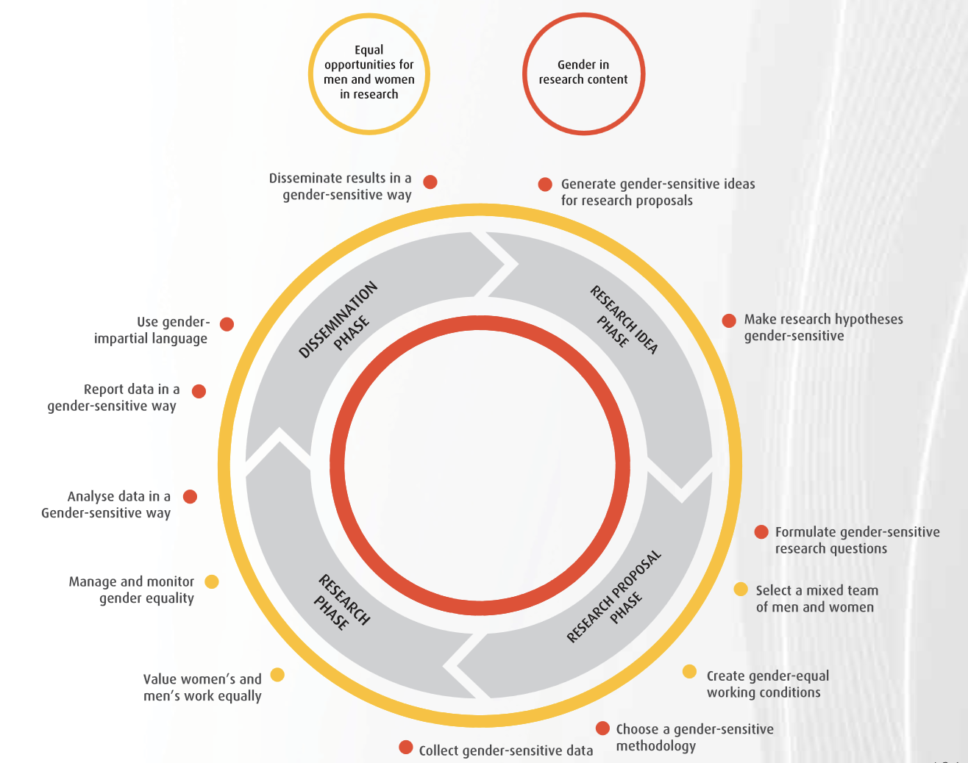
Source: European Commission: Directorate-General for Research and Innovation, Toolkit gender in EU-funded research, Publications Office, 2011, https://data.europa.eu/doi/10.2777/62947

Slide 27
Empowering Women in Tech through
Gender mainstreaming in R+D+i
What should I do?
Rethinking priorities
Rethinking concepts and theories
Formulating research questions
Analysing sex
Analysing gender assumptions
Analysing covariates
Rethinking standards and reference models
Participatory research
Source: Guía práctica para la inclusión de la perspectiva de género en los contenidos de la investigación. Fundación CIREM

Slide 28
Empowering Women in Tech through
Gender mainstreaming in R+D+i
R+D+I on gender in engineering and technology
Diagnosis of the gender situation - locally or globally
Determining the causes of gender gaps
Gender-sensitive disciplinary research
R+D+I with a gender dimension
Solving societal problems taking into account sex/gender analysis
Designing products for women and minorities

Slide 29
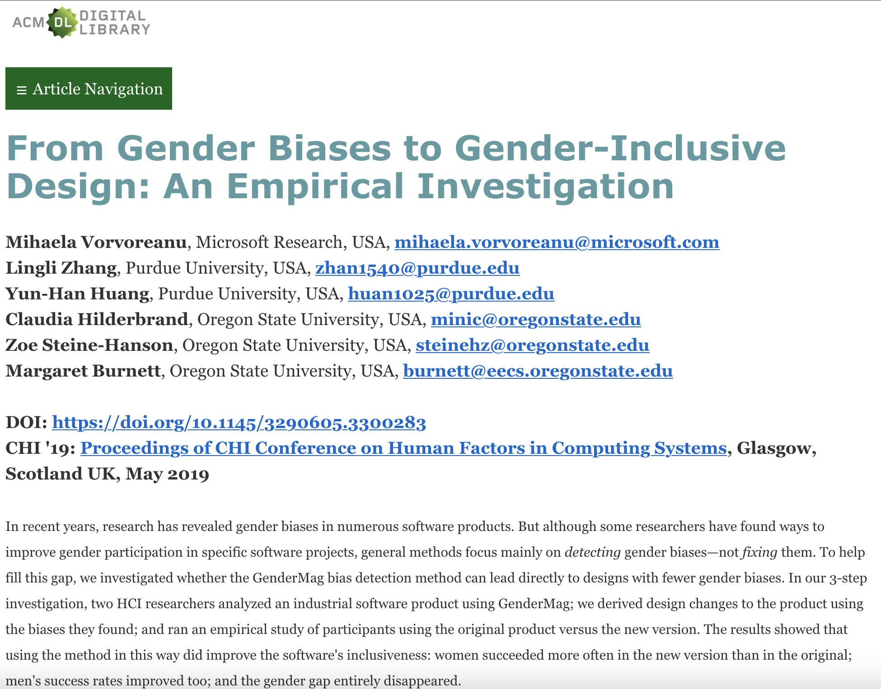
Empowering Women in Tech through
Gender mainstreaming in R+D+i
GenderMag Project (https://gendermag.org/index.php) enables software practitioners (e.g., developers, managers, UX professionals) find gender-inclusivity "bugs" in their software, and then fix the bugs they find
Source: https://dl.acm.org/doi/fullHtml/10.1145/3290605.3300283

Slide 30

Empowering Women in Tech through
Measures to reduce the gender gap in innovation and technology
Gender inequality remains a significant challenge in the fields of innovation and technology, where women continue to be underrepresented, particularly in leadership positions, entrepreneurship, and research
Addressing this gap requires a multi-level approach, involving educational institutions, businesses, policymakers, and funding bodies

Slide 31
Empowering Women in Tech through
Measures to reduce the gender gap in innovation and technology
In this section, we will explore good practices implemented by companies and universities to promote women’s participation in research, development, and innovation, as well as funding and support programmes specifically designed to empower women in these fields.
Additionally, we will examine European regulations that integrate gender mainstreaming into research and innovation projects, ensuring that gender perspectives are systematically included in technological and scientific advancements.

Slide 32
Empowering Women in Tech through
Measures to reduce the gender gap in innovation and technology
Many companies and universities have recognised the importance of diversity and inclusion in fostering creativity and excellence in research and innovation.
To encourage more women to enter and thrive in these fields, institutions have implemented initiatives such as mentorship programmes, leadership training, and dedicated funding schemes for female researchers.

Slide 33
Empowering Women in Tech through
Measures to reduce the gender gap in innovation and technology
Companies, particularly in the technology sector, have also introduced inclusive recruitment policies, flexible work arrangements, and unconscious bias training to create a more supportive environment for women in STEM fields.
Some have established internal networks and resource groups where female employees can access peer support, networking opportunities, and career development resources.
The implementation of family-friendly policies, such as parental leave and childcare support, has also proven effective in retaining female talent in research and innovation careers.

