Slide 1






HerTechVenture
“HerTechVenture” Entrepreneurship programme
Module D: Gendered Innovations
Erasmus+ Project - KA220-HED - Cooperation partnerships in higher education
University of Salamanca and University of Gdansk
Project Number 2023-1-PL01-KA220-HED-000156803

Slide 2

Content
Module Overview
Part 1: Building de basic concepts
Key concepts about gender
Horizontal and vertical segregation
“Sticky floor” and “glass maze”
Gender socialisation and media representation
Gender gap in STEM
Part 2: How the concepts influence
Gender mainstreaming in educational spaces
Gender gap in innovation
Measures to reduce the gender gap in innovation and technology
Conclusion
Agenda

Slide 3
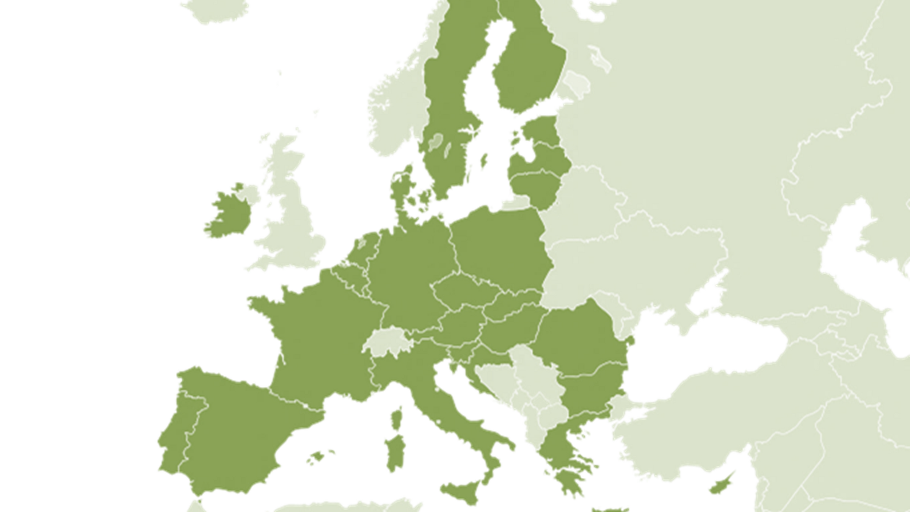












Slide 4




HerTechVenture aims to create a comprehensive entrepreneurship program that addresses the challenges and needs of female students for increasing their self-esteem and confidence and developing innovation and entrepreneurship competences to pursue tech business careers

Slide 5
Empowering Women in Tech through
Module D. Gendered Innovations
Module Overview
This module equips you with the knowledge and tools to understand the impact of gender on innovation, identify structural barriers, and develop strategies to promote equity in entrepreneurial and technological environments
Key Topics
Part 1: Building de basic concepts
Key concepts about gender: Biological sex, gender, gender identity, gender expression and sexual orientation.
Horizontal and vertical segregation
“Sticky floor”, “glass maze”, “imposter syndrome” and “queen bee syndrome
Gender socialisation and media representation
Gender gap in STEM
Part 2: How the concepts influence
Gender mainstreaming in educational spaces
Gender gap in innovation
Measures to reduce the gender gap in innovation and technology

Slide 6

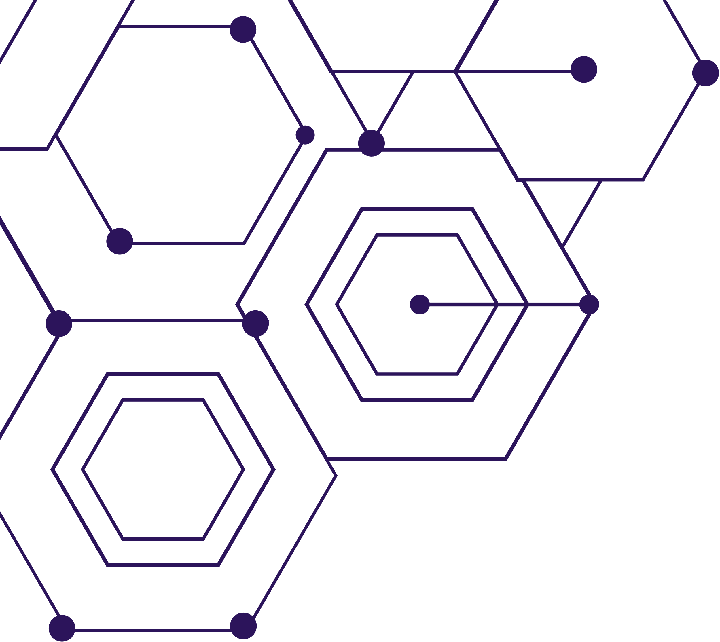
Part 1: Building the basic concepts

Slide 7

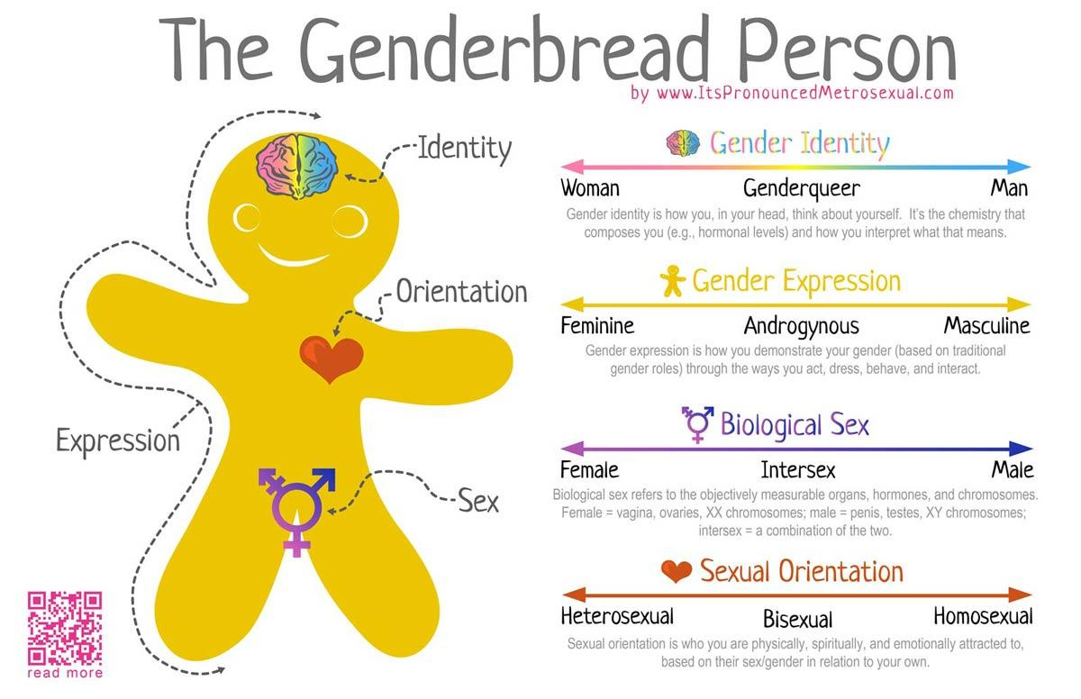
Empowering Women in Tech through
Key concepts about gender:

Slide 8
Empowering Women in Tech through
Key concepts about gender:
!
Biological sex:
Biological sex refers to the physical, hormonal and genetic characteristics a person is born with, such as sex chromosomes (XX or XY), reproductive organs and hormone levels
Although it has traditionally been considered a binary category (male or female), biology is more complex, and there are intersex variations that do not fit into this dichotomy

Slide 9
Empowering Women in Tech through
Key concepts about gender:
!
Gender:
Gender is a social construct that defines the roles, behaviours and expectations that society assigns to men and women.
It is not a static or universal concept, as it varies across cultures and over time.

Slide 10
Empowering Women in Tech through
Key concepts about gender:
!
Gender identity:
Gender identity is a person's internal, subjective perception of themselves in relation to their gender.
It may coincide with the sex assigned at birth (cisgender) or differ from it (transgender, non-binary, gender fluid, among other identities).

Slide 11
Empowering Women in Tech through
Key concepts about gender:
!
Gender expression:
Gender expression refers to the way a person manifests their gender identity through their appearance, behaviour and attitudes.
It includes aspects such as dress, body language and speech.
This expression does not always conform to traditional norms of masculinity or femininity, and is experienced uniquely by each person.

Slide 12
Empowering Women in Tech through
Key concepts about gender:
!
Sexual orientation:
Sexual orientation describes a person's emotional, romantic or sexual attraction to others.
It can be towards people of the same gender (homosexuality), the opposite gender (heterosexuality), both genders (bisexuality), independently of gender (pansexuality) or even lacking attraction (asexuality).
All these concepts are distinct from each other but are often confused or mistakenly assumed to be interchangeable.

Slide 13
Game activity to match concepts.
Let's Play!
Get ready for a fun matching game where we connect important concepts about identity and expression!
How it works:
You’ll see five key concepts and five definitions.
Your mission: match each concept with its correct meaning!
Quick thinking and teamwork will help you win!

Slide 14
Game activity to match concepts.
Concepts:
Biological Sex
Gender
Gender Identity
Gender Expression
Sexual Orientation

Slide 15
Game activity to match concepts.
Definitions:
Biological Sex: The physical characteristics (such as chromosomes, hormones, and anatomy) typically categorized as male, female, or intersex.
Gender: Social and cultural roles, behaviors, and expectations associated with being male, female, or other identities.
Gender Identity: A person’s internal sense of their own gender, which may or may not match their biological sex.
Gender Expression: How a person presents their gender outwardly, through clothing, behavior, hairstyle, voice, or body characteristics.
Sexual Orientation: Who someone is emotionally, romantically, or sexually attracted to.
Tip:
Some concepts are closely related, but each one is unique. Think carefully about the differences!
Let's start!
Match the concepts with the correct definitions — Good luck!

Slide 16
Empowering Women in Tech through
Horizontal segregation
Occurs when men and women are concentrated in different sectors or industries due to entrenched gender norms and stereotypes.
For example, women are often overrepresented in sectors such as education, health and social work, while men predominate in technology, engineering and finance.
This distribution reinforces economic inequalities and limits women's career choices.

Slide 17
Empowering Women in Tech through
Vertical segregation
Also known as glass ceiling.
It refers to the unequal distribution of women and men within the same job hierarchy.
Women are often at lower levels and have less access to leadership or decision-making positions.
This is due to structural barriers, such as lack of support networks, unconscious biases in selection and promotion processes, and difficulties in reconciling work and personal life.

Slide 18
Traps in social perception
OBJECTIVE
Individual activity for fostering group reflection based on Activity 2 of LTTA
PREPARATION
Create a forum thread for each of the sentences, at least, one true and one false
DEVELOPMENT
Each participant share their opinions on the forum and discuss over the previous opinions
Notes:
Online activity based on Dorota true/false activity in Guarda

Slide 19
Empowering Women in Tech through
“Sticky floor”
The concept describes the difficulty women face in moving out of low-paying, low-mobility positions within an organization.
Women are often trapped in roles with few opportunities for advancement, due to lack of recognition, under-investment in their training or assignment to tasks that do not lead to promotion.
This is particularly visible in sectors such as retail, customer service and administrative services.

Slide 20
Empowering Women in Tech through
“glass maze”
The metaphor illustrates the complex and multiple obstacles that women must overcome to reach leadership positions.
Unlike the ‘glass ceiling’ (an invisible but rigid barrier), the ‘glass maze’ emphasises that the path to professional success for women is complicated, full of detours and challenges not faced by their male colleagues.
These may include the need to constantly demonstrate competence, take on more family responsibilities or face leadership expectations based on gender stereotypes.

Slide 21
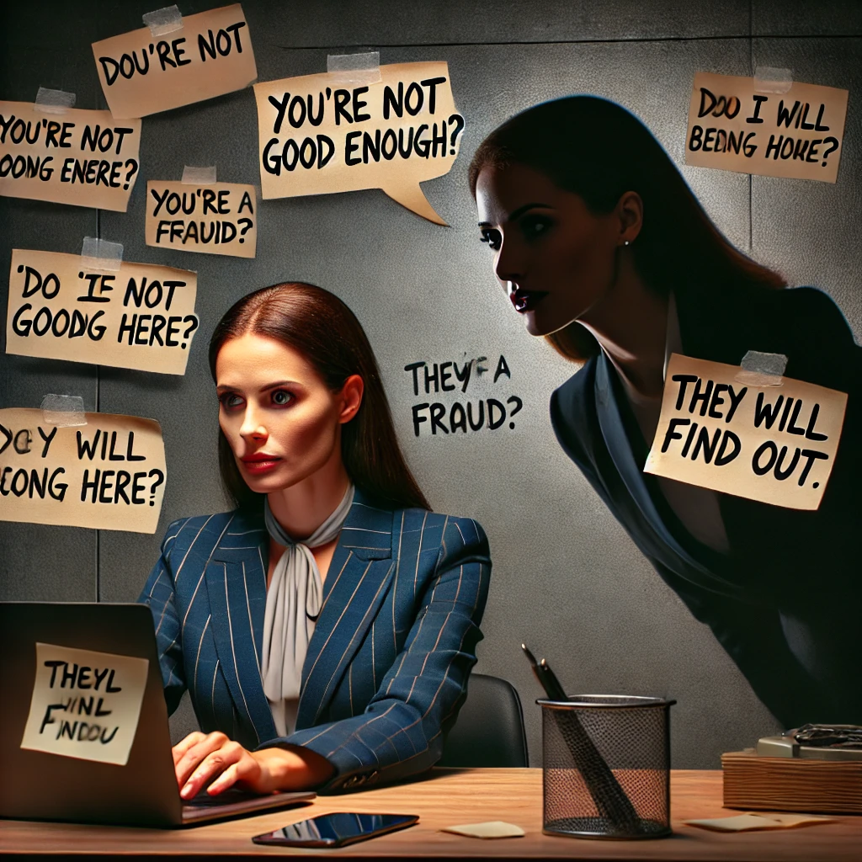
Empowering Women in Tech through
“Imposter Syndrome” and “Queen Been Syndrome”
Many women in business and innovation struggle with “Imposter Syndrome” and the “Queen Bee Syndrome”.
Imposter Syndrome, a psychological pattern in which they doubt their abilities and fear being exposed as “frauds,” despite their achievements.
This self-doubt can hinder women from seeking leadership roles, applying for funding, or scaling their businesses.

Slide 22
Empowering Women in Tech through
“Imposter Syndrome” and “Queen Been Syndrome”
Strategies to combat ”Imposter Syndrome” include:
Recognising the problem.
Reframing negative thoughts.
Seeking mentorship and community support.
Setting realistic standards.
Owning success.
Encouraging organisational change.

Slide 23

Empowering Women in Tech through
“Imposter Syndrome” and “Queen Been Syndrome”
The Queen Bee Syndrome occurs when women in leadership positions distance themselves from or even undermine other women in the workplace.
Instead of mentoring or supporting their female colleagues, they may see them as competition and exhibit behaviors that reinforce gender biases rather than dismantling them.
This behaviour often stems from the belief that there is only limited space for women at the top, leading them to see female colleagues as competition rather than allies.

Slide 24
Empowering Women in Tech through
“Imposter Syndrome” and “Queen Bee Syndrome”
Strategies to combat “Queen Bee Syndrome” this include:
Encourage women’s leadership networks. Change workplace culture fostering inclusive policies that support women at all levels.
Raise awareness about unconscious bias and workplace dynamics.
Redefine leadership styles.
Encourage women to support each other publicly.

Slide 25
Empowering Women in Tech through
Gender socialisation
Gender socialisation is the process by which individuals learn gender roles, behaviours, and norms from childhood. It influences aspirations, interests, and self-esteem.
From a young age, girls and boys receive messages about what is considered ‘appropriate’ for their gender, which influences their aspirations, interests and self-esteem. For example, in schools, boys often receive more encouragement to develop skills in mathematics and technology, while girls may be implicitly or explicitly discouraged from pursuing careers in these fields.
Social norms profoundly affect people's career choices and self-perception, limiting their personal and professional development.
It impacts self-esteem, as people may feel pressured to conform to rigid expectations that do not match their interests or abilities, which can lead to insecurity and lack of self-confidence.

Slide 26
Empowering Women in Tech through
Gender stereotypes / Gender expectations
Men | Women
Strong | Weak
Brave | Fearful
Tough | Sensitive
Mind | Body
Athlete | Creative
Unfaithful | Faithful
Protector | Dependent
Non-aesthetic | Aesthetic
Non-romantic | Romantic

Slide 27
Empowering Women in Tech through
Gender socialisation
It shapes how we see ourselves and how we interact with the world, creating barriers that limit people's potential by relying on traditional gender norms.
Key Influencers:
Family: Assigns gendered expectations through toys, colours, and household chores.
School: Directs boys and girls towards different subjects and activities that reinforce gender stereotypes (e.g., science for boys, humanities for girls).
Peers - they evaluate your behavior and choices, they can exclude you if you do not behave according to stereotypical gender norms.
Culture and media: Reinforces traditional gender expectations, portraying women in roles of care and beauty and men as leaders and providers.

Slide 28
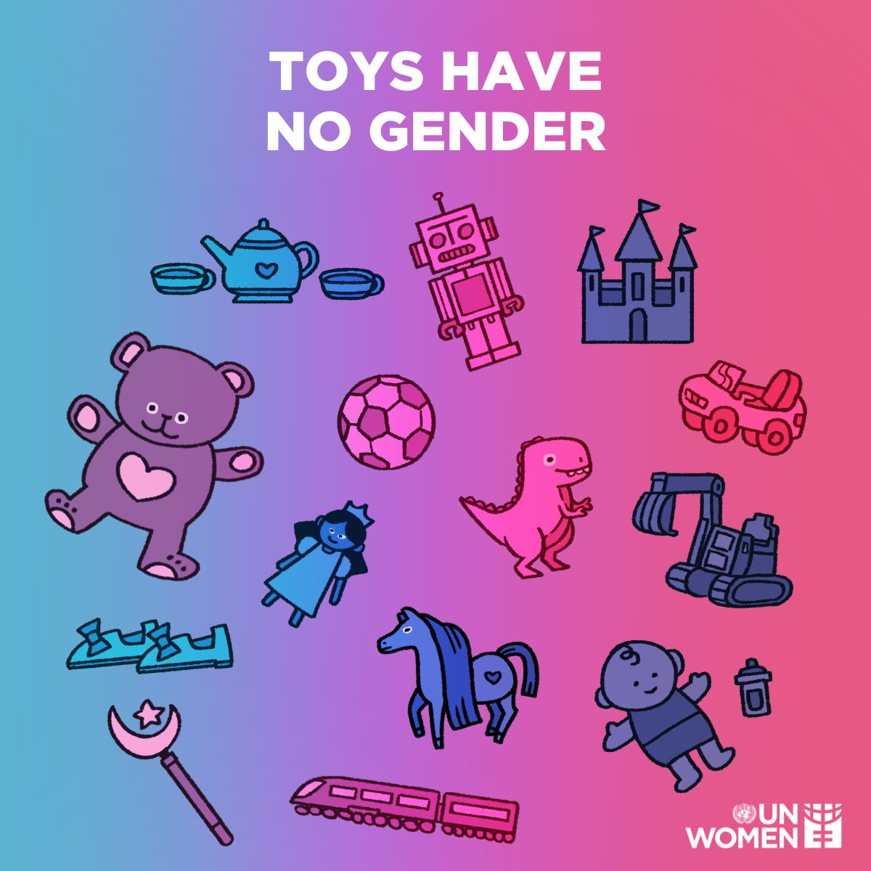
Empowering Women in Tech through
Gender socialisation
Analysis of images of 3.125 children across 32 toy catalogues in 9 countries: Belgium, Bulgaria, Croatia, Denmark, Germany, Italy, Spain, Sweden and the United Kingdom.
Key findings of the study:
12 catalogues, (37.5%) more than a third, had specific sections of toys “for boys” and “for girls” versus 20 catalogues (62.5%) having no specific sections. Most of those that are not formally divided into genders have, however, sections that are clearly marked by colours (pink and pastel colours for girls, darker and bolder colours for boys).
In 5 sections, boys were at least two thirds of the total children, respectively: videogames (67%), construction (69%), drones (72%), cars and transportations (74%), war and guns (88%). Girls were over the two thirds of total children only in two sections: care activities (87%) and beauty and grooming (94,5%).
Source: https://coface-eu.org/study-toy-catalogues-in-europe-making-or-breaking-stereotypes

Slide 29
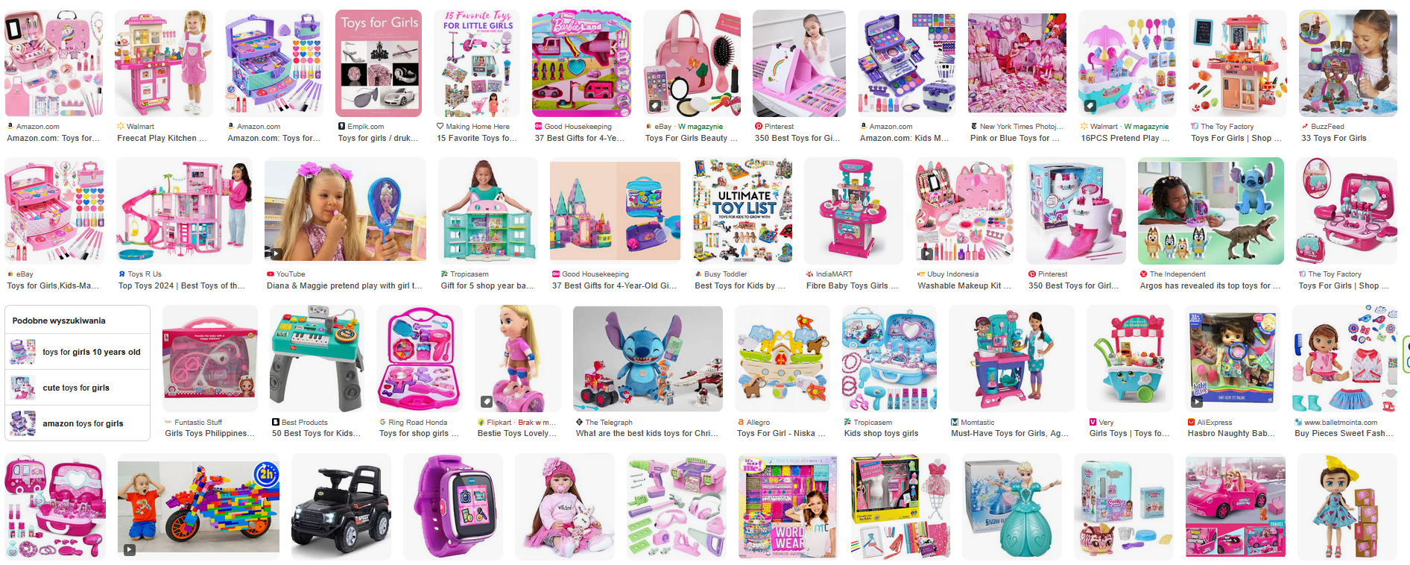
Empowering Women in Tech through
Gender socialisation

Slide 30
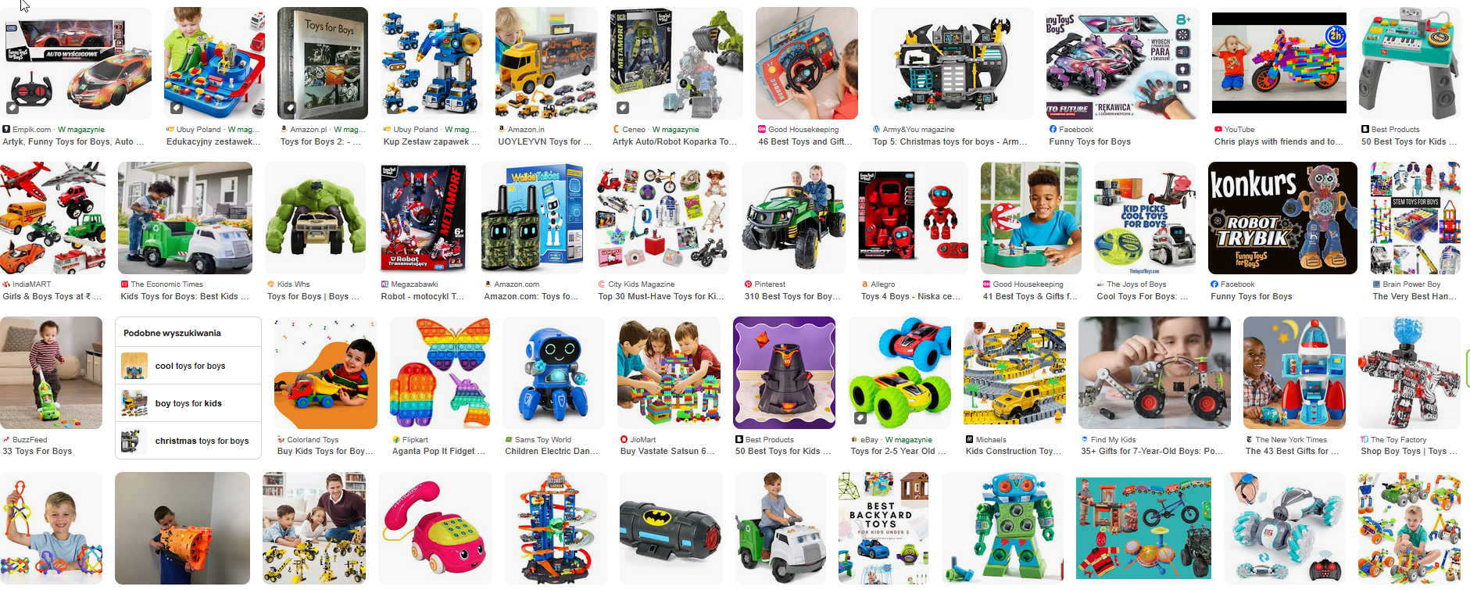
Empowering Women in Tech through
Gender socialisation

Slide 31
Empowering Women in Tech through
The role of media in gender socialisation
The media play a key role in the reproduction and perpetuation of gender stereotypes.
Television, films, advertising, and social media reinforce stereotypes about femininity and masculinity.
Women are often shown in subordinate roles, being depicted as hypersexualised, dependent characters, or as secondary figures that revolve around male characters.
Men are depicted as leaders, heroes, or decision-makers who make important decisions and control situations.
This unbalanced representation not only limits the vision of what women can or should be, but also influences social and personal expectations of how they should behave and what they should aspire to be.

Slide 32
Empowering Women in Tech through
The role of media in gender socialisation
Key issues in women in media representation
Women are underrepresented in leadership and power roles
This sends an implicit message that these roles are not for them
Impact
Lower self-esteem and reduced access to opportunities.
Reinforces gender barriers in professional and personal growth.
Despite there are attempts to make more female voices visible, stereotypes continue to be present, whether through idealised body image narrow femininity roles.
This repeated exposure to a biased representation of gender reinforces traditional ideas and limits the possibilities for the creation of a more equal and diverse society.

Slide 33
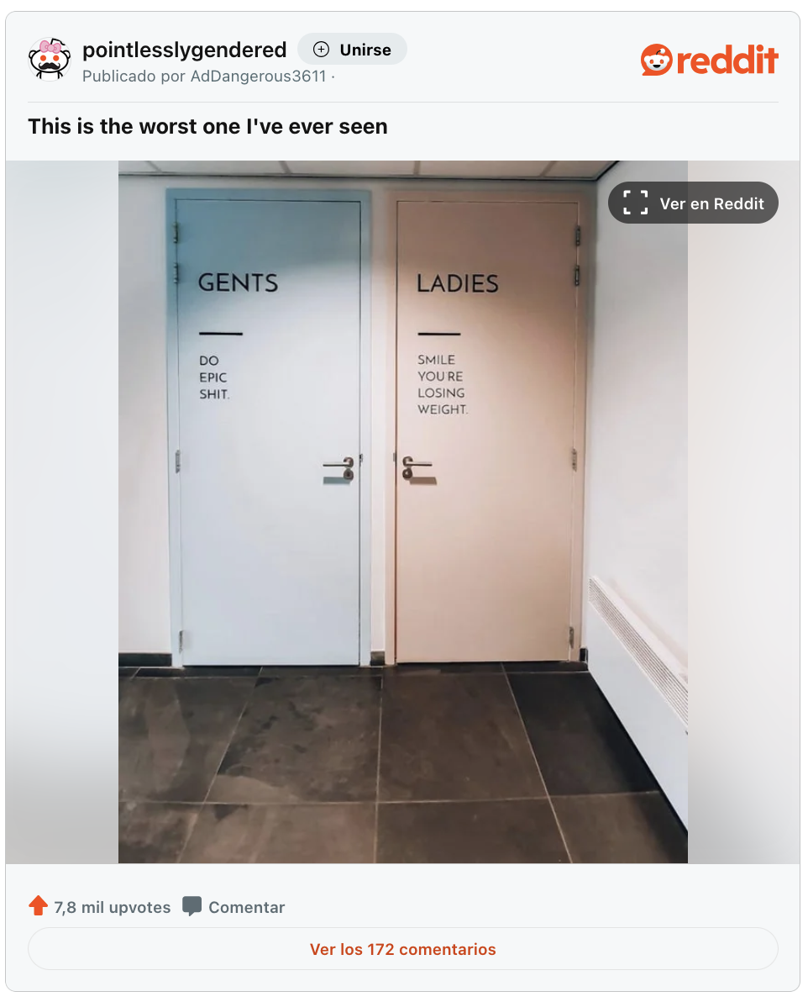
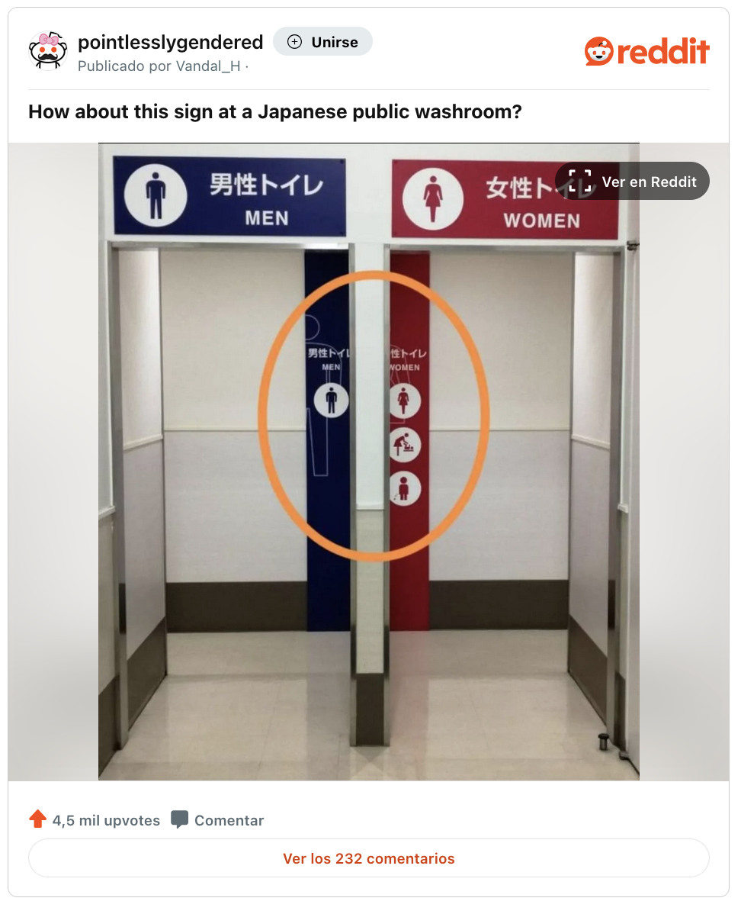
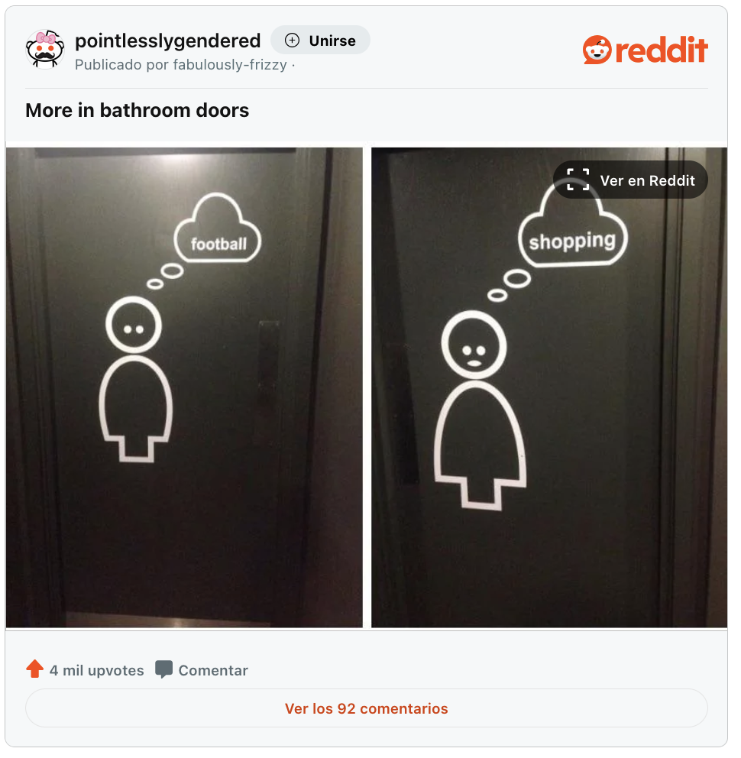
Empowering Women in Tech through
The role of media in gender socialisation
Source link (Reddit)
Source link (Reddit)
Source link (Reddit)

Slide 34

Empowering Women in Tech through
The role of media in gender socialisation

Slide 35

Empowering Women in Tech through
The role of media in gender socialisation

Slide 36

Empowering Women in Tech through
The role of media in gender socialisation

Slide 37
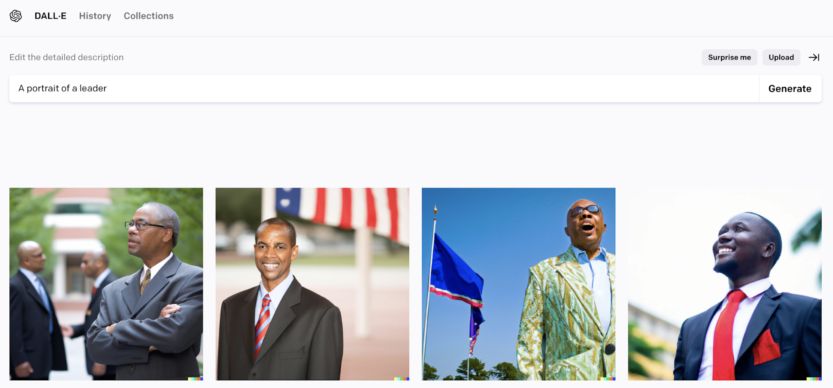
Empowering Women in Tech through
The role of media in gender socialisation

Slide 38
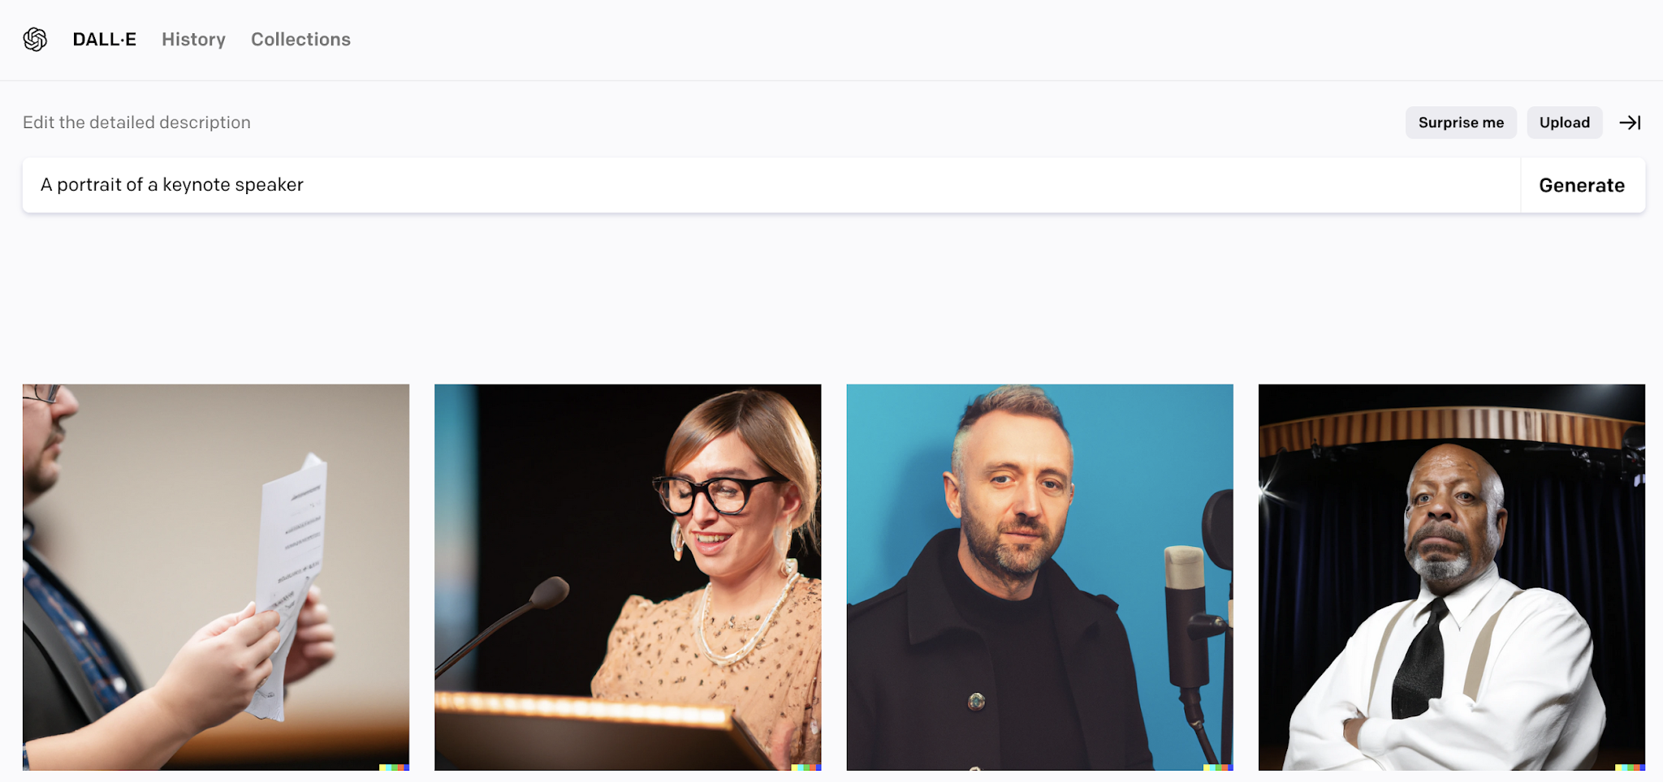
Empowering Women in Tech through
The role of media in gender socialisation

Slide 39
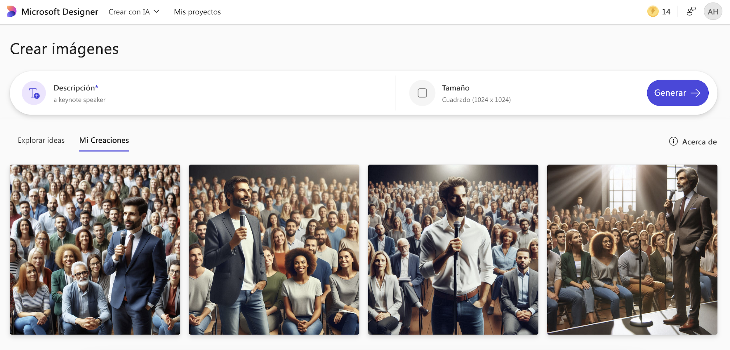
Empowering Women in Tech through
The role of media in gender socialisation

Slide 40
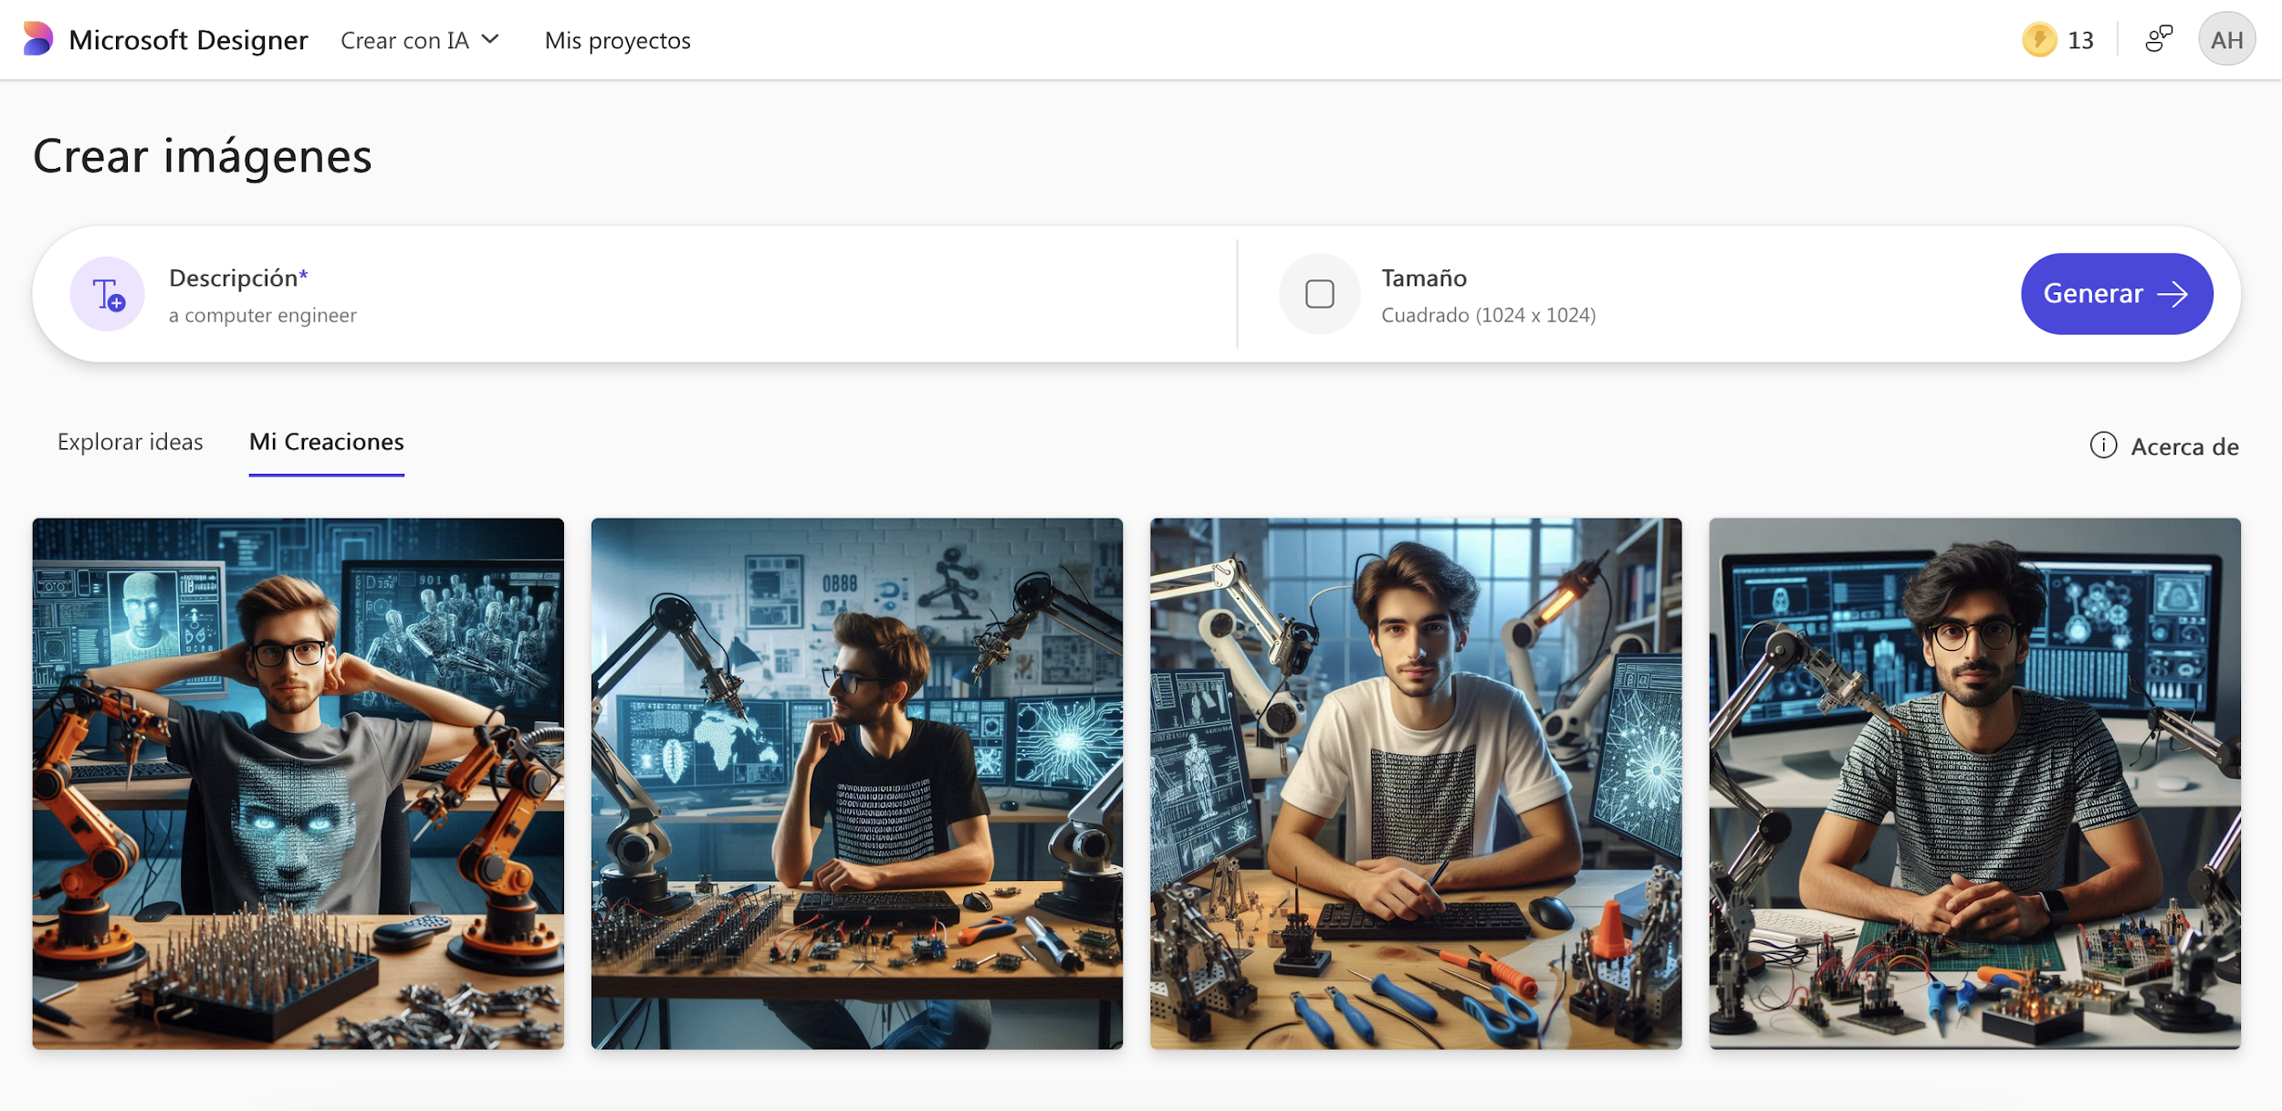
Stereotypes in technology

Slide 41
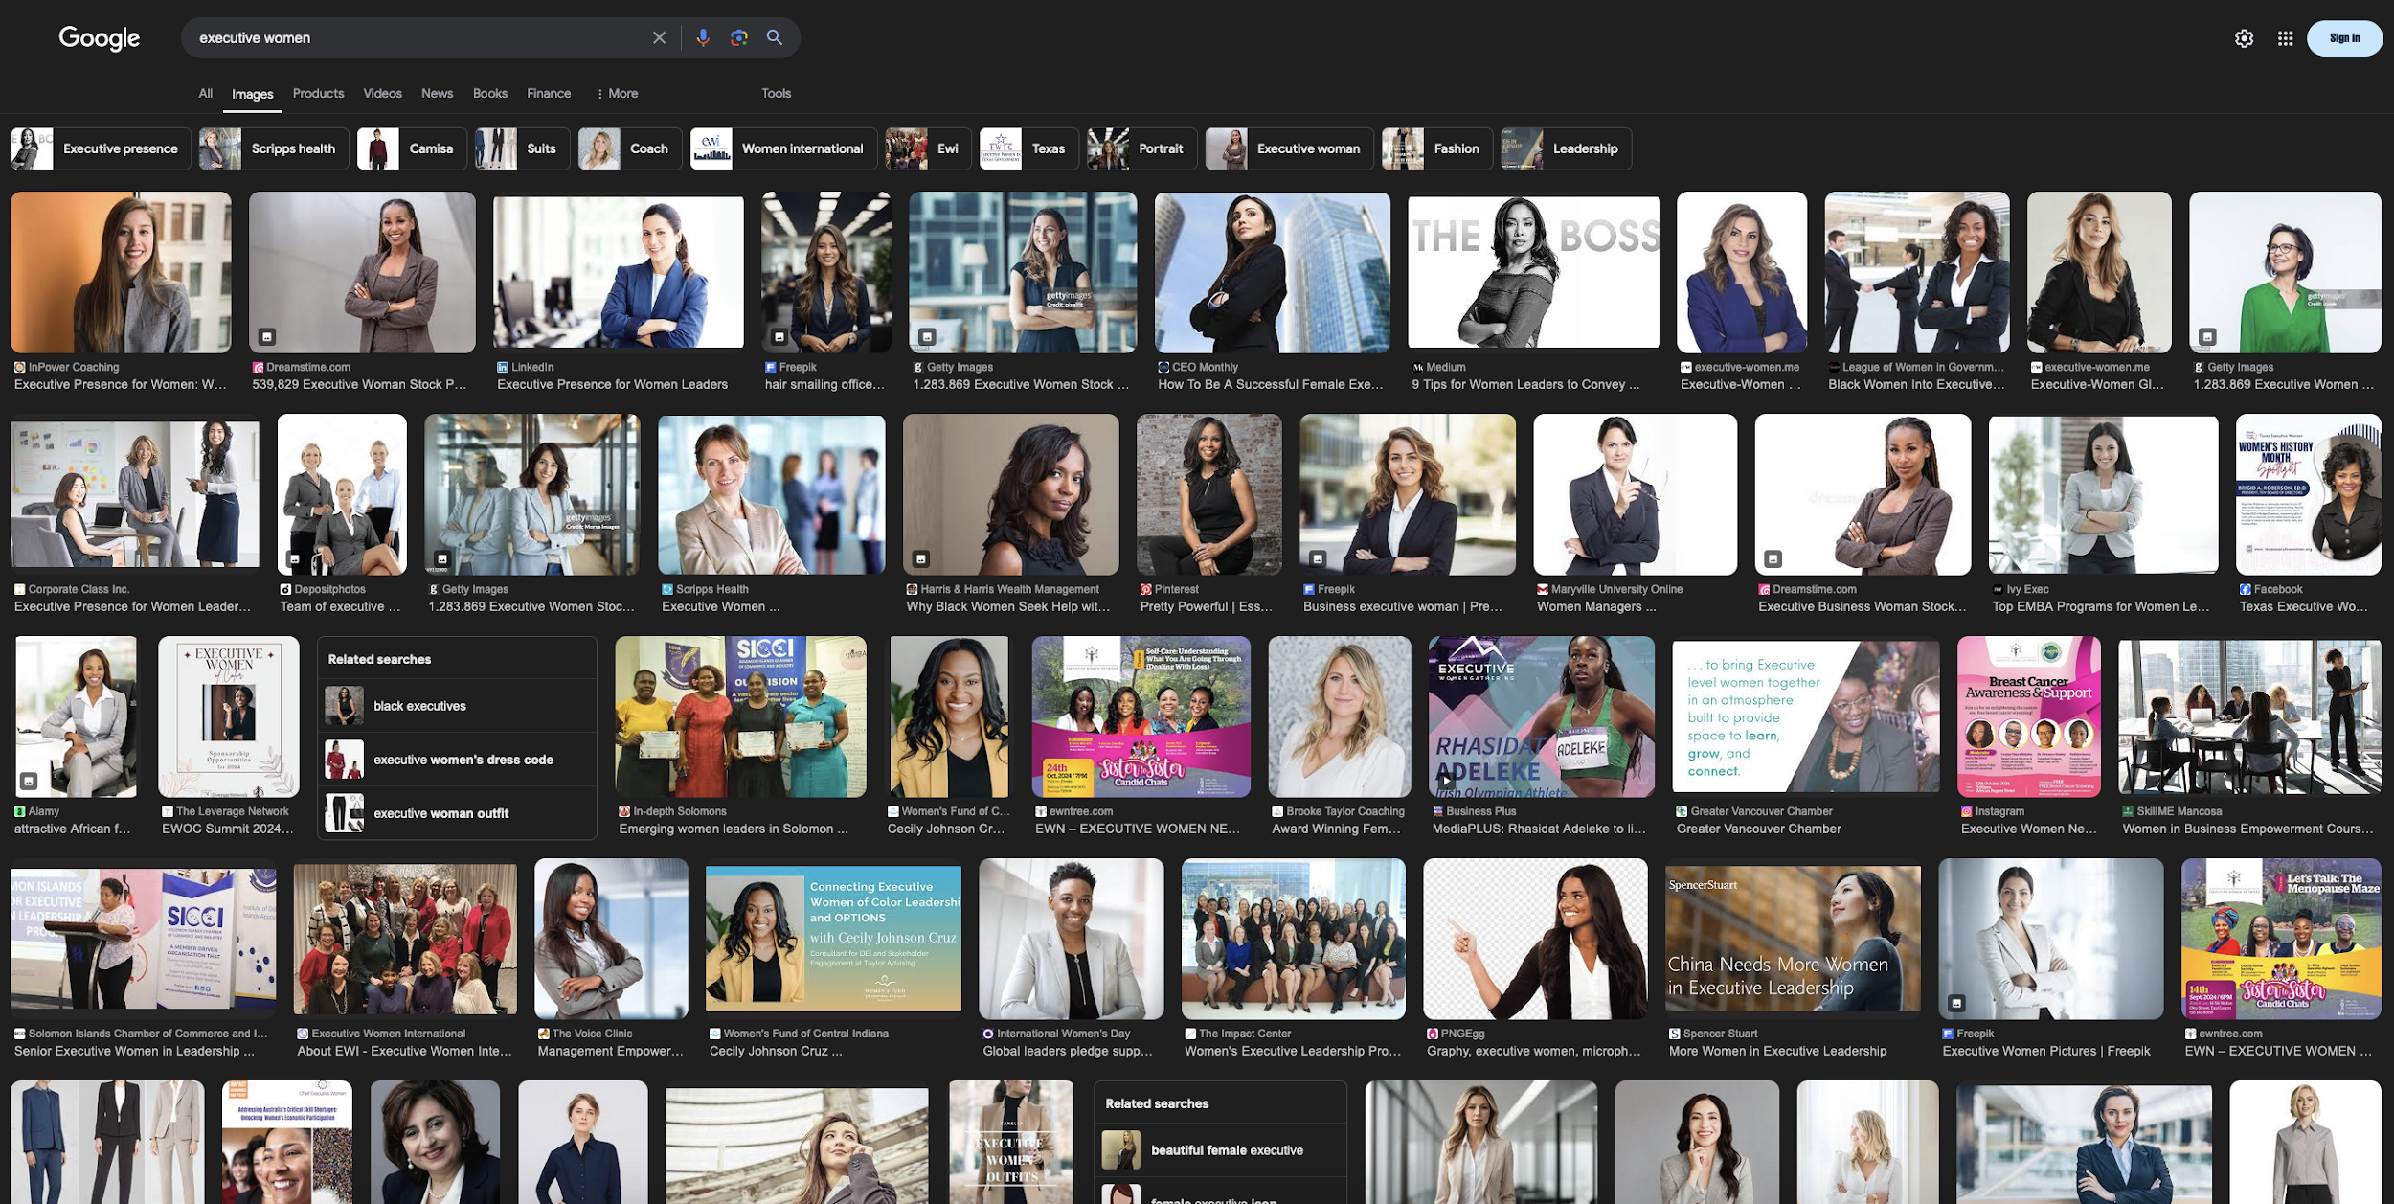
Empowering Women in Tech through
The role of media in gender socialisation

Slide 42
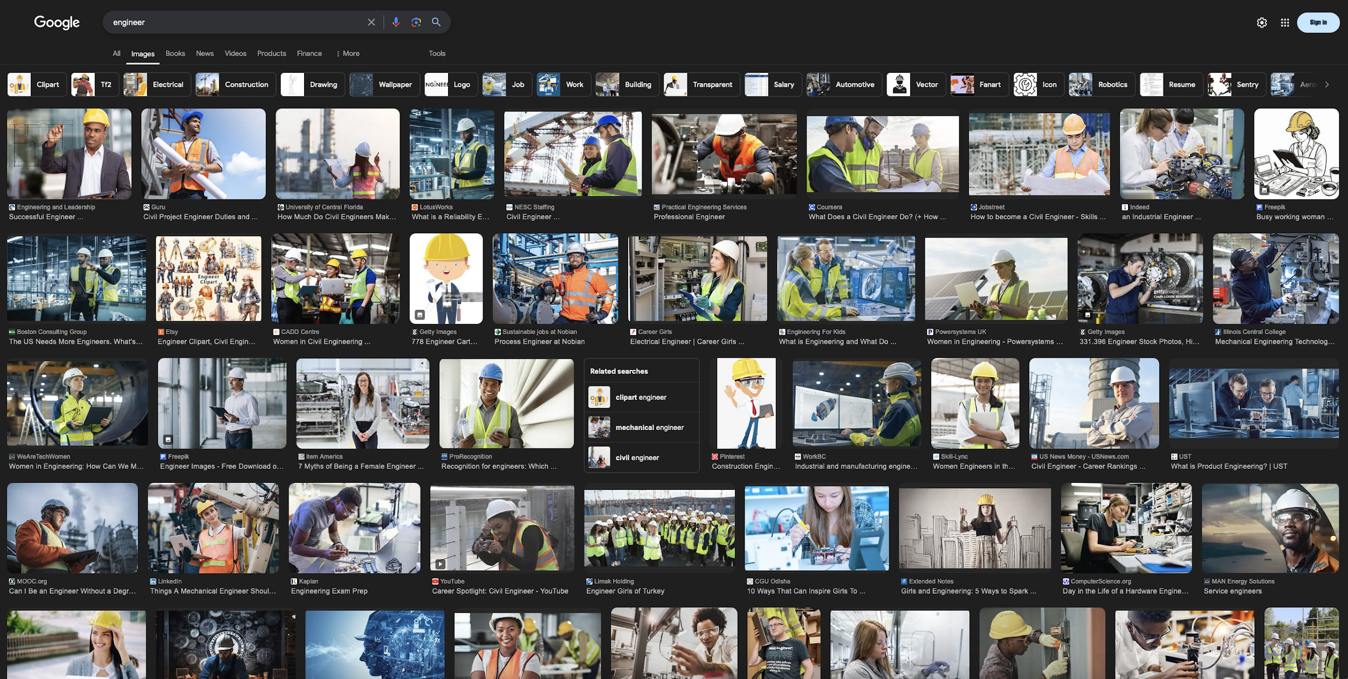
Empowering Women in Tech through
The role of media in gender socialisation

Slide 43
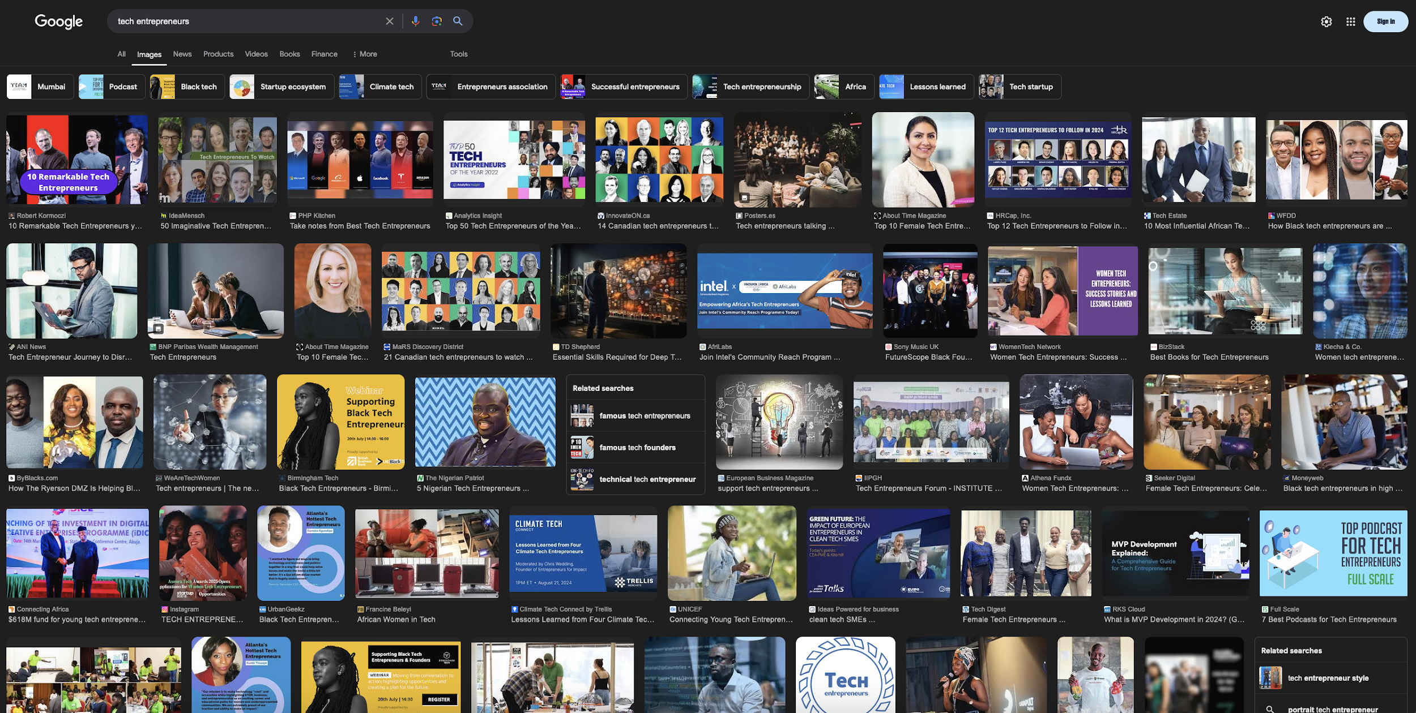
Empowering Women in Tech through
The role of media in gender socialisation

Slide 44
Empowering Women in Tech through
Gender gap in STEM
The gender gap in science, technology, engineering and mathematics (STEM) is one of the most obvious manifestations of horizontal segregation.
Women are under-represented in these disciplines, both in academia and industry.
The problem starts in childhood, with gender socialisation and the lack of female role models in STEM.

Slide 45
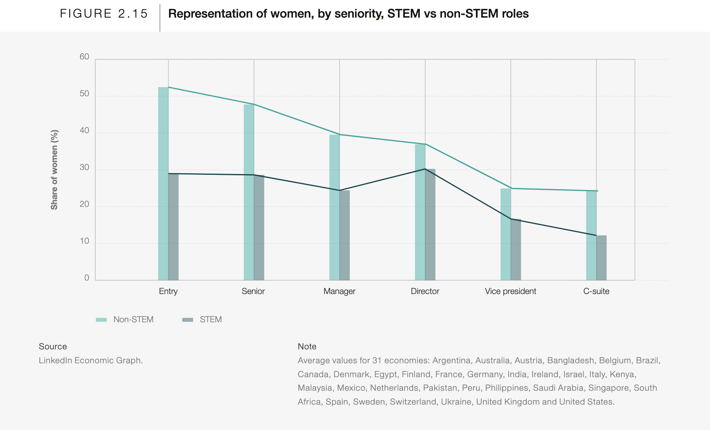
Empowering Women in Tech through
Gender gap in STEM
The “drop to the top”, illustrated in Figure 2.15, is
more pronounced in STEM occupations (C-suite-to entry-level ratio of 42%) compared to non-
STEM occupations (46.3%)
Source: World Economic Forum, Global Gender Gap Report, 2024

Slide 46
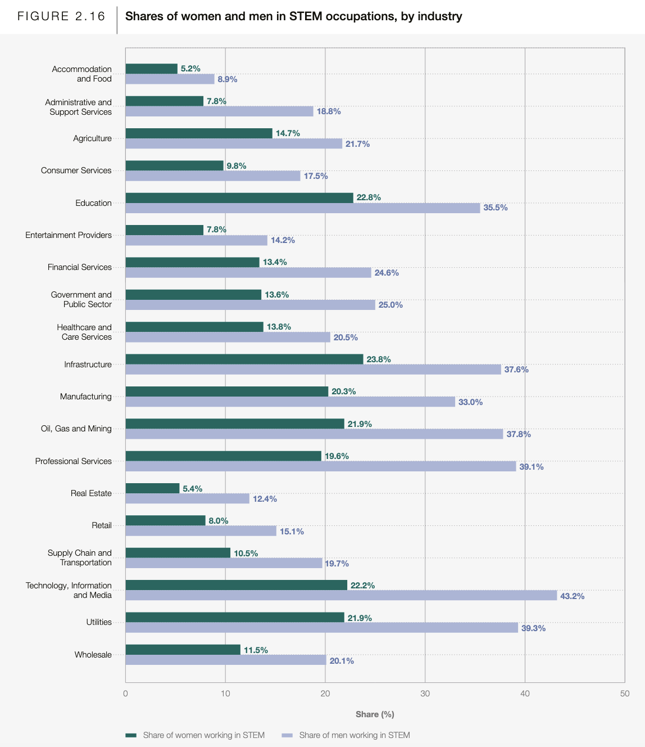
Empowering Women in Tech through
Gender gap in STEM
The proportions of women in both
the STEM and non-STEM workforce have gradually increased since 2016.
However, in 2024 women continue to have lower representation in the STEM workforce than in the non-STEM workforce, with representative shares of 28.2% and 47.3%, respectively.
Source: World Economic Forum, Global Gender Gap Report, 2024

Slide 47
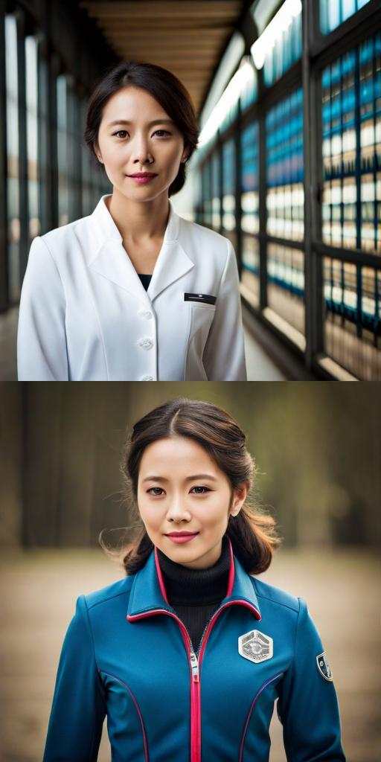

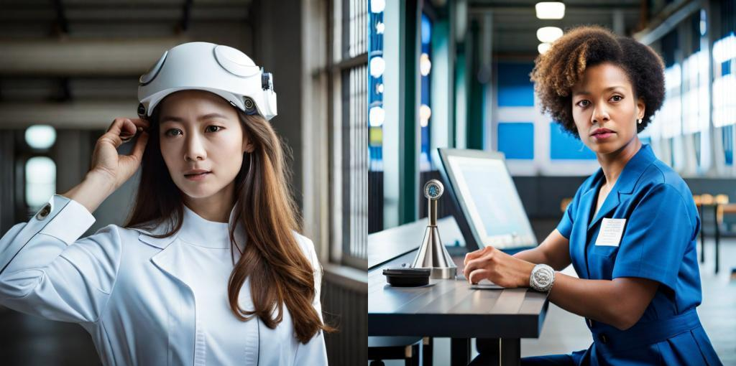
Empowering Women in Tech through
Gender gap in STEM
Some challenges faced by women in STEM
Lack of role models and support networks
Biases in recruitment and promotion
Male-dominated environments and exclusion
Strong 'glass ceiling' limiting leadership roles
Some strategies to reduce the gap
Mentoring programs and scholarships for women in STEM
Equality policies in education and workplaces
Campaigns to highlight women scientists and engineers
Gender-inclusive innovation to serve all of society

