Slide 1




HerTechVenture
“HerTechVenture” Entrepreneurship programme
Business planning
Erasmus+ Project - KA220-HED - Cooperation partnerships in higher education
University of Macedonia
Project Number 2023-1-PL01-KA220-HED-000156803

Slide 2

Content
Module Overview
Business Plan Fundamentals
Market Research
Product Development
Financial Planning
Marketing Plan and Strategies
Conclusion
Agenda

Slide 3
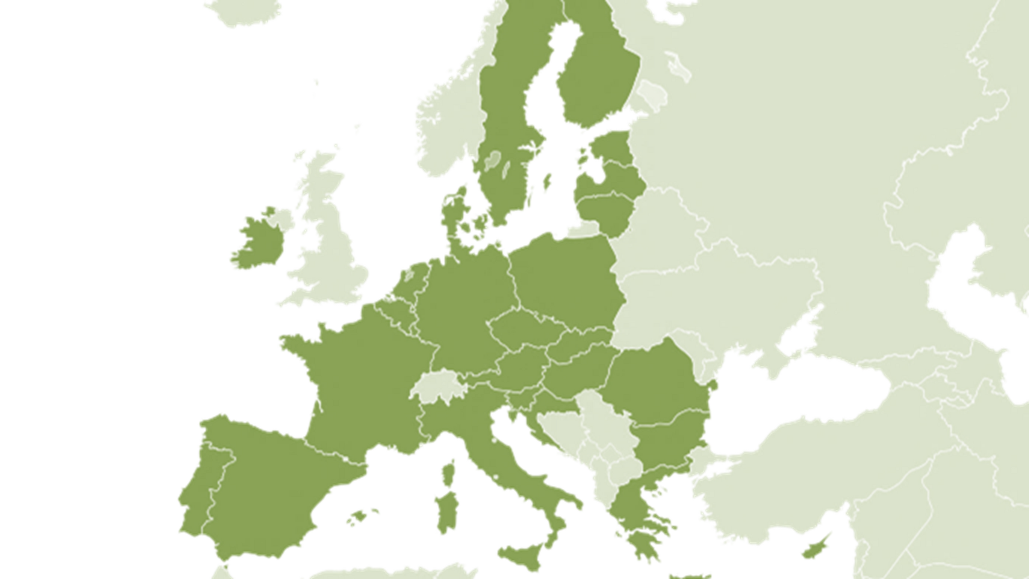











Slide 4




HerTechVenture aims to create a comprehensive entrepreneurship program that addresses the challenges and needs of female
students for increasing their self-esteem and confidence and developing innovation and entrepreneurship competences to
pursue tech business careers.

Slide 5
Empowering Women in Tech through
Strategic Business Planning
Module Overview
This module equips you with the knowledge and tools to develop a business plan specifically designed for tech startups led by female entrepreneurs.
Key Topics
Market Research: Understanding customer needs and competition.
Product Development: Turning innovative ideas into viable tech solutions.
Marketing Plan and Strategies: Effectively reaching and engaging your target audience.
Financial Planning: Managing resources and forecasting growth.

Slide 6
Empowering Women in Tech through
Strategic Business Planning
Module Overview
By the end of this module, participants will have a solid framework to craft their own business plans.
!
This session will arm you with tools to analyze markets, design innovative solutions, implement effective marketing, and maintain financial health

Slide 7

Empowering Women in Tech through
Strategic Business Planning
Business Plan Fundamentals
What is a Business Plan?
A business plan is a comprehensive document outlining your company’s goals, strategies, and action plans.
Core Purposes
Define Objectives: Clarify short-term and long-term goals.
Attract Investors: Provide a clear strategy for returns on investment.
Operational Roadmap: Serve as a guide for day-to-day operations and future scaling.

Slide 8
Empowering Women in Tech through
Strategic Business Planning
Business Plan Fundamentals
Key Components
1. Executive Summary: A snapshot of your business.
2. Company Description: Who you are and what you do.
3. Market Analysis: Insights into your industry, target market, and competition.
4. Organization & Management: Your team and leadership structure.
5. Marketing & Sales: How you’ll attract and retain customers.
6. Financial Projections: Revenue, expenses, and profitability forecasts.

Slide 9

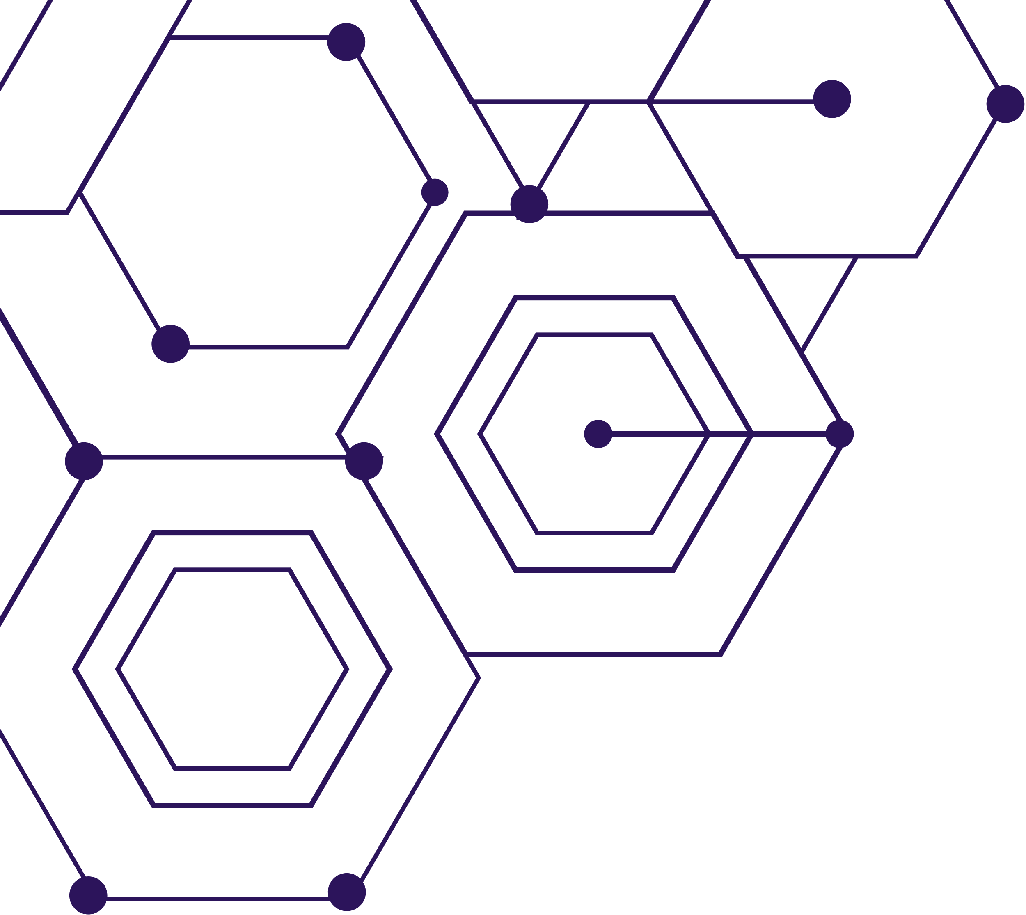
Market Research
Why Market Research is Vital
Helps identify your target audience’s needs.
Reveals market trends and opportunities.
Provides a competitive edge by analyzing competitors.
Types of Market Research
Primary Research: Direct interaction with potential customers through surveys, interviews, or focus groups.
Secondary Research: Analysis of existing data such as industry reports, market analyses, and academic studies.

Slide 10
Market Research
Primary Research: Direct Data Collection
Definition
Data collected firsthand by the researcher for a specific purpose.
Key Features
Original and unique to the research question.
Time-intensive but highly specific.
Examples
Surveys – Questionnaires to gather opinions.
Interviews – One-on-one or focus groups for in-depth insights.
Experiments – Controlled studies to observe outcomes.
Pros | Cons
Specific to needs | Time-consuming
High accuracy | Expensive
Greater control | Requires expertise

Slide 11
Market Research
Secondary Research: Using Existing Data
Definition
Analyzing and interpreting data already collected by others.
Key Features
Relies on pre-existing sources.
Time-efficient but less tailored.
Examples
Books and Journals – Established academic research.
Online Databases – Industry reports, statistics, etc.
Government Publications – Census data, official surveys.
Pros | Cons
Quick and accessible | May not fully match needs
Cost-effective | Risk of outdated data
Broad data coverage | Potential for bias

Slide 12
Market Research
Key Differences (Comparison Table)
Aspect | Primary Research | Secondary Research
Data Source | Original data directly from subjects | Pre-existing data from others
Cost | High | Low
Time Requirement | Long | Short
Relevance | Highly specific | May require adaptation

Slide 13


Market Research
Practical Tools
Google Trends: For analyzing popular topics.
Statista: For market data and consumer statistics.
Pestle Analysis: Political, Economic, Social, Technological, Legal, Environmental Factors.
SWOT Analysis: Strengths, Weaknesses, Opportunities, and Threats.
https://www.statista.com/
https://trends.google.com/trends/

Slide 14
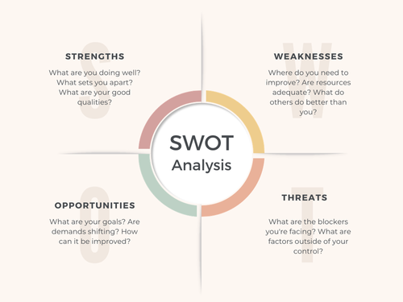
Market Research
SWOT Analysis
A SWOT analysis helps organizations evaluate internal factors (Strengths and Weaknesses) and external factors (Opportunities and Threats) to inform strategic planning
Strengths (S): Positive attributes internal to the organization.
Weaknesses (W): Internal challenges or areas to improve.
Opportunities (O): External factors that could benefit the organization.
Threats (T): External risks or challenges.

Slide 15
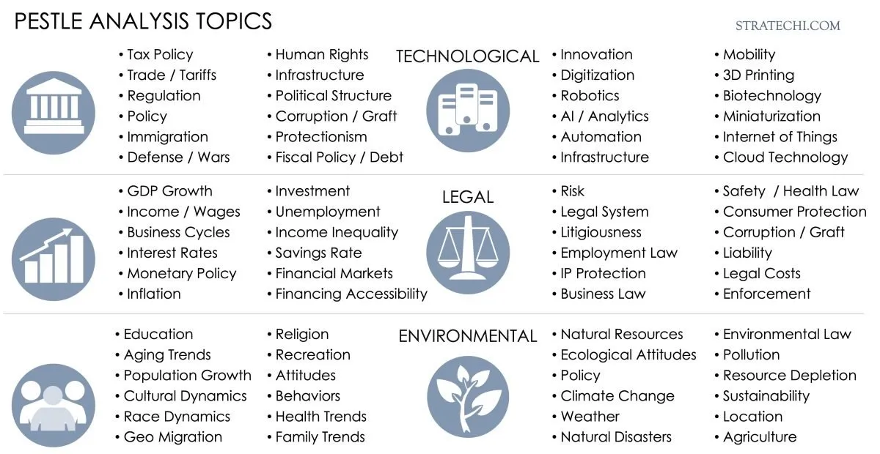
Market Research
PESTLE Analysis
PESTLE analysis is a critical part of the macro-environmental scanning process, which is used by businesses to identify external factors that could impact their operations, strategy, and decision-making.
P – Political factors (government policies, regulations)E – Economic factors (economic growth, income levels)
S – Social factors (cultural trends, demographics)
T – Technological factors (innovation, tech infrastructure)
L – Legal factors (laws, compliance)
E – Environmental factors (sustainability, environmental regulations)

Slide 16
Market Research
Quiz/Arrange the Blanks, etc., could be added there (via H5P/Genially, etc.) to Moodle.

Slide 17

Empowering Women in Tech through
Strategic Business Planning
Product Development
Key Principles
Innovation: Focus on novel solutions that address market gaps.
Inclusivity: Ensure your product serves diverse users, considering accessibility and usability.
Example: Many successful tech startups start with basic versions of their products, enhancing them based on user data.

Slide 18
Empowering Women in Tech through
Strategic Business Planning
Product Development
Transforming Ideas into Reality
MVP (Minimum Viable Product): Start small, gather feedback, and refine.
Prototyping: Create test models to evaluate functionality and user experience.
Iterative Process: Use customer feedback to continuously improve.

Slide 19
Empowering Women in Tech through
Strategic Business Planning
Financial Planning
Startup Financial Essentials
Startup Costs: Equipment, salaries, marketing, and legal fees.
Revenue Models: Subscription services, freemium models, licensing, or direct sales.
Financial Projections: Forecasting income, operating costs, and profitability.
Break-even Analysis
Helps determine when your business will become profitable.
Tip: Use financial tools like QuickBooks or Excel to keep your finances organized.

Slide 20

Empowering Women in Tech through
Strategic Business Planning
Financial Planning
What is Break-Even Analysis?
Definition
A financial calculation to determine the point at which revenue equals total costs, resulting in no profit or loss.
Purpose
Helps businesses understand the level of sales needed to cover costs.
Important Concepts in Break-Even Analysis
Fixed Costs (FC): Costs that do not change with production levels (e.g., rent, salaries).
Variable Costs (VC): Costs that vary with production (e.g., raw materials).
Total Costs (TC): Sum of fixed and variable costs.
Revenue: Income from sales.
Break-Even Point (BEP): The sales volume where total revenue equals total costs.

Slide 21
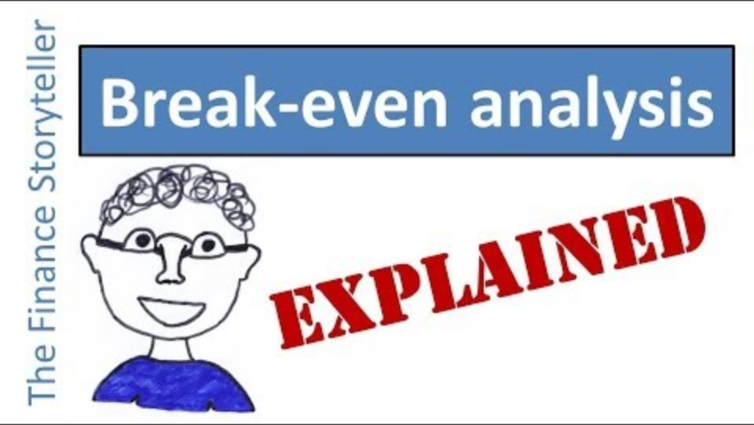
Empowering Women in Tech through
Strategic Business Planning
Financial Planning
What is Break-Even Analysis?

Slide 22
Empowering Women in Tech through
Strategic Business Planning
Financial Planning
What is Break-Even Analysis?
Quiz/Arrange the Blanks, etc., could be added there (via H5P/Genially, etc.) to Moodle.

Slide 23

Empowering Women in Tech through
Strategic Business Planning
Marketing Plan
A marketing plan is a critical component of a business plan, focusing on strategies to attract and retain customers while achieving business goals. It is structured around several key elements.
Market Analysis
Marketing Objectives
Target Market: Segmentation based on demographics, behavior, and psychographics.
Industry Trends: Insights into market size, growth rates, and emerging trends.
Competitor Analysis: Understanding competitors' strengths, weaknesses, and positioning.
Define measurable goals aligned with business objectives.
Key Points: Use SMART criteria (Specific, Measurable, Achievable, Relevant, Time-bound).
Examples:
Increase website traffic by 20% in six months.
Achieve 10% market penetration within the first year.

Slide 24
Empowering Women in Tech through
Strategic Business Planning
Marketing Plan
Product
Define features, benefits, and innovation.
Price
Determine pricing strategy (e.g., penetration, premium).
4P
Marketing Mix (4Ps Framework)
Create a balanced strategy using the following elements
Place
Choose distribution channels (online, retail, partnerships).
Promotion
Plan outreach methods (advertising, social media, PR).

Slide 25

Empowering Women in Tech through
Strategic Business Planning
Marketing Plan
Marketing Channels
Select platforms and tools to engage the audience.
Key Points
Content Marketing: Educational blogs, whitepapers, videos.
Social Media: Instagram, LinkedIn, Facebook for tailored audience outreach.
Digital Advertising: Google Ads, Facebook Ads for targeted promotions.
Influencer Marketing: Collaborations to boost credibility and reach.

Slide 26
Empowering Women in Tech through
Strategic Business Planning
Marketing Plan
Marketing Strategies
Outline the approaches to reach the target audience and achieve objectives.
Key Points:
Positioning: Define how the product will be perceived by customers.
Value Proposition: Highlight the unique benefits of the product/service.
Branding: Establish a consistent and appealing brand identity.

Slide 27

Empowering Women in Tech through
Strategic Business Planning
Marketing Strategies
Essential Strategies
Content Marketing: Blogs, whitepapers, and videos to educate your audience.
Social Media Engagement: Use platforms like LinkedIn for B2B and Instagram for broader reach.
Influencer Partnerships: Collaborate with industry leaders to boost credibility.
Key Performance Indicators (KPIs)
Measure the effectiveness of marketing strategies.
Examples
Customer acquisition cost (CAC).
Conversion rates on digital campaigns.
Social media engagement metrics (likes, shares, comments).
Digital Advertising Tools
Google Ads: For targeted reach.
Facebook/Instagram Ads: Ideal for specific demographics.

Slide 28

Empowering Women in Tech through
Strategic Business Planning
Marketing Strategies
Tips: Unique Tactics for Women in Tech
Highlight Female Leadership: Use stories, interviews, and campaigns showcasing women in tech to inspire and connect with audiences.
Host Inclusive Events: Organize hackathons, innovation challenges, or networking nights to empower women developers and entrepreneurs.
Champion Diversity: Feature and diverse women in tech roles in ads and branding to promote inclusivity.
Build Skills: Offer workshops or online courses in coding, entrepreneurship, or digital tools tailored to women.
„Be one of many“ | International Women’s Day -Mercedes

Slide 29
Empowering Women in Tech through
Strategic Business Planning
Marketing Plan
Budget and Resource Allocation
Allocate financial and human resources effectively.
Key Points
Define budgets for advertising, promotions, tools, and salaries.
Identify priorities based on ROI potential.

Slide 30
Empowering Women in Tech through
Strategic Business Planning
Marketing Plan
Quiz/Arrange the Blanks, etc., could be added there (via H5P/Genially, etc.) to Moodle.

Slide 31

Empowering Women in Tech through
Strategic Business Planning
Conclusion
Key Takeaways
Importance of planning and research.
Empowering women through innovative business solutions.
Practical applications of financial and marketing strategies.

Slide 32
END OF THEORETICAL PRESENTATION

Slide 33
HerTechVenture
“HerTechVenture” Entrepreneurship programme
Hands-On Activities
Erasmus+ Project - KA220-HED - Cooperation partnerships in higher education
University of Macedonia
Project Number 2023-1-PL01-KA220-HED-000156803

Slide 34
Theoretical Material Review
Any Questions?

Slide 35
Group Activity
Hands-On Application: SWOT Analysis for a Startup Idea
For Interactive Engagement: Scan the QR code to access the H5P activity, where you can participate in quizzes, fill-in-the-blank exercises, and drag-and-drop tasks to complete the assigned activity.
For a Traditional Approach: Complete the activity manually by referring to the provided resources and submitting your findings in a written report or presentation format.
Notes:
Scenario: Fitbit is considering entering the Indian market with its wearable tech products. India offers a large and growing market for fitness and health-conscious consumers, but also presents challenges like strong local competition, economic price sensitivity, and regulatory hurdles.
Task:
Step 1: Use secondary data (via Statista, Google Trends, etc.) to research relevant market trends, competition, and consumer behavior.
Step 2: Perform a PESTLE analysis based on your research to evaluate external factors that will impact Fitbit's market entry.
Step 3: Synthesize the findings into a SWOT analysis to determine the strategic opportunities and challenges for Fitbit.
Group Assignments:
Group 1: Conduct market research and focus on Statista and Google Trends to identify relevant trends, market size, and competition in India.
Group 2: Perform the PESTLE analysis using the data gathered to evaluate the Political, Economic, Social, Technological, Legal, and Environmental factors.
Group 3: Based on insights from Groups 1 and 2, conduct a SWOT analysis for Fitbit's entry into India.

Slide 36

BREAK

Slide 37
Empowering Women in Tech through
Strategic Business Planning
Hands-On Application
For Interactive Engagement: Scan the QR code to access the H5P activity, where you can participate in quizzes, fill-in-the-blank exercises, and drag-and-drop tasks to complete the assigned activity.
For a Traditional Approach: Complete the activity manually by referring to the provided resources and submitting your findings in a written report or presentation format.
Notes:
Group Activity
Assign each group a hypothetical product or service (e.g., a health app, an IoT smart device, or a green energy solution).Provide a brief description of the target audience and industry for each scenario.
Groups will create a basic marketing plan for their product, using the following structure:
Target Audience and Competitors: Define the audience and their needs based on theory and who are the competitors
4P:Marketing Mix of the product
Marketing Channels: Choose 2-3 platforms (e.g., Instagram, LinkedIn, newsletters) and justify their choices.
Value Proposition: Write a one-sentence value proposition.
Budget Allocation: Allocate a hypothetical budget across the channels.
KPIs: Define 2-3 measurable goals (e.g., conversions, click-through rates).
Group Presentations: Each group presents their marketing plan to the class.
Here are four hypothetical products for the group activity:
Health app for stress management
IoT smart home device
Green energy solution for small businesses
Eco-friendly fashion brand

Slide 38
BREAK

Slide 39

Case Study
Whitney Wolfe Herd & Bumble

Slide 40

Case Study
Whitney Wolfe Herd & Bumble
Bumble is a dating app that empowers women by allowing them to initiate conversations in heterosexual matches, fostering a safer and more inclusive online dating experience.
Founder: Whitney Wolfe Herd
Your opinion
What unmet need do you think Bumble identified that shaped its product?
How do you think Bumble's feature of allowing only women to initiate conversations impacted its appeal?
What strategies might Bumble have used to position itself as a feminist brand?

Slide 41
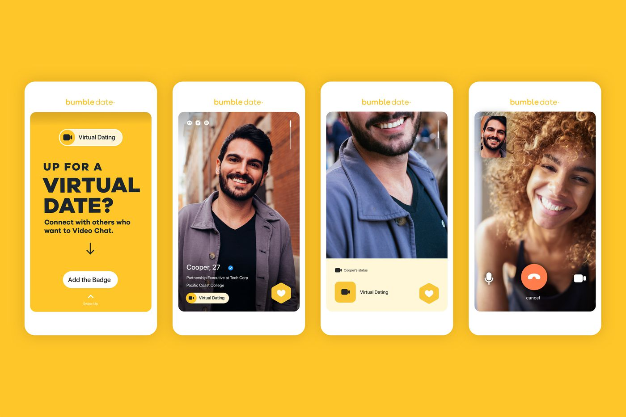

Case Study
Whitney Wolfe Herd & Bumble
Key Achievements
Market Research: Recognized the need for women-driven dating dynamics.
Product Innovation: Only women can initiate conversations in heterosexual matches, creating a safer space for users.
Marketing Excellence: Positioned Bumble as a feminist brand, using social media and influencer marketing.
Outcomes:
In 2021, Bumble went public, and Wolfe Herd became the youngest self-made female billionaire

Slide 42

Case Study
Whitney Wolfe Herd & Bumble
Bumble Founder's Business Lessons For Entrepreneurs | Forbes

Slide 43
Case Study
Whitney Wolfe Herd & Bumble
Discussion Questions
How did Bumble’s market research shape its product innovation?
Why is Bumble’s focus on female empowerment a game-changer in its industry?
How can tech startups incorporate similar values into their business models?

