Slide 1




HerTechVenture
Critique for the Future
University of Macedonia
Project Number 2023-1-PL01-KA220-HED-000156803

Slide 2

Content
1 Why is it important
2 Gibb’s reflective cycle
3 Critique using SWOT analysis

Slide 3

Critique for the Future: Reflect, Learn, Improve
Importance
Critique helps identify areas for improvement and fosters growth.
Learning from success and failure is essential for future endeavors.
Think of one of your past projects…
What went well?
What could have been better?
What would you do differently?
Notes:
This is a more structured, external evaluation that involves analyzing actions, outcomes, and performance with an aim to improve. It typically includes both positive and negative feedback, focusing on what went well and what could be improved. Critique can be individual or collective, and is more about constructive feedback to foster growth. It is reflective, but also evaluative, and involves looking forward to identify areas for improvement and future adjustments. Critique is not just about pointing out mistakes; it’s a powerful tool that allows us to identify areas for improvement. Learning from both our successes and failures is essential for growth as entrepreneurs. We’ll use a structured approach to critique our past projects. First, we’ll ask ourselves: What went well? Next, What could have been better? Finally, What would you do differently in the future? This will guide our reflections and discussions.

Slide 4
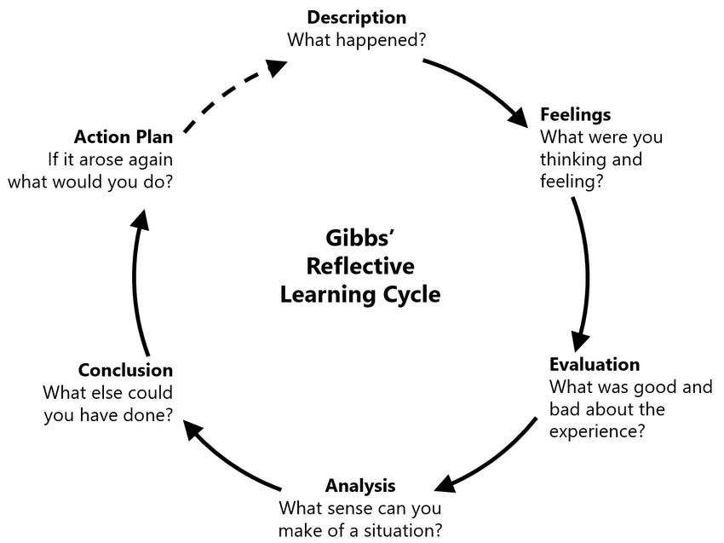
Gibbs’ Reflective Cycle
Step 1: Take 5 minutes to write down your thoughts. Consider using Gibbs’ Reflective Cycle—what happened, what were your feelings, and what can you improve?
Step 2: Focus on insights related to practical application. How will this reflection inform your future decisions and actions?

Slide 5

Critique Using SWOT Analysis
Choose a recent project you’ve worked on. We will evaluate it using the SWOT framework:
Strengths, Weaknesses, Opportunities, and Threats.
SWOT Analysis
Strengths
Weaknesses
Strengths: What went well? What were your internal strengths that contributed to success?
Weaknesses: What didn’t go well? What were the internal factors that hindered progress?
Opportunities: What external opportunities could have helped? Are there future opportunities you can leverage?
Threats: What external risks or challenges did you face? What might become a challenge in the future?
Opportunities
Threats
10-15 minutes to complete a SWOT analysis for one of your past projects
Notes:
Critique is essential for improvement. We will use the SWOT analysis framework to critique our past projects and experiences. This method will help us assess strengths and weaknesses while also considering opportunities and threats for the future.

Slide 6
Critique Using SWOT Analysis
SWOT Analysis
Group Sharing and Discussion
What skills/resources do you have? - How have your strengths helped you?
What challenges are you facing? - How can we support each other?
What opportunities can we pursue? - How can we collaborate to seize them?
What threats should we be aware of? - How can we navigate these together?
Strengths
Weaknesses
Opportunities
Threats

Slide 7
Key Takeaways
• Regularly critiquing your experiences helps identify areas for improvement and fosters a mindset of continuous learning.
!Collaboration is Key! Working together enhances creativity and problem-solving

Slide 8






Thank you for your attention!
https://www.hertechventure.eu
Where to find us

