Slide 1




HerTechVenture
Self-Reflection on Learning Achievements
University of Macedonia
Project Number 2023-1-PL01-KA220-HED-000156803

Slide 2

Content
1 Why is it important
2 Self-Reflection Activity - Identifying Your Learning Style
3 Draw your Entrecomp Flower

Slide 3

Importance of Self-reflection
Importance
“Why Reflect?“
Enhances self-awareness - Kolb’s Experiential Learning Cycle
Promotes personal growth - concept of transformational learning
Facilitates application of learning - Schön’s Reflective Practitioner approach
Reflection Prompts
1. What have you learned today?
2. How can you apply what you’ve learned?
3. What areas do you want to improve?
Notes:
This process focuses on the individual’s internal understanding and evaluation of their experiences, actions, and learning. It is introspective, personal, and often non-judgmental. Self-reflection is meant to increase self-awareness by helping individuals think about what they have learned, their strengths and weaknesses, and how they can apply this learning to future endeavors. The main aim is personal growth and understanding. Self-reflection is crucial for personal growth. It enhances our self-awareness, allowing us to recognize our strengths and areas needing improvement. By reflecting on our learning experiences, we can better apply what we’ve learned in future endeavors. I want you to take a moment to consider these reflection prompts:What are your key takeaways from today’s session?How can you apply this learning in your future work or projects?What areas do you feel you need to focus on for improvement?

Slide 4

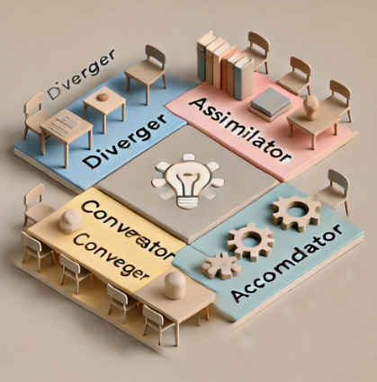
Self-reflection Activity: Identifying Your Learning Style
According to Kolb, we all have a preferred learning style. Which adventurer are you?
Diverger – The thinker who loves gathering information before making decisions.
Assimilator – The planner who enjoys deep analysis and understanding.
Converger – The problem-solver who loves hands-on challenges.
Accommodator – The doer who learns by diving right in!
Notes:
Every adventurer has a different way of tackling challenges! Let’s figure out what kind of learner you are and how you can make the most of your style in real-life projects.

Slide 5
Self-reflection Activity: Identifying Your Learning Style
Kolb’s Learning Style Quiz
There are four corners of the room, each representing a different learning style (Diverger, Assimilator, Converger, Accommodator)
Move to the corner that matches your learning style based on your answer.
Get ready for a fun, interactive journey!
Notes:
I’ll ask a series of questions about how you approach learning.
For each question, choose the answer that feels most like YOU.
Move to the corner of the room that matches your choice:
Diverger: The Thinker – Gather information before jumping in.
Assimilator: The Planner – Analyze deeply before taking action.
Converger: The Problem-Solver – Love hands-on challenges.
Accommodator: The Doer – Learn best by diving in and experimenting.
Ready? Let’s get started!

Slide 6
Self-reflection Activity: Identifying Your Learning Style
Kolb’s Learning Style Quiz
Question 1: Your Approach to New Challenges
When faced with a new challenge, do you:
  A) Gather information and think it through first? (Move to Diverger corner)
  B) Jump in and figure things out as you go? (Move to Accommodator corner)
  C) Solve it by trying out practical solutions? (Move to Converger corner)
  D) Analyse it deeply before making any moves? (Move to Assimilator corner)

Slide 7
Self-reflection Activity: Identifying Your Learning Style
Kolb’s Learning Style Quiz
Question 2: How Do You Solve Problems?
When solving a problem, do you:
  A) Love to get hands-on and try things out? (Move to Converger corner)
  B) Prefer to analyze the situation deeply before acting? (Move to Assimilator corner)
  C) Reflect on multiple options and think creatively? (Move to Diverger corner)
  D) Dive in immediately and adapt along the way? (Move to Accommodator corner)

Slide 8
Self-reflection Activity: Identifying Your Learning Style
Kolb’s Learning Style Quiz
Question 3: How Do You Like to Learn New Things?
When learning something new, do you prefer:
  A) Watching and observing to understand the process? (Move to Diverger corner)
  B) Reading about it and studying the theory? (Move to Assimilator corner)
  C) Testing things out through practical experiments? (Move to Converger corner)
  D) Jumping straight into action and figuring it out as you go? (Move to Accommodator corner)"

Slide 9
Self-reflection Activity: Identifying Your Learning Style
Kolb’s Learning Style Quiz
Question 4: Your Role in Group Projects
In a group project, your role is to:
  A) Come up with creative ideas and brainstorm possibilities. (Move to Diverger corner)
  B) Organize and analyze information to make sense of it. (Move to Assimilator corner)
  C) Focus on solving problems and getting practical results. (Move to Converger corner)
  D) Lead the action and encourage others to start working right away. (Move to Accommodator corner)

Slide 10
Self-reflection Activity: Identifying Your Learning Style
Kolb’s Learning Style Quiz
Question 5: How Do You Handle Uncertainty?
When you face uncertainty or a new situation, do you:
  A) Take time to reflect and gather information before acting? (Move to Diverger corner)
  B) Study theories or frameworks to make sense of it? (Move to Assimilator corner)
  C) Experiment with different solutions to find what works? (Move to Converger corner)
  D) Act quickly and adapt as you go? (Move to Accommodator corner)

Slide 11
Self-reflection Activity: Identifying Your Learning Style
Kolb’s Learning Style Quiz
Question 6: What Do You Value Most in Learning?
What do you value most in a learning experience?
  A) Exploring new perspectives and generating ideas. (Move to Diverger corner)
  B) Understanding the logic and theory behind things. (Move to Assimilator corner)
  C) Using knowledge to find practical solutions. (Move to Converger corner)
  D) Taking action and learning by doing. (Move to Accommodator corner)

Slide 12
Self-reflection Activity: Identifying Your Learning Style
Kolb’s Learning Style Quiz
Question 7: How Do You Approach a New Skill?
When learning a new skill, do you:
  A) Prefer to observe and gather information before trying it? (Move to Diverger corner)
  B) Read up on the theory and understand it deeply? (Move to Assimilator corner)
  C) Get hands-on and practice until you master it? (Move to Converger corner)
  D) Jump in and start experimenting right away? (Move to Accommodator corner)

Slide 13
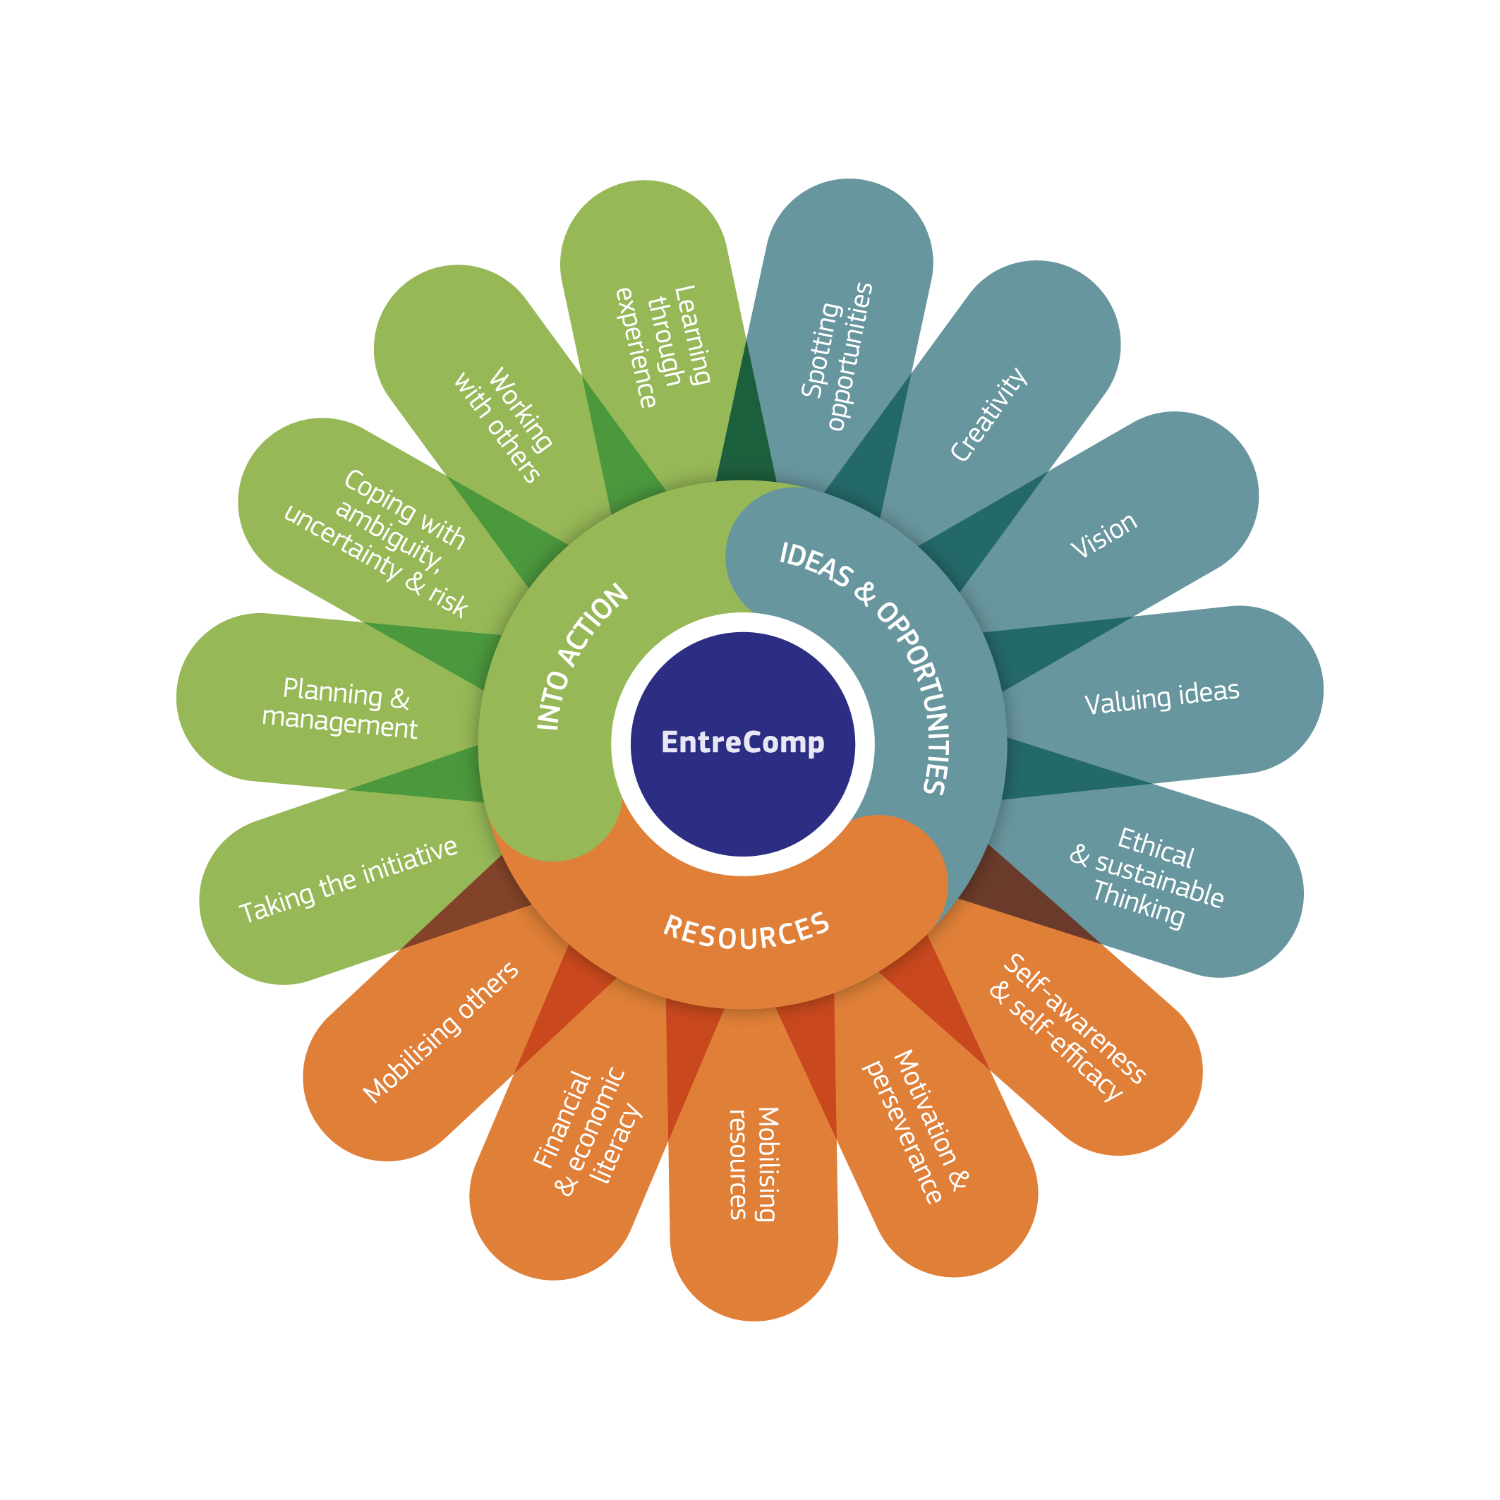
Draw Your EntreComp Flower
  Step 1 Read the 15 competences
  Step 2 Shade in the petals based on your confidence in each competency
10-15 minutes to complete your flower
Notes:
In this activity, you’ll create a flower with 15 petals, each representing one of the EntreComp competencies. Think of your level of confidence in each area—are you strong in spotting opportunities? How about working with others or managing resources? The more confident you feel in a particular area, the more you should shade that petal." "For example, if you feel very confident in Creativity, you might fully shade that petal. If Financial Literacy is something you’re still developing, you might shade it only partially. Take a moment to think about each competency as you work through the petals. 10-15 minutes to complete their flower.

Slide 14
Draw Your EntreComp Flower
Group Sharing and Discussion
Which competences are you strongest in?
Which competences would you like to improve?
What surprised you as you completed this reflection?
What common competences seem strong across the group?
Which competences seem like areas for growth for many of us?
Notes:
In this activity, you’ll create a flower with 15 petals, each representing one of the EntreComp competencies. Think of your level of confidence in each area—are you strong in spotting opportunities? How about working with others or managing resources? The more confident you feel in a particular area, the more you should shade that petal." "For example, if you feel very confident in Creativity, you might fully shade that petal. If Financial Literacy is something you’re still developing, you might shade it only partially. Take a moment to think about each competency as you work through the petals. 10-15 minutes to complete their flower.

Slide 15
Key Takeaways
•Understanding your strengths helps in personal and professional growth.
!Collaboration is Key! Working together enhances creativity and problem-solving

Slide 16






Thank you for your attention!
https://www.hertechventure.eu
Where to find us

