Slide 1




HerTechVenture
Means Inventory
University of Macedonia
Project Number 2023-1-PL01-KA220-HED-000156803

Slide 2

Content
1 What is Means Inventory
2 Hands-on Activity

Slide 3



What is the
Means Inventory?
Definition
The Means Inventory assesses your available resources, including skills, knowledge, and networks.
It is a self-reflection tool for understanding what you already possess and how you can leverage these resources in entrepreneurial endeavours.
Note: The inventory helps you recognise and optimise what you already have.
Notes:
"The Means Inventory is a self-assessment tool that helps you evaluate the resources you already have—whether it’s your skills, knowledge, or professional networks. It allows us to understand what assets we can leverage in our entrepreneurial endeavors, helping us to optimize our approach and act on opportunities more effectively."

Slide 4

What is the Means Inventory?
Importance
Understanding your resources helps you act on opportunities effectively.
More specific:
It allows you to act on opportunities quickly and efficiently.
By understanding your resources, you make better decisions and innovate faster.
Saras Sarasvathy’s Effectuation Principle emphasises starting with what you have rather than looking externally.
Notes:
"Why is the Means Inventory so important? It’s because it enables quicker decision-making and innovation. When you’re aware of the resources at your disposal, you can seize opportunities without waiting for the perfect moment. This idea ties into Sarasvathy's Effectuation Theory, which emphasizes starting with what you have rather than looking outside for resources."

Slide 5
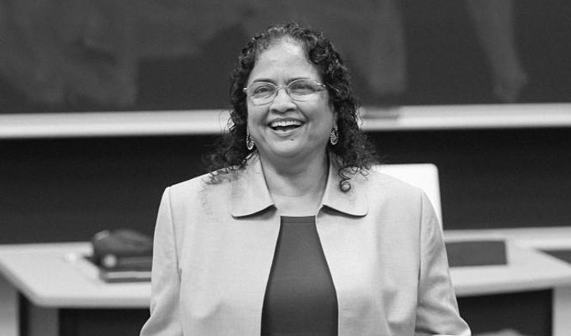
What is the Means Inventory?
Effectuation Theory in Entrepreneurship
Effectuation Theory, introduced by Saras Sarasvathy, argues that successful entrepreneurs don’t wait for perfect opportunities.
They start with their existing means—skills, knowledge, networks—and create opportunities from them.
This approach contrasts with the traditional view of opportunity recognition, which focuses on finding external opportunities.
Saras Sarasvathy
Source: https://www.ices.hr/en/izdvojeno/new-event-in-the-sief-series-of-webinars-and-events-held-to-build-on-the-ideas-of-professor-allan-gibb-1939-2019-who-was-a-pioneering-thinker-in-entrepreneurship-and-small-business-development-is-fo/
Notes:
"Effectuation Theory teaches us that entrepreneurs don’t wait for opportunities—they create them by starting with the means they already have. It’s about using your internal resources to generate new opportunities. This contrasts with traditional theories that focus on finding opportunities externally. Entrepreneurs use their skills, knowledge, and networks to shape their entrepreneurial path."

Slide 6
What is the Means Inventory?
Who Are You? (Skills and Strengths)
Identify your personal strengths and skills.
Examples include leadership, communication, project management, technical expertise, etc.
These personal assets shape how you approach and solve problems in entrepreneurial settings
Notes:
"The first element of the Means Inventory asks: 'Who are you?' This is where you identify your personal strengths and skills. Maybe you’re a strong leader, a great communicator, or have technical expertise. These strengths shape how you approach challenges and opportunities. So, think about the skills you bring to the table that can contribute to your entrepreneurial journey."

Slide 7
What is the Means Inventory?
What Do You Know? (Knowledge)
Reflect on your academic, professional, and life knowledge.
What expertise have you gained? Examples: Industry knowledge, technical skills, certifications, etc.
Use this knowledge to act on opportunities more efficiently.
Notes:
"The second element is: 'What do you know?' Reflect on your academic, professional, and life experiences. What specialized knowledge have you gained that could be useful? This could be industry expertise, technical skills, or lessons learned from past experiences. The knowledge you’ve accumulated helps you act on opportunities more effectively because it provides the foundation for making informed decisions."

Slide 8
What is the Means Inventory?
Whom Do You Know? (Networks)
Consider your social and professional networks.
These networks can offer advice, resources, and partnerships.
Strong networks are critical for accessing new opportunities, collaborations, and mentorship.
Notes:
"The third part of the Means Inventory is about your networks: 'Whom do you know?' Think about the people in your social and professional circles. These connections can provide valuable resources—whether it’s advice, partnerships, or access to new opportunities. Networking is critical for entrepreneurship because it allows you to leverage the strengths of others in your projects."

Slide 9
What is the Means Inventory?
Application of the Means Inventory
After identifying your skills, knowledge, and networks, you can apply these resources to real-world situations.
Entrepreneurs use their existing means to navigate challenges and make decisions.
Example: A person with strong networking skills may leverage contacts to secure initial funding.
Notes:
"Now that we’ve discussed skills, knowledge, and networks, let’s talk about how to apply the Means Inventory. Entrepreneurs use these resources to solve problems and take action. For example, someone with strong networking skills might use their contacts to find investors or collaborators. The key is to continuously reflect on your means and apply them in real-world situations."

Slide 10
What is the Means Inventory?
Hands-On Activity
Means Inventory Template
skills
knowledge
network
Think broadly – consider personal, professional, and academic experiences
Notes:
"Now, it’s time to put this into practice! Let’s take 10 minutes to fill out our Means Inventory template. Think about your skills, knowledge, and networks. Afterward, we’ll share our reflections and discuss how these resources can help us in our current and future projects. This activity will help you get a clearer picture of the assets you already have and how you can use them more effectively."

Slide 11
What is the Means Inventory?
Hands-On Activity
Discussion
Sharing Your Means Inventory
What skills, knowledge, or networks did you identify in your inventory?
How do you think these resources can help you in your entrepreneurial journey?
Are there any gaps or areas for improvement in your inventory?
How can you better leverage the resources you identified?
Notes:
"Now that we’ve completed the Means Inventory template, let’s move on to a group discussion. I’d like everyone to share one or two key takeaways from their inventory. What skills, knowledge, or networks stood out to you? How do you think these resources will help you in your entrepreneurial journey? Also, consider if there are any gaps or areas for improvement. Finally, let’s discuss how we can better leverage the resources we identified to reach our goals."

Slide 12
Key Takeaways
•Assessing your resources—skills, knowledge, and networks—enables you to leverage your strengths in entrepreneurial endeavours.
!Collaboration is Key! Working together enhances creativity and problem-solving

Slide 13






Thank you for your attention!
https://www.hertechventure.eu
Where to find us

