Slide 1




HerTechVenture
B5. Gender mainstreaming in your teaching:
self-assessment
University of Salamanca
Project Number 2023-1-PL01-KA220-HED-000156803

Slide 2

Details
GOAL | To help educators evaluate how well they integrate gender mainstreaming in their teaching practices by using a self-assessment rubric
SHORT DESCRIPTION | Participants will individually assess their teaching practices using a rubric specifically developed for analysing coeducation. This self-assessment will allow participants to reflect on areas where they are effectively incorporating gender-sensitive approaches and identify areas for improvement. The rubric covers various dimensions of teaching, from course content to interactions with students
DURATION | Minimum: 30 minutes The duration can be extended to include extra materials to support the self-assessment

Slide 3



Rubric for self-assessment
The rubric developed by González-González and García-Holgado (2019) evaluates how well gender mainstreaming is incorporated across various dimensions of teaching
It serves as a guide to analyse methodologies, language, contents and spaces
Use the rubric for reflecting on your teaching methods and identify strengths and areas for improvement regarding gender mainstreaming

Slide 4
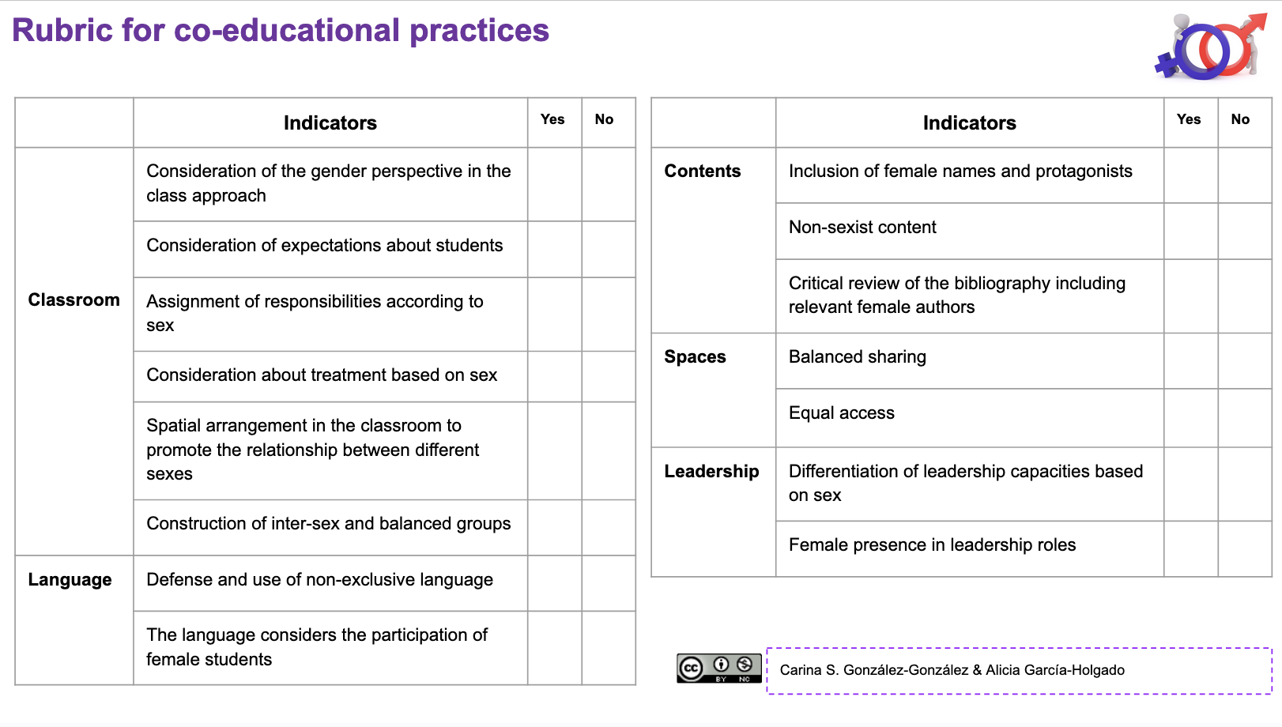
Reference: González-González, C. S., & García-Holgado, A. (2019). Model Canvas for the design of co-educational practices and rubrics for their assessment. http://shorturl.at/lEPUW

Slide 5
Self-assessment
15 minutes
Each one should complete the rubric, reflecting on your own teaching experiences and practices

Slide 6
Group sharing and reflection

Slide 7






More information
https://www.hertechventure.eu
Where to find us

