Slide 1




HerTechVenture
BEHIND THE SCENES
Understanding female gender constraints in entrepreneurship
Education Foundation PERSPEKTYWY
Project Number 2023-1-PL01-KA220-HED-000156803

Slide 2


success
work-life balance
work-family conflict
career
innovation
work values
STEM
entrepreneurship
How would you personally define it?
How would the society you live in define it?

Slide 3

success
work-life balance
work-family conflict
career
innovation
work values
STEM
entrepreneurship
Does gender influence how we define these concepts?
What are the differences?
What do they result from?

Slide 4
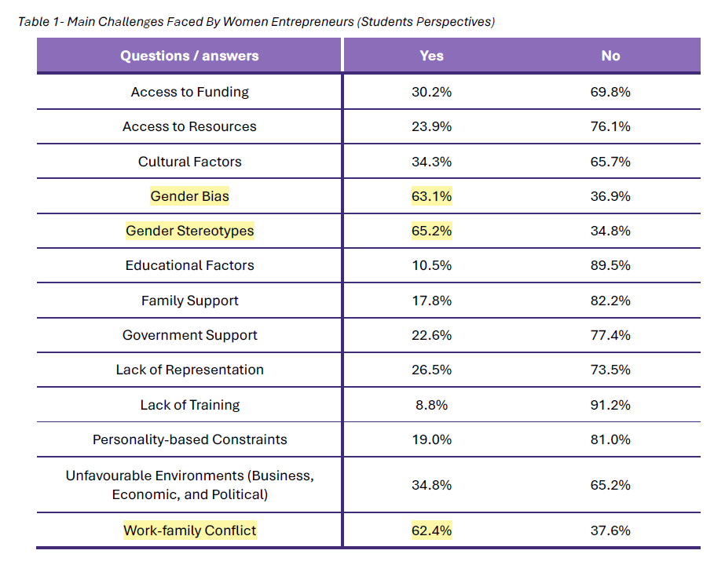

Main Challenges Faced By Women Entrepreneurs (Students perspectives: 768 responses, 5 higher education institutions: University of Gdansk, University of Macedonia, Polytechnic of Guarda, University of Salamanca, Polytechnic of Torino)
Research Report
T. Paiva; S. Salgado; M.Salaberri; T. Felgueira; C. Alves; N. Gomes, Needs Analysis. Empowering Women in Tech Innovation and Entrepreneurship, Instituto Politécnico da Guarda
www.hertechventure.eu

Slide 5







More information
https://www.hertechventure.eu
Where to find us

