Slide 1





HerTechVenture
B1. LET’S TALK ABOUT LANGUAGE –
exclusion, inclusion, sexism
University of Salamanca
Project Number 2023-1-PL01-KA220-HED-000156803

Slide 2

Details
GOAL | To explore the impact of gender-sensitive and gender-neutral language in academic contexts, addressing issues of exclusion, inclusion, and sexism, and reflecting on its implications in teaching and research
SHORT DESCRIPTION | Participants will be divided into groups based on their mother language to discuss gender-sensitive language in their institutions. Guided by specific questions, they will reflect on the role of inclusive and gender-neutral language in their academic contexts. Afterward, each group will share their conclusions with the larger group, followed by a final discussion. The session will close with highlights from a relevant TED talk on the subject
DURATION | Minimum: 30 minutes Recommended: 60 minutes for extending the discussion

Slide 3
Examples of Biased and Non-Biased Language

Slide 4
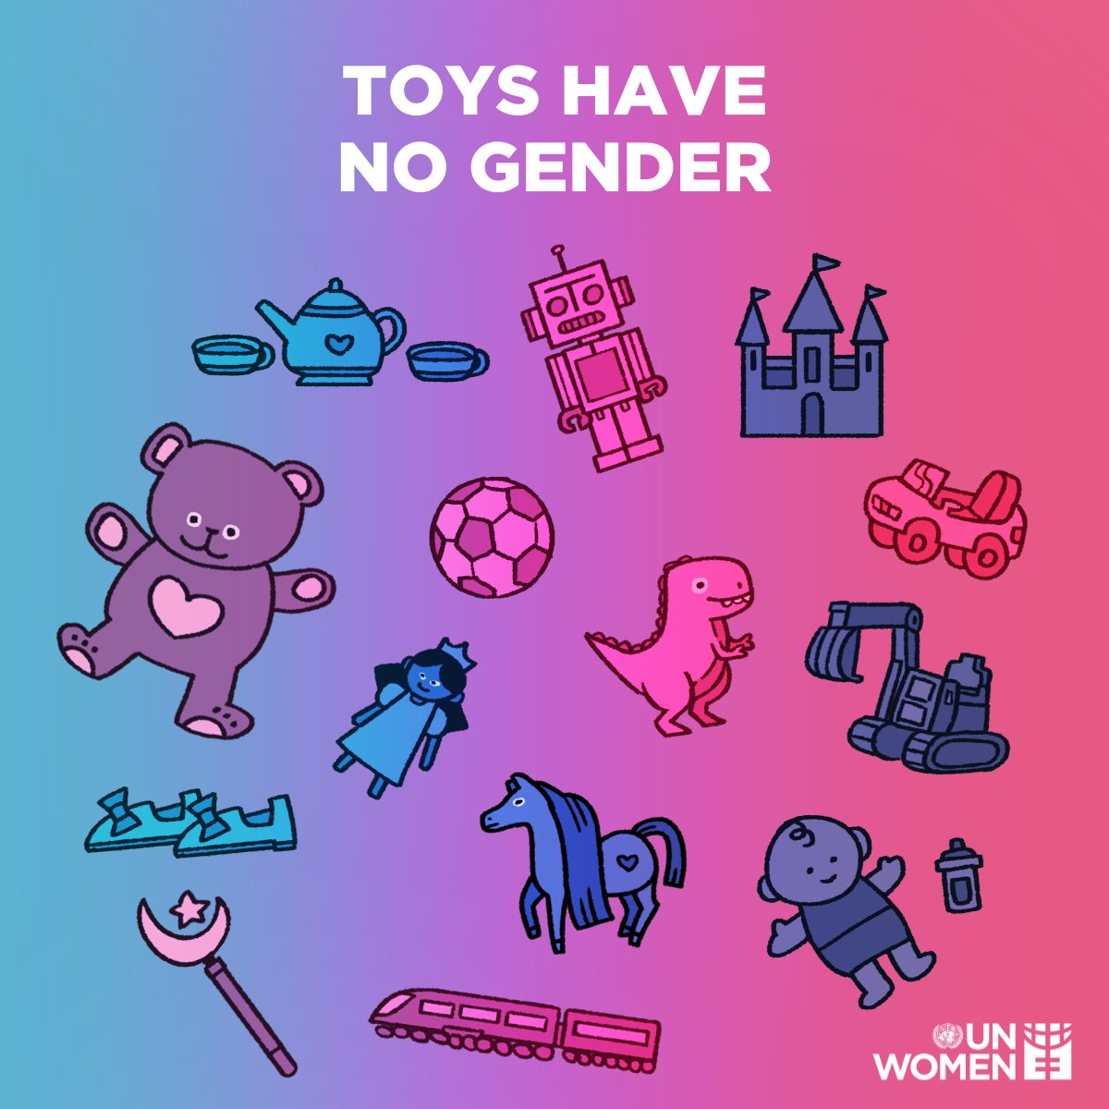
Stereotypes from early ages
Analysis of images of 3.125 children across 32 toy catalogues in 9 countries: Belgium, Bulgaria, Croatia, Denmark, Germany, Italy, Spain, Sweden and the United Kingdom
Key findings of the study:
12 catalogues, (37.5%) more than a third, had specific sections of toys “for boys” and “for girls” versus 20 catalogues (62.5%) having no specific sections. Most of those that are not formally divided into genders have, however, sections that are clearly marked by colours (pink and pastel colours for girls, darker and bolder colours for boys)
In 5 sections, boys were at least two thirds of the total children, respectively: videogames (67%), construction (69%), drones (72%), cars and transportations (74%), war and guns (88%). Girls were over the two thirds of total children only in two sections: care activities (87%) and beauty and grooming (94,5%)
Source: https://coface-eu.org/study-toy-catalogues-in-europe-making-or-breaking-stereotypes

Slide 5
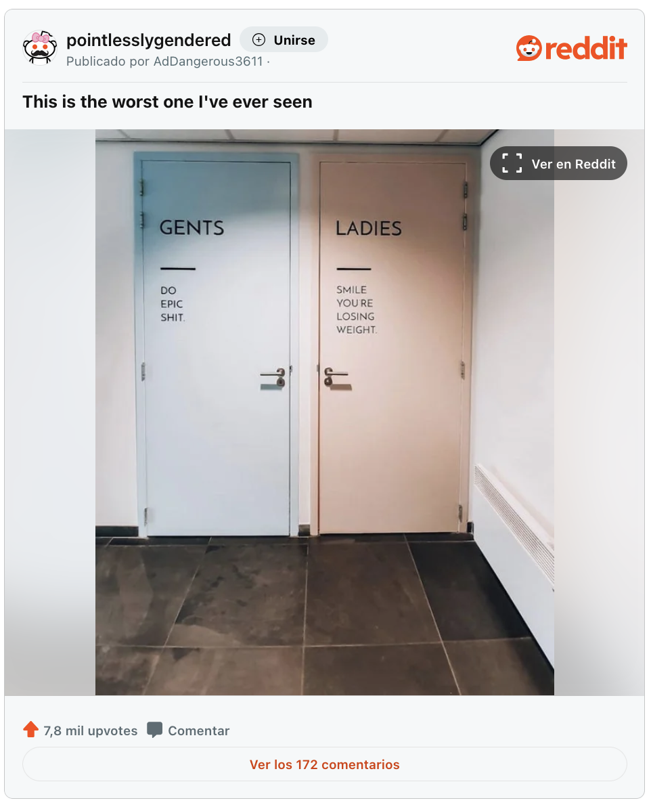
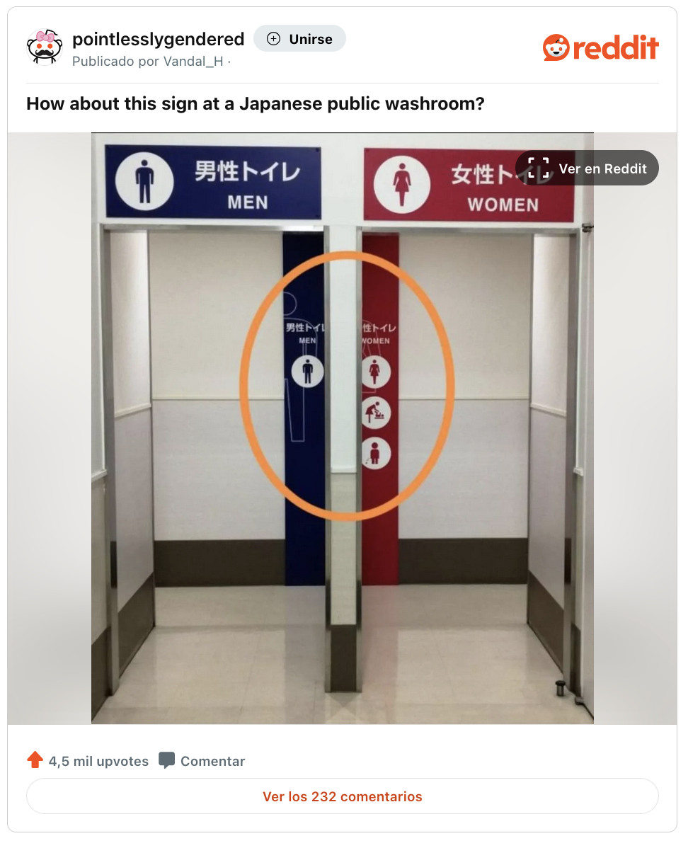
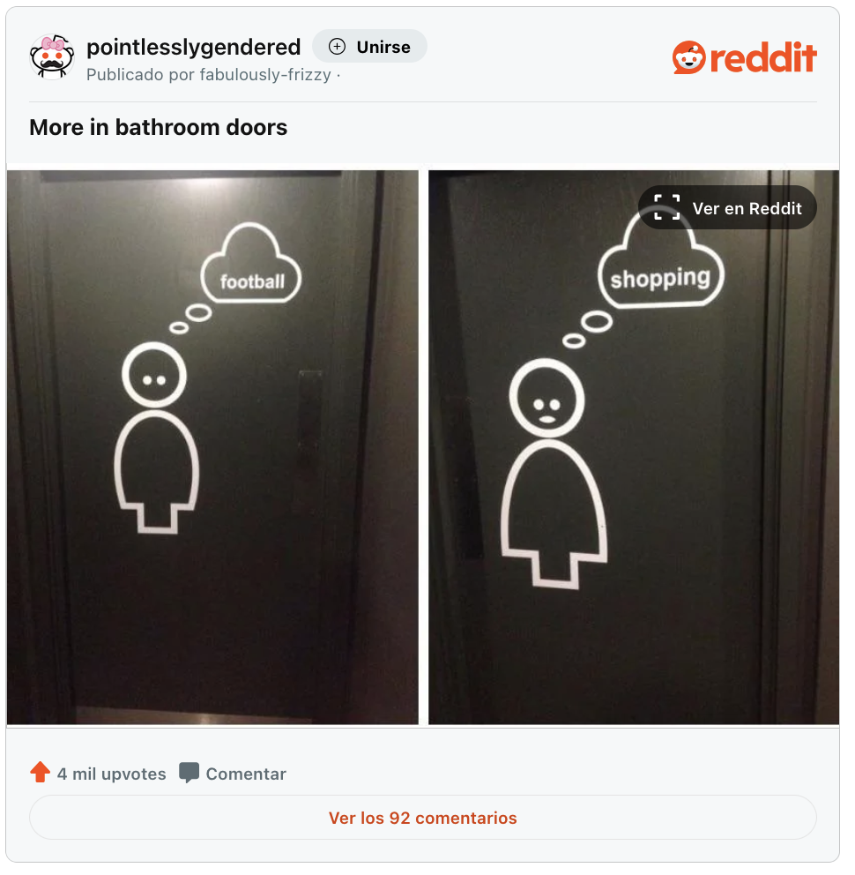
Stereotypes in public spaces
Source link (Reddit)
Source link (Reddit)
Source link (Reddit)

Slide 6
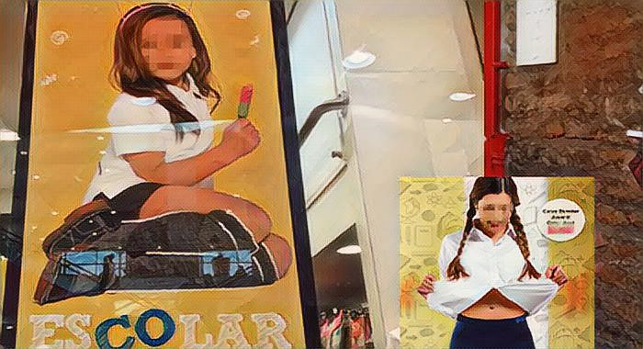
Stereotypes in public spaces

Slide 7
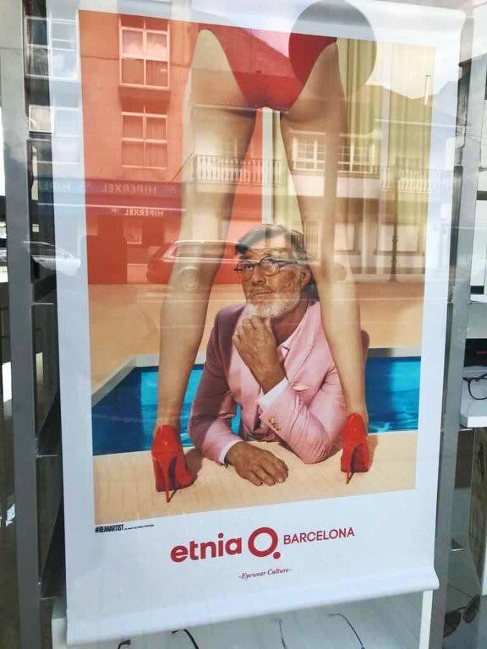
Stereotypes in public spaces

Slide 8
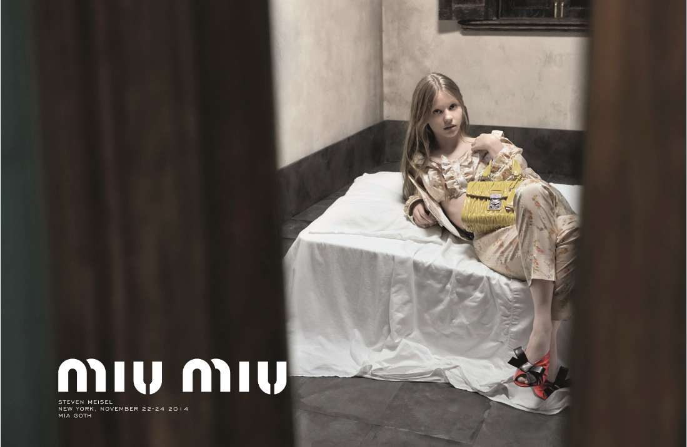
Stereotypes in public spaces

Slide 9
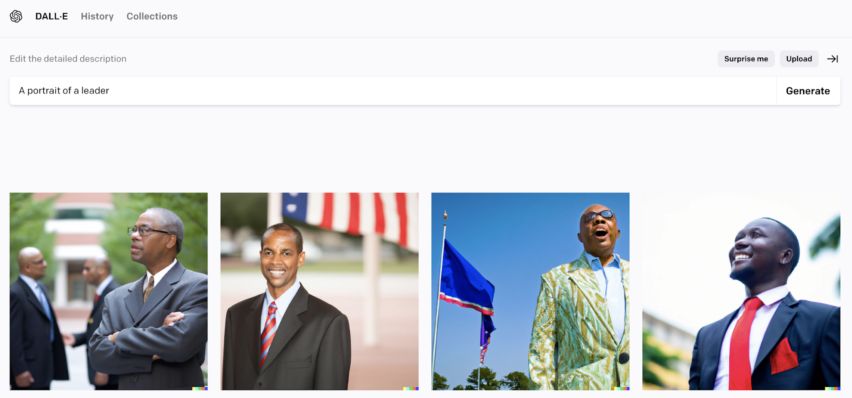
Stereotypes in technology

Slide 10
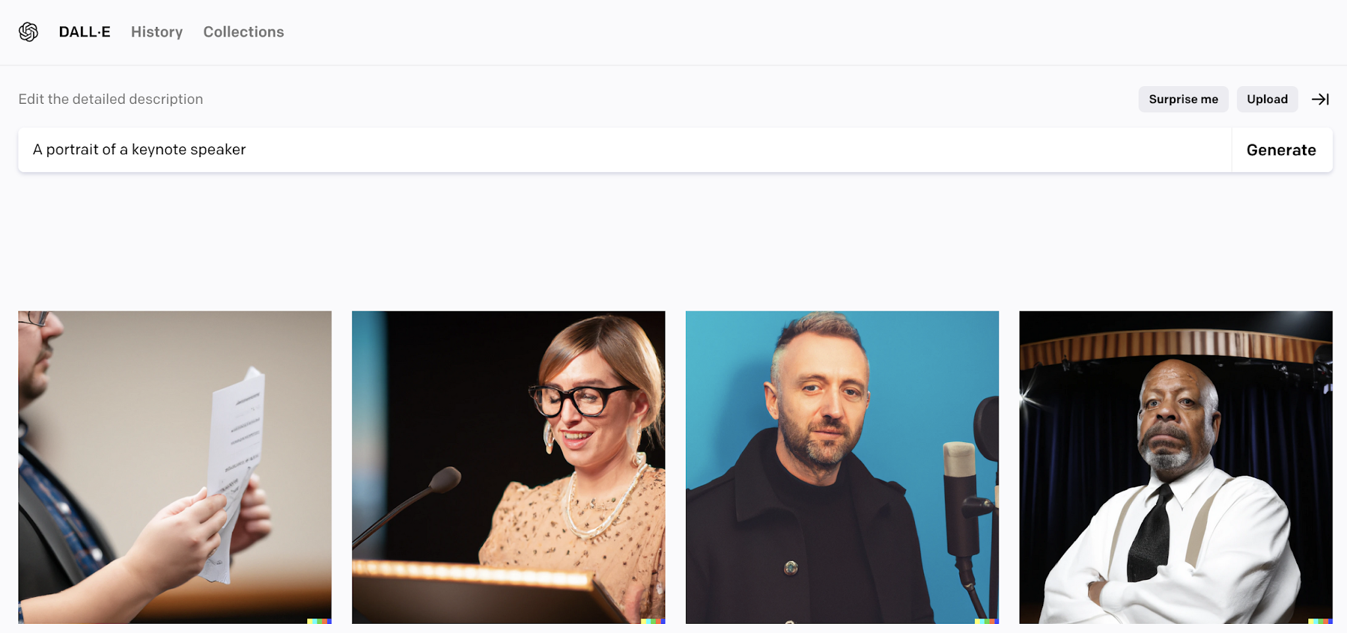
Stereotypes in technology

Slide 11
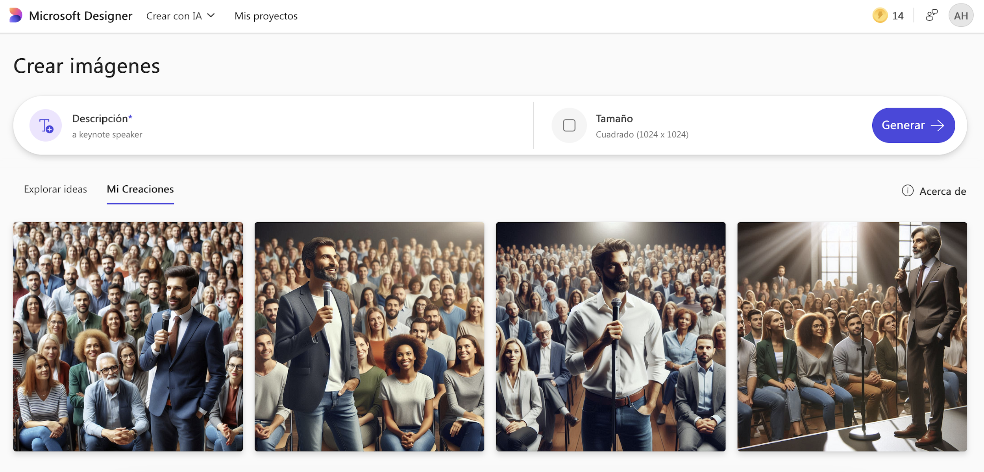
Stereotypes in technology

Slide 12
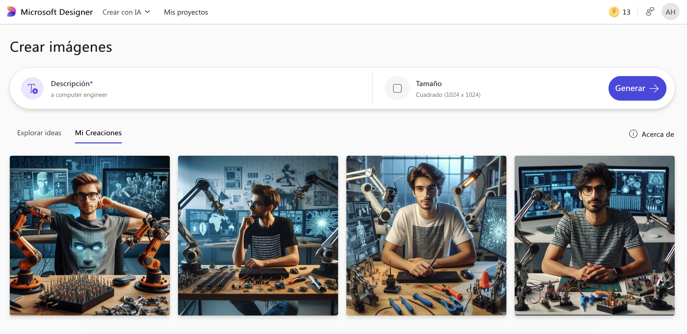
Stereotypes in technology

Slide 13
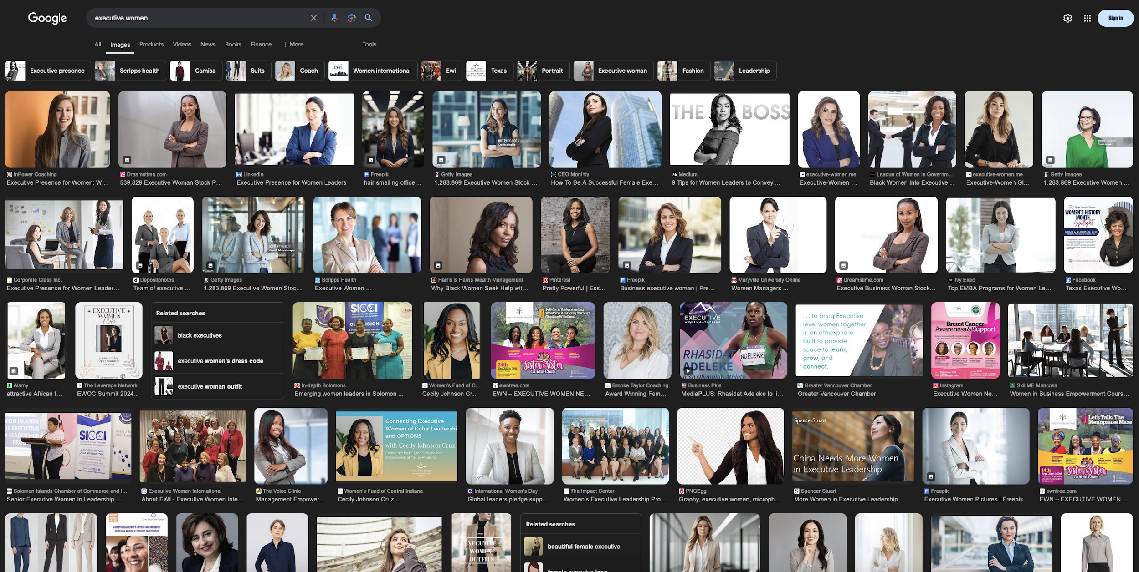
Stereotypes in jobs

Slide 14
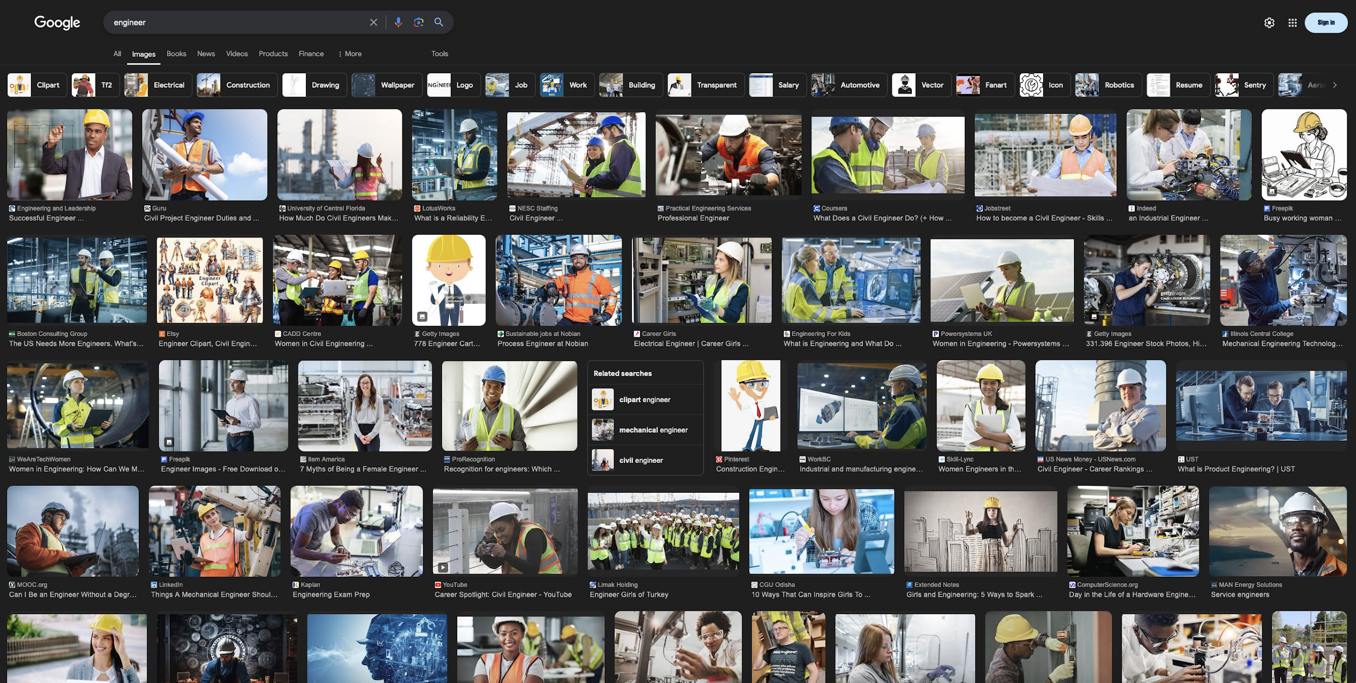
Stereotypes in jobs

Slide 15
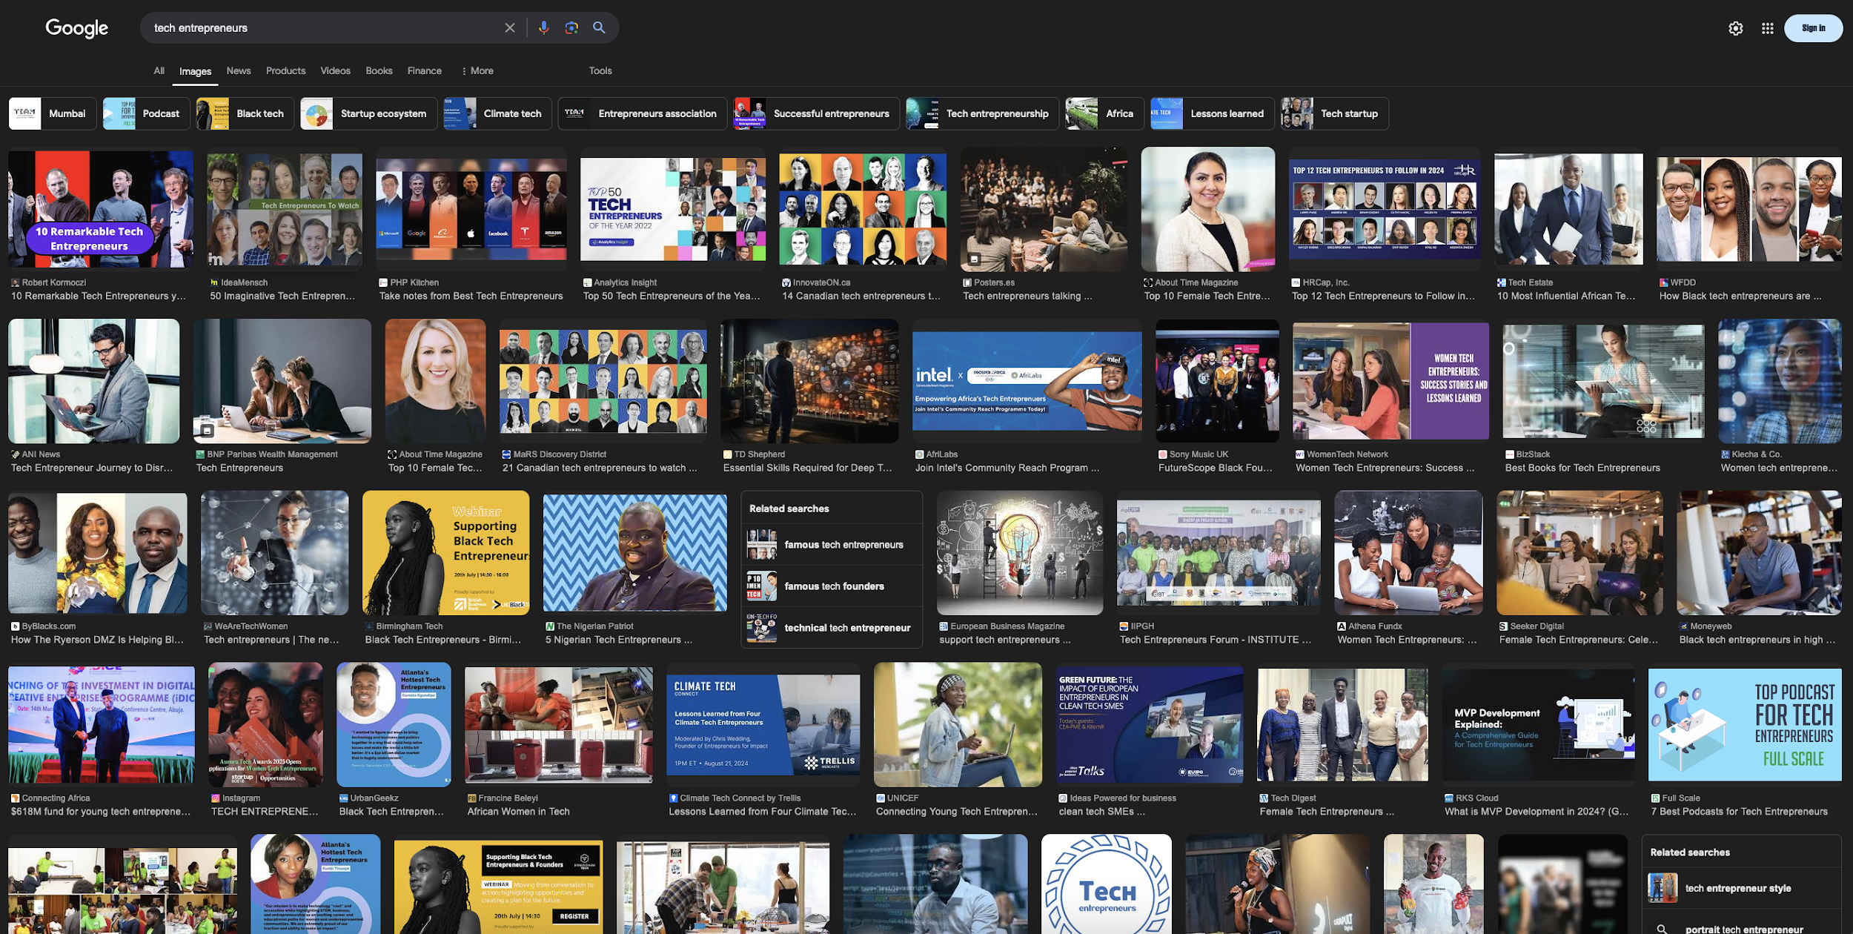
Stereotypes in jobs

Slide 16
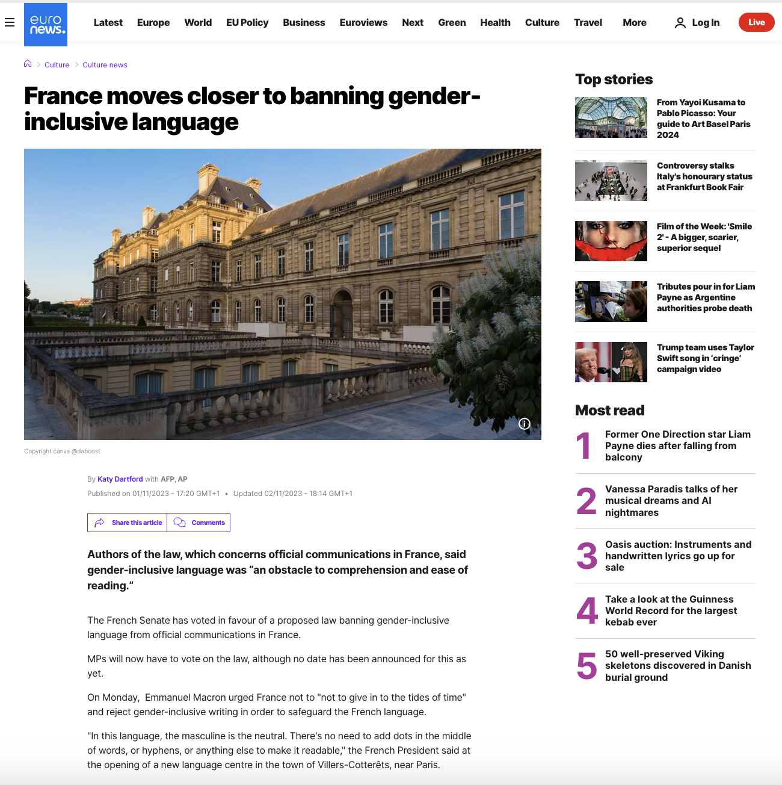
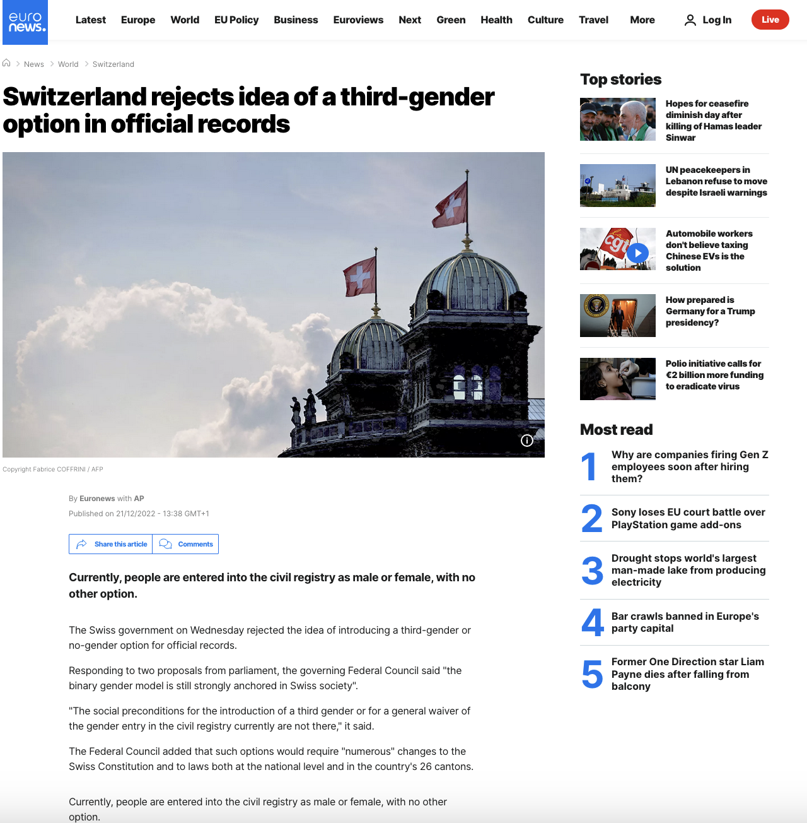
Gender-inclusive language?
Source: https://www.euronews.com/culture/2023/11/01/france-moves-closer-to-banning-gender-inclusive-language
Source: https://www.euronews.com/2022/12/21/switzerland-rejects-idea-of-a-third-gender-option-in-official-records

Slide 17
Stereotypes
Men | Women
Strong | Weak
Brave | Fearful
Tough | Sensitive
Mind | Body
Athlete | Creative
Unfaithful | Faithful
Protector | Dependent
Non-aesthetic | Aesthetic
Non-romantic | Romantic

Slide 18
Create groups by mother language

Slide 19
Questions

Slide 20
Have you noticed the use of gendered or biased language within your institution?
First question
Supporting questions:
In emails, reports, or signage at your institution, is the masculine form used as a generic, or are gender-neutral forms included?
How are individuals or groups referred to in your institution? Are both genders made equally visible?
Have you noticed gender stereotypes in the materials, textbooks, or images used at your institution?

Slide 21
What impact do you think this type of language could have on your teaching and research?
Second question
Supporting questions:
Do you think the use of inclusive or non-inclusive language affects students' perceptions of gender roles in their academic environment?
How do you think using more inclusive language could change the way you communicate with students?
Do you believe that biased or inclusive language influences how you interpret and present the outcomes of your research?

Slide 22
Should the academic context incorporate gender-inclusive or gender-neutral language?
Third question
Supporting questions:
What benefits or challenges do you see in implementing inclusive language within your institution?
How do you think inclusive language could impact the visibility and participation of women and other underrepresented groups in the academic environment?
What concrete measures would you propose to incorporate inclusive language into your institution's documents, materials, and official communications?

Slide 23
Each group will present their key insights to the whole group

Slide 24
Common themes and ideas

Slide 25
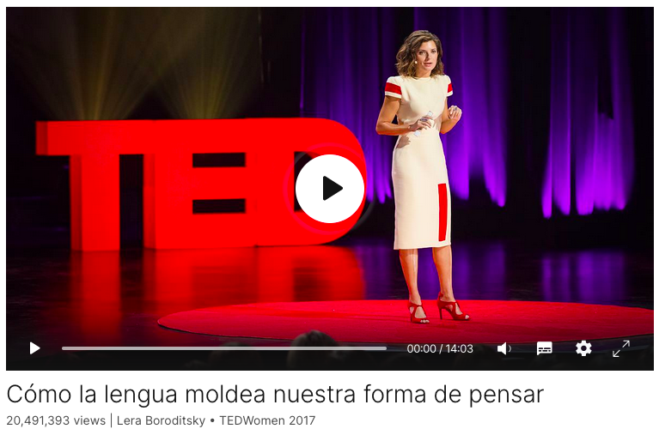
https://www.ted.com/talks/lera_boroditsky_how_language_shapes_the_way_we_think?language=es

Slide 26






More information
https://www.hertechventure.eu
Where to find us

