Slide 1
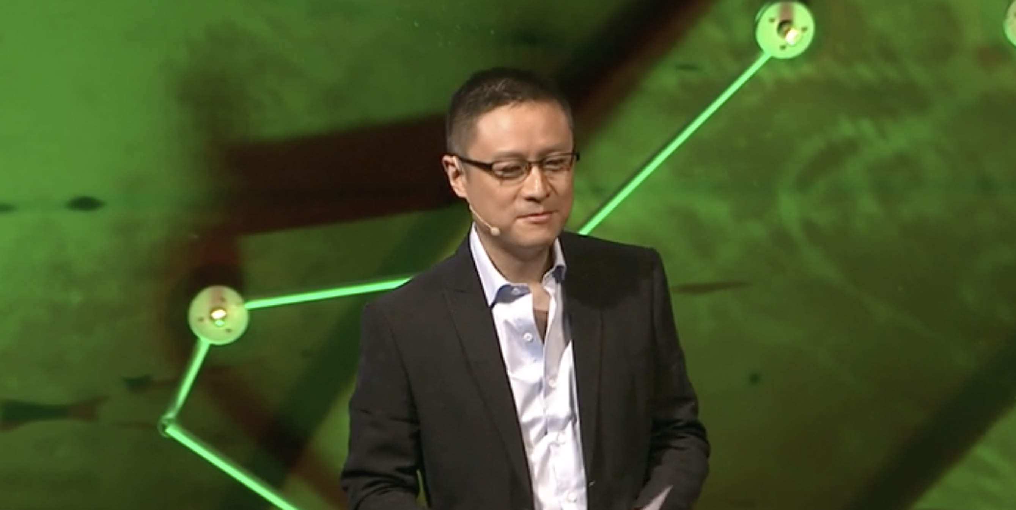
A tale of two political systems
by Eric Li

Slide 2
Core ideas
1. What three myths the speaker is referring to?
2. Which 3 assumptions are made by dominant political theories of our time about a one-party state - in particular Chinese communism and what how true are they?
3. How does the speaker counter these assumptions through the example of China?
4. What is the Party's Organization Department and how does it operate?
5. What role do patronage and merit play?
6. What does he believe about corruption in communistic and democratic systems?

Slide 3
Core ideas
7. What claim does he make about democracy in the end and the significance of China’ example?
8. On the basis of the above, what do you think the purpose is in giving this speech?

Slide 4
Rhetorical strategies
1. What introductory techniques is the speaker using to draw attention?
2. Comment on his use of presentation aids. What visual aids is he using and when. What, do you think is he trying to achieve?
3. The speaker is referring to his theories as “tales, myths, prospectuses that people buy”, “meta-narratives”, as a story “the Chinese didn’t buy this time”, “a story that became a best seller”. What is he implying through these names and how do they contribute to the cohesion of the speech?

Slide 5
Rhetorical strategies
4. The speaker is mainly using the ‘refutation strategy’. What is a ‘refutation strategy’ and how is it used here?
5. What kind of support does he provide for his arguments?
6. Give examples of strong contrast.
7. How does he establish credibility?

Slide 6
Vocabulary
1. Meritocracy | A. Appointing persons to government positions on the basis of political support and work
2. Sovereign | B. Replace
3. Feudalism | C. Self-governing, independent, exercising supreme permanent authority
4. Cadre | D. The outlook/ behavior of officials
5. Officialdom | E. The right or privilege of voting
6. Patronage | G. Praiseworthy
7. Suffrage | H. Political system of the 9th-15th century, in which vassals held land from a feudal lord and received protection
8. Indictment | I. A nucleus of trained personnel around which a larger organization can be built and trained
9. Supplant | J. A system in which advancement in based on individual ability or achievement
10. Laudable | K. A person who provides capital for new/innovative commercial enterprises
11. To vet | L. Formal accusation
12. Venture capitalist | M. To subject to thorough examination/evaluation
13. Meta-narrative | N. A big story, a grand story usually an explanation about what happens in society

Slide 7
Vocabulary
Hunky dory: perfectly satisfactory
mind-boggling: intellectually/emotionally overwhelming, astonishing, bewildering
Hubris: arrogance, overbearing pride
Wrench: to twist/distort/break/extract, to pull at the feelings of emotions, distress
Leaps and bounds (for progress): with unexpectedly rapid progress.
Mire: a disadvantageous/difficult position Literally: wet soggy soil or mud
To mire: to hinder, entrap, to cause to become stuck
Whopping: exceptionally large

Slide 8
Complete the blanks th the words given
mind-boggling, curb, dismal, put downs, dusk, leaps and bounds, hubris, wrenching, polls, recruit, unprecedented, mire, mandatory, alleviation, panacea
1. Governments have promised to _____ emissions to meet the target agreed for 2010.
2. We are entering the ______ of a new era.
3. The history of medicine shows that it can benefit from ______ changes.
4. Initially the task seemed ________, how to sensibly integrate such a wealth of different material.
5. ___ performance of the stock market is bad news for pension funds.
6. We’ve conducted a number of ____ to gauge the people’s attitudes on this.
7. Meanwhile, he continues to _______ scientists to study the case.

Slide 9
Complete the blanks with the words given
mind-boggling, curb, dismal, put downs, dusk, leaps and bounds, hubris, wrenching, polls, recruit, unprecedented, mire, mandatory, alleviation, panacea
8. The death sentence is still ____ in various countries in the world.
9. The _____ of the suffering of the poor should remain our main target in the future.
10. The judges are here to help so they will not be offering any sarcastic ______ to the contestants, like the ones in TV shows.
11. Her ____ prevented her from asking for help on the project, so it was late.
12. There is no single ______ for this country’s economic ills.
13. After years of troubles and wars, their economy is growing by _________.
14. The level of ambition is exceptional is not ________.
15. They slowly climbed out of the ______ through a little sacrifice and a lot of planning.

Slide 10
Derivatives
1. The ____________ (not-illusion) voters wanted an alternative to the two main parties.
2. Field workers worked ________ (not-tire) night and day to make a living.
3. Some political systems are __________ (operate) more flexible and ______ (adjust) than others.
4. According to a theoretical ______ (assume), a one-party system is _____ (inherit) incapable of self ______ (correct).
5. Many economic and political reforms of the present were __________ (not-imagine) in the past.
6. The ________ (enact) of new rules aimed at correcting previous ________ (not-function)
Put the word into the correct derivative

Slide 11
Derivatives cont.
7. It is difficult to find _________ (merit) political institutions nowadays.
8. ________ (Corrupt) is widespread and undermines the system and its moral ___________ (legitimate).
9. Telling people there is only one type of governance is _________ (not respond)
10. ___________ (Universal) should make way for ____________ (plural)
11. The first king’s _______ (succeed) managed to lift the country out of poverty.
Blank completion

