Slide 1

Evolutionary & Neuroscience
Perspectives of Leadership & HRM
Prof. Alexandros Psychogios
Loughborough Business School
Loughborough University

Slide 2

Who Am I…
Education
  BSc in Political Science & Public Administration (University of Athens)
  MSc in Public Policy & Public Finance (University of Athens)
  MA in Services Management (University of York, UK)
  PhD in Business Administration (University of Warwick, UK)
Current Positions
  Professor of HRM & OB, Head of Work & Organisation Group, Loughborough Business School, Loughborough University, UK
  Visiting Professor, Germany, Greece, Cyprus
  Associate Researcher, South-Eastern European Research Centre (SEERC)
Specialization & Experience
  Consultant: Leadership, HRM, TQM applications, Performance Management Systems and Reward Systems.
  Professional Trainer: Leadership Development, Complexity, Neuroscience & Management, Performance Management

Slide 3
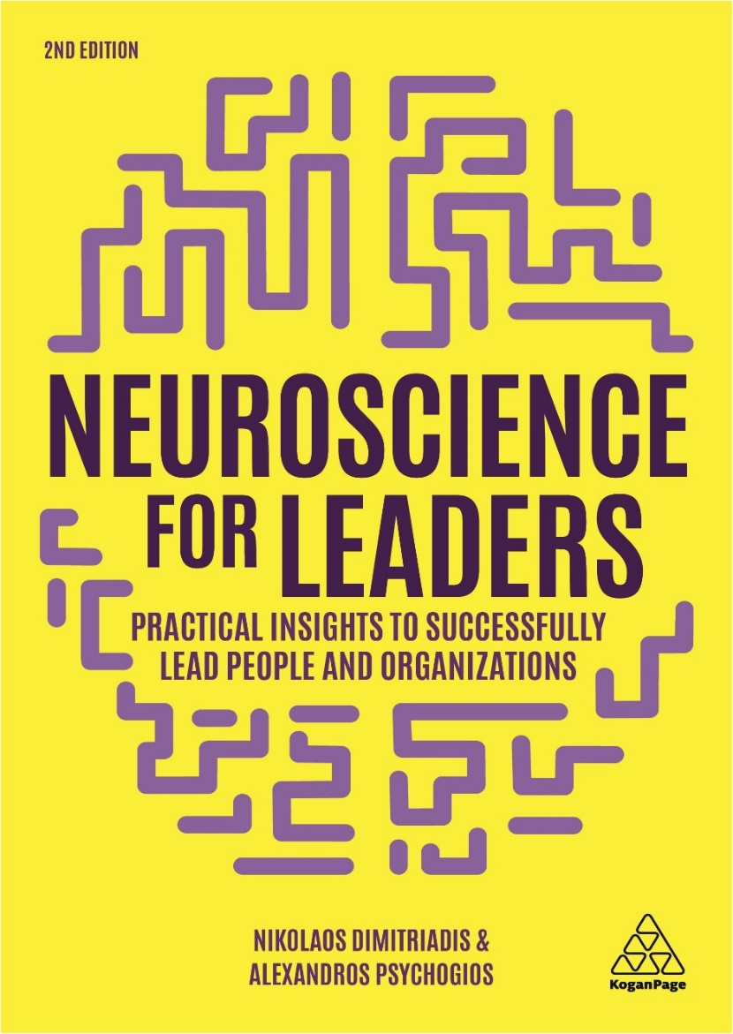

https://www.koganpage.com/product/neuroscience-for-leaders-9781789662146
https://www.propobos.gr/product/nevroepistimes-kai-igesia/

Slide 4
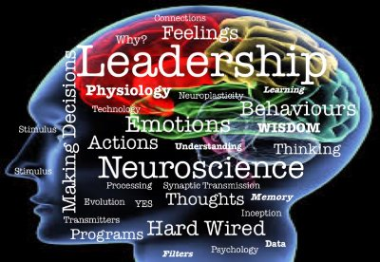
Outline of the Lecture
The Nature of Leadership
Evolutionary perspectives of Leadership
Evolutionary Theory Leadership
Evolutionary Psychology
Research Evidence
Neuroscience and leadership
The Three brains Leadership
Implications for Leadership Process: The BAL model
Organizational Neuroscience
Neuro- HRM

Slide 5
How serious are the following items in business situations?
STOP & ASK

Slide 6



Notes:
It seems not

Slide 7
Strange Corporate Behavior
Holding a heavy clipboard when interviewing candidates, interviewers are more likely to view the applicant as having gravitas and behave accordingly.
Sitting on a hard chair when negotiating the price of a car will make you negotiate harder.
Holding a hot cup of tea when meeting someone will make you behave more warmly disposed towards them than if you are holding an iced drink.
Notes:
7

Slide 8
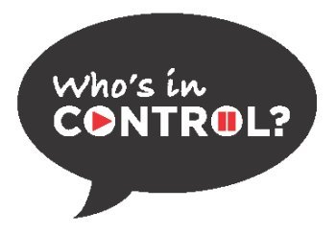

Our Behavior is Guided
by Hidden Force

Slide 9
What is Leadership?
Where leadership takes place?
STOP & ASK

Slide 10


Context
Leader
Follower
Interaction
Context
Context
Relational Process
Context
Dimitriadis & Psychogios (2020)
10

Slide 11
Are Leaders Born or Made?
STOP & ASK

Slide 12
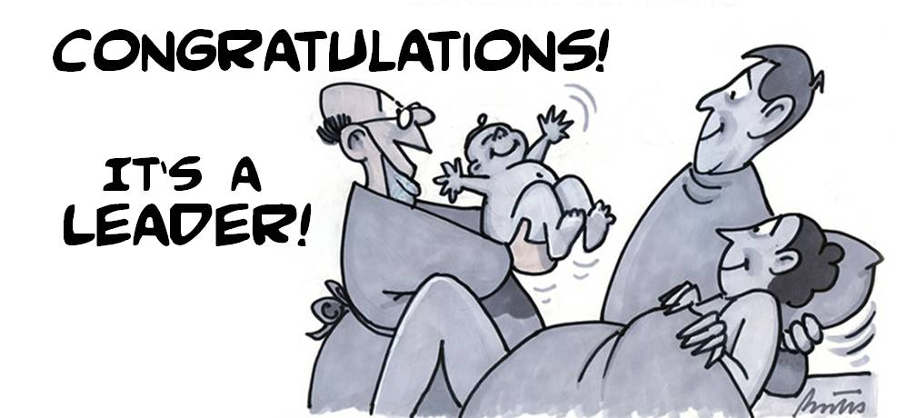
Leaders are born
Recent research suggested there might be such a gene in predicting leadership role occupancy
  Leadership role occupancy is associated with a genetic feature called rs4950 (De Neve et al. 2013).
  Leadership role occupancy is estimated at approximately 24% This is consistent with other twin study research, indicating approximately 30% heritability (Arvey et al., 2006; 2007).
By virtue of “good genes” some individuals appear to have a genetic advantage when it comes to emerging or ascending into leadership-related roles;
However, the results also suggest that anyone might become a better leader and increase their odds of occupying formal or informal leadership roles through deliberate practice and experience.

Slide 13
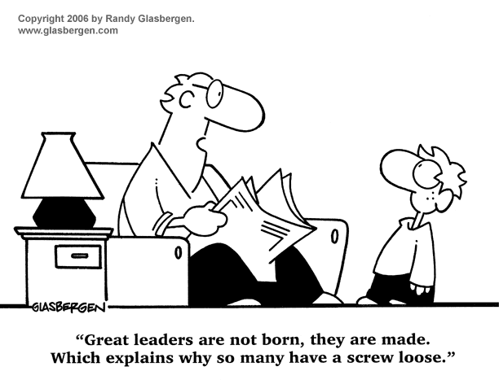
Leaders are Made
It has been estimated that U.S. organizations invest between US$20 billion and US$40 billion annually in leadership development programmes (Lamoureux, 2007).
It seems that organizations believe that leadership can be developed.
The Fullerton Longitudinal Study (FLS) is an ongoing long-term project designed to study child development through adolescence and into adulthood, providing insights into the early influences on leader development.
  Childhood intrinsic motivation and approach temperaments appear to be related to adolescent motivation and personality (extraversion) that predict aspects of motivation to lead.
  Implication: more introverted children and adolescents might benefit from youth leadership initiatives designed to help draw out and prepare them for future leadership roles

Slide 14
Born or Made does not matter
Leaders are Born
  Leadership Genes
  Can you do anything about it?
Leaders are Made
  Leadership Memes during our childhood
  Can you do anything about it?
Leaders born and made, but mainly they can develop themselves if they accept the challenge and go after difficult situations.

Slide 15
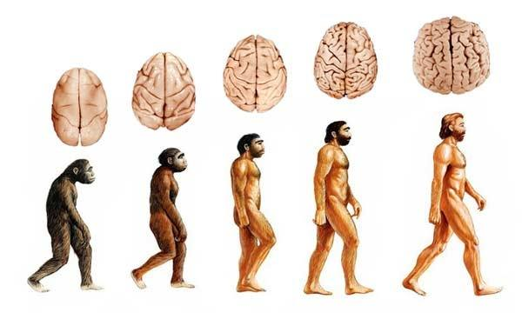
Evolutionary Perspectives in Leadership
Integrating knowledge from the natural, biological, and social sciences that all have interesting things to say about leadership & HRM (Antonakis, 2011; Bennis, 2007; Colarelli & Arvey, 2015)..
Most leadership theorists base their ideas on data from modern, complex organizations.
However, humans spent more than 95% of their evolutionary history in small-scale societies (van Vugt & Ronay, 2014; von Rueden & van Vugt, 2015).
Understanding leadership in small-scale societies helps test theories of why leadership exists at all and what contributes to leader emergence and effectiveness in any society.

Slide 16
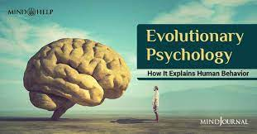
Evolutionary Leadership Theory
Evolutionary leadership theory (EvoL theory) explains how our leadership and followership behaviour shaped through selection pressures operating on humans in ancestral environments (van Vugt & Ronay, 2014).
EvoL theory starts with the recognition that the physiological, neurological, and psychological processes involved in producing human behaviours are first and foremost products of biological evolution.
Environmental (Cultural) processes matter too, in understanding human behaviour, but culture is also a product of biology, as humans have evolved psychological mechanisms for imitation and social learning (Henrich & Gil-White, 2001; Richerson & Boyd, 2006; Tooby & Cosmides, 2005).

Slide 17
Origins: Evolutionary Psychology Mechanisms
Evolutionary psychology proposes that human minds contain a number of specialized psychological mechanisms—or adaptations—that enable humans to solve many different problems affecting their reproductive success.
Evolutionary psychologists further assume that evolved psychological mechanisms
  (a) operate automatically (without requiring much conscious effort);
  (b) do not require extensive learning or training;
  (c) are relatively culture-free;
  (d) follow stable developmental pathways; and
  (e) are highly sensitive to relevant environmental inputs.

Slide 18

Evolutionary mismatches of Leadership
Evolutionary mismatches: Inconsistencies between ancestral and modern environments (van Vugt, et al., 2008).
Psychological mechanisms are adapted to past environments and not necessarily produce adaptive responses in modern environments.
  The heuristic “Follow a physically strong leader” may have been a functional mechanism in ancestral human environments in which physical strength mattered (Spisak et al., 2011).
  Yet this computational rule may backfire in modern environments in which the physical qualities of leaders arguably matter less (although it is still possible that tall and physically strong leaders attract more followers because they are seen as more influential).

Slide 19
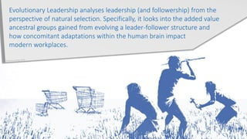
Evolutionary Functions of Leadership
Resource Acquisition: In hunter-gatherer societies, there are individual leaders for hunting (von Rueden & van Vugt, 2015).
Conflict Management: among various tribes, younger, more aggressive war leaders exercise authority over raids, but more senior peace leaders take over during peace time (von Rueden & van Vugt, 2015).
Distribution of Resources: in small-scale societies Big Men leaders emerge who generously provide resources and attract followers (van Vugt, et al., 2008).
Teaching in humans: in various hunter-gatherer societies there are leaders who coordinate religious rituals and form the bridge between the group and the spiritual world of ancestors (Harner, 1980).

Slide 20
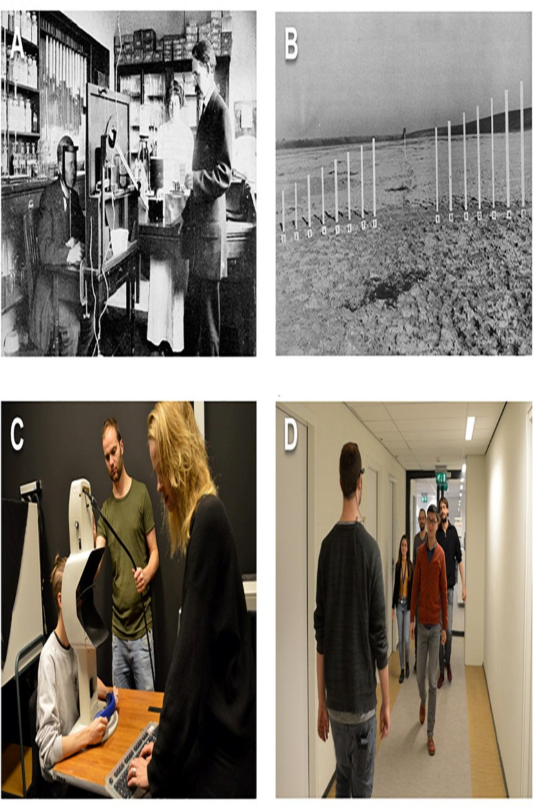
Methods of Testing EvoL Theory Hypotheses
Computer simulations: test the validity of hypotheses underlying the emergence of leadership.
Experimental methods: behavioral economics and social psychology are useful in testing evolutionary hypotheses about leadership.
Social neuroscience: the nascent field of organizational cognitive neuroscience applies neuroscience techniques to organizational behaviors such as leadership.
Hormonal studies: identify the hormonal correlates of leadership emergence or effectiveness.
Behaviour genetics studies: help to provide an indication of whether leadership emergence has a substantial genetic component.
Anthropological and ethnographic databases: testing the extent to which leadership phenomena are universal across human cultures.
Cross-species evidence: is instrumental in testing speculations about the evolutionary history of any alleged leadership mechanism or trait.

Slide 21

Indicative Evidence I
Agent-based models show that in groups with a heterogeneity in preferences between members yet a limited time to reach consensus, leadership emerges spontaneously. The leader position is taken by the most stubborn group member (Gavrilets, Auerbach, & van Vugt, 2016).
  Implication: this result explains why under time pressure groups revert to a more hierarchical decision-making structure.
A twin study reveals that about 40% of the variation in leadership emergence behaviours is explained by genetic factors (Chaturvedi, et al., 2012).
  Implication: there is a heritable component to leadership. Yet it is rather unlikely that there is a single gene responsible for the difference between born leader and born follower (De Neve et al., 2014).
A brain imaging study shows that when followers receive an unfair offer from their leader, it elicits brain activity in areas related to emotion (anterior insula) (Sanfey, 2007).
  Implication: emotions play a role in deciding whether to follow a leader

Slide 22
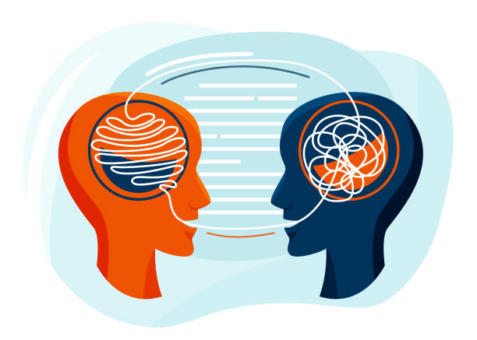
Indicative Evidence II
Anthropological data obtained among the Tsimane in Bolivia show that physically formidable men often hold high-status positions (von Rueden et al., 2011).
  Implication: Physically strong men are likely to receive high status because they are (seen as) better performers.
An experimental study revealed that individuals with high baseline levels of testosterone were more likely to abuse their power position in an economic game (Bendahan, Zehnder, Pralong, & Antonakis, 2015).
A hyperscanning (fNIRS) experiment shows that leader-follower dyads synchronize their neural activities more than leaderless dyads (Jiang et al., 2015).
  Implication: leader emergence is characterized by high levels of interpersonal neural synchronization between leaders and followers, (Psychogios, et al, 2019).

Slide 23
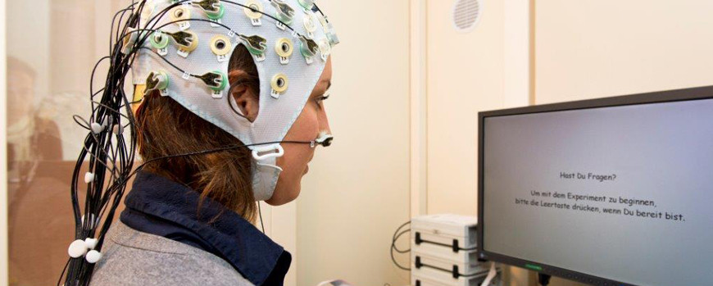
Indicative Evidence III
Data from management executive programs show that higher-ranked managers have higher levels of cortisol than lower-ranked ones (Sherman et al., 2012).
  Implication: lower-status leadership positions in society come with lower stress levels and ultimately predict better health.
A laboratory experiment shows that groups with punitive leaders reach higher levels of cooperation than groups without leaders (O’Gorman, Henrich, & van Vugt, 2009).
  Implication: leadership may have evolved partly to tackle the fundamental free-rider problem in (ancestral) human societies.
A cognitive experiment shows that after being primed with danger cues participants followed the eye gaze of dominant-looking faces more than nondominant ones (Ohlsen, Van Zoest, & van Vugt, 2013).
  Implications: in danger, people may be using an automatic “follow-the-strong-leader” heuristic, which may be an evolutionary heritage.

Slide 24
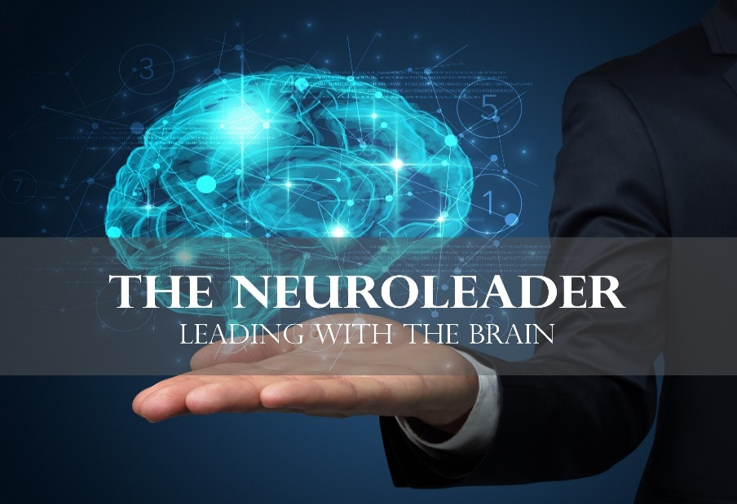
Neuroscience on board…
Neuroscience is the study of the nervous system including the brain
Neuroscience helps us to understand ourselves and others better
  Understanding more about our brains, what drives them and what gets in the way, has helped both to guide their actions and build their empathy for others
Neuroscience is there to explain things about human behaviour
  For example, it explains why we find uncertainty disrupting and distracting
  It helps us to realise that reactions and emotions are normal

Slide 25
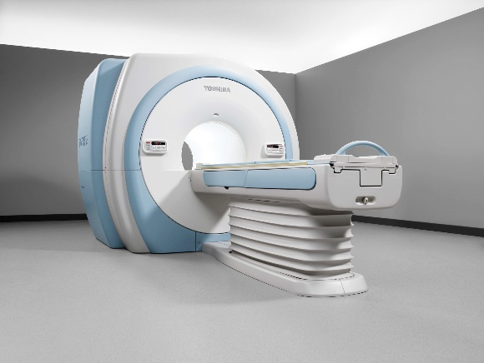
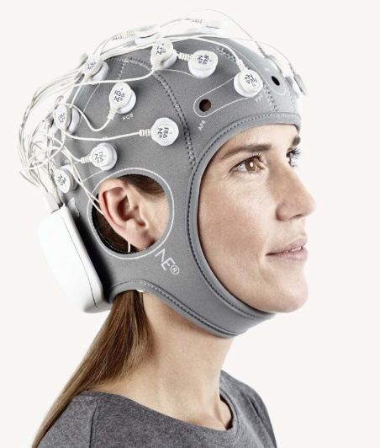
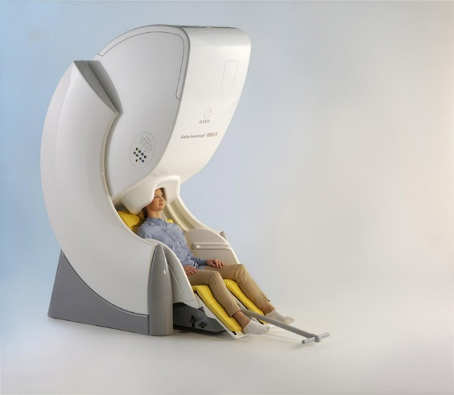

Neuroscience Methods
Functional Magnetic Resonance Imaging (FMRI)
  Detects magnetic field distortions
Electro-Encephalography (EEG)
  Detects electrical potential differences derived from neural activity
Magneto-Encephalography (MEG)
  Detects magnetic signals associated with the electrical activity in the brain
Positron Electron Tomography (PET)
  Detects the distribution of the tracer in the brain

Slide 26
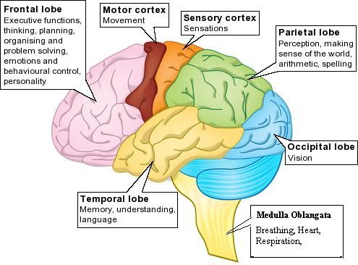
Our Brain Structure

Slide 27
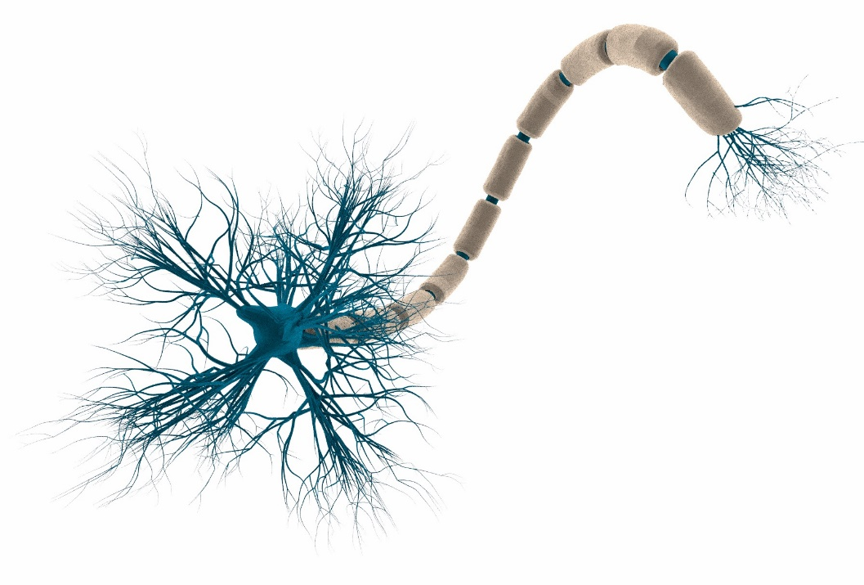
Neuro-connections
86 billion neurons - 1000 synapses
Neurons communicate with each other through electrical signaling that carry just 0.1 volts and can travel long distances with a speed of 120 meters per second.
This electrical signaling reach a synapses triggering neurotransmitters that in turn cause electrical switches on the neuron.
Neurotransmitters can excite or inhibit neuron activity.
Neurotransmitters’ activity is essential for our brain function since allows the brain to continuously changing and adapting to the stimuli from the external world.

Slide 28
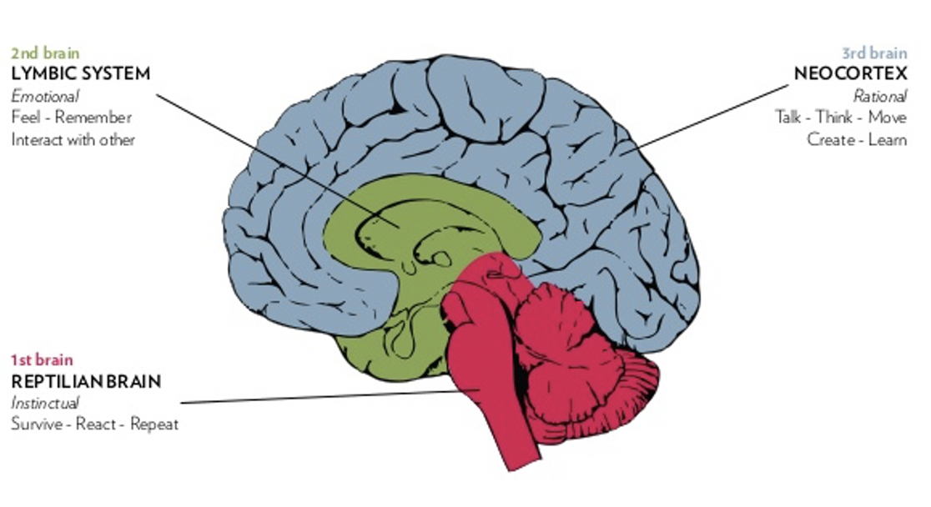
The Tribune Brain & Human Behaviour
Reptilian Brain
  Subconscious
  Guts Reaction
  Matches Patterns
  Survival actions
Limbic Brain
  Subconscious
  Assigns Value
  Past Experience
  Adjust Actions
Neocortex
  Conscious
  Gives Meaning & Reason
  Cultural norms
  Reflective

Slide 29
Five evolutionary facts about our brain
Survival
  The brain will do whatever it takes in order to keep us alive
Certainty
  Our brain does not like change and whatever is uncertain
Energy
  Our brain knows how to conserve energy (Brain Automations)
Easy solutions
  Our brain likes ‘Short cuts’
Neuroplasticity
  Our brain has the capability to modify its parts

Slide 30
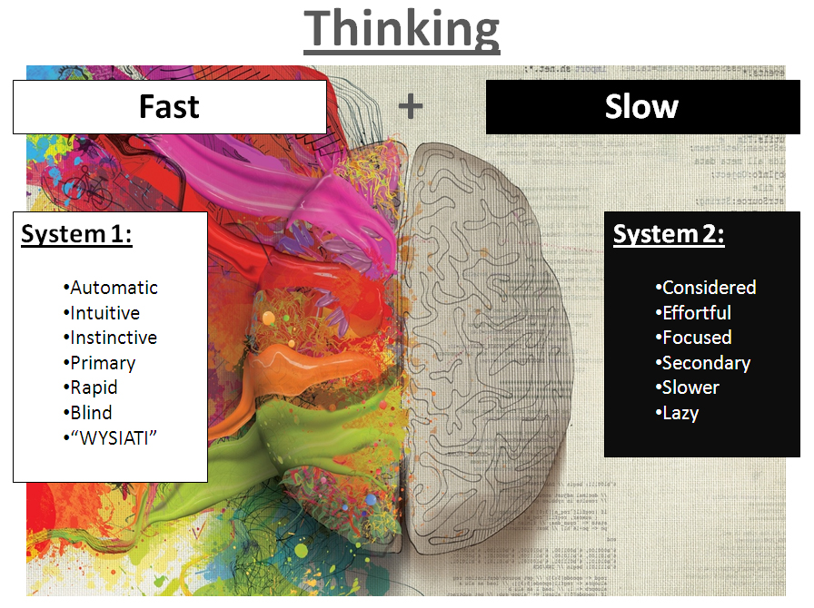
Understanding how the brain blinds the mind

Slide 31
Six reasons why neuroscience matters for understanding Management & Organizations
We need to change the way we manage change in organizations: by understanding the brain we can do this better
Neuroscience brings a new lens on understanding people and what motivates them
Neuroscience brings evidence that leading people, change management and employee engagement are not just ‘soft’ issues.
Neuroscience is all about what helps our brains to perform at their best
When we understand how our brains work we can work with the physiology, not fight it.
It provides science and evidence and these can be very persuasive to sceptical professionals and leaders.

Slide 32
Organizational Neuroscience
Organizational neuroscience is the field that integrates the use of neuroscientific methods and techniques to the study of managerial phenomena namely, Leadership and Human Resources Management
Three levels of analysis
  Individual – the neural base related to why individuals act and react in particular ways
  Group – the neural base of group functioning and social interactions
  Organization – the neural base of organizational structure and design, culture, change and politics
https://connect.aom.org/neu/home

Slide 33
Organizational Neuroscience fields
Neuro-HR
Neuro-leadership
Neuro-management of Change

Slide 34
How can HR use neuroscience?
  Recruitment
    We need to be aware of our limitations in making objectives judgements of others
  Performance Appraisals
    Feedback for performance usually lands badly. We need to take into consideration what makes the brain ‘comfortable’ and ‘focused’ in accepting and applying feedback.
  Learning & Development
    Neuroscience can find new ways to approach training and learning development that encourage greater learning retention by actually thinking about how the brain responds.
  Diversity
    Neurodiversity is the idea that biologically differences are the result of normal, natural variation in the human genome. Differently abled humans can contribute in a different way in organizational performance.
  Collaboration
    Neuroscience increases our awareness of insight and intuition because it helps us understand what kind of thinking enables and inhibits effective collaboration and idea generation

Slide 35
NeuroHR services with AI use
Neuro testing of core competences
Assessing the competences such as empathy, mindset, resilience, diversity and others.
Team compatibility neuro test
Identifying the collective team brain footprint; testing the fit of any potential new member.
Cultural fit neuro test
Identifying the culture of the company as perceived by the team’s brains, not by their statements.
Neuro testing in recruitment
Assessing the capabilities and compatibility of potential new employees.
Neuro optimizing internal communications
Analyzing the brain’s response to internal portals, announcements, printouts, speeches etc.

Slide 36
Key competences to test in HR
Empathy
cognitive vs. emotional
Mindset
fixed vs. growth
Resilience
temporary vs. sustained
Diversity
general vs. focused
Focus
Creative thinking
Risk taking

Slide 37
Brain Based Leadership
Brain based leadership focusses on organisational and employee- related aspects on how the brain and its underlying neuronal processes influence employees and their leaders (Ghadiri, Habermacher, & Peters, 2012; Rock & Cox, 2012).
The field is based on the neuroscience of four leadership activities:
  how leaders make decisions and solve problems,
  regulate their emotions,
  collaborate with others and
  facilitate change.

Slide 38
Our Research
PILLARS OF BRAIN ADAPTIVE LEADERSHIP
BRAIN AUTOMATION
Thinking
EMOTIONS
Dimitriadis & Psychogios, 2020; Psychogios & Dimitriadis, 2021

Slide 39
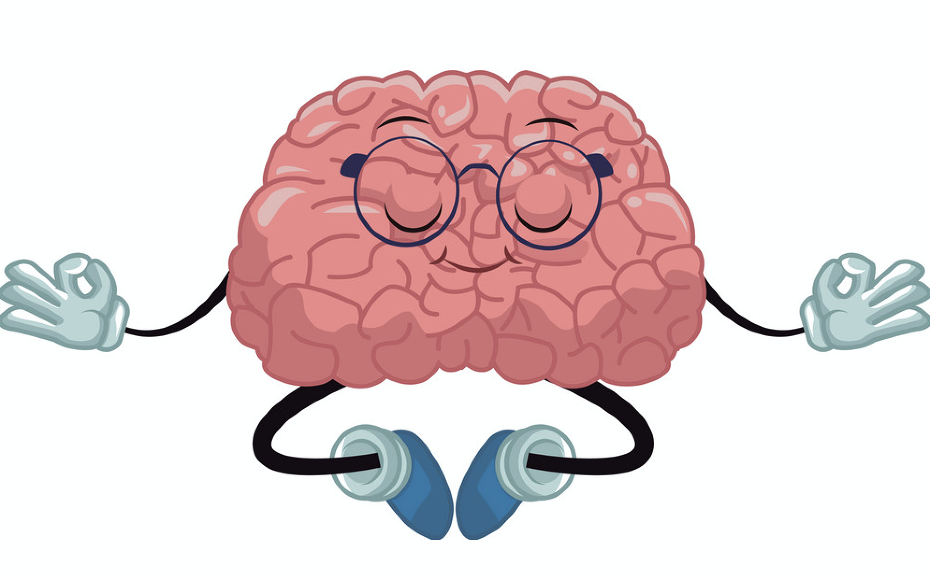
Brain Adaptive Leadership Pillars
Thinking
  Avoid Confusion & Overload
  Clear Message & Explain
  Focus on Performance
Emotions
  Be aware of the right emotion
  Motivate the brain
  Personalize it
Brain Automation
  Familiarize with the physical environment
  Do not neglect the power of habits

Slide 40
Our Current studies:
Hormonal studies:
  Exploring the Hormonal Foundations of Leadership Preferences
Experimental cognitive psychology studies:
  Exploring the Influence of Middle Managers' Cognitive Style on their Strategic Roles Enactment
  Impact of Anger on Leadership Behaviours & Strategic Roles of Middle Managers during Time Pressure
Social neuroscience studies:
  Investigating Neurofeedback Effects in Developing Leaders’ Resilience

Slide 41

Study 1:
Exploring the Hormonal Foundations of Leadership Preferences & Motivation to Lead
Aim:
The aim of this study is to explore the influences of specific hormones on leadership preferences and motivation to lead of professionals with managerial experience.
Research objectives:
To examine the influence of hormonal levels (testosterone and cortisol) that may influence’ leadership perception and preference (motivation to lead)
To test the implication of implicit leadership theories’ (ILTs) factors (i.e., Sensitivity, intelligence, dedication, dynamism masculinity and tyranny) proposed by Epitropaki and Martin (2004).
To test leadership preferences and motivation to lead under stress conditions.
Method:
Sample: 75 professionals working in various industries usually
Phase 1: A saliva sample was also taken from each participant before. Then participants were asked to fill-in a questionnaire on leadership preferences and motivation to lead.
Phase 2: After four months gap the same participant were called again. Each participant gave saliva samples before playing a game targeting to stress them up. Another saliva samples was collected immediately after playing the game. Each participant filled the same questioner as phase 1

Slide 42
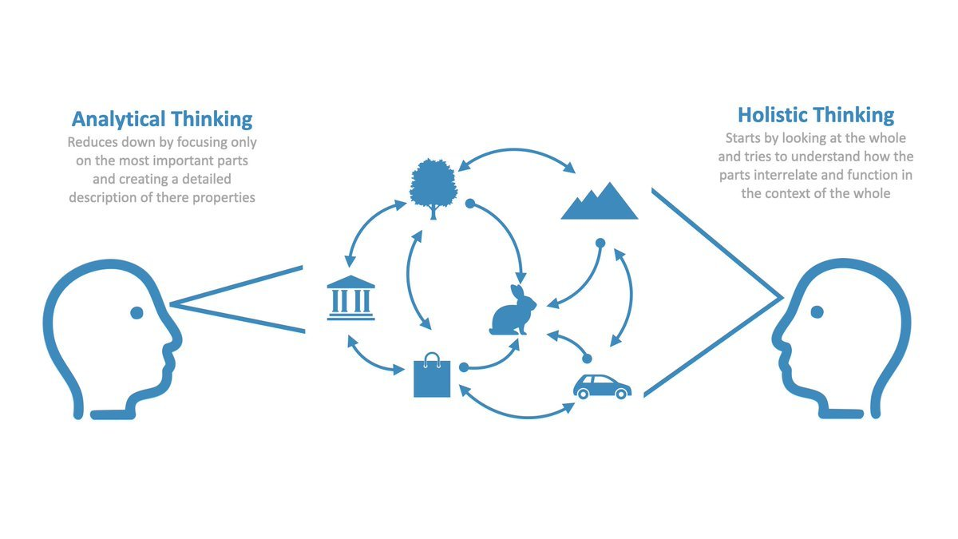
  Study 2:
  Exploring the Influence of Managers' Cognitive Style on their Strategic Roles Enactment
Aim:
This study aims to explore whether MMs' strategic roles are associated with their cognitive styles and overall underlying cognitive processes.
Research questions:
Do MMs' holistic & analytic styles influence the way they enact their strategic roles?
Can MMs' cognitive style predict the frequency of enacting specific strategic roles?
Can MMs' cognitive style predict potential conflict in particular strategic roles?
Can the frequency of acting specific strategic roles explain their attention behaviour?
Does their attention behaviour lead to conflict in particular strategic roles?
Method:
Sample: 140 Middle Managers working in various industries in UK and abroad.
Phase 1: analyse MMs' cognitive style (analytic or holistic) using the framed line task experiment. The process will be followed by a questionnaire about MMs' strategic roles and role conflict.
Phase 2: analyse MMs’ visual attention performance through the visual search with two tasks: features search and conjunction search. The process will be followed by a questionnaire about MMs' strategic roles and role conflict.

Slide 43

Study 3:
Impact of Anger on Servant Leadership behaviour and Strategic roles of MMs in Crisis
Aim:
  This study aims to investigate the impact of anger on leadership behaviour and strategic roles of middle managers. It explores time pressure as a moderator.
Research objectives:
  RQ1: How does anger impact middle managers’ perceived roles?
  RQ2: How does anger impact middle managers’ leadership behaviour? (Servant Leadership)
  RQ3: How does time pressure moderate the impact of anger?
Method:
  Sample: N = 120 Middle Managers from various industries. The experiment is designed into five phases:
  Stimulate anger emotion in a laboratory experiment, take their response to rate their experience of anger, and completion of the anger self-report measure.
  Measure of managers’ strategic behaviour and neutralize their anger.
  Measure of time pressure.
  Measure of servant leadership.
  Neutralize MMs’ emotion with a mood repair technique.

Slide 44
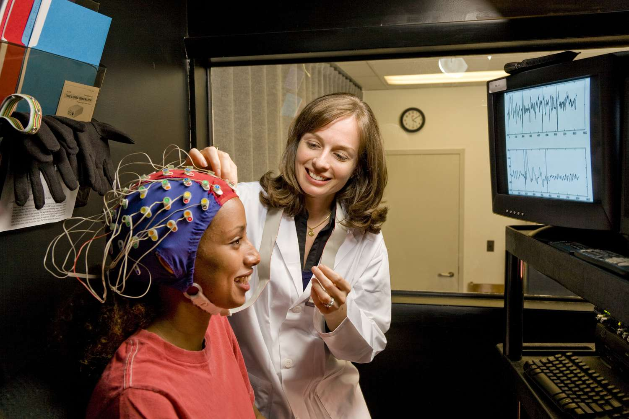
Study 4:
Investigating Neurofeedback Effects in Developing Leaders’ Resilience & Problem-Solving Skills
Aim:
  The aim of this study is to explore the ability of neurofeedback methods to develop leaders’ resilience and problem-solving skills.
Research Questions:
  What are the neural correlates of enhanced insightful problem solving?
  What are the neural correlates of enhanced resilience?
Method:
  The study makes use of a within-subjects design consisting of two experimental conditions observing stress resilience – experiment 1 and problem-solving ability – experiment 2
  Sample: approx. 100 professional managers.
  Electroencephalogram (EEG)

Slide 45
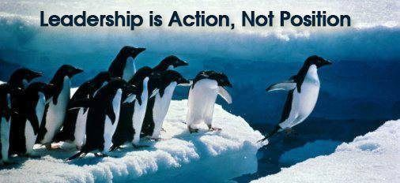
Conclusions I:
Implications for Leadership Practice
Who Is the Leader?
  EvoL theory explains why leadership correlates with physical traits such as height, voice pitch, and facial expressions that have little to do with good leadership—something not easily explained by existing leadership theories.
Why to follow?
  EvoL theory suggests that followership evolved in response to coordination problems such as group movement, group defence, conflict resolution, etc.
  This implies that followership should emerge more quickly in these evolutionarily relevant situations.
How Important Is Context?
  EvoL theory accounts for the fact that some leadership attributes are universally valued in leaders (such as fairness), whereas the importance of other attributes is context-driven.

Slide 46
Conclusions II:
Practical (evolutionary) tips for YOU!!!
Take the lead - Be active in the leadership game
Followership matters for you as well – Learn when to lead and when to follow
Actively empathise – Encourage people to voice their concerns
Trust imitation – People (most at least) will follow an example
Actively support – Support others when they’re struggling
Recognise Achievement (and sometimes effort) - Praise others when they succeed
Fairness matters – Be (as much as possible) fair when you make decisions about others
Your face matters – Do not forget that the most effective way to express strong emotions is through your face (similarly your body posture matters)

Slide 47
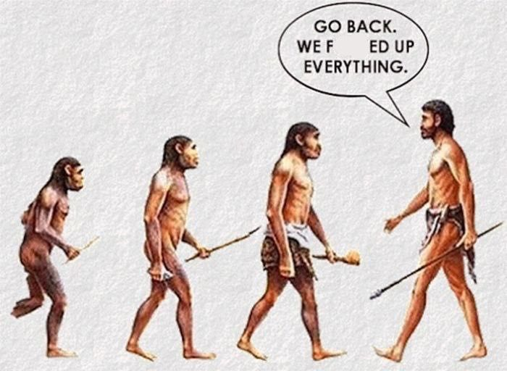
Prof. Alexandros Psychogios
Professor of HRM & OB
Head of W&O Group
Loughborough Business School
Loughborough University
a.psychogios@lboro.ac.uk

