Slide 1
Appendix: The Impact of Migration on Economic Growth and Wages

Slide 2
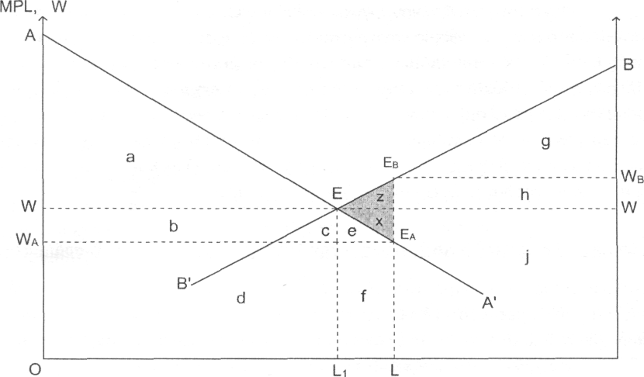

Slide 3
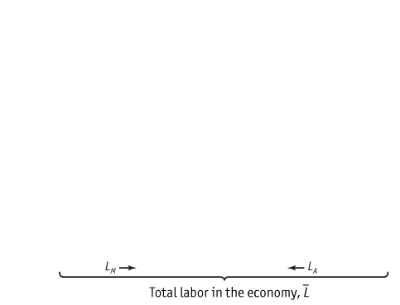
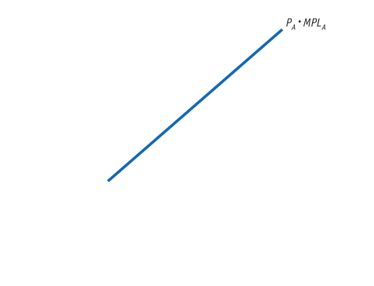
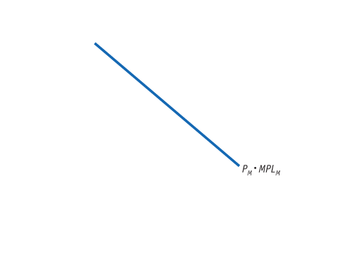
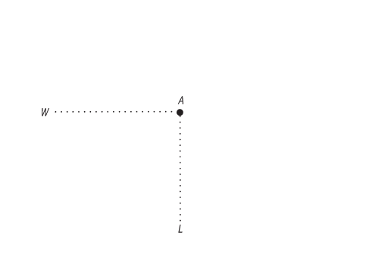
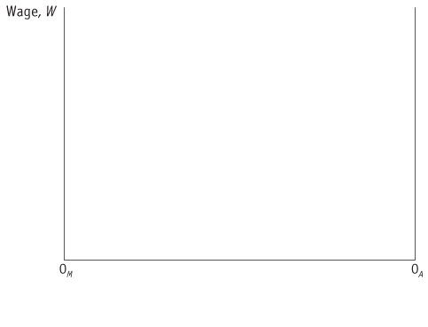
1 Movement of Labor between Countries: Migration
Effects of Immigration in the Short Run: Specific-Factors Model
Determining the Wage
Home Labor Market
FIGURE 5-1
The Home wage is determined at point A, the intersection of the marginal product of labor curves P_{M} • MPL_{M} and P_{A} • MPL_{A} in manufacturing and agriculture, respectively.
The amount of labor used in manufacturing is measured from left to right, starting at the origin 0_{M}, and the amount of labor used in agriculture is measured from right to left, starting at the origin 0_{A}. At point A, 0_{M}L units of labor are used in manufacturing and 0_{A}L units of labor are used in agriculture.

Slide 4
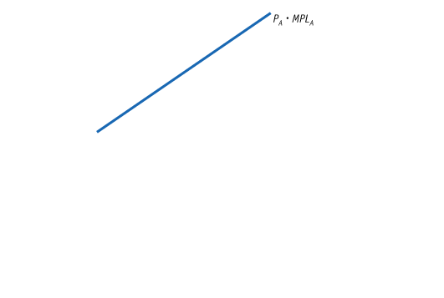
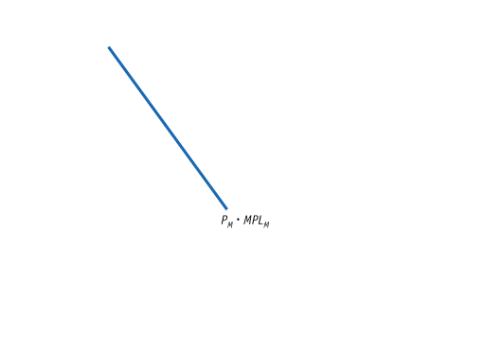
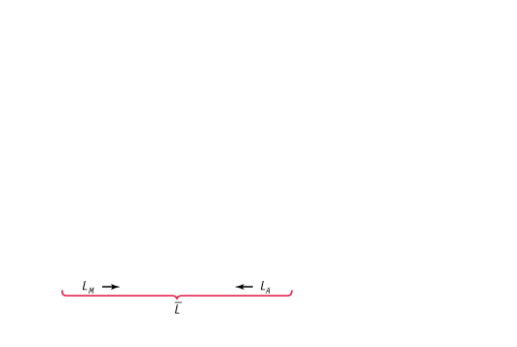
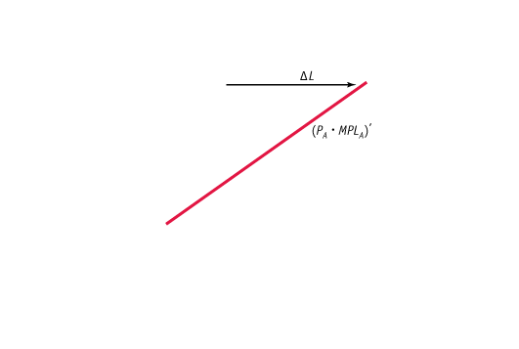
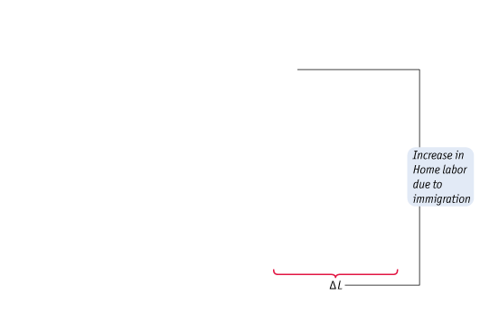
1 Movement of Labor between Countries: Migration
Effects of Immigration in the Short Run: Specific-Factors Model
Effect of Immigration on the Wage in Home
Increase in Home Labor
FIGURE 5-2
When the amount of labor at Home increases by the amount ΔL, the origin for agriculture shifts to the right by that amount, from 0_{A} to 0A′.
The marginal product of labor curve in agriculture also shifts right by the amount ΔL.
Equilibrium in the Home labor market is now at point B: wages have fallen to W′ and the amount of labor has increased in manufacturing (to 0_{M}L′) and in agriculture (to 0_{A}′L′).

Slide 5
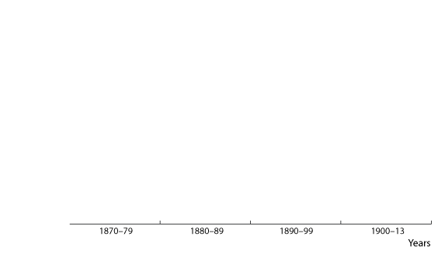
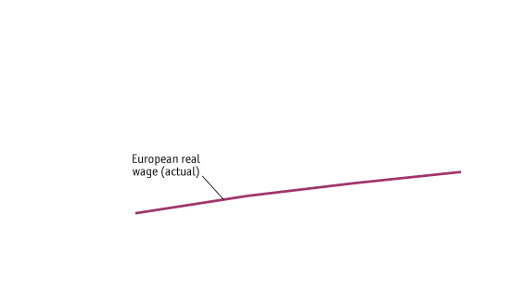
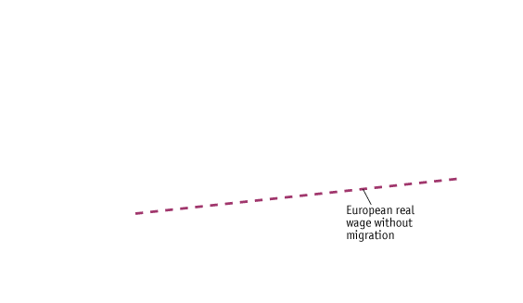
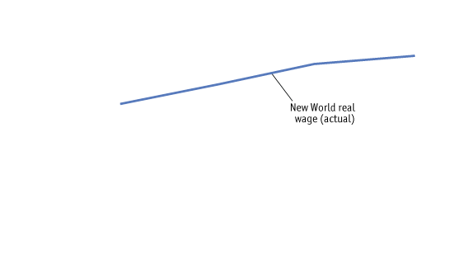
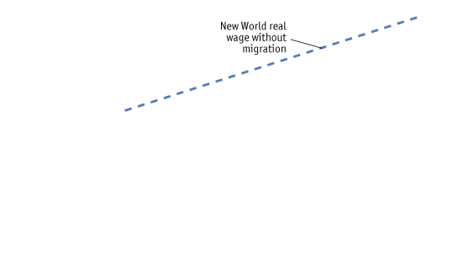
APPLICATION
Immigration to the New World
FIGURE 5-3
Wages in Europe and the New World
Large-scale migration from Europe to the New World in America and Australia closed the wage gap between the two locations. In 1870 wages in the New World were almost three times as high as wages in Europe, whereas in 1910 they were about twice as high.
Migration also slowed the growth of wages in the New World relative to what they would have been without migration and allowed for slightly faster growth of wages in Europe.

Slide 6
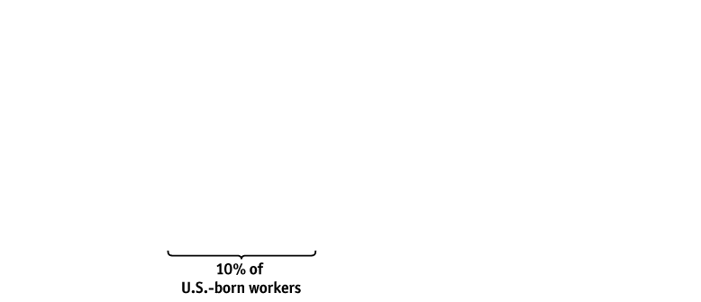
APPLICATION
Immigration to the United States and Europe Today
FIGURE 5-4 (1 of 3)
Share of Foreign-Born Workers in U.S. Workforce, 2008
This figure shows the share of foreign-born workers in the U.S. workforce, categorized by educational level.
For example, among workers with only 0 to 8 years of education, more than 70% were foreign born; for those with 9 to 11 years of education, more than 20% were foreign born.

Slide 7
APPLICATION
Immigration to the United States and Europe Today
FIGURE 5-4 (2 of 3)
Share of Foreign-Born Workers in U.S. Workforce, 2008
(continued)
At the other end of the spectrum, the foreign born make up 16% of workers with master’s and professional degrees and almost 30% of those with PhD’s.

Slide 8
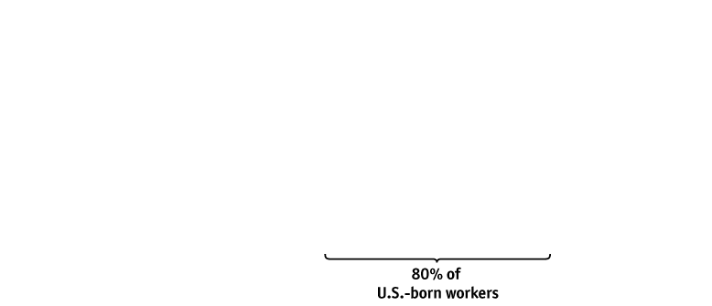
APPLICATION
Immigration to the United States and Europe Today
Share of Foreign-Born Workers in U.S. Workforce, 2008
(continued)
FIGURE 5-4 (2 of 3)
In the middle educational levels (high school and college graduates), there are much smaller shares of foreign-born workers, ranging from 10% to 15%. In contrast, only about 10% of U.S.-born workers are categorized in each of the low-education and high-education groups; most U.S.-born workers are either high school graduates or college graduates.

