Slide 1
Autoregressive Integrated Moving Average (ARIMA) Models
Chapter 6

Slide 2
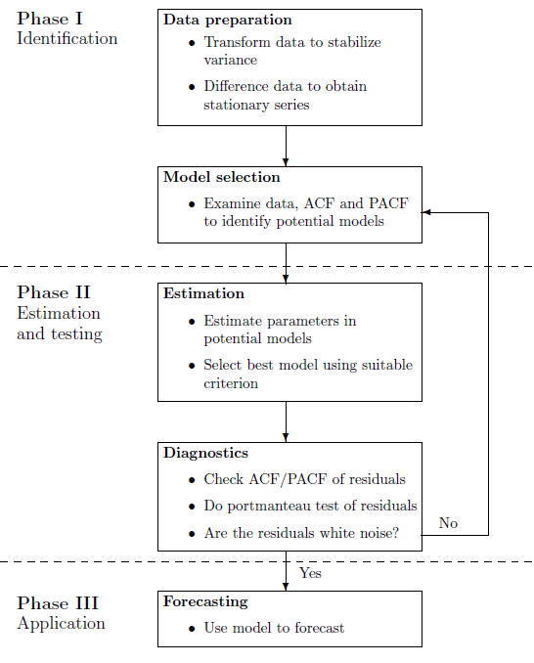
6.1 Methodology

Slide 3
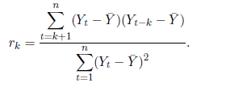
Autocorrelation
The first order (or lag 1) autocorrelation measures the correlation between successive observations in a time series.
The sample value is computed as:

Slide 4
The Sample Autocorrelation Function
Example 6.1: Calculation of First-Order Autocorrelation

Slide 5
Higher order autocorrelations
Higher order autocorrelations: The sample function for lag k is:
The plot of r_{k} against k for k=1,2,… is known as the sample autocorrelation function (ACF), typically plotted for the first n/4 lags or thereabouts.
The plot is supplemented with 5% significance limits to enable a graphical check of whether dependence exists at a given lag.
Example 6.2: The Autocorrelation Function for WFJ Sales
Figure 6.1 The ACF for WFJ Sales (Minitab)

Slide 6
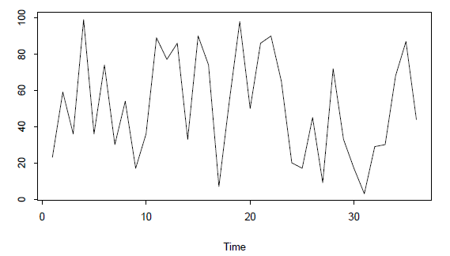
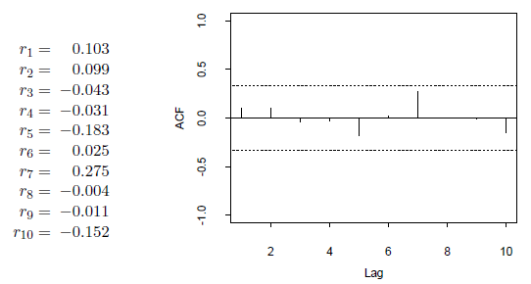
White noise

Slide 7
Autocorrelations: Distribution and tests
The sampling distribution of autocorrelations
Normal with mean zero and standard error
Portmanteau tests

Slide 8
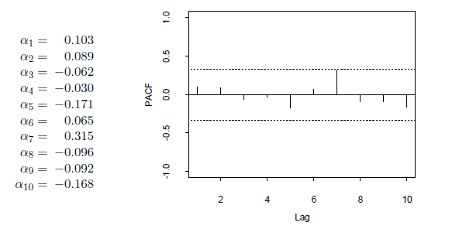
Partial autocorrelation
The partial autocorrelation coefficient

Slide 9
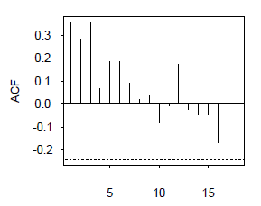
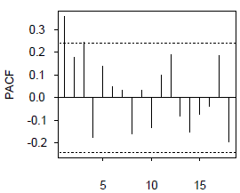
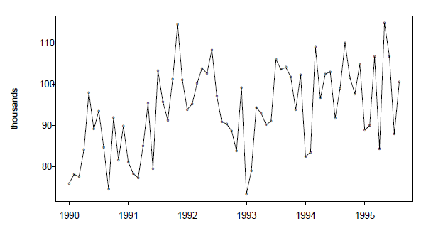
Recognizing seasonality in a time series
seasonality in a time series
Example: Pigs slaughtered (monthly total number of pigs slaughtered)

Slide 10
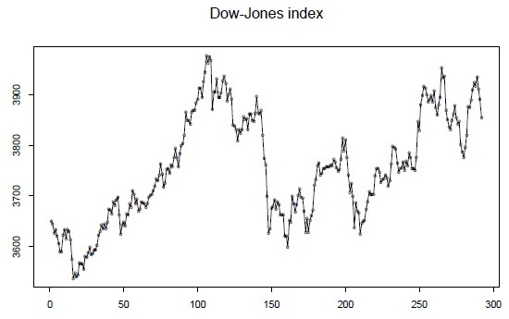
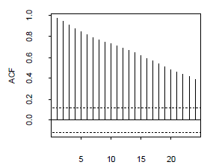
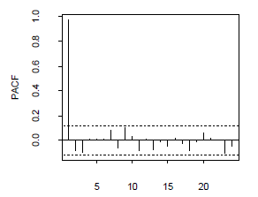
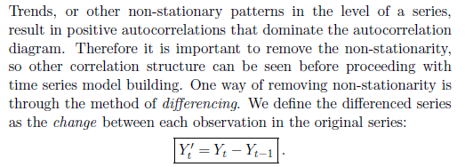
Examining stationarity of time series data

Slide 11
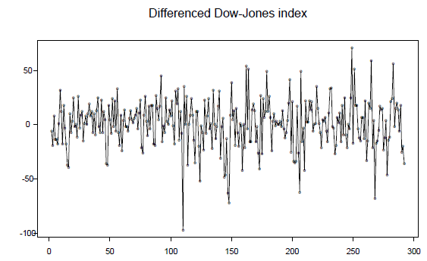
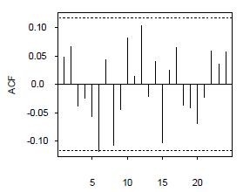
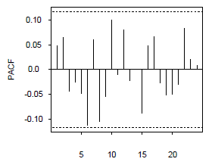
Examining stationarity of time series data

Slide 12
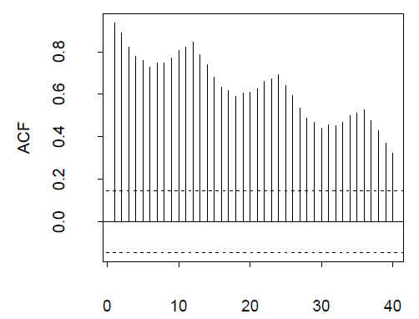
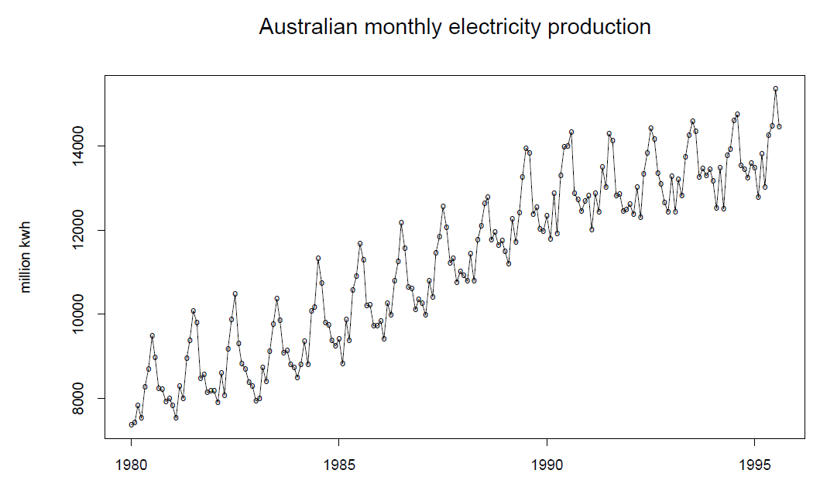
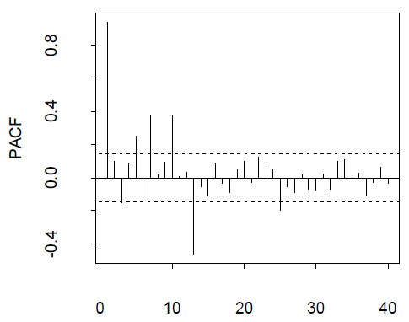
Seasonal differencing

Slide 13
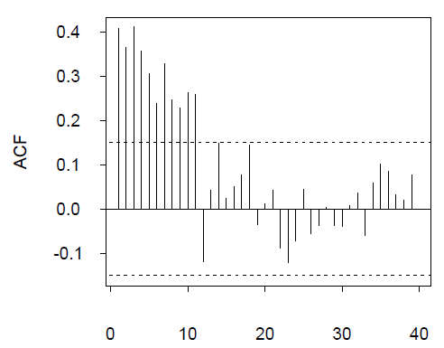
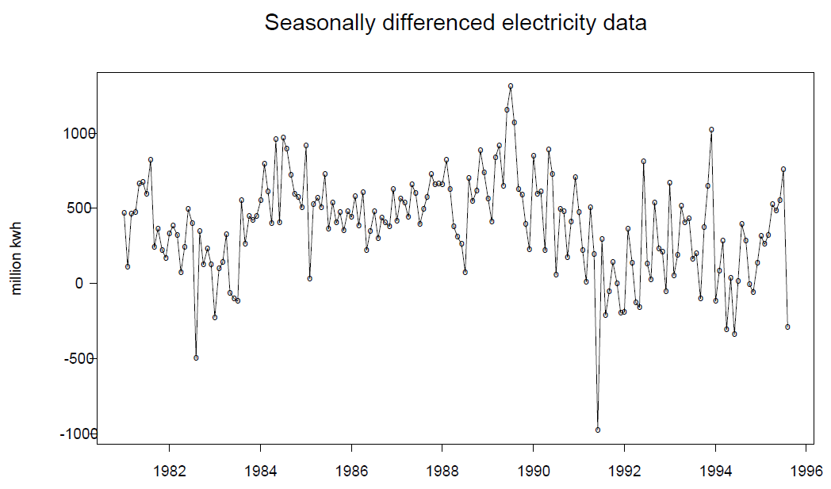
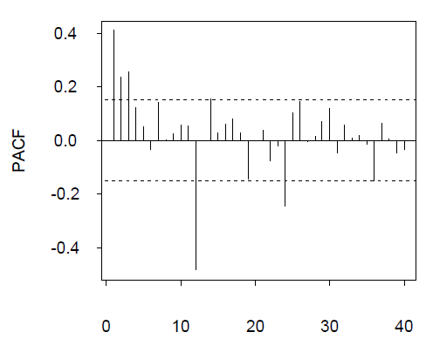
Seasonal differencing

Slide 14
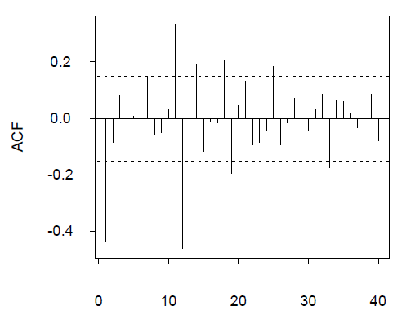
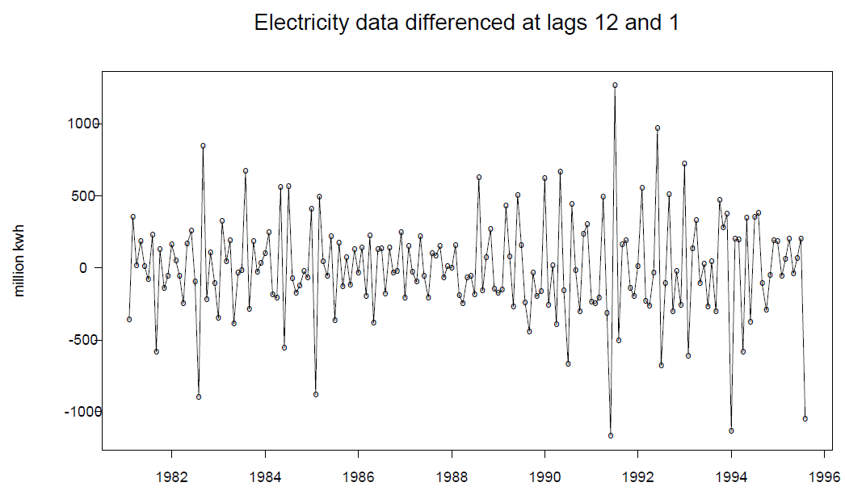
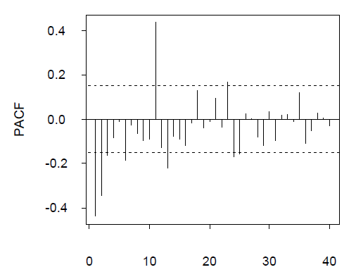
Seasonal differencing

Slide 15
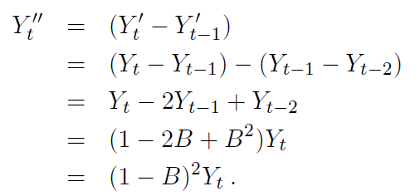
Backshift notation

Slide 16
Backshift notation

Slide 17
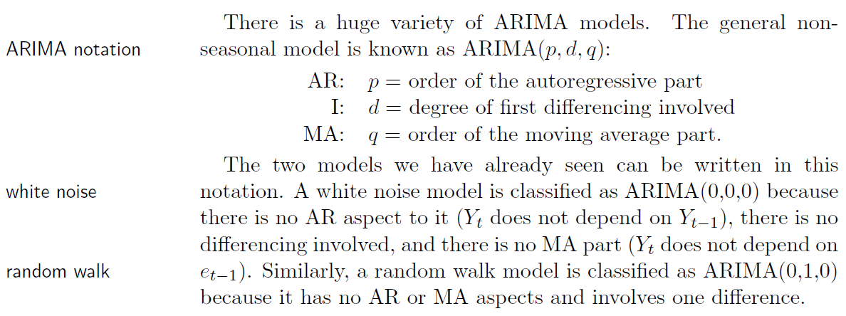
ARIMA models for time series data

Slide 18
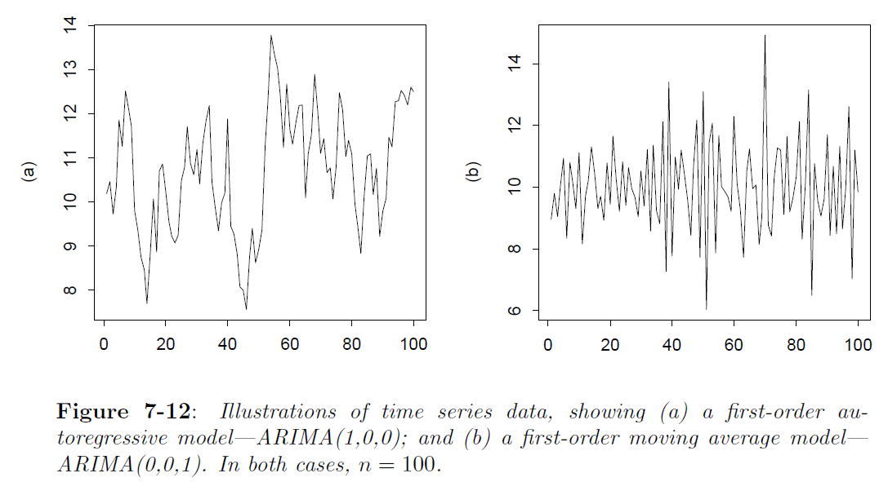
An autoregressive model of order one

Slide 19
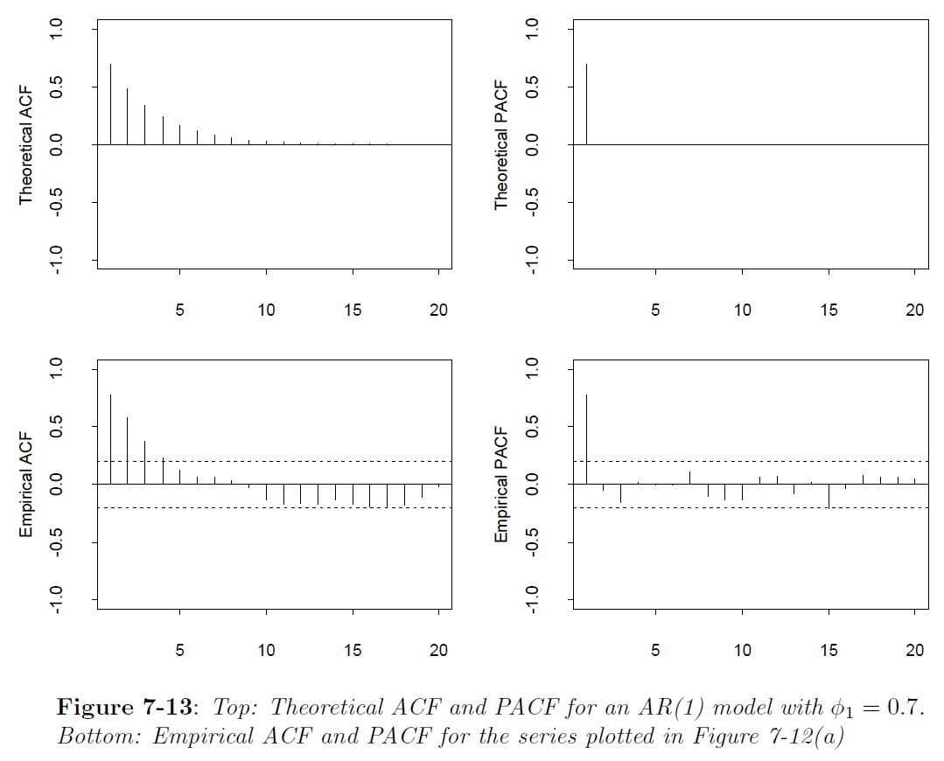
An autoregressive model of order one

Slide 20
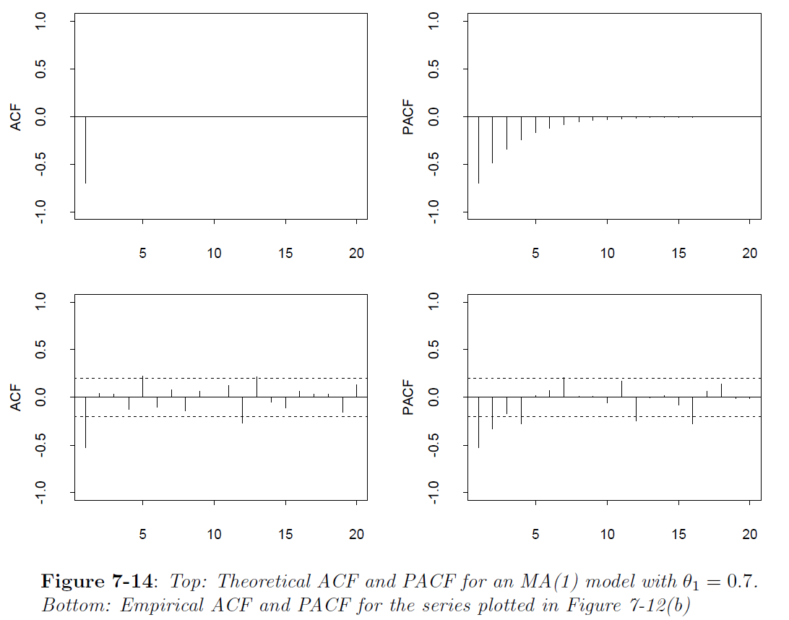
Moving average model of order one

Slide 21
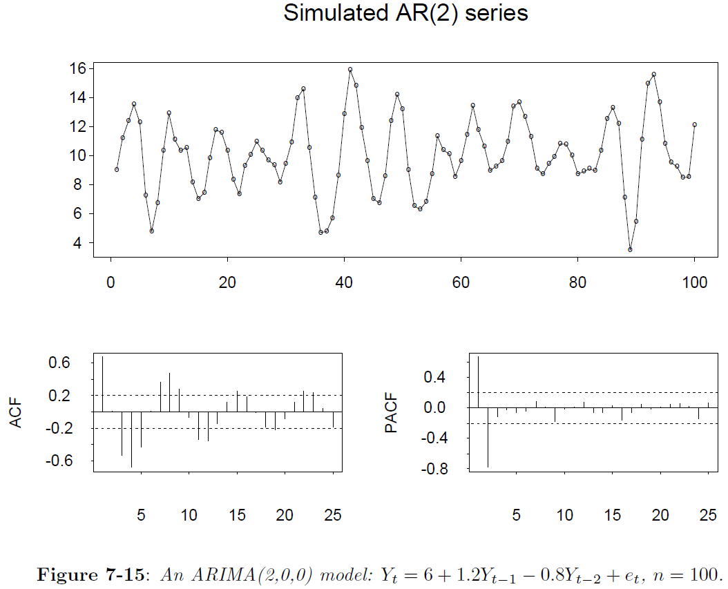
Higher-order autoregressive models

Slide 22
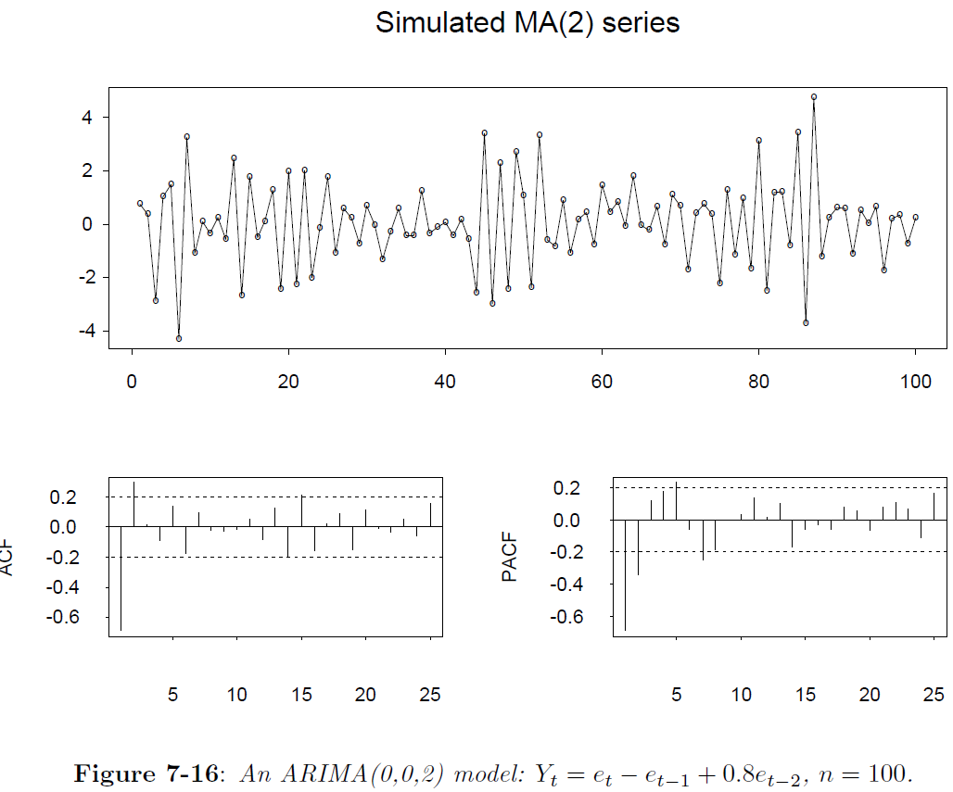
Higher-order moving average models

Slide 23
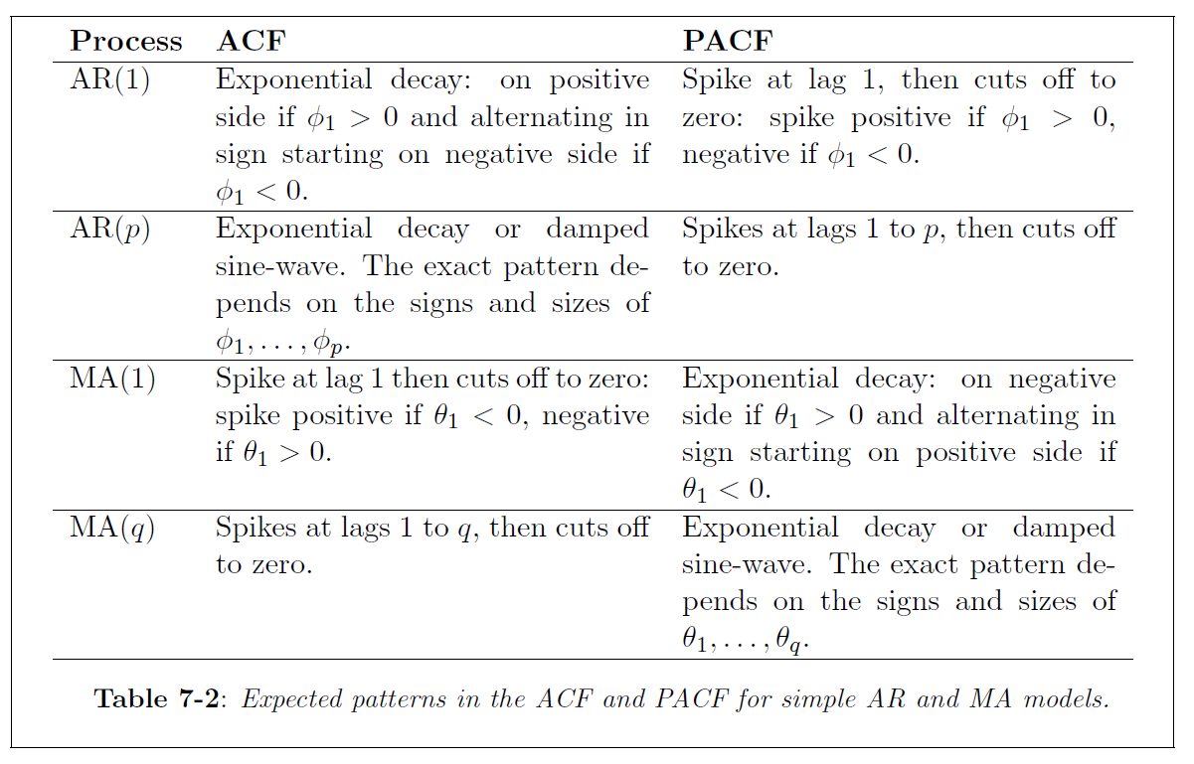
Summary

Slide 24
6.4 Model Estimation
Table 6.3 Fitted Models for Netflix Percentage Growth Series
AR(1) Model
Question: Choose the better model. Which criterion would you use?
MA(1) Model

Slide 25
Mixtures: ARMA models

Slide 26
Mixtures: ARIMA models

Slide 27
Model Estimation
Examples of Nonstationary Series: Netflix
Table 6.5 MSE and RMSE for Different ARIMA Models for the Log Transformed Netflix Sales Series
Results using Minitab
Results using R

Slide 28
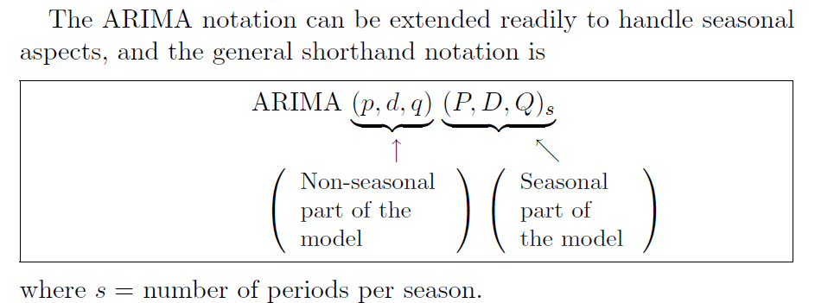
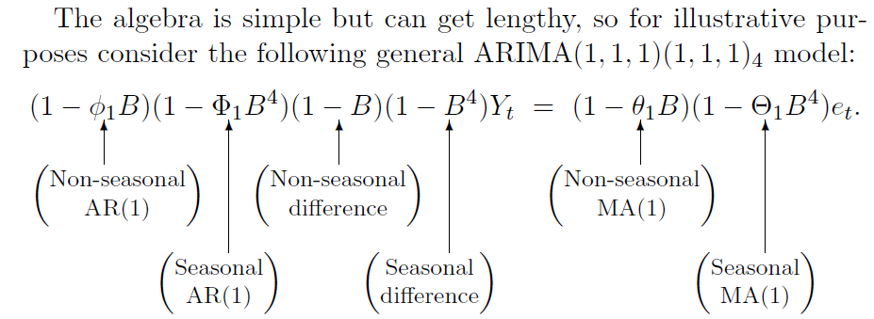
Seasonality and ARIMA models

Slide 29
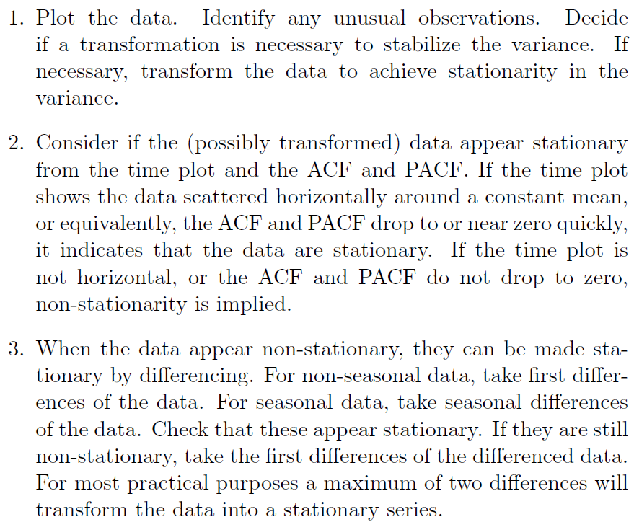
Identification

Slide 30
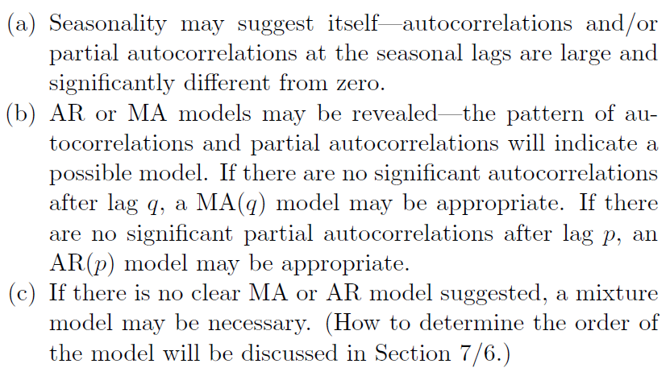
Identification

Slide 31
Model Choice
Model Choice Using Information Criteria
Use either the Akaike Information Criterion:
Or the Bayesian Information Criterion:
where p = NP = number of AR parameters + number of MA parameters + 1 (for the variance) + 1 (if a constant is included)
Question: Which criterion is likely to select the more complex model? Why?
Table 6.7 Values of Information Criteria for ARIMA Models for U.S. Retail Sales

Slide 32
Model Diagnostics
What can go wrong?
The errors may not be white noise.
The data may contain outliers.
The errors may be autocorrelated.
The time series may be non-stationary.
The errors may show changing variances over time.
The mean of the errors may be non-zero (only applies when the model does not contain a constant term).
How do we check for these problems and what do we do about them?
Check the:
Residuals; outliers; portmanteau test

Slide 33
6.7 Forecasting with ARIMA Models
You are already experts in forecasting !!!
Just press the forecast button

