Slide 1
Introduction
Forecast
Forecast is a prediction or estimate of an actual outcome expected in a future time period or for another situation.
The purpose of forecasting is to inform the process of planning.
The purpose of planning is to develop a course of action so that things don’t “just continue” based on a no-change forecast.

Slide 2
Discussion Question
Forecasts can be found everywhere!
What forecasts are regularly included in the daily newspapers, such as the Wall Street Journal, the New York Times, or the Times of London?

Slide 3
1.2 What and Why Do Organizations Forecast?
Costs
raw materials
semi-finished goods
wage rates & overheads
interest rates
Sales/Activities
by industry
by region
by market/product (market share)
by product category, wholesaler, retailer
new product sales
competitive position —
e.g., prices, exchange rates
competitive behavior
customer service
prices
competitor activities
Technology
new products
new processes
diffusion rates
Social and Political Trends
demographics
wealth profile
welfare and health provisions
impact of technology
Projects
duration
costs
life cycle maintenance

Slide 4
1.2 What and Why Do Organizations Forecast?
Figure 1.1 An Organization’s Forecasting Needs

Slide 5
Discussion Questions
What might a nuclear electricity supplier or a water company need to forecast with regard to its key assets? Why?
A state or national government provides unemployment benefits for a period of six months following a layoff (or leaving school). It continues for a further six months if the applicant attends a job training program. What variables would the government need to forecast for its annual planning?

Slide 6
1.2 What and Why Do Organizations Forecast?
Forecasting Horizons
Short term
Usually a few days or weeks
Medium term
Usually a few months to 1 or 2 years
Long term
Usually more than 2 years
Depends on the Problem Area
Discussion Questions
What type of organizations have the shortest forecasting horizons?
Which have the longest?

Slide 7
1.2 What and Why Do Organizations Forecast?
Forecasting Problem Structure
Forecasting object
Level of aggravation
For a period, cumulative across periods, growth rate, event
Forecasting horizon
How far into the future?
Forecasting frequency
Yearly ➡ Monthly ➡ Weekly ➡ Daily ➡ Within Day…
Structure derived from decision making process
Forecasts required to support planning and decision making

Slide 8
1.3 Examples of Forecasting Problems
Time Series
A time series is a set of observations ordered in time.
The values may refer to either a point in time (the current value of the Dow Jones Index is 22,000) or an aggregate over a period of time (total sales for the last month were 350 units).
Typically, we assume that the observations are equally spaced in time.
  How might we deal with irregular spacing such as stock markets closing at weekends or monthly sales?

Slide 9
1.3 Examples of Forecasting Problems
Figure 1.2 U.S. Monthly Retailers Sales

Slide 10
Time Series
A set of comparable observations ordered in time. The values may refer to either a point in time (“the current value of the Dow Jones Index is 17,000”) or an aggregate over a period of time (“total sales for the last month were 350 units”).
Trend: A time series contains a trend if it shows systematic movements (e.g., increase or decrease) over an extended period.
Seasonality: A time series has a season component if it displays a recurrent pattern with a fixed and known duration (e.g., months of the year, days of the week).
Cycle: A time series has a cyclical component if it displays somewhat regular fluctuations about the trend but those fluctuations have a periodicity of variable and unknown duration, usually longer than one year (e.g., a business cycle).

Slide 11
1.3 Examples of Forecasting Problems
Figure 1.3 Seasonally Adjusted Series for U.S. Monthly Retailers Sales

Slide 12
1.3 Examples of Forecasting Problems
Figure 1.4 Seasonal Factors for U.S. Monthly Retailers Sales

Slide 13
1.3 Examples of Forecasting Problems
Figures 1.5 & 1.6 Year-over-year Change and Percentage Changes in
U.S. Monthly Retail Sales

Slide 14
1.3 Examples of Forecasting Problems
Figure 1.7 Serious Injuries and Deaths on UK Roads,
January 1975–December 1984
Sudden shifts and changes in policy or circumstances
can change the basis for forecasting.

Slide 15
Discussion Question
How would you estimate the effect of 9/11 (September 11, 2001) upon the airline industry with respect to losses in revenue passenger miles?

Slide 16
1.3 Examples of Forecasting Problems
Figure 1.8 Monthly U.S. Air Revenue Passenger Miles (billions),
January 2000–December 2015

Slide 17
1.3 Examples of Forecasting Problems
Figure 1.10 Scatterplot of Baseball Players’ Salaries Against the
Number of Years Played in the Major Leagues

Slide 18
1.4 How to Forecast
Figure 1.11 A Simplified Methodology Tree for Forecasting

Slide 19
1.5 Forecasting Step by Step
Define the forecasting and planning problem.
Determine the resources to be devoted to providing the forecasts.
Collect relevant information, whether from a survey, from company records, or from information generated by other agencies (e.g., government).
Conduct an initial analysis of the data.
Select an appropriate forecasting method.
Generate forecasts.
Evaluate the forecasting exercise by checking forecasts against actual outcomes.

Slide 20
1.6 Data Sources
The Federal Reserve Bank of St. Louis maintains an extensive database of U.S. and international macroeconomic series. The website is known as FRED (https://research/stlouisfed.org/)
EconStats (http://www.econstats.com/index.htm) contains a large amount of economic and financial data on the United States and on several other countries, including the United Kingdom, China, and Japan.
Data.gov.uk (http://datagov.uk) offers easy-to-access government statistical series for the United Kingdom.
Econdata (http://econdata.net/) contains regional socioeconomic data for the United States.

Slide 21
Minicase 1.4 Adjusting for Inflation
The data file for U.S. retail sales (US_retail_sales_2.xlsx) also contains monthly data for the U.S. Consumer Price Index (CPI) (US_CPI_2.xlsx).
Create a series called “real prices” by dividing sales by the CPI; then replicate Figures 1.2, 1.5, and 1.6 for this series.
Compare your results with the three figures provided in the text, commenting on major differences. (Use the same seasonal adjustment factors.)

Slide 22
2.1 Types of Data
Data may be:
Categorical (e.g., industrial classification)
Ordinal (e.g., bond ratings, AAA, Aaa, …)
Interval-scaled (e.g., temperature: Fahrenheit or Celsius)
Ratio-scaled (e.g., monthly sales)
Discrete or continuous (e.g., number of commercials shown during a one-hour period vs. time devoted to commercials during that hour)
Time series or cross-sectional (e.g., stock price over time vs. multiple stock prices on a given day)
Stock or flow (e.g., capital vs. income)
Or even:
text

Slide 23
Measures of Forecasting Accuracy
Terminology
Forecast origin
  The time at which a forecast is made (time t)
Forecast horizon
  The time period to which the forecast relates
  One-step-ahead forecast F_{t+1} (1)
    Forecast made at time t; also denoted by F_{t+1}
  h-step-ahead forecast F_{t+h}(h)
    Forecast for period t+h made at time t
  One-step-ahead forecast error
  e_{t+1} = Y_{t+1} - F_{t+1}
  h-step-ahead forecast error
  e_{t+h}(h) = Y_{t+h} - F_{t+h}(h)

Slide 24
Measures of Forecasting Accuracy
Rolling Origin Forecasts
Starting at forecast origin t, generate forecasts successively (one-step-ahead) at time origins t + 1, t + 2, …, t + m-1, making m such forecasts in all.
This process is known as rolling origin forecasting. The one-step-ahead forecast error at time t + i may be denoted by

Slide 25
Measures of Forecasting Accuracy
Formulas apply for one-step-ahead forecasts
(Percentage error measures must have Y > 0):

Slide 26
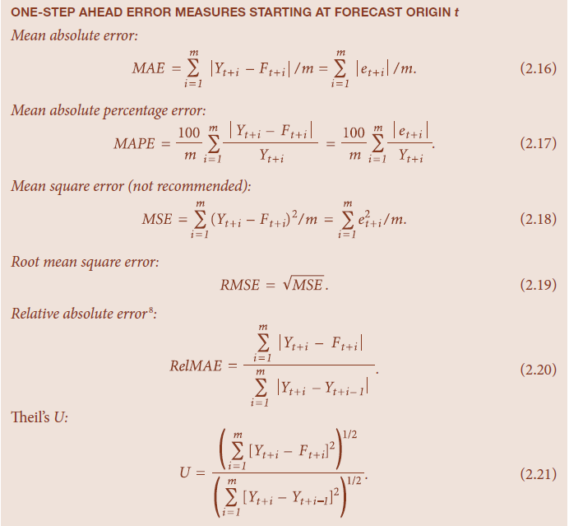
Measures of Absolute Error
All these measures are based upon differences between forecast and actual values.
They are symmetric in that positive and negative forecast errors of the same magnitude contribute equally to the measures.
One-Step-Ahead Error Messages Starting at Forecast Origin t
Mean absolute error
Mean absolute percentage error
Mean square error (not recommended)

Slide 27
Measures of Absolute Error (continued)
Root mean square error
Relative absolute error
Theil’s U

Slide 28
2.8 Prediction Intervals
Normal Prediction Intervals
If Z = value from normal tables, the 100(1-α) percent Prediction Interval for Y is:
Standard values for Z are:
100(1-α) | Z
80 | 1.282
90 | 1.645
95 | 1.960
99 | 2.576

Slide 29
2.8 Prediction Intervals
Normal Example
Suppose RMSE = 4.35
Given point forecast = 42
Use 1-α = 0.95, so Z = 1.96
Then 95% P.I. is 42 ± (1.96) × 4.35
= 42 ± 8.53
The P.I. is [33.47, 50.53]

