Slide 1
Welcome to:
Modelling and Forecasting
Economic Time Series
Instructor: Dr. T. Dergiades
e-mail: dergiades@uom.edu.gr
Office: 401

Slide 2
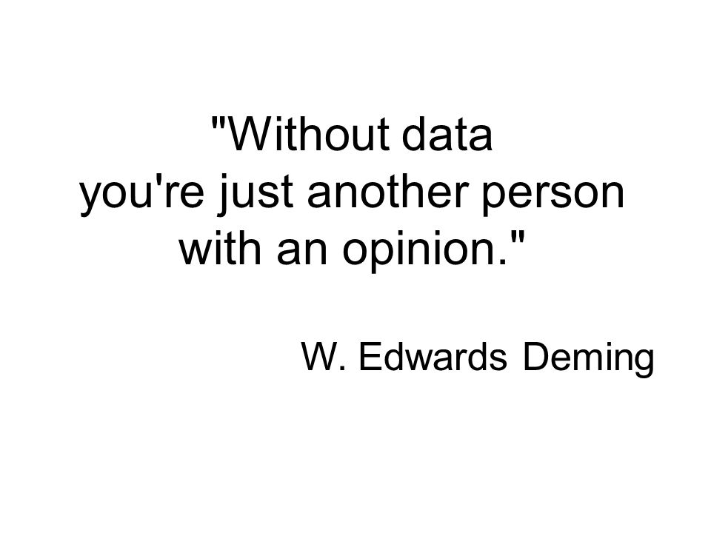
Modelling and Forecasting

Slide 3

Modelling and Forecasting

Slide 4
Introduction
Forecast
Forecast is a prediction or estimate of an actual outcome expected in a future time period or for another situation.
The purpose of forecasting is to inform the process of planning.
The purpose of planning is to develop a course of action so that things don’t “just continue” based on a no-change forecast.

Slide 5
Discussion Question
Forecasts can be found everywhere!
What forecasts are regularly included in the daily newspapers, such as the Wall Street Journal, the New York Times, or the Times of London?

Slide 6
Discussion Questions
What might a nuclear electricity supplier or a water company need to forecast with regard to its key assets? Why?
A state or national government provides unemployment benefits for a period of six months following a layoff (or leaving school). It continues for a further six months if the applicant attends a job training program. What variables would the government need to forecast for its annual planning?

Slide 7
1.3 Examples of Forecasting Problems
Figure 1.2 U.S. Monthly Retailers Sales

Slide 8
Time Series
A set of comparable observations ordered in time. The values may refer to either a point in time (“the current value of the Dow Jones Index is 17,000”) or an aggregate over a period of time (“total sales for the last month were 350 units”).
Trend: A time series contains a trend if it shows systematic movements (e.g., increase or decrease) over an extended period.
Seasonality: A time series has a season component if it displays a recurrent pattern with a fixed and known duration (e.g., months of the year, days of the week).
Cycle: A time series has a cyclical component if it displays somewhat regular fluctuations about the trend but those fluctuations have a periodicity of variable and unknown duration, usually longer than one year (e.g., a business cycle).

Slide 9
1.3 Examples of Forecasting Problems
Figure 1.3 Seasonally Adjusted Series for U.S. Monthly Retailers Sales

Slide 10
Discussion Question
How would you estimate the effect of 9/11 (September 11, 2001) upon the airline industry with respect to losses in revenue passenger miles?

Slide 11
1.4 How to Forecast
Figure 1.11 A Simplified Methodology Tree for Forecasting

