Slide 1
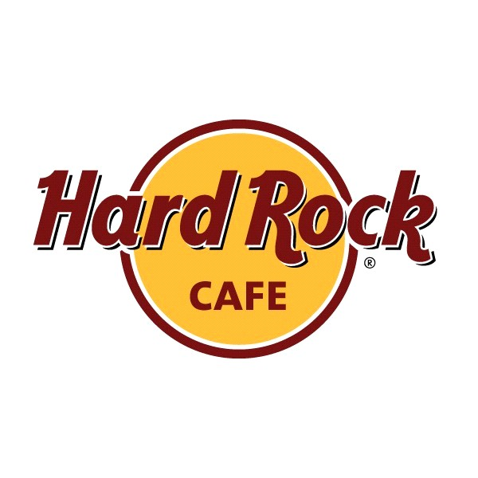
HARD ROCK CAFE

Slide 2
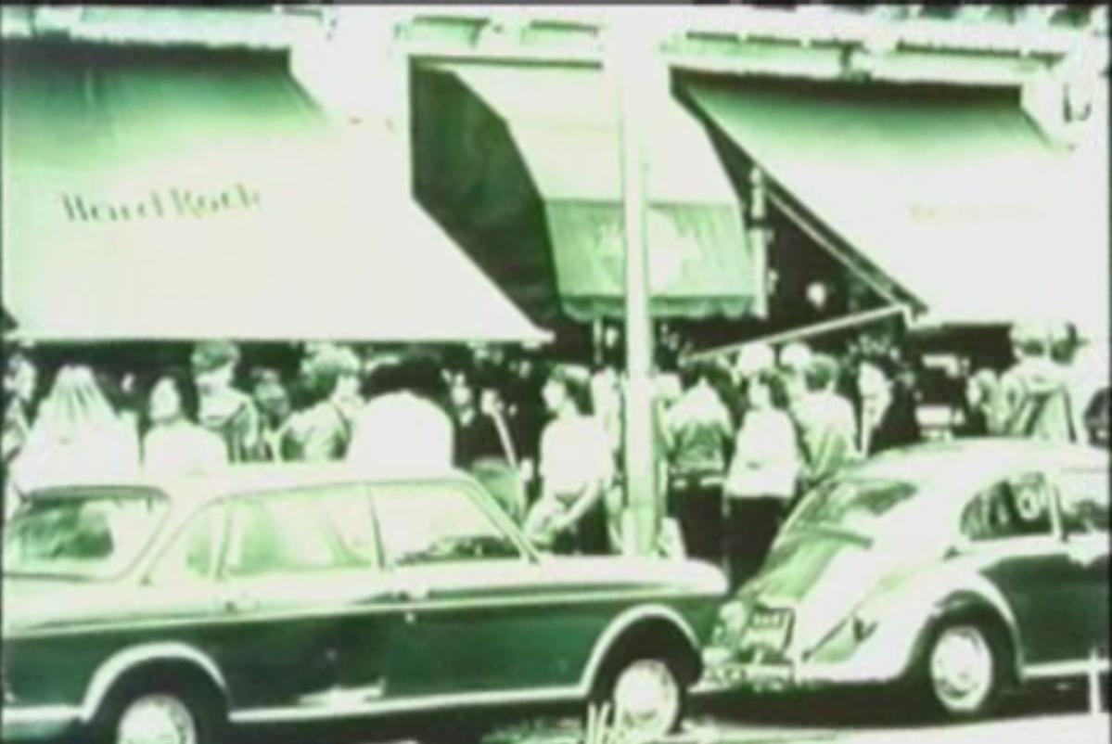
ORIGIN
The HARD ROCK CAFE started with only 1 cafe in London in 1971.
Today they have 110 locations in 41 countries (most of them opened in the last few years).

Slide 3
MISSION
At HARD ROCK, the experience concept is to provide not only a custom meal from the menu, but a dining event that includes a unique visual and sound experience not duplicated anywhere in the world.

Slide 4
STRATEGY
The Hard Rock Cafe focus on globalization, because globalization means:
Reduce costs
Improve supply chain
Provide better goods and services
Attract new markets
Learn to improve operations
Attract and retain global talent

Slide 5
STRATEGY
The HARD ROCK CAFE Company had raised Competitive Advantage through the creation of a unique advantage over competitors. Mainly they focus on differentiation. It means they offer another services and products than other restaurants, which the customer perceives as adding value. Those features are very difficult to copy!

Slide 6
STRATEGY
The 70% of HARD ROCK CAFE clients are tourists seeking to find a special and memorable time.
Because of that, The Company has only 52% of HARD ROCK CAFE restaurants and the rest are franchising. It is the good way to survive and make profits in bad times.

Slide 7
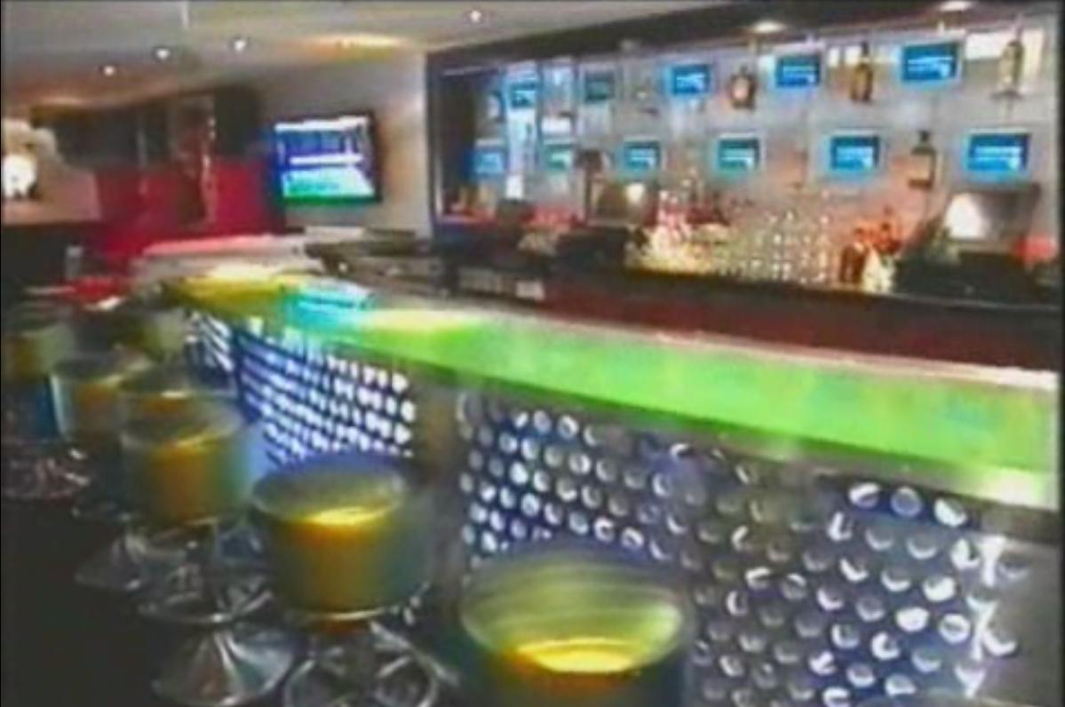
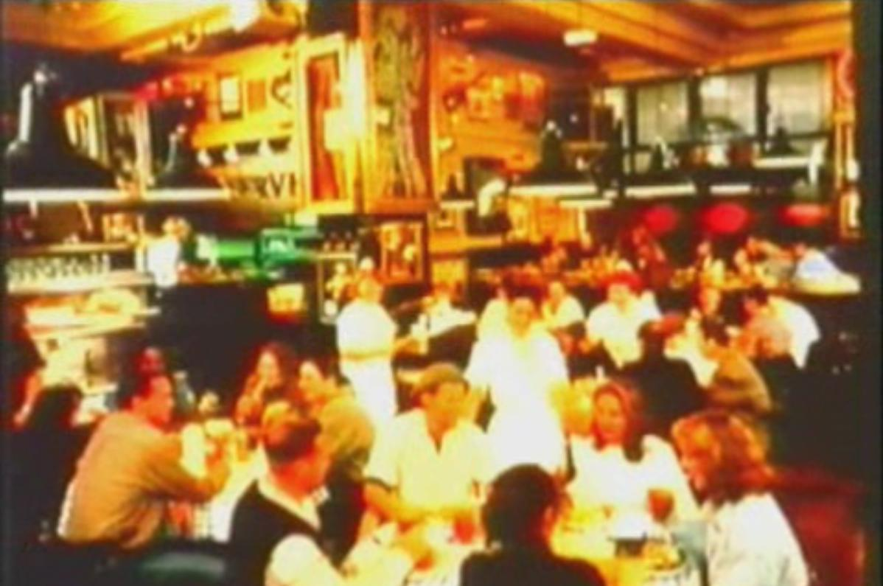
STRATEGY
Each HARD ROCK Restaurant is different. In addition each of restaurants is dynamic and unique – design, menu – depends on culture & country.

Slide 8
STRATEGY
The HARD ROCK CAFE spend milions of dolars each year to purchase new music souvenirs comes from legends of rock – mainly from Elvis, The Rolling Stones, Jimy Hendrix and The Beatles.
The souvenirs are in one restaurant only a shor period of time and then goes the next one in another city or country, to show tourists new suvenirs all the time.
The HARD ROCK CAFE collection is worth today about 40 milion $ !!!

Slide 9
STRATEGY
The HARD ROCK international operation strategy is Multi-domestic Strategy:
They use existing domestic model globally
Franchise, joint ventures, subsidiaries

Slide 10
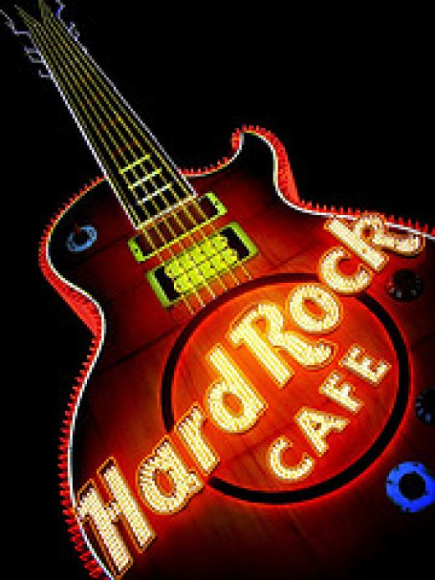
STRATEGY
The HARD ROCK CAFE to create network of restaurants takes into account some considerations, like:
Political risk
Currency risk
Social norms
Brand fit
Social costs
Business practices

Slide 11
STRATEGY - DIVERSIFICATION
The HARD ROCK CAFE is not only a network of restaurants. Those are as well hotels in some locations (Orlando, Las Vegas) and network of shops where tourists can buy souvenires with HARD ROCK CAFE special logo. Special because each shop has special collection with logo of HARD ROCK CAFE and the name of the city. The 48% of sale coming from merchandise.

Slide 12
STRATEGY
THE HARD ROCK’s global operation management strategy successfully combines:
Music
International locations
Globally branding merchandise
The World Wide Web attention to each quest experience
AND THIS STRATEGY WORKS

Slide 13
SUMMARY
#1 in the world – 92% name-brand recognition
The HARD ROCK CAFE is in the top ten of the world brands recognition.

