Slide 1
Turnitin use
How to use Turnitin

Slide 2
Turnitin
A widely used, Internet-based text-matching software that helps academic institutions detect plagiarism and potential AI-generated content in student work.
It compares submitted assignments against a vast database of academic papers, websites, and previous submissions, generating a similarity report to ensure academic integrity.

Slide 3
Turnitin reports
Similarity Report: Highlights matching text, allowing educators and students to check for proper citation and potential plagiarism.
AI Detection: Identifies text likely generated by AI tools like ChatGPT, helping maintain academic standards

Slide 4
Turnitin reports
Similarity Report: until 30% acceptable
AI Detection: under 40% acceptable

Slide 5
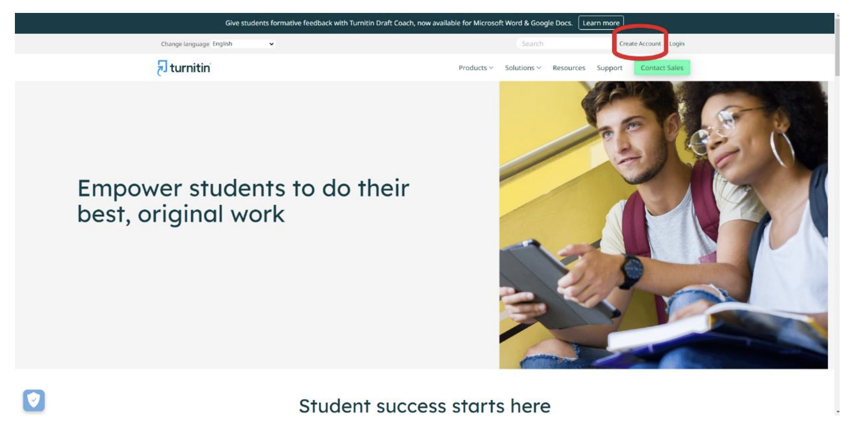
Instructions
Link to https://www.turnitin.com/?svr=37&lang=en_us&r=20.2846812103523 and choose create account

Slide 6
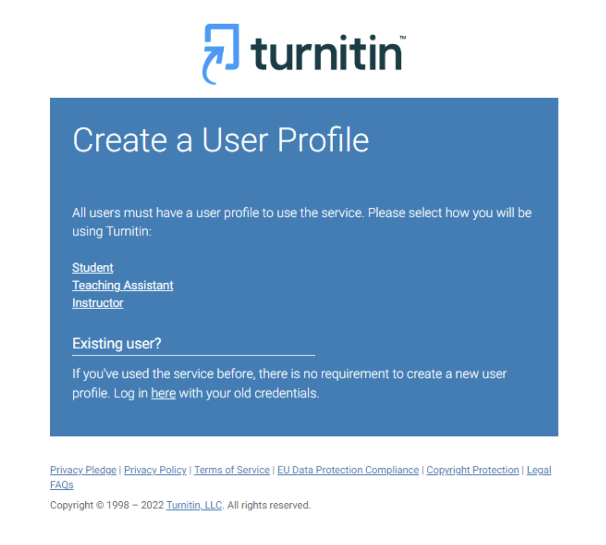
Instructions
Next choose student

Slide 7
Instructions
Complete all the information required in the form, your password, and press I agree – Create Profile
Use the information below:
Class ID: 51943271
Enrollment key: EA12345!
Use your uom.edu email!

Slide 8
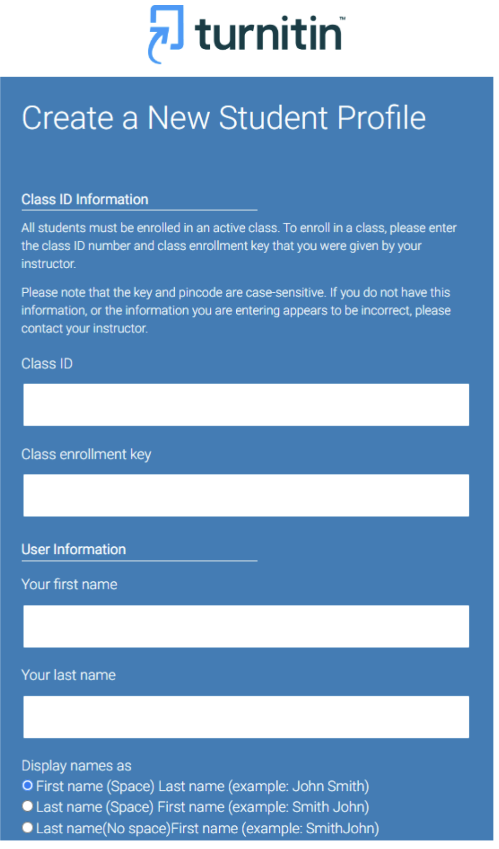
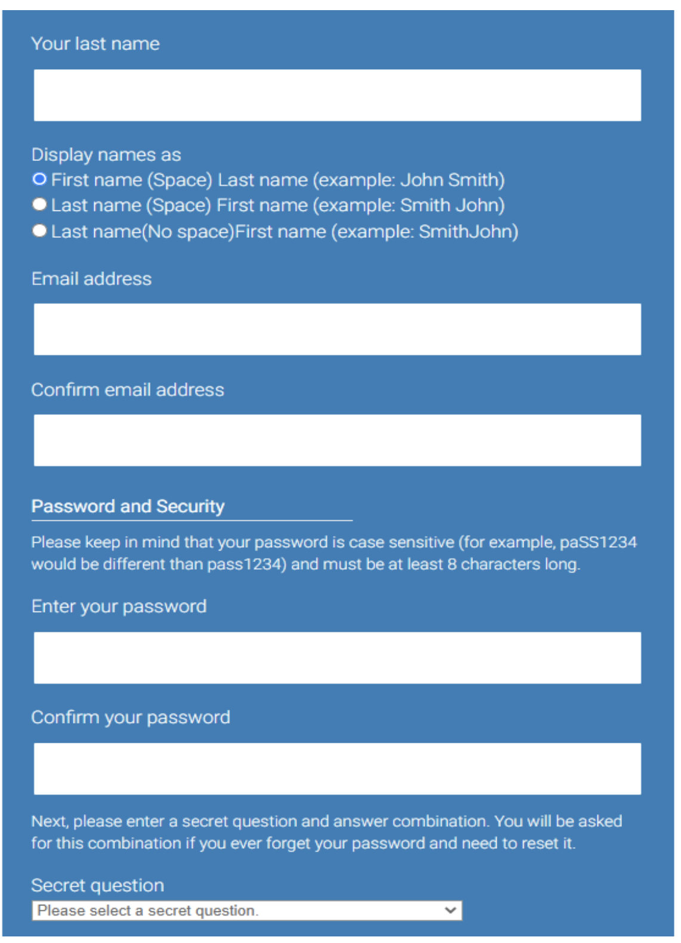

Slide 9
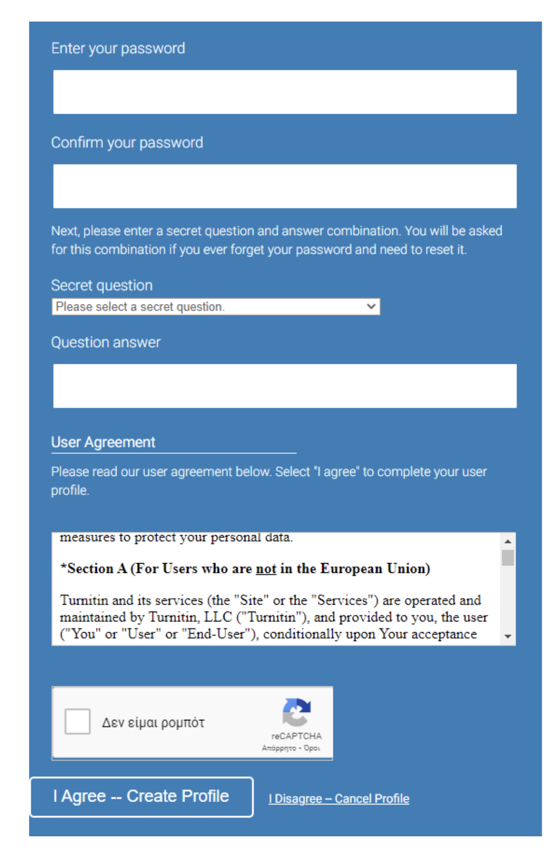

Slide 10
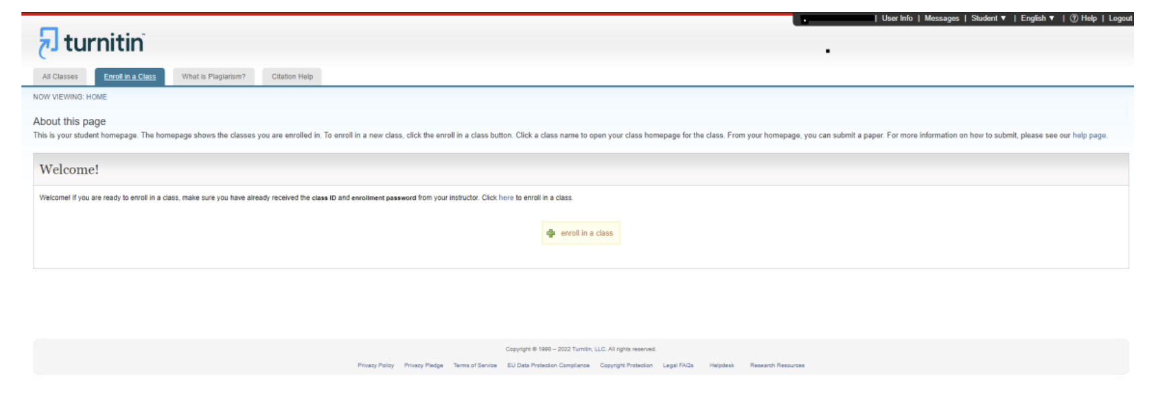
Instructions
Your account has been created. Now you choose Enroll in a class, completing your class ID and Enrollment key.

Slide 11
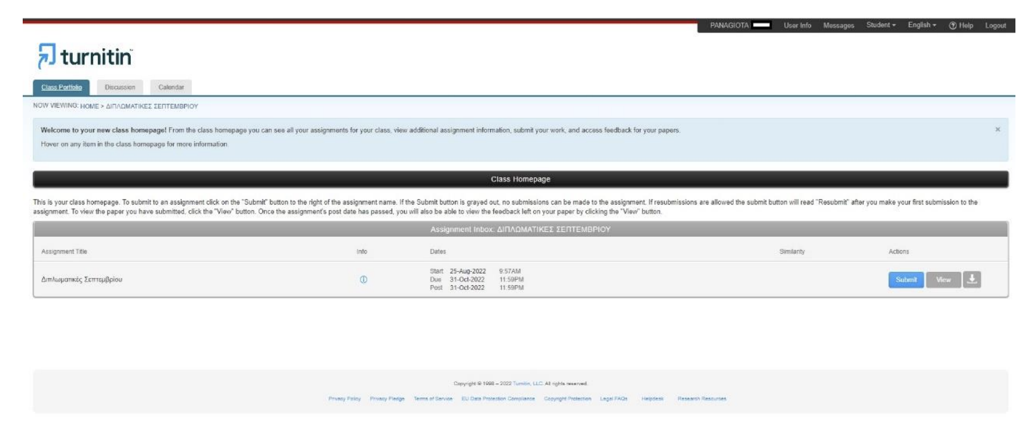
Instructions
Choose the folder “English for International Relations and Economics” to submit your paper
Choose Submit

Slide 12
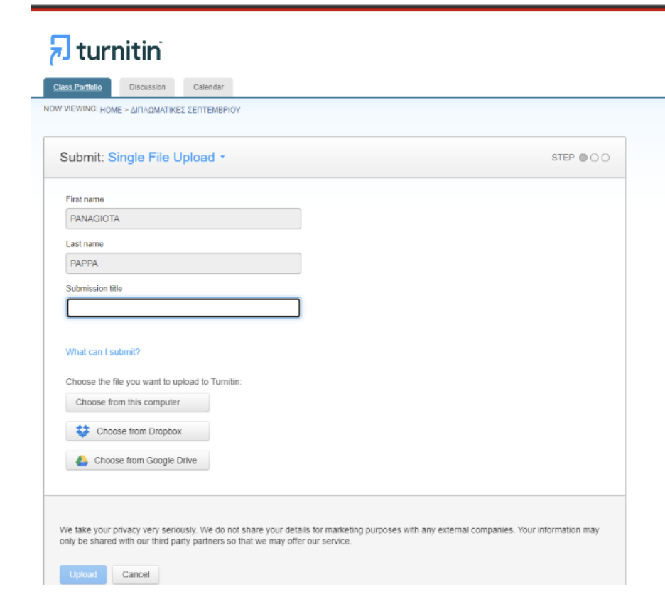
Instructions
Complete the title of your paper in Submission title and choose the file you will upload (from your computer, Dropbox or google drive)
Please upload a doc or docx file.

Slide 13
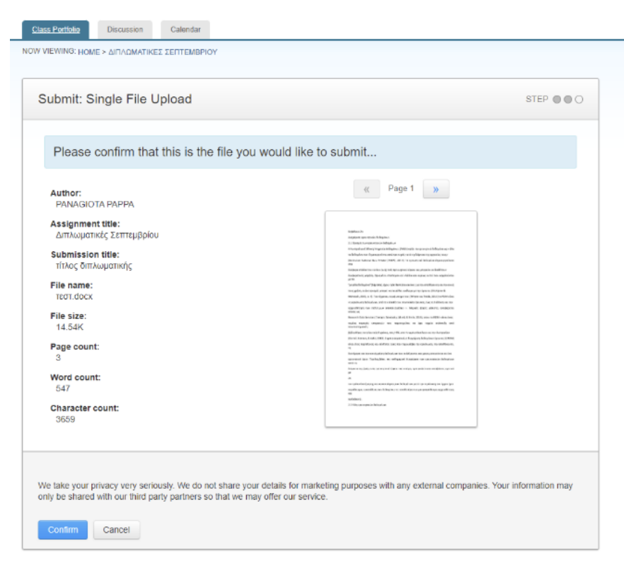
Instructions
Finally choose Confirm

Slide 14
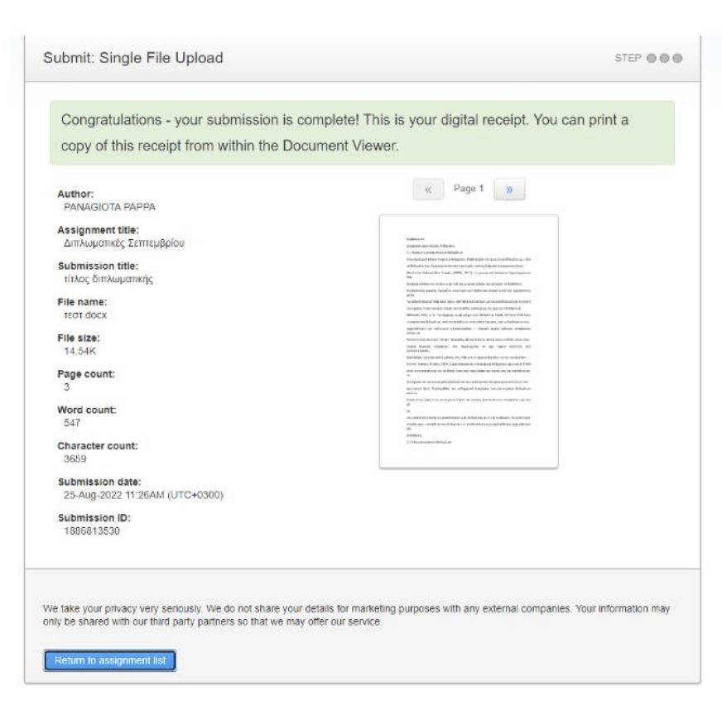
Instructions
Choose Return to assignment list

Slide 15
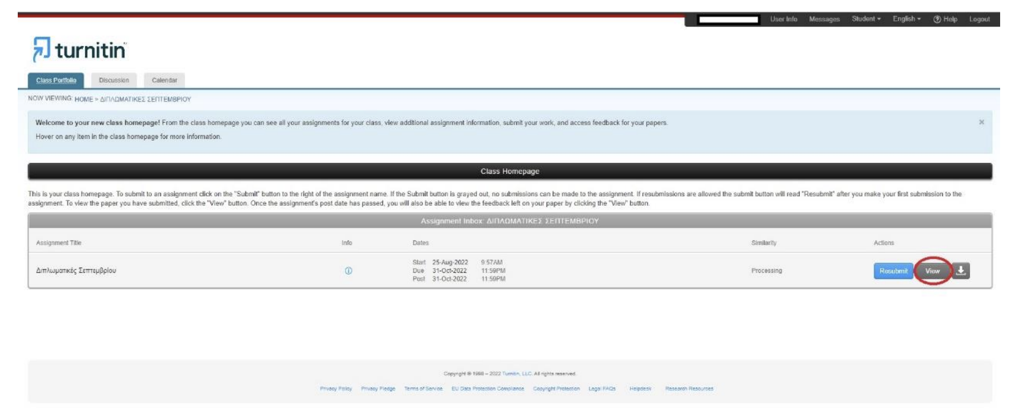
Instructions
Choose View to see the Similarity Report

Slide 16
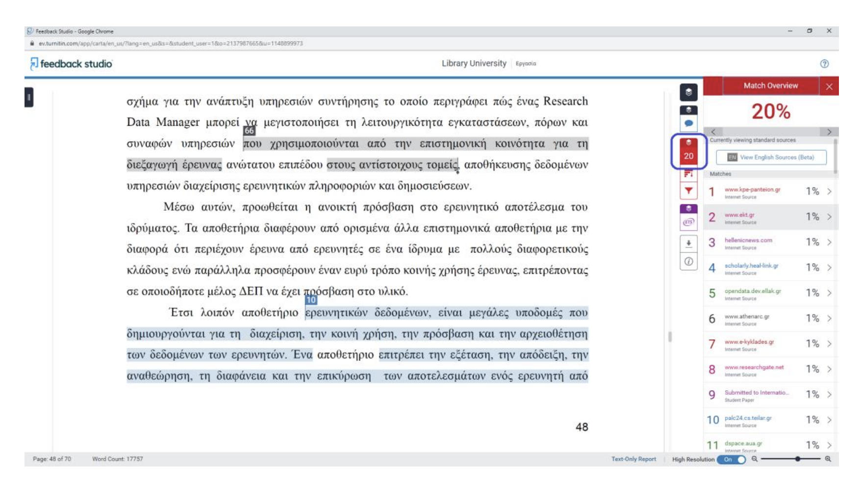
In the Similarity Report you will see the pieces of text that appear to be similar to another piece of original text. On the right you can find the percentage of similarities that that exist in the whole text (e.g. 20%). You will also find a list of the sources which bear similarity to your text.

Slide 17
Requirements
For the Extended Abstract Assignment, a similarity report until 30% is acceptable

Slide 18
Instructions
On the right you will also find and AI icon. Press it and you will see the pieces of text that are considered AI generated and the percentage of the whole text that is AI generated.
In this assignment this percentage needs to be up to 40% to be acceptable.

Slide 19
Instructions
For more details in Greek, go to
https://www.lib.uom.gr/index.php/el/services/item/967-perigrafh
Βιβλιοθήκη (lib.uom.gr), Υπηρεσίες, Υπηρεσία ανίχνευσης πιθανής λογοκλοπής Turnitin, Οδηγός χρήσης για φοιτητές

Slide 20
Good luck!

