Slide 1
IELTS
We start at 9.

Slide 2
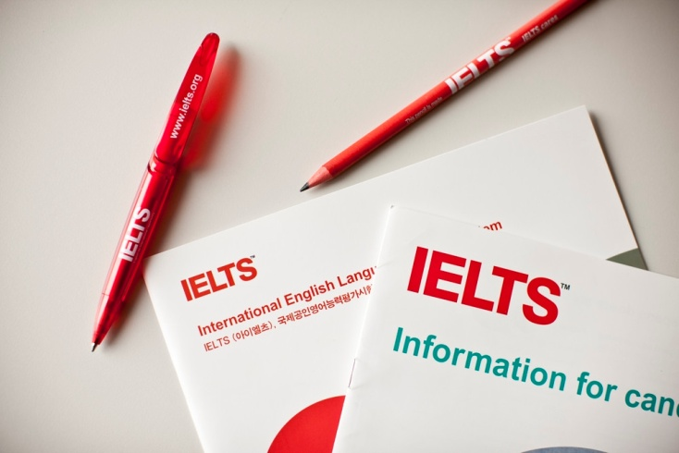
IELTS
General Training
To work abroad
Academic
Postgraduate studies
Professional registration
4 sections, listening, reading, writing and speaking.
The Listening and Speaking parts of the test are the same for both Academic and General Training, while the Reading and Writing parts are different.

Slide 3
IELTS Grading
You will be given a score from 1 to 9 for each part of the test – Listening, Reading, Writing and Speaking. The average produces your overall band score.
Listening
40 qu. x 1pt= 40 pts
Writing
Task Achievement
Coherence and Cohesion
Lexical Resource
Grammatical Range /Accuracy
Reading
40 qu. x 1pt= 40 pts
Speaking
1-9
1-9
1-9
Fluency and Coherence
Lexical Resource
Grammatical Range / Accuracy
Pronunciation
1-9

Slide 4
IELTS Grading
https://www.ielts.org/for-organisations/ielts-scoring-in-detail

Slide 5
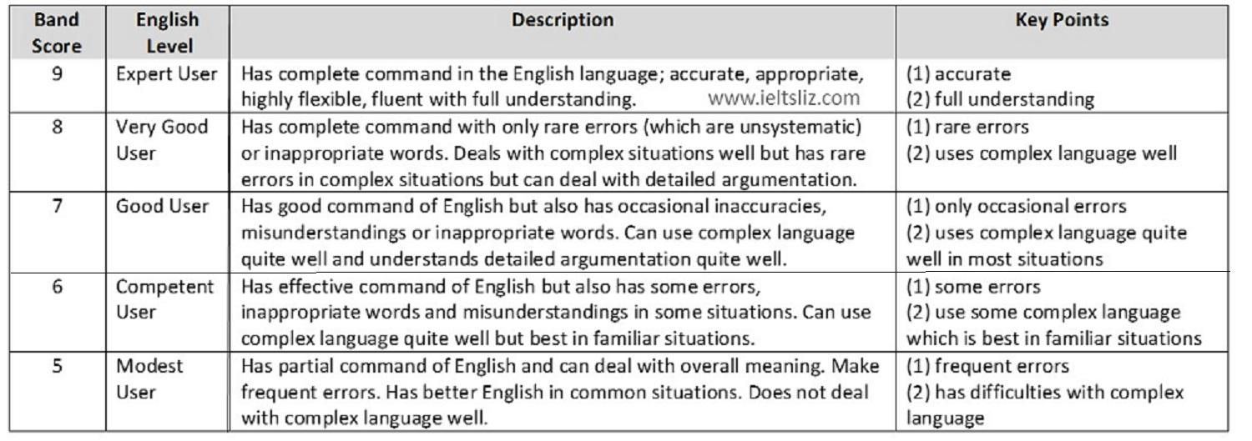
IELTS Score bands explained
Overall band scores are calculated to the nearest whole or half band.

Slide 6
IELTS
links
https://www.britishcouncil.gr/en/exam/ielts/prepare/online-materials?gclid=CjwKCAiAheacBhB8EiwAItVO2__2MhQ1uQ0EXEjxJ8bzV_Cr6XxOBbg7oQfpeaCyFba-x8AqyXa0dBoCq2MQAvD_BwE
Sample tests

Slide 7
IELTS
videos
1- introduction
https://www.youtube.com/watch?v=EH_Jn7SXQ7A&ab_channel=EverythingIELTS
2- writing (look at 1:40+)
https://www.youtube.com/watch?v=Jig-PFZtpwA&ab_channel=EverythingIELTS
3- speaking (5’ +)
https://www.youtube.com/watch?v=J-MGTe8mWP4&ab_channel=EverythingIELTS
https://www.youtube.com/watch?v=iT5dk3nkYfQ&ab_channel=E2IELTS (specific topics)
4- listening practice
https://www.youtube.com/watch?v=_B9-6uPxQjA&ab_channel=TheIELTSListeningTest
5- Full mock test
https://www.youtube.com/watch?v=NXJa7GFjY3U&ab_channel=E2IELTS

Slide 8
IELTS components
Academic Reading 60’
3 long texts from current books, journals, magazines and newspapers, on academic topics.
40 questions (multiple choice / identifying information or a writer’s view, matching headings, features and sentence endings, as well as sentence, summary, note, table and flow-chart completions, and short-answer questions).
Academic Listening 30’ + 10’
4 parts/40 questions.
Part 1,2, everyday context.
Part 3 4, education or training context.
Parts 1 and 3 conversation between two or more speakers,
Parts 2 and 4 will hear a monologue. You will need to answer questions connected to the recordings
Academic Speaking 11’ -14’
3 parts.
Part 1 general questions about familiar topics like work, family, studies and hobbies.
In Part 2 you will be given a card with a topic. 1’ to take notes + to prepare your response with a pencil and paper. Speak for 2’.
In Part 3, discussion with the examineron the topic discussed in Part 2.
Academic Writing 60’
AW Task 1, a visual representation of info.;
a graph, table, chart or diagram, to summarise, describe or explain the process.
3 parts, introduction/ overview /the main features supported by figures from the diagram.
AW Task 2. Essay (point of view, argument, problem)
GRADE: T1+ 2T2 /3 = AW final (8+6+6=20/3)

Slide 9
Tips
Be natural, Don't memorise answers (SP, WR)
Use a range of grammatical structures (SP, WR)
Fluency and coherence, Lexical resource, Grammatical range and accuracy play a major role. Make sure you use a wide range of Grammatical structures to express what you say.
Practice well
For both language development and time management
Ask for clarification (SP)
If you didn’t hear the question properly in the IELTS Speaking test or you aren’t sure what the examiner means, it is okay to ask for clarification. eg ‘Do you mean …?’.
Listening practice
(LIST pt1,3) multiple speakers, practice with various dialogues, such as a TV drama or discussion panel.
(LIST pt 2,4) 1 speaker, so practice with a short video lecture of about 5-7 min.
The order of answers in reading
(READ) Remember that some task types have answers that appear in order, such as True / False / Not Given or Multiple Choice. This means that you don’t have to begin with the first question and do them in order. Look for a KEYWORD (e.g. a name of a person or place) and start with that question. Then, the answer for the other questions will most likely appear above and below this point.

Slide 10
LISTENING

Slide 11
LISTENING
How many sections are there in the Listening part of the test?
How many times do you get to listen to each question?
What strategy is advised?

Slide 12
LISTENING
How many sections are there in the Listening part of the test? 4 in 30 min.
How many times do you get to listen to each question? Just once, but you get time to prepare
What strategy is advised? Preparing by isolating keywords

Slide 13
4 parts
10 questions each
Progressively harder
Duration: 30 +10’
LISTENING
PART 1
Qu.1-3 Form completion
Qu.4-8 Table completion
Qu.9-10 Multiple choice
PART 2
Qu.11-16 Multiple choice
Qu.17- 20 Map completion
PART 3
Qu.21-26 Sentence completion
Qu.27-30 Matching
PART 4
Qu.31-33 Multiple choice
Qu.34-40 Flow chart completion
https://www.youtube.com/watch?v=NXJa7GFjY3U&ab_channel=E2IELTS
0- 1.03.00

Slide 14
Useful language: rephrasing (p.14)
Be prepared to listen to similar phrases to the options you are given

Slide 15
Useful language: rephrasing (p.14)
1e, 2c, 3a, 4g, 5i, 6b, 7d, 8f, 9j, 10h

Slide 16
Useful language: signposts (p.22)
These will indicate to you what content will follow so you can look at different questions

Slide 17
Useful language: signposts (p.22)
2,4,5,8,11,14 B. 1,3,5,7,10,15,19
C. 5,13 D. 9, 17

Slide 18
READING

Slide 19
READING
How many texts are there in the reading test?
How much time should you spend on each?
What is the basic piece of advice?
What types of reading are there?
When you look for the general idea
When you look for specific info

Slide 20
READING key
How many texts are there in the reading test? Three
How much time should you spend on each? 20 minutes
What is the basic piece of advice? Read quickly + purposefully
What types of reading are there?
When you look for the general idea skimming (topic sentences)
When you look for specific info scanning (keywords, names, numbers)

Slide 21
SPEAKING tips
Adapted from https://www.ieltsidpindia.com/prepare-for-ielts/speaking
build confidence: Before the test, talk to friends in English. Record yourself + work on your pronunciation.
it is not about right or wrong, although it is about RELEVANCE. The examiner will see how articulate you are in expressing your opinions in English.
Avoid repeating the examiner’s question. Rephrase.
Have a natural pace.
Use detail. Avoid a simple ‘yes’ or ‘no’. Justifying your answers helps ( … because…)
Use the correct verb tenses. Eg., if you are asked ‘What kind of music do you like?’ (present tense), do not answer in past tense.
Practise how to pronounce the numbers clearly. For instance, when spoken, numbers like ‘Forty’ and ‘Fourteen’ may sound similar.
If you are not confident with complicated words, do not use them. Of course, advanced vocabulary will get you a higher score, but fluency matters in the overall impression you create.

Slide 22
SPEAKING tips questions
What should you look out for concerning your wording?
What is more important, correct responses or rich responses?
what guidance do cue cards and interviewers’ cues give you?

Slide 23
WRITING tips
Examine the questions properly and see that you cover all parts.
Respect the word limit.
Do not repeat the words from the question exactly.
Do not use bullets in your answers. Arrange your ideas into different paragraphs.
Rather than long, complicated answers, write coherent and well organised answers in correct grammar.
AW Task 1: do not copy the text from the question. Use your own words.
AW Task 2: of the 40 minutes use 5’ to first plan your answer and 5’ in the end to check for mistakes.
AW Task2. STRUCTURE: introduction, main body, conclusion.
Proofread for singular and plural nouns.
Use any spelling (eg. American, British) but be consistent.

Slide 24
3 sections
40 questions in total
Progressively harder
Duration: 60 mins
READING
PART 1
About 13 qu.
Match headings to paragraphs
Sentence completion
PART 2
About 13 qu.
True/False/ Not given
Match features
Diagram labelling
PART 3
About 13 qu.
Yes/ No/ Not given
Sentence endings
https://www.youtube.com/watch?v=NXJa7GFjY3U&ab_channel=E2IELTS
1.03.49

Slide 25
2 tasks
Duration: 60 mins
WRITING TASK 2
TASK 1
About 13 qu.
TASK 2 Discursive Essay 40 minutes
1-2 statements and question prompts
250+ words
66% of the writing score
ANALYSE prompt > PLAN > WRITE > PROOFREAD
Introduction 3-4 sentences
Paragraph 1 4-6 sentences
Paragraph 2 4-6 sentences
Conclusion 2-3 sentences
https://www.youtube.com/watch?v=NXJa7GFjY3U&ab_channel=E2IELTS
2.43.23

Slide 26
2 tasks
Duration: 60 mins
WRITING TASK 1
TASK 1
Describe data (bar charts, pie charts, processes)
150 words MAX
20 minutes
33% of overall Writing Score
Structure:
Overview/ paraphrase prompt+ observe notable trends
Data paragraph 1
Data paragraph 2
https://www.youtube.com/watch?v=NXJa7GFjY3U&ab_channel=E2IELTS
3.39.15 – 4:08

Slide 27
3 parts
Duration: 11-14 mins
SPEAKING
Identity check
PART 1
Small talk
Day to day topics (where you live, studies etc. 3-4 mins)
PART 2
2-minute talk (prepare for 1 min, speak for 2)
PART 3
Discussion
(follows up on the topic of part 2)
21 topic examples
https://www.youtube.com/watch?v=iT5dk3nkYfQ&ab_channel=E2IELTS Choose 3/time and talk about them
https://www.youtube.com/watch?v=NXJa7GFjY3U&ab_channel=E2IELTS
4.40.07

Slide 28
Speaking examples
https://www.ieltsbuddy.com/IELTS-speaking-questions-with-answers.html

Slide 29
Pt1 example
Leisure time
What do you like to do in your free time?
I do quite a lot of sport actually. I play football mostly - on Wednesday nights and Sunday afternoon with a local team. I also play tennis and squash when I can but I don't really get the time to do them as well every week. I work quite hard at the moment, so I don't get a lot of free time unfortunately.
Have your leisure activities changed since you were a child?
Not a great deal actually. I used to love playing football when I was young as well - I played a lot at school. Though of course I did all the other things kids loved to do such as going out on bike rides after school and things.
Do you prefer to spend your free time alone or with other people?
It depends on my mood really. I think most people need some time on their own. Sometimes my work is quite stressful and I spend a lot of time there with others, so it's good to just get home and relax and read a book or something. But I get bored if I am alone too much so I like to go out and meet friends in the evening or play football.

Slide 30
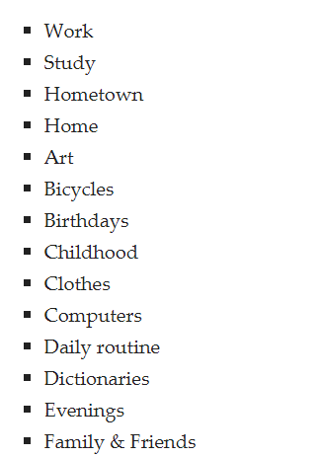
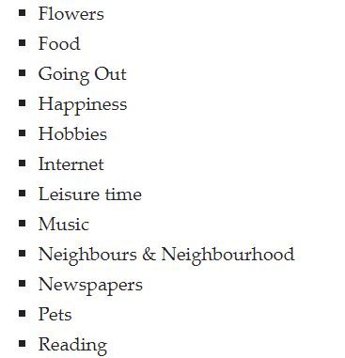
Pt1 sample topics

Slide 31
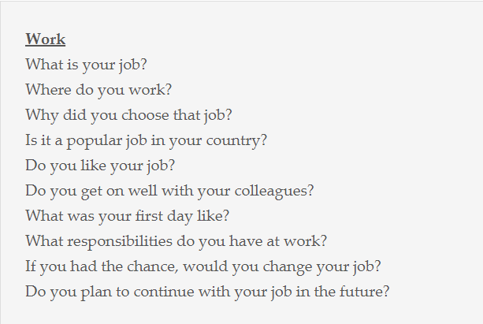
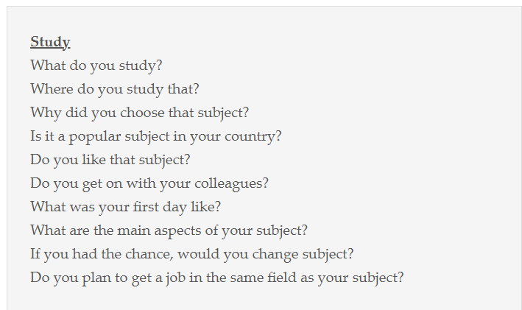
https://ieltsliz.com/ielts-speaking-part-1-topics/

Slide 32
Pt2 example
Describe an old person that you know. You should say:
What your relationship is to this person
How often you see them
What people think about this person
Explain why you like them
Ok, I’d like to tell you about an old person that I know.
His name is John, and he is the owner of a small convenience store at the end of my street.
I would say that my relationship with him is as a friend. I know him because I regularly go to the shop in order to buy things when I don’t have time to go to a supermarket. He’s quite friendly and I always have a chat with him. I’ve known him now for about five years - since I’ve lived in the area. That’s why I’d now call him a friend.
I’d say that I see him fairly regularly. Like I said, I go to the big supermarket out of town sometimes to stock up, but you always need odd things during the week such as milk, or some snack or other. So when this happens I just have a walk down to his shop. So I’d say I see him every one or two days.
I think John is pretty popular as he’s been there for years as far as I’m aware, so most of the locals around the area know him. There will always be someone in the shop having a chat with him. They like him because he’s not just the shopkeeper but he’s also very involved in activities in the community. For example, I know he helps out at the old people’s home some nights, and he runs the quizzes at the local pub. He also helps to organize the fete that is held each year in the town.
The reason that I like him is that he’s great to have a chat with. For instance, a while back I was having problems with my work, and I was really feeling stressed. I didn’t really have anyone to talk to at the time as my family is abroad and a couple of my good friends were not around. I mentioned it to John and he was great. He listened and also gave me some really good advice. He didn’t need to do that so it was great that he made the time to anyway. Generally, though, he’s really welcoming when you go to his shop. He’ll always have a smile on his face.

