Slide 1
GAME THEORY
SPRING 2026
LECTURE NOTES SET 5: REPEATED GAMES
Eleftherios Filippiadis
Office: ΓΔ3, 310
Phone number: 2310-891770
Email: efilipp@uom.gr

Slide 2
Repeated Games
What if a static game* is played again (repeated) once it is over?
If a game is played repeatedly, with the same players who know each other’s previous moves, the players may behave very differently than if the game is played just once (a one-shot game).
Is it possible that future promises/threats can affect/alter the outcome of the game?
  Cooperation in a current stage can be induced in some cases through promises and threats provided some conditions…
How do strategies in the repeated game look like?
  Players’ behavior can be conditioned on the “history” of the game → credibility of threats (?)
Can we represent graphically a repeated game with a game-tree?
  We can do that but it gets really complicated really fast (just with few repetitions)
What is the appropriate solution concept?
  Since the game is evolved over time (i.e., stages are taking place sequentially) the proper solution concept is Subgame Perfect Nash Equilibrium (SPNE)
  * The concept of repeated games can very well apply to extensive form games. With some differences in the way strategies are defined, the main results of the analysis that follow holds true for these cases as well.

Slide 3
Repeated Games
Characteristics of a repeated game:
Identical game played in every stage.
Payoffs are realized at the end of every stage and sequentially added until the end of the repeated game.
Payoffs from one stage do not directly affect payoffs of another stage.
Players know each other’s previous moves.
Two types of repeated games
Finitely repeated: the game is played for a finite and known number of rounds/stages.
Infinitely or Indefinitely repeated: the game has no predetermined length; players act as though it will be played indefinitely, or it ends only with some probability.
The outcome of a repeated game can greatly change depending on whether it is finitely or infinitely repeated!

Slide 4
Finitely Repeated Games
Example 1
Consider a typical “prisoner’s dilemma” game as in the table below:
This game, as we know, has a unique Nash Equilibrium, namely (Confess, Confess).
What will happen if this game is repeated twice? Can the cooperative outcome (-1, -1) be somehow supported?
Player 1 can, for example, ask player 2 to lie in the first stage and in exchange she will lie both in the first and in the second stage. Is this subgame perfect?
  Consider the last stage: since it is the last time this game is played, both players will adopt their dominant strategy, i.e., to Confess
  Any promise/threat about Stage 2’s action different than Confess is not credible! In stage 2, the only subgame Nash Equilibrium is the unique Nash Equilibrium of the game!
  Hence, in the first stage the only possible equilibrium (given that no cooperation can take place in the second stage) is for both to confess!
 |  | Player 2
 |  | Lie | Confess
Player 1 | Lie | -1, -1 | -9, 0
 | Confess | 0, -9 | -6, -6

Slide 5
Finitely Repeated Games
The previous example reveals two important results that can be generalized for finitely repeated games:
Proposition 1
In the final subgame players must play their action that corresponds to a Nash Equilibrium in all Subgame Perfect Nash Equilbria.
  All payoffs from before cannot change
  The Nash equilibrium Strategy is the only strategy that maximizes a player’s payoffs in the last stage.
Proposition 2 (Selten)
If the stage game has a unique Nash Equilibrium then for any finite number of repetitions the repeated game has a unique SPNE: the players play the actions that correspond to the unique Nash equilibrium in every stage of the game.

Slide 6
Finitely Repeated Games
One more significant result about repeated games is the following:
Proposition 3
A collection of Nash Equilibrium strategies in every stage of the game is indeed a Subgame Perfect Nash Equilbrium
  When choosing the Nash Equilibrium strategy future strategies cannot be affected
  The Nash equilibrium Strategy is the only strategy that maximizes a player’s payoffs in the future.
  Very Important: the above proposition does not describe all Subgame Perfect Nash Equilibria! There could be more, where players use strategies that contain actions-responses to previous plays! Cooperation, to some extend, may be possible!

Slide 7
Finitely Repeated Games
Example 2
Consider a static game described by the table below:
This game has two Nash Equilibria, namely (Up, Left) and (Down, Right). Moreover, there is coordination failure as none of these N.E. is Pareto Efficient.
What is (are) the SPNE of this game if it is repeated twice?
 |  | Player 2
 |  | Left | Center | Right
Player 1 | Up | 1, 1 | 5, 0 | 0, 0
 | Middle | 0, 5 | 4, 4 | 0, 0
 | Down | 0, 0 | 0, 0 | 3, 3

Slide 8
Finitely Repeated Games
… Example 2
Based on Proposition 1 we can infer that, in the last stage, players will either end up in (D, R) or in (U, L).
Assume that in the last stage the payers end up in (U, L). Then, at the beginning of the first stage the payoff matrix looks like
*** we have added in every cell the payoffs that correspond to the N.E. (U, L) of the last stage!
 |  | Player 2
 |  | Left | Center | Right
Player 1 | Up | 1+1, 1+1 | 5+1, 0+1 | 0+1, 0+1
 | Middle | 0+1, 5+1 | 4+1, 4+1 | 0+1, 0+1
 | Down | 0+1, 0+1 | 0+1, 0+1 | 3+1, 3+1
 |  | Player 2
 |  | Left | Center | Right
Player 1 | Up | 2, 2 | 6, 1 | 1, 1
 | Middle | 1, 6 | 5, 5 | 1, 1
 | Down | 1, 1 | 1, 1 | 4, 4

Slide 9
Finitely Repeated Games
… Example 2
We now look for Nash Equilibria in the new payoff matrix. The resulting Nash Equilibria can be supported as SPNEs provided some proper strategies!
This game supports two SPNEs:
#1 play U in the 1st period and play U in the 2nd period no matter what
#2 play L in the 1st period and play L in the 2nd period no matter what
#1 play D in the 1st period and play U in the 2nd period no matter what
#2 play R in the 1st period and play L in the 2nd period no matter what
 |  | Player 2
 |  | Left | Center | Right
Player 1 | Up | 2, 2 | 6, 1 | 1, 1
 | Middle | 1, 6 | 5, 5 | 1, 1
 | Down | 1, 1 | 1, 1 | 4, 4

Slide 10
Finitely Repeated Games
… Example 2
Assume that in the last stage the payers end up in (D, R). Then, at the beginning of the first stage the payoff matrix looks like
*** we have added in every cell the payoffs that correspond to the N.E. (D, R) of the last stage!
 |  | Player 2
 |  | Left | Center | Right
Player 1 | Up | 1+3, 1+3 | 5+3, 0+3 | 0+3, 0+3
 | Middle | 0+3, 5+3 | 4+3, 4+3 | 0+3, 0+3
 | Down | 0+3, 0+3 | 0+3, 0+3 | 3+3, 3+3
 |  | Player 2
 |  | Left | Center | Right
Player 1 | Up | 4, 4 | 8, 3 | 3, 3
 | Middle | 3, 8 | 7, 7 | 3, 3
 | Down | 3, 3 | 3, 3 | 6, 6

Slide 11
Finitely Repeated Games
… Example 2
We now look for Nash Equilibria in the new payoff matrix. The resulting Nash Equilibria can be supported as SPNEs provided some proper strategies!
This game supports two SPNEs:
#1 play U in the 1st period and play D in the 2nd period no matter what
#2 play L in the 1st period and play R in the 2nd period no matter what
#1 play D in the 1st period and play D in the 2nd period no matter what
#2 play R in the 1st period and play R in the 2nd period no matter what
 |  | Player 2
 |  | Left | Center | Right
Player 1 | Up | 4, 4 | 8, 3 | 3, 3
 | Middle | 3, 8 | 7, 7 | 3, 3
 | Down | 3, 3 | 3, 3 | 6, 6

Slide 12
Finitely Repeated Games
… Example 2
In this the end?
Is there any way to support the Pareto Efficient outcome of (M, C) at least for the first period?
proposition 1 makes clear that this outcome cannot be supported for the last period, but no one says it cannot be supported for a period before the last!
It turns out that outcomes other than those corresponding to N.E. can indeed be supported in previous stages provided a proper mechanism of rewards and punishments!
 |  | Player 2
 |  | Left | Center | Right
Player 1 | Up | 1, 1 | 5, 0 | 0, 0
 | Middle | 0, 5 | 4, 4 | 0, 0
 | Down | 0, 0 | 0, 0 | 3, 3

Slide 13
Finitely Repeated Games
… Example 2
It is possible that the players will anticipate that different first stage outcomes are linked with different Nash Equilibria of the last stage! For example, assume that players anticipate the outcome of (D, R) in the last stage only if the outcome of (M, C) results in the first stage. In any other case, the last stage outcome will be the one corresponding to (U, L). Then the payoff matrix is transformed as follows:
 |  | Player 2
 |  | Left | Center | Right
Player 1 | Up | 1+1, 1+1 | 5+1, 0+1 | 0+1, 0+1
 | Middle | 0+1, 5+1 | 4+3, 4+3 | 0+1, 0+1
 | Down | 0+1, 0+1 | 0+1, 0+1 | 3+1, 3+1
 |  | Player 2
 |  | Left | Center | Right
Player 1 | Up | 2, 2 | 6, 1 | 1, 1
 | Middle | 1, 6 | 7, 7 | 1, 1
 | Down | 1, 1 | 1, 1 | 4, 4

Slide 14
Finitely Repeated Games
… Example 2
This game supports three SPNEs:
#1 play U in the 1st period and play U in the 2nd period no matter what
#2 play L in the 1st period and play L in the 2nd period no matter what
#1 play D in the 1st period and play U in the 2nd period no matter what
#2 play R in the 1st period and play L in the 2nd period no matter what
#1 play M in the 1st period; play D in the 2nd period if (M, C) is observed in the 1st period, otherwise play U
#2 play C in the 1st period; play R in the 2nd period if (M, C) is observed in the 1st period, otherwise play L
 |  | Player 2
 |  | Left | Center | Right
Player 1 | Up | 2, 2 | 6, 1 | 1, 1
 | Middle | 1, 6 | 7, 7 | 1, 1
 | Down | 1, 1 | 1, 1 | 4, 4

Slide 15
Infinitely Repeated Games
Like in the finitely repeated games
the same stage game is played repeatedly
Unlike the finitely repeated games
There is no known final period
Hence, once again, players can condition actions on past behavior. This creates room for:
Reputation
Punishment
Reward
Cooperation
Question: Can we sustain cooperation in the Prisoner’s dilemma game if it is repeated infinitely many times?

Slide 16
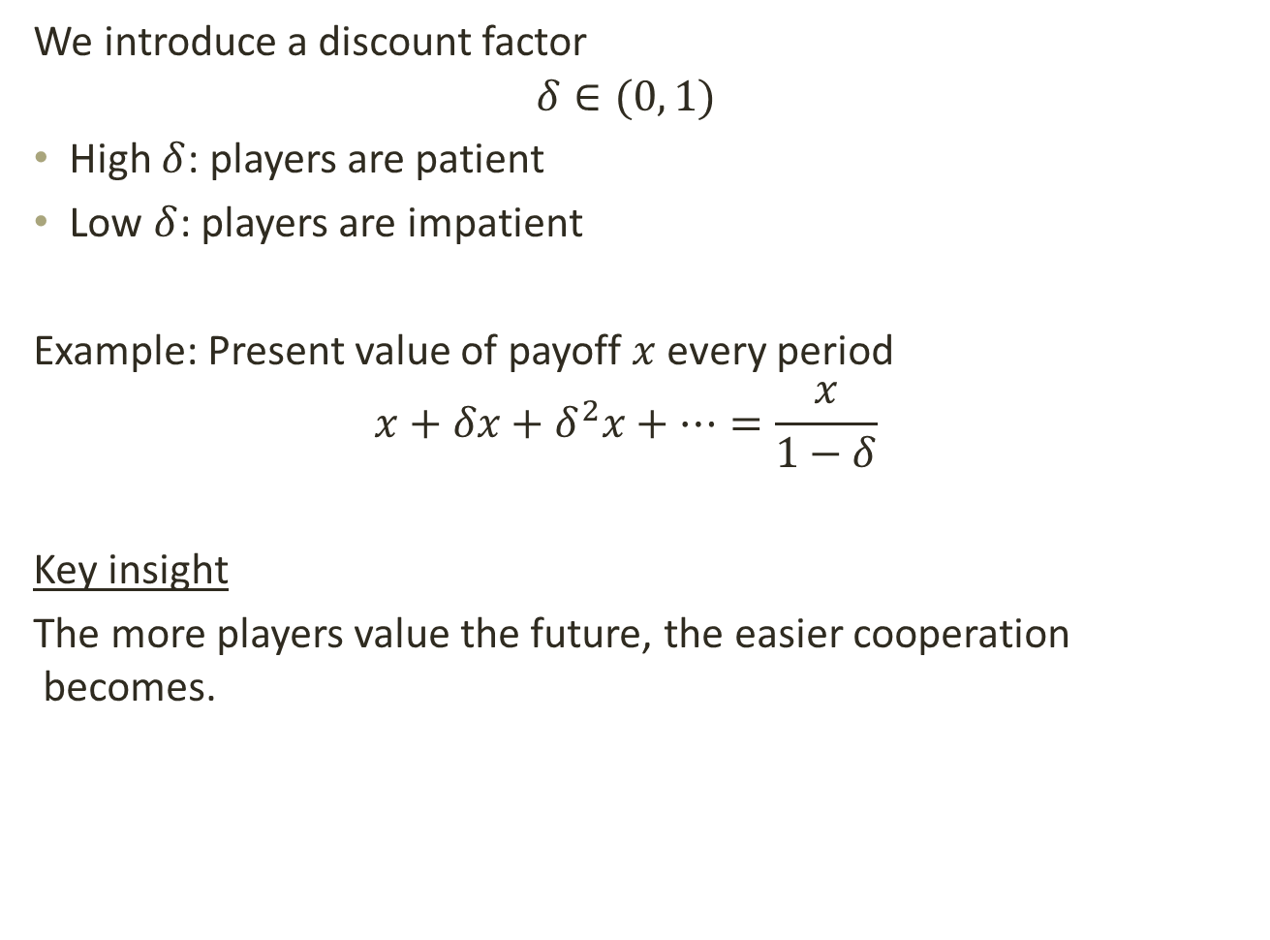
Infinitely Repeated Games and Discount
We introduce a discount factor
$$δ∈(0, 1)$$
High $δ$: players are patient
Low $δ$: players are impatient
Example: Present value of payoff $x$ every period
$$x+δx+δ^{2}x+⋯=\frac{x}{1−δ}$$
Key insight
The more players value the future, the easier cooperation becomes.

Slide 17
Infinitely Repeated Games and Trigger Strategies
As we saw, a strategy in a repeated game can depend on past actions.
Example 1: Grim Trigger
Start by cooperating
Continue cooperating as long as the other player has always cooperated
If the other player defects once, defect forever
Example 2: Tit-for-Tat
Start by cooperating
Continue cooperating as long as the other player has always cooperated
If the other player defects once, defect once
Return to cooperating afterwards

Slide 18
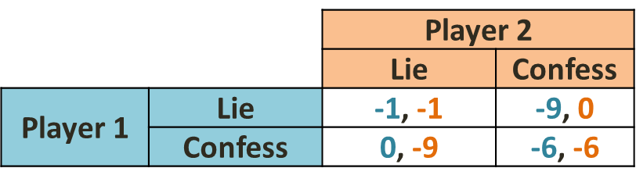
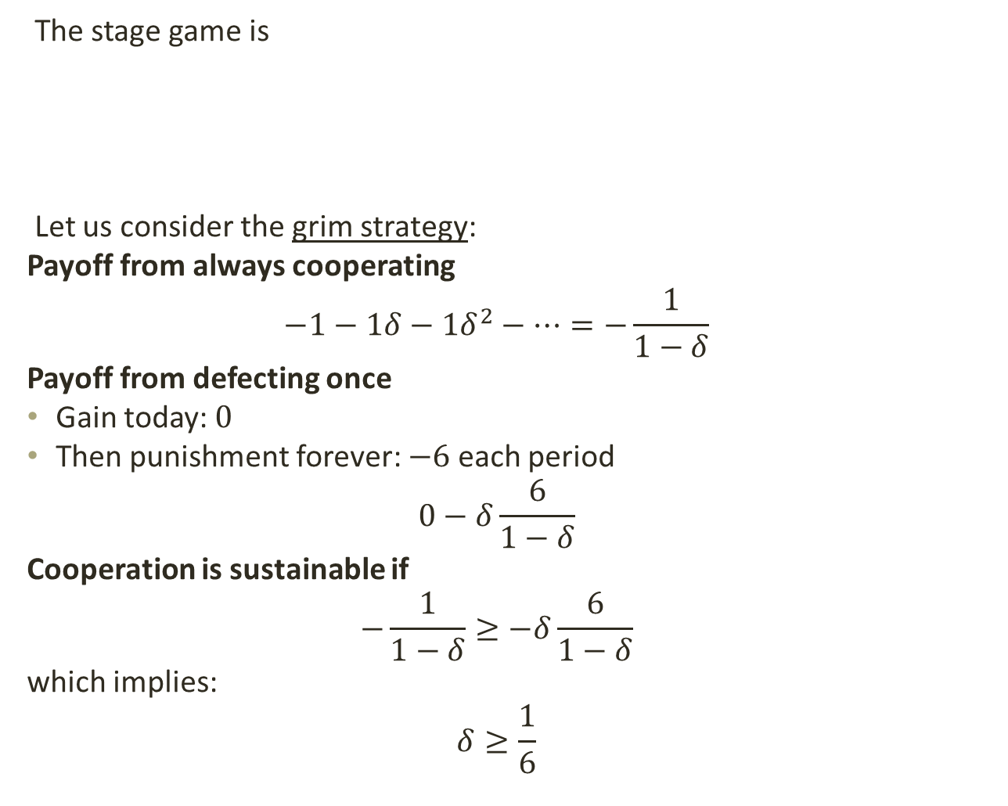
Infinitely Repeated Prisoner’s Dilemma
The stage game is
Let us consider the grim strategy:
Payoff from always cooperating
$$−1−1δ−1δ^{2}−⋯=−\frac{1}{1−δ}$$
Payoff from defecting once
Gain today: $0$
Then punishment forever: $−6$ each period
$$0−δ\frac{6}{1−δ}$$
Cooperation is sustainable if
$$−\frac{1}{1−δ}≥−δ\frac{6}{1−δ}$$
which implies:
$$δ≥\frac{1}{6}$$

