Slide 1
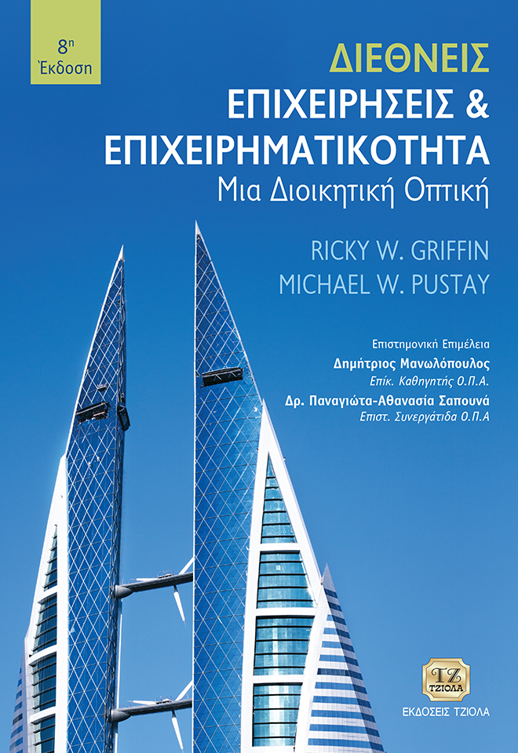
Διεθνείς Επιχειρήσεις και Επιχειρηματικότητα 8^{η} Έκδοση
ΚΕΦΑΛΑΙΟ 17
Διοίκηση Διεθνών Επιχειρησιακών Λειτουργιών
Griffin & Pustay

Slide 2
Μαθησιακοί Στόχοι
Να περιγράψετε τη φύση της διοίκησης διεθνών επιχειρησιακών λειτουργιών.
Να αναλύσετε τη διοίκηση της εφοδιαστικής αλυσίδας και τις αποφάσεις κάθετης ολοκλήρωσης που αντιμετωπίζουν τα ανώτατα στελέχη των διεθνών επιχειρησιακών λειτουργιών.
Να αναλύσετε την έννοια της παραγωγικότητας και να συζητήσετε πώς οι διεθνείς επιχειρήσεις προσπαθούν να τη βελτιώσουν.
Να εξηγήσετε τον τρόπο με τον οποίο οι επιχειρήσεις ελέγχουν την ποιότητα και προσεγγίζουν τη διοίκηση της ολικής ποιότητας στις διεθνείς επιχειρήσεις.
Να αναλύσετε πώς οι διεθνείς επιχειρήσεις ελέγχουν τις πληροφορίες που χρειάζονται τα διευθυντικά στελέχη τους για να λαμβάνουν αποτελεσματικές αποφάσεις.

Slide 3
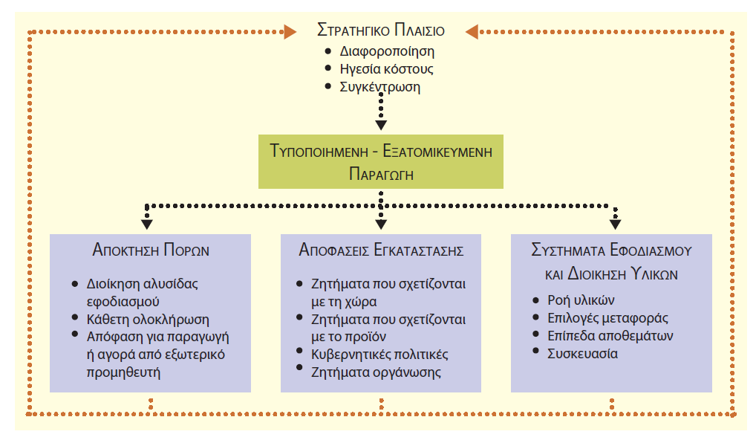
Η Φύση της Διοίκησης Διεθνών Επιχειρησιακών Λειτουργιών
Notes:
Operations management is the set of activities an organization uses to transform different kinds of inputs (materials, labor, and so on) into final goods and services. International operations management refers to the transformation-related activities of an international firm.
Figure 17.1 illustrates the international operations management process. As shown, a firm’s strategic context provides a necessary backdrop against which it develops and then manages its operations functions. Flowing directly from the strategic context is the question of standardized versus customized production. The positioning of a firm along this continuum in turn helps dictate the appropriate strategies and tactics for other parts of the operations management process. The next part of international operations management is the activities and processes connected with the acquisition of the resources the firm needs to produce the goods or services it intends to sell. Location decisions—where to build factories and other facilities—are also important. In addition, international operations managers are concerned with logistics and materials management—the efficient movement of materials into, within, and out of the firm.

Slide 4
Το Στρατηγικό Πλαίσιο της Διοίκησης Διεθνών Επιχειρησιακών Λειτουργιών
Υψηλότερη αξία
Επιχειρηματική στρατηγική
Διαδικασίες παραγωγής
Τεχνολογίες παραγωγής
Notes:
The central role of operations management is to create the potential for achieving superior value for the firm. That is, operations management is a value-adding activity intended to create or add new value to the organization’s inputs in ways that directly impact outputs.
International operations management must be aligned closely with a firm’s business strategy. Indeed, the business strategy set by top managers at the firm’s corporate and regional levels will affect all facets of the planning and implementing of operations management activities, such as supply chain management strategies, location decisions, facilities design, and logistics management.
Production processes and technologies also affect the firm’s choices. If the firm uses standardized systems in every market where it does business, then its operations should be globally integrated. If a firm uses a unique operations system in each market, global integration is not only unnecessary but also likely to be impossible.

Slide 5
Περιπλοκότητες της Διοίκησης Διεθνών Επιχειρησιακών Λειτουργιών
Πόροι
Τοποθεσία
Συστήματα εφοδιασμού
Notes:
International operations management presents one of the most complex and challenging set of tasks managers face today. The basic complexities inherent in operations management stem from the production problem itself—where and how to produce various goods and services. Operations managers typically must decide important and complex issues in three areas:
Resources: Managers must decide where and how to obtain the resources the firm needs to produce its products. Key decisions relate to supply chain management and vertical integration.
Location: Managers must decide where to build administrative facilities, sales offices, and plants, how to design them, and so on.
Logistics: Managers must decide on modes of transportation and methods of inventory control.
All firms, whether domestic or international, must address these issues. However, resolving them is far more complicated for international firms.

Slide 6
Διοίκηση Παραγωγής
Παραγωγή υλικών αγαθών
Παραγωγή άυλων υπηρεσιών
Διοίκηση παραγωγής
Διοίκηση επιχειρησιακών λειτουργιών στον τομέα των υπηρεσιών
Notes:
The operations management decisions, processes, and issues that involve the creation of tangible goods are called production management. Those involving the creation of intangible services are called service operations management. This section focuses on production management. Service operations management is addressed later in the chapter.

Slide 7
Διοίκηση Εφοδιαστικής Αλυσίδας και Κάθετη Ολοκλήρωση
Επίδραση της διοίκησης εφοδιαστικής αλυσίδας
Κόστος προϊόντος
Ποιότητα προϊόντος
Εσωτερικές απαιτήσεις σε κεφάλαια
Στρατηγική διοίκησης εφοδιαστικής αλυσίδας
Κάθετη ολοκλήρωση
Απόφαση ιδιοπαραγωγής ή αγοράς
Notes:
Because the production of most manufactured goods requires a variety of raw materials, parts, and other resources, the first issue an international production manager faces is deciding how to acquire those inputs. Supply chain management is the set of processes and steps a firm uses to acquire the various resources it needs to create its products (other common terms for this activity include sourcing and procuring). Supply chain management clearly affects product cost, product quality, and internal demands for capital. Because of these impacts, most international firms approach supply chain management as a strategic issue to be carefully planned and implemented by top management.
The first step in developing a supply chain management strategy is to determine the appropriate degree of vertical integration. Vertical integration is the extent to which a firm either provides its own resources or obtains them from other sources. At one extreme, firms that practice relatively high levels of vertical integration are engaged in every step of the operations management process as goods are developed, transformed, packaged, and sold to customers. Various units within the firm can be seen as suppliers to other units within the firm, which can be viewed as the customers of the supplying units. At the other extreme, firms that have little vertical integration are involved in only one step or just a few steps in the production chain. They may buy their inputs and component parts from other suppliers, perform one operation or transformation, and then sell their outputs to other firms or consumers.
The extent of a firm’s vertical integration is the result of a series of supply chain management decisions made by production managers. In deciding how to acquire the components necessary to manufacture a firm’s products, its production managers have two choices: The firm can make the inputs itself, or it can buy them from outside suppliers. This choice is called the make-or-buy decision.

Slide 8
Διοίκηση Εφοδιαστικής Αλυσίδας και Κάθετη Ολοκλήρωση
Απόφαση ιδιοπαραγωγής ή αγοράς
Στρατηγικοί παράγοντες
Μέγεθος
Εύρος εργασιών
Τεχνολογική εμπειρογνωμοσύνη
Φύση προϊόντος
Φθηνότεροι πόροι
Άλλοι παράγοντες
Έλεγχος
Κίνδυνος
Επενδύσεις
Ευελιξία
Notes:
The make-or-buy decision can be influenced by a firm’s size, scope of operations, and technological expertise and by the nature of its product.
All else being equal, a firm will choose to make or buy simply on the basis of whether it can obtain the resource cheaper by making it internally or by buying it from an external supplier.
In addition to these strategic considerations, other factors may play a role with respect to the make-or-buy decision. In particular, international firms typically must make trade-offs between costs and control, risk, investment, and flexibility.
Control: Making a component has the advantage of increasing the firm’s control over product quality, delivery schedules, design changes, and costs. A firm that buys from external suppliers may become overly dependent on those suppliers. Another issue of control relates to the ability to enforce contracts with outside suppliers. Buying a component from an external supplier has the advantage of reducing the firm’s financial and operating risks.
Risk: Buying a component from an external supplier has the advantage of reducing the firm’s financial and operating risks.
Investments in Facilities, Technology, and People Buying from others lowers the firm’s level of investment. By not having to build a new factory or learn a new technology, a firm can free up capital for other productive uses.
Flexibility: A firm that buys rather than makes retains the flexibility to change suppliers as circumstances dictate. This is particularly helpful in cases in which technology is evolving rapidly or delivered costs can change as a result of inflation or exchange rate fluctuations.

Slide 9
Αποφάσεις Σχετικές με την Τοποθεσία Εγκατάστασης
Απόφαση για την τοποθεσία
Θέματα που σχετίζονται με τη χώρα
Θέματα που σχετίζονται με το προϊόν
Κυβερνητικές πολιτικές
Οργανωσιακά θέματα
Notes:
An international firm that chooses to make inputs rather than buy them faces another decision: Where should it locate its production facilities? In reaching a location decision, the firm must consider country-related issues, product-related issues, government policies, and organizational issues.

Slide 10
Αποφάσεις Σχετικές με την Τοποθεσία Εγκατάστασης: Θέματα Σχετικά με τη Χώρα
Διαθεσιμότητα και κόστος των πόρων
Υποδομές
Επιδράσεις της χώρας προέλευσης
Notes:
Several features of countries can influence the decision about where to locate an international facility.
Resource availability and cost constitute a primary determinant of whether an individual country is a suitable location for a facility. As suggested by the classical trade theories, countries that enjoy large, low-cost endowments of a factor of production will attract firms needing that factor of production.
Infrastructure also affects the location of production facilities. Building a facility requires materials, equipment, suppliers, and contractors. Utilities will be necessary to operate the facility. In addition, employees, managers, and their families will need services.
Country-of-origin effects also may play a role in locating a facility. Certain countries have “brand images” that affect product marketing.

Slide 11
Αποφάσεις Σχετικές με την Τοποθεσία Εγκατάστασης: Θέματα Σχετικά με το Προϊόν
Λόγος της αξίας προς το βάρος του προϊόντος
Τεχνολογία παραγωγής
Notes:
Product-related characteristics also may influence the location decision. Among the more important of these are the product’s value-to-weight ratio and the required production technology.
The product’s value-to-weight ratio affects the importance of transportation costs in the product’s delivered price. Goods with low value-to-weight ratios, such as iron ore, cement, coal, bulk chemicals, and agricultural goods, tend to be produced in multiple locations to minimize transportation costs. Conversely, goods with high value-to-weight ratios, such as microprocessors or diamonds, can be produced in a single location or handful of locations without loss of competitiveness.
The production technology used to manufacture the good also may affect facility location. A firm must compare its expected product sales with the efficient size of a facility in the industry. If a firm’s sales are large relative to an efficient-sized facility, the firm is likely to operate many facilities in various locations. If its sales are small relative to an efficient-sized facility, the firm probably will utilize only one plant.

Slide 12
Αποφάσεις Σχετικές με την Τοποθεσία Εγκατάστασης: Κυβερνητικές Πολιτικές
Σταθερότητα πολιτικών διαδικασιών
Εθνικές πολιτικές για το εμπόριο
Κίνητρα οικονομικής ανάπτυξης
Ύπαρξη ζωνών εξωτερικού εμπορίου
Notes:
Government policies also may play a role in the location decision. Especially important are the stability of the political process, national trade policies, economic development incentives, and the existence of foreign trade zones.
The stability of the political process within a country can clearly affect the desirability of locating a factory there. Firms like to know what the rules of the game are so they can make knowledgeable business decisions. Unforeseen changes in taxation policy, exchange rates, inflation, and labor laws are particularly troublesome to international firms.
National trade policies also may affect the location decision. In order to serve its customers, a firm may be forced to locate a facility within a country that has high tariff walls and other trade barriers.
Economic development incentives may influence the location decision. Communities eager to create jobs and add to the local tax base often seek to attract new factories by offering international firms inexpensive land, highway improvements, job-training programs, and discounted water and electric rates.
An international firm may decide to locate in a foreign trade zone (or FTZ). This is a specially designated and controlled geographical area in which imported or exported goods receive preferential tariff treatment. The FTZ gives the firm greater flexibility regarding importing or exporting and creates avenues for lowering costs.

Slide 13
Αποφάσεις Σχετικές με την Τοποθεσία Εγκατάστασης: Οργανωσιακά Θέματα
Οργανωσιακή δομή
Διαχείριση αποθεμάτων
Επιχειρηματική στρατηγική
Notes:
An international firm’s business strategy and its organizational structure also may affect the location decision. Inventory management policies are important considerations as well.
A firm’s business strategy may affect its location decisions in various ways. A firm that adopts a cost leadership strategy must seek out low-cost locations, whereas a firm that focuses on product quality must locate facilities in areas that have adequate skilled labor and managerial talent.
The organizational structure of a company will influence the location of its factories. For example, adoption of a global area structure decentralizes authority to area managers. These managers are likely to favor locating factories within their area to produce goods sold within the area. In contrast, a firm having a global product structure will locate factories anywhere in the world to meet the firm’s cost and quality performance goals.
A firm’s inventory management policies are also affected by plant location decisions. Factory location affects the level of inventory that firms must hold because of the distances and transit times involved in shipping goods. Companies must balance the costs of maintaining inventory against the costs of running out of materials and/or finished goods.

Slide 14
Διεθνής Εφοδιαστική Διαχείριση και Διαχείριση Υλικών
Προμηθευτές
Διαχείριση υλικών
Υλικά, εξαρτήματα, προμήθειες και άλλοι πόροι
Επιχείρηση
Τελικά προϊόντα, υπηρεσίες και αγαθά
Πελάτες
Φυσική διανομή
Notes:
Regardless of the location of an international firm’s factories, its operations management must address issues of international logistics. International logistics is the management of the flow of materials, parts, supplies, and other resources from suppliers to the firm; the flow of materials, parts, supplies, and other resources within and between units of the firm itself; and the flow of finished products, services, and goods from the firm to customers.
The first two sets of activities usually are called materials management, and the third set often is called physical distribution, or, more simply, distribution. Since the topic of distribution issues is discussed in Chapter 16, the focus here is on the materials management area of logistics.

Slide 15
Διεθνής Εφοδιαστική Διαχείριση και Διαχείριση Υλικών
Διαχείριση υλικών σε εγχώριο και διεθνές επίπεδο
Αποστολές
Τρόποι μεταφοράς
Ρυθμιστικό πλαίσιο
Notes:
Three basic factors differentiate domestic and international materials management functions.
The first is simply the distance involved in shipping. Shipments within even the largest countries seldom travel more than a couple of thousand miles, and many shipments travel much less.
The second basic difference between domestic and international materials management functions is the sheer number of transport modes that are likely to be involved. Shipments within the same country often use only a single mode of transportation, such as truck or rail. However, shipments that cross national boundaries, and especially shipments traveling great distances, almost certainly involve multiple modes of transportation.
Third, the regulatory context for international materials management is much more complex than for domestic materials management. Most countries regulate many aspects of their internal transportation systems—price, safety, packaging, and so on. Shipments that cross through several countries are subject to the regulations of each of those countries. Although various economic trade agreements have streamlined international shipping guidelines and procedures, transporting goods across national boundaries is still complex and often involves much red tape.

Slide 16
Διεθνής Εφοδιαστική Διαχείριση και Διαχείριση Υλικών
Ζητήματα εφοδιαστικής διαχείρισης
Συσκευασία
Τοποθεσία εργοστασίου
Τεχνολογία πληροφοριών
Notes:
Seemingly simple logistics and materials management issues often become much more complex in an international context.
Packaging protects goods in transit, makes the goods easier to handle, and facilitates sale of the goods at their final destination. International shipping affects packaging decisions because of the use of multiple modes of transportation, as well as the variety of conditions that will be encountered
Logistical considerations can influence the decision of where to locate a factory. The costs of production may be lower in a domestic factory than in a foreign factory, but the firm also must consider the following materials management costs: packaging, warehousing, transporting, and distributing its goods, as well as its inventory carrying costs and those of its foreign customers.
Information technology (IT) has allowed companies to reengineer the logistics process and rethink the supplier-customer relationship. Successful firms use IT to boost their productivity and improve the satisfaction of their customers. Furthermore, investments in IT can substitute for investments in inventory and warehousing capacity, thus reducing capital costs and improving rates of return on assets.

Slide 17
Επιχειρησιακές Λειτουργίες στις Διεθνείς Υπηρεσίες
Πόροι
Άυλο προϊόν
Ωφέλεια
Notes:
The service sector has emerged as an increasingly important part of many national economies, especially those of developed countries. For example, the service sector accounts for almost three-fourths of the U.S. gross domestic product and is the source of most new jobs in the United States. It should come as no surprise that services are becoming a more integral part of international trade and the global economy.
An international service business is a firm that transforms resources into an intangible output that creates utility for its customers.

Slide 18
Χαρακτηριστικά των Διεθνών Υπηρεσιών
Είναι άυλες.
Δεν αποθηκεύονται.
Απαιτούν τη συμμετοχή του πελάτη.
Συνδέονται με την αγορά άλλων προϊόντων.
Υπηρεσίες υποστήριξης προϊόντων
Notes:
Services have unique characteristics that create special challenges for firms that want to sell them in the international marketplace.
Services Are Intangible. A consumer who goes to an accountant to obtain financial advice leaves with intangible knowledge that cannot be held or seen. Because of this intangibility, assessing a service’s value or quality often is more difficult than assessing the value or quality of a good.
Services Generally Are Not Storable. Often they cannot be created ahead of time and inventoried or saved for future usage. Therefore, service businesses use capacity planning to decide how many customers a firm will be able to serve at a given time. Failure to provide sufficient capacity often means permanently lost sales, whereas provision of too much capacity raises costs and lowers profits.
Services Often Require Customer Participation. International services such as tourism cannot occur without the physical presence of the customer. Because of customer involvement in the delivery of the service, many service providers need to customize the product to meet the purchaser’s needs.
Many Services Are Tied to the Purchase of Other Products. Many firms offer product-support services—assistance with operating, maintaining, and/or repairing products for customers. Such services may be critical to the sale of the related product.

Slide 19
Ο Ρόλος της Κυβέρνησης στο Διεθνές Εμπόριο των Υπηρεσιών
Κυβερνητικές ρυθμίσεις
Απελευθέρωση και μείωση των φραγμών στο εμπόριο υπηρεσιών
Στρατηγικές συμμαχίες
Διασυνοριακές επενδύσεις
Νέες νεοφυείς επιχειρήσεις
Notes:
The role of government is an important dimension of the international services market. Many governments seek to protect local professionals and to uphold domestic standards and credentials are upheld by restricting the ability of foreigners to practice such professions as law, accounting, and medicine. Furthermore, government regulations often stipulate which firms are allowed to enter service markets and the prices they may charge.
The past decade has seen a reduction in domestic and international regulation of many service industries. Continued reductions in barriers to service trade is a high priority of the World Trade Organization. Deregulation and reduced trade barriers have created opportunities for firms in industries such as banking and telecommunications and spurred them to aggressively seek new domestic markets and expand their operations to foreign markets. These changes have also triggered numerous strategic alliances, cross-border investments, and new start-up companies in every corner of the globe.

Slide 20
Διοίκηση Επιχειρησιακών Λειτουργιών στις Υπηρεσίες
Σχεδιασμός παραγωγικής ικανότητας
Σχεδιασμός τοποθεσίας εγκατάστασης
Σχεδιασμός και διάταξη των εγκαταστάσεων
Προγραμματισμός επιχειρησιακών λειτουργιών
Notes:
The actual management of international service operations involves a number of basic issues, including capacity planning, location planning, facilities design and layout, and operations scheduling.
Capacity planning is deciding how many customers the firm will be able to serve at one time. Because of the close customer involvement in the purchase of services, capacity planning affects the quality of the services provided to customers.
Location planning is important for international service operations. By definition most service providers must be close to the customers they plan to serve (exceptions might be information providers that rely on electronic communication). Indeed, most international service operations involve setting up branch offices in each foreign market and then staffing each office with locals.
International service facilities also must be carefully designed. At times, firms operating internationally may highlight their foreign identity or blend their home country heritage with the local culture. At other times, firms may chose to downplay their foreign identity.
Finally, international service firms must schedule their operations to best meet the needs of their customers.

Slide 21
Διοίκηση Παραγωγικότητας στις Διεθνείς Επιχειρήσεις
Σημασία της παραγωγικότητας
Βοηθάει στον προσδιορισμό της συνολικής επιτυχίας μιας επιχείρησης.
Συμβάλλει στη μακροχρόνια επιβίωση μιας επιχείρησης.
Συμβάλλει άμεσα στο γενικό βιοτικό επίπεδο μιας ορισμένης χώρας.
Notes:
A key consideration in operations management for many international firms is productivity. At its simplest level, productivity is an economic measure of efficiency that summarizes the value of outputs relative to the value of the inputs used to create them.
Productivity is important for various reasons. For one thing, it helps determine a firm’s overall success and contributes to its long-term survival. For another, productivity contributes directly to the overall standard of living within a particular country. If the firms within a country are especially productive, the country’s citizens will have more products and services to consume. Moreover, the firm’s goods and services can be exported to other countries, thereby bringing additional revenues back into the country of origin. Each of these factors positively impacts gross domestic product and benefits the whole country.

Slide 22
Διοίκηση Παραγωγικότητας στις Διεθνείς Επιχειρήσεις
Διατήρηση και αύξηση παραγωγικότητας
Αύξηση έρευνας και ανάπτυξης
Βελτίωση επιχειρησιακών λειτουργιών
Αύξηση της συμμετοχής των εργαζομένων
Notes:
Regardless of where a firm operates, one of its fundamental goals must be to continue to enhance its productivity. There are several general strategies that a firm can pursue in its efforts to maintain and/or boost productivity.
The starting point in improving productivity is often to invest more heavily in research and development. Through R&D, firms identify new products, new uses for existing products, and new methods for making products. These outcomes contribute directly to higher productivity.
Another important way to increase productivity is to improve operations. This is where control comes in; a firm seeking to increase productivity needs to examine how it does things and then look for ways to do them more efficiently. Replacing outmoded equipment, automating selected tasks, training workers, and simplifying manufacturing processes are all ways to improve operations and boost productivity.
Finally, productivity can be improved by increasing employee involvement. The idea is that if managers give employees more say in how they do their jobs, those employees will become more motivated to work and more committed to the firm’s goals. Further, because they are the ones actually doing the jobs, the employees probably have more insights than anyone else into how to do the jobs better. Increased involvement is generally operationalized through the use of self-managed teams.

Slide 23
Διοίκηση Ποιότητας στις Διεθνείς Επιχειρήσεις
Διεθνής Οργανισμός Τυποποίησης(ISO)
Έλεγχος προϊόντων
Κατάρτιση εργαζομένων
Τήρηση αρχείων
Σχέσεις με προμηθευτές
Πολιτικές επισκευών
Σημασία της ποιότητας
Ανταγωνισμός
Παραγωγικότητα
Εμπιστοσύνη πελάτων
Notes:
The American Society for Quality has defined quality as the totality of features and characteristics of a product or service that bear on its ability to satisfy stated or implied needs. Quality has become such a significant competitive issue in most industries that control strategies invariably have quality as a central focus.
The International Organization for Standardization (ISO) has been working to develop and refine an international set of quality guidelines. The ISO 9000 standards cover such areas as product testing, employee training, record keeping, supplier relations, and repair polices and procedures.
Quality is of vital importance in the world of global business for several reasons. First, many firms today compete on the basis of quality. Firms whose products or services have a poor reputation for quality are unlikely to succeed. Second, quality is important because it is directly linked with productivity. Higher quality means increased productivity because of fewer defects and fewer resources devoted to quality control itself. Finally, higher quality helps firms develop and maintain customer loyalty. Customers who buy products and services that fulfill quality expectations are more likely to buy again from the same firm.

Slide 24
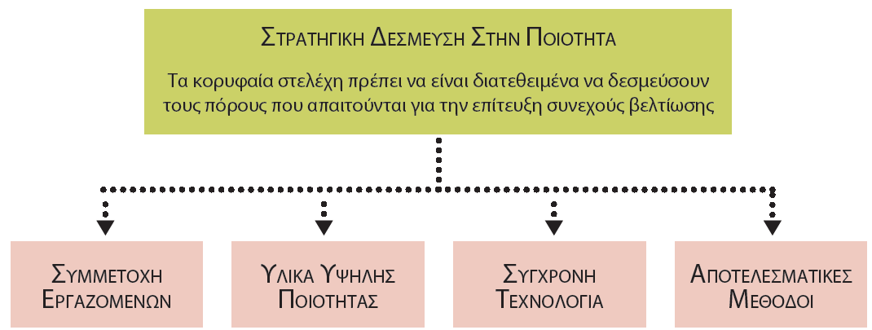
Διοίκηση Ποιότητας στις Διεθνείς Επιχειρήσεις
Notes:
Because of the increasing importance of quality, firms worldwide are using total quality management (TQM) to improve their products and services. TQM is an integrated effort to systematically and continuously improve the quality of an organization’s products and/or services.
TQM must begin with a strategic commitment to quality. Then, TQM programs rely on four operational components to implement quality improvement. Employee involvement is a critical requirement in quality improvement. All employees must participate in helping to accomplish the firm’s quality-related objectives. Materials also must be scrutinized. Firms can improve product quality by acquiring parts and materials from suppliers whose commitment to quality matches their own. The firm also must be willing to invest in new technology to become more efficient and to achieve higher-quality manufacturing processes. Finally, the firm must be willing to adopt new and improved methods of getting work done.

Slide 25
Διοίκηση Ποιότητας στις Διεθνείς Επιχειρήσεις
Τεχνικές διοίκησης ολικής ποιότητας
Στατιστικός έλεγχος διαδικασιών
Συγκριτική αξιολόγηση
Notes:
Firms using TQM have a variety of tools and techniques from which they can draw, including statistical process control and benchmarking.
Statistical process control is a family of mathematically based tools for monitoring and controlling quality. Its basic purposes are to define the target level of quality, specify an acceptable range of deviation, and ensure that product quality is hitting the target.
Another important TQM technique is benchmarking. Benchmarking is the process of legally and ethically studying how other firms do something in a high-quality way and then either imitating or improving on their methods.

Slide 26
Διοίκηση των Πληροφοριών σε Διεθνείς Επιχειρήσεις
Κατανόηση περιβάλλοντος, αλληλεπίδραση με αυτό και ανταπόκριση
Καθορισμός στρατηγικών στόχων
Χάραξη και εφαρμογή στρατηγικών σχεδίων
Ικανοποίηση στόχων και υλοποίηση σχεδίων
Notes:
An increasingly important aspect of operations in international business involves information. Information is data in a form that is of value to a manager in making decisions and performing related tasks.
Information is vitally important to any firm. Managers use it in every phase of their work because it is necessary to the decision-making process. Information allows managers to understand and interact with their firm’s business environment. Managers also use information to determine how to respond to the environment. They gather and process information to help them set strategic goals, map out strategic plans, and implement those strategic plans. Finally, information is an important part of the control process itself, as managers monitor and assess how well they are meeting their goals and executing their plans.

Slide 27
Διοίκηση των Πληροφοριών σε Διεθνείς Επιχειρήσεις
Συσχετισμένη έναντι ασυσχέτιστης διαφοροποίησης
Κεντρικός έναντι αποκεντρωμένου σχεδιασμού
Notes:
The importance of information management (IM) depends on the type of strategy and organization design the firm uses.
When using a related diversification strategy, communication among the various parts of the firm is essential. Effective IM will help the firm capitalize on the potential synergies of that strategy. On the other hand, if a firm is using a strategy of unrelated diversification, its IM needs will be quite different. In this case, communication among the various businesses within the firm will be far less important.
If the firm is highly centralized, information systems are vital for top managers, so they can maintain the control they seek from using this particular design. If the firm is using a decentralized form of organization design, top management will expect managers from various divisions and units to report somewhat less information.

Slide 28
Διοίκηση των Πληροφοριών σε Διεθνείς Επιχειρήσεις
Σύστημα πληροφοριών
Συγκέντρωση δεδομένων
Συνδυασμός δεδομένων
Παροχή δεδομένων
Notes:
Firms increasingly are working to develop integrated information systems to more effectively manage their information. An information system is a methodology created by a firm to gather, assemble, and provide data that is useful to managers.
Larger firms today almost always use computerized systems to manage their information. International firms use information systems to link their operations. That way, managers in any part of the world can access information and communicate with counterparts from any of the firm’s operations. The sheer size of this undertaking, however, along with computer software and hardware limitations, makes it difficult for firms to achieve true global integration of their information systems. Thus, most firms develop information subsystems for specific functional operations or divisions.

Slide 29
Ερωτήσεις Ανασκόπησης
Πώς επηρεάζει η εταιρική στρατηγική μιας επιχείρησης τη διοίκηση των επιχειρηματικών της δραστηριοτήτων;
Σε τι διαφέρουν η διοίκηση παραγωγής και η διοίκηση επιχειρησιακών λειτουργιών στον τομέα των υπηρεσιών;
Τι είναι η διοίκηση της εφοδιαστικής αλυσίδας; Τι είναι κάθετη ολοκλήρωση;
Ποιο βασικό σύνολο παραγόντων πρέπει να εξετάσει μια επιχείρηση για την επιλογή της τοποθεσίας ενός εργοστασίου;
Ποιοι βασικοί παράγοντες πρέπει να αντιμετωπιστούν κατά τη διοίκηση διεθνών επιχειρησιακών λειτουργιών στον τομέα των υπηρεσιών;
Γιατί είναι σημαντικό για τους οργανισμούς να ελέγχουν την παραγωγικότητα;

Slide 30
Σημείωση της αγγλικής έκδοσης των διαφανειών
Το παρόν έργο προστατεύεται από νόμους πνευματικών δικαιωμάτων των Ηνωμένων Πολιτειών και παρέχεται αποκλειστικά για χρήση από διδάσκοντες κατά τη διδασκαλία των μαθημάτων τους και την αξιολόγηση της εκμάθησης των φοιτητών. Η διάδοση ή πώληση οποιουδήποτε μέρους αυτού του έργου (συμπεριλαμβανομένης της δημοσίευσης στον Παγκόσμιο Ιστό) καταστρέφει την ακεραιότητα του έργου και δεν επιτρέπεται. Το περιεχόμενο του έργου δεν θα πρέπει ποτέ να διατίθεται στους φοιτητές, παρά μόνο στους διδάσκοντες που χρησιμοποιούν το συνοδευτικό κείμενο στα μαθήματά τους. Όλοι οι αποδέκτες αυτού του έργου αναμένεται να συμμορφώνονται με αυτούς τους περιορισμούς και να σέβονται τους προβλεπόμενους παιδαγωγικούς σκοπούς και τις ανάγκες των άλλων διδασκόντων που βασίζονται σε αυτήν την ύλη.
Αποκλειστικότητα για την ελληνική γλώσσα: ΕΚΔΟΣΕΙΣ ΤΖΙΟΛΑ

