Slide 1
Vision Zero Campaign a new approach for occupational health
[Date]
[Speaker]

Slide 2
Vision Zero – Why?

Slide 3
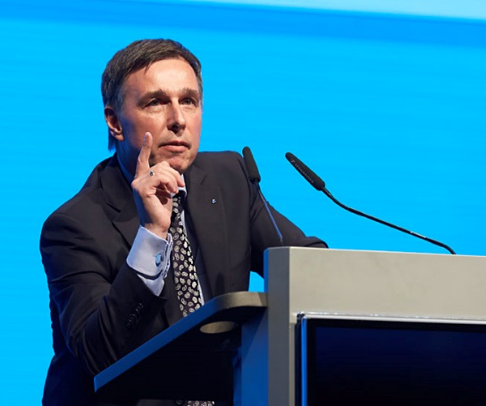
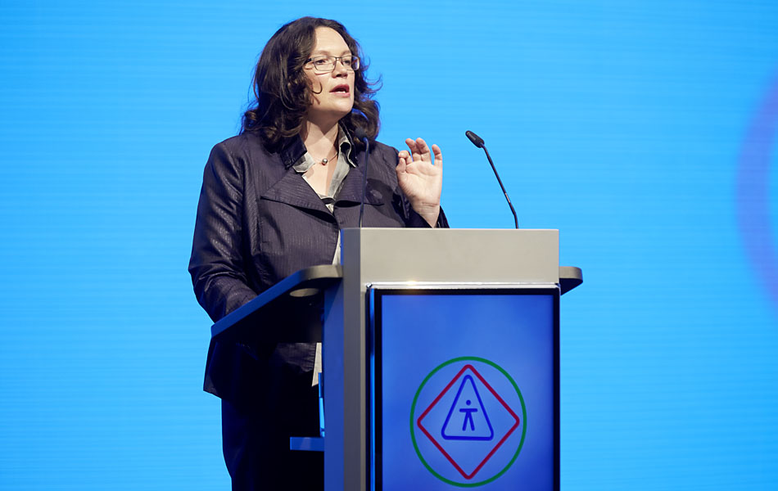


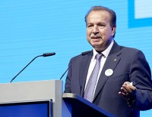
“Because we believe that a world of work without accidents and diseases is possible!”
XX. World Congress for Safety and Health at Work 2014, Frankfurt (Germany)
Vision Zero – Why?

Slide 4

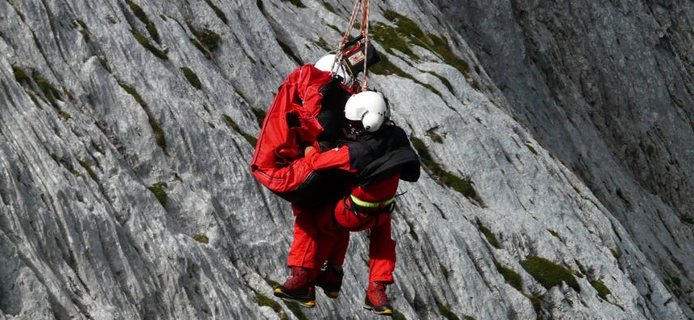

Vision Zero – Why?
2.78 Million
work-related deaths
374 Million
occupational accidents & illnesses worldwide
3.94%
annual economic loss worldwide

Slide 5
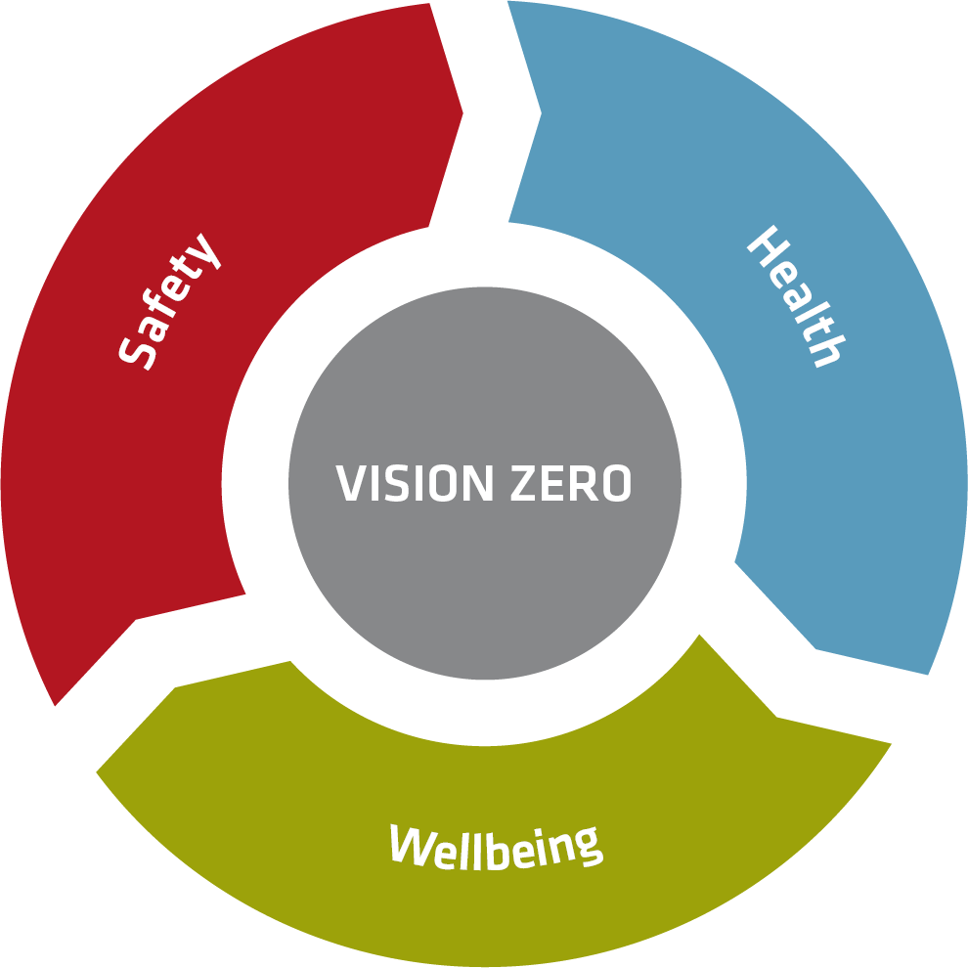
Vision Zero Campaign philosophy
Model based on: Zwetsloot, Leka, Kines. Vision zero: from accident prevention to the promotion of health, safety and well-being at work; in Policy and Practice in Health and Safety, IOSH 2017
All occupational accidents, harm and diseases are preventable
A process – rather than a target
A transformational approach to prevention
Building a culture of prevention that integrates both safety, health and well-being at work

Slide 6
- To provide a global strategy, platform and resources in support of Vision Zero
- To encourage synergies among prevention organizations worldwide through a joint campaign
- To support businesses in the development of a workplace prevention culture based on Vision Zero
Why a Vision Zero Campaign?

Slide 7

Vision Zero Campaign design
The Vision Zero approach is flexible. One can focus on health, on safety or on well-being issues depending on what is most relevant
With this flexibility Vision Zero is of benefit for all, for governments and health and safety organizations in any country and for companies of any scale
“Seven Golden Rules” form the roadmap towards Vision Zero, based on successful, practical management concepts

Slide 8
VISION ZERO.
ZERO HARM – HEALTHY WORK!
Is a PREVENTION STRATEGY for a safe & healthy future.
EVERY accident is preventable!
NOBODY gets killed at work!
NO SERIOUS occupational diseases, work accidents or traffic accidents!

Slide 9







Vision Zero - 7 Golden Rules
Vision Zero Guide outlines a roadmap with 7 Golden Rules to help improve your safety and health performance.
These rules have been developed together with the best safety and health experts and successfully tested in practice:
Take leadership – demonstrate commitment
Identify hazards – control risks
Define Targets – develop programmes
Ensure a safe and healthy system – be well-organised
Ensure safety and health in machines, equipments and workplaces
Improve qualifications – develop competence
Invest in People – motivate by participation
Notes:
Our Vision Zero Guide outlines a roadmap with 7 Golden Rules to help improve your safety and health performance.
These rules have been developed together with the best safety and health experts and successfully tested in practice:

Slide 10

Take leadership demonstrate commitment
1
Every employer, ever executive and every manager is responsible for safety and health in their enterprise. Leadership demands open communication and a clear management culture. Good leadership is exhibited for example by predictability, consistency and attentiveness. Executives and managers are role models: they lead by example. They establish the rules and they follow the rules. What managers do, tolerate and demand sets the standard for other employees.
Notes:
Every employer, ever executive and every manager is responsible for safety and health in their enterprise. Leadership demands open communication and a clear management culture. Good leadership is exhibited for example by predictability, consistency and attentiveness. Executives and managers are role models: they lead by example. They establish the rules and they follow the rules. What managers do, tolerate and demand sets the standard for other employees.

Slide 11

Identify hazards control risks
2
You use risk assessment that helps you to identify hazards and risks before accidents and production downtimes occur, and it assits you with evaluating the risk potential as well as establishing and documenting the required protective measures. Evaluating occupational accidents, injuries and near-misses is important for identifying main focus points or portential improvements.
Notes:
You use risk assessment that helps you to identify hazards and risks before accidents and production downtimes occur, and it assits you with evaluating the risk potential as well as establishing and documenting the required protective measures. Evaluating occupational accidents, injuries and near-misses is important for identifying main focus points or portential improvements.

Slide 12

Define targets develop programmes
3
There are several options for a goal-oriented, programme-based approach: Either you set a goal to continuously reduce the number of accidents, or you establish themes to focus on – such as the operation of machines, the use of forklifts and personal protective equipment, or the reduction of dust exposure.
Once your employees recognize that their safety and health is important to you personally and that something is being done in the enterprise, success will not be far off. You should also communicate regularly about the acheivement of goals.
Notes:
There are several options for a goal-oriented, programme-based approach: Either you set a goal to continuously reduce the number of accidents, or you establish themes to focus on – such as the operation of machines, the use of forklifts and personal protective equipment, or the reduction of dust exposure. Once your employees recognize that their safety and health is important to you personally and that something is being done in the enterprise, success will not be far off. You should also communicate regularly about the acheivement of goals.

Slide 13

Ensure a safe and healthy system be well-organized
4
With well-organized occupational safety and health, every enterprise runs more smoothly because disruptions, production downtime and quality problems are reduced.
Checklists can help you.
Those who want to do more should implement an OSH management system that allows for continuous improvement.
Once everything is in place, a successful audit is rewarded.
Notes:
With well-organized occupational safety and health, every enterprise runs more smoothly because disruptions, production downtime and quality problems are reduced. Checklists can help you. Those who want to do more should implement an OSH management system that allows for continuous improvement. Once everything is in place, a successful audit is rewarded with a certificate and recognition.

Slide 14

Ensure safety and health in machines, equipment and workplaces
5
Effective occupational safety and health strategies include technical, organizational and personal measures. Technical measure should take precedence. Therefore it is essential to keep machines, facilities, equipment and also the workplaces up to current OSH standards. Naturally, it is not always possible to use the latest technology. This is where retrofitting is required. Informing purchasing that safety comes first and that the principle that safety equipment must be part of any activity has proven itself. It‘s worth mentioning that most accidents occur in the course of troubleshooting, repaires or maintenance because design and construction is often not applicable to these tasks and also because safety devices are bypassed or fail to function.
Notes:
Effective occupational safety and health strategies include technical, organizational and personal measures. Technical measure should take precedence. Therefore it is essential to keep machines, facilities, equipment and also the workplaces up to current OSH standards. Naturally, it is not always possible to use the latest technology. This is where retrofitting is required. Informing purchasing that safety comes first and that the principle that safety equipment must be part of any activity has proven itself. It‘s worth mentioning that most accidents occur in the course of troubleshooting, repaires or maintenance because design and construction is often not applicable to these tasks and also because safety devices are bypassed or fail to function.

Slide 15

Improve qualifications develop competence
6
It is a top management responsibility to make sure that a detailed description of the qualification requirements for every position in your enterprise has been made and that every worker is able to perform the duties of his or her position. The half-life of knowledge is growing shorter and shorter, and the skills of workers need to be refreshed at regular intervals. Providing training and continuing education is a must.
Notes:
It is a top management responsibility to make sure that a detailed description of the qualification requirements for every position in your enterprise has been made and that every worker is able to perform the duties of his or her position. The half-life of knowledge is growing shorter and shorter, and the skills of workers need to be refreshed at regular intervals. Providing training and continuing education is a must.

Slide 16

Invest in people motivate by participation
7
Motivating your employees to act in a safe and healthy manner is one of your most important leadership responsibilities. Enterprises that show appreciation for their employees and also actively involve them in safety and health within the enterprise are tapping into important potential: their knowledge, abilities and idea. The goal is for everyone to look after their colleagues as well as themselves – „one for all and one for all“
Notes:
Motivating your employees to act in a safe and healthy manner is one of your most important leadership responsibilities. Enterprises that show appreciation for their employees and also actively involve them in safety and health within the enterprise are tapping into important potential: their knowledge, abilities and idea. The goal is for everyone to look after their colleagues as well as themselves – „one for all and one for all“

Slide 17

Campaign website and resources www.visionzero.global

Slide 18

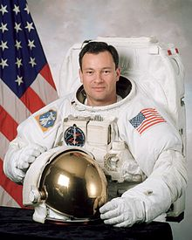
Vision Zero Campaign – working together
Companies
Employers and managers of companies committed to safe and healthy working conditions
Partners
Governments, OSH-agencies and social partners
International and regional organizations
Safety and health professionals and networks
Ambassadors
Renowned personalities supporting Vision Zero

Slide 19
Join the global Vision Zero Campaign now!
Sign up at www.visionzero.global

Slide 20
Thank you for your attention!

